Slide 1

Byzantine-Robust Federated Learning: Impact of Client Subsampling and Local Updates
12332463 Geng Tian
Department of Computer Science and Engineering, Southern University of Science and Technology, Shenzhen, China

Slide 2
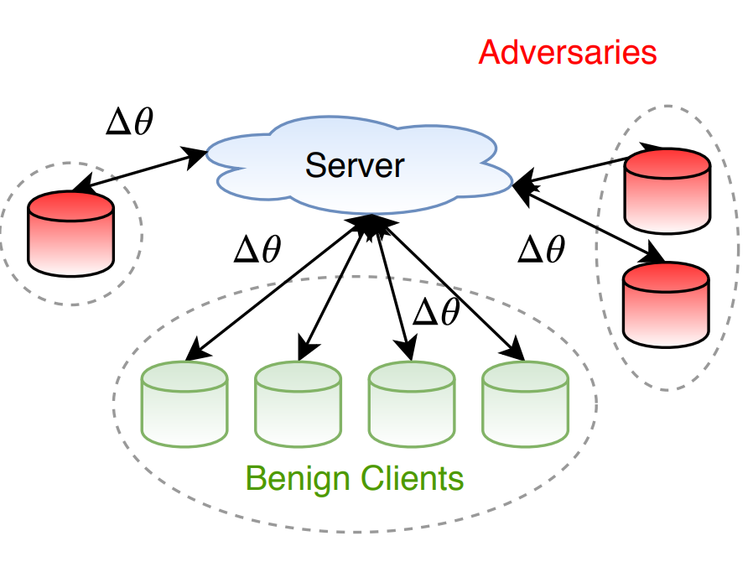
Byzantine Clients
Byzantine clients may be among those who participate in federated learning who attack the global model
Byzantine client’s attack mode
Malicious gradient updating
Data Poisoning

Slide 3
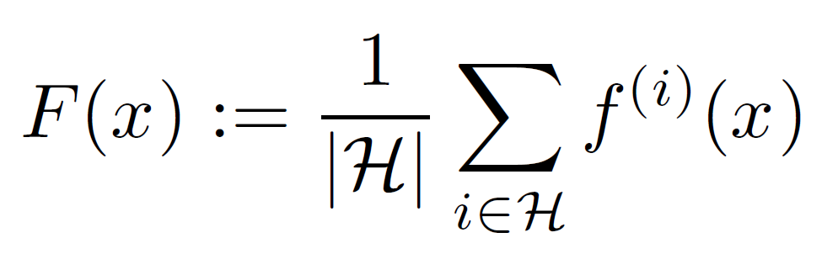
The Goal of Federated Learning
The goal of FedAvg is to minimize loss

Slide 4
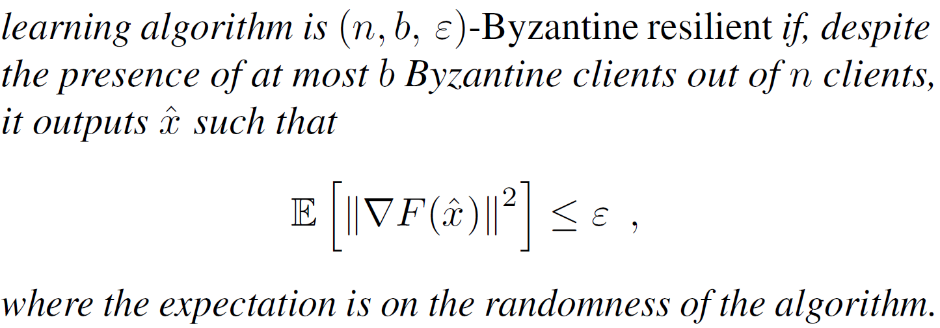
The Goal of Federated Learning
The goal of FedRo is to find ε:

Slide 5
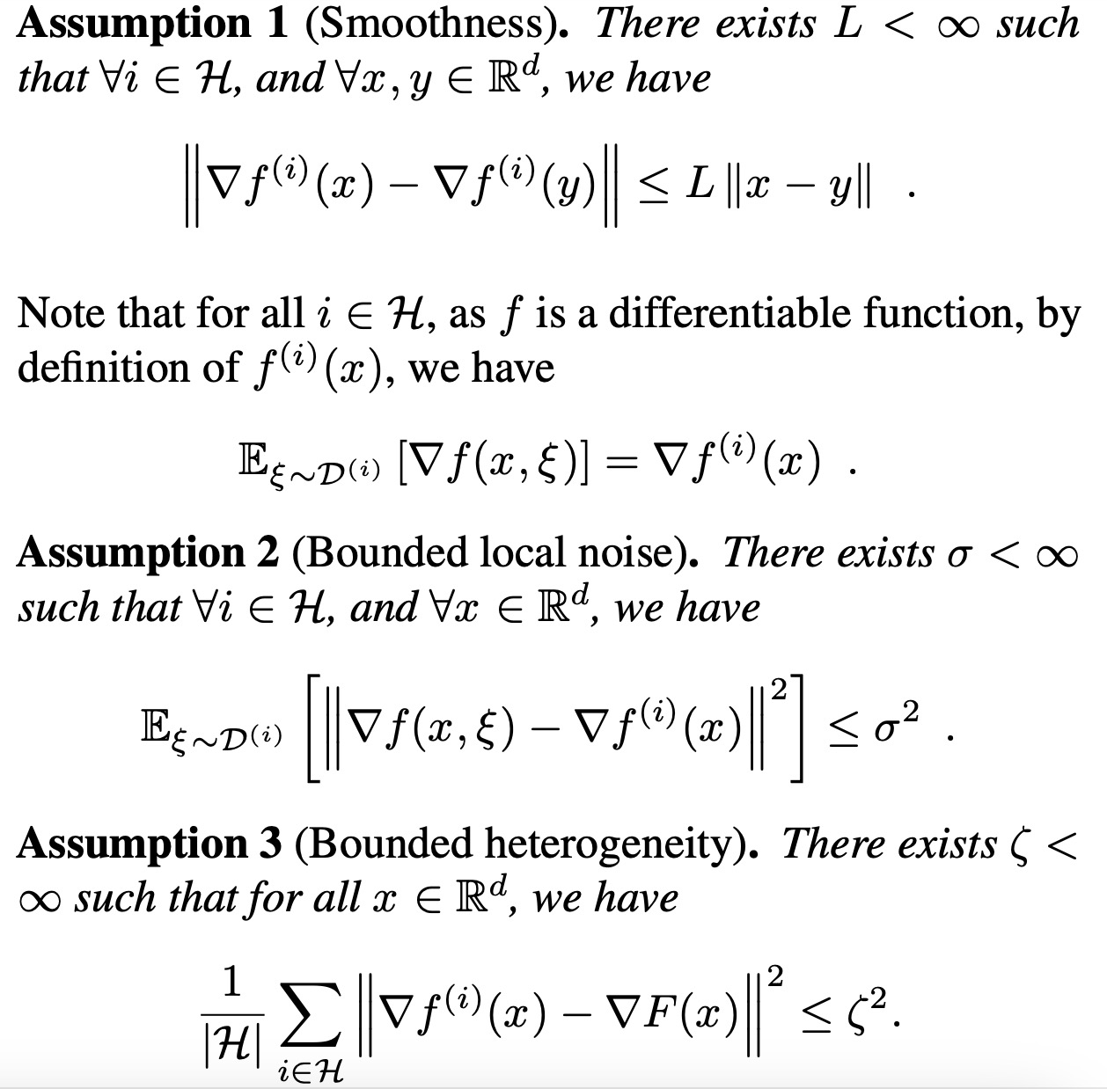
Assumption

Slide 6
Related Work Problem of Prior
Existing problems:
Client sampling is not considered
The local update for each client is 1
Solution of this paper:
Consider client sampling and local update for complex cases
Prove the convergence of the federation learning algorithm in the presence of Byzantine clients
Look for suitable parameters

Slide 7
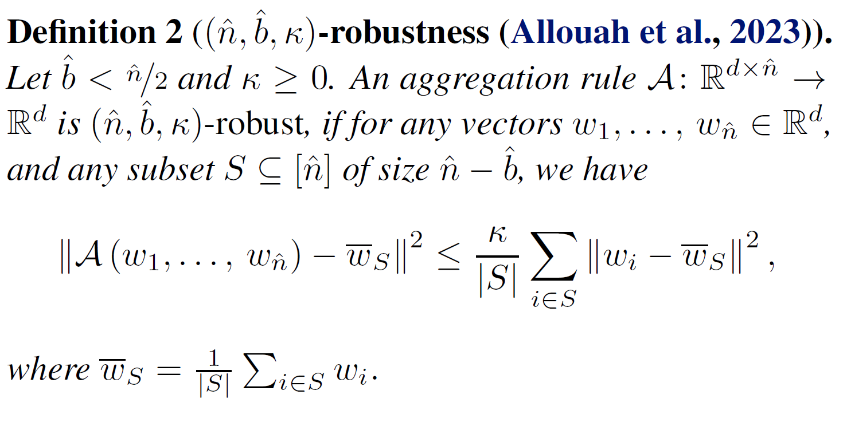
Summary of Robust Algorithms: FedRo
Use more robust aggregation rules A instead of FedAvg, collectively known as FedRo

Slide 8
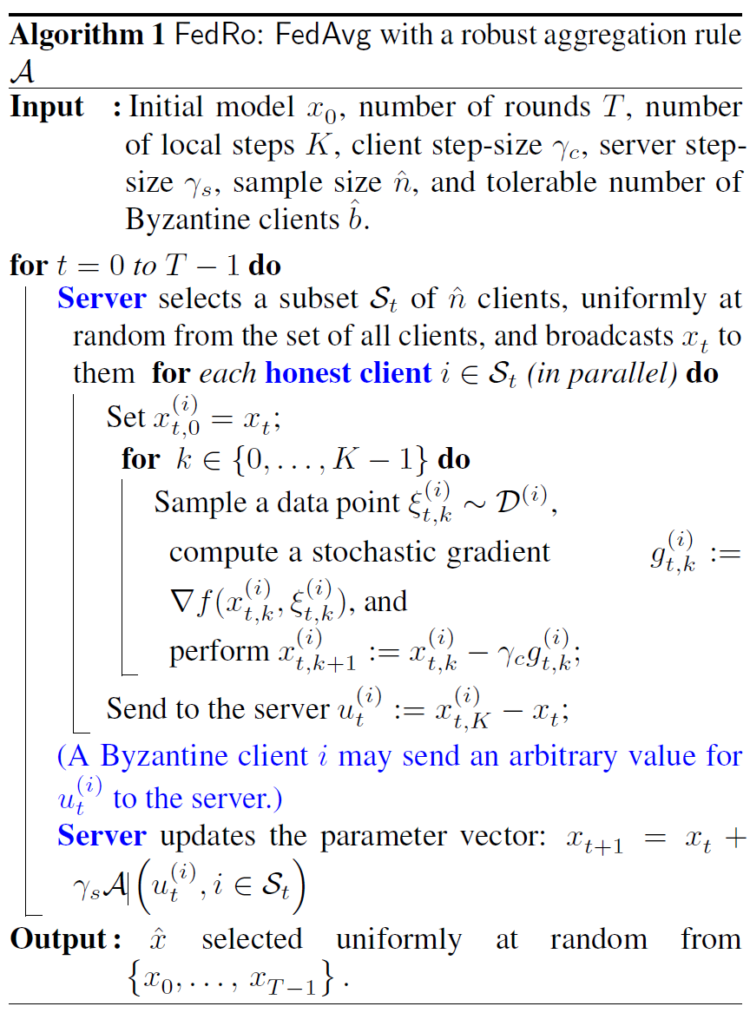
Summary of Robust Algorithms: FedRo
Use more robust aggregation rules A instead of FedAvg, collectively known as FedRo
n: total number of clients
b: total number of Byzantine clients
FedRo steps
Local computations
Communication phase
Global model update

Slide 9
Sufficient Condition of Client Sampling
If only one client is selected per round, there is a high probability that Byzantine clients will be selected during the training process, and the globle model will not converge

Slide 10
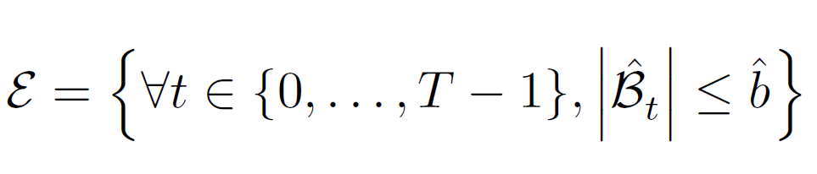
Sufficient Condition of Client Sampling
Since the sampling of users in each round is random, the probability of this event occurring is not equal to 1.
If you want the probability of this event to be greater than p, you have the following inference:

Slide 11
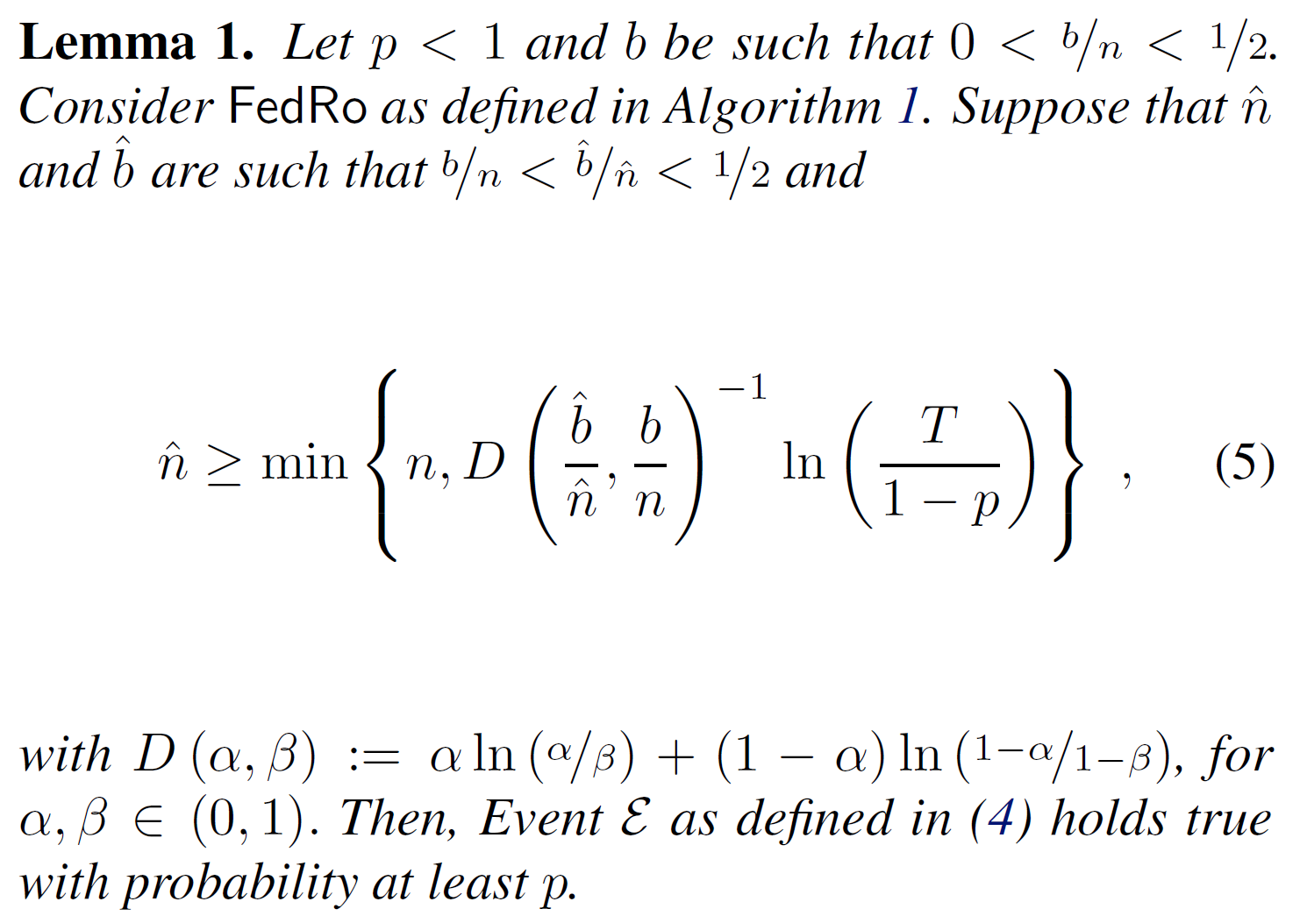
Sufficient Condition of Client Sampling

Slide 12
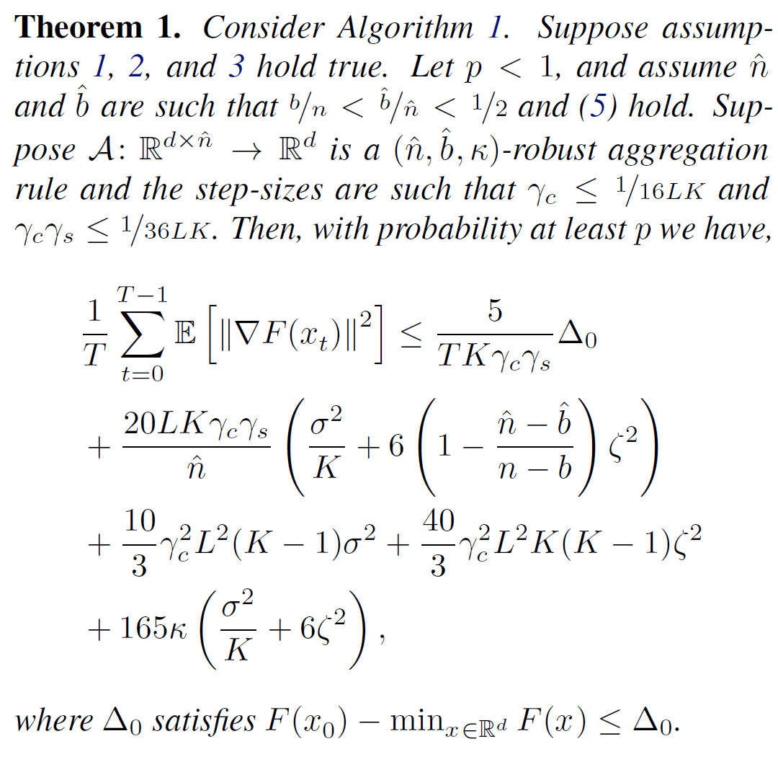
Convergence of FedRo

Slide 13
Convergence of FedRo

Slide 14
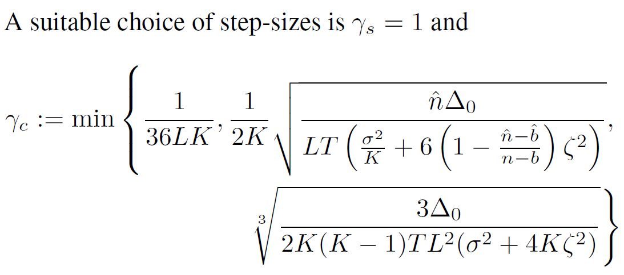
Convergence of FedRo

Slide 15
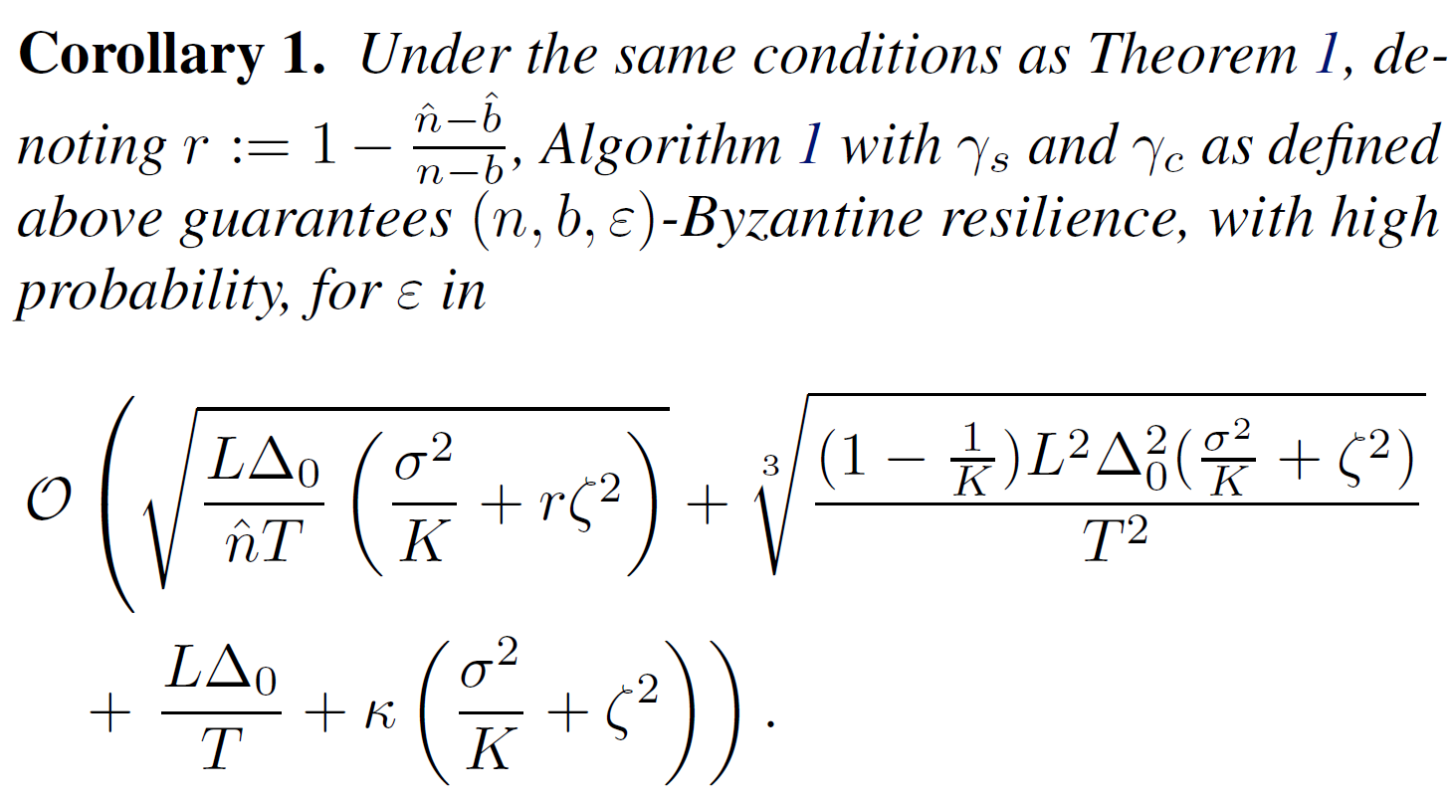
Convergence of FedRo

Slide 16
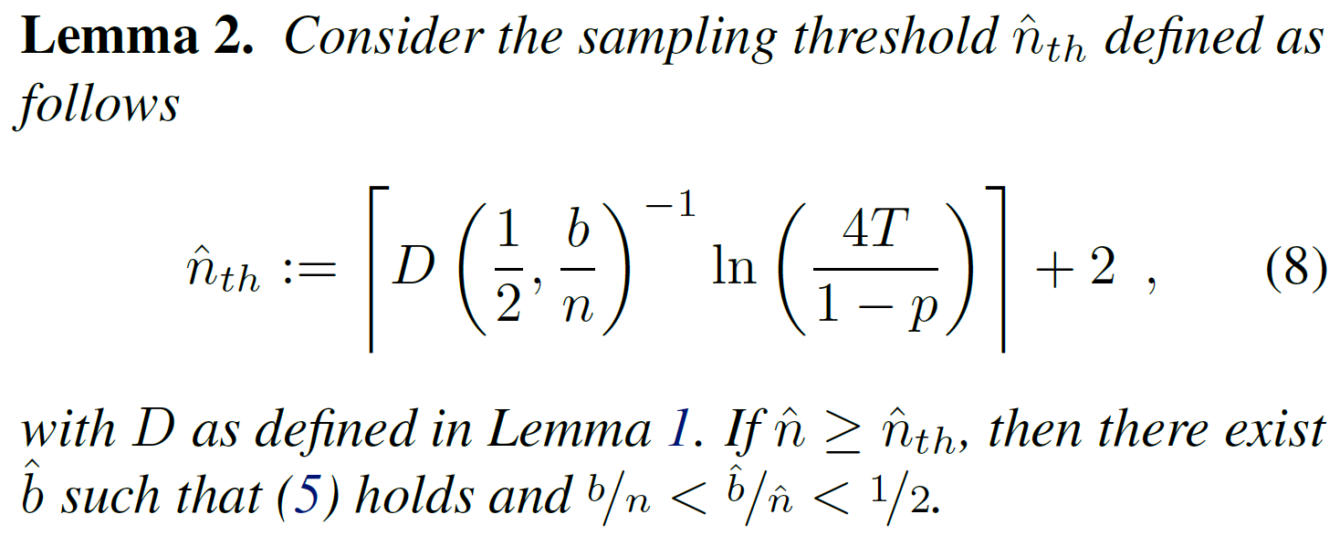
The Choice of Client Sampling

Slide 17
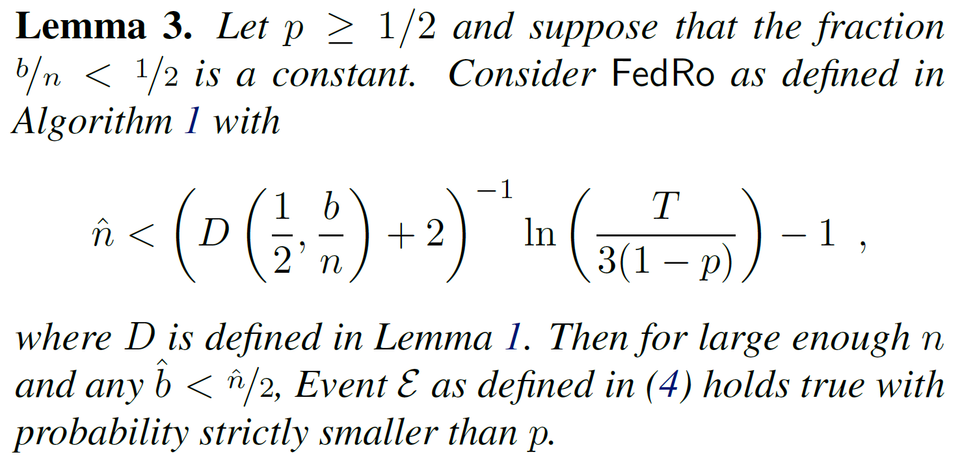
The Choice of Client Sampling

Slide 18
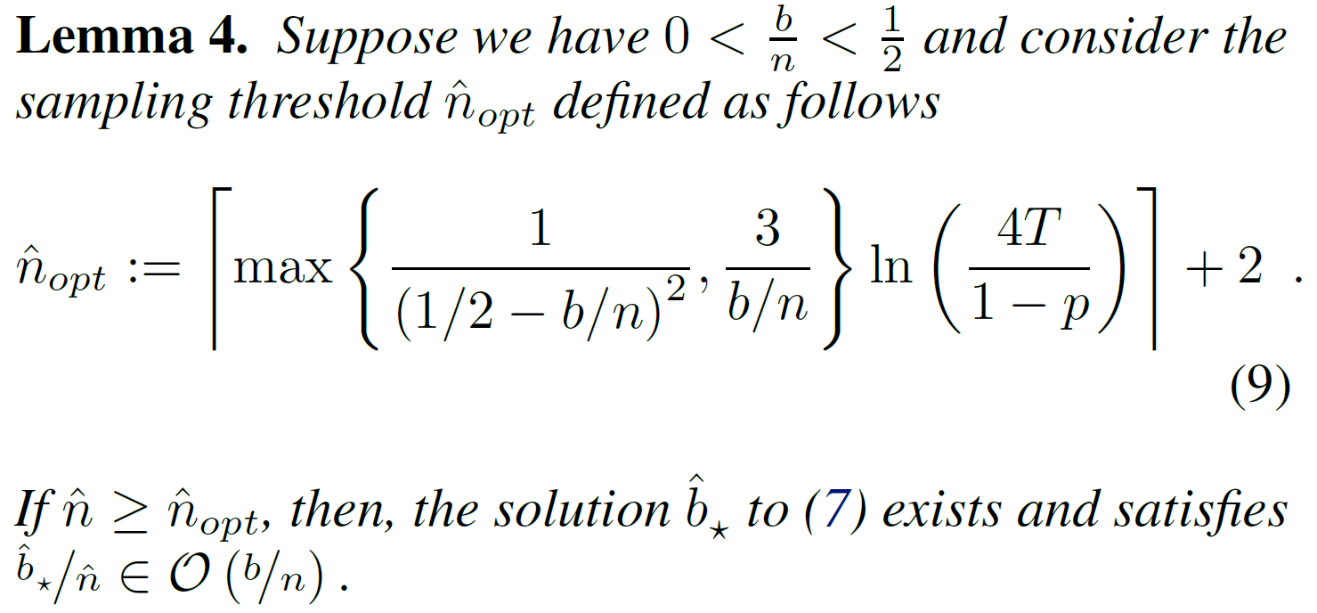
The Choice of Client Sampling

Slide 19
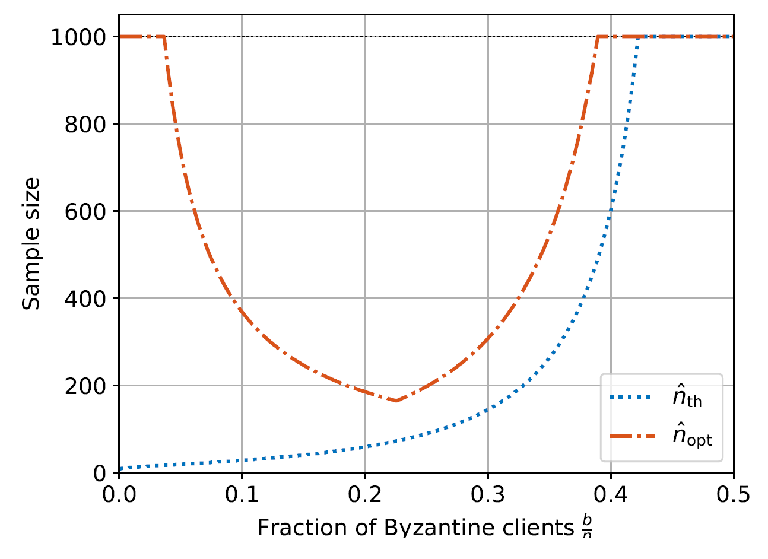
Empirical Results

Slide 20
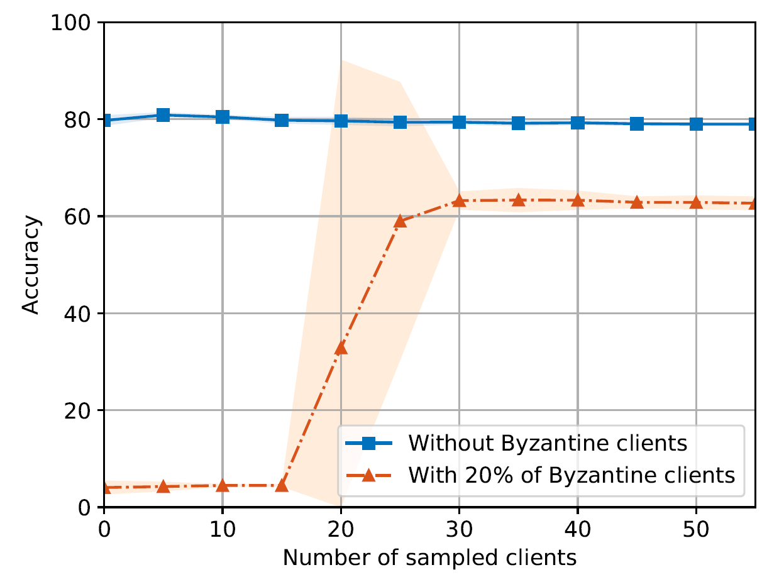
Empirical Results

Slide 21
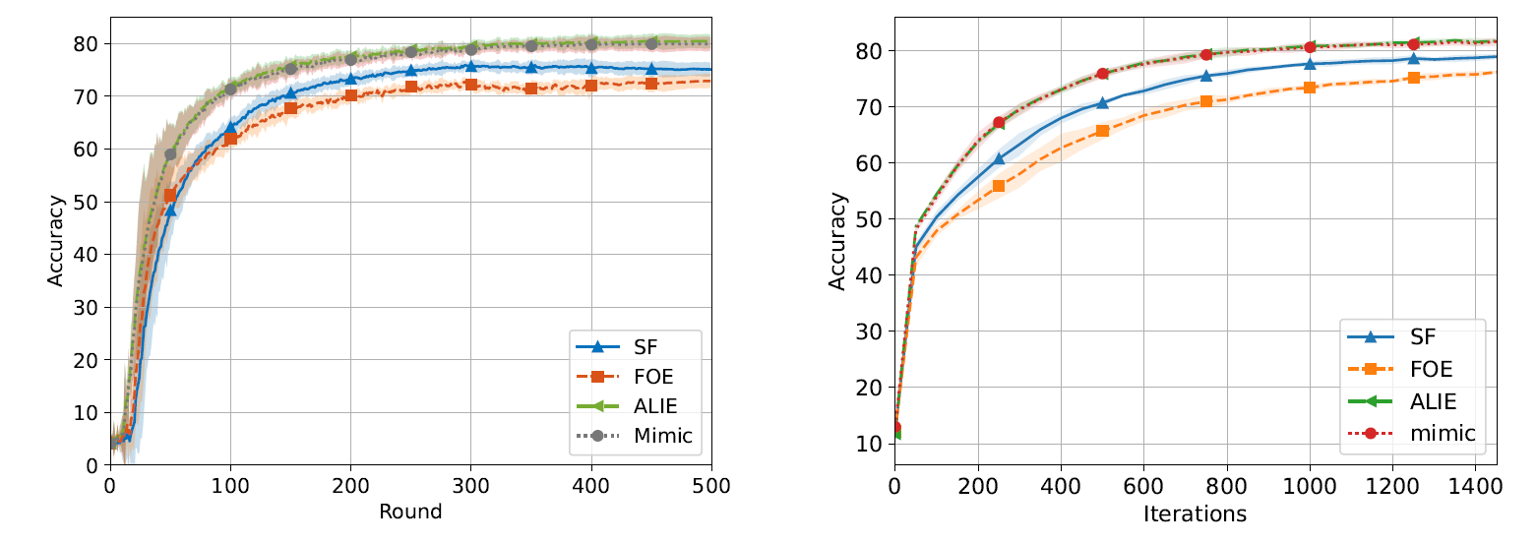
Empirical Results

Slide 22
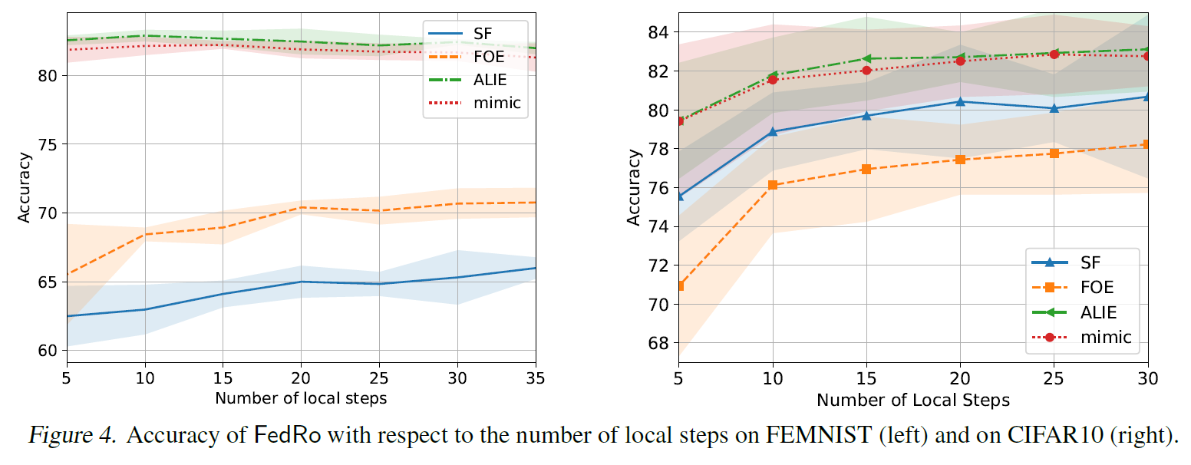
Empirical Results

Slide 23
Thank You! Questions are welcome!
For further questions and comments, please feel free to contact me at 12332463@mail.sustech.edu.cn

