Slide 1



SplitFed: When Federated Learning Meets Split Learning

Slide 2
Content
Structure of the SplitFed
The reason for proposing SplitFed
The effect of the SplitFed
Problems to be solved

Slide 3
Structure of the SplitFed
SplitFed=Split Learning+Federated Learning

Slide 4
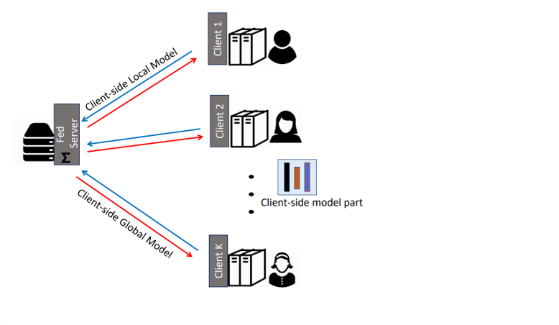
Structure of the Federated learning

Slide 5
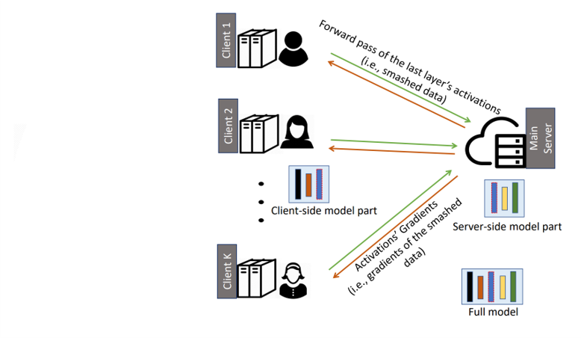
Structure of the Split learning

Slide 6
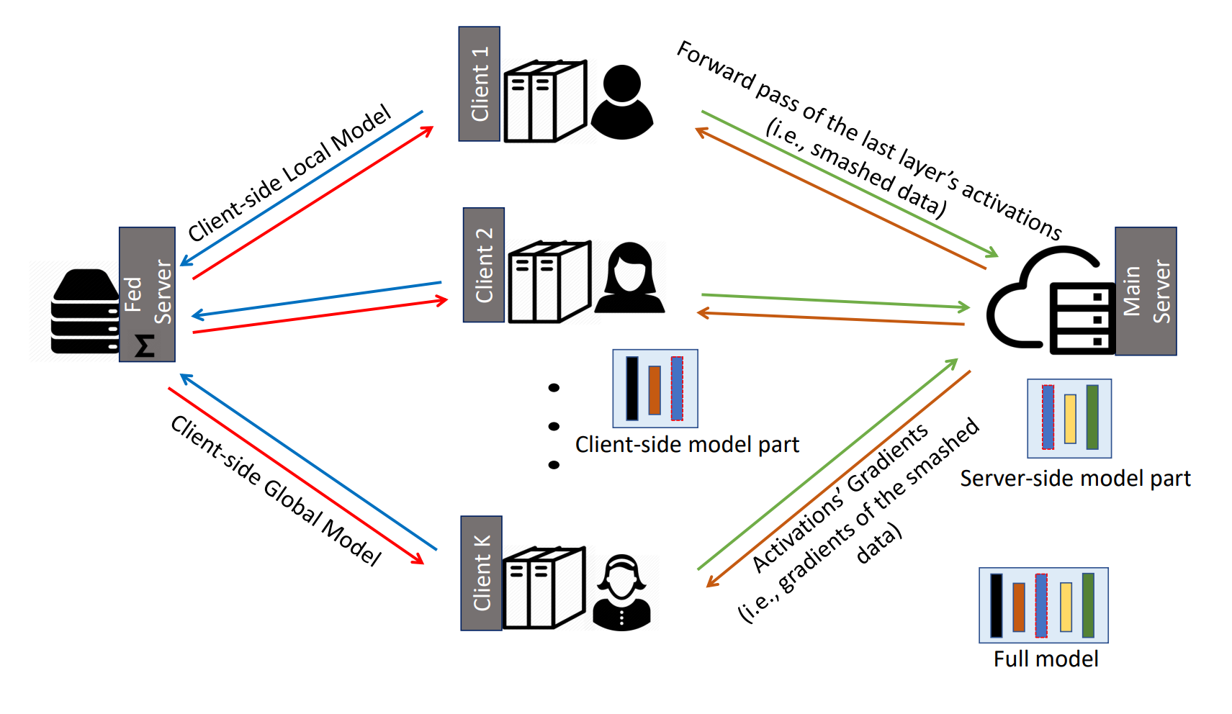
Structure of the SplitFed

Slide 7
The reason for proposing SplitFed
Protect user privacy
Get as much data as possible
Get as much computing power as possible

Slide 8
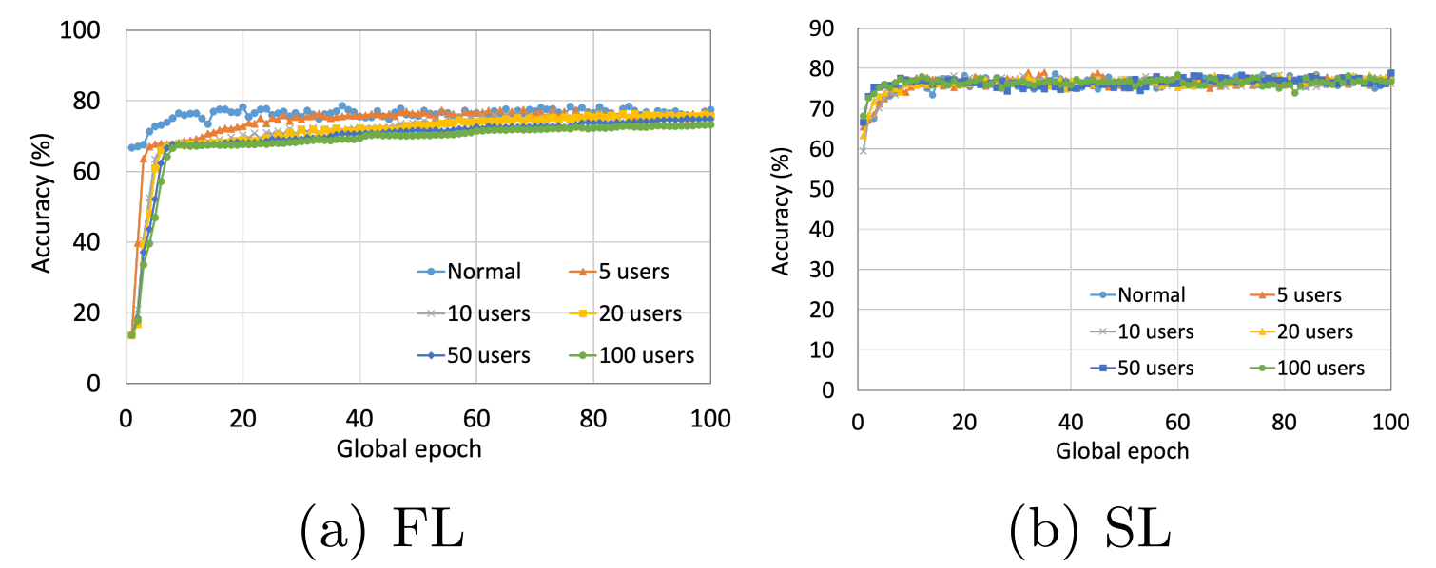
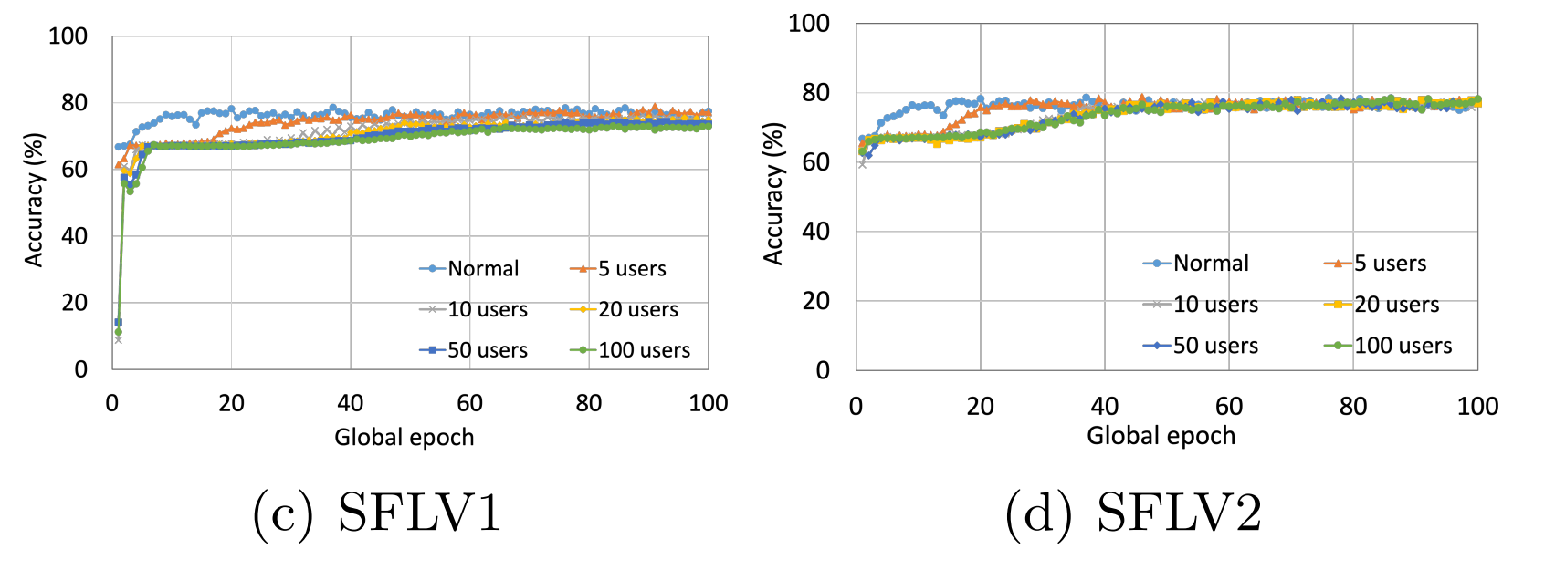
The effect of the SplitFed

Slide 9
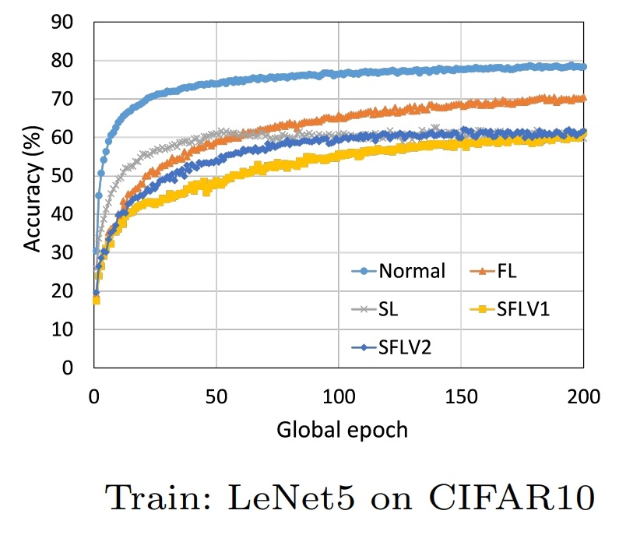
The effect of the SplitFed

Slide 10
Problems to be solved
The communication load is too large
Model accuracy needs to be improved

Slide 11
THANK YOU

