Slide 1


Summary of the Week

Slide 2
Content
1. Jensen-Shannon Divergence
2. FedCorr

Slide 3
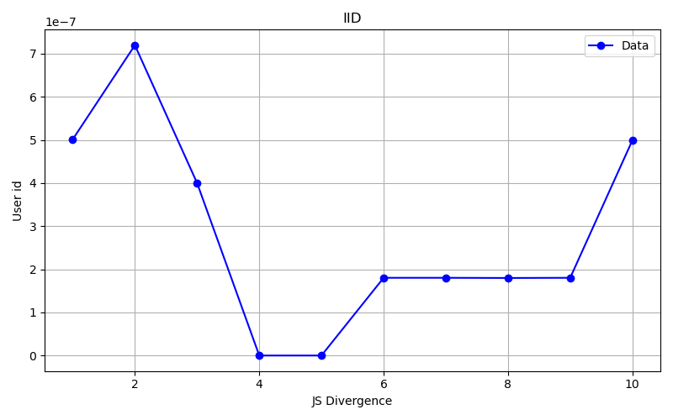
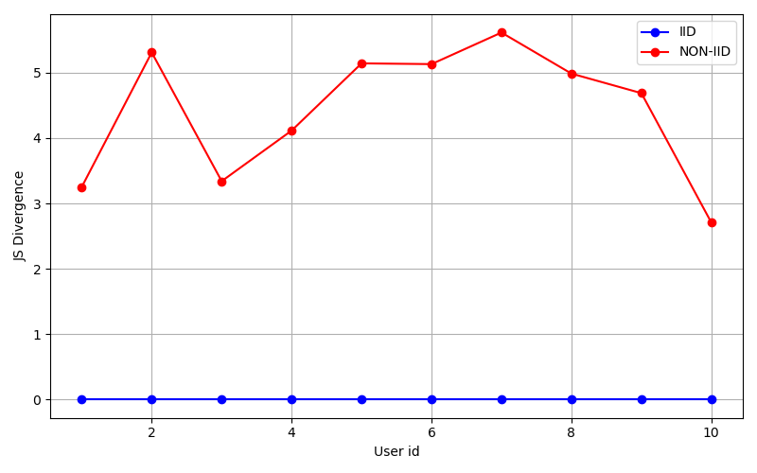
Jensen-Shannon Divergence

Slide 4
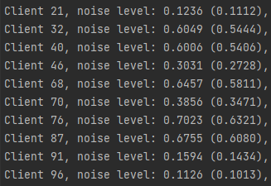
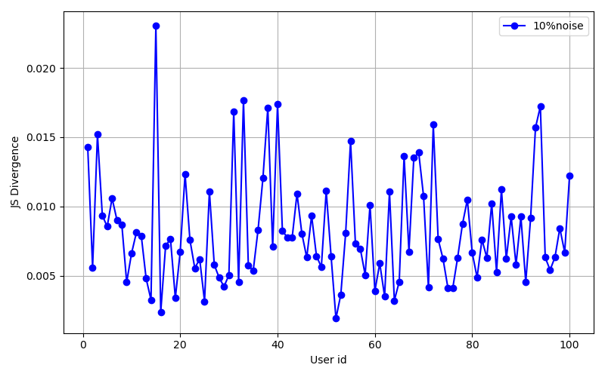
Jensen-Shannon Divergence

Slide 5
LID
Actual noise users: 60
Identified noise users: 63
Recognition accuracy rate is about 90%
Beta=∞
60% of users contain noise

Slide 6
LID
Actual noise users: 60
Identified noise users: 39
Recognition accuracy rate is about 65%
Beta=1
60% of users contain noise

Slide 7
New calculation method
The higher the LID score -> the greater the probability of being a noisy user
The higher the JS score -> the greater the degree of Non-iid
Result=LID-k*JS

Slide 8
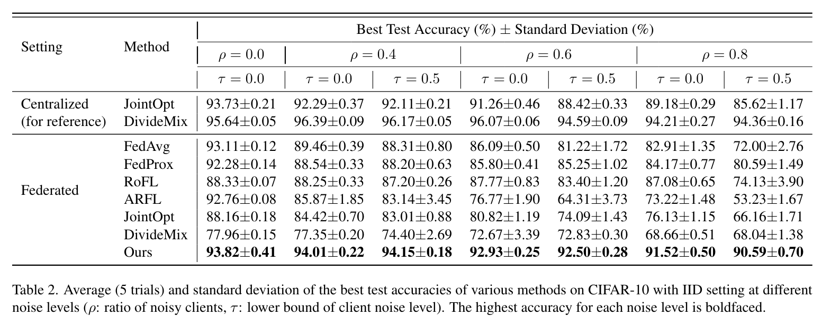
FedCorr

Slide 9
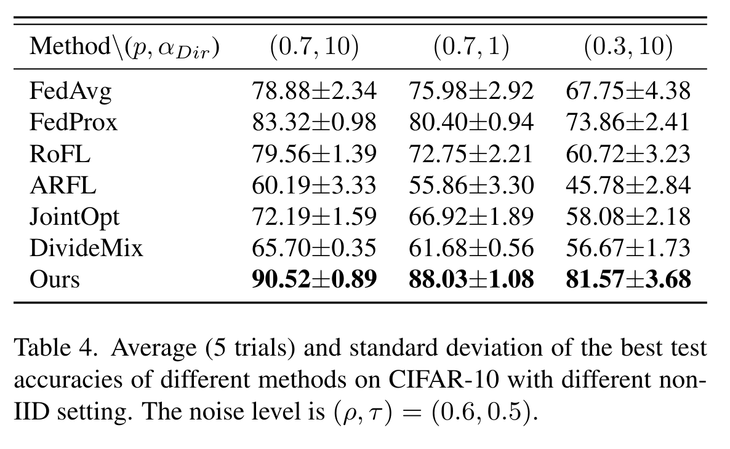
FedCorr

Slide 10
THANK YOU

