Slide 1
Eighth International Conference "Crimea 2001"
Libraries and Associations in the Transient World:
New Technologies and New Forms of Cooperation"
Sudak, Ukraine, June 9-17, 2001

Slide 2
Mathematics Subject Classification and related classifications in the digital world
Antonella De Robbio, Dario Maguolo
Mathematics Library
S.B.A. Università degli Studi di Padova - ITALY
Alberto Marini
Consiglio Nazionale delle Ricerche (IAMI-CNR), Milano - ITALY
Notes:
In this presentation we described The Scientific Classifications Page, which collects:
1. groups of Web pages produced by a pool of software tools for developing hypertextual presentations of single or paired subject classifications from sequential source files;
2. facilities for grasping information from KWIC lists of classification descriptions.

Slide 3
Contents
Connecting classifications in the digital world
Subject classifications in Mathematics, Computing, Physics (specialists)
General subject classifications (librarians)
Displaying classifications: our achievements
Conclusions
Notes:
1. Connecting classifications in the digital world
In the present work we point out opportunities, problems, tools and techniques about interconnecting discipline-specific subject classifications, primarily organised as search devices in bibliographic databases, with general classifications originally devised for book shelving in public libraries. In the proceedings paper we trace the basis of a methodology for interconnecting subject classifications, which is based on object identification and description;
2. Subject classifications in Mathematics, Computing, Physics
Here we take a look at discipline-specific classifications in Mathematics, Computing and Physics, on one hand,
3.General subject classifications
and on general classifications on the other;
4.Displaying scientific classifications: our achievements
In this setting we show a pool of hypertextual presentations of subject classifications, in single or paired view, that we produced by means of dedicated software tools for developing highly linked groups of Web pages from sequential source files. Furthermore, we show presentations of KWIC lists extracted from the descriptions in one or more classifications that allow the rapid exploration of lexical similarities among descritions to obtain suggestions about possible affinities of contents.

Slide 4
Connecting classifications in the digital world
Connecting classifications
Organization, functionalities, interaction modes
Users in different settings
Approaches to the issues of connecting classifications
Encoded in the metadata
Notes:
Connecting classifications in the digital world
Reliable connections among such knowledge representation, information retrieval and lexical tools as classifications, lists of subject headings, thesauri, terminological collections and ontologies, are a necessity in the ever more pervasive world of networked knowledge-based activities.
The organization, the functionalities and the interaction modes exploited by networked digital libraries may be completely different from those generally met with in traditional paper-based libraries. Moreover, just on the line of e-print systems, the development of technical mechanisms and organisational structures to support their interoperability, which is promoted by the Open Archives Initiative (OAI), is making them evolve into genuine building blocks of a transformed scholarly communication model, radically different form the traditional one, which is dominated by the heavy mediation business of scholarly publishing companies. See the OAI Website at http://www.openarchives.org

Slide 5
Users in different settings
different demands and expectations
information needs
cutting costs and times
heterogeneity of sources:
  specialised databases
  dedicated portals
  general online library catalogues
  Web search engines
  reference (metadata) databases
  full-text or hypermedial digital libraries
  e-journal aggregators
  preprint servers and authors' self-archives
Notes:
Users in different settings, with different demands and expectations want to fulfil their information needs wherever information is available, cutting costs and times as much or more than possible, regardless of the heterogeneity of sources: from quite specialized databases or dedicated portals to general online library catalogues or Web search engines, from reference (metadata) databases to full-text or hypermedial digital libraries, from e-journal aggregators to preprint servers and authors' self-archives (commonly called e-print systems). On the other hand, users do not want to change their mind to meet the particular way of storing, indexing and presenting information for any source they face: this should be automatically worked out by the system.
But such a task is not trivial.

Slide 6
Approaches to the issues of connecting classifications
The specialized world of discipline-oriented classifications
  Subject classifications in Mathematics, Computing, Physics, Engineering …
General library subject classifications
  such as Dewey Decimal Classification, Universal Decimal Classification or Library of Congress:
  widely used in public, school or even general academic libraries
Notes:
While a number of approaches to the issues of connecting classifications or thesauri exploit statistical methods or neural network techniques, a different trend is oriented towards the analysis, modeling and support of conceptual organization by humans. The former can be very helpful, even in view of the latter; a well defined integration seems to be the recipe for the near future.
Actually, it's still worthwile, and not only for educational purposes, to work out well defined connections between classifications or the like, which provide that the objects each of them refers to are identified unambiguously by means of a suitable representation language. With the knowledge representation languages currently being designed and implemented in computer applications, this task is getting feasible.

Slide 7
Subject classifications in Mathematics, Computing, Physics
Mathematics Subject Classification
Referativnyj zhurnal: Matematika. Classification Scheme
Zentralblatt für Didaktik der Mathematik Classification Scheme
ACM Computing Classification System
PACS: Physics and Astronomy Classification Scheme
INSPEC Classification
Notes:
As for subject indexing, different classifications, thesauri or otherwise structured terminologies, or even ontologies, while insisting over the same area, can keep presenting strong linguistic (which can not be worked out by mere translation), structural and semantic disagreements, in spite of any effort for harmonization.
Misinterpretations are easy to occur when the same words are used in different contexts or for different purposes. Moreover, even in using one and the same classification, differences and inconsistencies are normal practice, either among different applications or inside the same application. Correctly-minded people could expect that good interconnections among classifications are at the basis of good retrieval across classifications, but this seems not to be a common case.

Slide 8
General library subject classifications
Dewey Decimal Classification
Universal Decimal Classification
Library of Congress Classification
Other ...
Notes:
Dramatic disagreements are evidenced in passing from the specialized world of discipline-oriented classifications to general classifications widely used in public, school or even general academic libraries, such as Dewey Decimal Classification, Universal Decimal Classification or Library of Congress Classification.
Dewey Decimal Classification
DDC is widely used all over the world, not only for book shelving in libraries, especially in public, school and general academic ones, but also for subject indexing in general online document retrieval tools, such as bibliographic databases, online library catalogues, digital libraries, Web search engines.
Universal Decimal Classification (UDC)
UDC was created towards the end of the Nineteenth century by Paul Otlet and Henri LaFontaine as an adaptation of DDC in view of the preparation of a universal bibliography. The scheme consists of 60,000 classes (divisions and sub-divisions) as well as a number of auxiliary tables.
Library of Congress Classification
Created on 1899, the LCC is an enumerative system built on 21 major classes, each class being given an arbitrary capital letter between A-Z, with 5 exceptions: I, O, W, X, Y.

Slide 9
Encoded in the metadata
set of structured descriptions should be encoded in the metadata
metadata are managed by search engines
standard format metadata sets
  are the result of conversions from heterogeneous databases
  serve as indexes for queries in the original databases
Notes:
The set of structured descriptions so obtained is the leading pole of the connections: through it, correct reference links can be established between such descriptions and items in the classifications. Starting from one classification, users can choose for the structured description(s) that correctly represent the intended meaning, and hence pass to the corresponding items in another classification. Moreover, such descriptions should be encoded in the metadata that are managed by search engines. Frequently such standard format metadata sets are the result of conversions from heterogeneous databases, and serve as indexes for queries in the original databases.

Slide 10
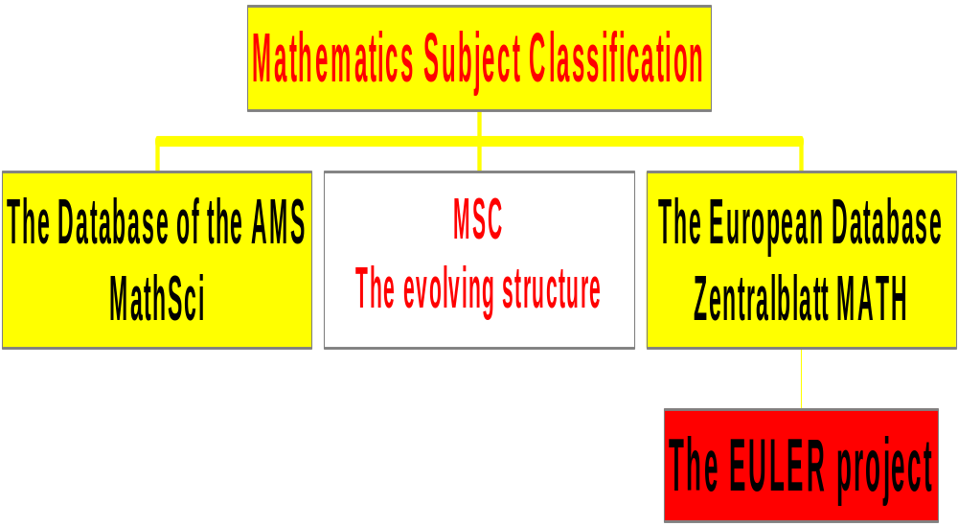
The Mathematics Subject Classification
Notes:
The project EULER
Mathematics Subject Classification is one of the classification systems provided for by the Dublin Core (DC) metadata format, and is used inside DC metadata for the search engine developed in the European Union project European Libraries and Electronic Resources in Mathematical Science (EULER).
The main objective of EULER was the realization of a "one-stop shop" for research on mathematics information resources such as books, pre-prints, Web pages, abstracts, collections of articles and reviews, periodicals, technical reports and theses.
The result is a Web meta-interface for parallel simultaneous queries to a heterogeneous collection of databases.
See the EULER site: http://www.emis.de/projects/EULER/

Slide 11
Mathematics Subject Classification
compiled and updated by the editorial offices of MathSci and Zentralblatt MATH.
covers all branches of pure and applied mathematics
  including probability and statistics, numerical analysis and computing, mathematical physics and economics, systems theory and control, information and communication theory.
Notes:
Mathematics Subject Classification (MSC)
MSC is compiled and updated by the editorial offices of the world most important bibliographical directories for mathematical research: MathSci and Zentralblatt MATH.
The classification covers all branches of pure and applied mathematics, including probability and statistics, numerical analysis and computing, mathematical physics and economics, systems theory and control, information and communication theory.

Slide 12
The evolving structure of MSC
From 1959 to 1985 the MathSci version of MSC counts 60 major sections; 61 from 1986 to 1999 and 63 since 2000.
Until 1972 the classification was issued in two levels; an intermediate level became available in 1973, and is progressively being exploited, as far as MSC increases in detail and so grows in size.
After 1973 major MSC revisions came in use in 1980, 1985, 1986, 1991, 2000.
Notes:
The evolving structure of MSC
After 1973 major MSC revisions came in use in 1980, 1985, 1986, 1991, 2000.
From 1959 to 1985 the MathSci version of MSC counts 60 major sections; 61 from 1986 to 1999 and 63 since 2000.
Until 1972 the classification was issued in two levels; an intermediate level became available in1973, and is progressively being exploited, as far as MSC increases in detail and so grows in size.

Slide 13
The evolving structure of MSC
Started with 1436 numbers in 1959, MSC counts 4895 numbers in 1999 and 5590 since 2000.
A consistent and ever growing apparatus of cross references helps understanding connections between different branches of mathematics.
Notes:
Started with 1436 numbers in 1959, MSC counts 4895 numbers in 1999 and 5590 since 2000.
A consistent and ever growing apparatus of cross references helps understanding connections between different branches of mathematics

Slide 14
The Referativnyj zhurnal:
Matematika classification scheme
It is prepared as a piece of the Universal Decimal Classification (UDC) for Referativnyj zhurnal: Matematika.
An English translation is provided by the AMS site in textual form, at the address: http://www.ams.org/mathweb/Classif/RZhClassification.html
Notes:
Let's look other classifications in the field of Mathematics:
The Referativnyj zhurnal: Matematika classification scheme
It is prepared as a piece of the Universal Decimal Classification (UDC) for Referativnyj zhurnal: Matematika.
An English translation is provided by the AMS site in textual form, at the address:
http://www.ams.org/mathweb/Classif/RZhClassification.html

Slide 15
Zentralblatt für Didaktik der Mathematik Classification Scheme (ZDM)
paper version of the database is Zentralblatt fur Didaktik der Mathematik
used for the bibliographic database on mathematics education and related fields MATHDI, active since 1976, which can be accessed through the sites of the European Mathematical Information Service (EMIS).
  http://www.mathematik.uni-osnabrueck.de/projects/zdm
Notes:
Zentralblatt für Didaktik der Mathematik Classification Scheme (ZDM)
This scheme is used for the bibliographic database on mathematics education and related fields MATHDI, active since 1976, which can be accessed through the sites of the European Mathematical Information Service (EMIS).
The paper version of the database is Zentralblatt fur Didaktik der Mathematik.
A Web presentation of the ZDM classification is available at:
http://www.mathematik.uni-osnabrueck.de/projects/zdm

Slide 16
ACM Computing Classification System (CCS)
ACM's first classification system for the computing field was published in 1964. Then, in 1982, the ACM published an entirely new system. New versions based on the 1982 system followed, in 1983, 1987, 1991, and 1998.
issued by the (ACM), for the directories Computing Reviews (CR) and Guide to Computing Literature (GCL).
adopted by the bibliographic database CompuScience, which contains references from CR since 1976, from GCL since 1977 and from Section 68 Computer Science of MSC in ZM/MA.
  http://www.acm.org/class/1998
Notes:
ACM Computing Classification System (CCS)
This classification is issued by the Association for Computing Machinery (ACM) in the USA, for the directories Computing Reviews (CR) and Guide to Computing Literature (GCL).
Moreover, it is adopted by the bibliographic database CompuScience, produced by Fachinformationszentrum (FIZ) Karlsruhe, Department of Mathematics & Computer Science Berlin, which contains references from CR since 1976, from GCL since 1977 and from Section 68 Computer Science of MSC in ZM/MA.
ACM's first classification system for the computing field was published in 1964. Then, in 1982, the ACM published an entirely new system. New versions based on the 1982 system followed, in 1983, 1987, 1991, and 1998.
Web presentations of the 1964, 1991 and 1998 versions are available at: http://www.acm.org/class/1998

Slide 17
INSPEC Classification
INSPEC was formed in 1967, based on the Science Abstracts service, which has been provided by the Institution of Electrical Engineers (UK) since 1898.
  Section A: Physics - it's a version of PACS;
  Section B: Electrical & Electronic Engineering
  Section C: Computer & Control
  Section D: Information Technology
Notes:
INSPEC is an English-language bibliographic information service providing access to the world's scientific and technical literature in physics, electrical engineering, electronics, communications, control engineering, computers and computing, and information technology.
NSPEC was formed in 1967, based on the Science Abstracts service, which has been provided by the Institution of Electrical Engineers (UK) since 1898. Still today Physics Abstracts, Electrical & Electronics Abstracts and Computer & Control Abstracts together form the Science Abstracts series of journals, which is the paper version of the INSPEC database.
INSPEC Classification is divided into four major sections:
Section A: Physics - it's a version of PACS;
Section B: Electrical & Electronic Engineering
Section C: Computer & Control
Section D: Information Technology

Slide 18
Physics and Astronomy Classification Scheme (PACS)
Prepared by the American Institute of Physics (AIP)
The most recent internationally agreed scheme was published by ICSTI in 1991.
Revised editions of PACS are published biennially, or as necessary, by AIP.
PACS contains 10 broad categories subdivided into 66 major topics http://www.aip.org/pubservs/pacs.html
Notes:
Moving into the field of Physics we find:
Physics and Astronomy Classification Scheme (PACS)
PACS is prepared by the American Institute of Physics (AIP) in collaboration with certain other members of the International Council on Scientific and Technical Information (ICSTI) having an interest in physics and astronomy classification. The most recent internationally agreed scheme was published by ICSTI in 1991.
Revised editions of PACS are published biennially, or as necessary, by AIP.
PACS contains 10 broad categories subdivided into 66 major topics
http://www.aip.org/pubservs/pacs.html

Slide 19
Displaying classifications: our achievements
classification schemes, terminologies, metadata collections are complex documentation structures
generation of highly portable hypertexts
  to facilitate readability and discovery of meaning
  to move to and from parallel views of the same or similar structures along links inside or between the structures
hypertexts are produced mainly by a pool of standard C programs
Notes:
Displaying subject classifications: our achievements
Our work with subject classifications has been directed to the generation of highly portable hypertexts, suitable to facilitate readability and discovery of meaning by humans in a generality of complex documentation structures as classification schemes, terminologies, metadata collections, etc.
We are especially exploiting a presentation mode (double view) that allows moving to and from parallel views of the same or similar structures along links inside or between the structures; this proves very useful in our setting.
Such hypertexts are produced mainly by a pool of standard C programs, which operate only on sequential ASCII files and are aimed to the analysis and transformation of specific texts and to the generation of groups of syntactically simple but highly connected and JavaScript enriched HTML pages (H-volumes).

Slide 20
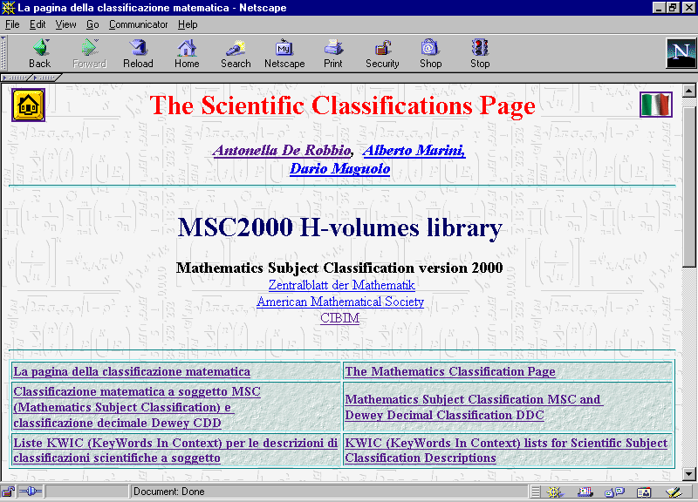
Notes:
The Scientific Classifications Page
Various tools for exploring subject classifications have been realized in this way and are collected in The Scientific Classifications Page
http://www.math.unipd.it/~biblio/math/eng.htm
Besides hypertextual presentations of subject classifications, the page collects some H-volumes presenting KWIC (Key-Word-In-Context) lists extracted from the descriptions of one or more combined classifications. Descriptions are circularly permuted on significant words, i.e. words out of a stop-word list; the very long list of resulting strings is displayed on the right, subdivided into smaller manageable lists, which can be accessed through an index appearing in the left frame. This redundant but properly paginated presentation allows the rapid exploration of lexical similarities among descritions to obtain suggestions about possible affinities of contents.
The Scientific Classifications Page page includes:
The Mathematics Classification Page
Mathematics Subject Classification MSC and Dewey Decimal Classification DDC
KWIC (KeyWords In Context) lists for Scientific Subject Classification Descriptions

Slide 21
The Mathematics Classification Page
Simple frame
Double view presentation
Simple frame presentation, Italian translation
Interleaved English and Italian texts
Simple frame presentation, including changes from MSC 1991
Simple frame presentation, with links to subject specific pages of relevant Websites
Notes:
Various hypertextual frame presentations of the latest version of Mathematics Subject Classification, MSC2000, have been realized in this way and are collected in the Web pageThe Mathematics Classification Page
http://www.math.unipd.it/~biblio/math/engmsc.htm
Collects six hypertextual frame presentations of the latest version of Mathematics Subject Classification, MSC2000.
From a sequential ASCII file containing the whole MSC2000, two H-volumes were obtained, respectively
MSC2000b H-volume, simple frame presentation:
http://www.math.unipd.it/~biblio/math/mainb/mhbmain.htm
MSC2000d H-volume, double view presentation:
http://www.math.unipd.it/~biblio/math/doppiaeng/mhdmain.htm
The same process being worked out on a file containing an Italian translation of MSC2000, we obtained the simple frame
MSC2000id H-volume, Italian translation:
http://www.math.unipd.it/~biblio/math/italiana/mhimain.htm
while instead of the double-view one, we processed the two files in combination with the first file, to obtain the simple frame
MSC2000l H-volume, interleaved English and Italian texts:
http://www.math.unipd.it/~biblio/math/it+eng/mhlmain.htm

Slide 22
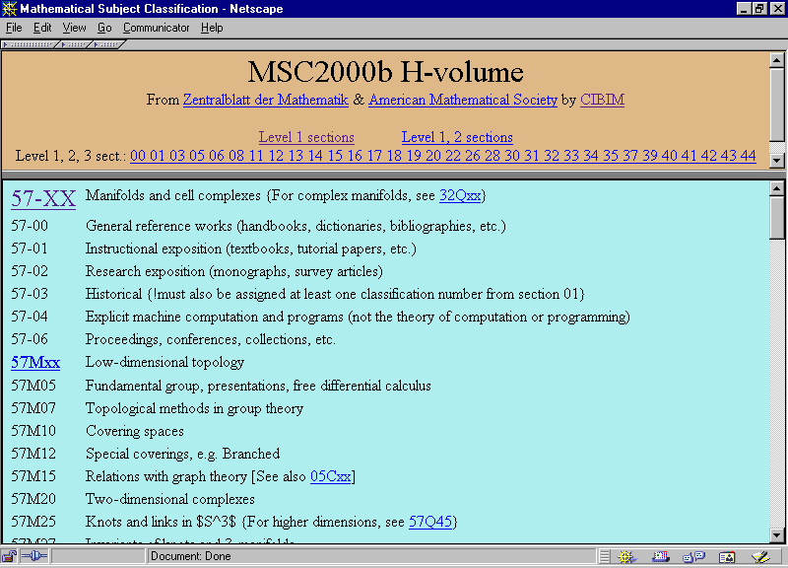
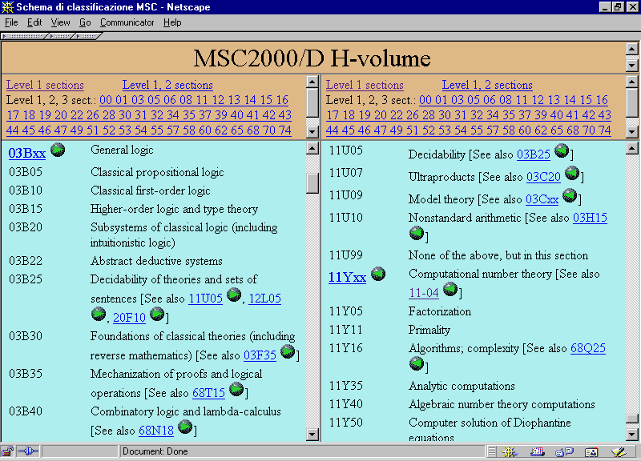
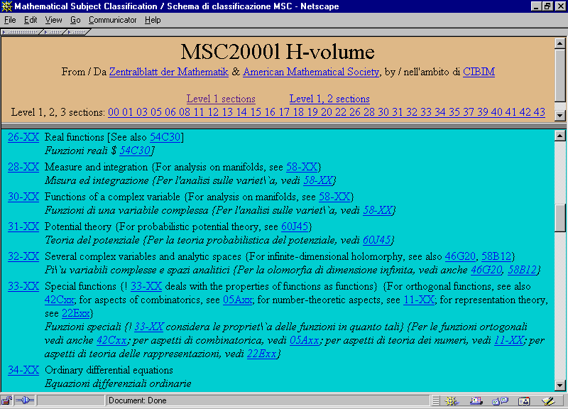
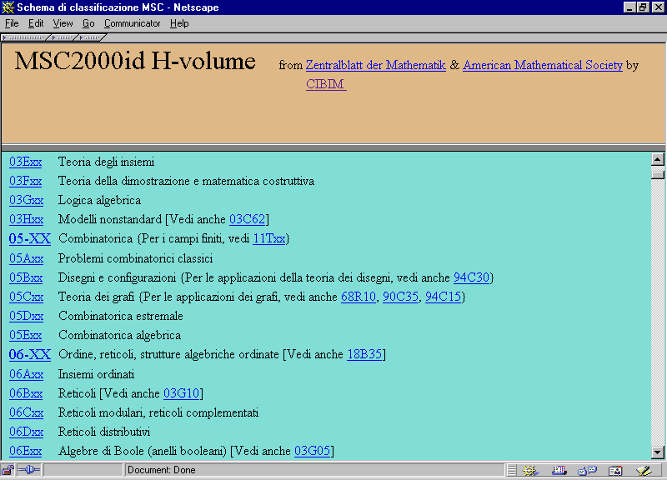
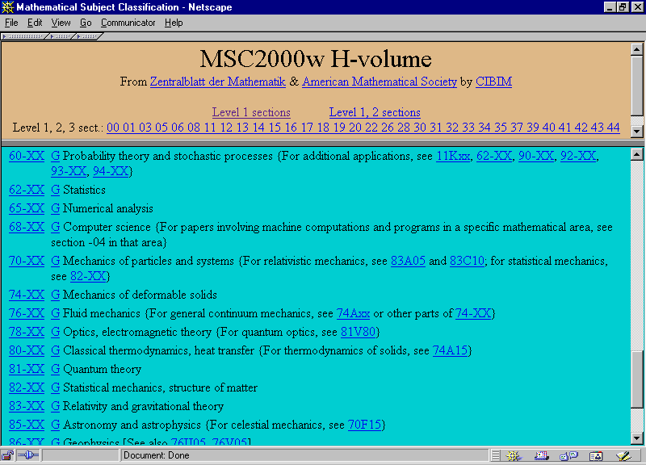
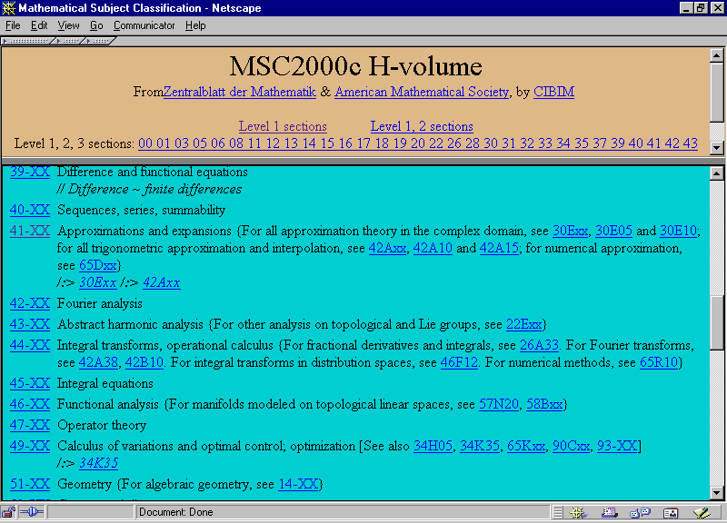
The Mathematics Classification Page
MSC2000 libraries H-volumi
Notes:
From the combination of the first ASCII file with other ones, containing collections of specific data, we obtained other H-volumes:
From a file resulting from a comparison of MSC2000 with the 1991 version, we obtained
MSC2000d H-volume, simple frame presentation, including changes from MSC 1991:
http://www.math.unipd.it/~biblio/math/mainb/mhcmain.htm
From a file containing data about subject specific pages of relevant Websites, we obtained a true Virtual Reference Desk for Mathematics,
MSC2000w H-volume, simple frame presentation, with guide pages linking to subject specific pages of relevant Websites
http://www.math.unipd.it/~biblio/math/travel/mhwmain.htm

Slide 23
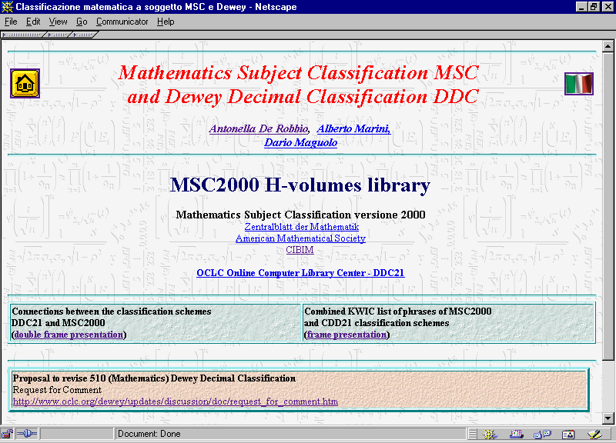
Notes:
Mathematics Subject Classification MSC and Dewey Decimal Classification DDC
http://www.math.unipd.it/~biblio/math/engddc.htm
We advanced on this line by throwing off connections between classification numbers from the DDC 21 and MSC2000 schemes; a draft page in double view presentation was then produced:
Connections between the classification schemes DDC21 and MSC2000
http://www.math.unipd.it/~biblio/msc-cdd/index.html

Slide 24
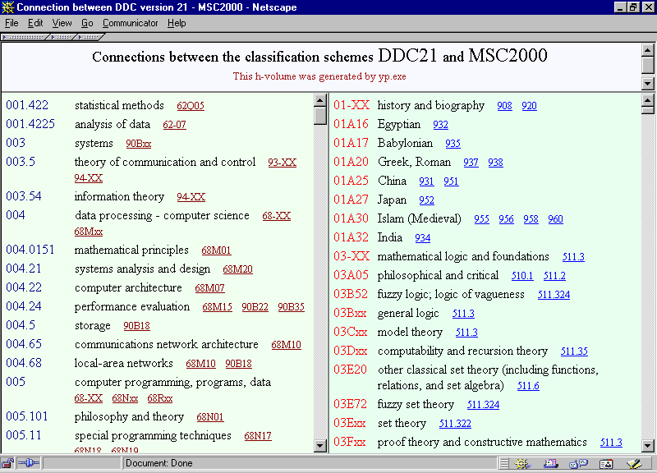

Slide 25
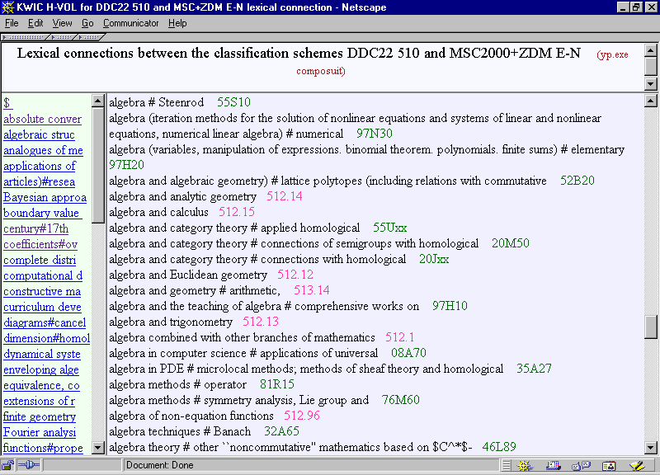
Notes:
In view of the revision of the 510 section of DDC, Mathematics, we are updating such a draft along the proposal presented by Giles Martin, Assistant Editor of the Dewey Decimal Classification.
Meanwhile, we have put together the descriptions of:
- the proposed revision of the 510 DDC section
- MSC2000
- the sections E - N of the ZDM classification, encoded as 97E - 97N
in the MSC style to produce the KWIC list H-volume
Lexical connections between the classification schemes DDC22 510 and MSC2000 + ZDM E-N
http://www.math.unipd.it/~biblio/kwic/msc-cdd/index.html.

Slide 26
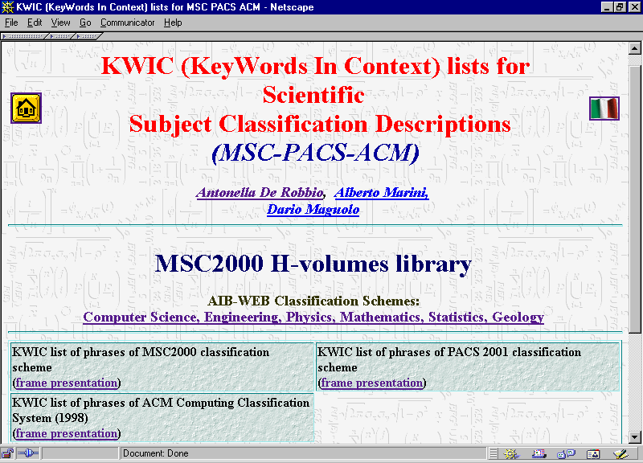
Notes:
KWIC (KeyWords In Context) lists for Scientific Subject Classification Descriptions
http://www.math.unipd.it/~biblio/math/engkwic.htm.
The following H-volumes have been produced:
KWIC list of phrases of MSC2000 classification scheme
http://www.math.unipd.it/~biblio/kwic/msc/
KWIC list of phrases of PACS 2001 classification scheme
http://www.math.unipd.it/~biblio/kwic/pacs/
KWIC list of phrases of ACM (1998)
http://www.math.unipd.it/~biblio/kwic/acm/

Slide 27
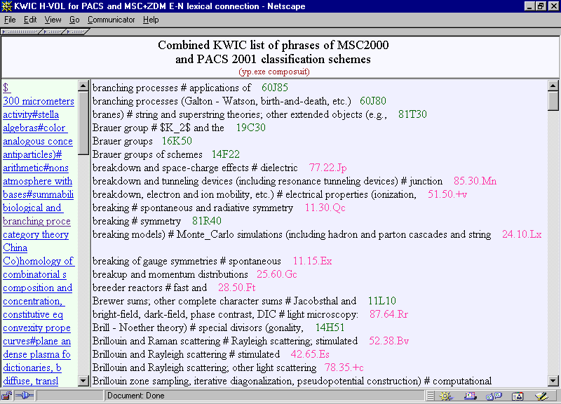
Notes:
Combined KWIC list of phrases of MSC2000 and
PACS 2001 classification schemes
http://www.math.unipd.it/~biblio/kwic/msc-pacs/
Combined KWIC list of phrases of MSC2000 and
ACM Computing Classification System (1998)
http://www.math.unipd.it/~biblio/kwic/msc-acm/.
Such kind of preliminary lexical support shall be worked out for investigating the connections among other groups of classification schemes.
Furthermore, some improvements obtainable by discrimination of homonyms, synonyms and secondary terms shall be investigated.

Slide 28
Another project...
about interconnecting classifications is
the German project
Content Analysis, Retrieval an Metadata: Effective Networking" (CARMEN)
(from October 1999 to February 2002)
Notes:
about interconnecting classifications is
the German project
Content Analysis, Retrieval an Metadata: Effective Networking" (CARMEN)
(from October 1999 to February 2002)
Within the Working Package 12: Cross concordances of classifications and thesauri, programs for interconnecting general classifications such as DDC and discipline-specific ones, (MSC, PACS, and the classification for social sciences) will be developed in Java on a relational database system with an abstract intermediate level to allow a transit to different producers of database software.

Slide 29
Conclusions
integration inside OPACs
gateway for e-print server OAI compliants
classification schemes encoded in metadata formats
Notes:
Anyway, the most effective (and obvious) way for interconnecting subject classifications, thesauri or lists of subject headings is provided by bibliographic records, when more than one system is used for subject indexing inside the same records. Actually, the same documents come mostly to be represented, in different bibliographic utilities or catalogues, with indexing data from different systems. While general library OPACs rely on DDC and national lists of subject headings, specialized bibliographic databases are each confident on its discipline-specific classification or thesarus. It would suffice to put these data for matching records together to create the bridge. In this way, browsing inside one subject indexing system can be integrated either with direct access to document metadata (or possibly documents), or with passage to another subject indexing system for further navigation. Suitable metadata for identifying versions of subject indexing systems should be required for effective navigation tracking, but a metadata format for such objects has yet to be defined.
Work for defining a metadata format for subject classifications and their versions in the framework of metadata formats for documents is strongly at issue now.
While backing such developments, our realizations in subject classification displaying are intended to demonstrate possibilities for library OPACs to integrate their functionalities with discipline-specific environments for document search and retrieval. Moreover, our approach could be exploited in the development of gateways and portals pointing to e-print servers. By means of our KWIC list displays for descriptions of single or combined classifications, words or phrases used to describe places in different classification spaces could be turned into addresses of communicating sites in different environments. Through the metadata that match the identified codes in the discipline-specific classifications, an OAI compatible service provider could transform these abstract addresses into actual full-text documents available from discipline-specific servers.
In the next future, the keywords that will index a cooperative effort on scientific classifications will be OPAC, OAI compatible e-print server, metadata.

