Slide 2
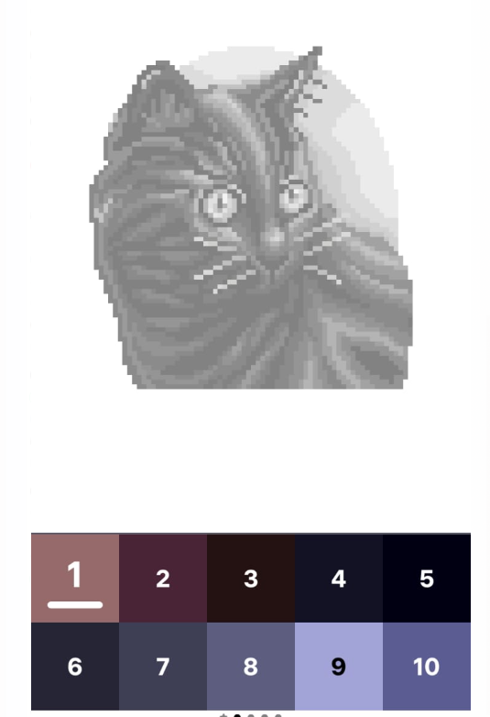


Slide 4
4 x 5 =
a
20
c
34
b
14
d
25
4 x 5 =
a
20
c
34
b
14
d
25

