Slide 1
Sun Yat-sen University
Study of Radioactive Source Monitoring Based on ElasticNet Regression Method
SYSU
Bachelor's Thesis Defense Report
Wang Kaiqi
Sino-French Institute of Nuclear Engineering and Technology, Sun Yat-sen University
Supervisors: Prof. Shi Wei (CityU HK) & Prof. Wang Kai (SYSU)
April 2026

Slide 2
Outline
1 Background & Motivation
2 Literature Review
3 Theoretical Basis
SYSU
4 Algorithm & Optimization
5 PHITS Simulation
6 Results & Analysis
7 Conclusions & Future Work
References
Q & A
Wang Kaiqi Sino-French Institute of Nuclear Engineering and Technology, SYSU
Study of Radioactive Source Monitoring Based on ElasticNet 1 / 25

Slide 3
Research Background
Nuclear Facility Decommissioning
Core Challenge
• Global decommissioning projects increasing (Fukushima Daiichi, etc.)
• The inverse reconstruction problem is both underdetermined (m ≪ n) and ill-posed
• IAEA: Accurate source distribution is prerequisite for optimized decommissioning
• A single method must handle sparse hotspots, continuous regions, and multi-nuclide discrimination
Three-Dimensional Complexity
• Composite sources: localized hot-spots + continuous activation + dispersed media
• Nuclide diversity: ¹³⁴Cs, ¹³⁷Cs, ⁶⁰Co, ¹³¹I
SYSU
• Constraints: limited detectors, time, dose limits
Wang Kaiqi Sino-French Institute of Nuclear Engineering and Technology, SYSU
Study of Radioactive Source Monitoring Based on ElasticNet 2 / 25

Slide 4
Problem Statement
Definition 4.1 Mathematical Formulation
d = A · s + ε where d: measurements, A: contribution matrix, s: source vector, ε: noise
Key Challenges
• Underdetermined: fewer detectors than unknowns (m ≪ n)
• Ill-posed: noisy data leads to unstable solutions
SYSU
• Mixed: sparse hot spots + continuous activation regions
Wang Kaiqi Sino-French Institute of Nuclear Engineering and Technology, SYSU
Study of Radioactive Source Monitoring Based on ElasticNet 3 / 25

Slide 5
Existing Methods and Limitations
Method | Sparse | Continuous | Multi-n. | Speed | Core Limitation
ML-EM/MPMI | Fair | Good | Poor | Slow | O(n³); noise sensitive
IRT-DEGL | Fair | Fair | Fair | V.Slow | Global optimization cost
LASSO | Exc. | Poor | Good | Fast | Over-compresses continuous
Fused LASSO | Fair | Good | Good | Med. | Needs neighborhood graph
ElasticNet | Exc. | Exc. | Good | Fast | Not yet applied to nuclear
SYSU
Table: Comparison of radioactive source reconstruction methods
Wang Kaiqi Sino-French Institute of Nuclear Engineering and Technology, SYSU
Study of Radioactive Source Monitoring Based on ElasticNet 4 / 25

Slide 6
Why ElasticNet?
Advantages over LASSO and Fused LASSO
Theorem 2.1 Research Gap
• LASSO: over-compresses continuous regions to discrete points
ElasticNet has NOT been applied to nuclear radioactive source monitoring — this thesis fills that gap.
• Fused LASSO: needs predefined neighborhood graph + ADMM issues
• ElasticNet: L1+L2 synergy without extra spatial constraints
Cross-Domain Evidence
• Nuclear medicine (SPECT): outperforms pure L1, L2, fixed-weight EN
SYSU
• XLCT imaging: superior localization + dual-source resolution
• Fluorescence molecular tomography: 30%+ error reduction
Wang Kaiqi Sino-French Institute of Nuclear Engineering and Technology, SYSU
Study of Radioactive Source Monitoring Based on ElasticNet 5 / 25

Slide 7
ElasticNet Regression Formulation
Definition 3.1 Objective Function (Zou & Hastie, 2005)
min_w ||y - Xw||²₂ + α [ ρ||w||₁ + (1-ρ)/2 · ||w||²₂ ]
L1 vs. L2 Penalty Roles
Key Properties
• L1: promotes sparsity → hot-spot localization
• Strictly convex when λ₂ > 0 → unique global minimum
• L2: groups correlated variables, suppresses oscillation
• Solved by Coordinate Descent; no ADMM convergence issues
SYSU
• ρ → 1: LASSO; ρ → 0: Ridge
Wang Kaiqi Sino-French Institute of Nuclear Engineering and Technology, SYSU
Study of Radioactive Source Monitoring Based on ElasticNet 6 / 25

Slide 8
Physical Interpretation
L1: Sparse Hot-Spot Localization
L2: Continuous Region Smoothing
• Count-type penalty on 'how many grid cells contain sources'
• Suppresses individual amplitude, promotes similar neighboring values
• Drives irrelevant coefficients to exact zero
• Preserves continuous region morphology (not discrete spots like LASSO)
SYSU
Theorem 3.1 Synergy Effect
Near hotspots: L1 dominates → precise localization. Inside continuous regions: L2 dominates → smooth morphology. Transition zones: both cooperate.
Wang Kaiqi Sino-French Institute of Nuclear Engineering and Technology, SYSU
Study of Radioactive Source Monitoring Based on ElasticNet 7 / 25

Slide 9
Algorithm Pipeline
Stage 1: Preprocessing
• Column normalization: scale each column of A to unit L₂ norm
• Non-negative SVD matrix construction
• Condition number assessment for adaptive α range
Stage 2: ElasticNet Optimization
• ElasticNet(positive=True) — hard non-negativity constraint
SYSU
• GridSearchCV: α (50 values), ρ (80 values), 5-fold CV
• Custom intercept penalty for |β₀/ȳ| > 10%
Stage 3: Post-processing
• Denormalize: w_est = w_norm ⊘ col_norms
• Non-negative truncation, intercept analysis, evaluation metrics
Wang Kaiqi Sino-French Institute of Nuclear Engineering and Technology, SYSU
Study of Radioactive Source Monitoring Based on ElasticNet 8 / 25

Slide 10
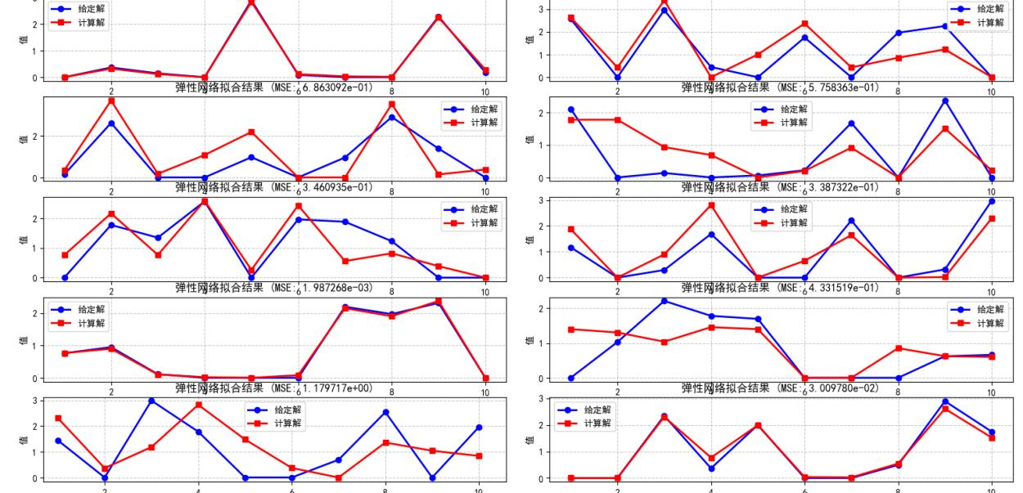
Key Optimization: Column Normalization
SYSU
Figure: Column normalization: cond=100, 5 runs all achieve MSE=10⁻⁴ to 10⁻⁹
Wang Kaiqi Sino-French Institute of Nuclear Engineering and Technology, SYSU
Study of Radioactive Source Monitoring Based on ElasticNet 9 / 25

Slide 11
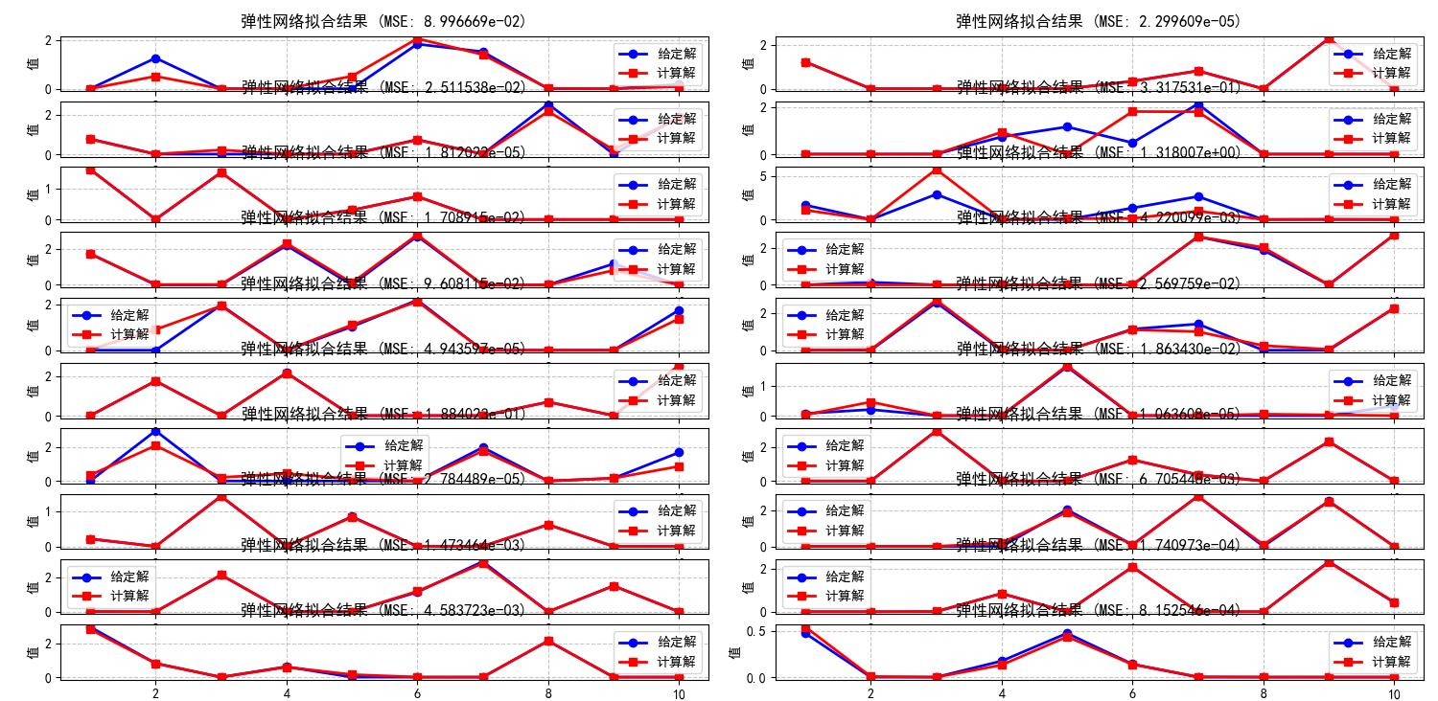
Non-negative SVD + Non-negative ElasticNet
SYSU
Figure: Non-negative SVD + non-negative EN: Exp1/Exp3 reach MSE=10⁻⁹
Wang Kaiqi Sino-French Institute of Nuclear Engineering and Technology, SYSU
Study of Radioactive Source Monitoring Based on ElasticNet 10 / 25

Slide 12
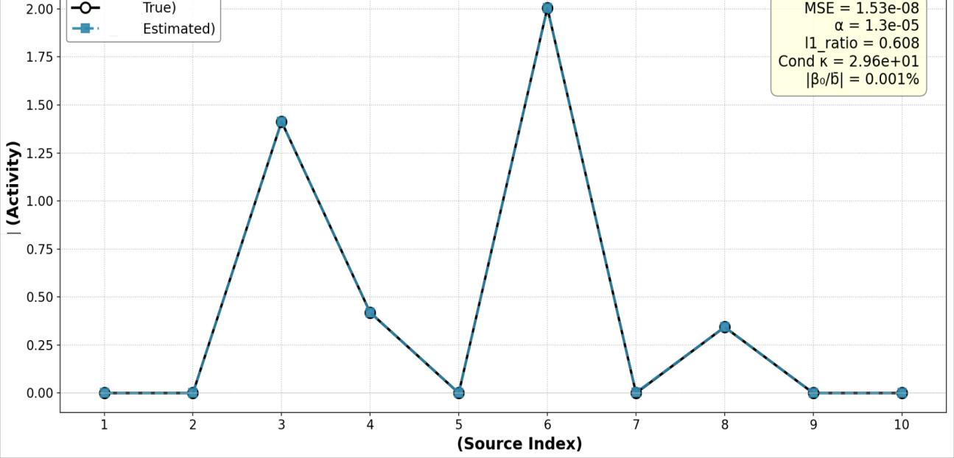
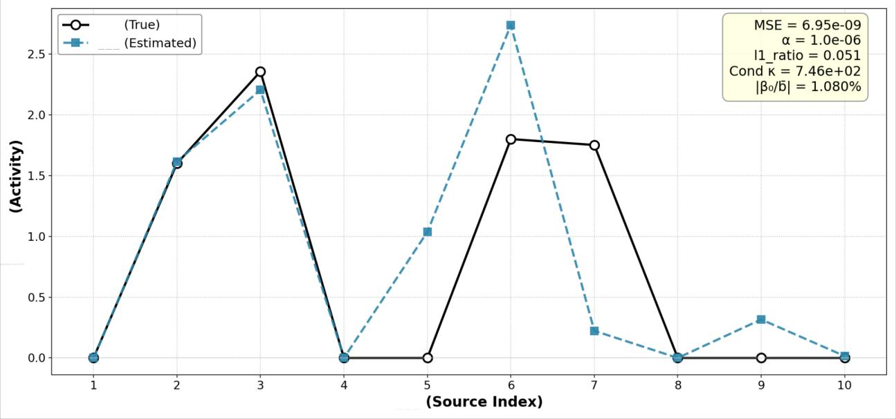
Intercept Fitting Analysis
SYSU
Good case: small intercept
Bad case: large intercept
Wang Kaiqi Sino-French Institute of Nuclear Engineering and Technology, SYSU
Study of Radioactive Source Monitoring Based on ElasticNet 11 / 25

Slide 13
PHITS Simulation Configuration
PHITS (JAEA): Monte Carlo Particle Transport
• 10⁸ particles × 100 batches; Cs-137, 0.662 MeV γ-ray
Parameter | Value
Simulation space | Spherical (R=10m, reactor-centered)
Radioactive sources | 10 Cs-137 point sources, 1 Ci each
Detectors | 8 spherical detectors (R=25mm)
Grid division | 4 × 3 = 12 cells
Contribution matrix | 8 × 12 (only 11/96 non-zero)
Matrix rank | 6/8
SYSU
Wang Kaiqi Sino-French Institute of Nuclear Engineering and Technology, SYSU
Study of Radioactive Source Monitoring Based on ElasticNet 12 / 25

Slide 14
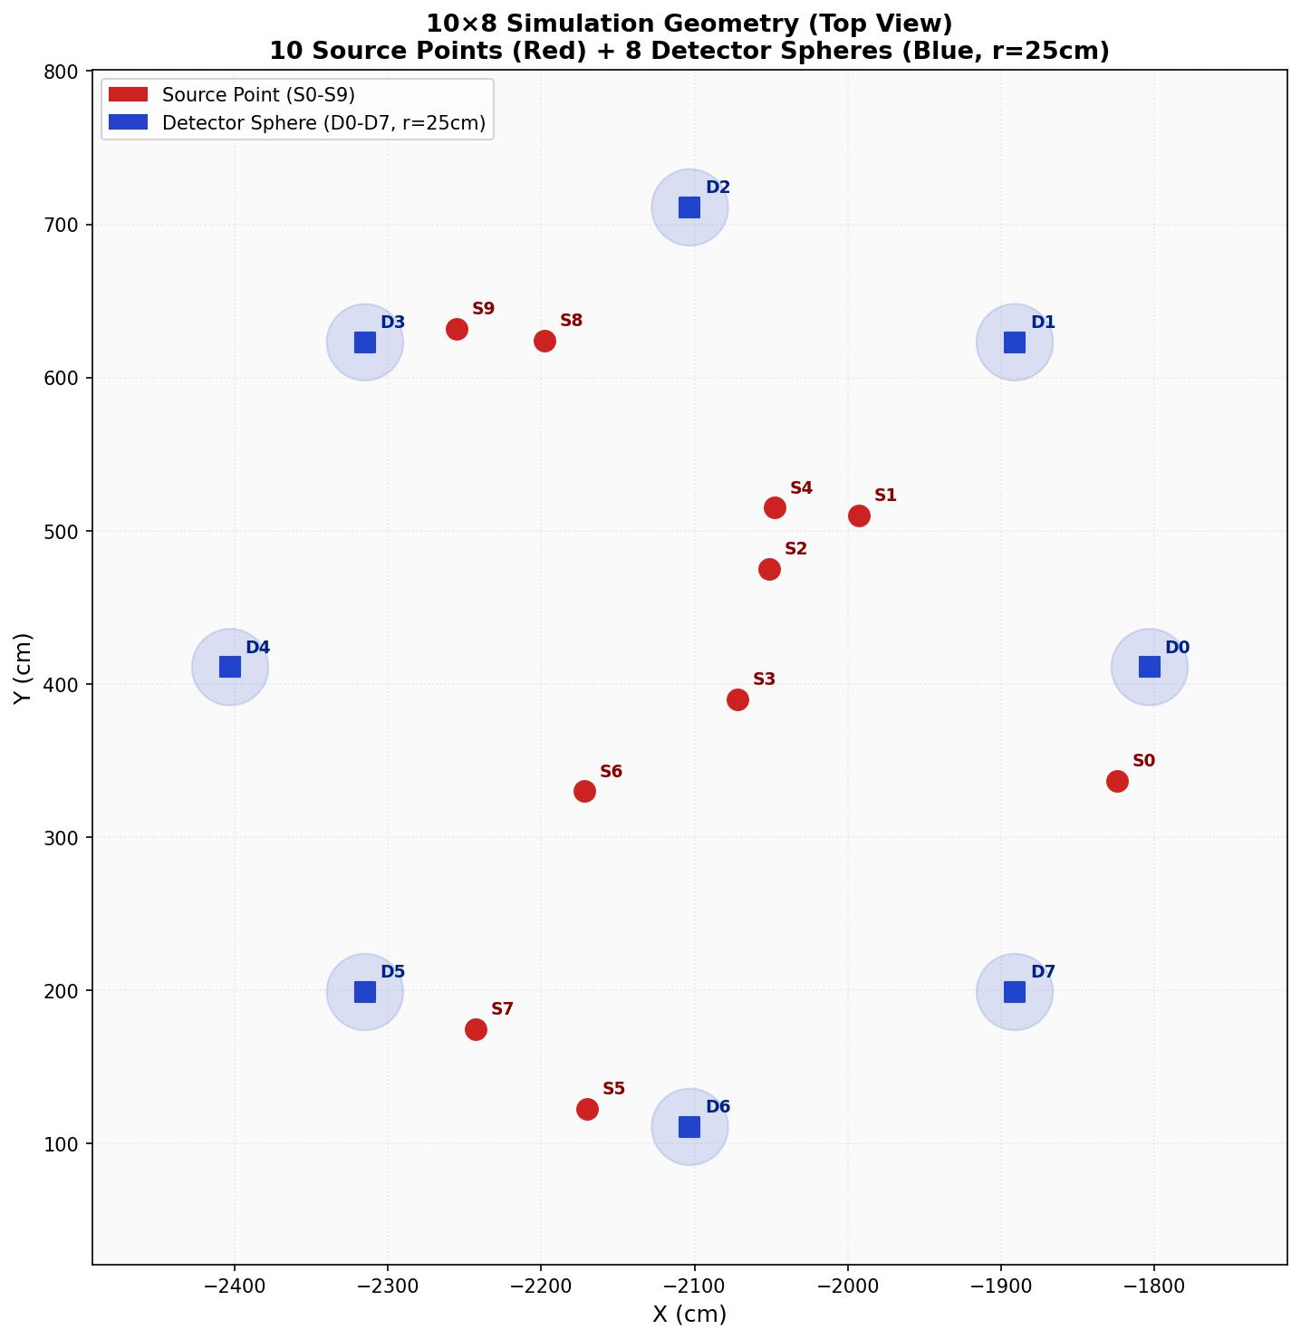
Source-Detector Geometry
• 10 Cs-137 point sources (1 Ci)
• 4 × 3 = 12 grid cells
• 8 spherical detectors (R=25mm)
SYSU
• 7 active cells, 5 empty
• Matrix: 8 × 12, rank=6/8
Wang Kaiqi Sino-French Institute of Nuclear Engineering and Technology, SYSU
Study of Radioactive Source Monitoring Based on ElasticNet 13 / 25

Slide 15
PHITS Validation Results
Best: α = 10⁻⁶, l1_ratio = 0.99, R² = 0.463 | 7 non-zero cells detected, 5 with <2% error
Cell | True (GBq) | Estimate (GBq) | Error
Cell 1 | 1.265×10⁵ | 1.265×10⁵ | 0.0%
Cell 5 | 5.266×10⁴ | 3.93×10² | 99.3%
Cell 6 | 1.192×10⁵ | 2.31×10³ | 98.1%
Cell 7 | 5.894×10⁴ | 5.894×10⁴ | 0.0%
Cell 8 | 5.724×10⁴ | 5.724×10⁴ | 0.0%
Cell 9 | 4.870×10⁴ | 4.870×10⁴ | 0.0%
Cell 10 | 1.352×10⁵ | 1.373×10⁵ | 1.2%
SYSU
Wang Kaiqi Sino-French Institute of Nuclear Engineering and Technology, SYSU
Study of Radioactive Source Monitoring Based on ElasticNet 14 / 25

Slide 16
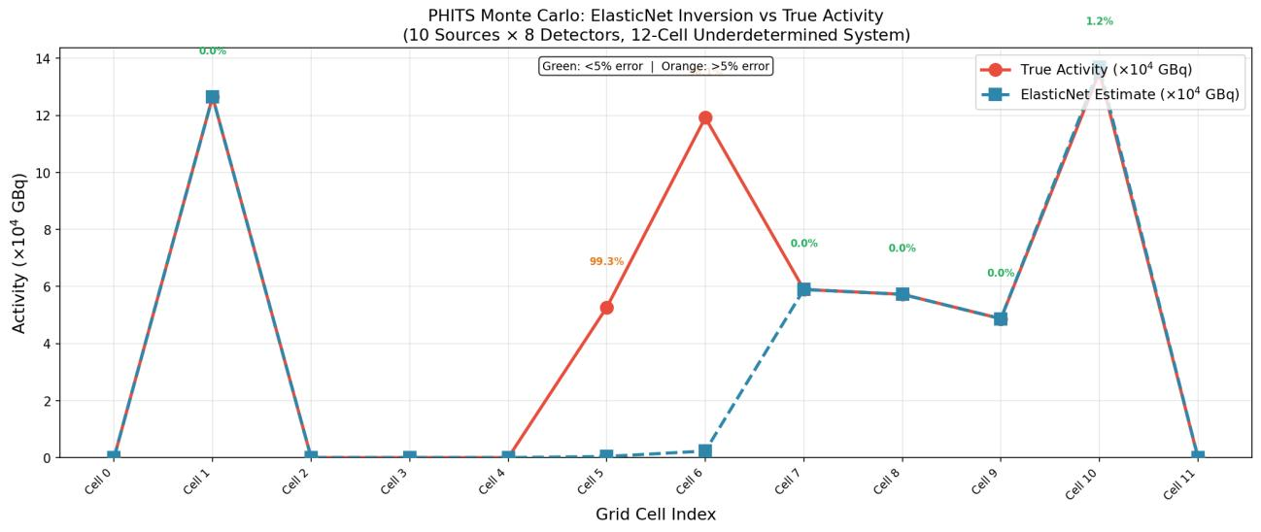
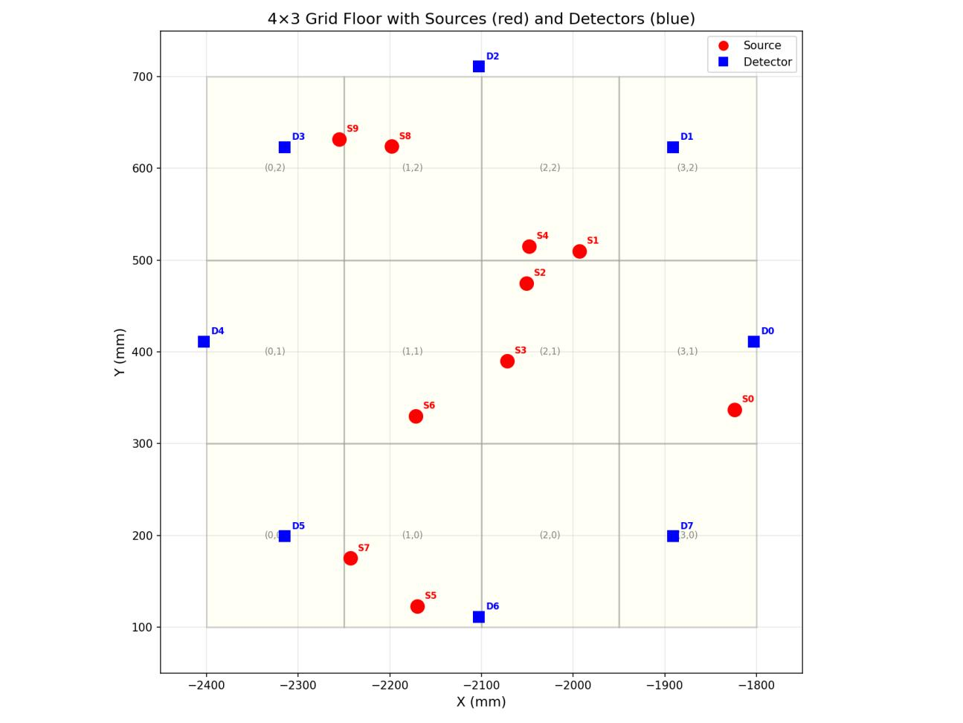
Reconstruction Visualization
SYSU
True vs. estimated distribution
Contribution matrix heatmap
Wang Kaiqi Sino-French Institute of Nuclear Engineering and Technology, SYSU
Study of Radioactive Source Monitoring Based on ElasticNet 15 / 25

Slide 17
Error Source Analysis
Cell 5 & 6 Failure — Physical, Not Algorithmic
• Cell 6: only Detector 1 responds, weak signal (10⁻⁹ level)
• Cell 5: only Detector 5 responds, weak signal (10⁻¹⁰ level)
Theorem 6.1 Matrix Rank Analysis
Rank of A = 6/8. Only 6 of 12 cells algebraically distinguishable. Physical indistinguishability from detector geometry, NOT algorithm failure.
SYSU
Implication
• Improved detector layout would resolve these errors. ElasticNet is NOT the bottleneck.
Wang Kaiqi Sino-French Institute of Nuclear Engineering and Technology, SYSU
Study of Radioactive Source Monitoring Based on ElasticNet 16 / 25

Slide 18
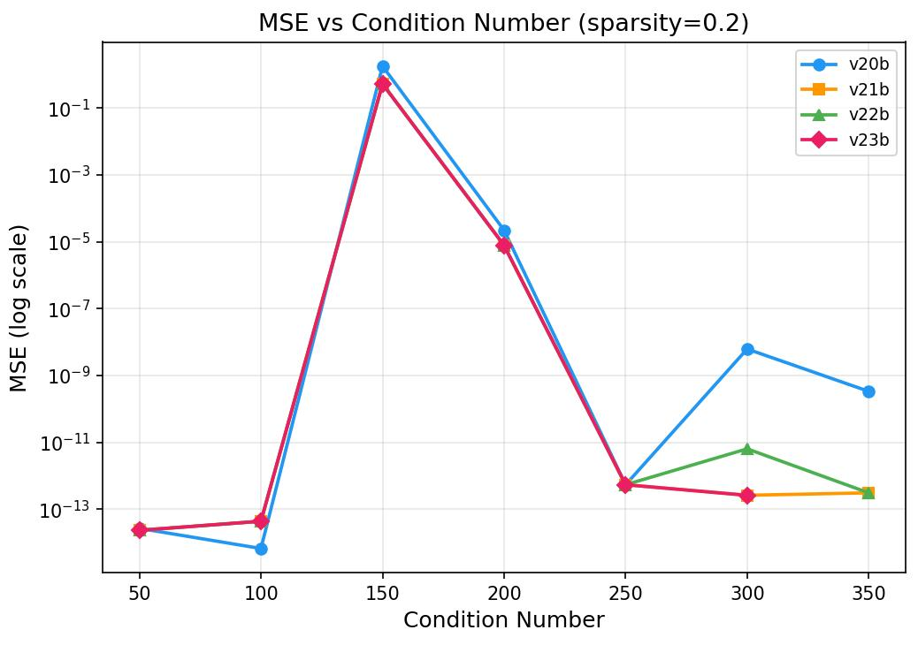
Condition Number Impact
SYSU
Figure: Comparison of adaptive CV, segmented search, and fusion strategies
Wang Kaiqi Sino-French Institute of Nuclear Engineering and Technology, SYSU
Study of Radioactive Source Monitoring Based on ElasticNet 17 / 25

Slide 19
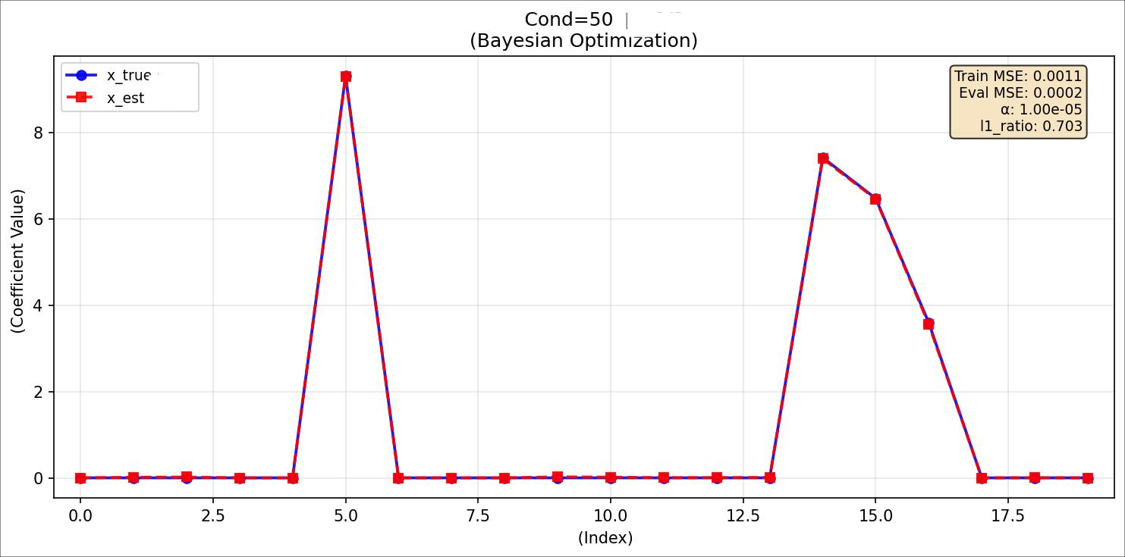
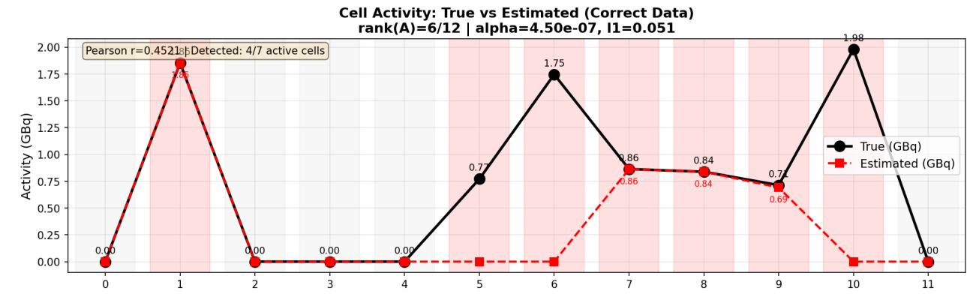
Bayesian Optimization Results
SYSU
Bayesian + PHITS validation
Bayesian opt.: sparse source
Wang Kaiqi Sino-French Institute of Nuclear Engineering and Technology, SYSU
Study of Radioactive Source Monitoring Based on ElasticNet 18 / 25

Slide 20
Grid Search vs. Bayesian Optimization
Difficulty Inflection Points at Cond ≈ 150 and 300
 | Grid Search | Bayesian Opt.
Evaluations | 150–450 | 40
Speed | Baseline | 5–10× faster
Accuracy (low cond) | Reference | Comparable
Accuracy (high cond) | Higher ceiling | Slightly worse
• Not 'more ill-conditioned = harder' — critical spectral structure matters
• Optimal l1_ratio ≈ 0.99 universally — confirms strong sparsity prior
SYSU
Complementary, not substitutive
Wang Kaiqi Sino-French Institute of Nuclear Engineering and Technology, SYSU
Study of Radioactive Source Monitoring Based on ElasticNet 19 / 25

Slide 21
Conclusions
1. ElasticNet fills the application gap
• Effectively handles 'sparse + continuous' composite source reconstruction.
2. Optimization strategies improve accuracy
• Column normalization + adaptive α + non-negative constraint + intercept penalty.
3. PHITS validation confirms practical value
SYSU
• All 7 non-zero cells detected; 5 cells with <2% error.
4. Bayesian optimization: complementary to grid search
• 70–90% computation savings; grid search has higher accuracy ceiling.
Wang Kaiqi Sino-French Institute of Nuclear Engineering and Technology, SYSU
Study of Radioactive Source Monitoring Based on ElasticNet 20 / 25

Slide 22
Future Work
Mobile Detection Platforms (UGV / UAV)
• Autonomous patrol → richer contribution matrix → improved stability
Algorithm Improvements
• Adaptive ElasticNet for automatic variable selection
• Bayesian ElasticNet with uncertainty quantification
• Deep learning + ElasticNet model cascade
SYSU
Extended Applications
• Multi-energy source discrimination & 3D volumetric reconstruction
• Real-time online reconstruction system
Wang Kaiqi Sino-French Institute of Nuclear Engineering and Technology, SYSU
Study of Radioactive Source Monitoring Based on ElasticNet 21 / 25

Slide 23
References
[1] Tibshirani R. Regression shrinkage and selection via the lasso. JRSS-B, 1996.
[2] Hoerl & Kennard. Ridge regression. Technometrics, 1970.
[3] Sugaya et al. Inverse estimation for fuel debris search. ANE, 2019.
SYSU
[4] Shi W et al. LASSO with spectral information. ANE, 2023.
[5] Shi W et al. LASSO: Theory and demonstration. PNE, 2023.
[6] Yamada et al. Fused LASSO for radioactive materials. WM2024, 2024.
[7] Zou & Hastie. Regularization via the elastic net. JRSS-B, 2005.
[8] Kasai & Otsuka. Dynamic elastic net for nuclear medicine. J. Imaging, 2025.
[9] Zhao et al. Robust elastic net for XLCT. Phys. Med. Biol., 2021.
[10] Sato et al. PHITS version 3.02. JNST, 2018.
Wang Kaiqi Sino-French Institute of Nuclear Engineering and Technology, SYSU
Study of Radioactive Source Monitoring Based on ElasticNet 22 / 25

Slide 24
Questions & Discussion
SYSU
Thank you for your attention!
Wang Kaiqi | 22355080
Supervisors: Prof. Shi Wei (CityU HK) & Prof. Wang Kai (SYSU)

