Slide 1



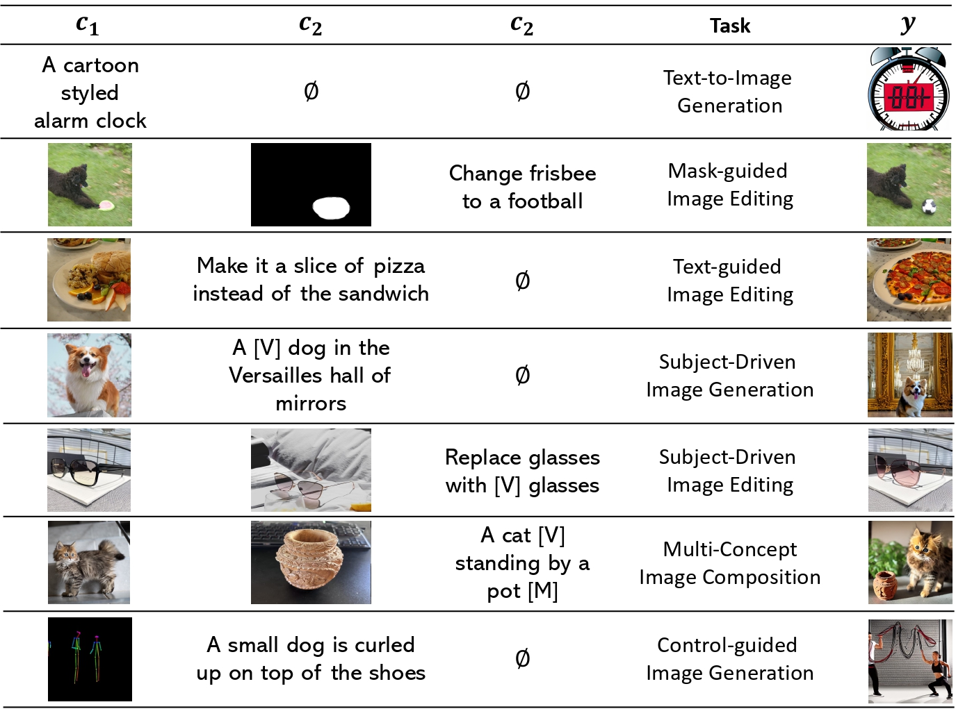
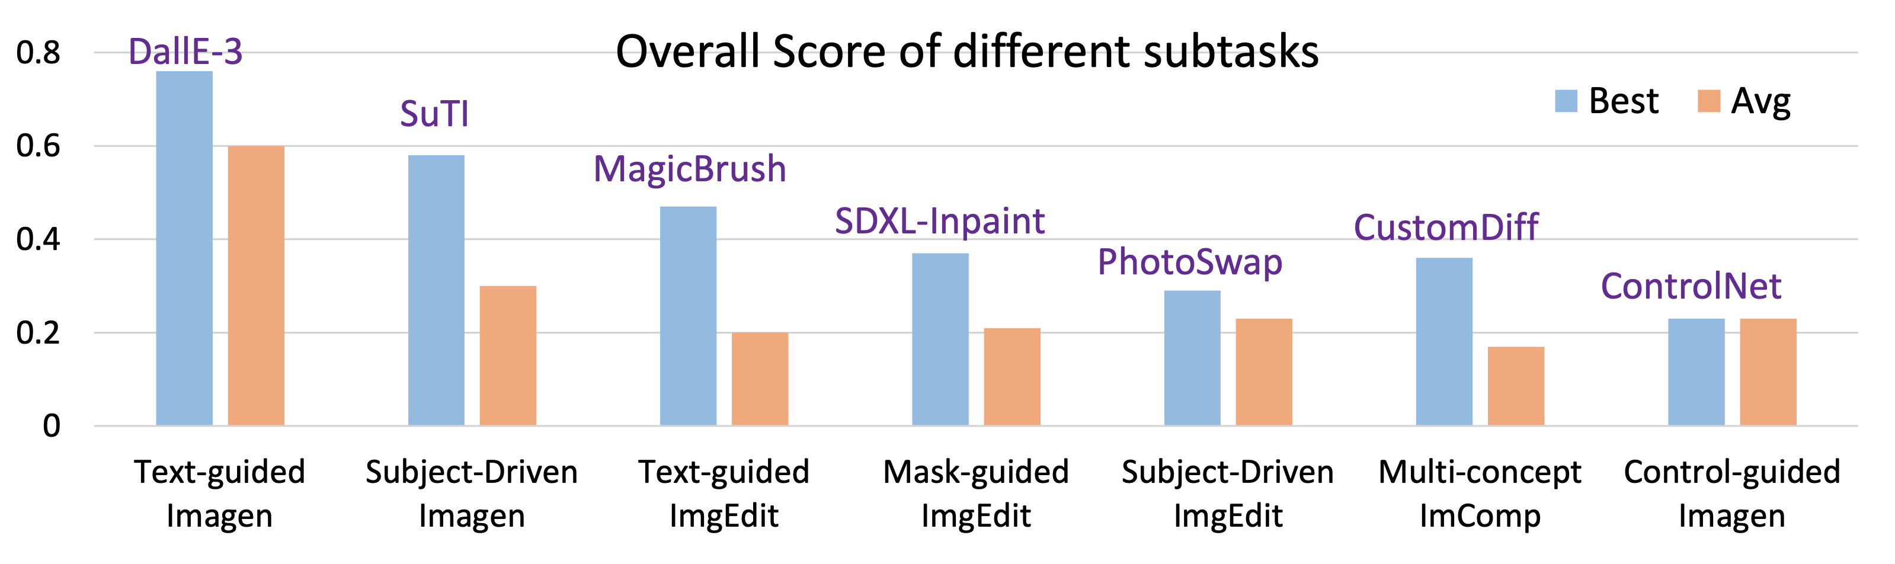

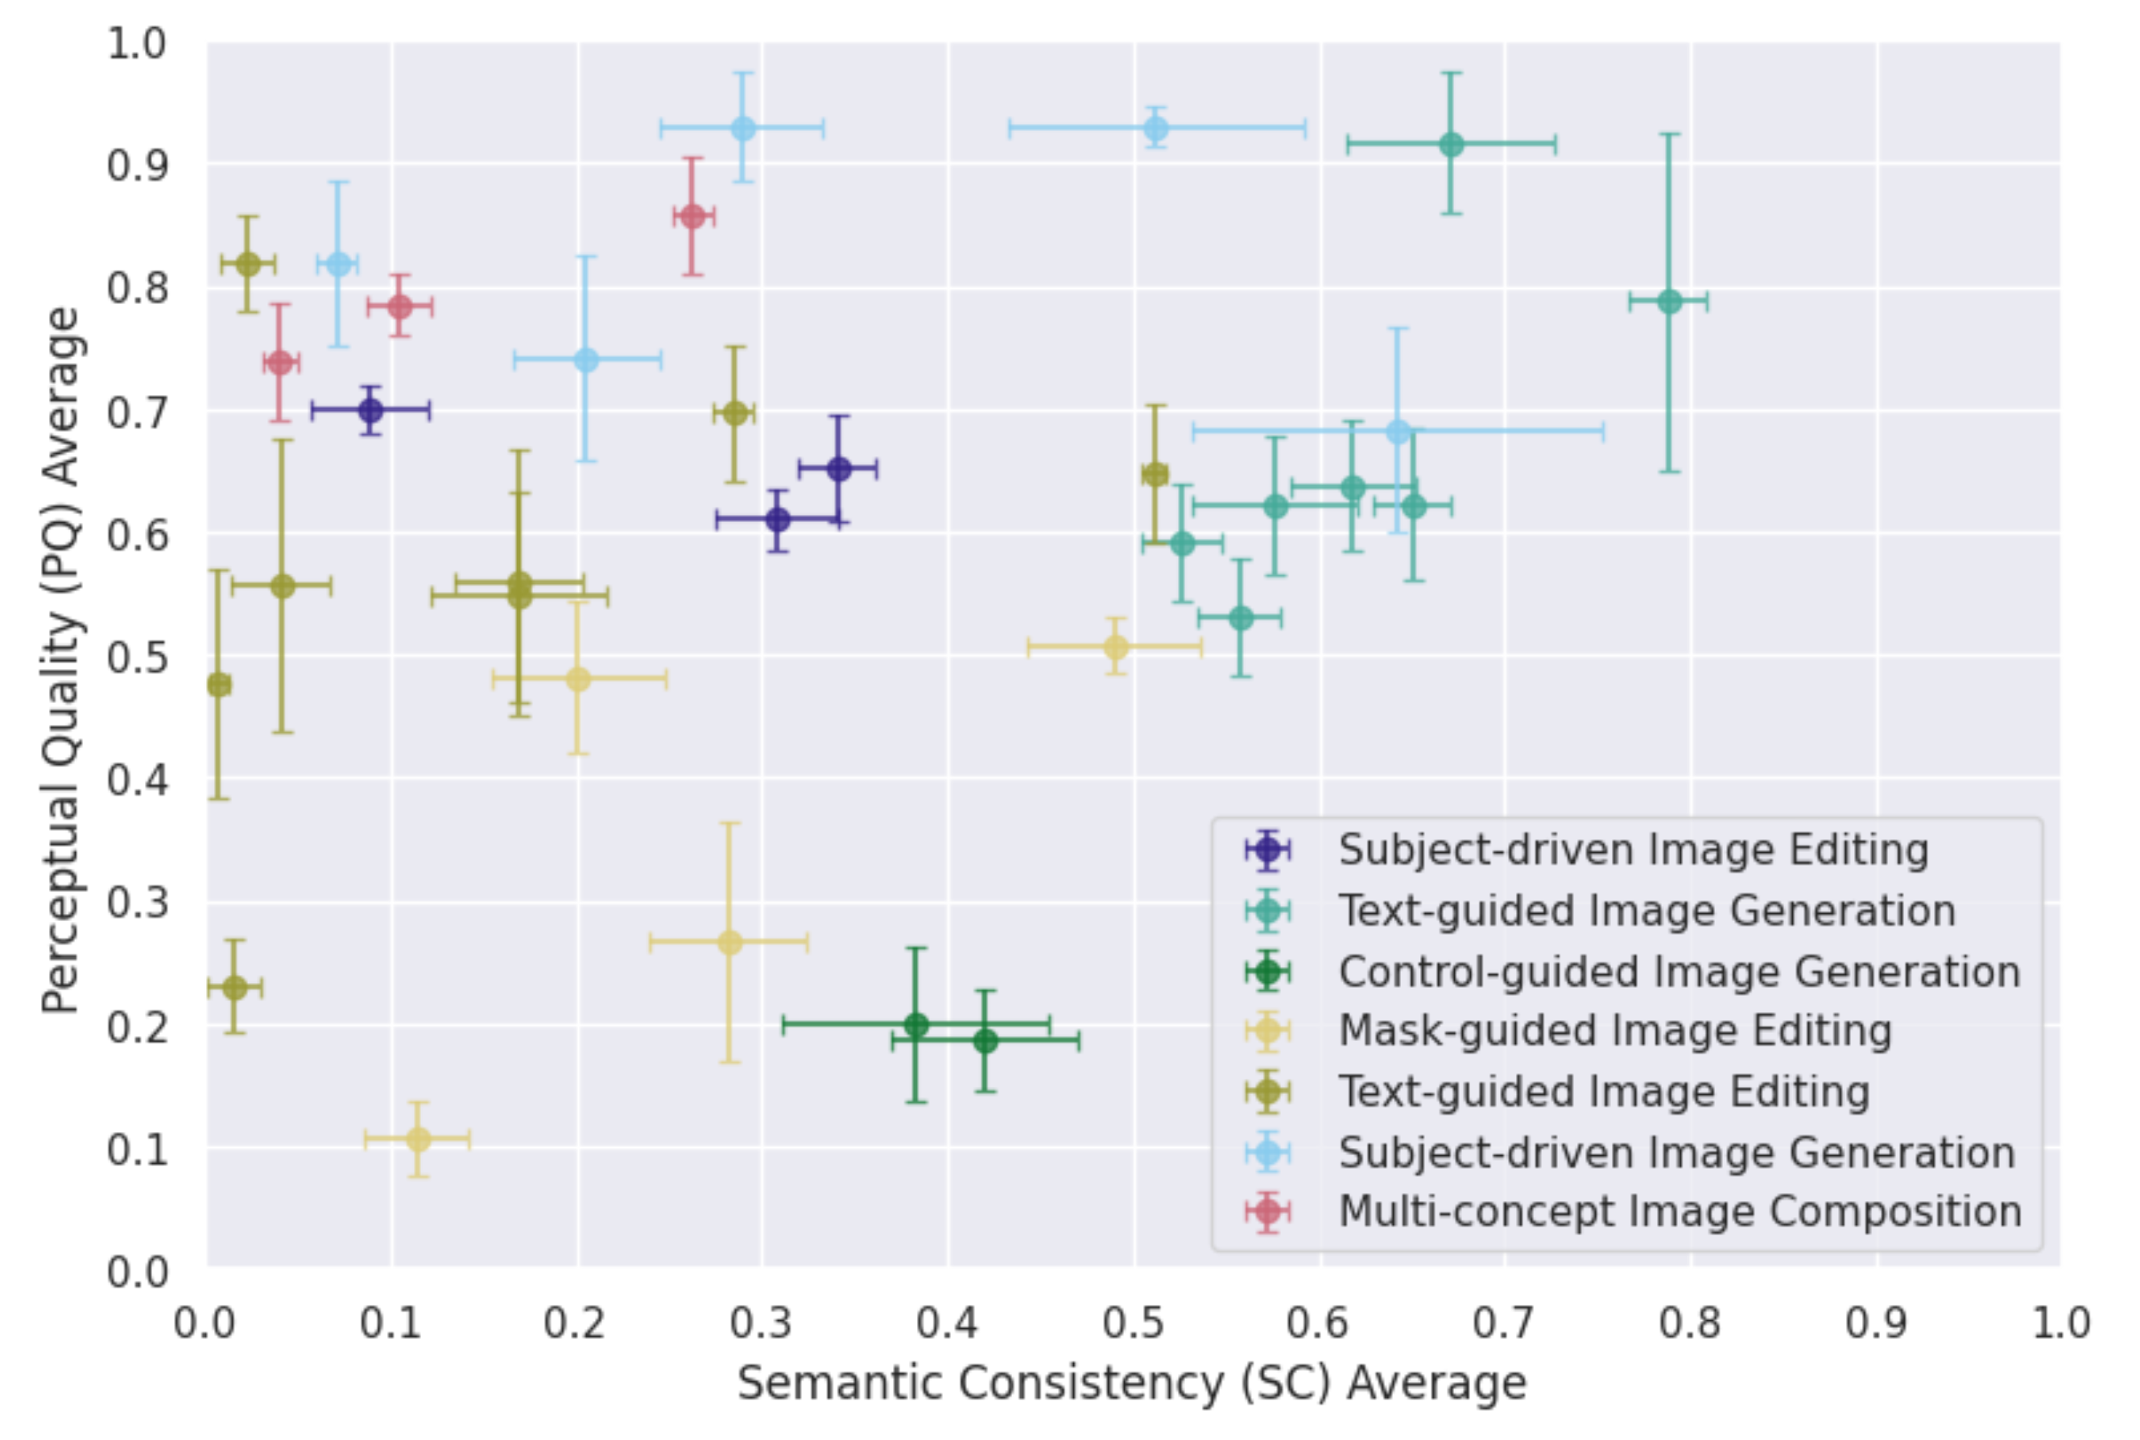
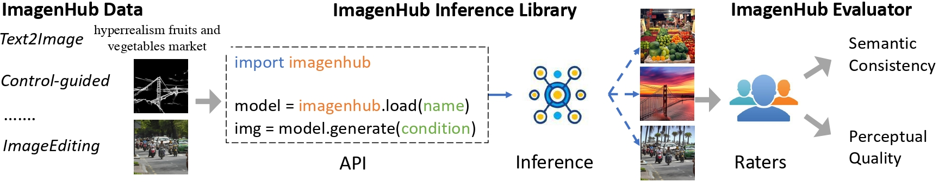
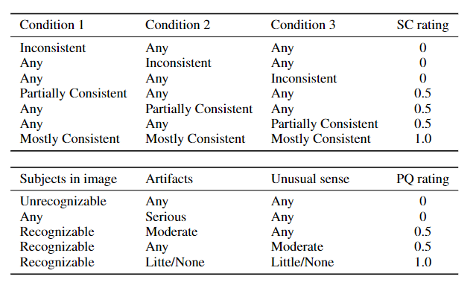
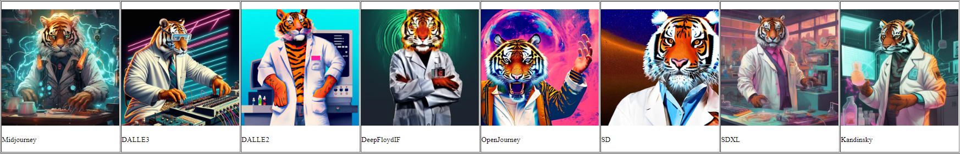
ImagenHub: Standardizing The Evaluation of Conditional Image Generation Models
♠️Max Ku, ♠️Tianle Li, †Kai Zhang, ♣Yujie Lu, ♥Xingyu Fu, ♢Wenwen Zhuang, ♠️Wenhu Chen
♠️University of Waterloo, †Ohio State University, ♣University of California Santa Barbara, ♥University of Pennsylvania, ♢Central South University
To identify current progress in the field
The Seven Tasks and Evaluation
How robust are the image models?
Rapid research development of numerous image generation models. However, significant inconsistencies in:
Evaluation Datasets
Inference methods
Evaluation methodology
Leading difficulties in fairly comparing models
Hinder the understanding of the true progress in the research field
Code, Visualization, etc.
The evaluation platform we needed
ImagenHub is a python library to standardize the evaluation and analyze model reliability across seven common image generation tasks.
Three raters achieve high inter-worker agreement
Easy-to-follow guidelines and optimal options
Data: Curated high-quality human evaluation dataset for each task
Library: Standardized inference pipeline for fair comparison
Evaluator: Evaluated over 30 image models on two human metrics
Semantic Consistency (SC) : is image aligned with the condition(s)?
Perceptual Quality (PQ) : is image making sense and in good quality?
Transparency: Results Hosted Online

