Slide 1






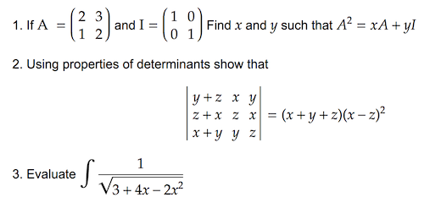
Math
Physics
Biology
Chemistry
Engineering
100K seed documents
Calculus
Probability
Combinatorics
Complex anal..
Number theo..
Geometry …
Numerical an..
Kinetics
Electromagnetics
Atom
Wave
Particle
Relativity
Quantum
Cell Biology
Genetics
Evolution
Botany
Microbiology
Zoology
Anatomy
Chemical Reaction
Organic Chem
Inorganic Chem
Physical Chem
Biological Chem
Medical Chem
Computer Science
Electronical Eng
Machine Learning
Signal Process
Management
Mechanical Eng
Crowd-sourcing
40K documents
Augment

Slide 3




Subject Domains
Crowd Sourcing
20K Q-A pairs
Augment
100K seed
Math
Biology
1
Physics
Chem
Engineering
Finance
Social
Humanities
Fast-Text
URL
Fast-Text
2
100K seed data
CC
Round-1 Recall
CC
18M Docs
26B Tokens
4B Tokens
Extraction
Yes?
Decontaminate
Refinement
3
Mixtral 7x8B
Mixtral 7x8B;
Qwen-72B;
18M Docs
5M Extracted
10M Q-A Pair

Slide 4
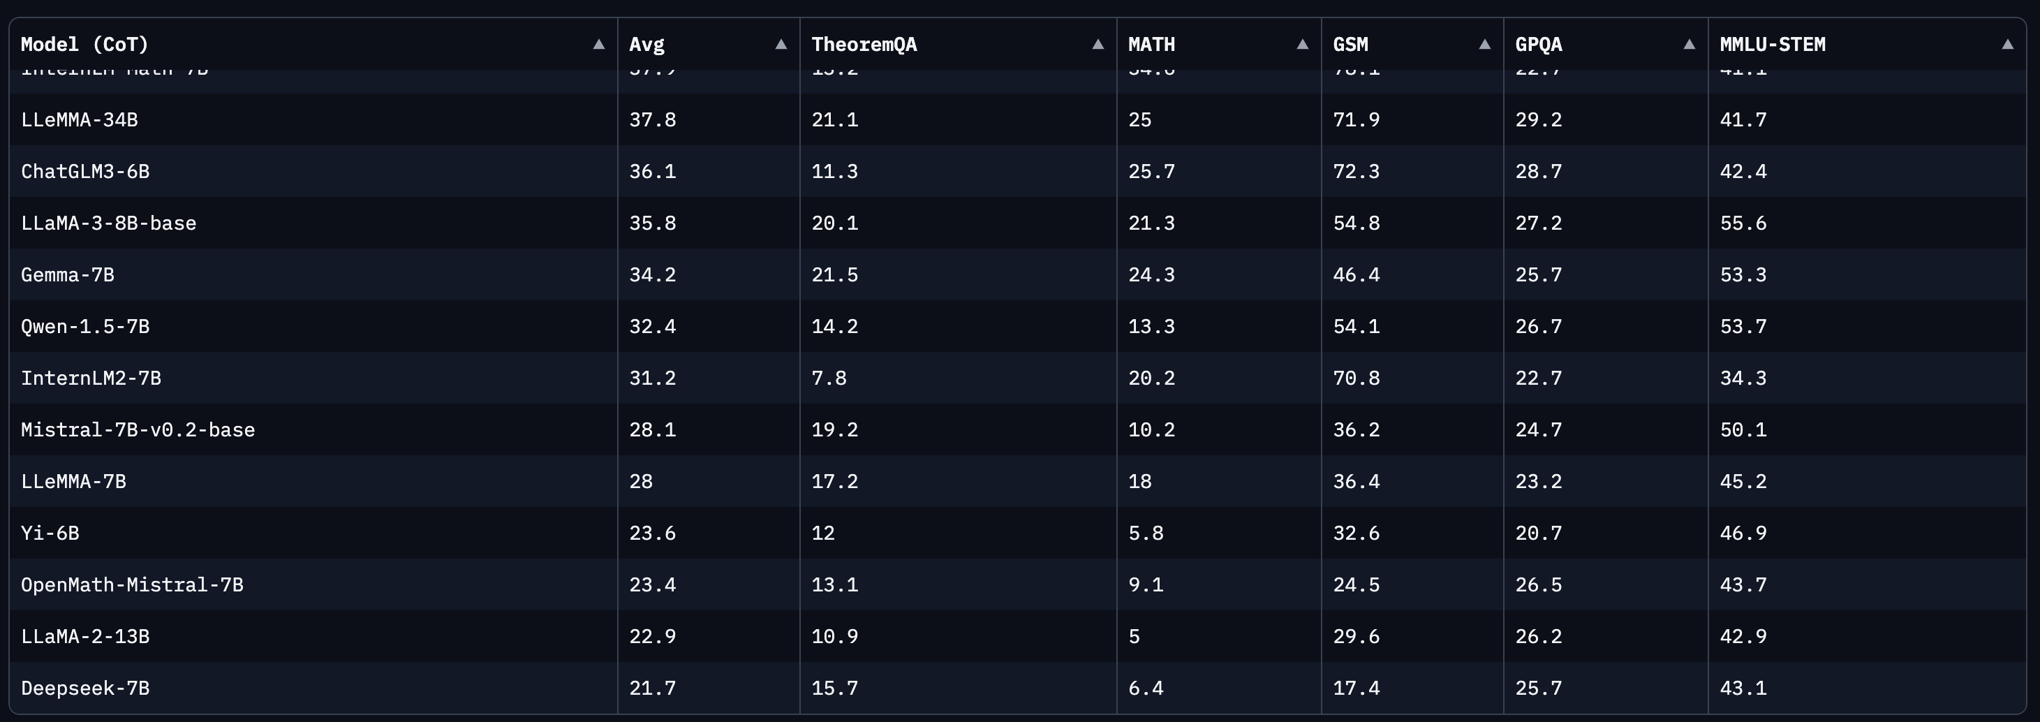

Slide 5
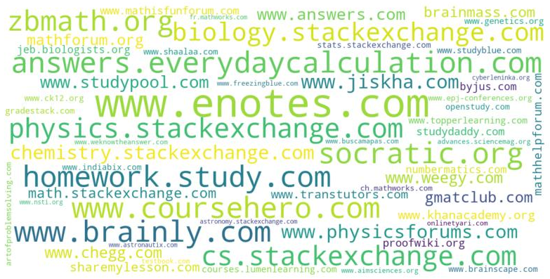
Math
36%
Science
31%
Engineer
14%
Social
14%
Humanity
5.6%
Others
6.4%

