Slide 1









Previous Method
Our Method
Recall
Extract
Refine
Annotators
Annotated
Seed Data
Synthetic
Web
Raw data
Q-A data
Final
Human annotation
Distillation from GPT-4
WebInstruct: 10M instruction data from the web
Costly, usually small-scale
Prone to bias & hallucinations
Diverse, high quality and large-scale

Slide 2





Subject Domains
Crowd Sourcing
20K Q-A pairs
Augment
100K seed data
Math
Biology
1
Physics
Chem
Engineering
Finance
Social
Humanities
Fast-Text
URL
Fast-Text
2
100K seed data
CC
Round-1 Recall
CC
18M Docs
26B Tokens
4B Tokens
Extraction
Yes?
Decontaminate
Refinement
3
Mixtral 7x8B
Mixtral 8x7B;
Qwen-72B;
18M Docs
5M Extracted
10M Q-A Pair

Slide 3
1
Recall from Web
Seed
Fast-Text
CC
URL Filter
Fast-Text
CC
2
Q-A Pair Extraction
3
Q-A Pair Refinement
Pre-process
LLM Extraction
LLM Refinement
Decontaminate

Slide 4
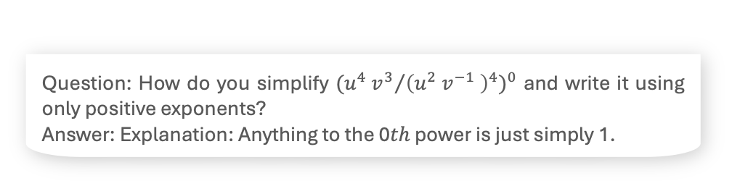
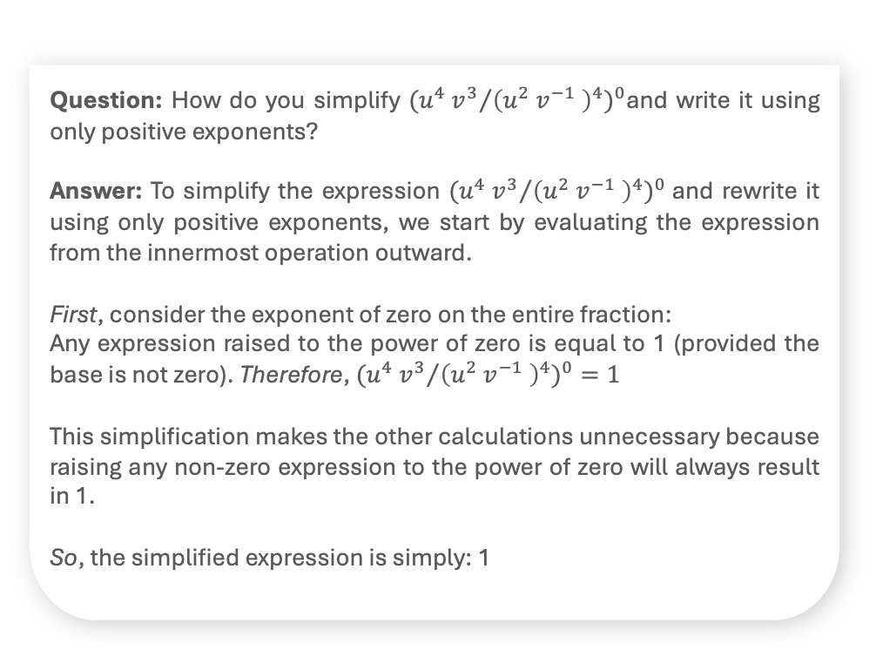
Raw Docs
Refined QA
Unformatted Text, Site Information, Ads
Formatted Q&A augmented with detailed solutions
Topics Science\nAnatomy&Physiology\nAstronomy\nAstrophysics
\nBiology\nChemistry \n...Socratic Meta...Featured Answers
How do you simplify #((u^4v^3)/(u^2v^-1)^4)^0# and write it using only positive exponents?
Answer by NickTheTurtle (Apr 1, 2017)
Explanation:\nAnything raised to the \(0^{th}\) power is simply 1. \n\nRelated Questions\n What is the quotient of powers property? \n\n\n\n How do you simplify expressions using the quotient rule?…\nImpact of this question\n1274 views around the world #Apps\niOS\nAndroid\nLinks\n[Privacy](#)\n[Terms](#)\n[Help](#)
Question: How do you simplify ${{{(u}^{4} v^{3}}/{{\left(u^{2} v^{−1} \right)}^{4}})}^{0}$and write it using only positive exponents?
Answer: To simplify the expression ${{{(u}^{4} v^{3}}/{{\left(u^{2} v^{−1} \right)}^{4}})}^{0}$and rewrite it using only positive exponents, we start by evaluating the expression from the innermost operation outward.
First, consider the exponent of zero on the entire fraction:
Any expression raised to the power of zero is equal to 1 (provided the base is not zero). Therefore,${{{ (u}^{4} v^{3}}/{{\left(u^{2} v^{−1} \right)}^{4}})}^{0}=1$
This simplification makes the other calculations unnecessary because raising any non-zero expression to the power of zero will always result in 1.
So, the simplified expression is simply: 1
Extracted QA
Formatted QA but lacking detailed solutions
Question: How do you simplify ${{{(u}^{4} v^{3}}/{{\left(u^{2} v^{−1} \right)}^{4}})}^{0}$ and write it using only positive exponents?
Answer: Explanation: Anything to the 0𝑡ℎ power is just simply 1.

Slide 5
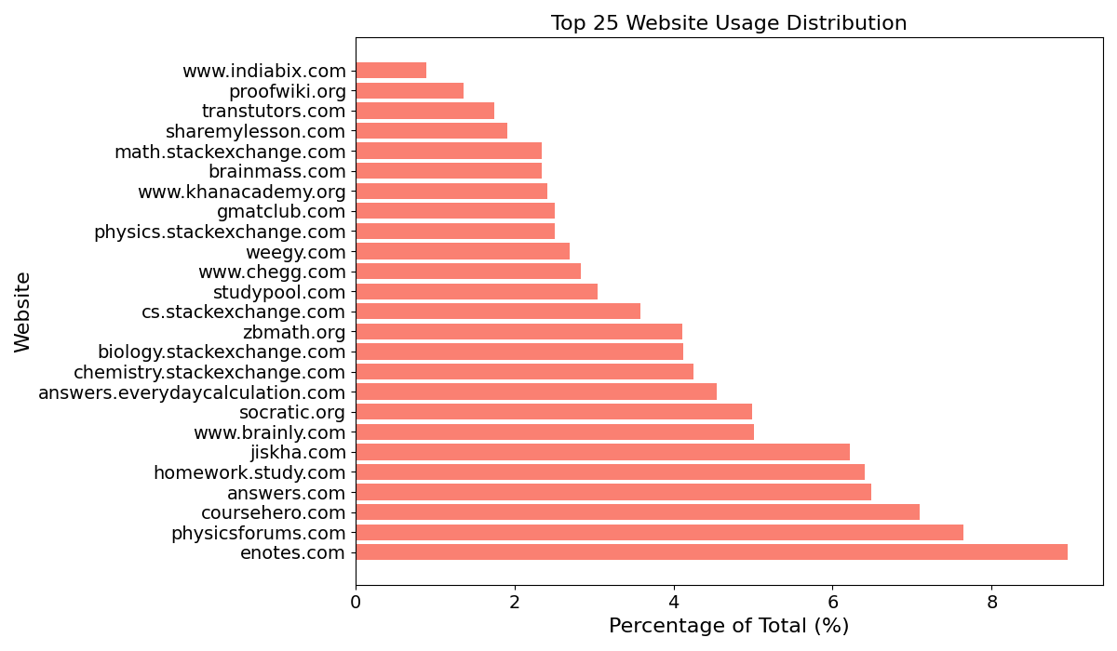
Math
36%
Science
31%
Engineer
14%
Social
14%
Humanity
5.6%
Others
6.4%

