Slide 1




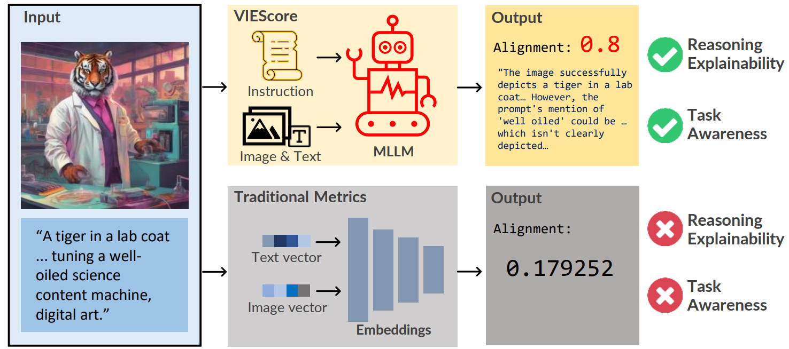
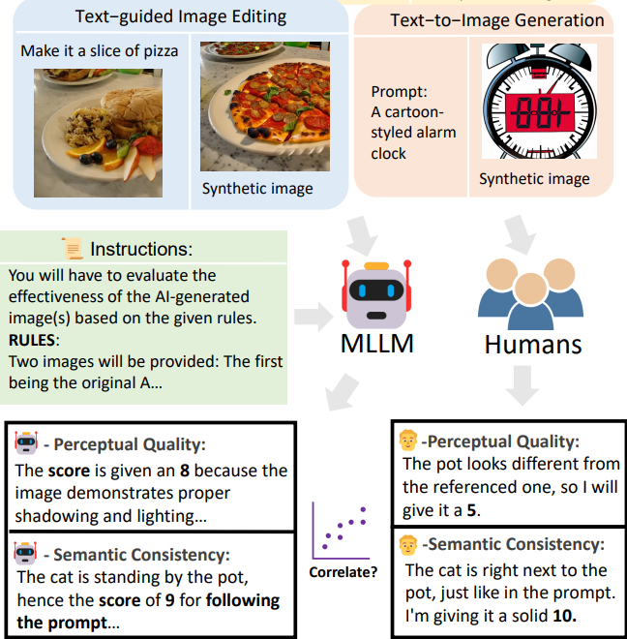
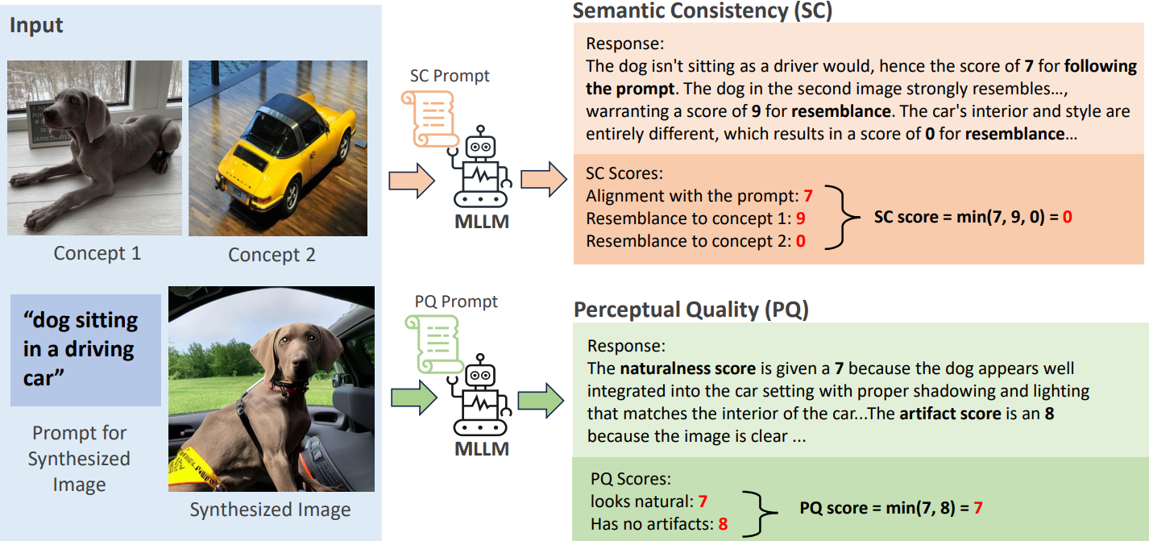
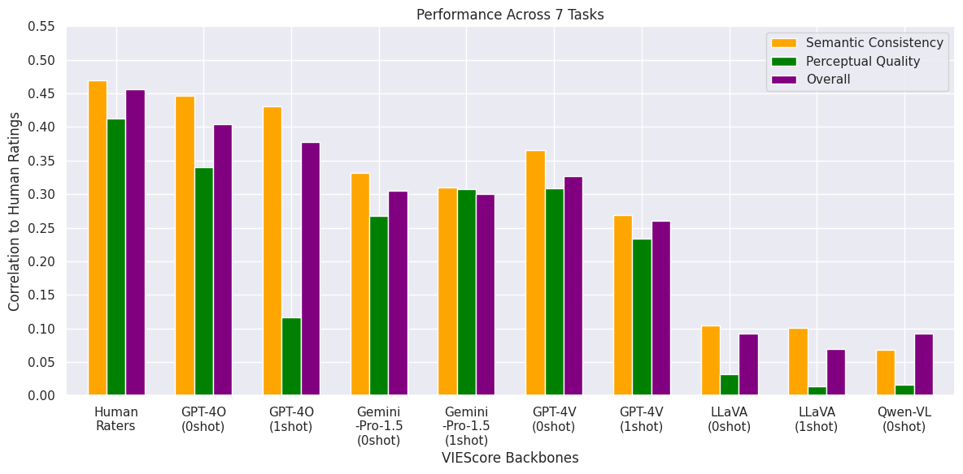
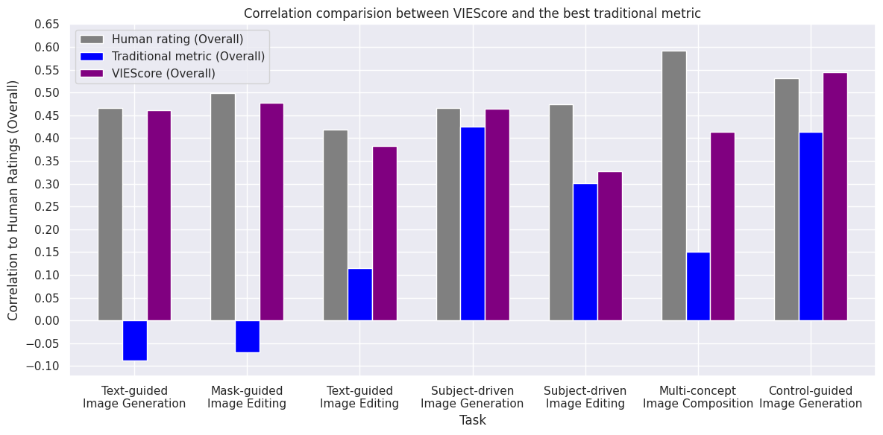
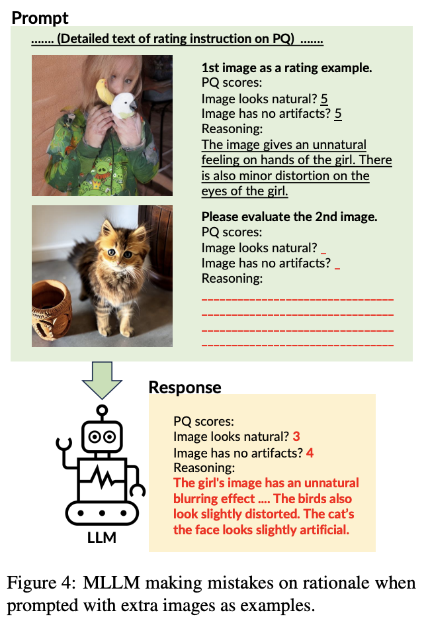

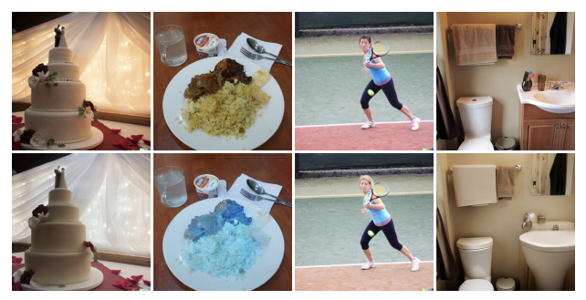
Code/Leaderboard
VIEScore: Towards Explainable Metrics
for Conditional Image Synthesis Evaluation
♠️Max Ku, ♠️Dongfu Jiang, ♠️Cong Wei,
♥Xiang Yue, ♠️Wenhu Chen
♠️University of Waterloo, ♣IN.AI Research
Visual Instruction-guided Explainable (VIE) Metric is needed for image synthesis tasks
Experiment Setup
Apply VIEScore on the evaluation of a wide range of image generation and editing tasks (7 tasks) and compute the correlations with human
Method of VIEScore
Human annotations from ImagenHub (ICLR2024), 14000+ instances of 29 models rating across 7 synthesis tasks
How effective is VIEScore with existing Multimodal LLMs?
VIEScore+GPT-4O achieve on par correlation with human ratings
VIEScore excels in evaluating common image synthesis tasks
VIEScore+Close-sourced MLLMs achieve better results in image evaluation.
Traditional Metrics has poor correlation with human ratings on image.
Challenges and Obstacles Towards Explainable Metrics
General MLLMs struggle in image editing tasks
In-Context Learning with images confuses MLLMs
These are identical images.
LLM

