Slide 1
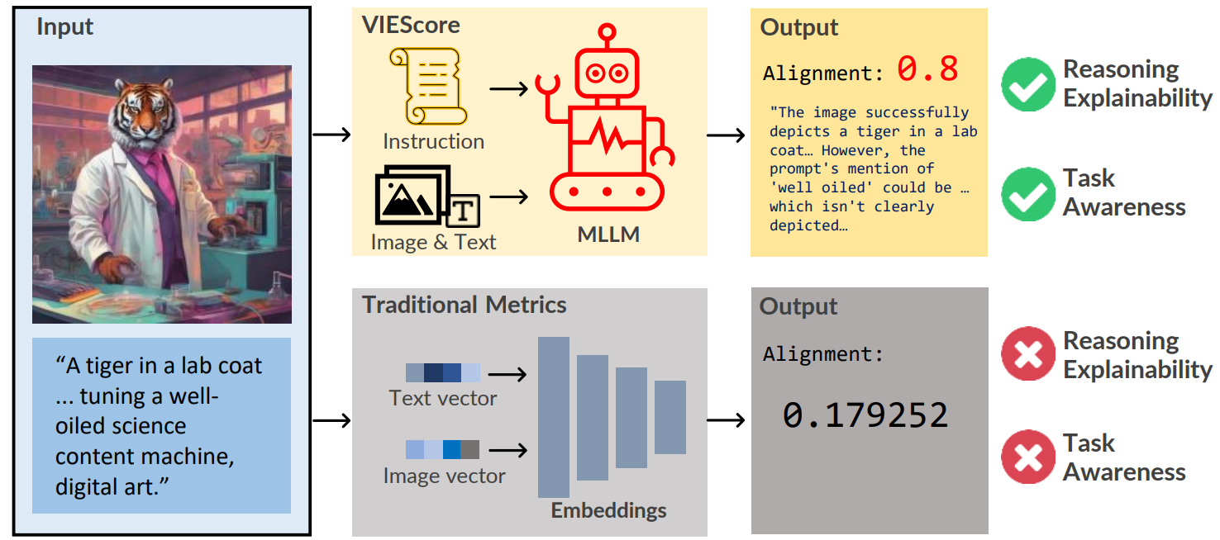



VIEScore: Towards Explainable Metrics for Conditional Image Synthesis Evaluation
♠️Max Ku, ♠️Dongfu Jiang, ♠️Cong Wei, ♥Xiang Yue, ♠️Wenhu Chen
♠️University of Waterloo, ♥IN.AI Research
tiger-ai-lab.github.io/VIEScore
Paper ID: #2258
Notes:
Hello everyone, I am Max, and I am presenting the paper “VIEScore: Towards Explainable Metrics for Conditional Image Synthesis Evaluation”.

Slide 2
Motivation
Metrics in the future would provide not just the score but also the rationale
Understanding of judgment per instance is needed
Traditional metrics are not task aware
Notes:
Our motivation is that we believed the metrics in the future would provide not just the score but also the rationale. We want to enable the understanding of each judgement. We also noticed that traditional metrics are not task aware, which means it cannot be boardy adapted into different tasks.

Slide 3
Visual Instruction-guided Explainable Score (VIEScore)
Notes:
This implies traditional metrics lack task awareness and the reasoning ability. To address this issue, we propose VIEScore, known as Visual Instruction-guided explainable score to tackle both downsides. The main idea is that we want to leverage a Multimodal Large Language model is do the evaluation for us.

Slide 4
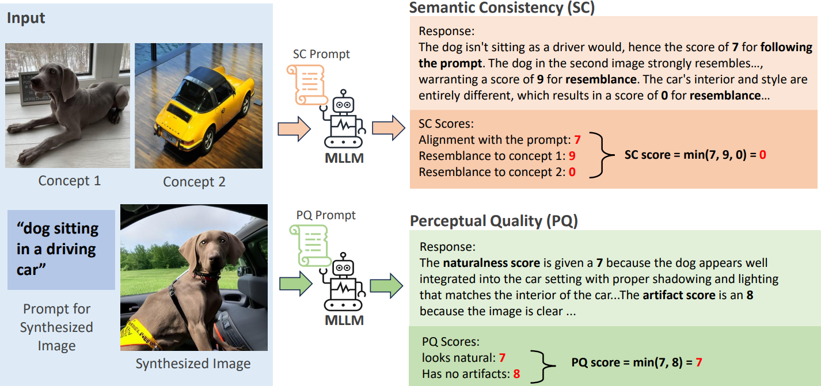
How VIEScore works?
Notes:
In VIEScore, all input conditions, synthesized images, and rating instructions are fed together to the MLLM in one pass. Then we retrieve the score in any scale and the rationale. In this example, we can see this is a multi-concept image composition task where the goal is to synthesize an image that contains both concepts and align with the prompt input. The input conditions and the synthesized image are fed to a MLLM with a corresponding instruction prompt, thus get the score result and the reasoning. The image here is rated through two human perspective: the semantic consistency to rate the conditions and the synthesized image alignment in the range of 0 to 10, while perceptual quality access the image fidelity and the naturalness.

Slide 5
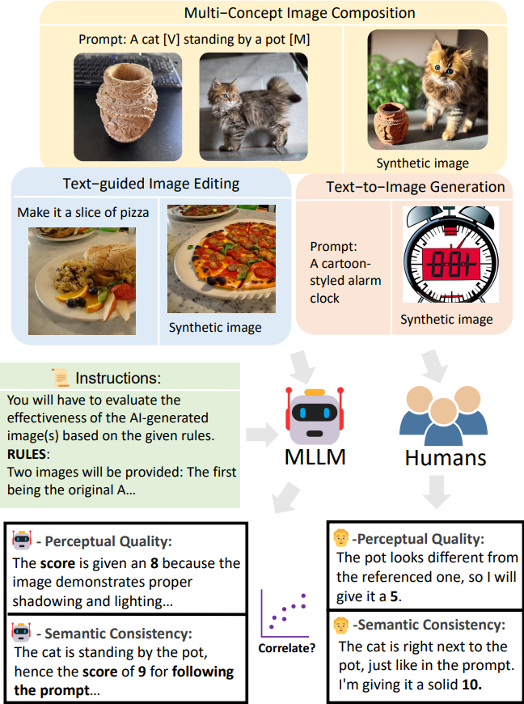
Experiment Setup
A wide range of image synthesis tasks study
Correlation of VIEScore to Human
V.S.
Correlation of Traditional metrics to Human
Where can we get this kind of human annotation data?
Notes:
To comprehensively test this method out, we conducted a study on a wide range of image synthesis tasks to compare the correlations. The goal is to find out whether at current state we can replace traditional metrics with our proposed VIEScore on image evaluation tasks. So the flow is like the figure on the right: we have several tasks on the top, then for each task we fed a task-aware instruction, the conditions and the synthesized image to the MLLM. In the same time, we ask 3 humans to do the same. Then we compare their results to check the spearman correlation. But how can we get this kind of human annotation data?

Slide 6
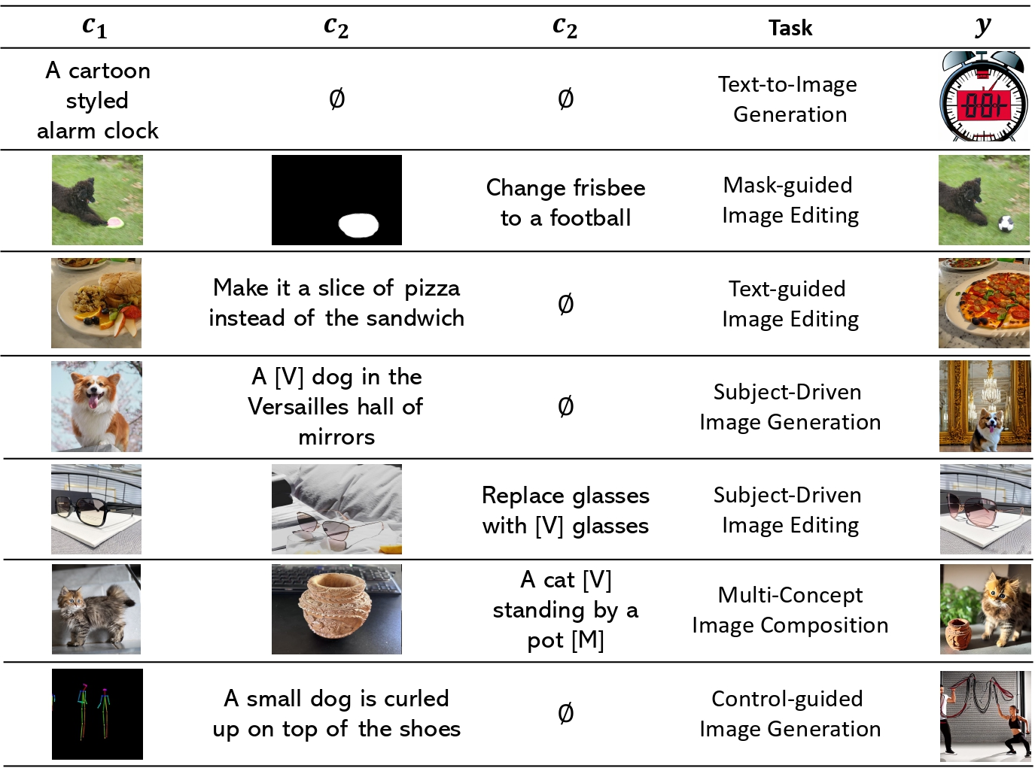
Experiment Setup (Cont.)
Human data from ImagenHub(ICLR 2024)
29 Models across 7 tasks
Total 14403 annoations
Each annotation 3 human metrics:
SC : Conditions-Image alignment
PQ: Realism and Natural sense
Overall: sqrt(SC x PQ)
Human guideline is used as prompt
ImagenHub: Standardizing the evaluation of conditional image generation models
https://arxiv.org/abs/2310.01596
Notes:
From the work ImagenHub, this work provided a large scale human study on around 30 models across 7 image synthesis tasks, which involve of total 14403 annotations. Each instance are rated by 3 human raters, and they contain the SC which is the semantic consistency score, to check whether the conditions and the image is aligned, PQ for perceptual quality and check the realism and the natural sense, and the overall score is the geometric mean of both aspects. In our experiment we embed the human rating guideline in our prompt, which cover the seven tasks including Text-to-image generation, mask-guided image editing, …. , C1, 2, 3 are the conditions and y is the synthesized image.

Slide 7
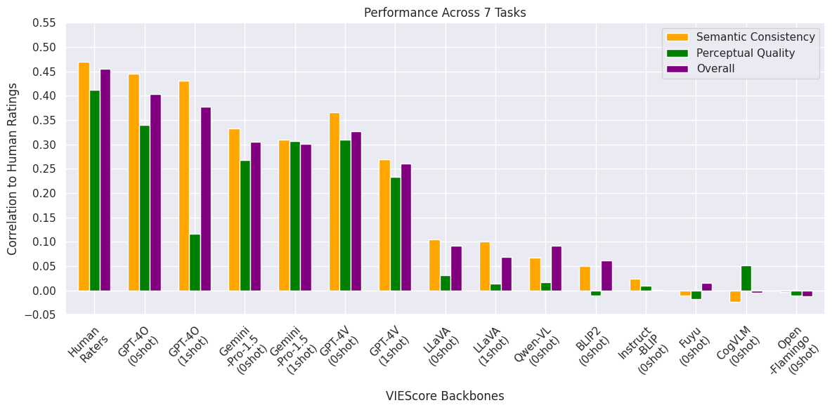
Main Result
Notes:
With this all set we run our VIEScore across 7 tasks with different MLLM backbones, across all 7 tasks mentioned. We can see the human-to-human correlation is around 0.45, and GPT4O achieves on par correlation with human. Gemini also achieve a relatively high correlation. We also noticed the performance of close-source MLLMs are generally much better than the open-source MLLMs, marking a big gap in this ability. We also noticed when In Context Learning (that is one-shot setting) is applied, the correlation decreased.

Slide 8
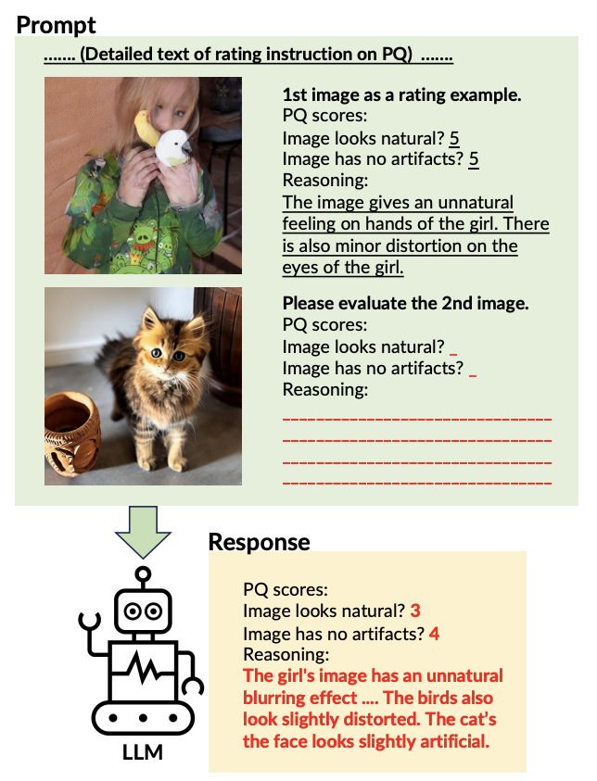
Why one-shot setting achieve worse performance?
MLLMs struggle in In-Context Learning when multiple images exists
Reasoning is affected
Appears on all MLLMs we benchmarked
Notes:
We looked into the reasonings and realized that the general MLLMs struggle in in-context learning when multiple images exists. The model will get confused. For example, a girl image is fed as an example to teach the model how to evaluate the cat image. Then the model start rating based the girl image and also the cat image. This is likely related to the poor ability of MLLMs to understand multiple images.

Slide 9
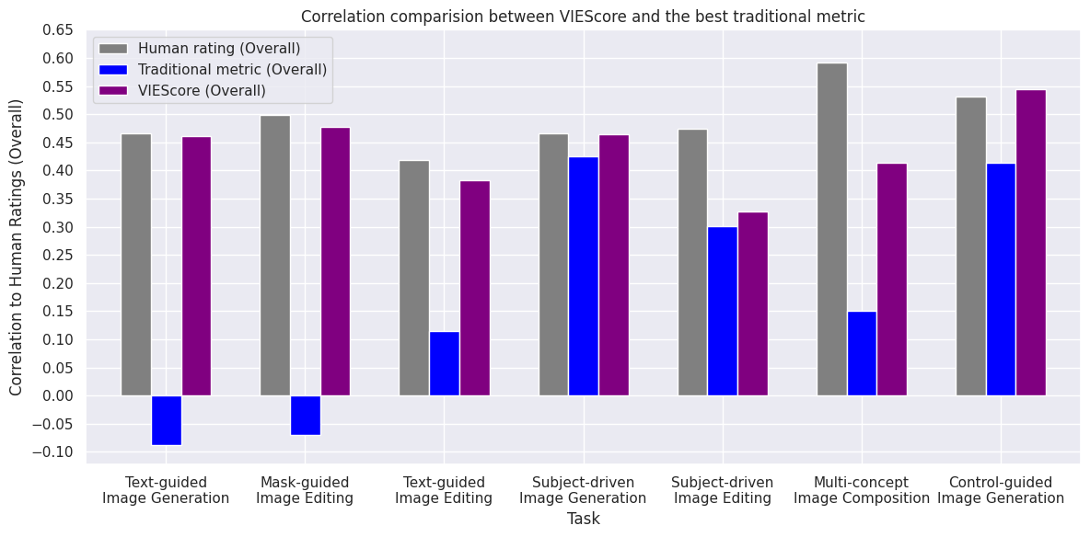
VIEScore achieve higher correlation than Traditional metrics
Notes:
We also explored the correlation to human based on VIEScore and Traditional metrics across all the 7 image synthesis task from ImagenHub. We noticed VIEScore beats Traditional metrics in every task, such as the CLIPScore from text-to-image generation task, LPIPS from image editing task, and DINO from subject-driven image generation task.

Slide 10
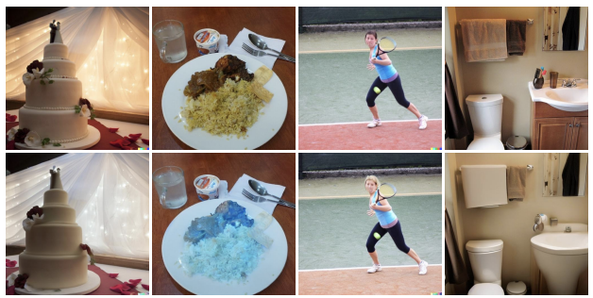
There’s still obstacles toward explainable metrics
MLLMs struggles to see minor difference when given 2 similar images
Notes:
But we would say we are there are still obstacle for us to deploy explainable metrics at current state. One big issue that we found is that MLLMs often struggle to see minor difference in two similar content images, as MLLM tend to understand the images at structure level but not detail enough. There are still room to improve, and we believe VIEScore will be a mainstream evaluation method in the near future, as in practice multiple image QA is an aarean coming with many applications and the MLLMs will certainly be improved in the future.

Slide 11
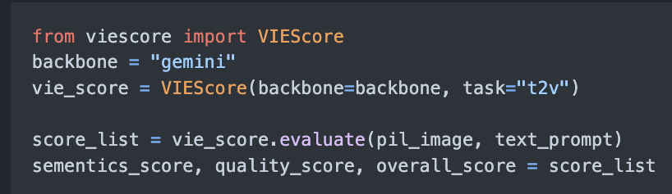
Code Release
Code available on GitHub
Easy to use and modify
Notes:
Finally, we encourage open science and have already released our modularized code so that other researchers can pick up our work with ease. Thank you for listening!

