Slide 1


NEXT GEN EMPLOYABILITY PROGRAM
CREATING A FUTURE-READY WORKFORCE
Student Name :
Aishwarya Gupta
Student ID :
STU61eebb04f16dd1643035396
Mobile No:
7505815898
Mail ID:
aryangupta1510@gmail.com
College Name :
KIET Group Of Institutions

Slide 2
CAPSTONE PROJECT SHOWCASE
Project Title
Health Care Data Driven Decisions using Power BI
Abstract | Problem Statement | Project Overview | Proposed Solution | Technology Used | Modelling & Results | Conclusion | Q&A

Slide 3
Abstract
1
Firstly, Import and pre-processing of datasets.
2
Learned to use DAX Functions.
3
Visualize the Dataset.
4
By utilizing Power BI, healthcare organizations can improve decision-making, patient outcomes, and operational efficiency.

Slide 4


Problem Statement
Data Fragmentation: How can healthcare organizations integrate fragmented data from various systems and departments for comprehensive analysis?
Limited Data Accessibility: What strategies can be implemented to improve accessibility to healthcare data for informed decision-making?
Suboptimal Patient Outcomes: What measures can be taken to address longer hospital stays and increased readmission rates?
Lack of Predictive Analytics: How can predictive analytics anticipate future healthcare trends?
Limited Operational Visibility: What methods enhance operational efficiency through data analysis in healthcare?

Slide 5

Project Overview
Data Collection, Data Cleaning and Data Pre-Processing
Using DAX Expressions
Visualizations(Cards, Slicers, Charts)
Formatting of Report
Testing
Storytelling

Slide 6
Proposed Solution
Data Fragmentation: Implement data integration pipelines within Power BI to consolidate data from disparate systems and departments, creating unified datasets for comprehensive analysis.
Limited Data Accessibility: Develop user-friendly dashboards and reports within Power BI to provide healthcare professionals with easy access to critical data, enabling informed decision-making without the need for complex data retrieval processes.
Suboptimal Patient Outcomes: Create performance dashboards within Power BI to monitor key patient .care metrics in real-time, enabling healthcare providers to identify trends, intervene proactively, and .improve patient outcomes.
Lack of Predictive Analytics: Develop predictive analytics models within Power BI using historical healthcare data to forecast patient trends, disease outbreaks, and resource demands, empowering proactive decision-making and planning.
Limited Operational Visibility: Create operational dashboards within Power BI to visualize key performance indicators, such as patient wait times, bed utilization rates, and staffing levels, enabling healthcare administrators to identify inefficiencies and streamline operations.

Slide 7
Technology used
SPREADSHEETS
Format of Datasets(.xls)
POWER BI
For Visualizing Dataset and creating Dynamic Dashboard

Slide 8
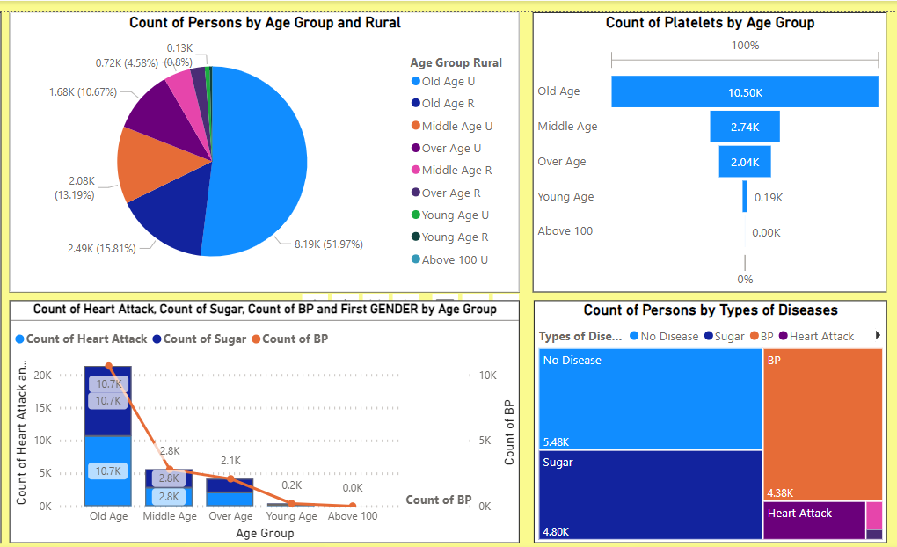
Modelling & Result

Slide 9
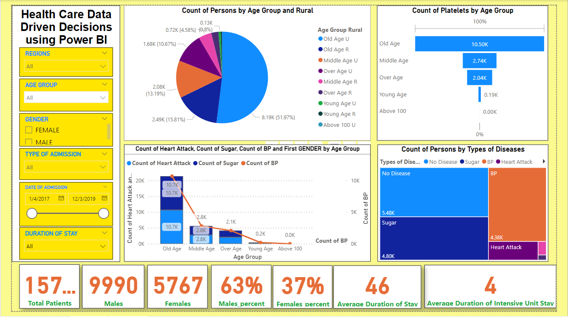
Dashboard - 1

Slide 10
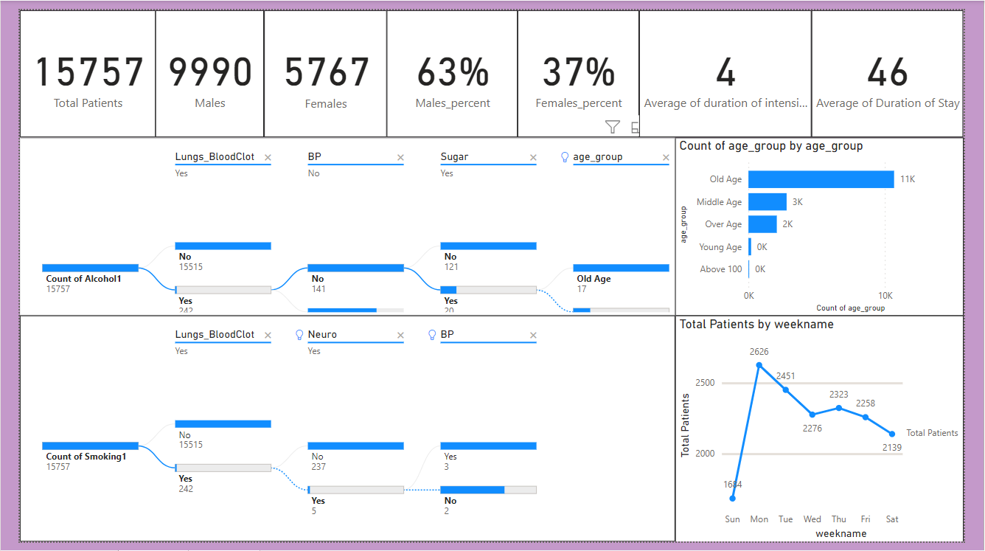
Dashboard - 2

Slide 11

Conclusion
By leveraging Power BI's interactive visualizations, stakeholders gained a deeper understanding of healthcare processes and trends, allowing for more informed decision-making.
Power BI has provided valuable insights that have empowered healthcare organizations to optimize resource allocation, enhance patient care outcomes, and improve operational efficiency.

Slide 12


Notes:
Thank You !!

