Slide 1



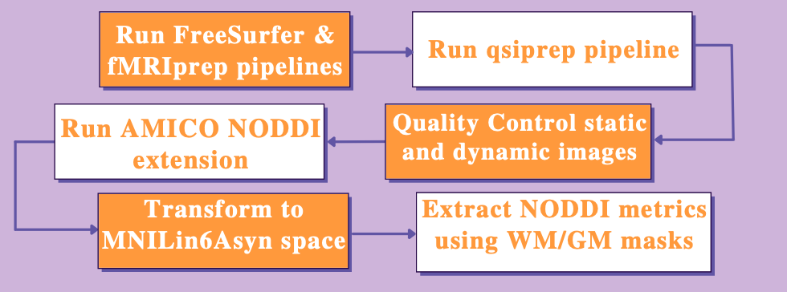
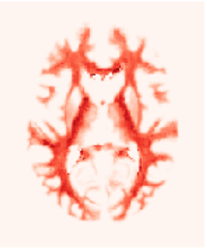
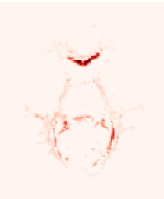
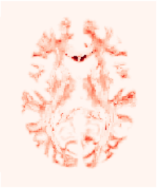
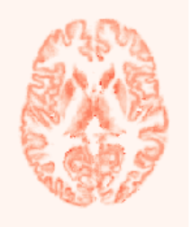
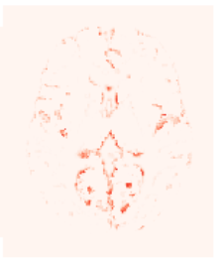
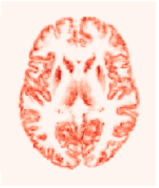
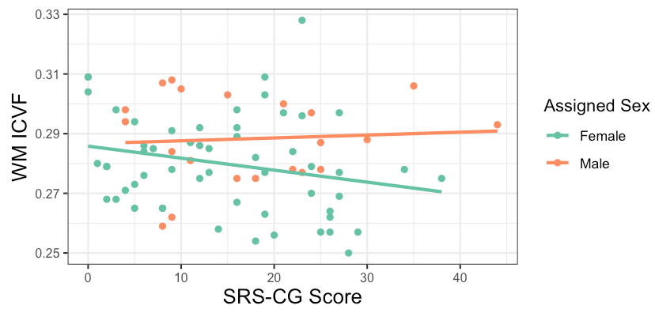
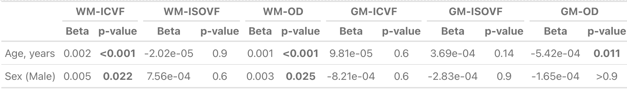
Effect of Autism Spectrum Disorder Symptom Severity on Brain Microstructural NODDI Indices
F. OGUNSANYA^{1,2}, E.W. Dickie¹², C. Schifani¹, M Joseph, J¹. Wong. A¹, Voineskos, B^{1,2}. Goldstein, D.^{1,2}, Felsky, G.^{1,2}, Foussias,.^{1,2},H Hamilton¹, J.^{1,2}, Henderson, J.D.^{1,2} Haltigan, K.^{1,2} Cleverley, L.^{1,2}, Quilty, N.^{1,2}, Kozloff, S.^{1,2} Hill, S.^{1,2} Kidd, W.^{1,2} Tempelaar, W.^{1,2} Wang, W ¹, and Y. Nikolova^{1,2}, S. Ameis^{1,2}
1. Campbell Family Mental Health Research Institute, Centre for Addiction and Mental Health, Toronto, Canada, 2. Department of Psychiatry, University of Toronto, 3. Hurvitz Brain Sciences Research Program, Sunnybrook Research Institute, University of Toronto, Toronto, ON, Canada
between neurite density index in WM and communication scores of ASD participants.
Introduction
Results/Discussion
Autism Spectrum Disorder (ASD) is a neurodevelopmental disorder characterised by deficits in social cognition
Neurite orientation dispersion and density imaging(NODDI) is a biophysical model in dMRI that estimates microstructural complexity with specificity
Intracellular volume fraction(ICVF), orientation dispersion(OD) and isotropic volume fraction(ISOVF) can quantify microstructure in grey and white matter (GM & WM)
Previous study of NODDI in ASD showed negative association between ICVF in WM and communication scores¹
The CAMH TAY cohort study is a longitudinal study recruiting youth accessing mental health services
SRS model Results
SRS a significant variable in the caregiver group, not the self-reporters
SRS was pos. assoc. with GM-ISOVF(β = 3.92 x 10⁻⁴, p = 4.93 x 10⁻⁴) and neg. assoc. with WM-ICVF(β = - 2.95 x 10⁻⁴ , p = 0.024) (Figure 3.)
ASD subgroup
Caregiver SRS now pos. assoc. with WM-ICVF(β = 6.19 x 10⁻⁴, p = 0.045), deviating from previous finding¹
Limited by global measure and sample size
Next steps: WM and GM regional analysis
Mean FD
Negative relationship with WM-ICVF & GM-OD in entire sample and in caregiver SRS group
Figure 1. Preprocessing and Data extraction process
1.0
0.75
0.5
0.25
0.0
Purpose
Understand correlation between ASD symptoms and NODDI indices in general youth population and how associations are altered in individuals diagnosed with autism
Evaluate age and sex effects on NODDI values
Figure 2. Top (left to right): WM-ICVF, WM-ISOVF, WM-OD
Bottom (left to right): GM-ICVF, GM-ISOVF, GM-OD
Methods
175 subjects analyzed, with various mental health diagnoses
dMRI images were preprocessed, fit to NODDI model & had indices extracted (Figures 1,2)
Linear model was created with age and assigned sex at birth
Additional models created with social responsiveness scale (SRS) as 3rd variable, separating self-reports and caregiver-reports
Same analysis re-done for autism diagnosis group
Mean MRI fractional displacement (Mean FD) added as variable in models with significant relationships
Figure 3. Correlation between SRS-CG score and WM-ICVF(n = 77)
Conclusion
Global WM/GM NODDI microstructure analysis was a first step in uncovering microstructural trends associated with ASD
Future studies should implement regional analysis for further validation
Table 1. Results of Age and Sex Multivariate Regression models

