Slide 1




Flight Delay Prediction Based on GP Algorithms

Slide 2
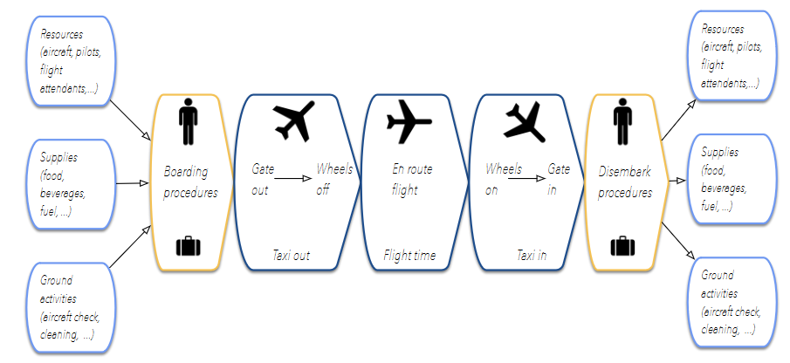
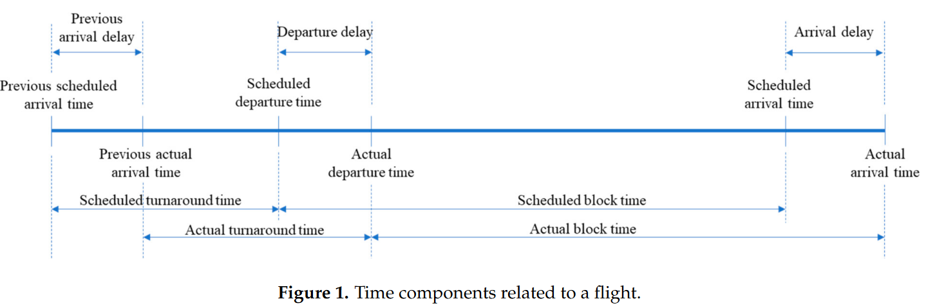
Definitions
Different between Airlines
0~15 mins Delay: No Delay
15~45 mins Delay: Moderate Delay
45~ mins Delay: Heavy Delay

Slide 3

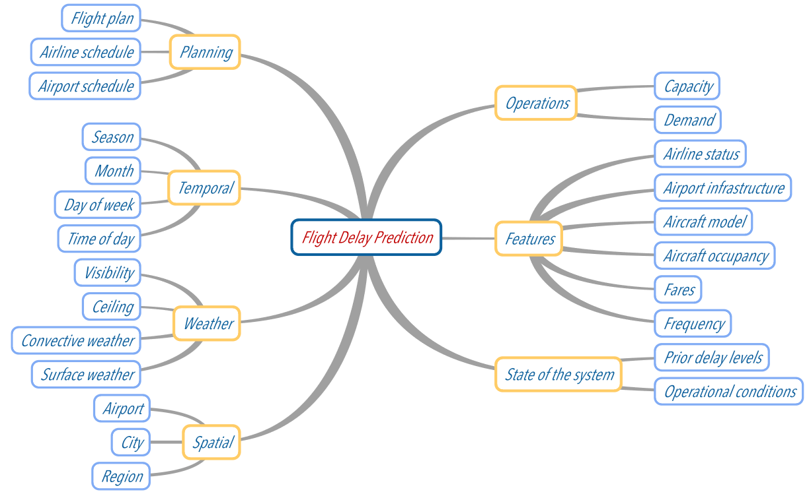
Literature Review
Data Source:
Government, Authorities Database (BTS, FAA, USDT)
Synthetic Data
Kaggle
Additional
Weather (NOAA, Weather Company)
Single/ Multiple Airports
Data Preprocessing
Subsets of database (top 10 airports)
Cleaning (NAs, outliers)
Emerging (weather data)
Encoding (One-Hot encoding)
Subsampling (imbalanced data)
Normalization (skewed distribution)
Feature Variables

Slide 4
Literature Review
Algorithms Chosen
Mostly classification problems
Deep Learning (Coevolutionary Neural Network)
Tree-Based/ Ensemble Techniques (Random Forest, Decision Tree, Gradient Boosting)
Neural Network
Performance Metric
ROC&AUC
Precision, Recall → PR AUC
F1 Score
Accuracy

Slide 5
Contribution & Innovation
Dataset Properties
Feature variables easier to measure and easier to understand
(arrival and departure time, taxiin taxiout time, date, etc.)
Classify heavy delay rather than whether delay or not
practical and versatile in real application
Methodology
Use random forest to draw inference on importance of features to support feature selection
More solid conclusion and more streamlined workflow in future research,
universally applicable
GP Power
Especially important in this study

Slide 6
Dataset
Data Source: Kaggle (derived from other datasets) → 29 * 484551
https://www.kaggle.com/datasets/undersc0re/flight-delay-and-causes
Variable Name | Description
DayofWeek | Mon – Sun
Date | Scheduled Date (mmdd)
DepTime | Actual Dep
ArrTime | Actual Arr
CRSArrTime | Scheduled Arr
UniqueCarrier | Unique Carrier Code
Airline | Airline Company
Variable Name | Description
FlightNum | Flight Number
TailNum | Tail Number
ActualElapsedTime | + TaxiIn + TaxiOut +Air
CRSElapsedTime | Scheduled Elapesd Time
AirTime | Flght Time
ArrDelay | Scheduled vs. Actual
Origin | Origin Airport Code
Variable Name | Description
Origin_Airport | Airport Name
Dest | Destination Airport Code
Dest_Airport | Airport Name
Distance | Distance Between In miles
TaxiIn | Wheels Down – Gate
TaxiOut | Gate – Wheels Off
Cancelled | 1=yes 0=no

Slide 7
Dataset
Variable Name | Description
CancellationCode | Reason for cancellation
Diverted | 1 = yes, 0 = no
CarrierDelay | Flight delay due to carrier(e.g. maintenance or crew problems, aircraft cleaning, fueling, etc
WeatherDelay | Flight delay due to weather
NASDelay | Flight delay by NSA(National Aviation System)
SecurityDelay | Delay by this Reason
Variable Name | Description
Dep_Delay | Scheduled vs. Actual
LateAirCraft_Delay | Due to Late Aircraft

Slide 8
First Stage Data Preprocessing
Achieved by R
Rename
Check uninformative columns and delete (Cancel, Diverted, CacellatonCode)
Calculate Total Delay
(CarrierDelay + WeatherDelay + NASDelay + SecurityDelay+ LateAircraftDelay)
Retreive month and date from “date” column
Classify delay (No, Moderate, Heavy)
Classify classes (No + Moderate → class 0, Heavy → class1)
Get rid of redundant columns (repetitive information)
Filter top 5 airports (largest sum of arrival counts and departure counts)

Slide 9
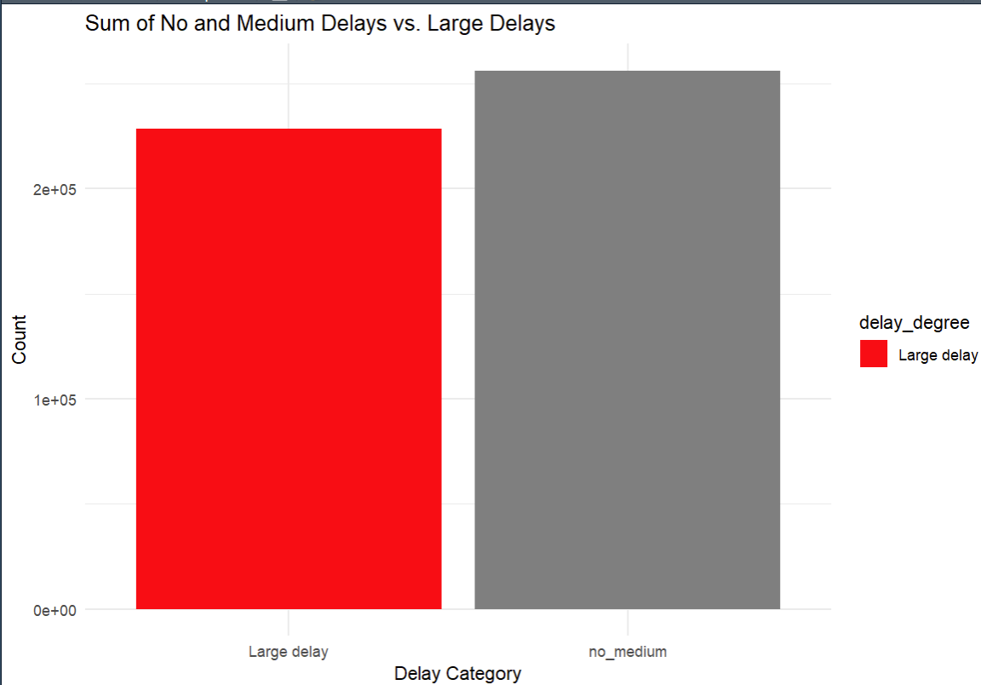
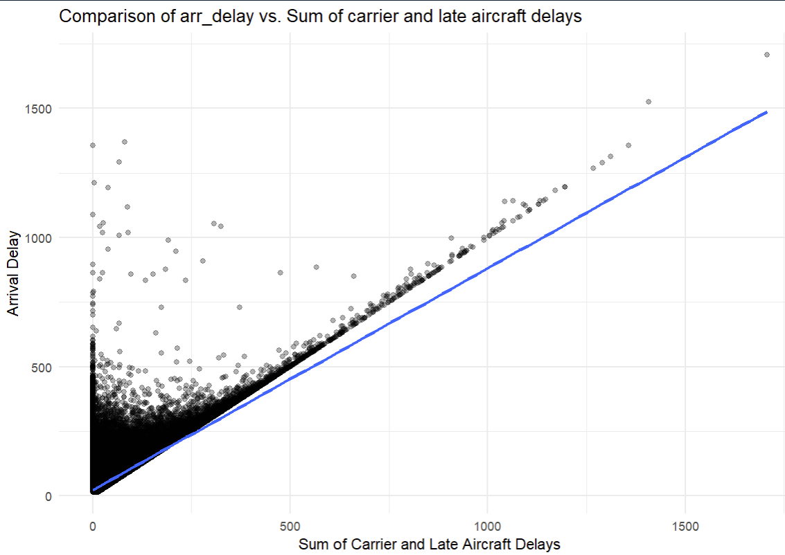
Exploratory Data Analysis (EDA)
Count data points for each class
Whether Arr_Delay = Carrier_Delay + Late_Aircraft_Delay
(Characteristics in first few observations)
45% of the time the formula stands
Balanced Dataset

Slide 10
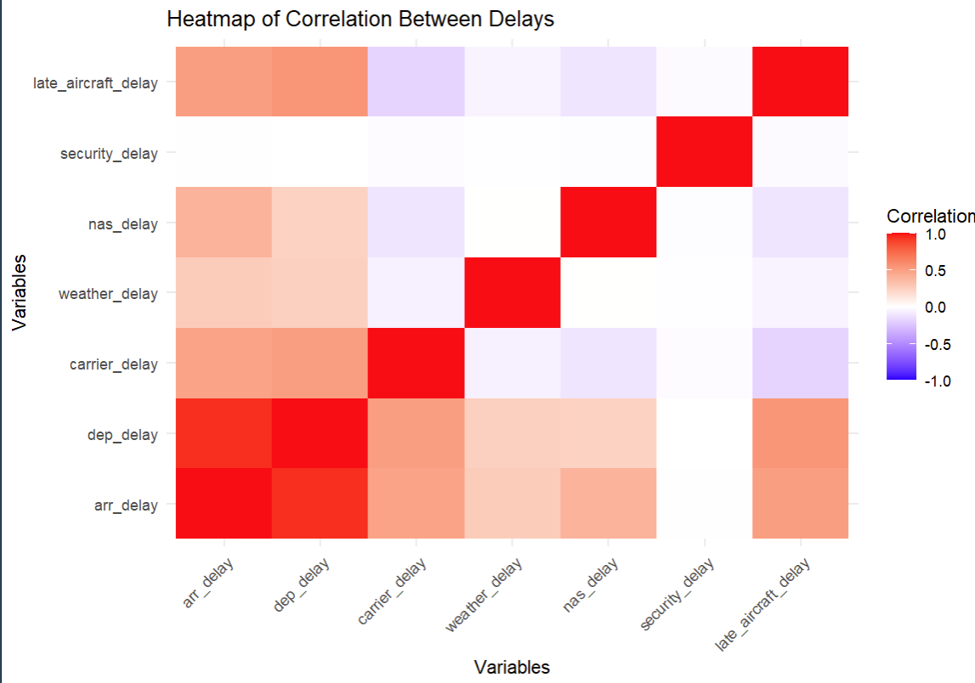
Exploratory Data Analysis (EDA)
Further explore the relationship
Heatmap for correlation matrix
Arr_delay is highly correlated with dep_delay
Might consider
leave one in feature selection

Slide 11
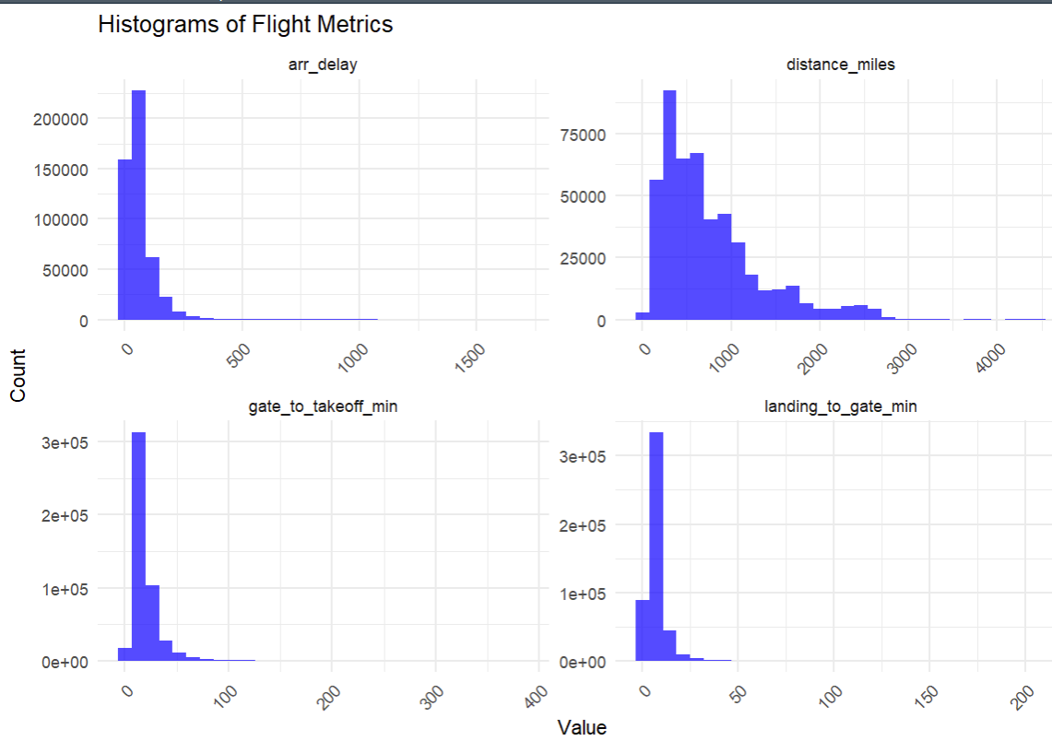
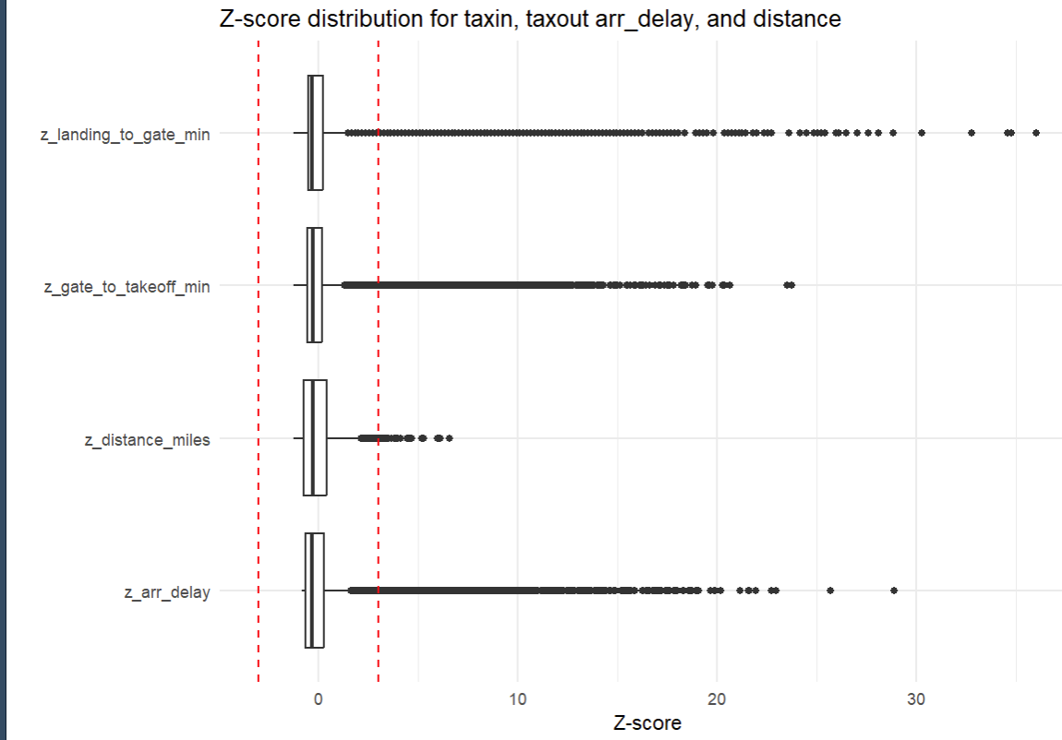
Exploratory Data Analysis (EDA)
Skewed data distribution
Verified by Z-score plot
→ Less mathematically stable (outliers)
Normalization/ Categorization required

Slide 12
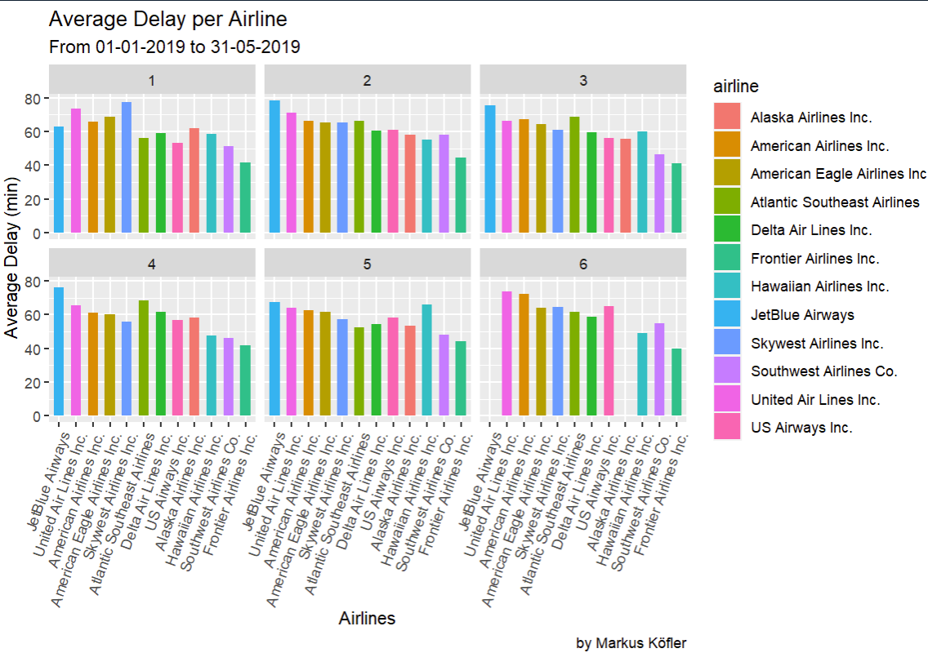

Research on Airlines
Whether Airlines has relationship with delay
Fluctuate among months and airlines
Suggest relationships
Delay of Alaska Airline in June is 0
Good enough/ Record error?
0 flights in June → Error
→ may delete related data points

Slide 13
Stage 2 Data Preprocessing
Apply domain knowledge + Typical Encoding (Airports, Airlines)
Time in a day → Categorize time (arrival) into morning, afternoon, evening, night → one-hot encoding
Flights in the morning →
has most of the potential issues checked by mechanics in routine examination
May have fog (low vision), moisture (runway) depends on region (e.g. San Francisco)
Human Factors: Employees love working in the morning → more experienced crew and airport workers, passenger issue
2. Month is a cyclic process
The last month of the last year goes after the first month of the next year → cyclic encoding (sin, cos)
3. Extreme distribution of taxiin, taxiout, distance & scale of distance→
log-normal normalization and min-max normalization

Slide 14

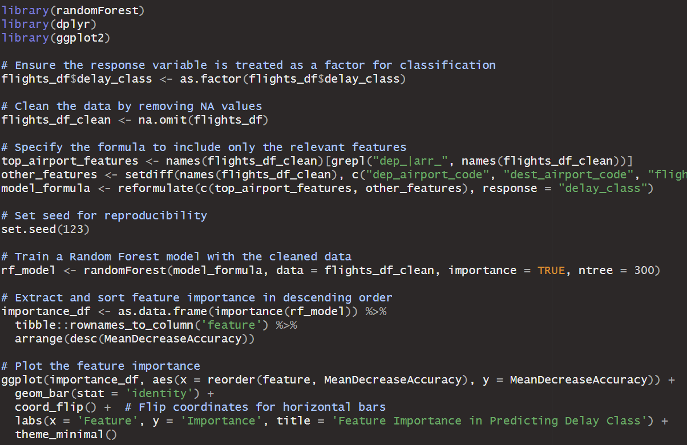

Random Forest
Why use this?
1. Mean Decrease Impurity (MDI): node impurity (variance in regression, Gini impurity for classification) weighted by the probability of reaching that node across all the trees number.
2. Mean Decrease Accuracy (MDA): observing the mix-up of the values of a particular feature, number measuring decreasing in accuracy
Trustworthy?
The objective is not a prediction model
The importances are derived from trees structure and properties, which is generall among different models
Less demand on hyperparameters (tree number)

Slide 15
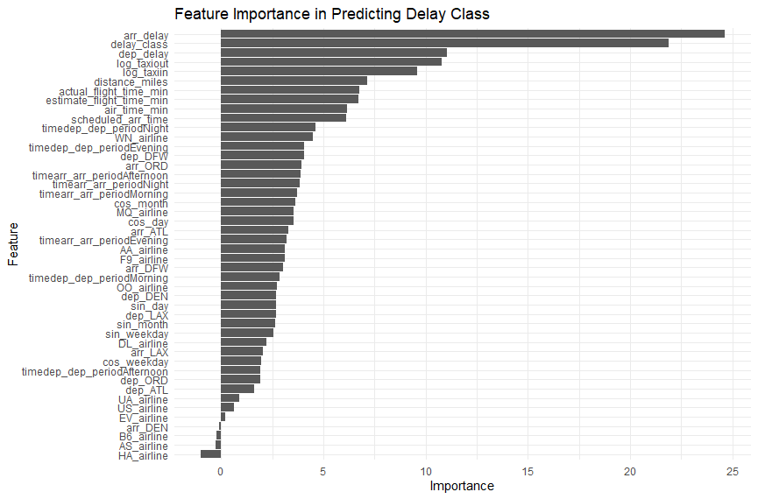
Random Forest
Select first nine features
without
high correlation features overlap
Stage 3 data preprocessing
→ Final dataset for model training

Slide 16
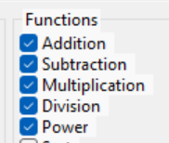
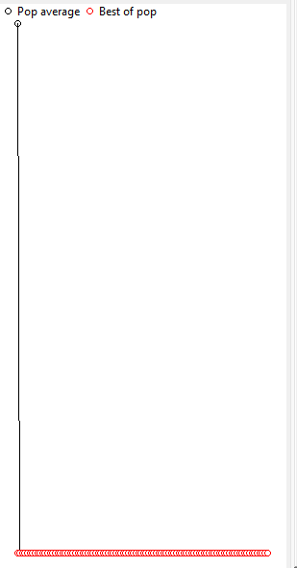
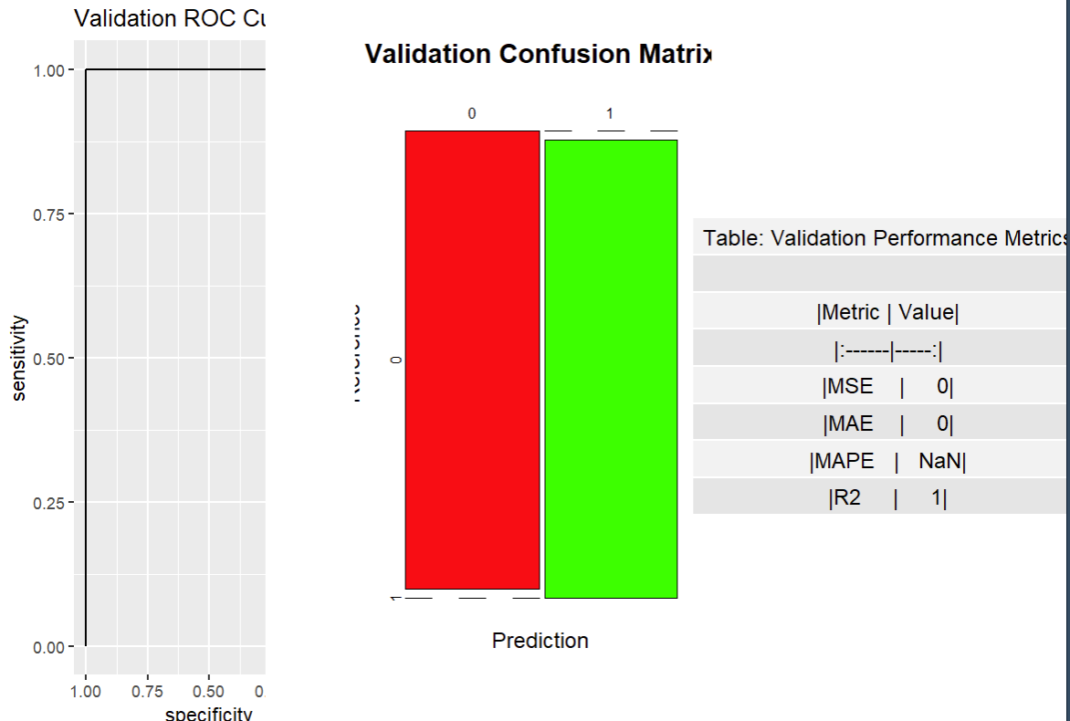
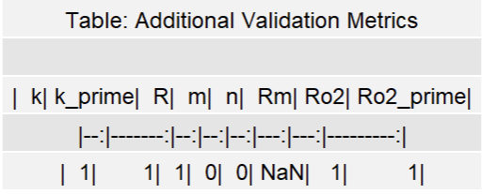
MEP Model
All other configuration set default
The error is 0 (100% accuracy)
Cannot find the reason to justify the result
y=e^d1​+d4​+e^d3​((d2​−d8​)+(d5​−d9​)−((d5​−d1​)×(d6​−d2​)))+d5​+((d2​−(d4​−d^69.81078524124882​)))

Slide 17
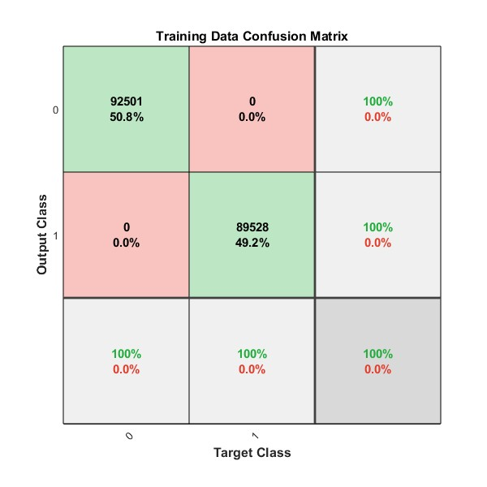
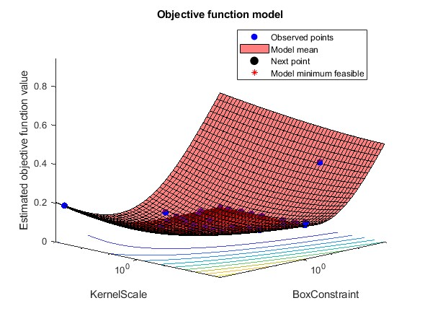
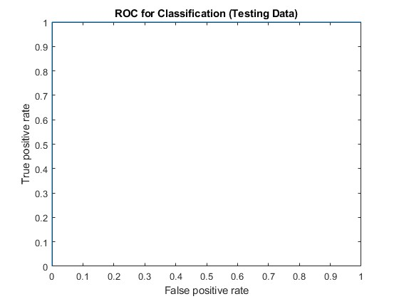
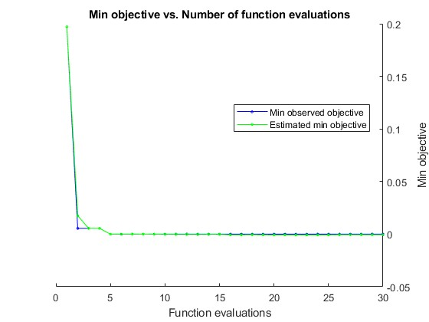
SVM Model

Slide 18
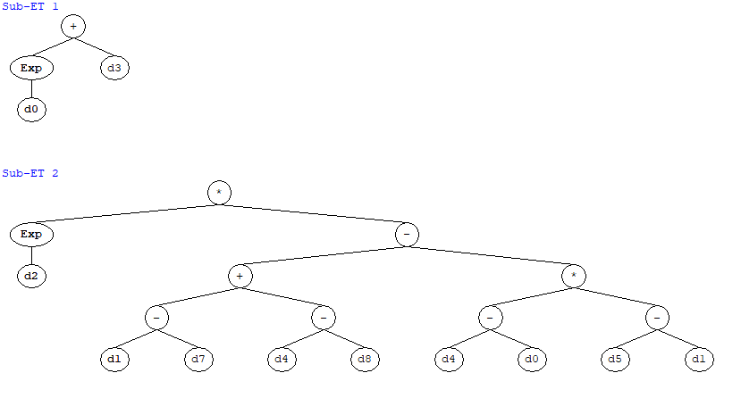
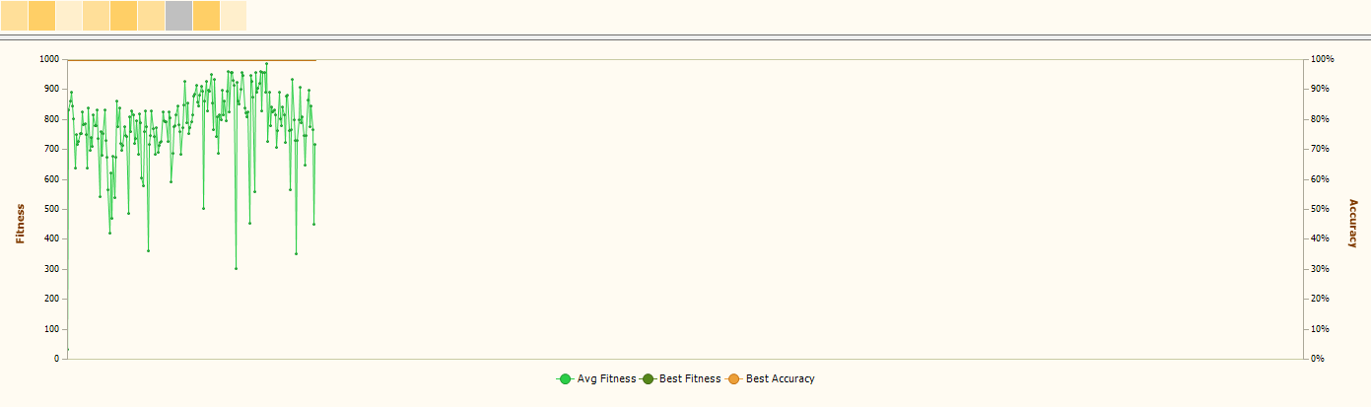

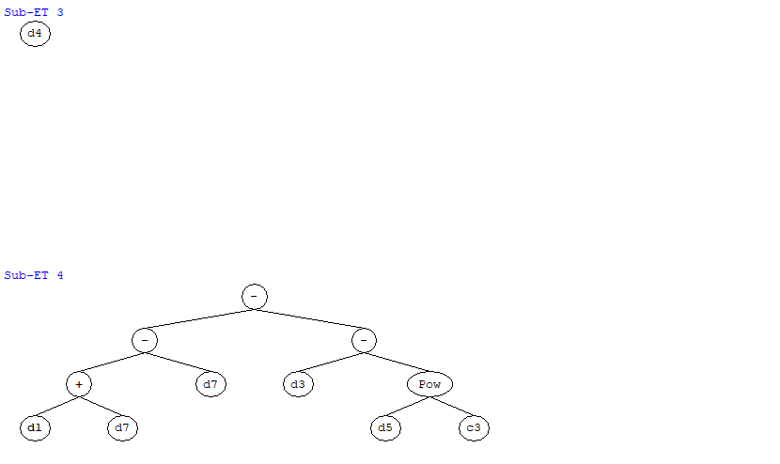
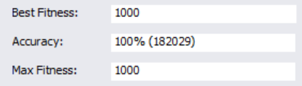
GEP Model

Slide 19
Guesses for Verification
Since SVM model show the same (0 error), the problem/ root cause might be from dataset itself
Check with similar studies, with similar database (same input variables), others have decent but normal (90%~100%) performance metrics, cause might from data handling and heavy delay type characteristics
Maybe because the binary classification naturally have less error

Slide 20
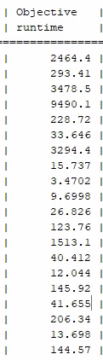
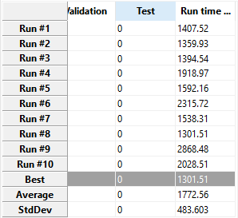
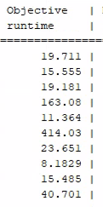
Conclusion and Further Studies
Due to large scale of dataset, all the run times are extremely high
High occupation of CPU, RAM
Arr_Delay is the most important
Further try MGGP
Sensitivity Analysis and Parametric Analysis
Integrate more advanced data processing techniques & domain knowledge

Slide 21

Questions?

