Slide 1
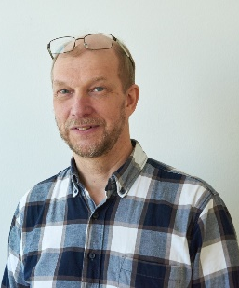

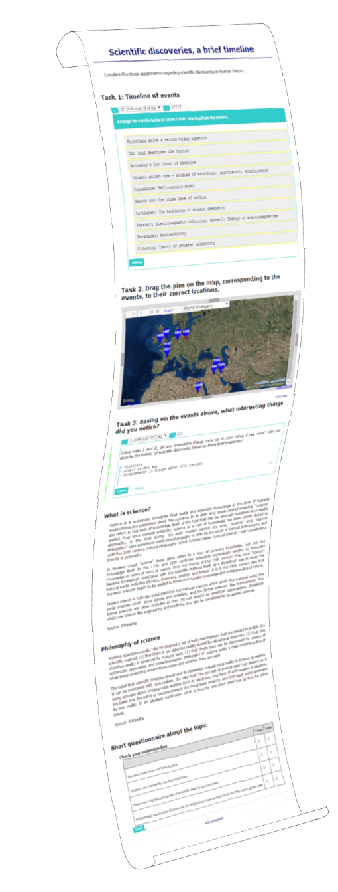

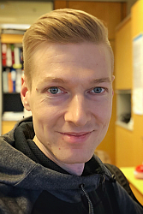
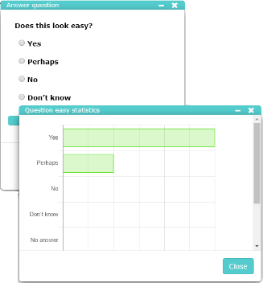
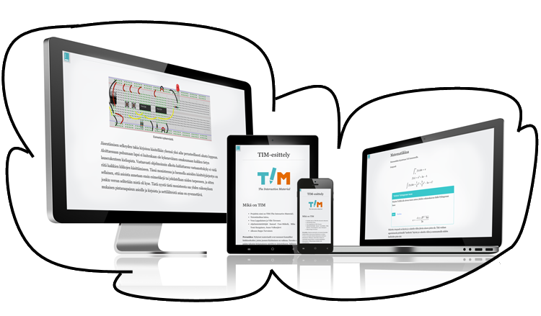

Less is More
Vesa Lappalainen, Ville Isomöttönen, Antti-Jussi Lakanen,
University of Jyväskylä, Finland,
Faculty of Information Technology
The Interactive Material
One tool (less)
covers everything needed (more) in teaching
Document-based Open Source LMS tool for writing open
learning materials that fluently combine theory and interaction
  World is made from documents, which is a natural unit
We have used TIM for
interactive lecture notes
for example with runnable program codes
from MOOC to
traditional learning
entry exams with automatic assessments
course exams
contests
Master Thesis
track what have been read
Scalable
read and produce anywhere,
any time, with any device.
clicker questions
Linear model
- less links, more work

Slide 2
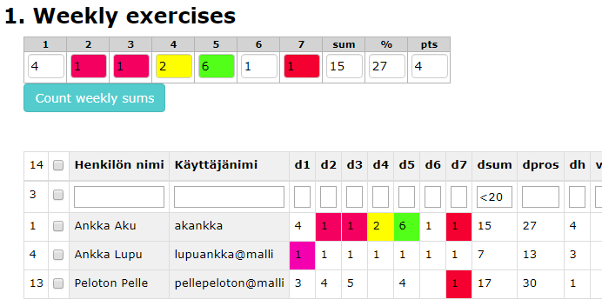
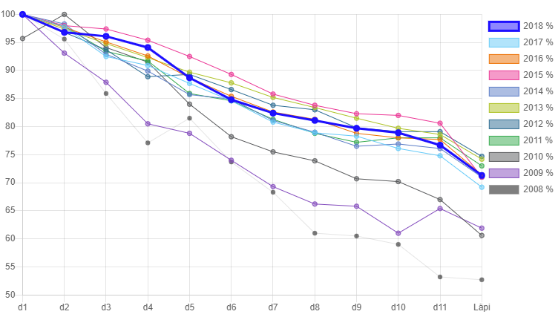
What teachers say:
[P8] The platform can be subordinated to pedagogic use as one wants to. The platform is a tool on which intended pedagogy can be built on.
So, everything is in the same place. [P14] Learning material, exercises, all you can think of, is in the same place. [This] facilitates logistics of teacher and students. [P4] You can include interactive components. Moreover, videos and all other material linked becomes available, and also exercises can be returned to the same system.
[P1, talking about automatic assessment features:] In my teaching, compared to previous hand-work, I have been able to substantially increase the number of exercises while reducing the time needed for assessment
What students say:
TIM lecture notes are excellent.
TIM has been neatly written. Topics are clearly presented. The best “lecture notes” ever.
TIM system is fantastic, it may well be the biggest reason why I experience learning how to program as an easy task.
I have been using TIM with a Windows laptop, an iPad, an Android tablet, a phone and an iPhone with great success. TIM is one of the most interactive learning environments I have used and I take my hat off to its versatility.
Many respondents hoped for the possibility to deﬁne a course-level summative assessment function.
So we made:

