Slide 1
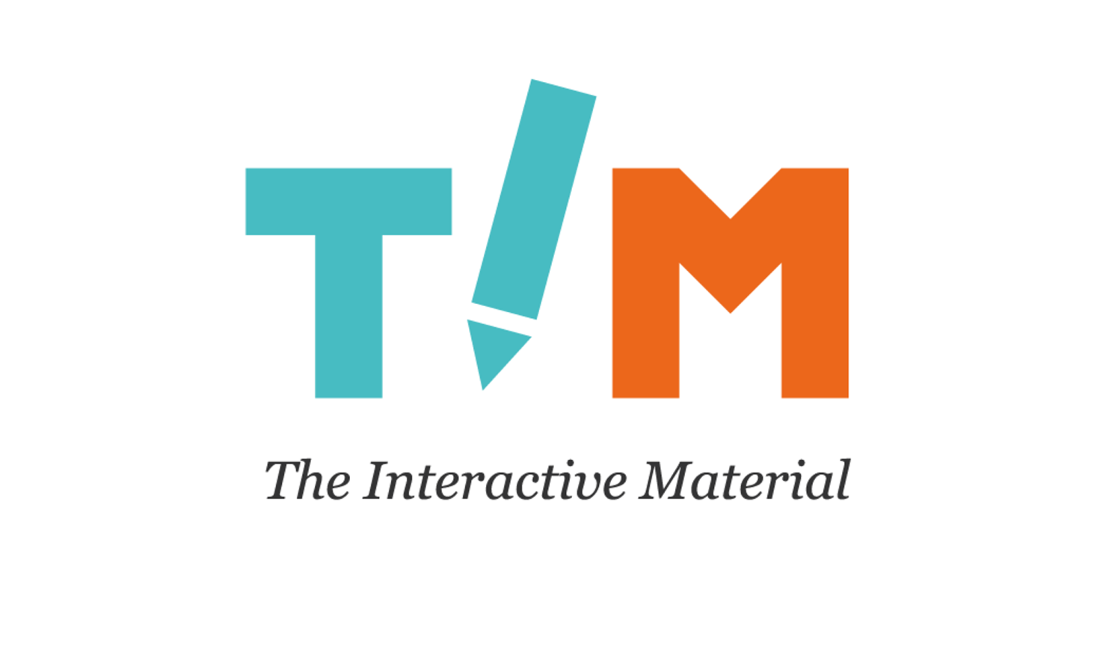
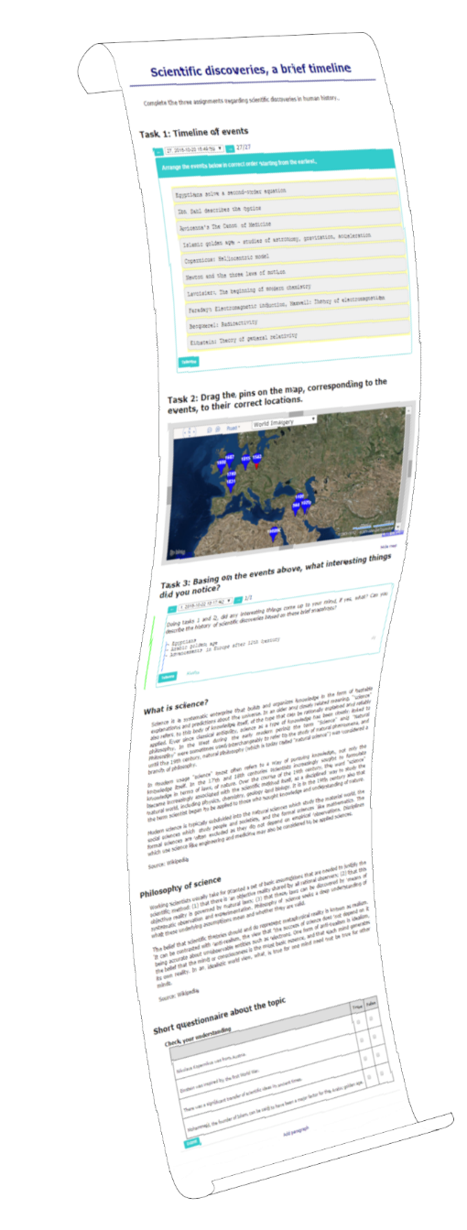
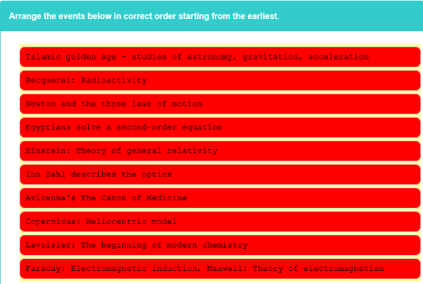
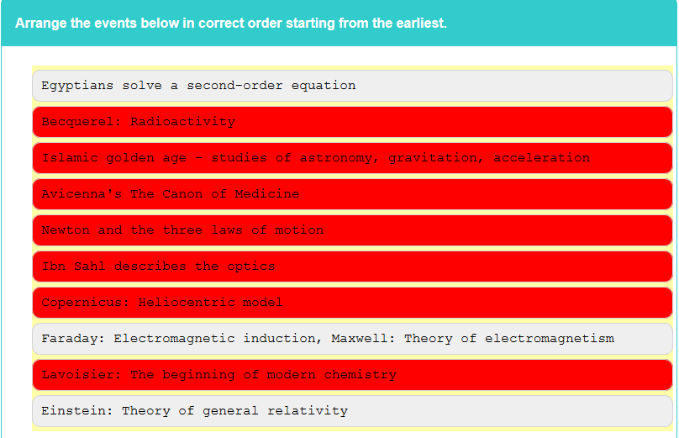
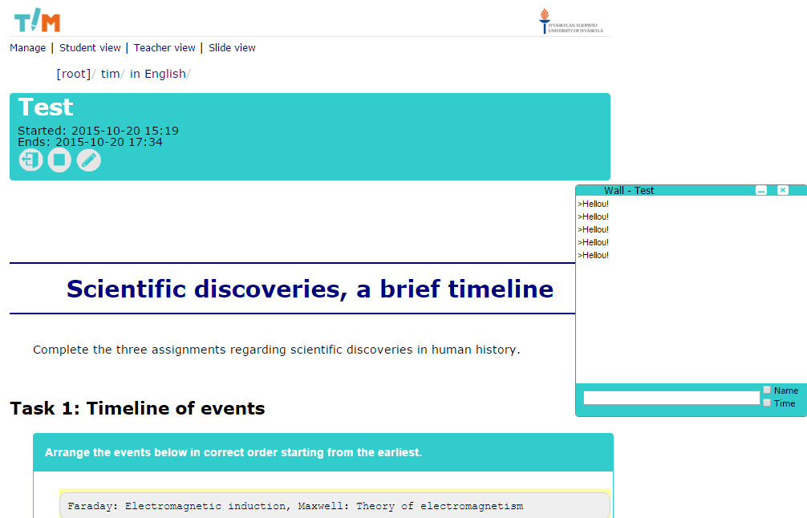
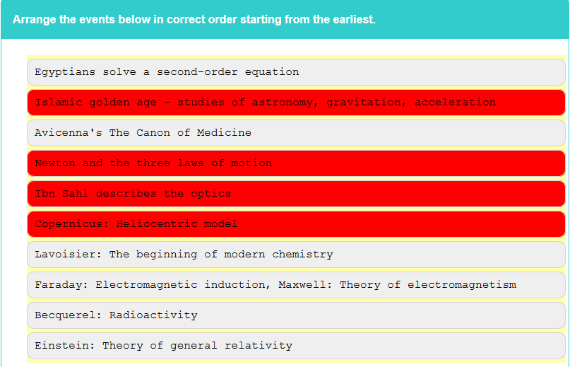
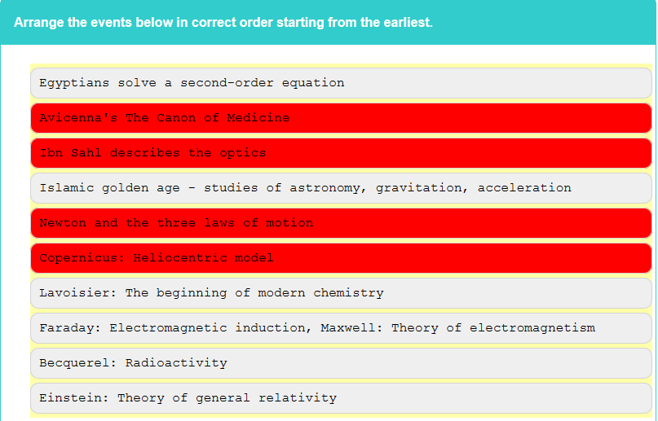
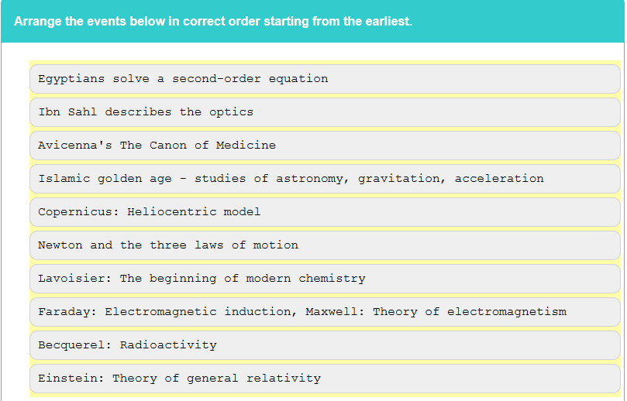

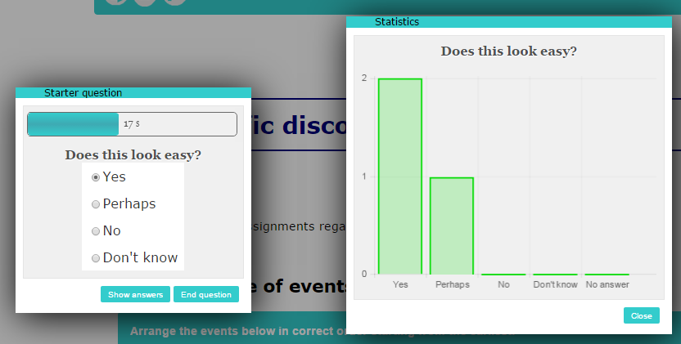
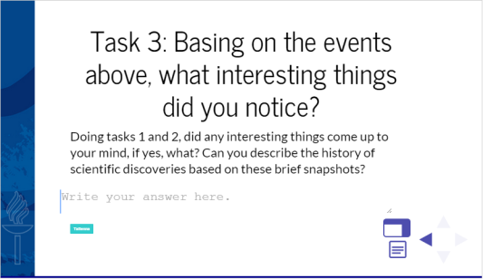
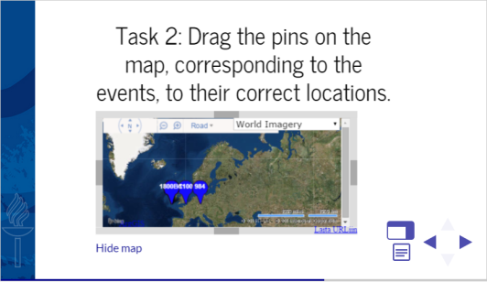
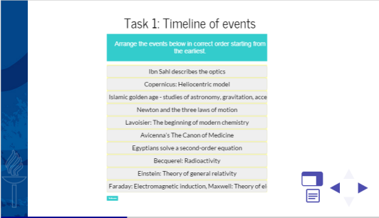
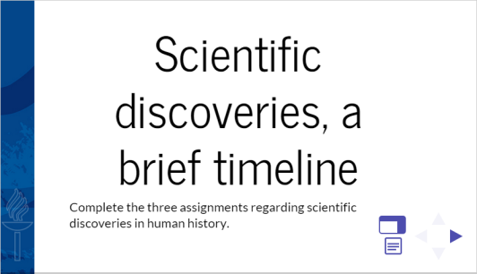
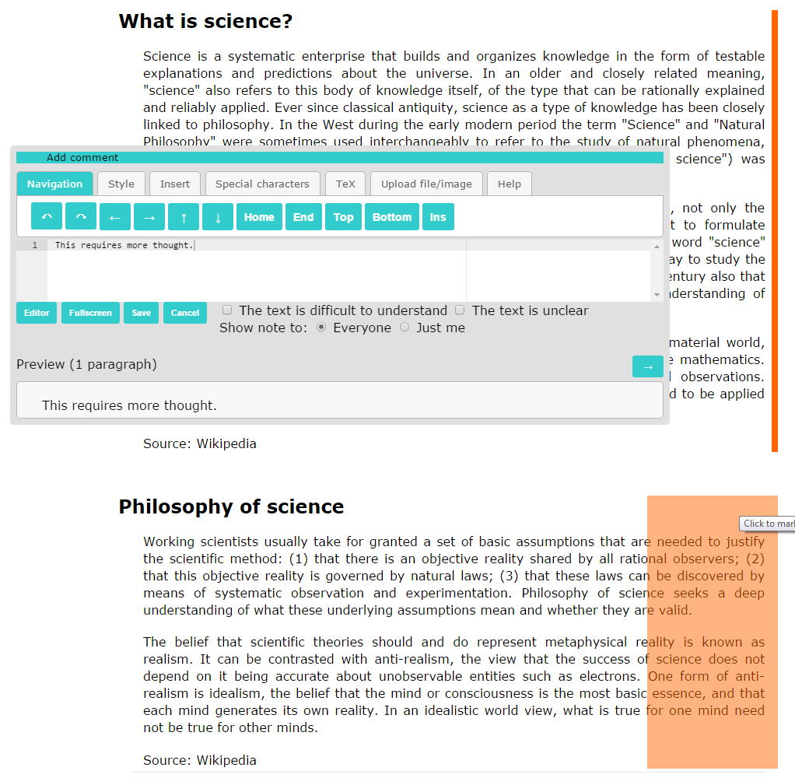
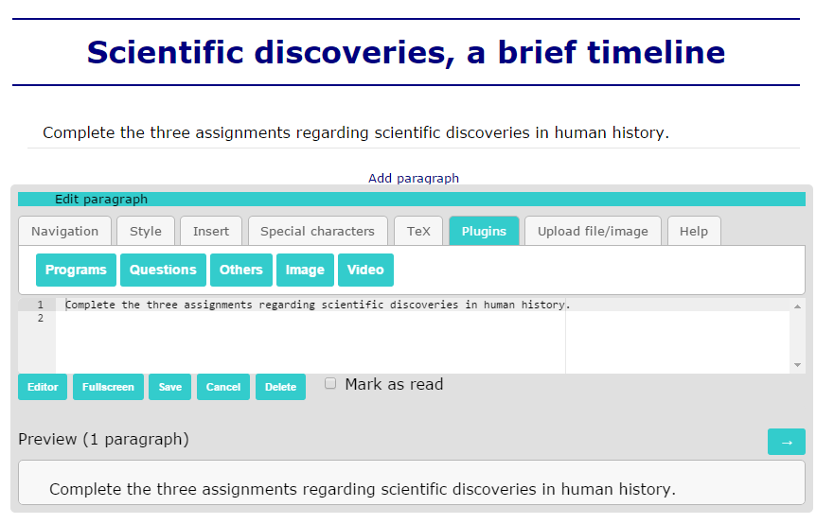

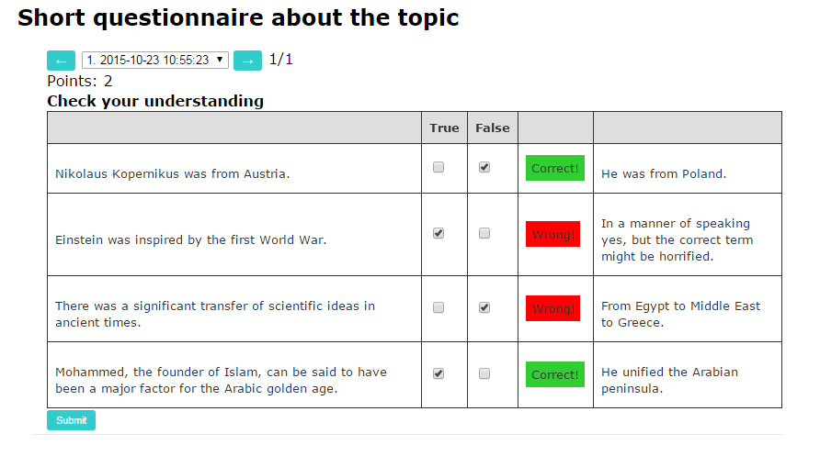
Teacher
can browse the full history of submitted assignments of each student, and marks given for each assignment
is provided with an overall view on how well students succeeded in a particular assignment
can use a lecture mode with a lecture wall and clicker question tools as well as a slide show
https://tim.jyu.fi tim@jyu.fi
a web browser-based electronic learning material, based on the concept of documents
a document is a continuous stream of elements, such as text, images, and many kinds of interactive components
Author
can simply use a web browser
can add and modify interactive elements just like text and images
Reader
can do the assignments that are embedded in the material
can use orange indicators that appear next to unread text paragraphs
can comment the material privately or publicly
Faculty of Information Technology UNIVERSITY OF JYVÄSKYLÄ

