Slide 1
Brief Introduction to Conversation Systems
Yiping Song
18.4.2
Notes:
Hello, everyone. My name is yiping song. My research interests lie in natural language process, deep learning, and especially conversation systems.
Today, I’m will give a brief presentation about conversation systems. This is the topic I have worked on in the last three years.

Slide 2
Overview
Problem definition
Retrieval-based methods
Generation-based methods
Combination
Notes:
This is the overview of this pre. I will first talk about what the conversation systems is like, showing some well-known commercial products. Then, I will introduce two main streams of methods to build the systems. In the end, I will give a approach that naturally combined theses two methods.
Now, let’s start.

Slide 3

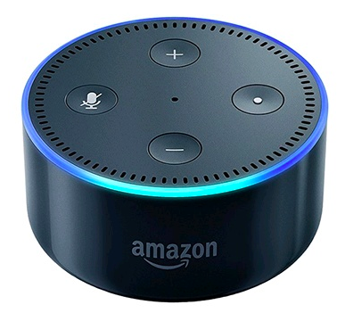








Conversation Systems
Notes:
Look at this page. I believe most of you are familiar with at least one or two commercial products presented here. The first one is siri, apple users would know that. The second one is echo, his name is alexa, and I have one in my room to wake me up every day. The third one is from misrosoft, her name is xiaobing. The last two are from China.
All these products may seem similar to each other, but as a researcher, when we try to build them from scartch, we would find out that they actually belong to different categories.

Slide 4


Conversation Systems
weather …
open-domain VS specific-domain
open-domain
free talk about anything
specific-domain
book a flight
complete a task
weather …
……
job …
job …
……
Notes:
Now, let see how can we conversation systems from different perspectives.
First, open-domain and specific-domain conversations. Open-domain allows the user to talk about anything they want, about the weather, job, whether he or she are in a good mood today, anything you want. It's a kind of like on-line taking platform, such as tweets, weibo.

Slide 5
Conversation Systems
flight time…
open-domain VS specific-domain
open-domain
free talk about anything
specific-domain
book a flight
complete a task
search…
destination …
search …
……
Notes:
While, the do-main specific conversation only allows users taking about a specific topic, such as book a flight, or complete a task.
This kind of systems are usually supported by other systems, For example, as shown in this picture, their conversation mush based on a real flight database.

Slide 6
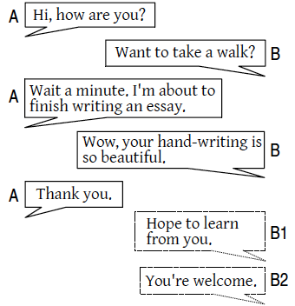
Conversation Systems
single turn VS multi turn
single turn
multi turn
Song et al, INTERSPEECH, 2016
Notes:
Another important setting in conversation systems is whether it is single-turn or multi turn. We all know that in the conversations between human-being, we always consider about the context. While for a machine, it is a difficult process to memorize the chatting history, judge whether it's relevant to the current chatting topic. So, to simplify the question, some times we only care about the current query issued by the user.
While, let's have a look on this sample. If we only consider about one-turn, when the user says thank you, the machine probably respond "you are welcome."

Slide 7
Conversation Systems
single turn VS multi turn
single turn
multi turn
Notes:
But actually, they are talking about hand-writing, so it's better to say "", they we can realize that "you're welcome" is not a proper response in this case. Hence, there are a lot of works focusing on how to utilize the context information.

Slide 8
Conversation Systems
personality
18-year old girl Dongbei(dialect) style
Notes:
Another way to classify the conversation systems is whether the machine has its own personality. For example, xiaobin from microsoft is a 18-year old girl, which we can easily see from her profile photo. So her language style, the topics she is interested in are more similar to a teenager. Xiaodu from baidu also has a dongbei style, when you trigger dongbei style by clicking a button, it will talk to you like a people from dongbei. Here, dongbei is a dialect from china.
As for now, we have talked about different kinds of conversation systems, Next, we will start to talk about two main methods for building a real system.

Slide 9

Retrieval-based methods
<p_1, r_1>
<p_2, r_2>
…
<p_n, r_n>
<p_1, r_1>
<p_2, r_2>
…
<p_m, r_m>
<p_1, r_1>
<p_2, r_2>
…
<p_k, r_k>
q
n (the bigger, the better) >> m (1000) > k (5)
Notes:
There are two main streams. One is the retrieval based method. The pipeline is shown in this page.
Given a user issued query, we search this query in a pre-constructed database. This database contains a lot of post, reply pair, which are from the real conversations of human-being. The database will return a list of pairs, where the user-issued q matches the posts in the pairs. This process is just like the search engine, and we could use the technic from information retrieval.
So far, we have m pairs from the database, we then match q with all the associated replies of these pair. I want to clarify that the first matching in database happens between q and all the posts, and this time, the matching happens between q and each replies. In this step, we could train a classifier to score each pair and obtain the top-k pairs as the final results.
In practice, th n here, the bigger the better, and m is usually keeps as 1000, and k is about 5. The system will randomly choose one of these 5 replies to respond to user.
For the retrieval based methods, most works focus on the matching algorithm in this step, because the retrieval technic has developed for a very long time and is relatively mature.

Slide 10
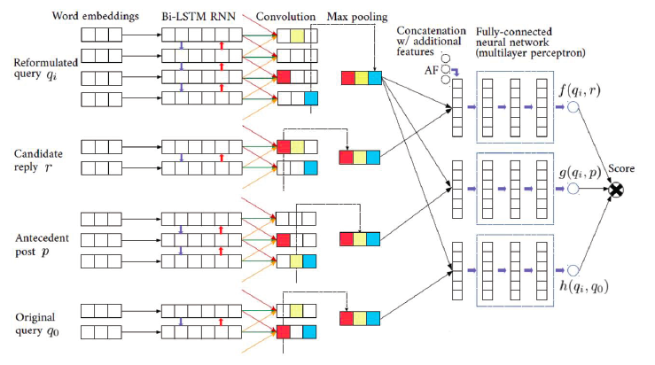
Retrieval-based methods
Yan et al, SIGIR, 2016
Notes:
This is a work that builds a matching network for the user issued query q, the post that retrieved from the retrieval system, and all candidate replies from the retrieval systems. This reformulated query q is q_0 with the chatting history.
It’s easier to see that it uses bi-direction RNN to model each sentence, and use convolution layer with max pooling to choose the useful nodes, then add some additional features before feeding into a multi-layer-perception.

Slide 11
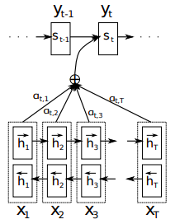
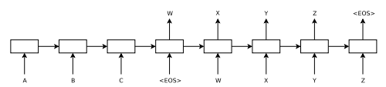
Generation-based methods
Notes:
While, nowadays, more and more attention has been payed to the generation-based methods, especially after the seq2seq model has been proposed.
The right part is a illustration of attention, the difference is, for each cell in decoder, there is a context vector that would summarize the information from the encoder, so that the cell in decoder would know which one should be aligned to itself. The attention mechanism is first applied in machine translation, and it works well in conversation systems.

Slide 12
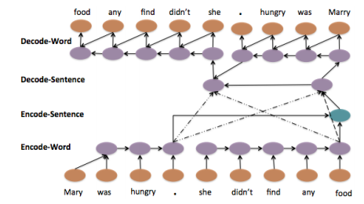
Generation-based methods
context-aware
li et al, arxiv, 2015
Notes:
https://arxiv.org/pdf/1506.01057v2.pdf
While, there also exists many works that are specifically designed for conversation systems.
This is a hierarchical network, the under layer is for both query and chatting history. at the end of each sentence, we feed it to the upper layer. Thus we could formulate both query and chatting history into on model, then decode the reply based on this network.

Slide 13
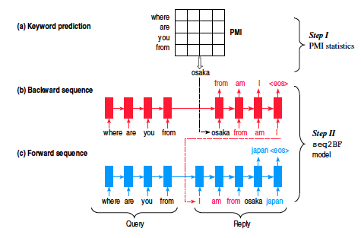
Generation-based methods
controlled generation
Mou et al, COLING, 2016
Notes:
This is a another work. This work try to solve the universal reply problem in the generation based model.
As I said, the seq2seq model is introduced from machine translation task, and the training objective function is to maximize the likelihood of the target sentence. But for conversation systems, the universal replies such as “I do not know”, “you are right” seems suitable for all the queries, but user may not like these replies, they expect more informative and meaningful sentences.
To overcome this problem, this work first predict a keyword that is supposed to appear in the generated reply via pointwise mutual information (PMI). For example , the query is where are you from, and we predict the keyword osaka. Now we generate the reply in two directions.
We first use the query in the encder, and generate the target reply in backward order, which is osaka from am i.
After that, we generate the whole sentence in forward order, which is..
Actually, a lot of works aim to solve the universal reply problem in the conversation systems.

Slide 14
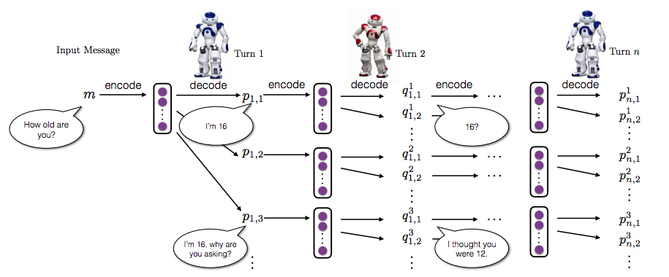
Generation-based methods
two agents
Li et al, arxiv, 2016
Notes:
https://arxiv.org/pdf/1606.01541.pdf

Slide 15
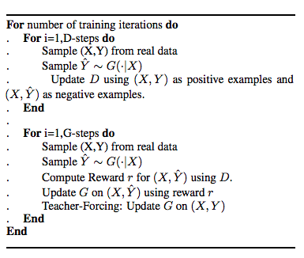
Generation-based methods
adversarial training
Li et al, arxiv, 2017
Notes:
https://arxiv.org/pdf/1701.06547.pdf

Slide 16
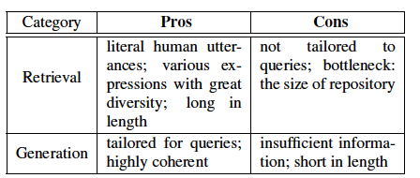
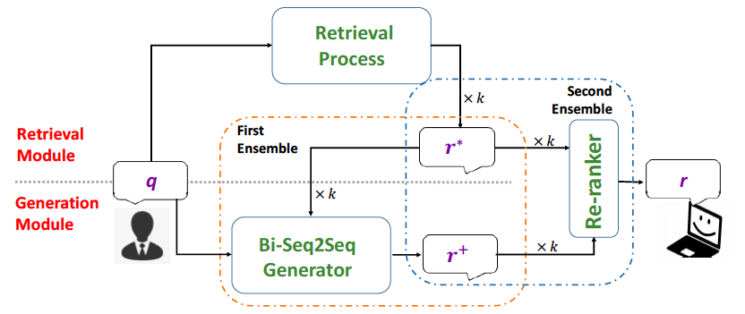
Combination
Song et al, arxiv, 2016
Notes:
https://arxiv.org/pdf/1701.06547.pdf
For now, we have some understanding about both retrieval and generation-based methods. So, let’s summarize their advantages and disadvantages.
For the retrieval systems, … on the other hand, they …
While for the generation based systems, the good trait are…., but owing to the limitation of statistical methods, they ….
Then, one thought arises in my head, why not combine theses two and take advantages of their both traits?
Hence, I propose this ensemble model, which are comprised of two parts, namely the retrieval module and generation module.
In the retrieval part, we feed the q into the pre-constructed database, and it outputs k retrieved replies.
Then, the generation part takes both q and k retrieved replies as the input, and produce k generated replies. The reason for feeding the retrieved replies is to provide more information and also correct some inconsistence in the retrieved replies.
Now we have k retrieved ones and k generated ones from both A and B, then we use a re-ranker to score all the candidates and return the top-ranked one as the final result.
So far, we finish all the technical part in this pre.

Slide 17

Ultimate goal
Thank you !
Notes:
There is a famous saying in the field of conversation systems. The ultimate goal for all the researchers is to build to soul mate for everyone, the machine has its own memory, feelings, could understand you very much, and is willing to be with you until you are getting older and older. At that time, we believe that we have solved all the problems we mentioned above.
That is the end of my pre. Thank you very much!

