Slide 1
Chinese Poetry Generation
Ran Li
University of Illinois at Urbana - Champaign

Slide 2
Outline
Introduction to Chinese Poetry (Quatrains)
Current Chinese Poetry Generation Models
Chinese Poetry Generation with Improved Syntactic Level
Extend word embedding with syntactic features
Plug-in couplet model

Slide 3
Introduction to Chinese Poetry
Classification:
Quatrains (4 lines)
Regulated verses (8 lines)
Basic requirements for quatrains (“jueju” in Chinese):
Same number (5 or 7) of characters per line
Alternate level (平) and oblique (仄) tones between lines
Rhyme in last characters of even-numbered verses (or 1, 2, 4 lines)

Slide 4
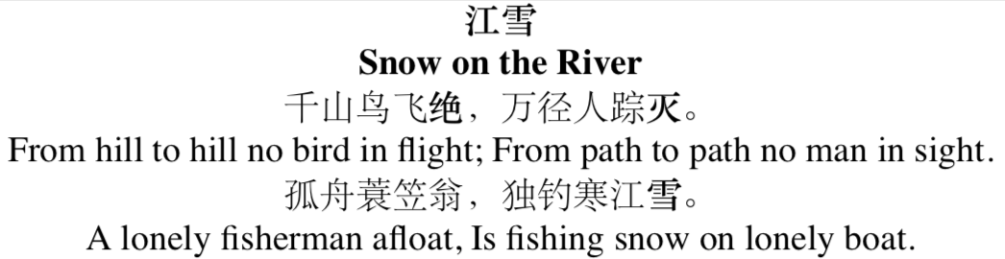
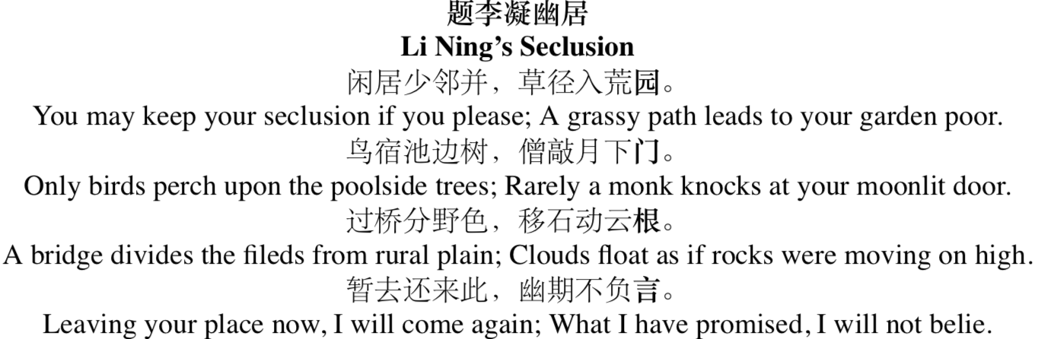
Introduction to Chinese Poetry
Quatrains
Regulated Verses
English translation by Xu et al. [2014]

Slide 5
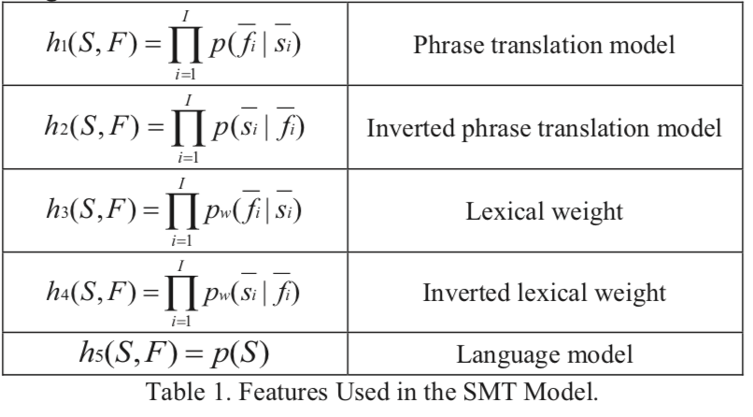
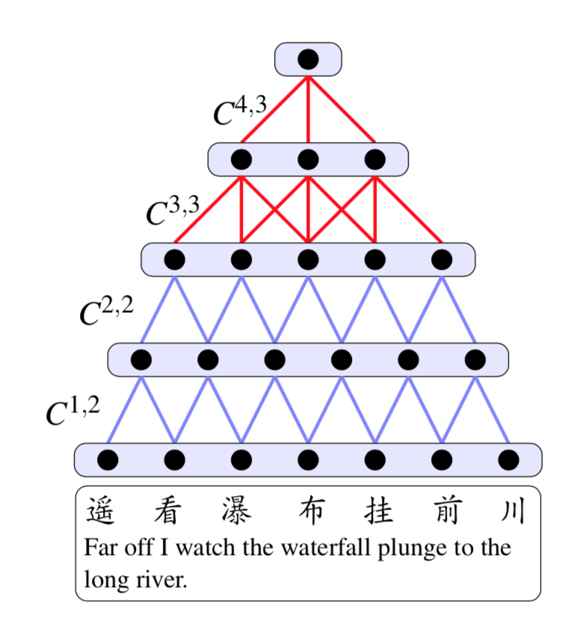
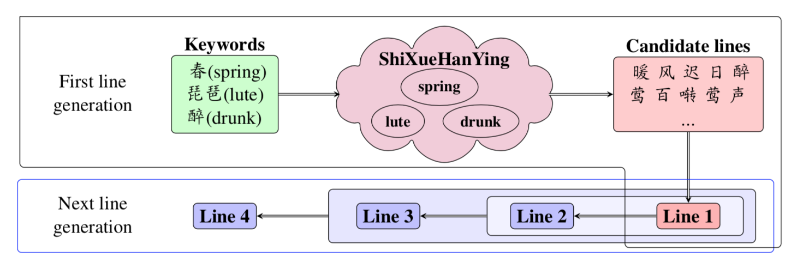
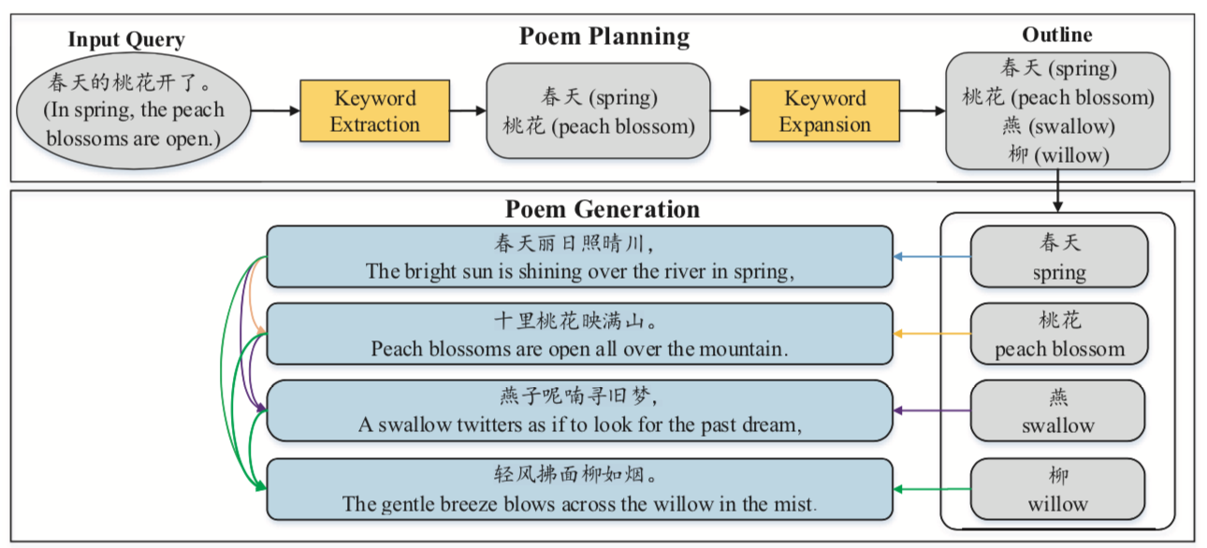
Current Chinese Poetry Generation Models
Statistical Machine Translation (He et al. [2012])
Convolutional Neutral Network & Recurrent Neutral Network (Zhang and Lapata [2014])
Planning Based Recurrent Neutral Network (Wang et al. [2016])

Slide 6
Planning Based Recurrent Neutral Network
Wang et al. [2016]

Slide 7
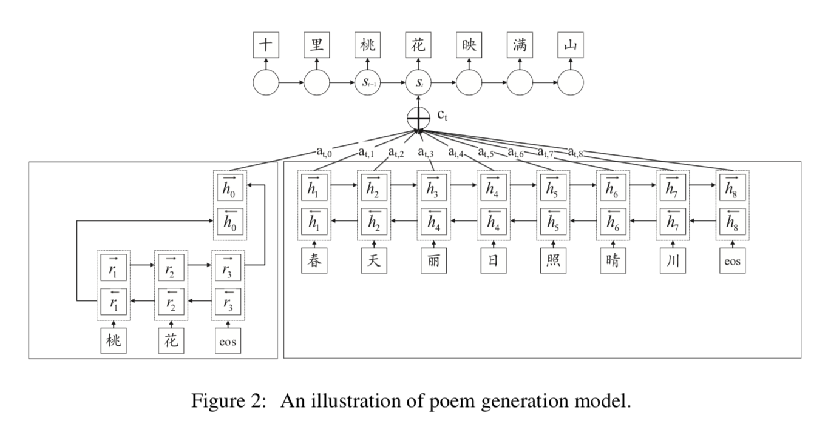
Planning Based Recurrent Neutral Network
Wang et al. [2016]

Slide 8
Problems & Goals
Problems:
Failed to explicitly capture the tones and rhymes of Chinese characters
The semantic meaning of characters in two lines inside one sentence are not fully matched
Goals of My Work
To better capture the tonal and rhythmical restriction with neural network
To reconstruct the parallel structure of certain couplets in the poems
To improve the semantic coherence of the poems

Slide 9
Improvement - New Word Embedding
Context features: 128 dimension wording embedding according to characters in same line + characters in antithetical positions
Rhyme features: 115 one hot rhyme features according to a collection of ancient Chinese rhymes “平水韵”
千 山 鸟 飞 绝，
万 径 人 踪 灭。
孤 舟 蓑 笠 翁，
独 钓 寒 江 雪。
. . . . . .
0
0
1
0
0
0
115 dimensions

Slide 10
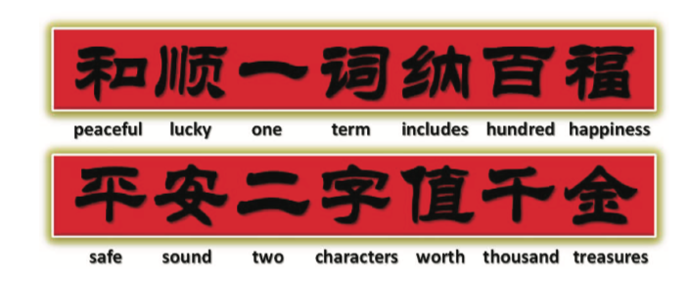
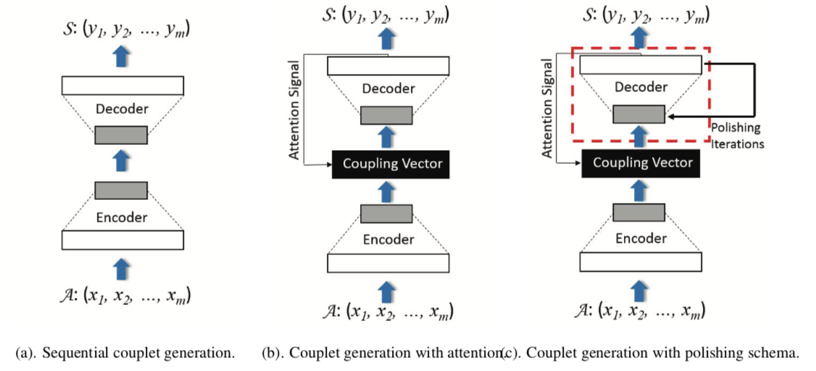
Improvement – Plugged-in Couplet Model
Couplet: a sentence with 2 lines that are strictly dual
Couplet model: a simple seq2seq model trained by “good quality” sentences (1 sentence = 2 lines)
Good quality sentences: ~ 800,000 sentences retrieved by regulated verses poems in Song Dynasty, where the poetry format is well-restricted and poetry rules are closely followed.
Figures from Yan et al. [2016]

Slide 11
Improvement – Plugged-in Couplet Model
Input
Couplet Model
Output

Slide 12
Results so far
Input: 考试太难了(exam is so hard)
Output keywords: 空 春 径 考试
Output Poem:
载酒为官事不空，
Holding wines, I feel being an official is really busy
碾春始觉雪花红。
Walking in the spring, I just realize the snowflakes are red
原头四望谁孙柳，
Looking around who is Sun Liu
便作侬期一笑中。
Just keep smile during my term
Input: 小雨 (small raining)
Output keywords: 数点 嫩 小雨 冻
Output Poem:
数点深藏碧玉枝，
Many pieces of rain hide themselves behind willow branches
且看添水弄轻丝。
Look at they increasing the rainfall and playing with the shapes
今朝一卷西窗雨，
Today the rain fall over my west window
正抵芭蕉雨叶时。
It is perhaps just the time that raindrops are rattling on the leaves of bananas.

Slide 13
Thanks for Listening!

