Slide 1
Mobile Money
Loan Eligibility & Amount Prediction
Hybrid Machine Learning Project: Supervised & Unsupervised Learning
Dataset: PaySim Mobile Money Simulation | 6.36M transactions
Platform: GPU-accelerated (NVIDIA cuML / cuDF) on Kaggle
Goals: Predict loan eligibility · Predict loan amount (UGX) · Cluster customers by risk
Master-Level ML Project | MoKash-Inspired Credit Scoring

Slide 2
Presentation Agenda
01
Project Overview, Context & Objectives
Dataset, motivation, and research goals
02
Methodology, Feature Engineering & Data Leakage Control
EDA, derived features, leakage columns removed
03
Unsupervised Learning & Clustering Segmentation
K-Means vs GMM vs Agglomerative — risk profiling
04
Supervised Learning: Classification & Regression
Loan eligibility classification + loan amount regression
05
Limitations, Ethics, Future Plan & Conclusion
Model constraints, fairness, and strategic next steps

Slide 3
01
Project Overview,
Context & Objectives
Dataset · Motivation · Research Goals

Slide 4
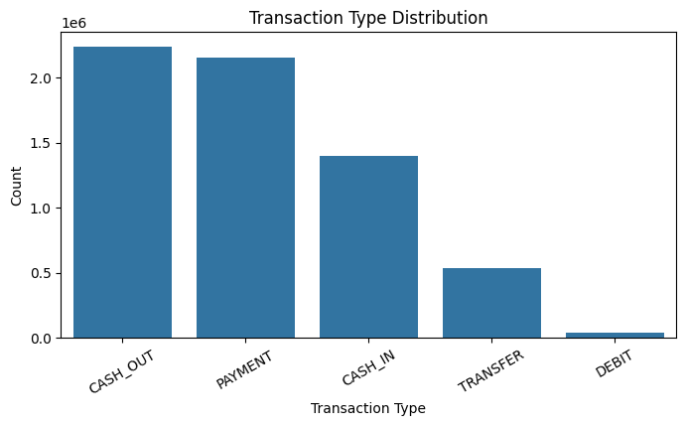
Project Context & Dataset
Motivation
Transaction Type Distribution
Inspired by MoKash — MTN's mobile credit service in Uganda, traditional banking leaves many unbanked customers without credit access. Mobile money transaction data provides a rich behavioral signal for credit-worthiness assessment without a formal credit history.
Dataset — PaySim
6,362,620
6,353,307
Transactions
Unique Customers
5
0
Transaction Types
Missing Values
Source: Kaggle PaySim1 — PS_20174392719_1491204439457_log.csv

Slide 5
Research Objectives
Loan Eligibility Classification
1
Predict whether a mobile money customer qualifies for a loan using binary classification. Six models compared: Logistic Regression, Decision Tree, Random Forest, Gradient Boosting, SVM, and KNN.
Loan Amount Regression
2
For eligible customers, estimate the loan limit in UGX (2,000 – 500,000) using behavioral and balance features. Six regression models evaluated by MAE, RMSE, and R².
Risk-Based Customer Segmentation
3
Use unsupervised clustering (K-Means, GMM, Agglomerative) to group customers into Low, Medium, and High Risk profiles based on transaction behavior — without using fraud labels.

Slide 6
02
Methodology, Feature
Engineering &
Data Leakage Control
EDA · Customer Aggregation · Leakage Prevention

Slide 7
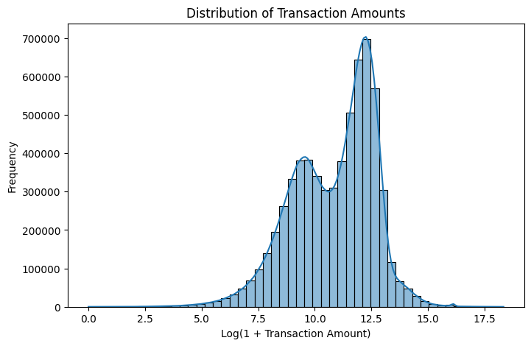
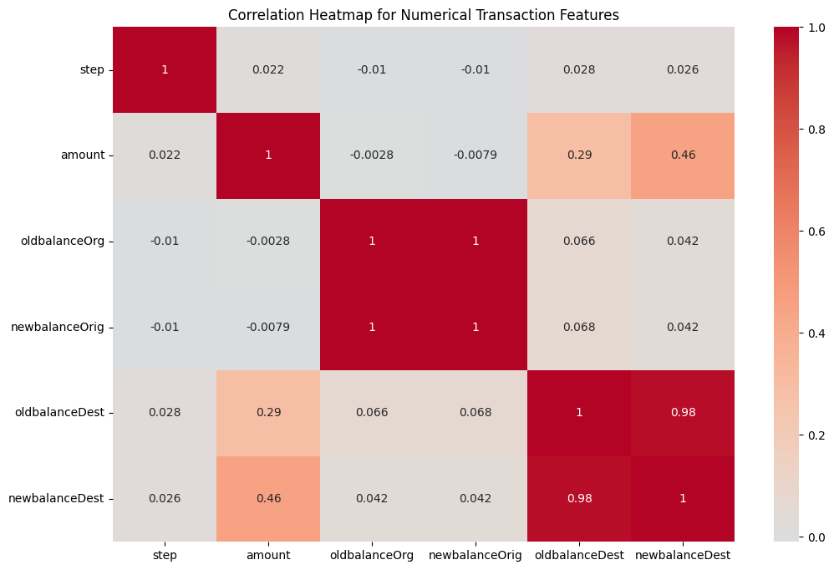
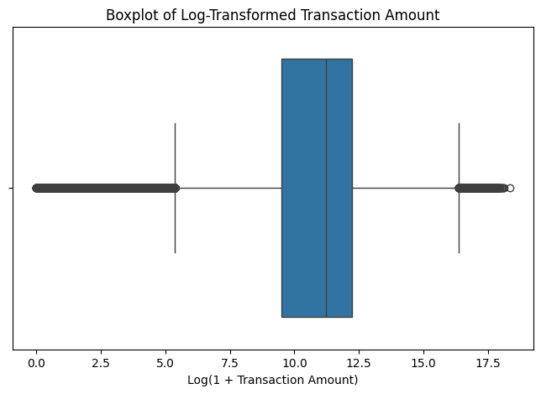
Exploratory Data Analysis
Transaction Amount Distribution (log scale)
Correlation Heatmap — Numeric Transaction Features
Key Findings:
• No missing values across 6.36M rows
• Amount is highly right-skewed → log transform applied
• Old/new balances are strongly correlated
• PAYMENT and TRANSFER dominate transaction types
Boxplot — Log(1+Amount), outlier detection

Slide 8
Feature Engineering — Customer Aggregation
Transaction data was grouped by customer (nameOrig) to create 25 behavioral features:
Transaction Features
Balance Features
transaction_count
avg_transaction_amount
total_transaction_amount
max_transaction_amount
std_transaction_amount
avg_oldbalance_org
max_oldbalance_org
avg_newbalance_orig
avg_oldbalance_dest
avg_newbalance_dest
Cash Flow Features
Transaction Type Ratios
avg_cash_flow_ratio
max_cash_flow_ratio
avg_origin_balance_change
avg_dest_balance_change
dest_balance_ratio
type_ratio_PAYMENT
type_ratio_TRANSFER
type_ratio_CASH_IN
type_ratio_CASH_OUT
type_ratio_DEBIT
6,362,620 transaction rows → 6,353,307 customer-level records | Shape: (6,353,307 × 25)

Slide 9
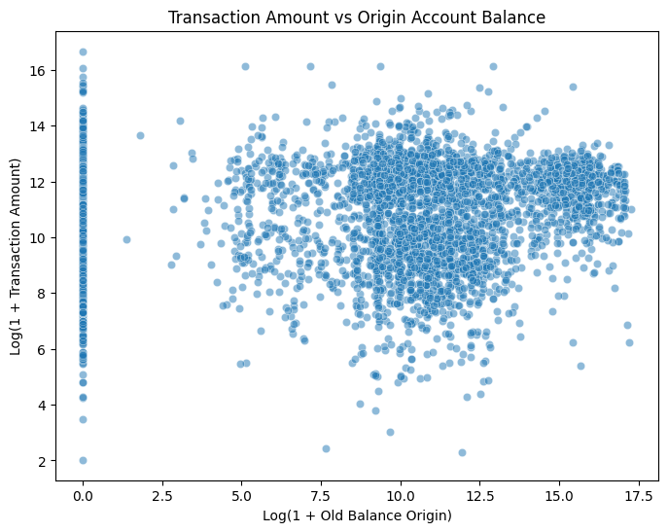
Data Leakage Control
Why Leakage Is Critical
Including cluster labels or risk scores derived after target creation in the training features causes the model to 'cheat' — learning from the answer rather than from observable signals.
Leakage Columns Removed
✗ cluster
✗ risk_group_encoded
✗ avg_log_cash_flow_ratio
Transaction Amount vs Origin Balance
✗ avg_cash_flow_ratio
✗ max_cash_flow_ratio
After removing leakage columns: 21 clean features used for supervised models

Slide 10
03
Unsupervised Learning
& Clustering Segmentation
K-Means (GPU) · GMM · Agglomerative | Risk Profiling

Slide 11
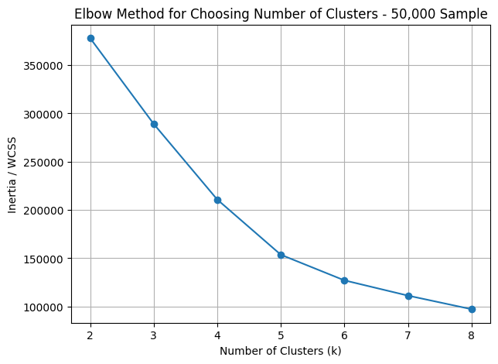
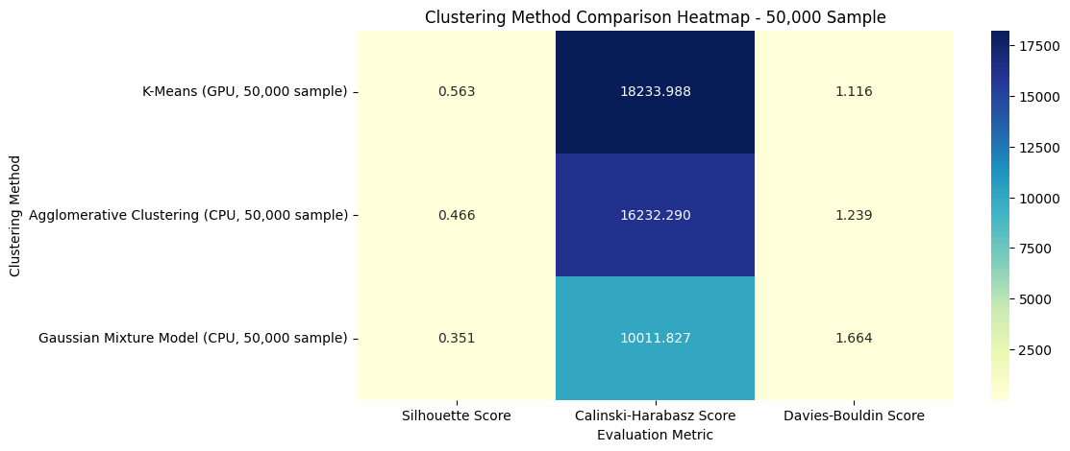
Clustering Method Comparison
Elbow Method — Optimal k=3
Silhouette & Calinski-Harabasz Scores by Method
Method | Silhouette | Calinski-H | DB Score
K-Means (GPU) | 0.5625 ★ | ~High | ~Low
Agglomerative | 0.4657 | Medium | Medium
GMM | 0.3511 | Lower | Higher
K-Means (GPU via cuML) selected as best — highest Silhouette Score on 50,000-customer sample

Slide 12
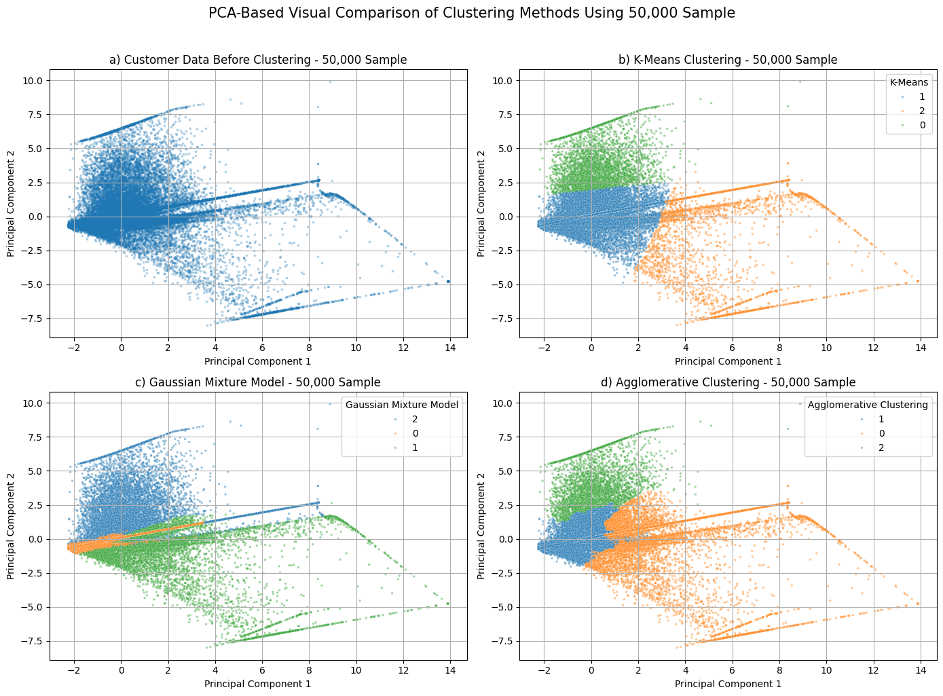
PCA Cluster Visualization & Risk Profiling
Cluster Risk Distribution
Medium Risk
43,114 (86.2%)
Low Risk
3,622 (7.2%)
High Risk
3,264 (6.5%)
PCA used for 2D visualization only — models trained on full 25-feature space

Slide 13
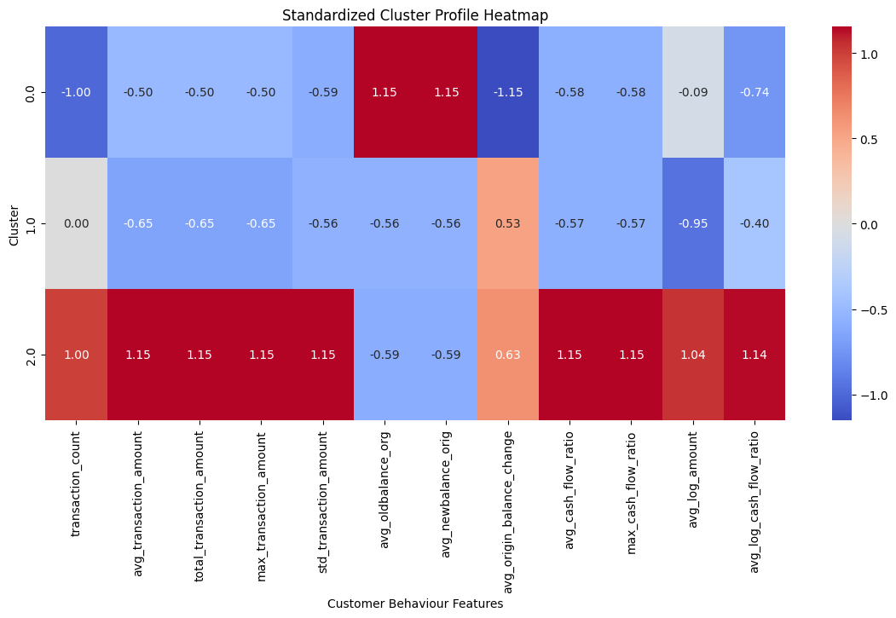
Cluster Profile Heatmap — Risk Interpretation
Risk Group Interpretation
Cluster 0
Low Risk
Low transaction volume, moderate balances, stable cash flow
Cluster 1
Medium Risk
Average behavior, typical of the bulk of customers
Cluster 2
High Risk
High cash-flow pressure, large balance volatility

Slide 14
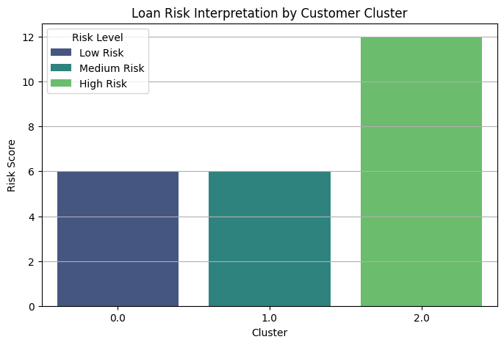
Customer Count per K-Means Cluster
Cluster 1 (Medium Risk) dominates — 86.2% of customers · Clusters 0 & 2 represent smaller high-signal groups

Slide 15
04
Supervised Learning:
Classification &
Regression
Loan Eligibility · Loan Amount Prediction

Slide 16
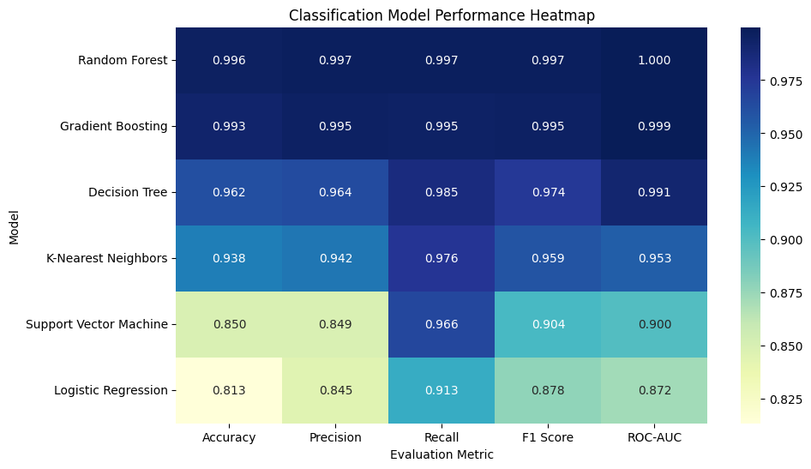
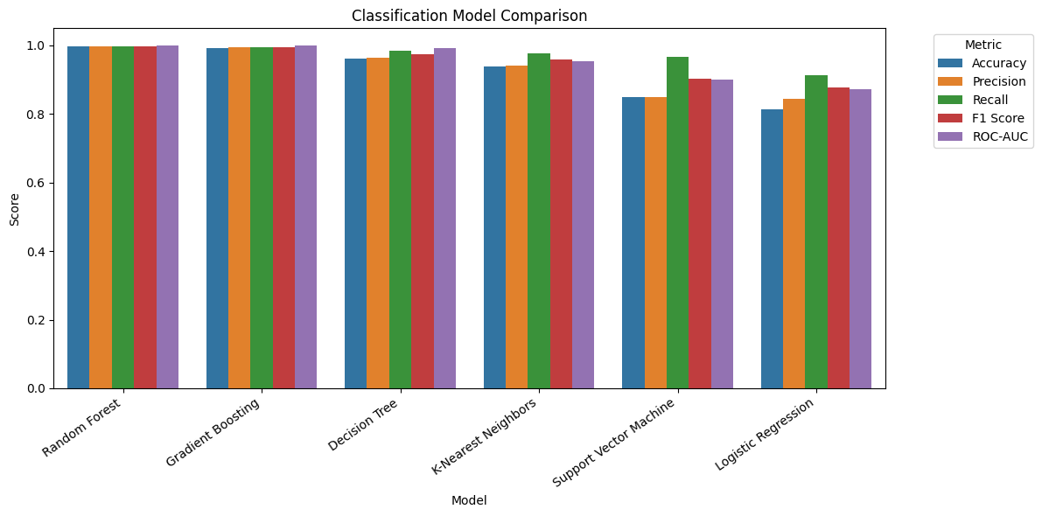
Classification — Loan Eligibility Model Comparison
Performance Heatmap (all metrics)
Grouped Bar — Accuracy, Precision, Recall, F1, AUC
Winner: Random Forest Accuracy 99.6% · Precision 99.7% · Recall 99.7% · F1 99.7% · ROC-AUC 99.99%
6 models trained on 75,000 customer sample | Test set: 15,000 customers | Leakage-controlled features

Slide 17
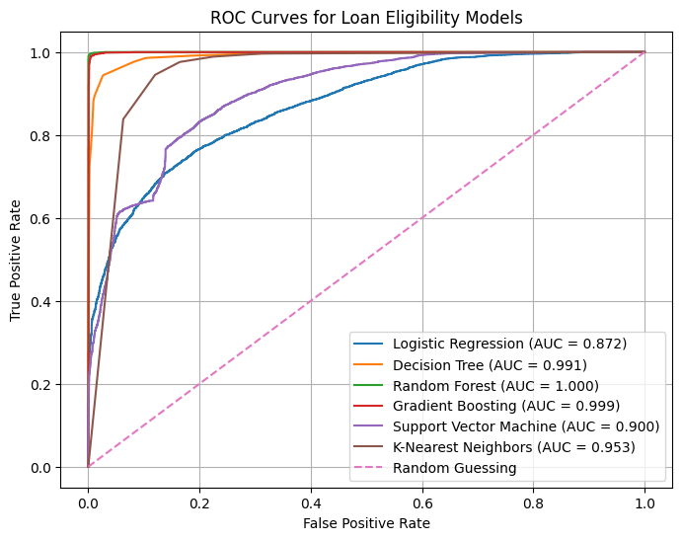
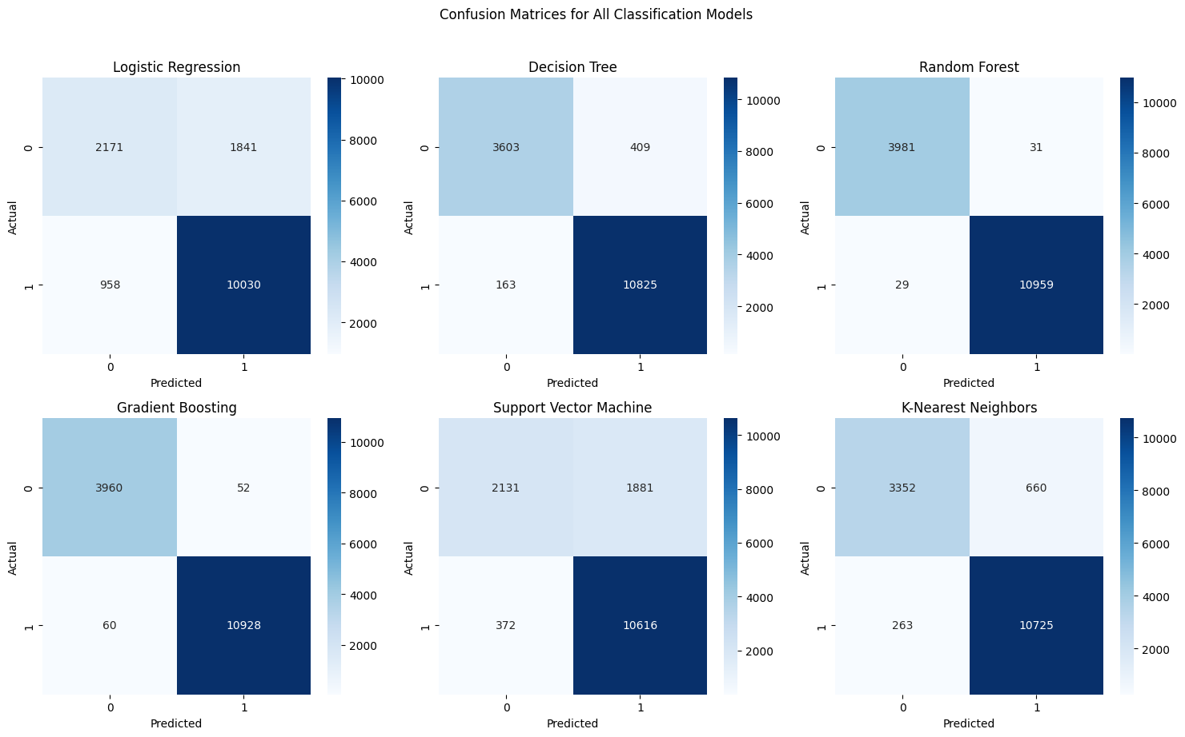
ROC Curves & Confusion Matrices
ROC Curves — All 5 Classifiers
Confusion Matrices — All Models

Slide 18
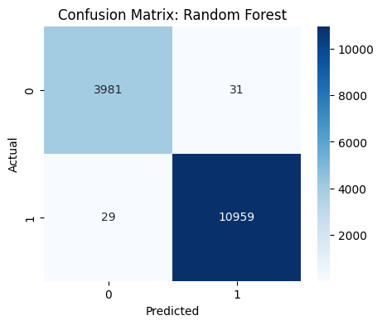
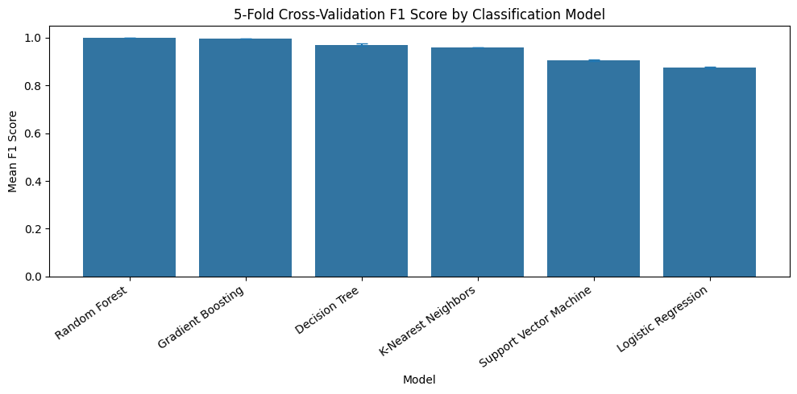
Best Classifier: Random Forest — Cross Validation
Random Forest Confusion Matrix
5-Fold Cross-Validation F1 Scores (50,000 sample)
Cross-Validation Results (5-Fold, 50k sample)
Random Forest: Mean F1 = 0.9978 ±0.0003 | Gradient Boosting: Mean F1 = 0.9951 ±0.0005 | Decision Tree: Mean F1 = 0.9700 ±0.0039 | KNN: Mean F1 = 0.9579 ±0.0013

Slide 19
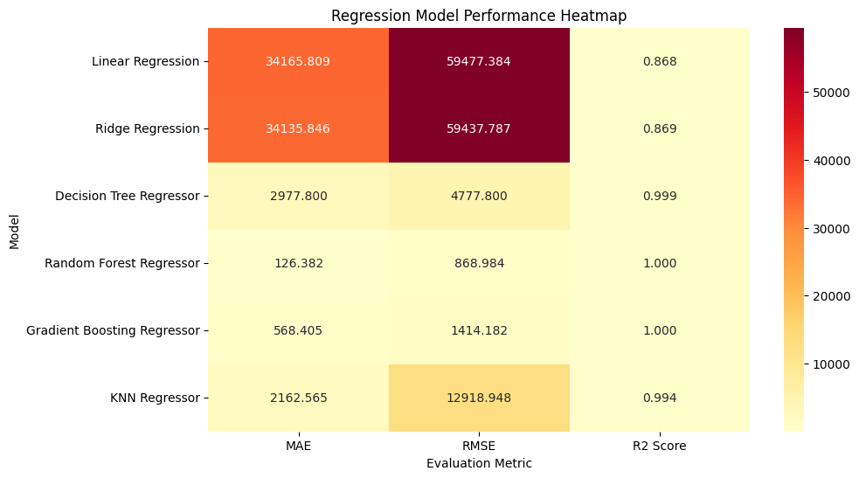
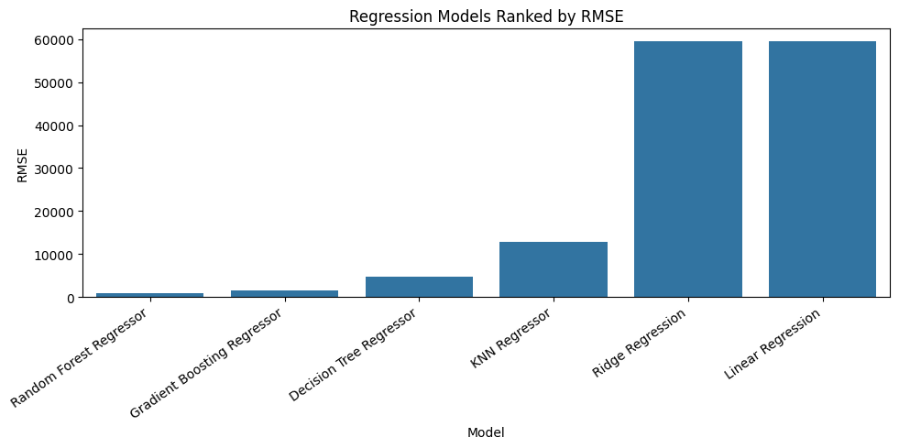
Regression — Loan Amount Prediction
Regression Heatmap (MAE / RMSE / R²)
Models Ranked by RMSE
Model | MAE (UGX) | RMSE (UGX) | R²
Random Forest ★ | 126 | 869 | 0.99997
Gradient Boosting | 568 | 1,414 | 0.99993
Decision Tree | 2,978 | 4,778 | 0.99915
KNN Regressor | >5000 | >8000 | <0.999

Slide 20
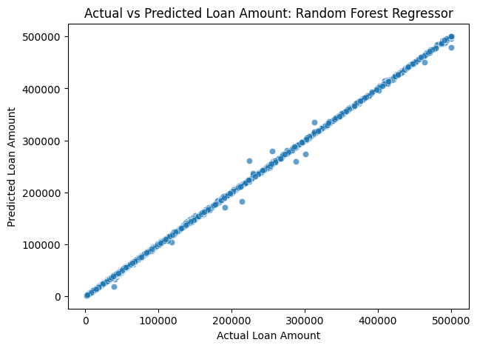
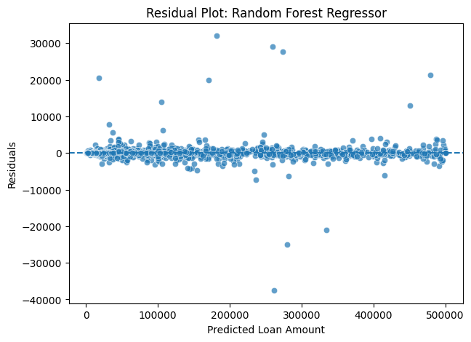
Regression Diagnostics — Random Forest Regressor
Actual vs Predicted Loan Amount
Residual Plot — Errors evenly distributed
Random Forest Regressor results: MAE = UGX 126 · RMSE = UGX 869 · R² = 0.99997
Actual vs Predicted points tightly cluster on the diagonal — near-perfect fit on eligible customer subset

Slide 21
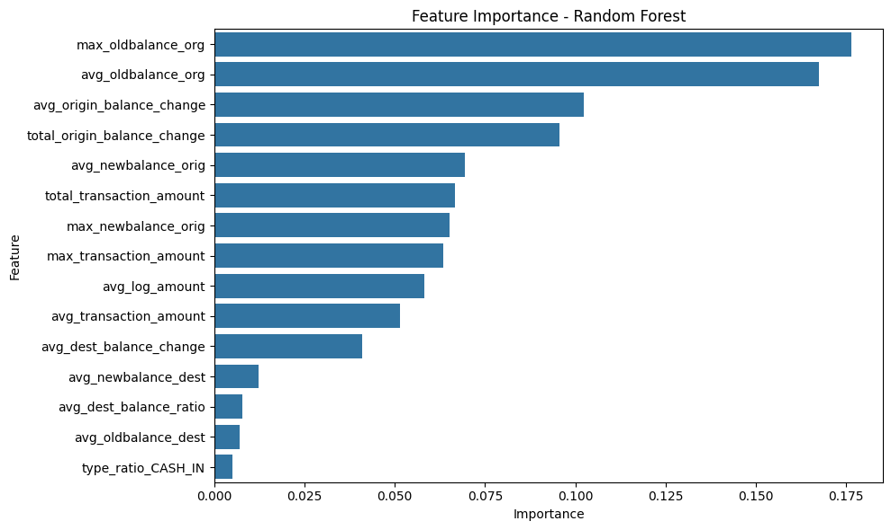
Feature Importance — Classification & Regression
Top Influential Features
max_oldbalance_org (17.6%)
Peak account balance
avg_oldbalance_org (16.8%)
Avg account balance
avg_origin_balance_change (10.2%)
Net balance shift
total_origin_balance_change (9.6%)
Cumulative balance change
avg_newbalance_orig (6.9%)
Top Feature Importances — Random Forest
Post-transaction balance

Slide 22
05
Limitations, Ethics,
Future Plan &
Conclusion
Constraints · Fairness · Strategic Next Steps

Slide 23
Limitations & Ethical Considerations
Synthetic Dataset
Engineered Targets
PaySim is a simulation — real-world data would include repayment history, defaults, and demographic signals not captured here.
Loan eligibility and loan amount targets were created using rule-based heuristics, not actual bank approval records. High accuracy partly reflects how targets were defined.
Data Leakage Risk
Ethical Fairness
Despite removing five leakage columns, derived features (e.g. balance change) may still correlate with the engineered target — warranting caution in production.
Credit models can encode systemic bias. Future deployment requires fairness audits across gender, geography, and income group — even when those variables are implicit in behavior.

Slide 24
Future Strategic Plan
Short Term
Medium Term
Long Term
Replace synthetic targets with real loan approval labels
Deploy as a real-time API using Flask/FastAPI
Monitor model drift over time with periodic retraining
Collect repayment history to improve eligibility labels
Integrate with MoKash or similar mobile money platforms
Fairness audit for gender/geography bias before production
Apply SMOTE or class weighting if imbalance occurs in real data
Add XGBoost or LightGBM for production-grade performance
Expand to multi-country mobile money ecosystems (Rwanda, Tanzania, Kenya)

Slide 25
Conclusion
Clustering
K-Means (GPU) outperformed GMM & Agglomerative with Silhouette = 0.5625, cleanly segmenting customers into Low, Medium, and High Risk groups.
Classification
Random Forest achieved 99.6% accuracy and 99.99% ROC-AUC for loan eligibility — consistent across 5-fold cross-validation (F1 = 0.9978 ± 0.0003).
Regression
Random Forest Regressor predicted UGX loan amounts with R² = 0.99997, MAE = UGX 126, demonstrating near-perfect fit on eligible customers.
Key Insight
Account balance features (max & avg old balance, balance change) are the strongest predictors of credit-worthiness in mobile money data.
This project demonstrates that GPU-accelerated ML on mobile money data can build a viable, explainable credit scoring system for the unbanked.

