Slide 1
Mobile Money Loan Eligibility
and Loan Amount Prediction
Mobile money loan providers need a reliable way to decide who qualifies for a loan and how much they should receive. Wrong decisions can cause losses if risky customers are approved, while strict rules may reject good customers. This project uses customer transaction behavior with supervised learning to predict loan eligibility and loan amount, and unsupervised learning to group customers into risk levels for better loan decision-making.
Presenters:
Aroba Joseph
Mwizerwa Timothy
Kinda Kelsey Naluwafu
Kato Adrian Mugerwa
Naluyima Pauline Oliver
Dataset: PaySim mobile money transactions | Tools: Python, cuDF/cuML, scikit-learn
Notes:
Start by explaining that this deck turns the notebook into a professor-ready ML story, with every graph location clearly labeled.

Slide 2
Presentation roadmap
01
Research problem and business motivation
02
Data preparation and customer-level modelling
03
EDA graph explanations and feature insights
04
Clustering results and risk interpretation
05
Classification table, ROC, confusion matrix, and cross-validation
06
Regression table, diagnostics, and critical reflection
Notes:
Tell the professor the deck follows the notebook sequence: data, EDA, feature engineering, unsupervised learning, supervised learning, evaluation.

Slide 3
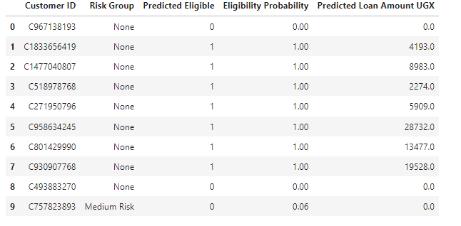
Research problem and motivation
Mobile money lenders need to decide both loan eligibility and loan amount using customer transaction behaviour.
The project builds a hybrid ML workflow: clustering for risk groups, classification for eligibility, regression for loan limit.
The business value is faster and more consistent credit scoring for customers with limited formal banking history.
3
50,000
6.35M
outputs: risk, eligibility, amount
sample used for modelling graphs
customer rows before sample
Notes:
Emphasize that the notebook is a prototype for credit scoring, not final deployment.

Slide 4
End-to-end workflow
Raw
transactions
Cleaning
+ EDA
Feature
engineering
K-Means
risk groups
Classify
eligibility
Regress
loan amount
GPU/cuML: K-Means and PCA for scalable clustering visualisation.
scikit-learn: Logistic Regression, Decision Tree, Random Forest, Gradient Boosting, SVM, KNN, and regression models.
Final decision: combine statistical evidence with model comparison tables.
Notes:
The pipeline slide helps the professor understand how the notebook concepts connect.

Slide 5
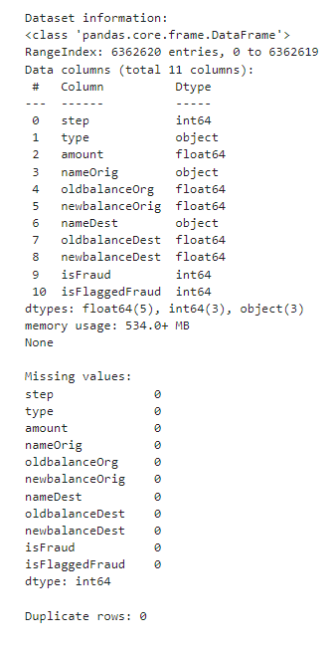

Dataset preparation and inspection
The raw transaction data was cleaned and aggregated from transaction-level records to customer-level profiles.
Fraud-related fields were removed so the target focuses on loan scoring rather than fraud detection.
Customer aggregation improves modelling because each row represents a borrower profile, not a single transaction.
Notebook evidence
Value / meaning
Original customer_df size
6,353,307 rows × 25 columns
Clustering sample
50,000 customers
Supervised learning rows
50,000 rows after target cleanup
Target distribution
36,626 eligible; 13,374 not eligible
Notes:
Mention that modelling at customer level avoids treating every transaction as an independent borrower.

Slide 6
EDA graph placement guide
Exact notebook graph name
What to say when presenting it
Missing Values Heatmap
Shows whether preprocessing left missing values that could affect model reliability.
Correlation Heatmap for Numerical Transaction Features
Shows linear relationships among numeric transaction variables.
Boxplot of Log-Transformed Transaction Amount
Shows outliers after log transformation.
Transaction Amount vs Origin Account Balance
Shows relationship between customer balance and transaction size.
Pairplot of Key Log-Transformed Financial Features
Shows pairwise structure among core financial variables.
Distribution of Transaction Amounts
Shows skewness; supports use of log(1 + amount).
Transaction Type Distribution
Shows behavioral mix: CASH_IN, CASH_OUT, PAYMENT, TRANSFER, DEBIT.
Notes:
This slide is a direct graph placement guide: use the exact names from the notebook titles.

Slide 7
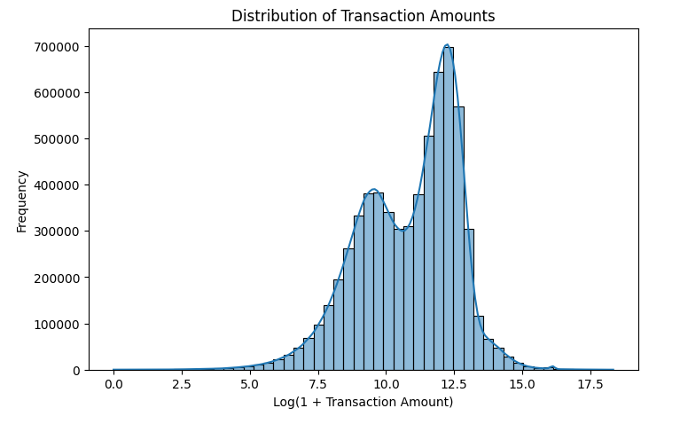
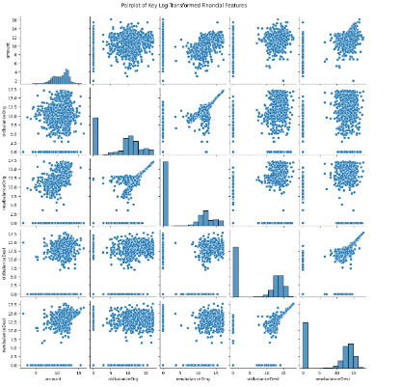
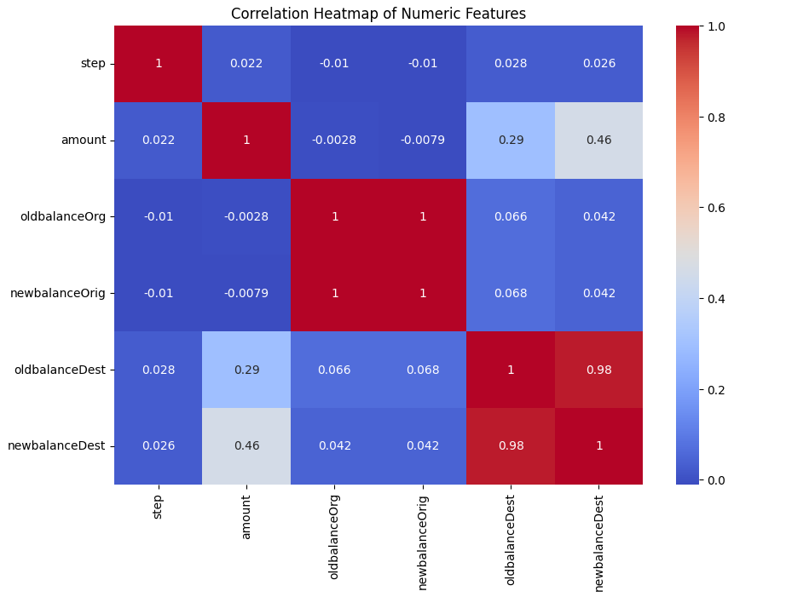
EDA interpretation: why the graphs matter
Transaction amounts are highly skewed, so log transformation makes patterns easier to model and visualize.
Outlier checks show whether extreme values could dominate distance-based models such as K-Means and KNN.
Correlation heatmaps help detect predictive relationships and possible leakage before supervised learning.
Notes:
Use this slide to explain the EDA logic, not just show graphs.

Slide 8
Feature engineering and target construction
Feature group
Examples from notebook
Purpose
Activity
transaction_count, total_transaction_amount
Measures customer usage level.
Amount behaviour
avg, max, std transaction amount
Captures scale and volatility.
Balance capacity
avg_oldbalance_org, avg_newbalance_orig
Approximates affordability/liquidity.
Cash-flow pressure
avg_cash_flow_ratio, max_cash_flow_ratio
Measures pressure between transaction size and balance.
Transaction mix
type_ratio_CASH_IN, PAYMENT, TRANSFER
Represents financial behaviour composition.
Eligibility target thresholds: transaction threshold = 1, balance threshold = 0.0, cash-flow threshold = 2.2243.
After target construction, the sample had 36,626 eligible customers and 13,374 non-eligible customers.
Leakage columns were removed before classification to avoid over-optimistic model performance.
Notes:
This is an important master-level slide because it explains how the target was created and how leakage was handled.

Slide 9
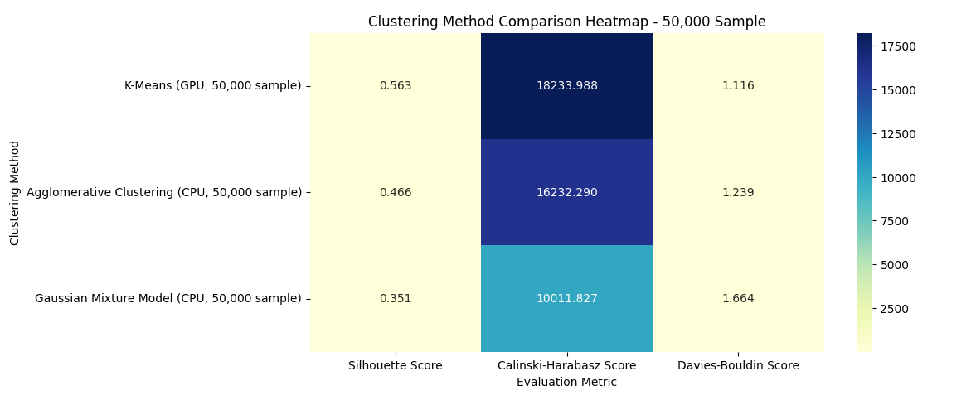
Unsupervised learning results
Clustering method
Silhouette
Calinski-Harabasz
Davies-Bouldin
Interpretation
K-Means (GPU, 50,000 sample)
0.5625
18,233.99
1.1162
Best separation; selected for risk groups.
Agglomerative Clustering (CPU)
0.4657
16,232.29
1.2391
Second best but less scalable.
Gaussian Mixture Model (CPU)
0.3511
10,011.83
1.6639
Weakest separation.
Silhouette is higher for K-Means, meaning customers are more clearly separated into clusters.
Davies–Bouldin is lowest for K-Means, supporting the same conclusion from another metric.
This provides evidence for using K-Means clusters as risk-group input.
Notes:
Make clear that K-Means was chosen based on multiple cluster-quality metrics, not personal preference.

Slide 10
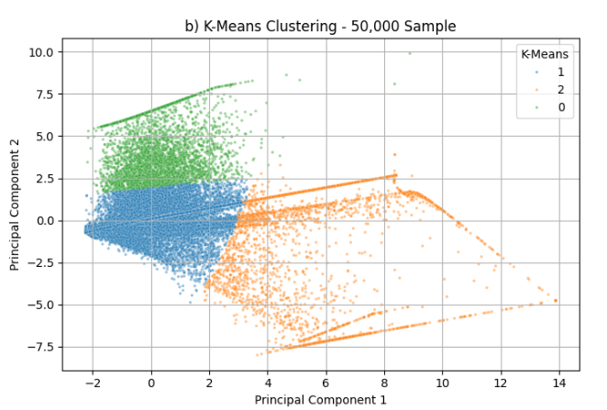
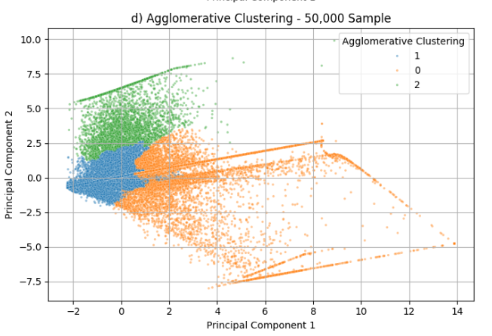
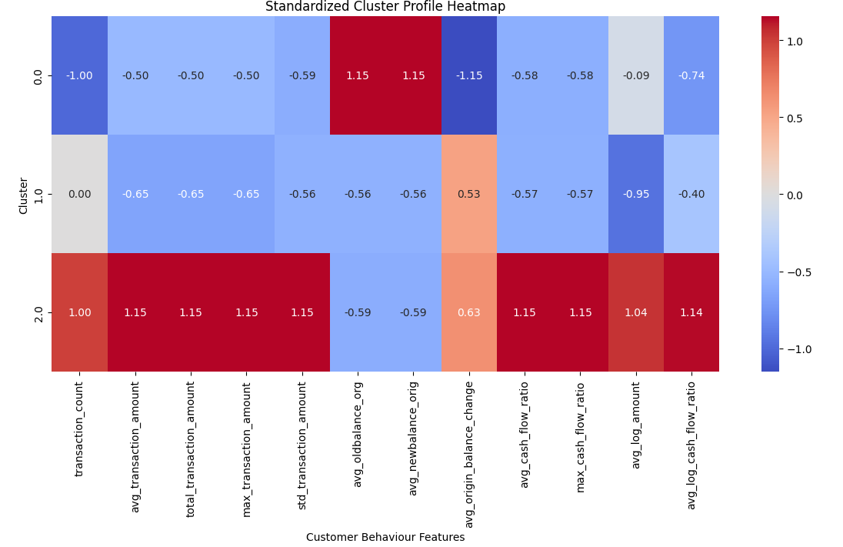
Clustering graph placement and risk interpretation
Cluster
Count
Risk interpretation
Why
1
43,114
Medium Risk
Largest group; moderate behaviour profile.
0
3,622
Low Risk
Lower cash-flow pressure and stronger balance profile.
2
3,264
High Risk
Highest cash-flow pressure and high transaction scale.
Notes:
Explain that risk groups are interpretations of cluster profiles, not real default labels.

Slide 11
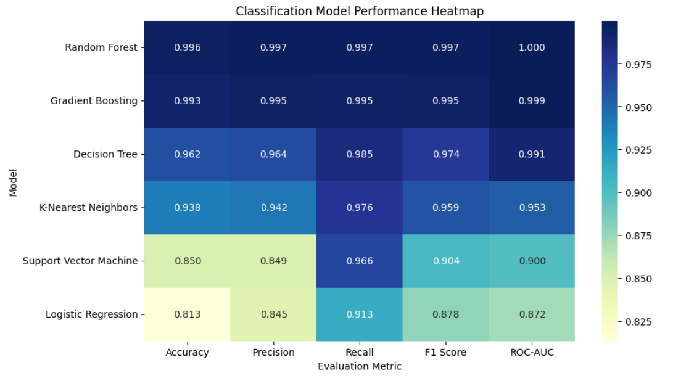
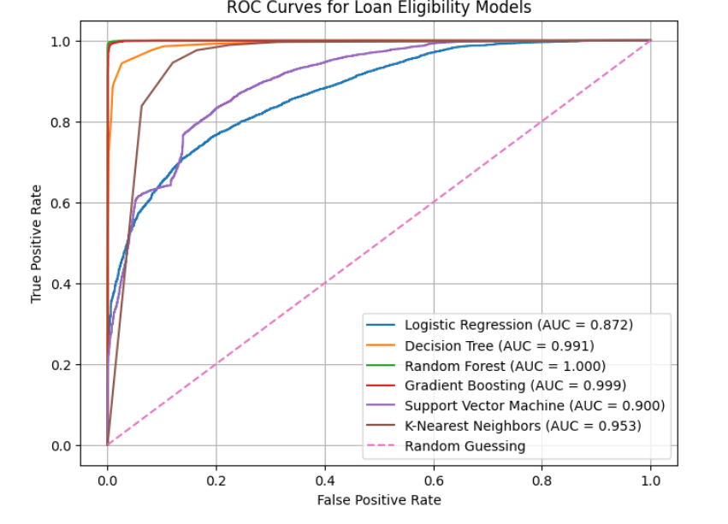
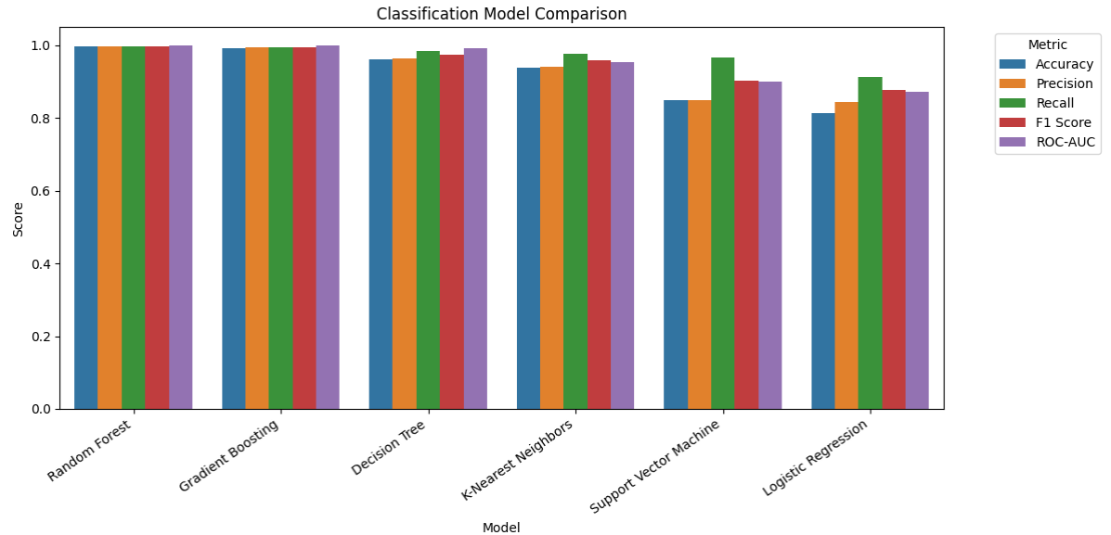
Classification model comparison
Model
Accuracy
Precision
Recall
F1 Score
ROC-AUC
Random Forest performed best with F1 = 0.9973 and ROC-AUC = 0.9999.
Gradient Boosting was close, but Random Forest had the strongest balance of precision and recall.
For loan approval, F1 and precision are important because false approvals can create financial loss.
Random Forest
0.9960
0.9972
0.9974
0.9973
0.9999
Gradient Boosting
0.9925
0.9953
0.9945
0.9949
0.9992
Decision Tree
0.9619
0.9636
0.9852
0.9743
0.9912
K-Nearest Neighbors
0.9385
0.9420
0.9761
0.9587
0.9526
Support Vector Machine
0.8498
0.8495
0.9661
0.9041
0.8996
Logistic Regression
0.8134
0.8449
0.9128
0.8776
0.8723
Notes:
Use numbers from the table to emphasize the best model and explain why F1 was prioritized.

Slide 12
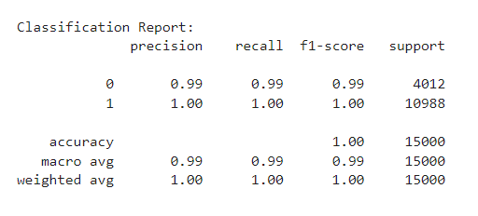
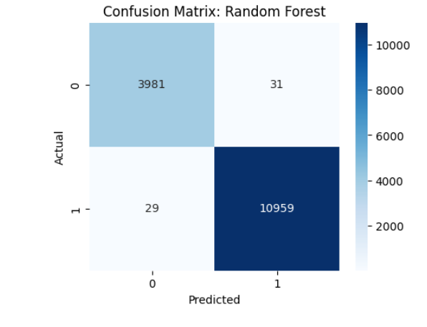
Best eligibility model: Random Forest
0.9973
0.9972
0.9974
0.9999
F1 Score
Precision
Recall
ROC-AUC
Random Forest captured non-linear relationships and feature interactions better than linear models.
Compared with Logistic Regression (F1 = 0.8776), Random Forest improved eligibility classification substantially.
Compared with Gradient Boosting (F1 = 0.9949), Random Forest still had the highest F1 and ROC-AUC.
Notes:
Say: Random Forest is selected because it provides the strongest F1, precision, recall, and ROC-AUC combined.

Slide 13
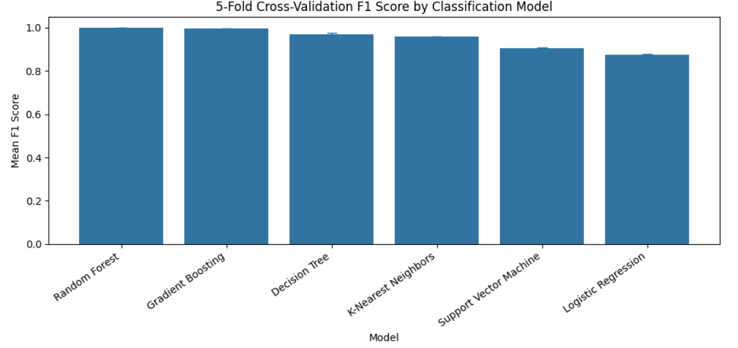
Cross-validation: generalization check
Model
Mean CV F1
Std CV F1
Meaning
Random Forest
0.9978
0.0003
Most stable and best-performing model.
Gradient Boosting
0.9951
0.0005
Very strong alternative.
Decision Tree
0.9700
0.0039
Good but less stable than ensembles.
KNN
0.9579
0.0013
Reasonable but weaker.
SVM
0.9047
0.0027
Moderate.
Logistic Regression
0.8736
0.0037
Lowest CV F1.
The 5-fold CV result confirms Random Forest performance is consistent across data splits.
Low standard deviation (0.0003) means the model is not highly sensitive to a single train/test split.
Notes:
Cross-validation gives a stronger academic argument than reporting only test performance.

Slide 14
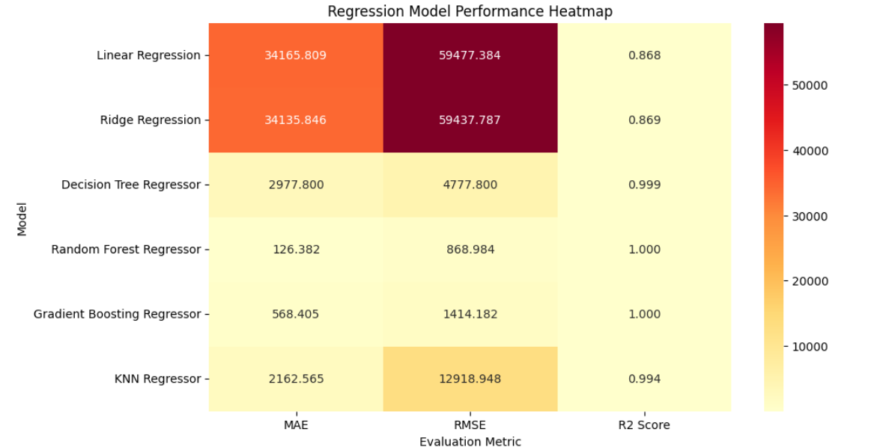
Regression model comparison
Model
MAE
RMSE
R² Score
Interpretation
Random Forest Regressor
126.38
868.98
0.999972
Best: lowest RMSE and highest accuracy.
Gradient Boosting Regressor
568.41
1,414.18
0.999926
Strong second option.
Decision Tree Regressor
2,977.80
4,777.80
0.999151
Good fit but higher error.
KNN Regressor
2,162.57
12,918.95
0.993789
Large RMSE; less reliable.
Ridge Regression
34,135.85
59,437.79
0.868538
Linear model underfits.
Linear Regression
34,165.81
59,477.38
0.868363
Weakest regression option.
Random Forest Regressor is selected because it has the lowest RMSE = 868.98 and MAE = 126.38.
Linear and Ridge models underperformed, showing that the loan amount relationship is non-linear.
Notes:
For regression, lower RMSE and MAE are better, while higher R² is better.

Slide 15
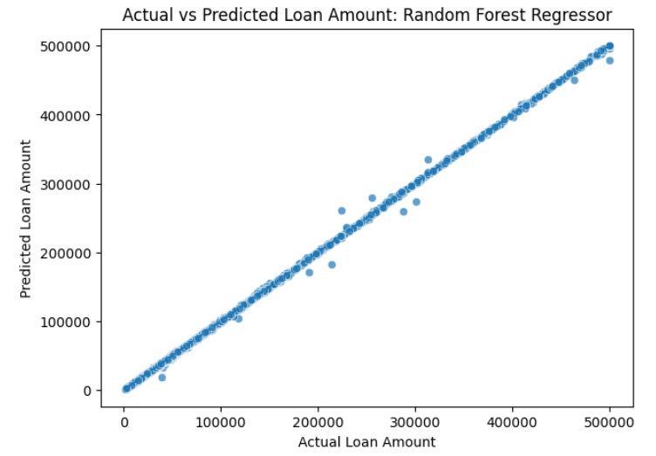
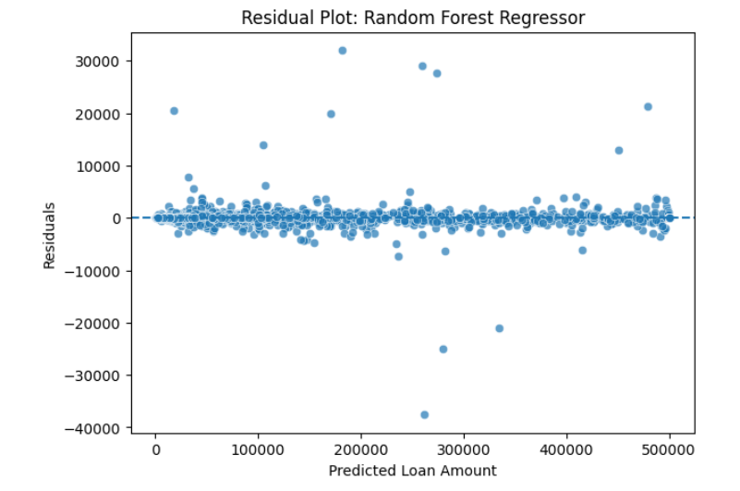
Best loan amount model: Random Forest Regressor
126.38
868.98
0.999972
MAE
RMSE
R² Score
The model predicts eligible loan amount with much lower error than linear models.
Actual-vs-predicted points should lie close to the diagonal line if predictions are strong.
Residuals should be centered around zero; major patterns would suggest model bias.
Because the target is engineered, the very high R² should be interpreted carefully.
Notes:
Mention that high performance is promising but may be inflated because eligibility and loan amount targets were constructed from rules.

Slide 16
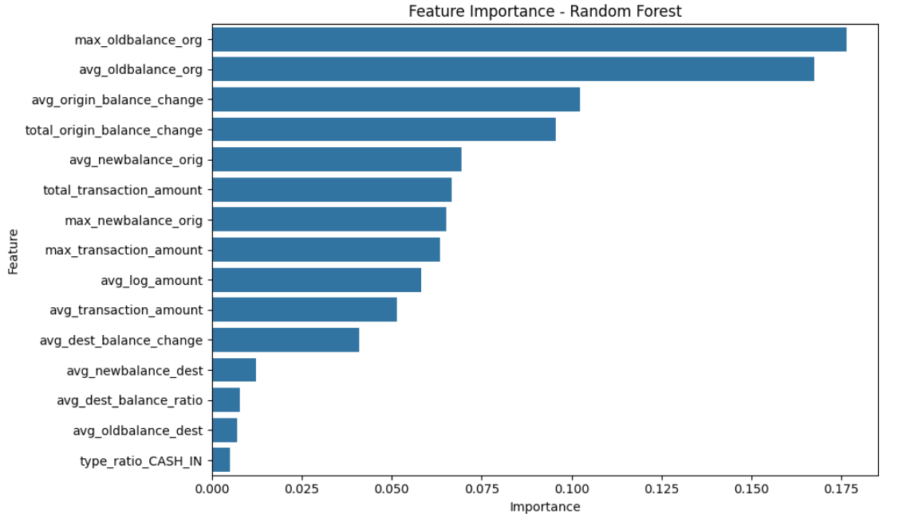
Feature importance: why the model predicts eligibility
Rank
Feature
Importance
Meaning
1
max_oldbalance_org
0.1764
Maximum origin balance strongly signals capacity.
2
avg_oldbalance_org
0.1675
Average balance reflects customer affordability.
3
avg_origin_balance_change
0.1023
Balance movement supports risk/eligibility decision.
4
total_origin_balance_change
0.0956
Total change captures account activity.
5
avg_newbalance_orig
0.0695
Post-transaction balance indicates remaining capacity.
The best classifier is not a complete black box because feature importance shows which variables drive decisions.
Balance-related features dominate, which is logical for credit scoring because they represent affordability.
Notes:
Connect the top features to lending logic: more stable balances usually mean greater capacity to borrow.

Slide 17
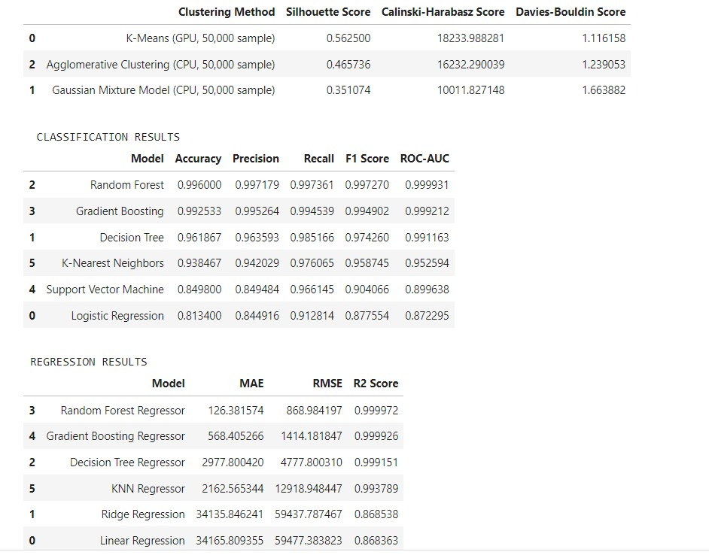
Final results table and academic interpretation
Task
Best method
Value obtained
Academic interpretation
Clustering
K-Means (GPU, 50,000 sample)
Silhouette = 0.5625; DB = 1.1162
Best separation of customer risk groups.
Eligibility classification
Random Forest
F1 = 0.9973; ROC-AUC = 0.9999
Best at separating eligible vs non-eligible customers.
Cross-validation
Random Forest
Mean CV F1 = 0.9978 ± 0.0003
Performance is stable across folds.
Loan amount regression
Random Forest Regressor
RMSE = 868.98; R² = 0.999972
Best loan-limit estimator among tested models.
Tree-based ensemble models were strongest because they handle non-linear financial behavior.
The result should be presented as an academic prototype because the targets are engineered, not real repayment outcomes.
Notes:
This slide is the final evidence slide before limitations.

Slide 18
critical analysis
Strength: full ML workflow with EDA, feature engineering, clustering, classification, regression, evaluation, and explainability.
Limitation: PaySim is synthetic; real lending needs repayment/default labels, not engineered targets.
Limitation: very high scores may reflect constructed labels and feature relationships, so results should not be oversold.
Future work: add time-window features, repayment history, fairness testing, calibration, monitoring, and real deployment validation.
Professor question
Strong answer
Why Random Forest?
Best F1, ROC-AUC, CV F1, and non-linear feature handling.
Why K-Means?
Best Silhouette and lowest Davies–Bouldin score.
Why caution?
Synthetic data and engineered labels can inflate performance.
Notes:
This slide shows maturity: acknowledge limitations and avoid making unsupported deployment claims.

Slide 19
Conclusion
The notebook demonstrates a complete hybrid machine learning system for mobile money credit scoring: risk segmentation, eligibility prediction, and loan amount estimation.
Best clustering model: K-Means, Silhouette = 0.5625.
Best classification model: Random Forest, F1 = 0.9973 and ROC-AUC = 0.9999.
Best regression model: Random Forest Regressor, RMSE = 868.98 and R² = 0.999972.
Main contribution: a lecture-aligned, explainable ML pipeline with critical evaluation.
Notes:
End confidently while reminding the professor that future work requires real repayment data.

