Slide 1
EE 1520 計算機概論二 （一一三學年下學期） Introduction to Computer Science (II)
S. Felix Wu
sfelixwu@gs.ncku.edu.tw
https://github.com/sfelixwu/ee1520
https://www.youtube.com/@sfelixwu
DISCORD -- TBA

Slide 2
Syllabus
Unix/Linux tools and basic OS concepts
Object-oriented Programming in C++
g++, instead of Visual C++
GPU Programming
Final Projects

Slide 3
Instructor’s Objectives
Your Interest in Programming and CS
“If you have never written the program, you don’t know what you are talking about!”
No written exam(s), only interactive grading
You should learn from programming, and not from preparing for exams
“Do you know your own code?” versus “Do you know ALL the principles regarding Programming?”
In-class Learning (10-15 minutes per block)
Participation check, starting the third week
Final Project, the whole process

Slide 4
Office Hours -- TBA
Two regular hours plus appointments
Communications via Discord or LINE or our own tools
The instructor will not communicate directly via emails (unlikely)
We will have a few graduate students to serve as “TAs”.

Slide 5
Grading Policy
Participation – 10%, you are allowed to miss eight hourly classes during the semester without any penalty. After those 8 classes, 0.5% deduction for each miss. We will take attendance, starting the third week.
Programming – 50% (10%, 15%, 15%, 10%) with interactive grading
Final Project – 40% (10%, 10%, 5%, 5%, 10%)
No written exam

Slide 6
Questions?
What is your expectation regarding this class?
What do you hope to learn?

Slide 7
Syllabus (!! Experimental Class !!)
Unix/Linux tools and basic OS concepts
Object-oriented Programming in C++
g++, instead of Visual C++
GPU Programming
Final Projects

Slide 8
Unix
First, I like to introduce the content of EE-1520 under the context of Unix/Linux and GNU tools (such as g++ and gdb), instead of Visual C++. As you might have known, C/C++ was developed together with the Unix operating systems in the 70’s, and, it is more precise to introduce this programming language under the context of the Unix process memory layout. Therefore, I plan to introduce just enough Unix-related knowledge and usage at the very beginning of this semester (see below detailed schedule).

Slide 9
OO Programming
Modern C++
C++11, C++14, C++17, and maybe C++20, C++23

Slide 10
GPU Programming
CUDA – Multiple Threads and Memory Management

Slide 11
Projects
Your opportunity to Dream
We build the system and we use it first

Slide 12
Bit, Byte, Addressable Memory

Slide 13
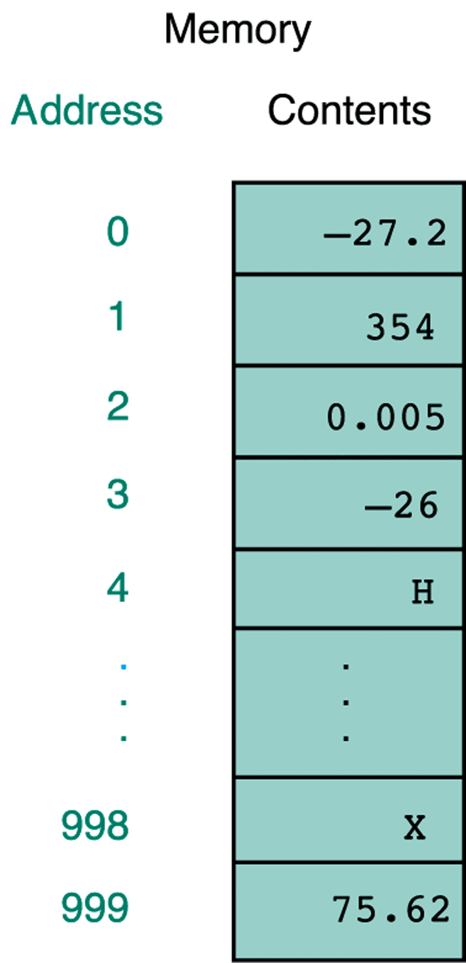
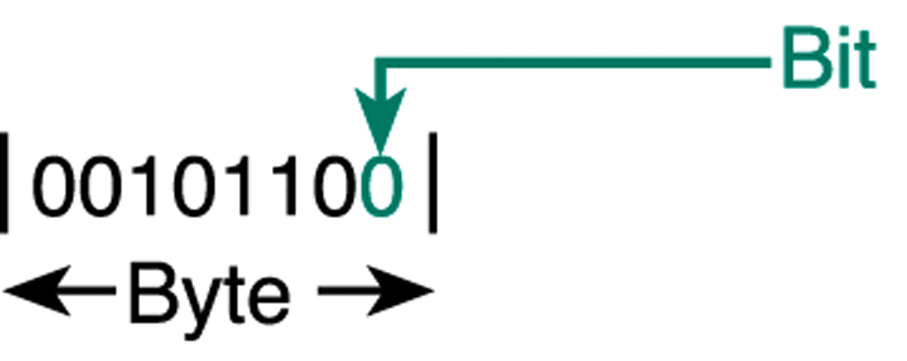
Addressable “Memory Box”
Each “address-able” box is ONE Byte
1 byte = 8 bits
1 bit is 0 or 1
Binary representation
2^64
2^32

Slide 14
Fat32
Addressability 2^32
Memory cell 1 byte
File size 2^32 * 1 byte
2^10 is 1K, 2^20 is 1M, 2^30 is 1G --- 4G
2^40 is tera 2^50 is peta, extfat, 2^64

Slide 15
addr[0] = 18. 0
addr[1] = b4. 0
addr[2] = 89. 0
addr[3] = 6d. 1
addr[4] = 1. 6d
addr[5] = 0. 89
addr[6] = 0. b4
addr[7] = 0. 18
the address of x is 0x00 00 00 01 6d 89 b4 18

Slide 16
“The story of X”
int X;
X, &X, *X,
((struct S *) X)->index,
((int *) X)[20],
*(((int *) X)+20),
((double *) X)[20],
((struct S *) 0)->index,…

Slide 17
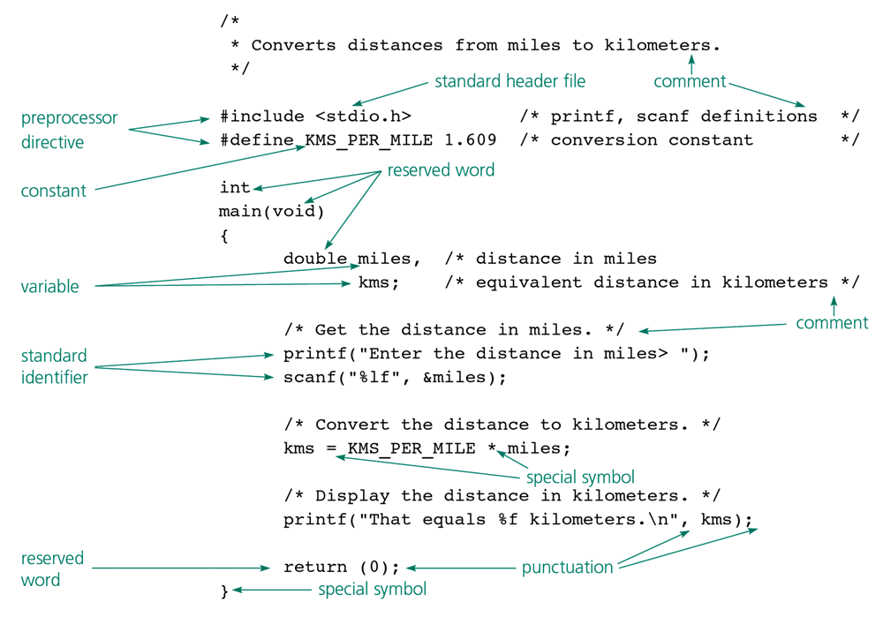

Slide 18
C program
The preprocessor part
Definitions: Macro and Variable
Define the memory/data
Variable name and its data type
Control Flow
Where should we start to execute? “main”
Reserved words
Function and blocks/scope of code

Slide 19
{ … }
{ … }
{… { … {…}…} … {…}…}
int main (void) { … }
float myfunc (int x) { …; return f;}
{ <declarations> <statements> }

Slide 20
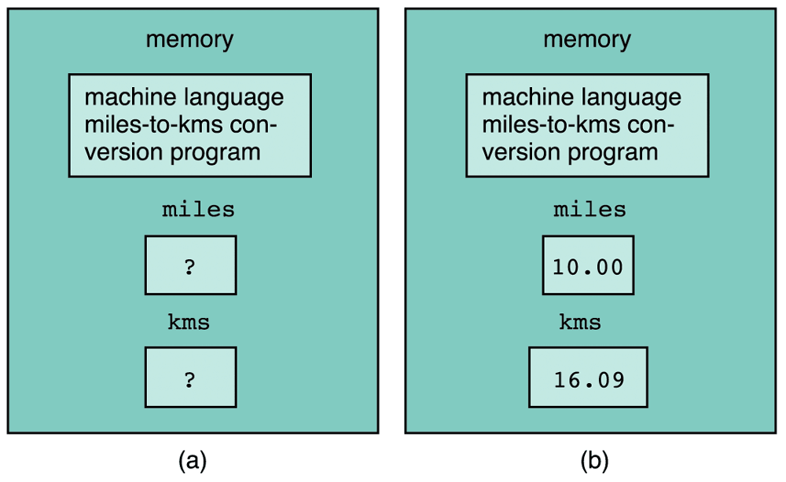
Memory Cell Concept Again

Slide 21
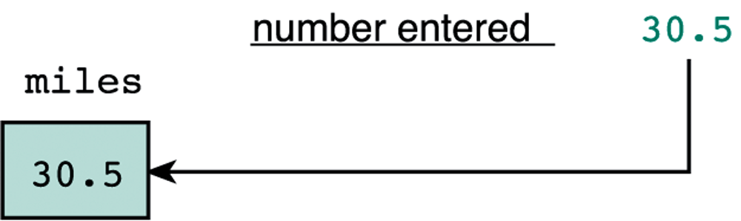

Slide 22
Byte versus Double
Each Memory cell is 1 Byte
How about Double?
How will Double map to your hardware memory?

Slide 23
Information Representation:
We need Memory to store both Programs/Data. But How?
bit: 0/1 physical memory. (BInary digiT)
byte: 8 bits
word: 32 bits
Numbers (Decimal/Binary/Hexadecimal):
How do we use bits to represent an integer.
0, 1, 2, 3, 4, 5, 6, 7, 8, 9 ===> Decimal
0, 1 ===> Binary
0, 1, 2, 3, 4, 5, 6, 7, 8, 9, a, b, c, d, e, f ===> Hexadecimal

Slide 24
Numbers:
Base: 10, 2, 16
Binary {0,1}
0,1,2,3,4,5,6,7,8,9, 10,11,
0,1,2…,10,11,12,…99,100,101,102,…
0,1,10 (2), 11(3), 100 (4), 101(5), 110(6),
4 2 1
2², 2¹, 2⁰
1 0 0
1 0 +
1 1 0

Slide 25
0+1 = 1 1 2⁰
1+1 = 10 2 2¹
10+1 = 11 3
11+1 = 100 4 2²
100+1 = 101 5
101+1 = 110 6
110+1 = 111 7
111+1 = 1000 8 2³
9 = 1+8
0001
1000
1001
001
010
100
111
001
100
101
5 = 1 + 4
7=1+2+4

Slide 26
Information Representation:
We need Memory to store both Programs/Data. But How?
bit: 0/1 physical memory. (BInary digiT)
byte: 8 bits
word: 32 bits
Numbers (Decimal/Binary/Hexadecimal):
How do we use bits to represent an integer.
0, 1, 2, 3, 4, 5, 6, 7, 8, 9 Decimal
0, 1 Binary
0, 1, 2, 3, 4, 5, 6, 7, 8, 9, a, b, c, d, e, f Hexadecimal

Slide 27
0 = 0000 = 0 * 8 + 0 * 4 + 0 * 2 + 0 * 1
1 = 0001 = 0 * 8 + 0 * 4 + 0 * 2 + 1 * 1
2 = 0010 = 0 * 8 + 0 * 4 + 1 * 2 + 0 * 1
3 = 0011 = 0 * 8 + 0 * 4 + 1 * 2 + 1 * 1
.......
7 = 0111 = 0 * 8 + 1 * 4 + 1 * 2 + 1 * 1
8 = 1000 = 1 * 8 + 0 * 4 + 0 * 2 + 0 * 1
9 = 1001 = 1 * 8 + 0 * 4 + 0 * 2 + 1 * 1
10 (a) = 1010 = 1 * 8 + 0 * 4 + 1 * 2 + 0 * 1
11 (b) = 1011 = 1 * 8 + 0 * 4 + 1 * 2 + 1 * 1
12 (c) = 1100 = 1 * 8 + 1 * 4 + 0 * 2 + 0 * 1
13 (d) = 1101 = 1 * 8 + 1 * 4 + 0 * 2 + 1 * 1
14 (e) = 1110 = 1 * 8 + 1 * 4 + 1 * 2 + 0 * 1
15 (f) = 1111 = 1 * 8 + 1 * 4 + 1 * 2 + 1 * 1
Examples:
09FE (in Hex) == ? (in Binary) == ? (in Decimal)

Slide 28
Arithmetic Operations in Binary/Bits?
+/- 0001 + 0001 = 0010
bit: 0/1 physical memory.
byte: 8 bits
in Unix, “usually” an integer has 4 bytes, i.e., 32 bits.
unsigned 0 ~ 4294967295 (i.e. 2 ³² -1)
signed -2147483648 ~ 2147483647 (i.e. -(2³¹) ~ (2³¹ - 1))

Slide 29
How do I represent a character? (Internal coding)
ASCII (American Standard Code for Information Interchange)
use 7 bit to represent a character
(might or might not on your keyboard)
Example: 'A' 1100001 (in Byte, 0110001) (Appendix A: page 839)
Decimal: 65, Hex: 41.
Question: How many different characters can we represent?

Slide 30
Binary Representation
Integer (int) 4 bytes
Double 8 bytes
Character 1 byte

Slide 31
/* an example program for the sizeof operator in C */
#include <stdio.h>
main()
{
printf("The size of an integer is %d.\n", sizeof(int));
printf("The size of a float is %d.\n", sizeof(float));
printf("The size of a double is %d.\n", sizeof(double));
printf("The size of a character is %d.\n", sizeof(char));
}
The size of an integer is 4.
The size of a float is 4.
The size of a double is 8.
The size of a character is 1.

Slide 32
printf("value = %d, address = %d\n",
cats, &cats);
===> value = 3, address = -268438156;
****
printf("value = %d, address = %x\n",
cats, &cats);
===> value = 3, address = effff574;
-268438156 (in decimal) == effff574 (in hex)
aa = -268438156;
aa = 0xeffff574;

Slide 33
0 = 0000 = 0 * 8 + 0 * 4 + 0 * 2 + 0 * 1
1 = 0001 = 0 * 8 + 0 * 4 + 0 * 2 + 1 * 1
2 = 0010 = 0 * 8 + 0 * 4 + 1 * 2 + 0 * 1
3 = 0011 = 0 * 8 + 0 * 4 + 1 * 2 + 1 * 1
.......
7 = 0111 = 0 * 8 + 1 * 4 + 1 * 2 + 1 * 1
8 = 1000 = 1 * 8 + 0 * 4 + 0 * 2 + 0 * 1
9 = 1001 = 1 * 8 + 0 * 4 + 0 * 2 + 1 * 1
10 (a) = 1010 = 1 * 8 + 0 * 4 + 1 * 2 + 0 * 1
11 (b) = 1011 = 1 * 8 + 0 * 4 + 1 * 2 + 1 * 1
12 (c) = 1100 = 1 * 8 + 1 * 4 + 0 * 2 + 0 * 1
13 (d) = 1101 = 1 * 8 + 1 * 4 + 0 * 2 + 1 * 1
14 (e) = 1110 = 1 * 8 + 1 * 4 + 1 * 2 + 0 * 1
15 (f) = 1111 = 1 * 8 + 1 * 4 + 1 * 2 + 1 * 1
Examples:
09FE (in Hex) == ? (in Binary) == ? (in Decimal)

Slide 34
“Memory Box”
Each “address-able” box is ONE Byte
1 byte = 8 bits
1 bit is 0 or 1
Binary representation

Slide 35
Review of last week
Addressable Memory Box
Memory Address
8 bytes (how to find out? Sizeof())
2^10 (K), 2^20 (M), 2^30 (G), 2^40 (T), 2^50 (P),
2^60 (E, Exabyte), 2^70 (Z, Zettabyte)
USB File system (FAT32 versus ExFAT)
Network byte order versus Host byte order
MSB (Most Significant Byte) LSB (Least Significant Byte)
Big Endian versus Little Endian
Chapter 7 of your textbook (just reference, not mandatory)

Slide 36
“Memory Box”
Decimal
“1”
Each “address-able” box is ONE Byte
1 byte = 8 bits
1 bit is 0 or 1
Binary representation

Slide 37
“Memory Box”
00000000
00000000
00000000
00000001
Each “address-able” box is ONE Byte
1 byte = 8 bits
1 bit is 0 or 1
Binary representation

Slide 38
“Memory Box”
00000001
00000000
00000000
00000000
Each “address-able” box is ONE Byte
1 byte = 8 bits
1 bit is 0 or 1
Binary representation

Slide 39
Host (vs. Network) Byte Order
There are two common host byte order methods:
Little-endian byte ordering places the least significant byte first. This method is used in Intel microprocessors, for example.
Big-endian byte ordering places the most significant byte first. This method is used in IBM® z/Architecture® and S/390® mainframes and Motorola microprocessors, for example.

Slide 40
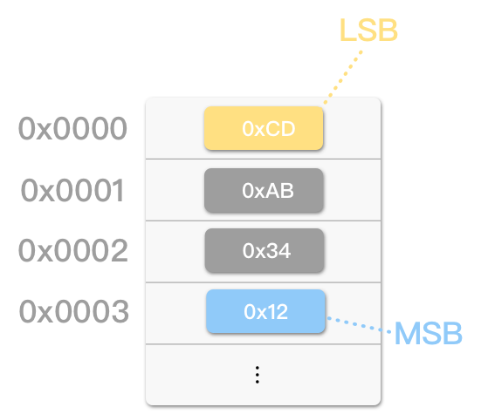
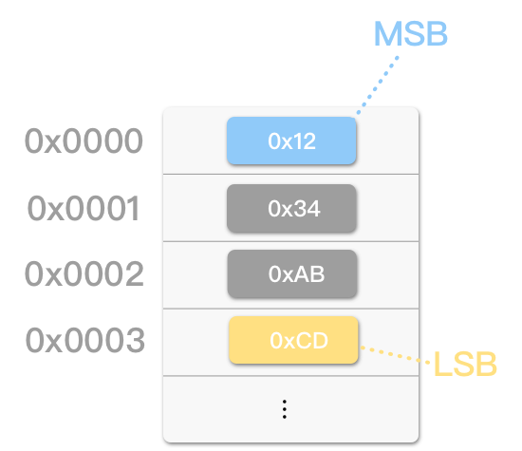
0x1234ABCD
0x12 34 AB CD
0x00000001
0x00 00 00 01
Little Endian
Big Endian
TCP、UDP、IPv4、IPv6

Slide 41
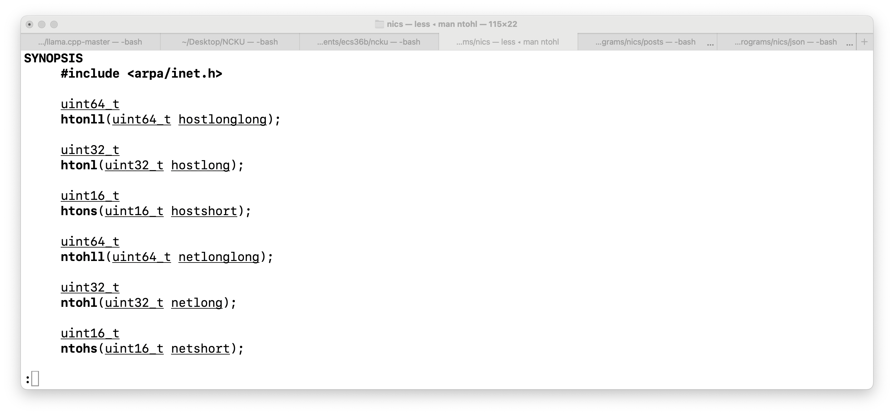

Slide 42
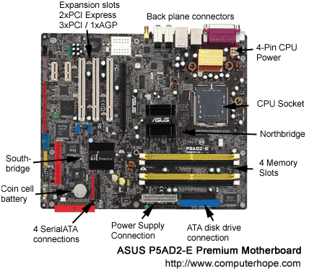
Do I need to know exactly where to store/save the variable?

Slide 43
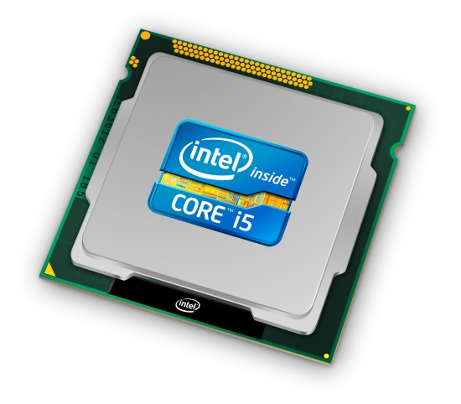
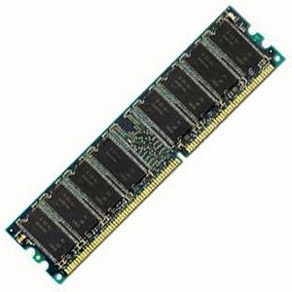
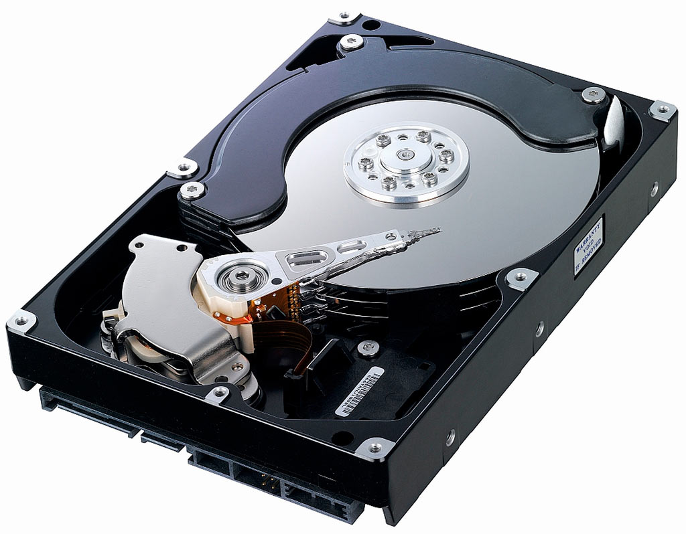
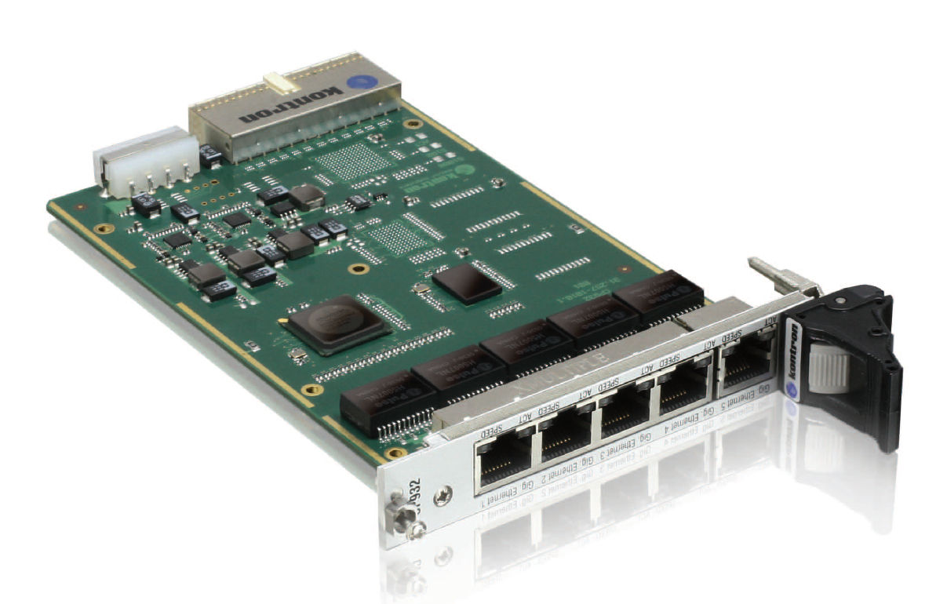
….where applications meet Hardware!!!
Applications……..
OS
Hardware: CPUs/Memory/HDs/DVD/Wireless/Internet…

Slide 44
….where applications meet Hardware!!!
Applications……..
OS
Hardware: CPU/Memory/HD/DVD/Wireless…
Multi-cores/Racks, Energy, Mobility, Social Informatics

Slide 45
virtualization
Unmodified Applications
Unmodified OS (XP, Linux, Solaris, or, FreeBSD)
Standard Full Virtualization
Hardware

Slide 46
FreeBSD Kernel: Services
Timer/clock, descriptor, process
Memory Management: paging/swapping
I/O control and terminal
File System
Inter-process communication
Networking

Slide 47
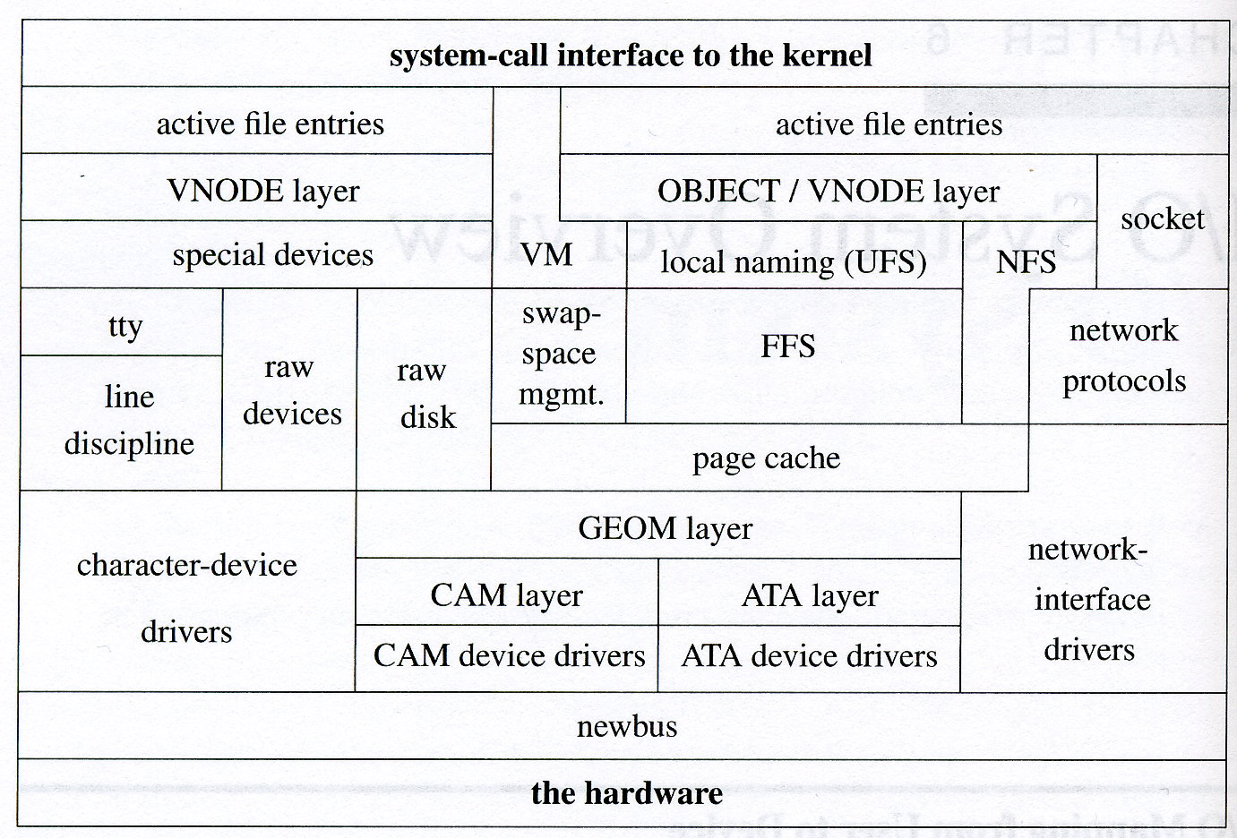

Slide 48
Kernel of SVR2 of AT&T Unix
User programs
Libraries
user
trap
System Call Interface
File subsys
Process
Control
Subsys.
Inter-Process
Communication
Buffer cache
kernel
Scheduler
Character block
device drivers
Memory
Management
Hardware Control
hardware

Slide 49
Kernel and User Space
Memory
space for this
process
Process FOO
program
System call
(or trap into the kernel)
conceptually
Process FOO
in the Kernel
System Call
Kernel Resources
(disk or IO devices)

Slide 50
Program vs process
Program
gcc int_size.c
A.out executable program
Process execution of a program w/ support from OS

Slide 51
Processes
> ps
PID TTY TIME CMD
2910 pts/4 0:00 tcsh
> ps -ef
UID PID PPID C STIME TTY TIME CMD
root 0 0 0 Sep 25 ? 0:01 sched
root 1 0 0 Sep 25 ? 0:00 /etc/init -
root 2 0 0 Sep 25 ? 0:00 pageout
root 3 0 0 Sep 25 ? 0:01 fsflush
root 223 1 0 Sep 25 ? 0:00 /usr/lib/utmpd
root 179 1 0 Sep 25 ? 0:00 /usr/sbin/cron
root 273 1 0 Sep 25 ? 0:00 /usr/lib/saf/sac -t 300
root 56 1 0 Sep 25 ? 0:00 /usr/lib/devfsadm/devfseventd
root 58 1 0 Sep 25 ? 0:00 /usr/lib/devfsadm/devfsadmd
root 106 1 0 Sep 25 ? 0:00 /usr/sbin/rpcbind
root 197 1 0 Sep 25 ? 0:01 /usr/sbin/nscd
root 108 1 0 Sep 25 ? 0:00 /usr/sbin/keyserv
root 168 1 0 Sep 25 ? 0:00 /usr/sbin/syslogd
root 118 1 0 Sep 25 ? 0:00 /usr/lib/netsvc/yp/ypbind
root 159 1 0 Sep 25 ? 0:00 /usr/lib/autofs/automountd

Slide 52
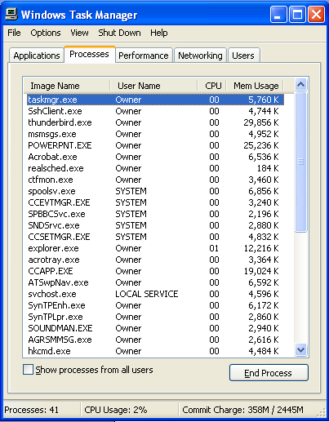

Slide 53
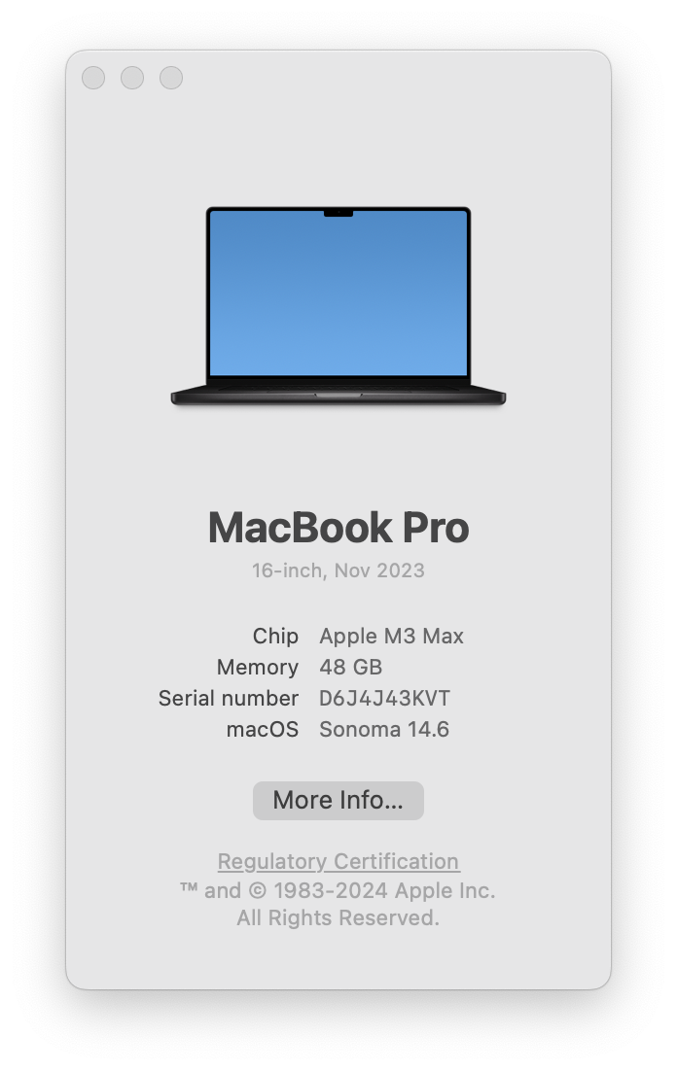
Virtual Memory
L1/L2/L3 Cache
Hardware
DRAM 48 GB Main Memory (48 * 2^30 byte)
OS
Operating System
Program Execution
VM 2^64 or 16 EB virtual memory for each process
Process ➔ an activated instance of a Program

Slide 54
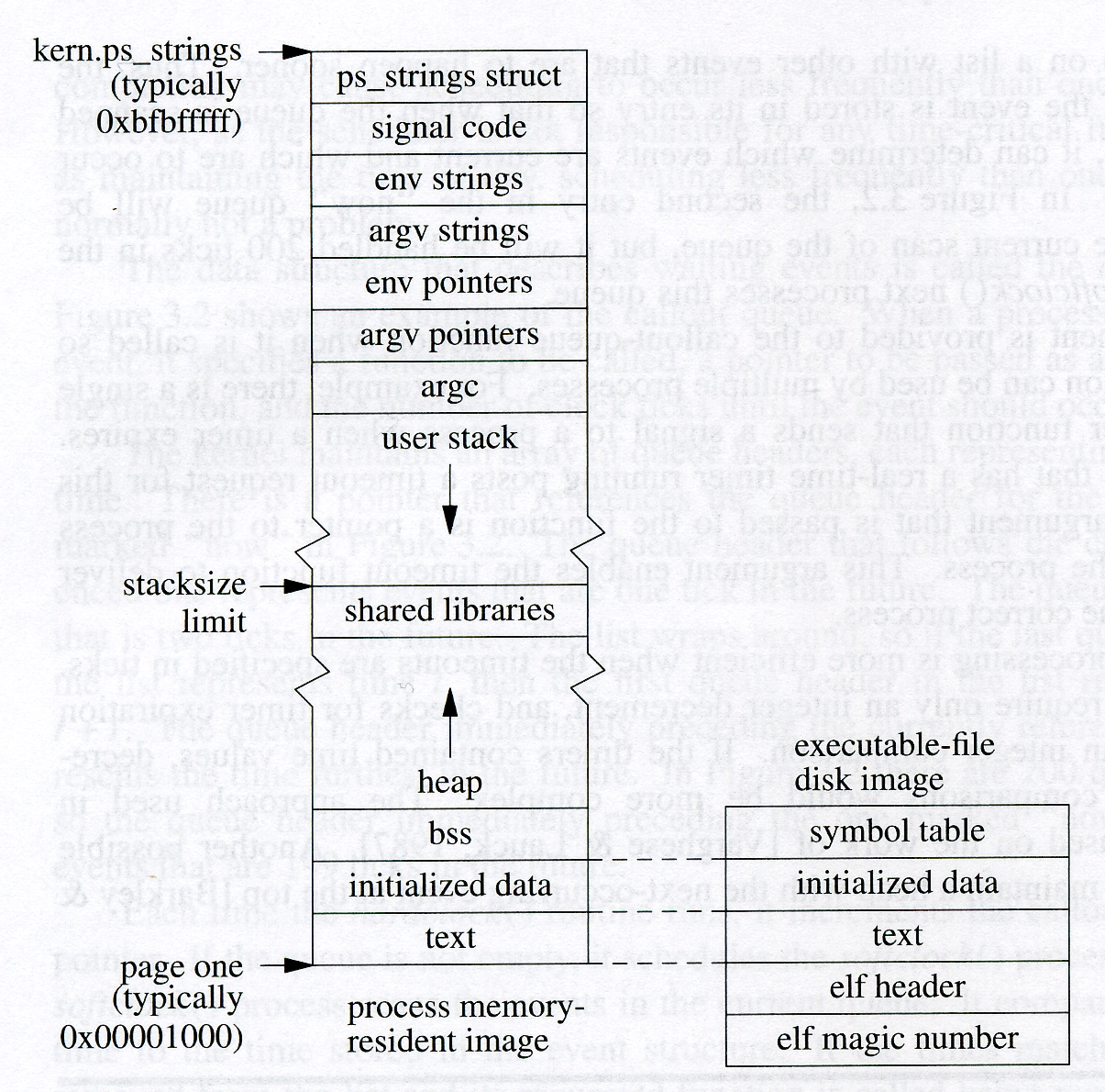

Slide 55
Data -- variables
main
main
main
main
foo
foo
foo
bar
bar
baz
Code/text – somewhere , but not on the stack
zx = 3 0x16b38b33c
ret_addr(0) = 0x104a77e48 [baz]
ret_addr(1) = 0x104a77ec0 [baz]
ret_addr(2) = 0x104a77f10 [baz]

Slide 57
A small program
int bar(int x)
{
…
}
void foo(float y)
{
…
i = bar(j);
…
}

Slide 58
Memory Structure
High
heap
Arguments
String Growth
Return address
library
Prev. frame pointer
stack
Local variables
Stack Pointer
Stack Growth
Low

Slide 59
Memory Structure
High
heap
foo
Arguments
String Growth
Return address
bar( )
{……}
foo( )
{ ……
call bar( );
……
}
bar
Prev. frame pointer
Local variables
Stack Pointer
Stack Growth
Low

Slide 60
Procedure Call ➔ on the same User Stack
Per-process
Kernel Stack
User-stack
Disk
Heap
Initialized data
Initialized data
text
text
Memory
a.out header
a.out magic number

Slide 61
System Call ➔ on a different stack
Per-process
Kernel Stack
User-stack
Disk
Heap
Initialized data
Initialized data
text
text
Memory
a.out header
a.out magic number

Slide 62
System Calls
Not a “normal” procedure call
It is a software trap “into” the kernel
Hardware interrupt
Hardware trap
Software trap

Slide 64
System Entry
Hardware interrupt
Asynchronous, might not relate to the context of the executing process
Hardware trap
Related to the current executing process, e.g., divided by zero
Software-initiated trap
Instructions, int

Slide 65
System Entry Vector
fork()
Trap
:
:

Slide 66
System Entry Vector
fork()
Trap
Reserved for
loadable system calls
:
:
XYZ()

Slide 67
“Address”
Linguistics in C/C++
Where is THIS really located on my device?
Then, we need a way to represent “address”!

Slide 68
scanf(“%lf”, &miles);
“Format String” -- I am going to take a Long Float # (double) from the stdin (Standard Input device)”

Slide 69
“Address”
32 bits or 64 bits address
01101001 10110001 11100000 10100111
0x69b1e0a7

Slide 70
scanf(“%lf”, &miles);
0x 7014ae00
0x 7014ae01
0x 7014ae02
0x 7014ae03
0x 7014ae04
0x 7014ae05
0x 7014ae06
0x 7014ae07
8 bytes
scanf(“%lf”, 0x7014ae00);

Slide 71
“Memory Box”
Each “address-able” box is ONE Byte
1 byte = 8 bits
1 bit is 0 or 1
Binary representation

Slide 72
Basic data types
/* an example program for the sizeof operator in C */
#include <stdio.h>
int
main(void)
{
printf("The size of an integer is %d.\n", sizeof(int));
printf("The size of a float is %d.\n", sizeof(float));
printf("The size of a double is %d.\n", sizeof(double));
printf("The size of a character is %d.\n", sizeof(char));
}
Output:
The size of an integer is 4.
The size of a float is 4.
The size of a double is 8.
The size of a character is 1.

Slide 73
“Memory Box”
00000000
00000000
00000000
00000001
00000000
12312345
01236712
12190562
Each “address-able” box is ONE Byte
1 byte = 8 bits
1 bit is 0 or 1
Binary representation

Slide 74
Memory Cell Layout
main
scan_address
scanf
malloc/free
new/delete
a.out

Slide 75
<type> * <variable name>;
I declare a variable xp such that xp is an address containing a type-T object.
int x; // declaration of an integer x
int * xp; // declaration of a pointer
xp = &x; // assign address to the pointer
&xp == 0x34ef5d00
34ef5f12
0x34ef5d00
xp
xp = &x;
&x == 0x34ef5f12
T(int) = 222
0x34ef5f12
x
x == 222
*xp == 222

Slide 76
int num3D[8][6][4];
struct chess_board piece[8][8];

Slide 77
Declare the array
<type> <array_name>[size]([]…[]);
Access the array
<array_name>[index] ([]…[])
Memory Cell models for the array
(low level implementation)
*(num+i) == num[i]
m[x][y] ~ *(m + x*columns + y)

Slide 78
0,0
0,1
0,2
0,3
char m[4][4];
1,0
1,1
1,2
1,3
void
printMatrix
(char m[][4])
{
m[2][1]
…
}
2,0
2,1
2,2
2,3
3,0
3,1
3,2
3,3
m == &(m[0][0])
“Cache miss”
m[x][y] ~ *((char *) m + x*columns + y)
0,0
0,1
0,2
0,3
1,0
1,1
1,2
1,3
2,0
2,1
2,2
2,3
3,0
3,1
3,2
3,3
How many rows I should skip?

Slide 79
0,0
0,1
0,2
0,3
char m[4][4];
1,0
1,1
1,2
1,3
void
printMatrix
(char m[][4])
{
m[2][1]
…
}
2,0
2,1
2,2
2,3
3,0
3,1
3,2
3,3
m == &(m[0][0])
&(m[x][y]) ~ ((char *) m + x*columns + y)
0,0
0,1
0,2
0,3
1,0
1,1
1,2
1,3
2,0
2,1
2,2
2,3
3,0
3,1
3,2
3,3
How many rows I should skip?

Slide 80
m[x][y] ~ *((char *) m + x*columns + y)
((int) m) + ((x*columns) + y) * sizeof(char)
m[x][y] ~ *((int *) m + x*columns + y)
((int) m) + ((x*columns) + y) * sizeof(int)

Slide 81
#define MSize 2048
void copyij(long int src[MSize][MSize],
long int dst[MSize][MSize])
{
long int i,j;
for (i = 0; i < MSize; i++)
for (j = 0; j < MSize; j++)
dst[i][j] = src[i][j];
}
void copyji(long int src[MSize][MSize],
long int dst[MSize][MSize])
{
long int i,j;
for (j = 0; j < MSize; j++)
for (i = 0; i < MSize; i++)
dst[i][j] = src[i][j];
}
0,0
0,1
0,2
0,3
1,0
1,1
1,2
1,3
2,0
2,1
2,2
2,3
3,0
3,1
3,2
3,3
m == &(m[0][0])
0,0
0,1
0,2
0,3
1,0
1,1
1,2
1,3
2,0
2,1
2,2
2,3
3,0
3,1
3,2
3,3

Slide 82
Memory Cell Model
With different data types
Address &x
Pointer xp
Array x_array[]

Slide 83
malloc & free
malloc:
Input: the size of the memory cells
return: the address of the first memory cell
#include <stdlib.h>
void *xp;
xp = malloc(sizeof(planet_t));

Slide 84
malloc & free
** Chapter 6: C++ smart pointers **
malloc:
Input: the size of the memory cells
return: the address of the first memory cell
#include <stdlib.h>
void *xp;
xp = malloc(sizeof(planet_t));

Slide 85
#define STRSIZ 10
typedef struct {
char name[STRSIZ]; // 10
double diameter; // 8
int moons; // 4
double orbit_time, // 8
rotation_time; // 8
} planet_t; // 38 ➔ 40

Slide 86
#define STRSIZ 10
typedef struct {
char name[STRSIZ]; // 10
double diameter; // 8
int moons; // 4
double orbit_time, // 8
rotation_time; // 8
} planet_t; // 38 ➔ 40
planet_t *ptp;
ptp = (planet_t *) malloc(sizeof(planet_t));

Slide 87
I386 architecture
typedef struct {
char name[10];
double diameter;
int moons;
double orbit_time,
rotation_time;
} planet_t;

Slide 88
Memory Layout in C/C++
Single Inheritance ⬅
Multiple Inheritance
Virtual Inheritance
class Planet
{
public:
Planet() {}
std::string name;
double diameter;
int moons;
double orbit_time;
double rotation_time;
};
http://www.vishalchovatiya.com/memory-layout-of-cpp-object/

Slide 90
Module/Function
<Return DATA TYPE>
<Function_Name>
(<input parameter declaration>)
{…, return 0;}

Slide 92
scanf(“%lf”, &miles);

Slide 93
scanf(“%lf”, &miles);
“Format String” -- I am going to take a Long Float # (double) from the stdin (Standard Input device)”

Slide 94
scanf(“%lf”, &miles);
0x 7014ae00
0x 7014ae01
0x 7014ae02
0x 7014ae03
0x 7014ae04
0x 7014ae05
0x 7014ae06
0x 7014ae07
8 bytes

Slide 95
scanf(“%lf”, &miles);
0x 7014ae00
0x 7014ae01
0x 7014ae02
0x 7014ae03
0x 7014ae04
0x 7014ae05
0x 7014ae06
0x 7014ae07
8 bytes
scanf(“%lf”, 0x7014ae00);

Slide 96
printf(“%lf\n”, &miles);
printf(“%lf\n”, miles);
printf(“%lf\n”, 0x7014ae00);
printf(“%lf\n”, 30.5);
8 bytes
0x 7014ae00
0x 7014ae01
0x 7014ae02
0x 7014ae03
0x 7014ae04
0x 7014ae05
0x 7014ae06
0x 7014ae07

Slide 97
printf(“%lf\n”, &miles);
printf(“%lf\n”, miles);
printf(“%lf\n”, 0x7014ae00);
printf(“%lf\n”, 30.5);
0.0000
30.5
0.0000
30.5
8 bytes
0x 7014ae00
0x 7014ae01
0x 7014ae02
0x 7014ae03
0x 7014ae04
0x 7014ae05
0x 7014ae06
0x 7014ae07

Slide 98
printf(“%lf\n”, &miles);
printf(“%lf\n”, miles);
printf(“%lf\n”, 0x7014ae00);
printf(“%lf\n”, 30.5);
printf(“%lf\n”, *(&miles));
printf(“%lf\n”,
*((double *) 0x7014ae00);
8 bytes
0x 7014ae00
0x 7014ae01
0x 7014ae02
0x 7014ae03
0x 7014ae04
0x 7014ae05
0x 7014ae06
0x 7014ae07
C gives you many options to access and control your memory!

Slide 99
Data type
Basic types:
char, int, float, double,…
Pointer/Address types:
Pretty much pointing at anything…
All 32/64 bits
(int *), (char *), (void *), (struct XYZ *),…

Slide 100
printf(“%lf\n”, &miles);
printf(“%lf\n”, miles);
printf(“%lf\n”, 0x7014ae00);
printf(“%lf\n”, 30.5);
printf(“%lf\n”, *(&miles));
printf(“%lf\n”,
*((double *) 0x7014ae00);
8 bytes
In C, Pointer = Address + Type!
And, Address is merely a 32 bit unsigned integer!
0x 7014ae00
0x 7014ae01
0x 7014ae02
0x 7014ae03
0x 7014ae04
0x 7014ae05
0x 7014ae06
0x 7014ae07

Slide 101
Pointer ~ Address
You can pretty much point to anything in the memory (via address), even include “pointing to the functions”.

Slide 102
#include <stdio.h>
int
main
(void)
{
int x;
double y = 99.9;
unsigned char *p = (unsigned char *) &y;
x = y;
printf("%lf\n", y);
printf("%lf\n", *(&y));
printf("%d\n", x);
printf("%d\n", y);
printf("%d\n", *((int *) (&y)));
printf("%lf\n", *((double *) (&y)));
printf("[%x] %x %x %x %x\n",
p, *p, *(p+1), *(p+2), *(p+3));
printf(“%x\n”, ((char *) p) + 1);
printf(“%x\n”, ((int *) p) + 1);
}

Slide 104
printf("value = %d, address = %d\n",
cats, &cats);
===> value = 3, address = -268438156;
****
printf("value = %d, address = %x\n",
cats, &cats);
===> value = 3, address = effff574;
-268438156 (in decimal) == effff574 (in hex)
aa = -268438156;
aa = 0xeffff574;

Slide 105
Compare?
kms
&kms
*kms
*(&kms)
*(((char *) &kms) + 1)
*(((int *) &kms) + 1)

