Slide 1
EE 1520 計算機概論二 （一一三學年下學期） Introduction to Computer Science (II) Slide Set 02
S. Felix Wu
sfelixwu@gs.ncku.edu.tw
https://github.com/sfelixwu/ee1520
https://www.youtube.com/@sfelixwu
https://discord.gg/PrJKQsKT

Slide 2
Syllabus
Unix/Linux tools and basic OS concepts
Object-oriented Programming in C++
g++, instead of Visual C++
GPU Programming
Final Projects

Slide 3
Unix
First, I like to introduce the content of EE-1520 under the context of Unix/Linux and GNU tools (such as g++ and gdb), instead of Visual C++. As you might have known, C/C++ was developed together with the Unix operating systems in the 70’s, and, it is more precise to introduce this programming language under the context of the Unix process memory layout. Therefore, I plan to introduce just enough Unix-related knowledge and usage at the very beginning of this semester (see below detailed schedule).

Slide 4
Review of 1st week
Addressable Memory Box
Memory Address
8 bytes (how to find out? Sizeof())
2^10 (K), 2^20 (M), 2^30 (G), 2^40 (T), 2^50 (P),
2^60 (E, Exabyte), 2^70 (Z, Zettabyte)
USB File system (FAT32 versus ExFAT)
Network byte order versus Host byte order
MSB (Most Significant Byte) LSB (Least Significant Byte)
Big Endian versus Little Endian
Chapter 7 of your textbook (just reference, not mandatory)

Slide 5
Review of 2nd week
OS ➔ Hardware/Devices, OS Kernel, Application processes
Program versus Process
Per-Process Virtual Memory Space (32 versus 64 bits address)
Power of C ➔ we can always write a C/C++ program to validate OS internal concepts and information!!
Memory allocation/layout ➔ stack_01.c, heap_01.c
Question: when will a specific region of memory be overwritten or freed?
Contrast: garbage collection in Java and Python

Slide 6
Kernel and User Space
Memory
space for this
process
Process FOO
program
System call
(or trap into the kernel)
conceptually
Process FOO
in the Kernel
System Call
Kernel Resources
(disk or IO devices)

Slide 7
Program vs process
Program
gcc int_size.c
a.out executable program
Process execution of a program w/ support from OS

Slide 8
Processes
> ps
PID TTY TIME CMD
2910 pts/4 0:00 tcsh
> ps -ef
UID PID PPID C STIME TTY TIME CMD
root 0 0 0 Sep 25 ? 0:01 sched
root 1 0 0 Sep 25 ? 0:00 /etc/init -
root 2 0 0 Sep 25 ? 0:00 pageout
root 3 0 0 Sep 25 ? 0:01 fsflush
root 223 1 0 Sep 25 ? 0:00 /usr/lib/utmpd
root 179 1 0 Sep 25 ? 0:00 /usr/sbin/cron
root 273 1 0 Sep 25 ? 0:00 /usr/lib/saf/sac -t 300
root 56 1 0 Sep 25 ? 0:00 /usr/lib/devfsadm/devfseventd
root 58 1 0 Sep 25 ? 0:00 /usr/lib/devfsadm/devfsadmd
root 106 1 0 Sep 25 ? 0:00 /usr/sbin/rpcbind
root 197 1 0 Sep 25 ? 0:01 /usr/sbin/nscd
root 108 1 0 Sep 25 ? 0:00 /usr/sbin/keyserv
root 168 1 0 Sep 25 ? 0:00 /usr/sbin/syslogd
root 118 1 0 Sep 25 ? 0:00 /usr/lib/netsvc/yp/ypbind
root 159 1 0 Sep 25 ? 0:00 /usr/lib/autofs/automountd

Slide 9
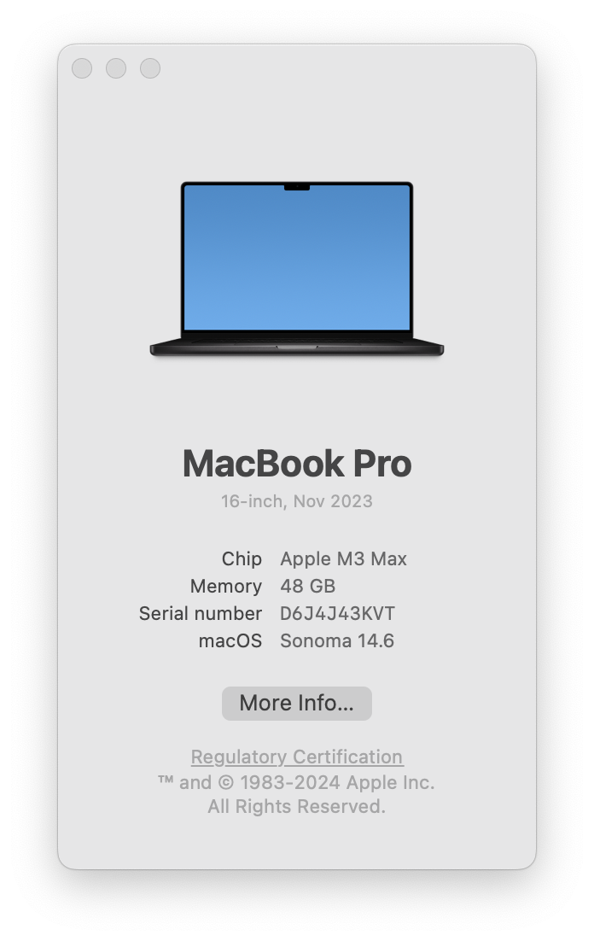
Virtual Memory
L1/L2/L3 Cache
Hardware
DRAM 48 GB Main Memory (48 * 2^30 byte)
OS
Operating System
Program Execution
VM 2^64 or 16 EB virtual memory for each process
Process ➔ an activated instance of a Program

Slide 10
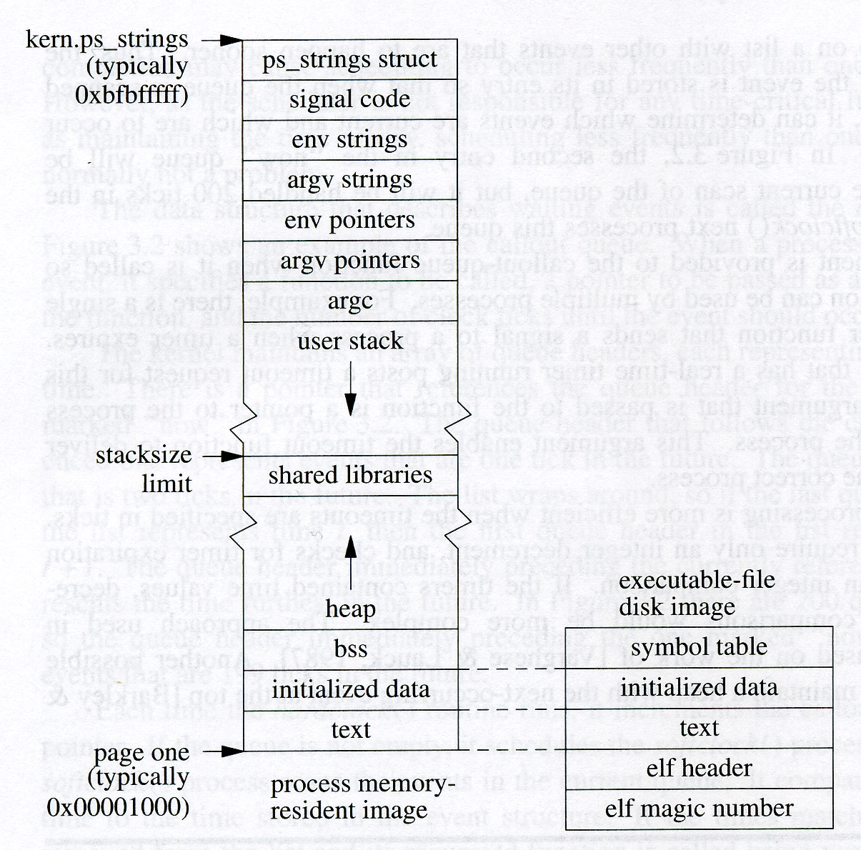

Slide 11
Data -- variables
main
main
main
main
foo
foo
foo
bar
bar
baz
Code/text – somewhere , but not on the stack
zx = 3 0x16b38b33c
ret_addr(0) = 0x104a77e48 [baz]
ret_addr(1) = 0x104a77ec0 [baz]
ret_addr(2) = 0x104a77f10 [baz]

Slide 13
Memory Cell Layout
main
scan_address
scanf
malloc/free
new/delete
a.out

Slide 14
A small program
int bar(int x)
{
…
}
void foo(float y)
{
…
i = bar(j);
…
}

Slide 15
Memory Structure
High
heap
Arguments
String Growth
Return address
library
Prev. frame pointer
stack
Local variables
Stack Pointer
Stack Growth
Low

Slide 16
Memory Structure
High
heap
foo
Arguments
String Growth
Return address
bar( )
{……}
foo( )
{ ……
call bar( );
……
}
bar
Prev. frame pointer
Local variables
Stack Pointer
Stack Growth
Low

Slide 17
Procedure Call ➔ on the same User Stack
Per-process
Kernel Stack
User-stack
Disk
Heap
Initialized data
Initialized data
text
text
Memory
a.out header
a.out magic number

Slide 18
System Call ➔ on a different stack
Per-process
Kernel Stack
User-stack
Disk
Heap
Initialized data
Initialized data
text
text
Memory
a.out header
a.out magic number

Slide 19
System Calls
Not a “normal” procedure call
It is a software trap “into” the kernel
Hardware interrupt
Hardware trap
Software trap

Slide 20
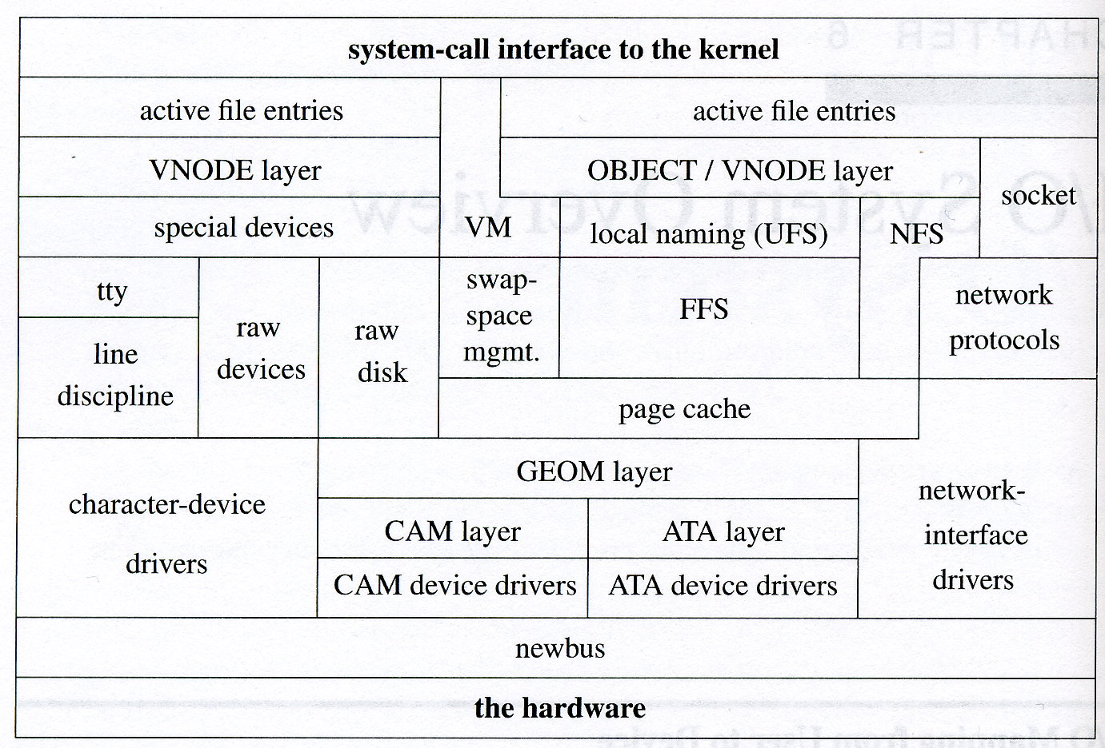

Slide 21
System Entry
Hardware interrupt
Asynchronous, might not relate to the context of the executing process
Hardware trap
Related to the current executing process, e.g., divided by zero
Software-initiated trap
Instructions, int

Slide 22
System Entry Vector
fork()
Trap
:
:

Slide 23
System Entry Vector
fork()
Trap
Reserved for
loadable system calls
:
:
XYZ()

Slide 24
Separate Compilation and Makefile

Slide 25
Preprocessing, Compiling, Linking
From a C/C++ program to an excutable program
gcc –E stack_01.c Pre-processing
gcc –c stack_01.c Compiling
gcc stack_01.c Compiling + Linking
gcc stack_01.o –o stack_01 Linking

Slide 26
Separate Compilation
stack_01.c
stack_01.o
a.out
stack_main.c stack_foo.c stack_bar.c stack_baz.c stack_address.c
stack_main.o stack_foo.o stack_bar.o stack_baz.o stack_address.o
stack_executable
What is (are) the benefit(s)?

Slide 27
make & Makefile
a software development tool
Makefile
Configuration/specification of an automated software build process
Rules
What is a rule? (And, rule-based programming)
How to “trigger” a rule and a chain of rules?

Slide 28
rule
target, dependency, action
(triggered if any of the dep list is newer than the target)
target:<tab>dependency<ret>
<tab>action
stack_executable: stack_main.o stack_foo.o stack_bar.o stack_baz.o stack_address.o
gcc stack_main.o stack_foo.o stack_bar.o stack_baz.o stack_address.o –o stack_executable
stack_main.o: stack_main.c stack_01.h
gcc –c stack_main.c

Slide 29
ls -l
-rw-r--r-- 1 sfwu staff 1432 Feb 27 12:05 stack_01.c
-rw-r--r-- 1 sfwu staff 143 Mar 6 04:44 stack_01.h
-rw-r--r-- 1 sfwu staff 752 Mar 6 04:53 stack_address.c
-rw-r--r-- 1 sfwu staff 2864 Mar 6 05:21 stack_address.o
-rw-r--r-- 1 sfwu staff 198 Mar 6 04:39 stack_bar.c
-rw-r--r-- 1 sfwu staff 2488 Mar 6 05:21 stack_bar.o
-rw-r--r-- 1 sfwu staff 230 Mar 6 04:54 stack_baz.c
-rw-r--r-- 1 sfwu staff 2472 Mar 6 05:21 stack_baz.o
-rwxr-xr-x 1 sfwu staff 34704 Mar 6 05:21 stack_executable
-rw-r--r-- 1 sfwu staff 155 Mar 6 04:38 stack_foo.c
-rw-r--r-- 1 sfwu staff 2456 Mar 6 05:21 stack_foo.o
-rw-r--r-- 1 sfwu staff 105 Mar 6 04:33 stack_main.c
-rw-r--r-- 1 sfwu staff 2272 Mar 6 05:21 stack_main.o

Slide 30
ls -l
Do we need to do anything to build stack_executable?
-rw-r--r-- 1 sfwu staff 1432 Feb 27 12:05 stack_01.c
-rw-r--r-- 1 sfwu staff 143 Mar 6 04:44 stack_01.h
-rw-r--r-- 1 sfwu staff 752 Mar 6 04:53 stack_address.c
-rw-r--r-- 1 sfwu staff 2864 Mar 6 05:21 stack_address.o
-rw-r--r-- 1 sfwu staff 198 Mar 6 04:39 stack_bar.c
-rw-r--r-- 1 sfwu staff 2488 Mar 6 05:21 stack_bar.o
-rw-r--r-- 1 sfwu staff 230 Mar 6 04:54 stack_baz.c
-rw-r--r-- 1 sfwu staff 2472 Mar 6 05:21 stack_baz.o
-rwxr-xr-x 1 sfwu staff 34704 Mar 6 05:24 stack_executable (even newer)
-rw-r--r-- 1 sfwu staff 155 Mar 6 04:38 stack_foo.c
-rw-r--r-- 1 sfwu staff 2456 Mar 6 05:21 stack_foo.o
-rw-r--r-- 1 sfwu staff 105 Mar 6 04:33 stack_main.c (older)
-rw-r--r-- 1 sfwu staff 2272 Mar 6 05:21 stack_main.o (newer)
Nothing to be done

Slide 31
ls -l
Do we need to do anything to build stack_executable?
-rw-r--r-- 1 sfwu staff 1432 Feb 27 12:05 stack_01.c
-rw-r--r-- 1 sfwu staff 143 Mar 6 04:44 stack_01.h
-rw-r--r-- 1 sfwu staff 752 Mar 6 04:53 stack_address.c
-rw-r--r-- 1 sfwu staff 2864 Mar 6 05:21 stack_address.o
-rw-r--r-- 1 sfwu staff 198 Mar 6 04:39 stack_bar.c
-rw-r--r-- 1 sfwu staff 2488 Mar 6 05:21 stack_bar.o
-rw-r--r-- 1 sfwu staff 230 Mar 6 04:54 stack_baz.c
-rw-r--r-- 1 sfwu staff 2472 Mar 6 05:21 stack_baz.o
-rwxr-xr-x 1 sfwu staff 34704 Mar 6 05:24 stack_executable
-rw-r--r-- 1 sfwu staff 155 Mar 6 04:38 stack_foo.c
-rw-r--r-- 1 sfwu staff 2456 Mar 6 05:21 stack_foo.o
-rw-r--r-- 1 sfwu staff 105 Mar 6 05:27 stack_main.c
-rw-r--r-- 1 sfwu staff 2272 Mar 6 05:28 stack_main.o
Trigger stack_executable rule

Slide 32
ls -l
Do we need to do anything to build stack_executable?
-rw-r--r-- 1 sfwu staff 1432 Feb 27 12:05 stack_01.c
-rw-r--r-- 1 sfwu staff 143 Mar 6 04:44 stack_01.h
-rw-r--r-- 1 sfwu staff 752 Mar 6 04:53 stack_address.c
-rw-r--r-- 1 sfwu staff 2864 Mar 6 05:21 stack_address.o
-rw-r--r-- 1 sfwu staff 198 Mar 6 04:39 stack_bar.c
-rw-r--r-- 1 sfwu staff 2488 Mar 6 05:21 stack_bar.o
-rw-r--r-- 1 sfwu staff 230 Mar 6 04:54 stack_baz.c
-rw-r--r-- 1 sfwu staff 2472 Mar 6 05:21 stack_baz.o
-rwxr-xr-x 1 sfwu staff 34704 Mar 6 05:24 stack_executable
-rw-r--r-- 1 sfwu staff 155 Mar 6 04:38 stack_foo.c
-rw-r--r-- 1 sfwu staff 2456 Mar 6 05:21 stack_foo.o
-rw-r--r-- 1 sfwu staff 105 Mar 6 05:27 stack_main.c
-rw-r--r-- 1 sfwu staff 2272 Mar 6 05:23 stack_main.o
Trigger stack_main.o rule
Trigger stack_executable rule

Slide 33
rule
If any of the dependency is NEWER than the target, then we need to trigger the corresponding rule(s).
And, recursively apply this check to each dependency until the dependency reaches no other rules (the dependency is a non-target)!
target, dependency, action
target:<tab>dependency<ret>
<tab>action
stack_executable: stack_main.o stack_foo.o stack_bar.o stack_baz.o stack_address.o
gcc stack_main.o stack_foo.o stack_bar.o stack_baz.o stack_address.o –o stack_executable
stack_main.o: stack_main.c stack_01.h
gcc –c stack_main.c

