Slide 1


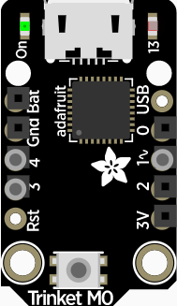


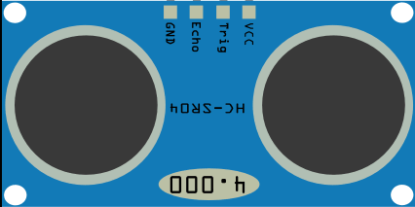

Vibration motor
Active buzzer
Ultrasonic Distance Sensor
Adafruit Trinket M0

