Slide 1


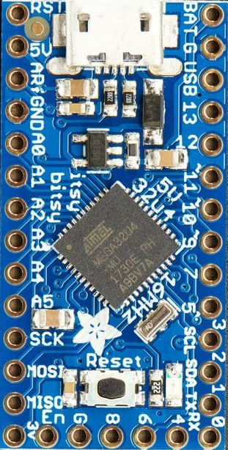


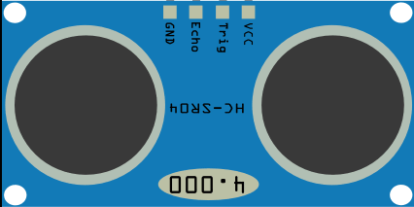







Vibration motor
Active buzzer
Ultrasonic Distance Sensor
Adafruit ItsyBitsy 32u4 5v

