Slide 1

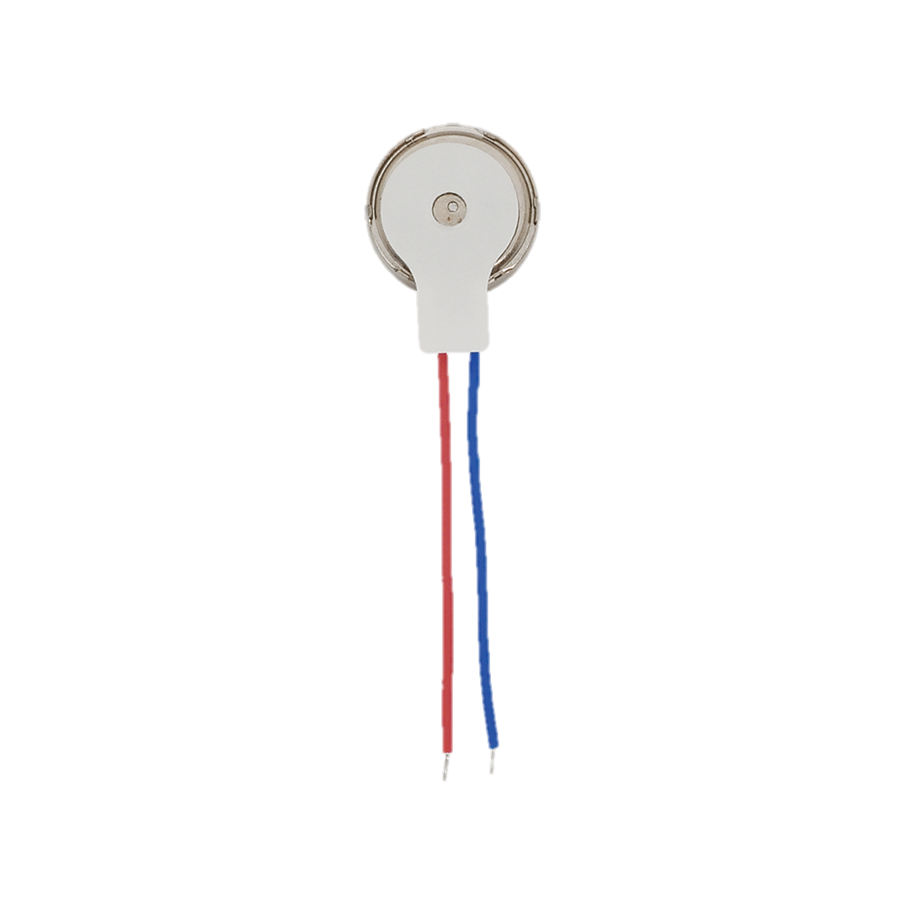
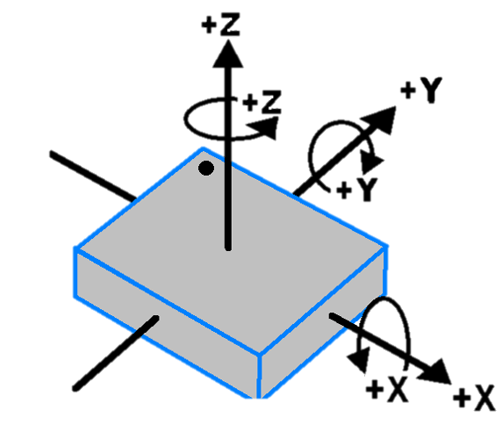
GUI Host
Serial Connection
ArdNet Connection
Gamepad
Wearable

