Slide 1
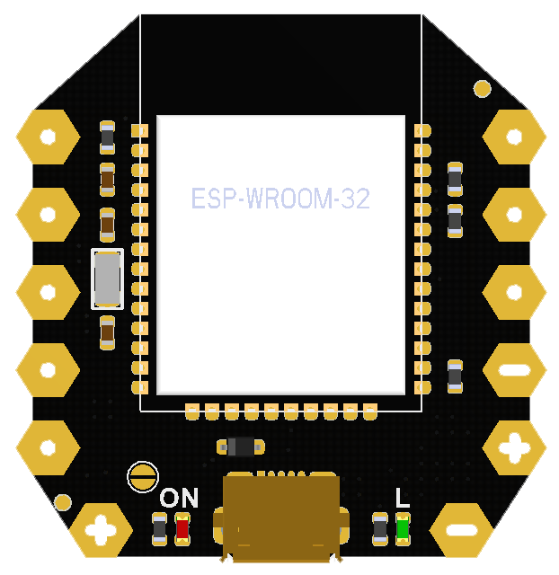
LED: GPIO 2
Input Only
GPIO 35
GPIO 34
Input Only
DAC 1
GPIO 25
GPIO 39
Input Only
DAC 2
GPIO 26
GPIO 36
Input Only
Touch 7
GPIO 27
Touch 4
GPIO 13

Slide 2
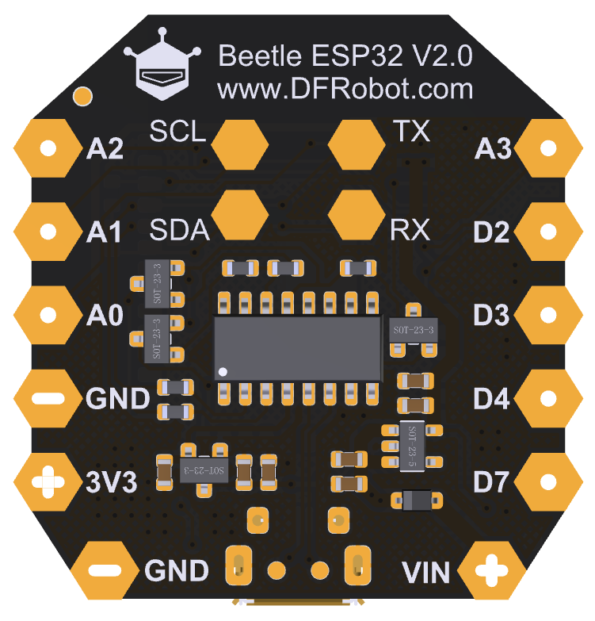
Input Only
GPIO 34
GPIO 35
Input Only
Input Only
GPIO 39
GPIO 25
DAC 1
Input Only
GPIO 36
GPIO 26
DAC 2
GPIO 27
Touch 7
GPIO 13
Touch 4

