Slide 1




Introduction to various online tools for forms,documents,storage etc.

Slide 2
Prepared by:
Patel Dev Pragneshbhai
24002170110139
Antala Tirth Arvindbhai
24002170110009
Mungalpara Yashbhai Pareshbhai
24002170110095
Jain Suhani Pankajkumar
24002170110062
Limbasiya Ayushkumar Champakbhai
24002170110083

Slide 3
Index:
1.Online Tools for Forms & Surveys
a) Google Forms
b) Microsoft Forms
2.Online Tools for Documents & Collaboration
a) Google Docs
b) Notion
3.Online Tools for Cloud Storage
a) Google Drive
b) iCloud Drive

Slide 4
Introduction:
In today’s digital world, online tools help individuals and businesses work efficiently.
They enable collaboration, automation, and accessibility from anywhere.
This presentation explores tools for creating forms, managing documents, and cloud storage solutions

Slide 5
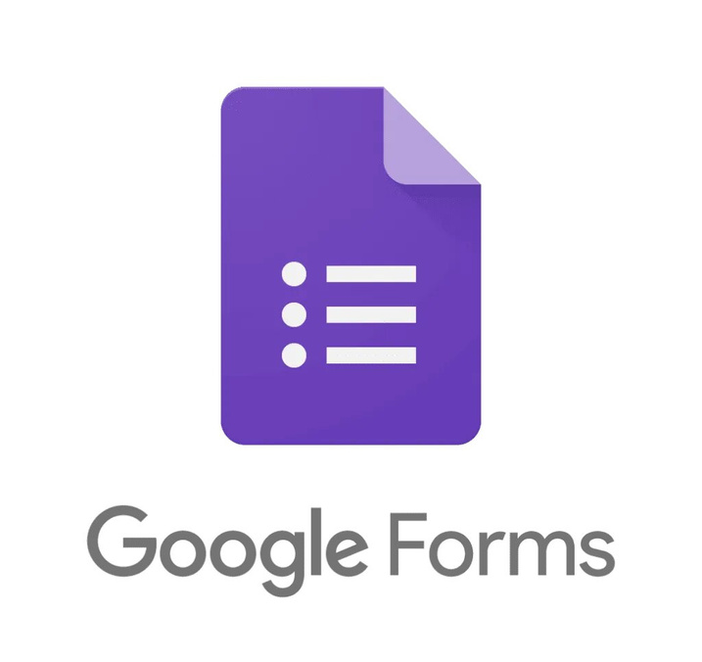
1. Online Tools for Forms & Surveys
a) Google Forms
Google Forms is a free, user-friendly tool for creating surveys, quizzes, and forms with multiple question types like MCQs, checkboxes, and dropdowns.
It supports real-time collaboration, auto-grading, and response analysis via Google Sheets.
Features like conditional logic, file uploads, and Google Workspace integration enhance usability.
Forms can be shared via links, emails, or embedded on websites, and responses are automatically saved in Google Drive.

Slide 6

1. Online Tools for Forms & Surveys
b) Microsoft Forms
Microsoft Forms is a cloud-based tool within the Microsoft 365 suite, designed for creating surveys, quizzes, and polls with an intuitive interface.
It offers multiple question types, automatic grading for quizzes, and AI-powered insights for data analysis.
Responses are stored in real-time and can be exported to Excel for advanced processing.
Seamlessly integrating with Microsoft Teams, OneDrive, and SharePoint, it enhances collaboration in education, businesses, and organizations.

Slide 7
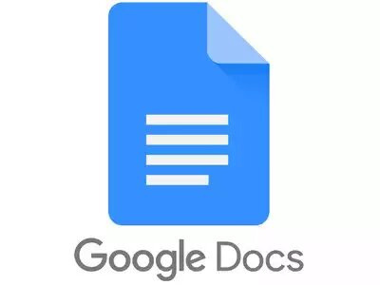
2. Online Tools for Documents & Collaboration
a) Google Docs
Google Docs is an online word processor developed by Google that allows users to create, edit, and share documents in real-time.
It is a part of Google Drive and works on web browsers, making it accessible from any device with an internet connection.
It also supports collaboration, where multiple people can edit a document at the same time and leave comments.
Users can format text, insert images, create tables, and use various templates to make documents look professional.

Slide 8

2. Online Tools for Documents & Collaboration
b) Notion
Notion is an all-in-one productivity tool for organizing notes, tasks, and projects.
It combines note-taking, databases, and collaboration features, allowing users to create, customize, and share content in real-time.
It is available on web, desktop, and mobile, it syncs across devices for seamless use.
It supports real-time collaboration, where multiple people can edit and comment on the same document.

Slide 9
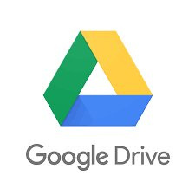
3. Online Tools for Cloud Storage
a) Google Drive
Google Drive is a cloud-based storage service by Google that allows users to store, access, and share files securely from any device.
It supports a wide range of file types, including documents, images, videos, and PDFs, with automatic syncing across devices.
Google Drive offers free storage with additional space available through paid plans.
It is widely used for personal storage, business collaboration, and backup solutions.

Slide 10
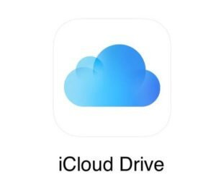
3. Online Tools for Cloud Storage
b) iCloud Drive
iCloud Drive is Apple’s cloud storage service that allows users to store, access, and share files across all Apple devices.
It syncs documents, photos, and app data automatically, ensuring seamless access on iPhone, iPad, Mac, and even Windows.
Users can organize files into folders and share them with others while maintaining control over permissions.
It is widely used for backing up files, syncing data, and accessing documents from anywhere.

Slide 11
Real time uses:
1. Google Forms: During the COVID-19 pandemic, government agencies and healthcare organizations used Google Forms to collect real-time data on symptoms, vaccine registrations, and public feedback.
2.Microsoft Forms: Microsoft Forms is widely used by companies like Deloitte to conduct employee satisfaction surveys, gather training feedback, and improve workplace policies.
3. Google Docs: Companies like Buffer and Zapier, which operate fully remotely, rely on Google Docs for seamless document collaboration, reducing the need for excessive emails

Slide 12
Real time uses:
4. Notion: Teams at startups like Figma and MatchGroup use Notion to manage projects, organize knowledge bases, and streamline workflows, boosting efficiency.
5. Google Drive: Media companies like BuzzFeed and The New York Times use Google Drive to store and share large multimedia files, ensuring quick access for global teams.
6. iCloud Drive: Creative professionals, including photographers and designers, use iCloud Drive to sync projects across Mac, iPad, and iPhone, ensuring seamless access on all Apple devices.

Slide 13
THANK YOU...

