Slide 1


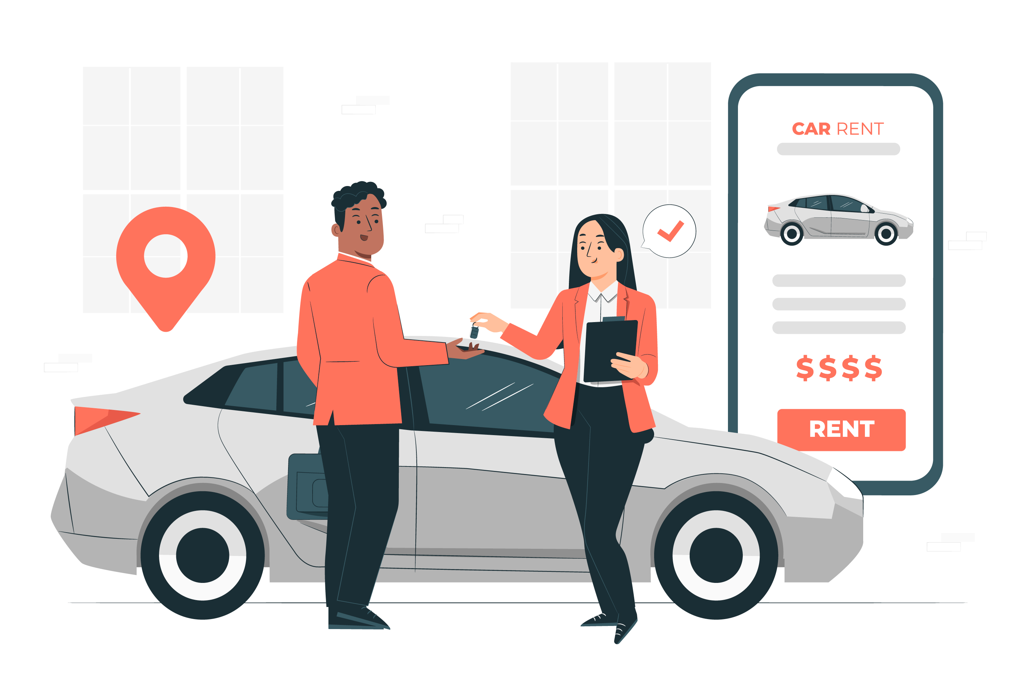
CAR RENTAL SYSTEM
A java-based Application

Slide 2
PREPARED BY :
Patel Dev Pragneshbhai
24002170110139
Antala Tirth Arvindbhai
24002170110009
Mungalpara Yashbhai Pareshbhai
24002170110095
Jain Suhani Pankajkumar
24002170110062
Limbasiya Ayushkumar Champakbhai
24002170110083

Slide 3
INTRODUCTION :
The Car Rental System is a console-based application designed to facilitate the rental of cars to users while maintaining an inventory of available vehicles.
The system allows administrators to manage the fleet and track revenue, while users can register, rent, and return cars seamlessly.

Slide 4
SCOPE :
Allows administrators to add and remove cars from the system.
Provides a user-friendly interface for customers to register and rent cars.
Calculates rental costs based on the duration of the rental.
Tracks total revenue earned from car rentals.

Slide 5
FUNCTIONAL REQUIREMENTS
Admin Functionalities :
User Functionalities :
Secure login with a password.
Add new cars to the system.
Remove cars from the fleet.
View total revenue generated.
View registered users.
Register as a user.
View available cars for rent.
Rent a car for a specified duration.
Return a rented car.

Slide 6
Security Measures :
Password protection for admin access.
User identity verification before renting a car.
Data encryption for secure transactions.
Logging and monitoring of rental activities.

Slide 7
Limitations & Conclusion :
Limitation :
Conclusion :
Limited storage capacity for cars and users.
No database integration,data is stored temporarily.
No late return warnings.
The Car Rental System provides a simple yet effective solution for managing car rentals in a structured manner.
It automates administrative tasks and ensures a smooth rental experience for users.

Slide 8
Future Work :
Integration with a database for persistent storage.
Web-based or mobile application development.
Online payment gateway for rental transactions.
Advanced analytics and reporting features.
Real-time GPS tracking of rented vehicles.

Slide 9
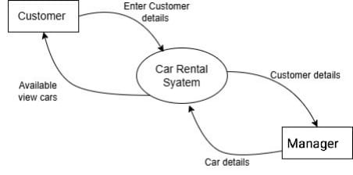
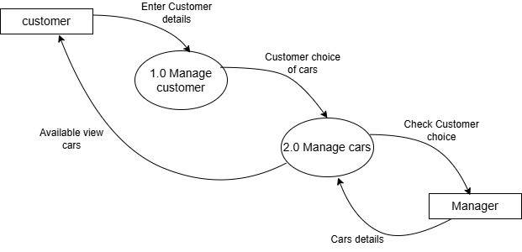
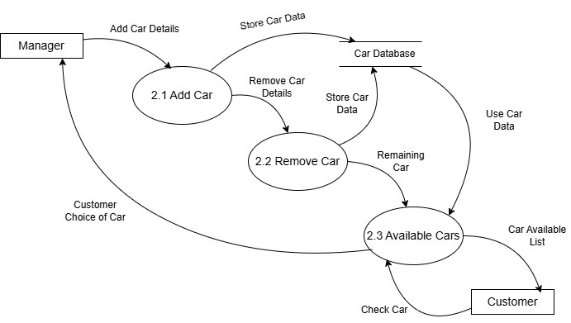
DFD Diagram:
Level 0:
Level 1:
Level 2 :

Slide 10
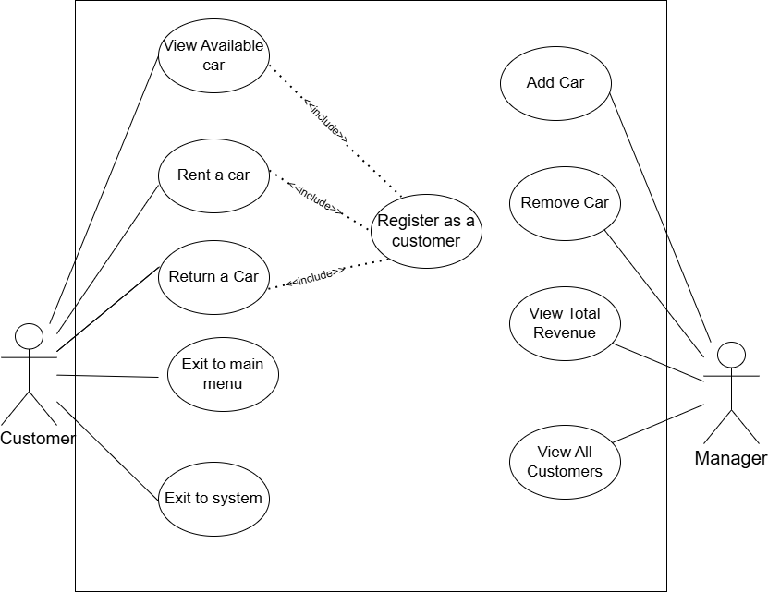
Usecase Daigram:

Slide 11
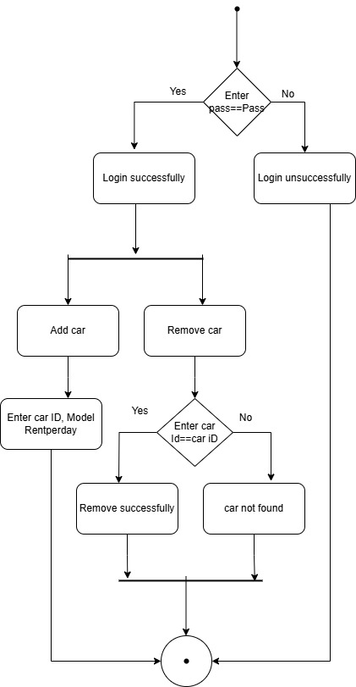
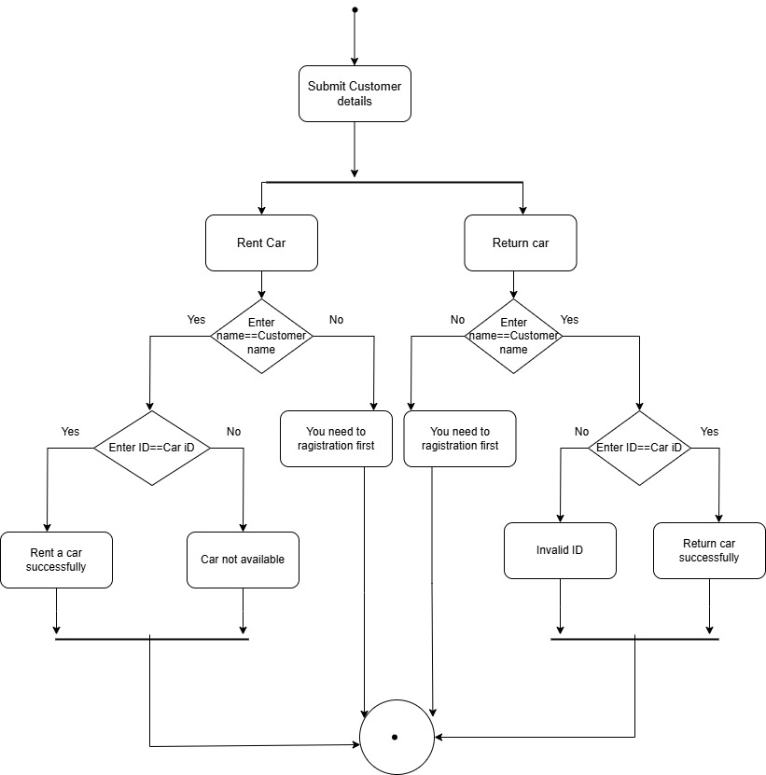
Activity Diagram:
For Manager:
For Customer:

Slide 12
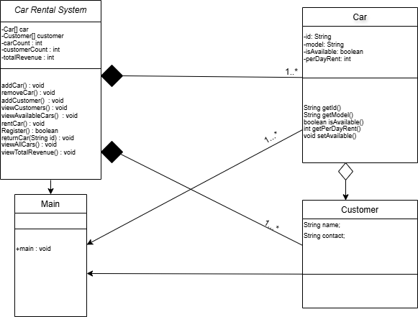
Class Diagram:

Slide 13
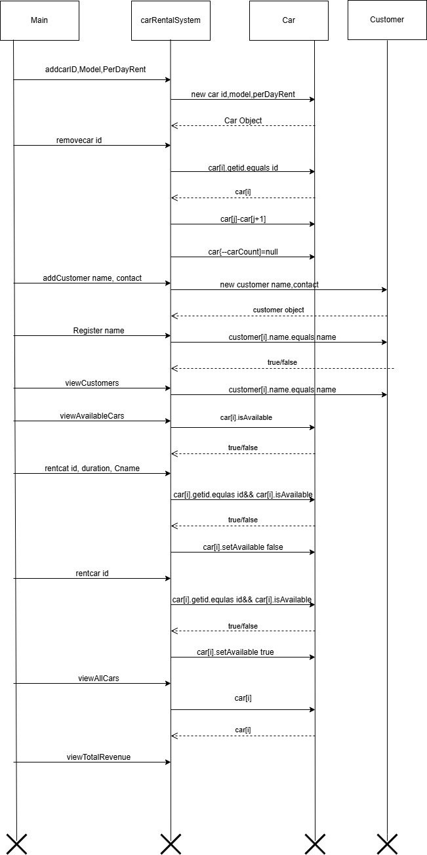
Sequence Diagram:

Slide 14
THANK YOU

