Slide 1


PHOTODOIDE FIRE ALARM SYSTEM
NAME:-ANTALA TIRTH ARVINDBHAI
ENR NO:-2400217011009
DIV:-D2
Prepared By:-
NAME:-LIMBASIYA AYUSHKUMAR CHAMPAKBHAI
ENR NO:-24002170110083
DIV-D2
NAME:-PATEL DEV PARGNESHBHAI
ENR NO:-24002170110139
DIV:-D2
NAME:-MUNGALPARA YASHBHAI PARESHBHAI
ENR NO:-24002170110095
DIV:-D2
NAME:-JAIN SUHANI PANKAJKUMAR
ENR NO:-24002170110062
DIV:-D2

Slide 2
PROJECT OUTLINE:-
INTRODUCTION
THE PHOTODIODE FIRE ALARM WORKS
COMPONENTS USED
CIRCUIT DIAGRAM
FUTURE SCOPES / ADVANTAGE / DISADVANTAGE

Slide 3
INTRODUCTION:-
Photodiode Fire Alarm System is an innovative approach to early fire detection using light sensors. It works by detecting sudden changes in light intensity, which could be a result of a fire or smoke.
1.The photodiode, typically a semiconductor, detects the intensity of light in its environment.
2.When the system detects an unusual amount of light (such as the light emitted during a fire), it triggers an alarm by activating components such as a buzzer and an LED.

Slide 4
THE PHOTODIODE FIRE ALARM WORKS:-
Photodiode Fire Alarm System works :
Fire Detection: When a fire occurs, the light intensity increases, causing the photodiode to generate a signal.
Signal Amplification: The signal is amplified by a transistor to make it strong enough to trigger the alarm.
Alarm Activation: The amplified signal activates the buzzer and LED, alerting people to the fire.

Slide 5
COMPONENTS USED:-
1.Transistors (for signal amplification)
2.Photodiode (for fire detection)
3.Resistors (for circuit stability)
4.Buzzer (for alarm sound)
5.LED (for visual indication)
6.Power Supply (9V battery)

Slide 6
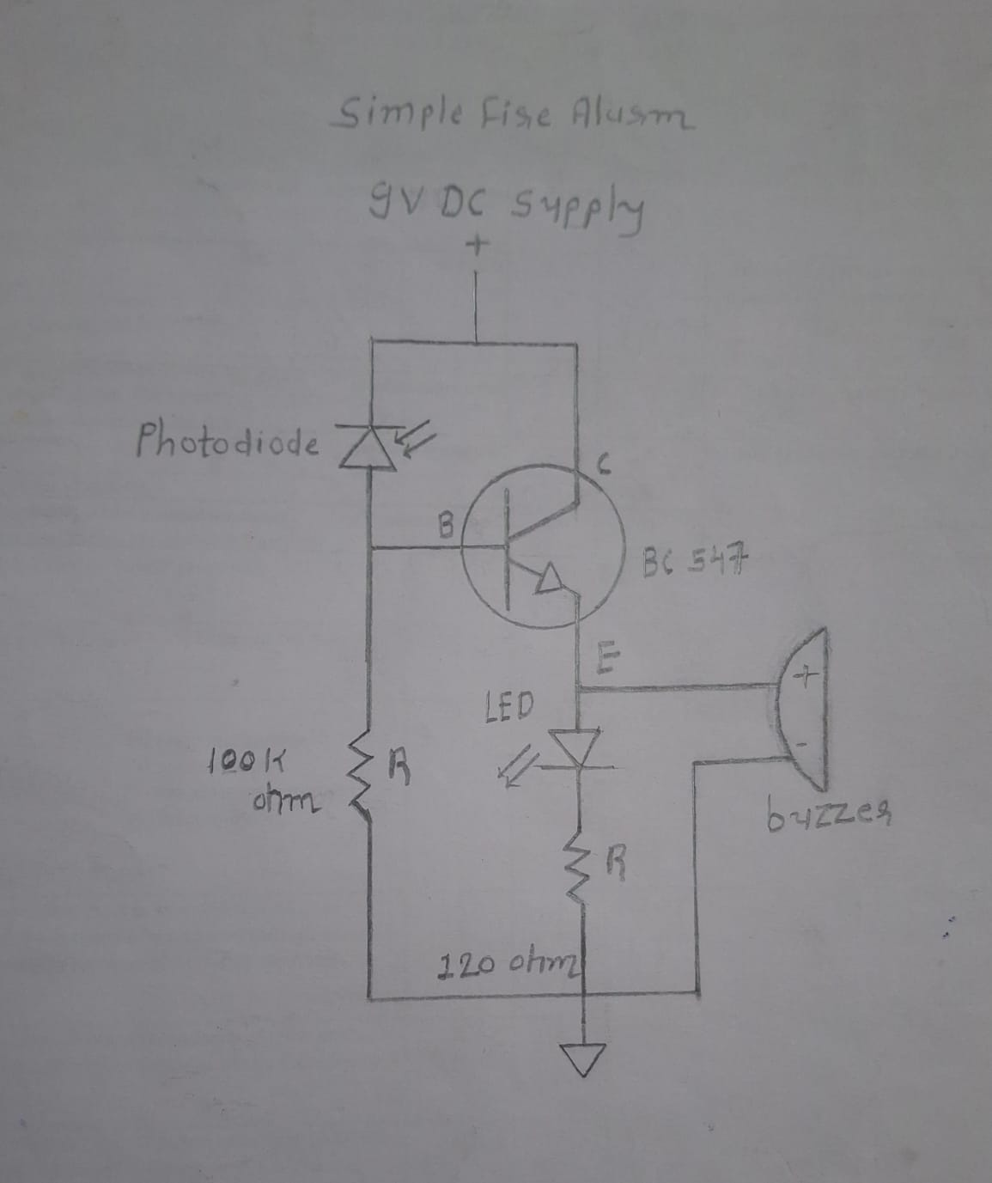
CIRCUIT DIAGRAM :-

Slide 7
ADVANTAGE/ DISADVANTAGE
Advantage:
1.Low-cost fire detection system.
2.Quick response time.
3.Easy to implement.
Disadvantage:
1.May give false alarms due to external light sources.
2.Limited range of detection.

Slide 8
FUTURE SCOPES
Future Scope:
1.Integration with IoT for remote monitoring.
2.Use of GSM modules for SMS alerts.
3.Improved accuracy using IR flame sensors.

Slide 9
THANK YOU….

