Slide 1
Terma Self Protection Suite
Intelligent self protection solution for F-16 fighters
of the Royal Danish Air force

Slide 2
System Overview
Presentation of overall system

Slide 3
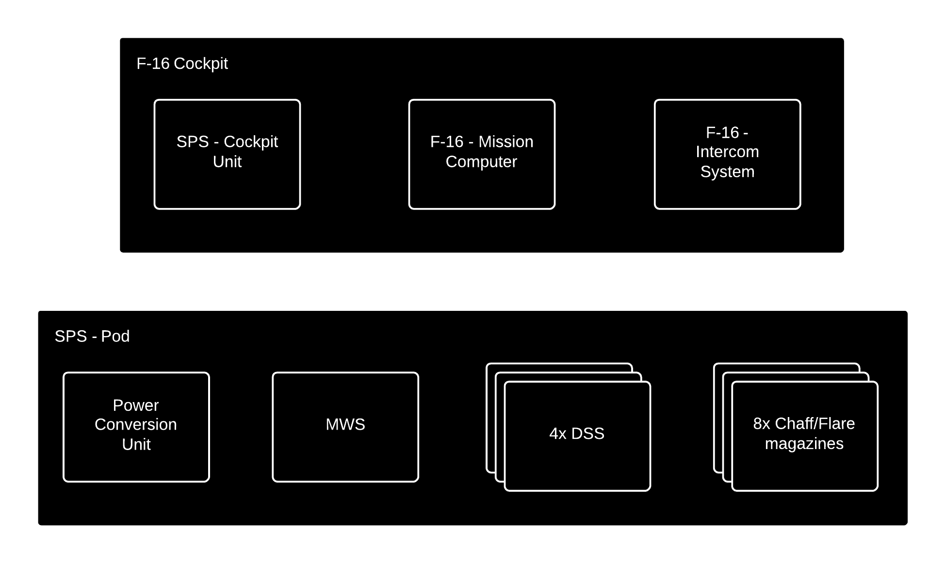
Concept of operations

Slide 4
Features
Automatic and Semi-automatic operation
Lessens pilot load
Intelligent selection of dispensing patterns
Optimal coverage for all threats
Direct audio cues in pilot headset
Faster and more direct threat response

Slide 5
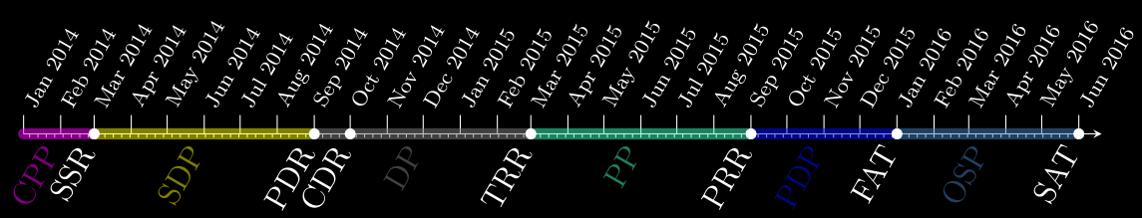
Project schedule

