Slide 1
Terma Self Protection Suite
Intelligent self protection solution for F-16 fighters
of the Royal Danish Air force

Slide 2
System Overview
Presentation of overall system

Slide 3
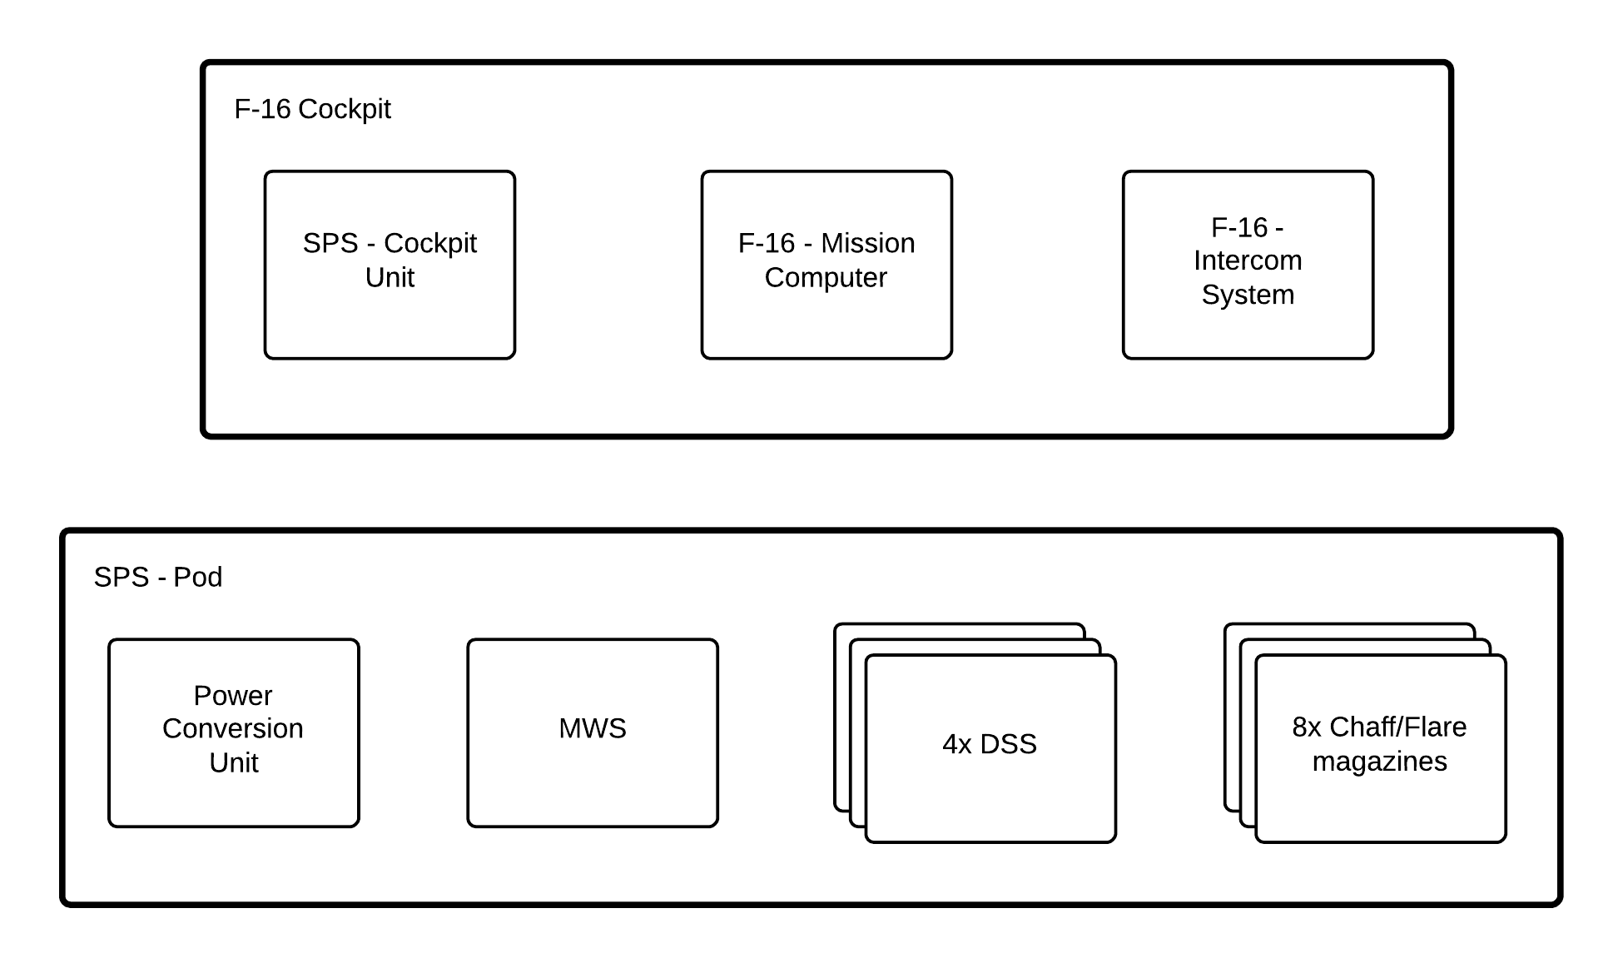
Concept of operations
Con Ops etc.

Slide 4
Features
System excelences

Slide 5
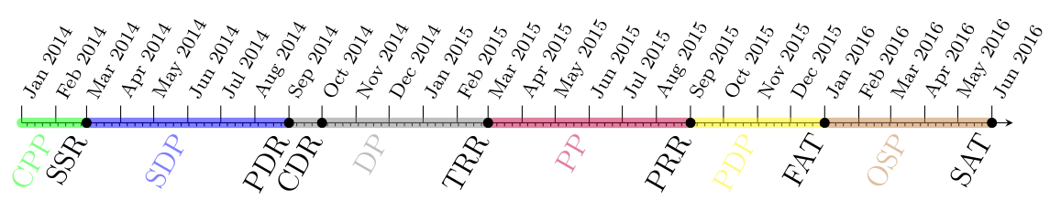
Project schedule

