Slide 1
Terma Self Protection Suite
Intelligent self protection solution for F-16 fighters
of the Royal Danish Air force

Slide 2
About Terma
Est. 1949
Located in:
Denmark (Lystryp, Grenaa, Herlev)
USA
Netherlands
Specialized in:
Aerostructures
Integrated Defense Systems
Radar Systems
Space

Slide 3
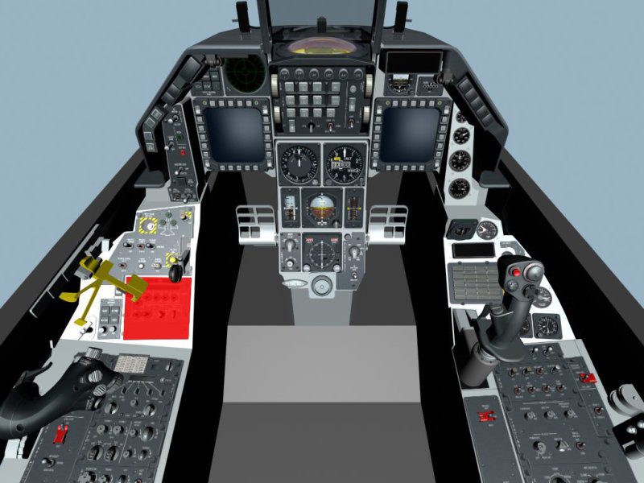
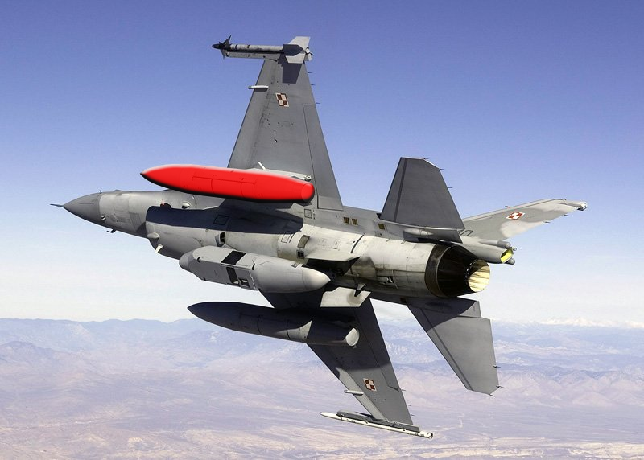
System Overview
Cockpit Unit + Wing-mounted Pod

Slide 4
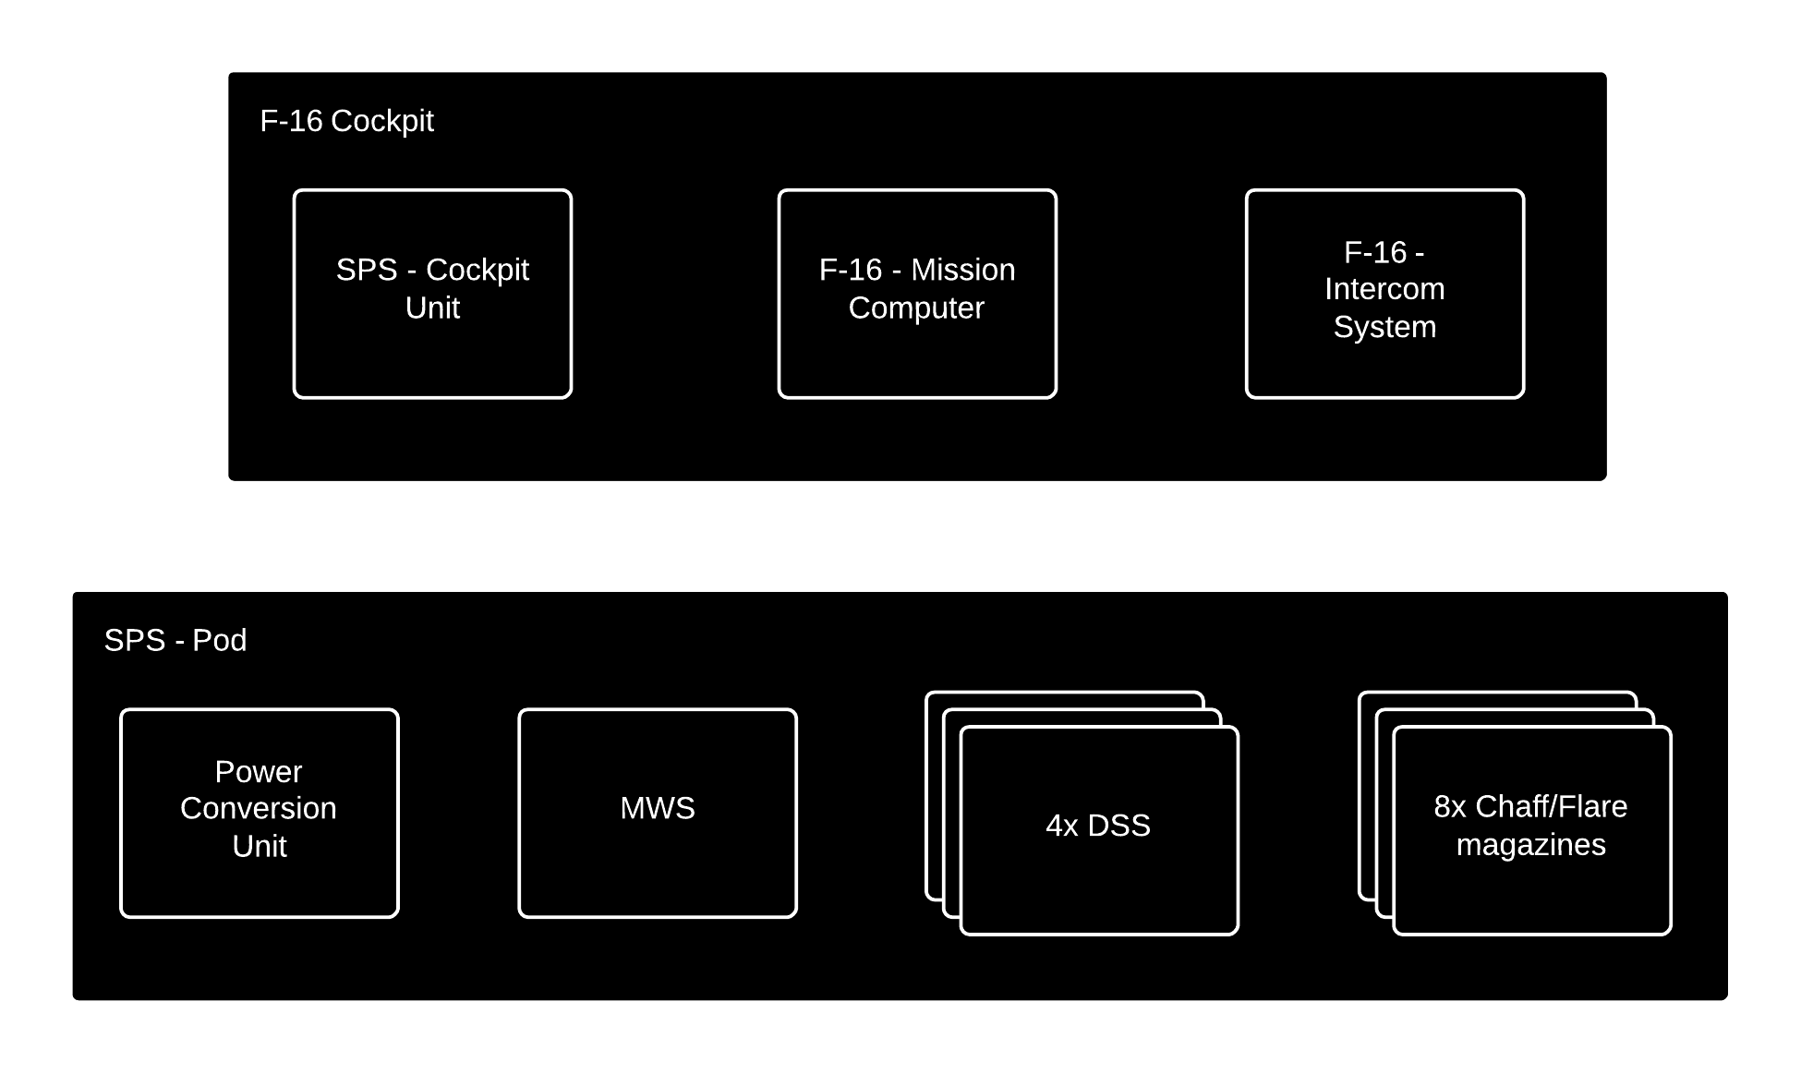
Concept of operations

Slide 5
Distinguishing Features
Automatic and Semi-automatic operation
Lessens pilot load
Intelligent selection of dispensing patterns
Optimal coverage for all threats
Direct audio cues in pilot headset
Faster and more direct threat response
Small price compared to a new F-16 plane

Slide 6
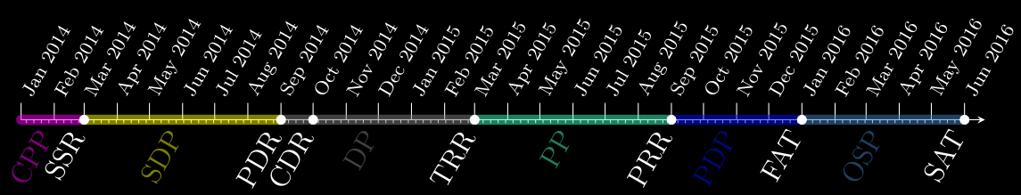
Project schedule

Slide 7
Project Progress
NOW

