Slide 1
Terma Self Protection Suite
Intelligent self protection solution for F-16 fighters
of the Royal Danish Air force

Slide 2
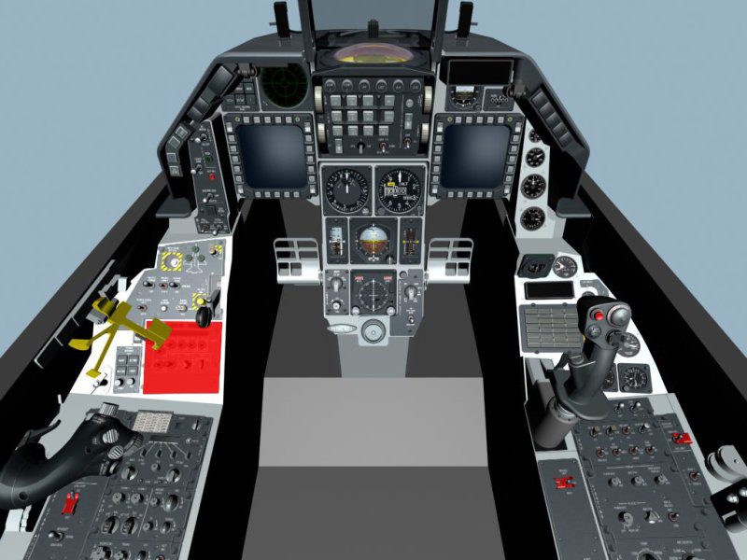
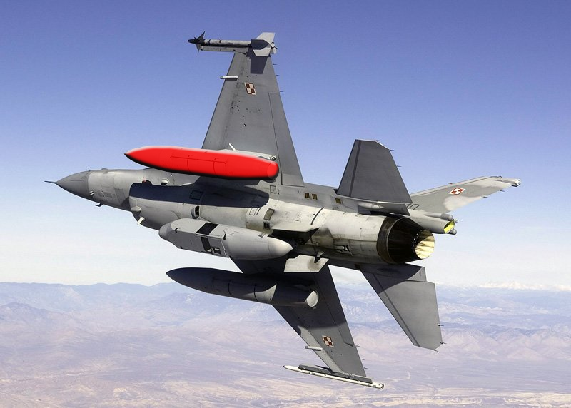
System Overview
Cockpit Unit + Wing-mounted Pod

Slide 3
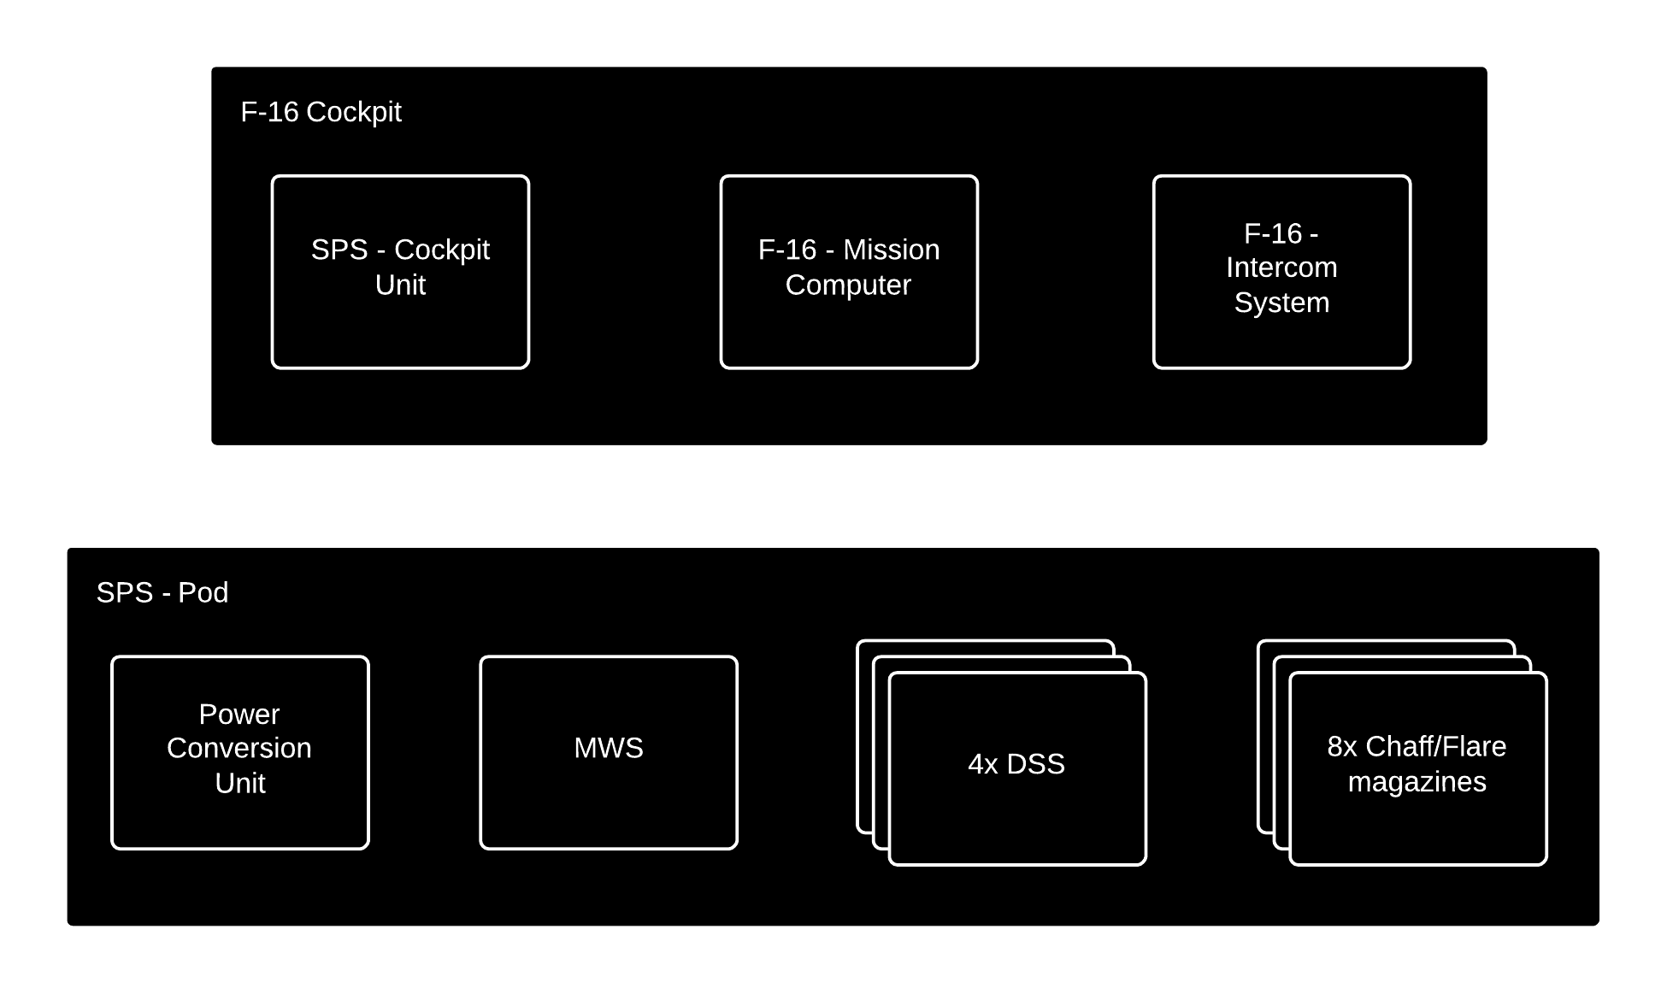
Concept of operations

Slide 4
Distinguishing Features
Automatic and Semi-automatic operation
Lessens pilot load
Intelligent selection of dispensing patterns
Optimal coverage for all threats
Direct audio cues in pilot headset
Faster and more direct threat response

Slide 5
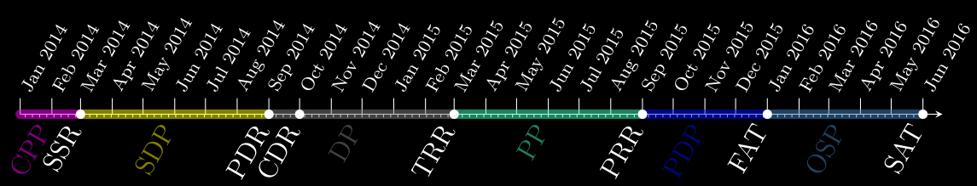
Project schedule

Slide 6
Project Progress
NOW

