Slide 1
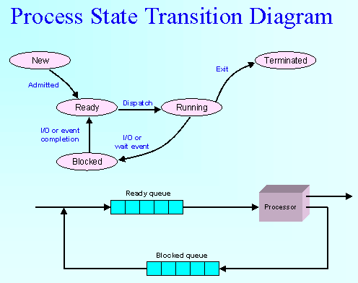
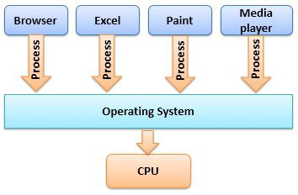
CPU SCHEDULING
MULTI-PROCESSING
Several Process are coming to execute
By the CPU

Slide 2
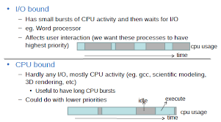

Slide 3
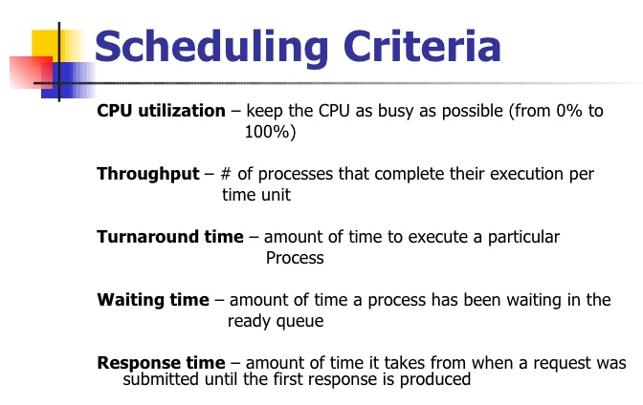

Slide 4
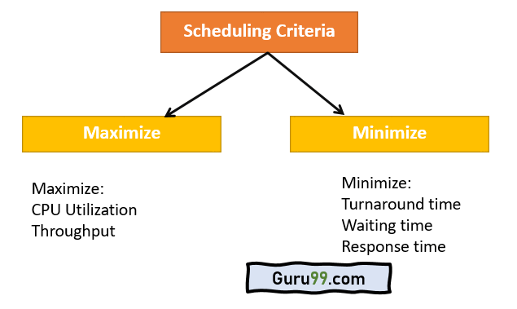

Slide 5
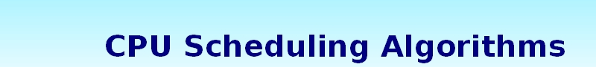
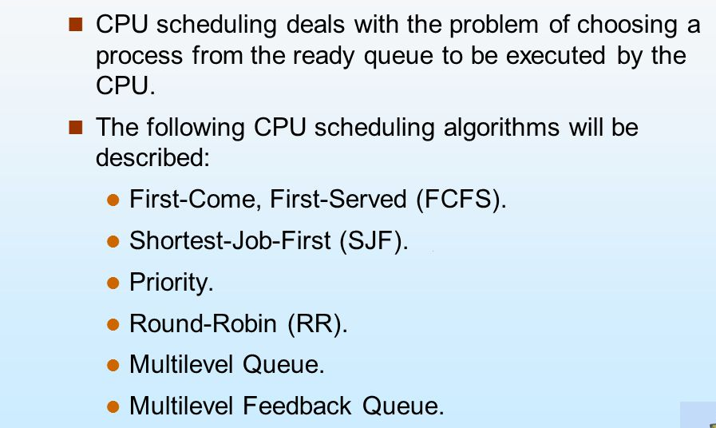

Slide 6
First-Come, First-Served (FCFS) scheduling algorithm
Simplest CPU-scheduling
The FCFS scheduling algorithm is non-preemptive. (can not give up the CPU)
With this scheme, the process that requests the CPU first is allocated the CPU first.
When the CPU is free, it is allocated to the process at the head of the queue.
The average waiting time under the FCFS policy, however, is often quite long.
Consider the following set of processes that arrive at time 0, with the length of the CPU burst given in milliseconds:

Slide 7
1.First-Come, First –Served (FCFS) Scheduling algorithm
Example :
Process Burst Time (Execution Time- in millisec)
P1 24
P2 3
P3 6
Gantt Chart
P1
P2
P3
0
24
27
33

Slide 8
P₁
P₂
P₃
0
24
27
33
FCFS
Waiting Time (WT):
The waiting time Process P1 is 0 milliseconds,
The waiting time Process P2 is 24 milliseconds,
The waiting time Process P3 is 27 milliseconds.
Average Waitinng Time (AWT):
Thus, the average waiting time is (0 + 24 + 27)/3 = 51/3 = 17 msec
Turnaround Time (TT):
Turnaround time for Process P1 = 24
Turnaround time for Process P2 = 27
Turnaround time for Process P3 = 33
Average Turnaround Time ATT = (24+27+33) / 3 = 84/3 = 28 msec
.

Slide 9
2.Shortest – Job – First (SJF) Scheduling algorithm
Shortest job first (SJF) or shortest job next, is a scheduling policy that selects the waiting process with the smallest execution time to execute next. SJN is a non-preemptive algorithm.
Shortest Job first has the advantage of having a minimum average waiting time among all scheduling algorithms.
Sort all the process according to the arrival time.
Then select that process which has minimum arrival time and minimum Burst time.
After completion of process make a pool of process which after till the completion of previous process and select that process among the pool which is having minimum Burst time.

Slide 10
2.Shortest – Job – First (SJF) Scheduling algorithm
Example 1:
Process Burst Time (Execution Time- in millisec)
P1 24
P2 3
P3 6
Gantt Chart
P2
P3
P1
0
3
9
33

Slide 11
P2
P3
P1
0
3
9
SJF
33
Waiting Time (WT):
The waiting time Process P1 is 9 milliseconds,
The waiting time Process P2 is 0 milliseconds,
The waiting time Process P3 is 3 milliseconds.
Average Waitinng Time (AWT):
Thus, the average waiting time is (9 + 0 + 3)/3 = 12/3 = 4 msec
Turnaround Time (TT):
Turnaround time for Process P1 = 33
Turnaround time for Process P2 = 3
Turnaround time for Process P3 = 9
Average Turnaround Time ATT = (33+3+9) / 3 = 45/3 = 15 msec
.

Slide 12
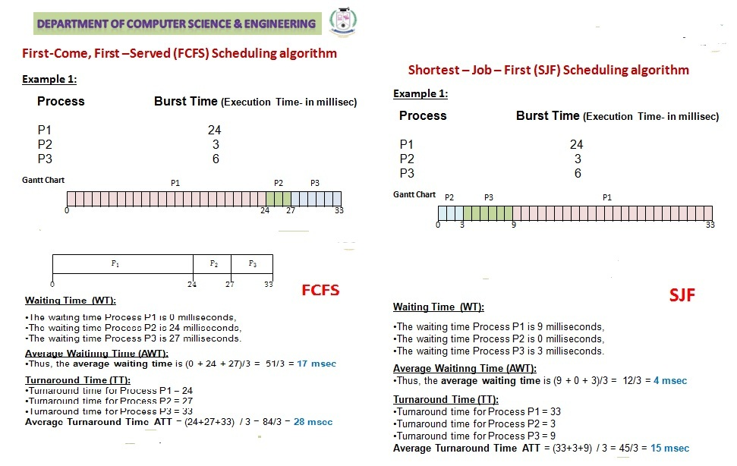

Slide 13
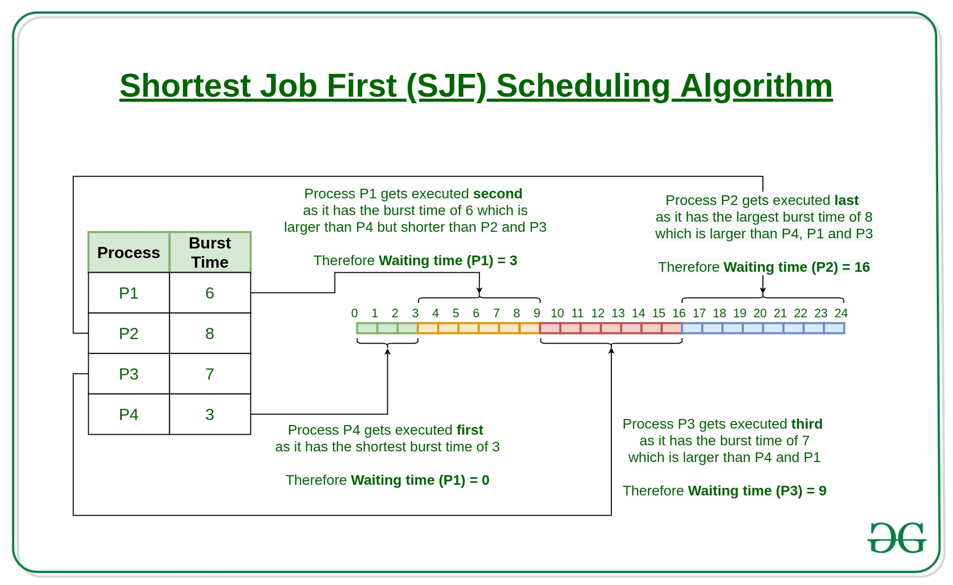

Slide 14
3.Round Robin (RR) Scheduling algorithm
A fixed time is allotted to each process, called quantum, for execution.
Once a process is executed for given time period that process is preempted and other process executes for given time period.
Context switching is used to save states of preempted processes.

Slide 15
3.Round Robin Scheduling
Example :
Process Burst Time (Execution Time- in millisec)
P1 24
P2 3 Time Slice = 4 msec
P3 6
Gantt Chart
P1
P2
P3
P1
P3
P1
P1
P1
P1
0
4
7
11
15
17
21
25
29
33

Slide 16
P1
P2
P3
P1
P3
P1
P1
P1
P1
0
4
7
11
15
17
21
25
29
33
P1 = 4; P2= 3; P3 = 4; P1 =4, P3=2; P1 = 4; P1 = 4 ; P1 = 4; P1 = 4
First Round
P1 = 4 (24-4) Remaining BT 20 ms
P2= 3 (Process completed, because Time slice =4 ms)
P3 = 4 (6-4) Remaining BT 2 ms
Second Round
P1 =4 (20-4) Remaining BT 16ms
P3=2 (Process Completed)
Third Round
P1 = 4 (16-4) Remaining BT 12ms
Fourth Round
P1 = 4 (12-4) Remaining BT 8 ms
Fifth Round
P1 = 4 (8-4) Remaining BT 4 ms
Sixth Round
P1 = 4 (Process completed)
3.Round Robin Scheduling

Slide 17
3.Round Robin Scheduling
P1
P2
P3
P1
P3
P1
P1
P1
P1
0
4
7
11
15
17
21
25
29
33
Waiting Time (WT):
The waiting time Process P1 is (0+3+4+2) = 9 milliseconds,
The waiting time Process P2 is 4 milliseconds,
The waiting time Process P3 is ( 7+4) = 11 milliseconds.
Average Waitinng Time (AWT):
Thus, the average waiting time is (9 + 4 + 11)/3 = 24/3 = 8 msec
Turnaround Time (TT):
Turnaround time for Process P1 = 33
Turnaround time for Process P2 = 7
Turnaround time for Process P3 = 17
Average Turnaround Time ATT = (33+7+17) / 3 = 57/3 = 19 msec
.

Slide 18
Advantage of Round-robin Scheduling
Here, are pros/benefits of Round-robin scheduling method:
It doesn't face the issues of starvation or convoy effect.
All the jobs get a fair allocation of CPU.
It deals with all process without any priority
If you know the total number of processes on the run queue, then you can also assume the worst-case response time for the same process.
This scheduling method does not depend upon burst time. That's why it is easily implementable on the system.
Once a process is executed for a specific set of the period, the process is preempted, and another process executes for that given time period.
Allows OS to use the Context switching method to save states of preempted processes.
It gives the best performance in terms of average response time.

Slide 19
Disadvantages of Round-robin Scheduling
Here, are drawbacks/cons of using Round-robin scheduling:
If slicing time of OS is low, the processor output will be reduced.
This method spends more time on context switching
Its performance heavily depends on time quantum.
Priorities cannot be set for the processes.
Round-robin scheduling doesn't give special priority to more important tasks.
Decreases comprehension
Lower time quantum results in higher the context switching overhead in the system.
Finding a correct time quantum is a quite difficult task in this system.

Slide 20
4.Priority Scheduling algorithm
A priority is associated with each process, and the CPU is allocated to the process with the highest priority.
Note that we discuss scheduling in terms of high priority and low priority.
Priorities are generally indicated by some fixed range of numbers, such as 0 to 7 or 0 to 4,095.
However, there is no general agreement on whether 0 is the highest or lowest priority.
Some systems use low numbers to represent low priority; others use low numbers for high priority. This difference can lead to confusion.
Here, we assume that low numbers represent high priority.
As an example, consider the following set of processes, assumed to have arrived at time 0, in the order P1, P2, ….., P5, with the length of the CPU burst given in milliseconds:

Slide 21
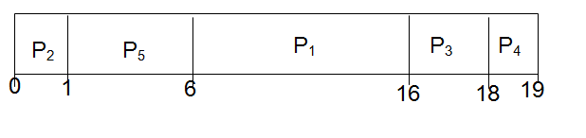
4.Priority Scheduling algorithm
Example:
Process Burst Time Priority
P1 10 3
P2 1 1
P3 2 4
P4 1 5
P5 5 2
Using priority scheduling, we would schedule these processes according to the following Gantt chart:

Slide 22
4.Priority Scheduling algorithm
Process P2 is started at time 0, since it is having the highest priority among the processes in the queue.
After execution of P2 process, process P5 is started at time 1.
Process P2 is started at time 0, since it is having the highest priority among the processes in the queue.
After execution of P2 process, process P5 is started at time 1.
Then P1,P3 and P4 as P2 processes are executed. is having shortest time, P2 will get executed first.

Slide 23
4.Priority Scheduling algorithm
Waiting time: WT
Waiting time for process p1 = 6
Waiting time for process p2 = 0
Waiting time for process p3 = 16
Waiting time for process p4 = 18
Waiting time for process p5 = 1
The average waiting time AWT = (6+0+16+18+1)/4 = 40/4 = 8 milliseconds.
Turnaround time: TT
Turnaround time for P1 = 16
Turnaround time for P2 = 1
Turnaround time for P3 = 18
Turnaround time for P4 = 19
Turnaround time for P5 = 6
Average Turnaround time ATT = (16+1+18+19+6) / 5 = 60/5= 12 milliseconds

Slide 24
4.Priority Scheduling algorithm
Advantages
It considers the priority of the processes and allows the important processes to run first.
Priority scheduling in preemptive mode is best suited for real time operating system.
Disadvantages
Processes with lesser priority may starve for CPU.
There is no idea of response time and waiting time.

Slide 25
5.Multilevel Queue Scheduling algorithm
Another class of scheduling algorithms has been created for situations in which processes are easily classified into different groups.
A multi-level queue scheduling algorithm partitions the ready queue into several separate queues.
The processes are permanently assigned to one queue, generally based on some property of the process, such as memory size, process priority, or process type.
Each queue has its own scheduling algorithm.

Slide 26
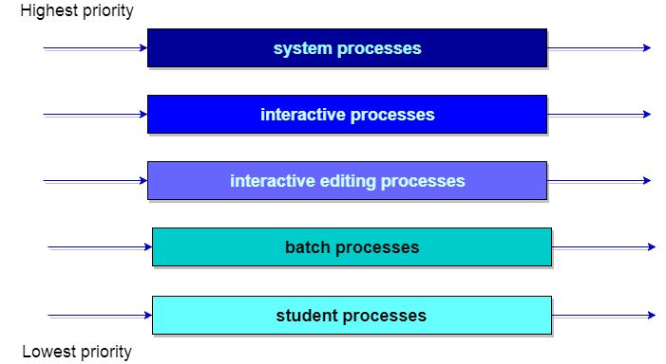
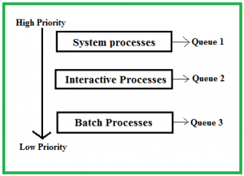
5.Multilevel Queue Scheduling algorithm

Slide 27
5.Multilevel Queue Scheduling algorithm
Scheduling among the queues :
What will happen if all the queues have some processes?
Which process should get the cpu?
To determine this Scheduling among the queues is necessary. There are two ways to do so –
Fixed priority preemptive scheduling method
Each queue has absolute priority over lower priority queue.
Let us consider following priority order queue 1 > queue 2 > queue 3.
According to this algorithm no process in the batch queue(queue 3) can run unless queue 1 and 2 are empty.
If any batch process (queue 3) is running and any system (queue 1) or Interactive process(queue 2) entered the ready queue the batch process is preempted.
Time slicing – In this method each queue gets certain portion of CPU time and can use it to schedule its own processes.
For instance, queue 1 takes 50 percent of CPU time queue 2 takes 30 percent and queue 3 gets 20 percent of CPU time.

Slide 28
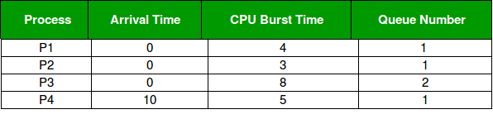
5.Multilevel Queue Scheduling algorithm
Example Problem :
Consider below table of four processes under Multilevel queue scheduling.
Queue number denotes the queue of the process.
Priority of queue 1 is greater than queue 2.
queue 1 uses Round Robin (Time Quantum = 2) and queue 2 uses FCFS.

Slide 29

5.Multilevel Queue Scheduling algorithm
Below is the Gantt chart of the problem :

Slide 30
5.Multilevel Queue Scheduling algorithm
At starting both queues have process so process in queue 1 (P1, P2) runs first (because of higher priority) in the round robin fashion and completes after 7 units then process in queue 2 (P3) starts running (as there is no process in queue 1) but while it is running P4 comes in queue 1 and interrupts P3 and start running for 5 second and after its completion P3 takes the CPU and completes its execution.
Advantages:
The processes are permanently assigned to the queue, so it has advantage of low scheduling overhead.
Disadvantages:
Some processes may starve for CPU if some higher priority queues are never becoming empty.
It is inflexible in nature.

