Slide 1
UNIT 4
REPLACEMENT MODEL AND
GAME THEORY

Slide 2
REPLACEMENT MODEL
REPLACEMENT MODEL
If any equipment or machine is used for a long period of time, due to wear and tear, the item tends to worsen. A remedial action to bring the item or equipment to the original level is desired. Then the need for replacement becomes necessary. This may be due physical impairment, due to normal wear and tear, obsolescence etc. The resale value of the item goes on diminishing with the passage of time.
The depreciation of the original equipment is a factor, which is responsible not to favour replacement because the capital is being spread over a long time leading to a lower average cost. Thus there exists an economic trade-off between increasing and decreasing cost functions. We strike a balance between the two opposing costs with the aim of obtaining a minimum cost. Replacement model aims at identifying the time at which the assets must be replaced in order to
minimize the cost.
4.3REPLACEMENT MODELS:
Assets that fails Gradually:
Certain assets wear and tear as they are used. The efficiency of the assets decline with time. The maintenance cost keeps increasing as the years pass by eg. Machinery, automobiles, etc.
Gradual failure without taking time value of money into consideration
Gradual failure taking time value of money into consideration
Assets which fail suddenly
Certain assets fail suddenly and have to be replaced from time to time eg. bulbs.
Individual Replacement policy (IRP)
Group Replacement policy (GRP)

Slide 3
Procedure for replacement of an asset that fails gradually (without considering Time value of money):
Note down the years
Note down the running cost ‘R’ (Running cost or operating cost or Maintenance cost or other expenses)
Calculate Cumulative the running cost ‘∑R’
Note down the capital cost ‘C’
Note down the scrap or resale value ‘S’
Calculate Depreciation = Capital Cost – Resale value
Find the Total Cost
Total Cost = Cumulative Running cost + Depreciation
Find the average cost
Average cost = Total cost/No. of corresponding year
Replacement decision: Average cost is minimum (Average cost will decrease and reach minimum, later it will increase)
Procedure for replacement of an asset that fails gradually (with considering Time value of money): Assumption:
Maintenance cost will be calculated at the beginning of the year
Resale value at the end of the year
Procedure:
Note down the years
Note down the running cost ‘R’ (Running cost or operating cost or Maintenance cost or other expenses)
Write the present value factor at the beginning for running cost
Calculate present value for Running cost
Calculate Cumulative the running cost ‘∑ R’
Note down the capital cost ‘C’
Note down the scrap or resale value ‘S’
Write the present value factor at the end of the year and also calculate present value for salvage or scrap or resale value.
Calculate Depreciation = Capital Cost – Resale value
Find the Total Cost = Cumulative Running cost + Depreciation
Calculate annuity factor (Cumulative present value factor at the beginning)
Find the Average cost = Total cost / Annuity
Replacement decision: Average cost is minimum (Average cost will decrease and reach minimum, later it will increase)

Slide 4
INDIVIDUAL REPLACEMENT POLICY (IRP):
Under this strategy equipments or facilities break down at various times. Each breakdown can be remedied as it occurs by replacement or repair of the faulty unit.
Examples: Vacuum tubes, transistors
Calculation of Individual Replacement Policy (IRP): n Average life of an item = Σi * Pi
i-1
Pi denotes Probability of failure during that week i denotes no. of weeks No. of failures = Total no. of items/Average life of an item
Total IRP Cost = No. of failures * IRP cost
GROUP REPLACEMENT
As per this strategy, an optimal group replacement period 'P' is determined and common preventive replacement is carried out as follows.
) Replacement an item if it fails before the optimum period 'P'.
Replace all the items every optimum period of 'P' irrespective of the life of individual item. Examples: Bulbs, Tubes, and Switches. Among the three strategies that may be adopted, the third one namely the group replacement policy turns out to be economical if items are supplied cheap when purchased in bulk quantities. With this policy, all items are replaced at certain fixed intervals.
Procedure for Group Replacement Policy (GRP):
Write down the weeks
Write down the individual probability of failure during that week
Calculate No. of failures:
N0 - No. of items at the beginning
N1 - No. of failure during 1st week (N0P1)
N2 - No. of failure during 2nd week (N0P2 + N1P1)
N3 - No. of failure during 3rd week (N0P3 + N1P2 + N2P1)
Calculate cumulative failures
Calculate IRP Cost = Cumulative no. of failures * IRP cost
Calculate and write down GRP Cost = Total items * GRP Cost
Calculate Total Cost = IRP Cost + GRP Cost
Calculate Average cost = Total cost / no. of corresponding year

Slide 5
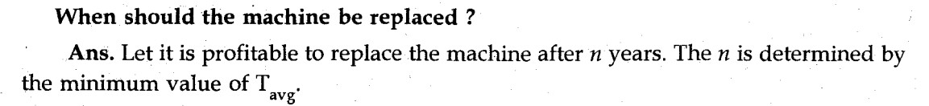
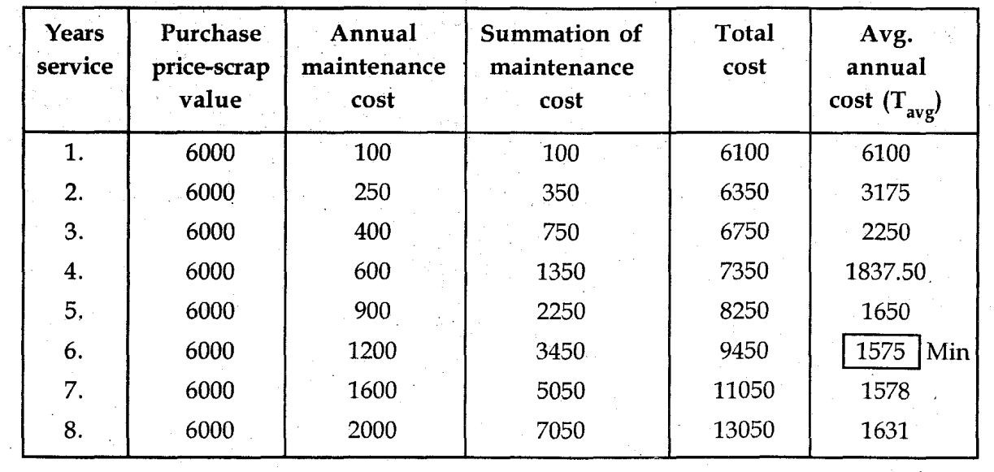
Problems
Problem 1. The cost of a machine is Rs. 6100/- and its scrap The maintenance costs found from experience are as follows:
The avg. annual cost is minimum Rs(1575/-) during the sixth year. Hence the m/c . should be replaced after 6 years of use.

Slide 6
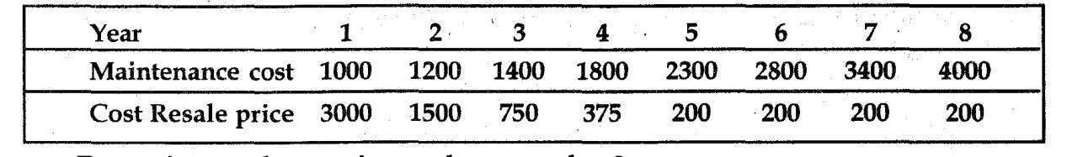
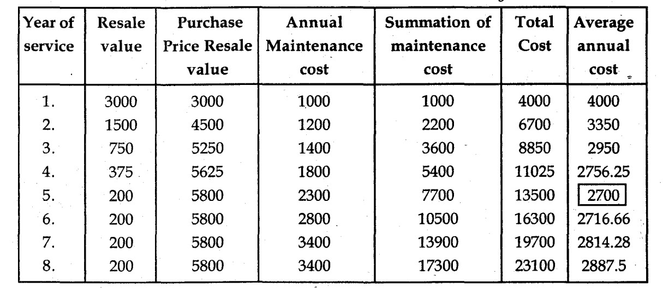
Problem 2. A machine owner finds from his past records that the costs per year of maintaining a machine whose purchase price is Ks. 6000 are as given below
Determine at what age is a replacement due?
Ans. Capital cost C = 6000/-. Let it be profitable to replace the. machine after n
years. Then n should be determined by the minimum value of Tav•
We observe from the table that avg. annual cost is minimum (Rs. 2700/-). Hence the m/c should replace at the end of 5th year.

Slide 7
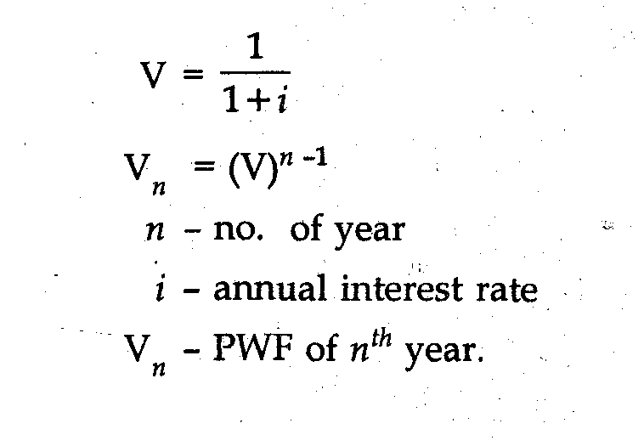
Type B. Replacement of items whose maintenance costs increase with time and value of money also changes with time. The machine should be replaced if the next period’s cost is greater than weighted average of previous cost.
Discount rate [Present worth factor (PWF)

Slide 8
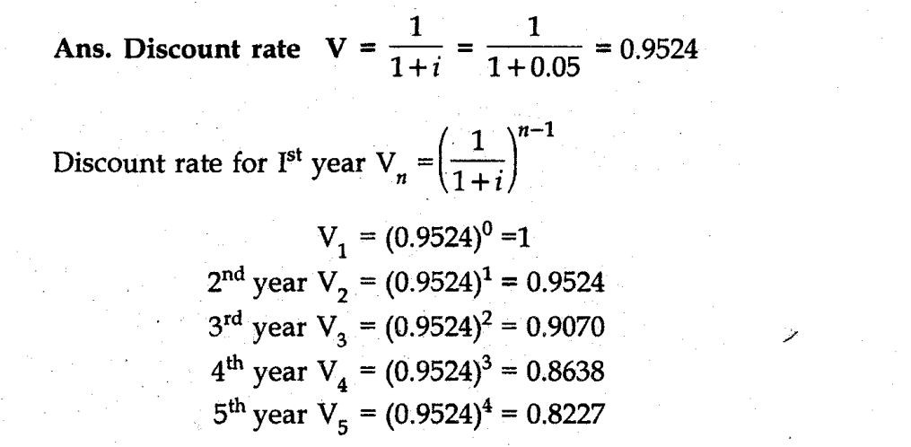
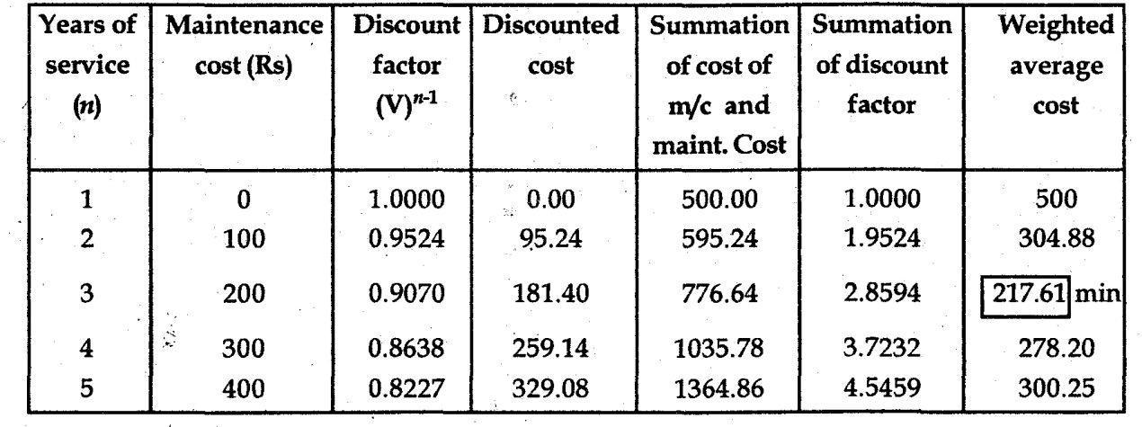
Problem 3. A machine costs Rs. 500/— Operation and Maintenance cost are zero for the first year and increase by Rs. 100/— every year. If money. is worth 5% every year, determine the best age at which the machine should be replaced. The resale value of the machine is negligible small. What is the weighted average cost of owning and operating the machine?
M/c shou1d be replaced at the end of 3rd year.

Slide 9
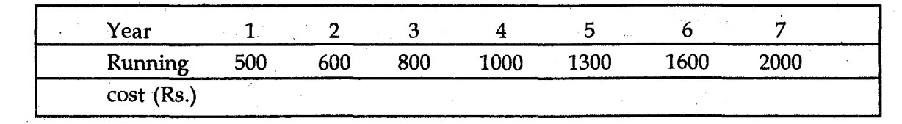
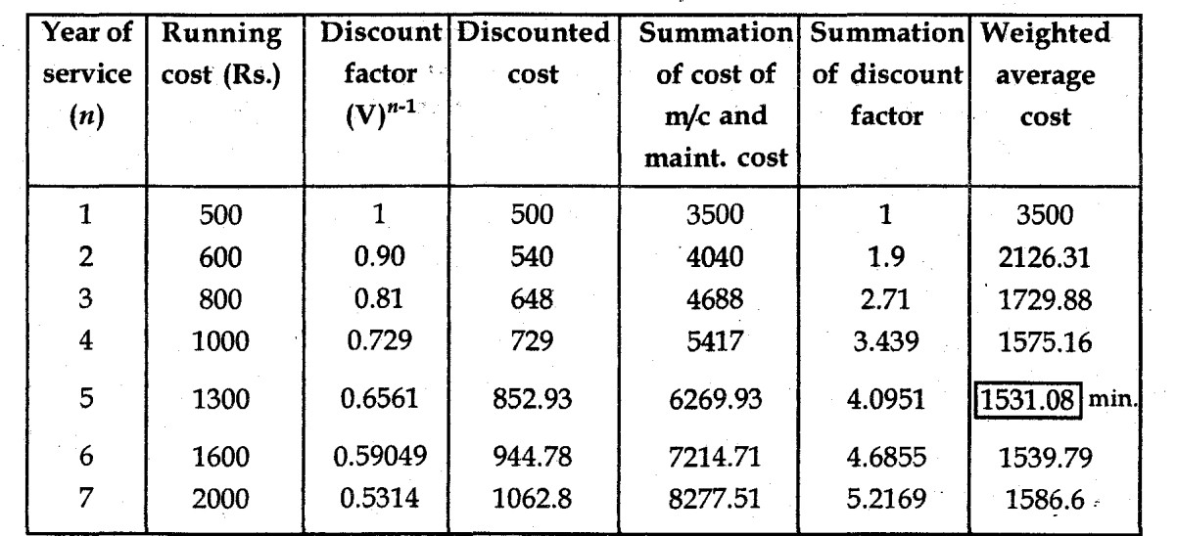
Problem 3. Purchase price of a machine is Rs. 3000/— and its running cost is given in the table below. If should be replaced. the discount rate is 0.90. Find at what age the machine
Ans. V (Discount rate) = 0.90
M/c should be replaced at the end of 5th year.

Slide 10
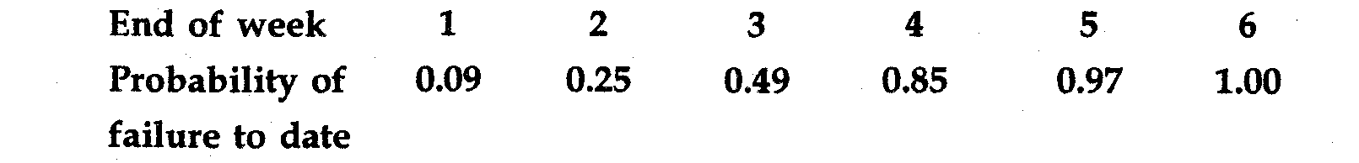
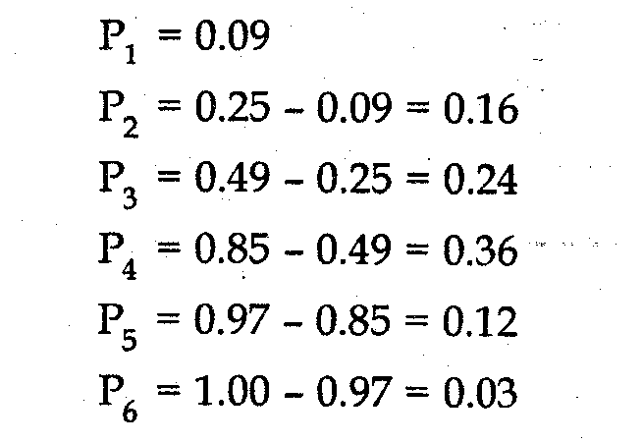
Problem 4. The following mortality ratio have been observed for a certain type of light bulbs in an installation with 1000 bulbs
There are a large no. of such bulbs which are to be kept in working order. If a bulb fails in service, it cost Rs. 3 to replace but if all the bulbs all replaced in the same operation it can be done for only Rs. 0.70/— a bulb. It is proposed to replace all bulbs at fixed intervals, whether or not they have burnt out and continue replacing burnt out bulb as they fail.
What is the best interval between group replacement?
Also establish if the policy, as determined by you is superior to the policy of replacing bulbs as and when they, fail, there being nothing like group replacement.
Solution : Let p. be the probability that a new light bulbs fail during the 1th week of the life.

Slide 11
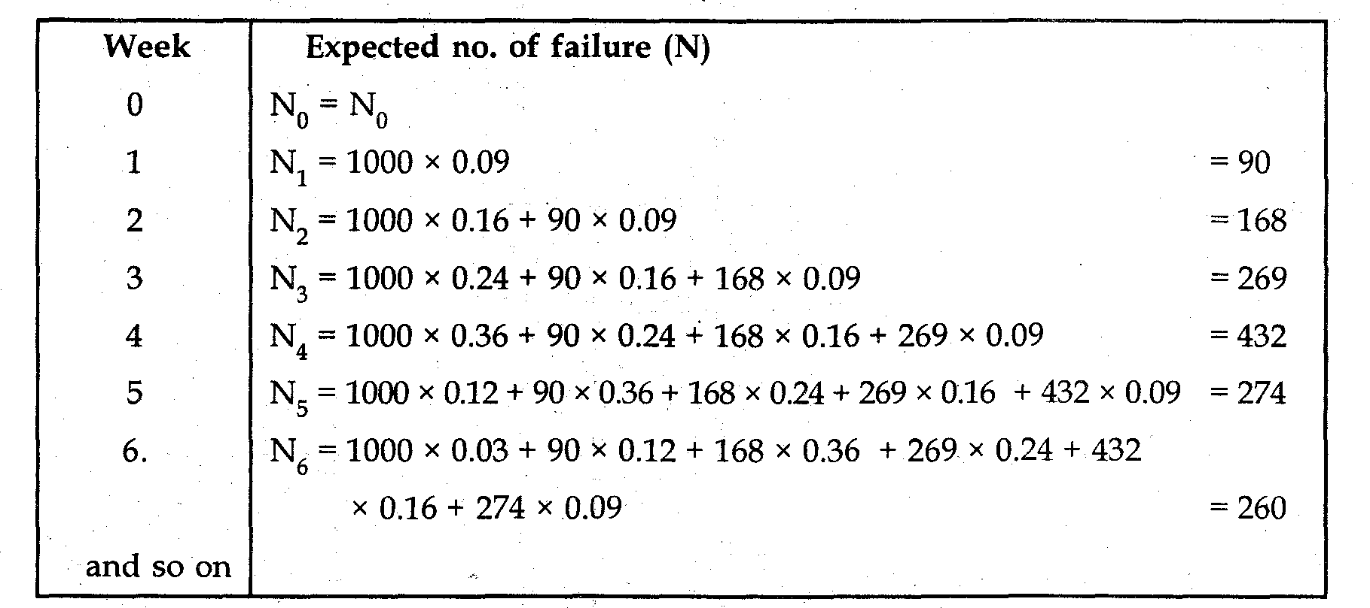
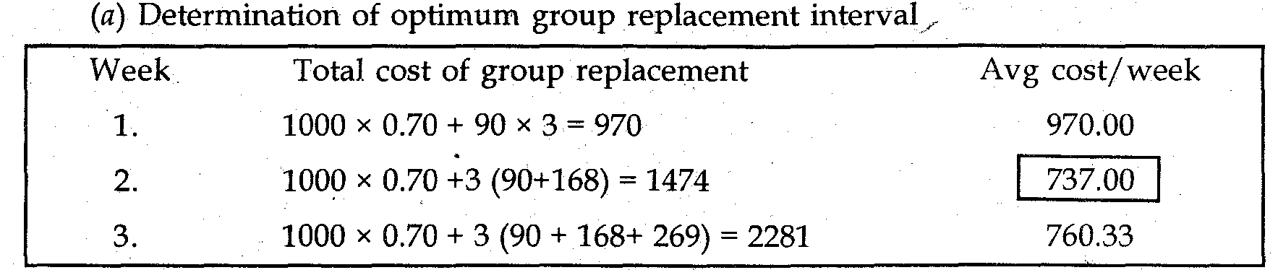

Slide 12
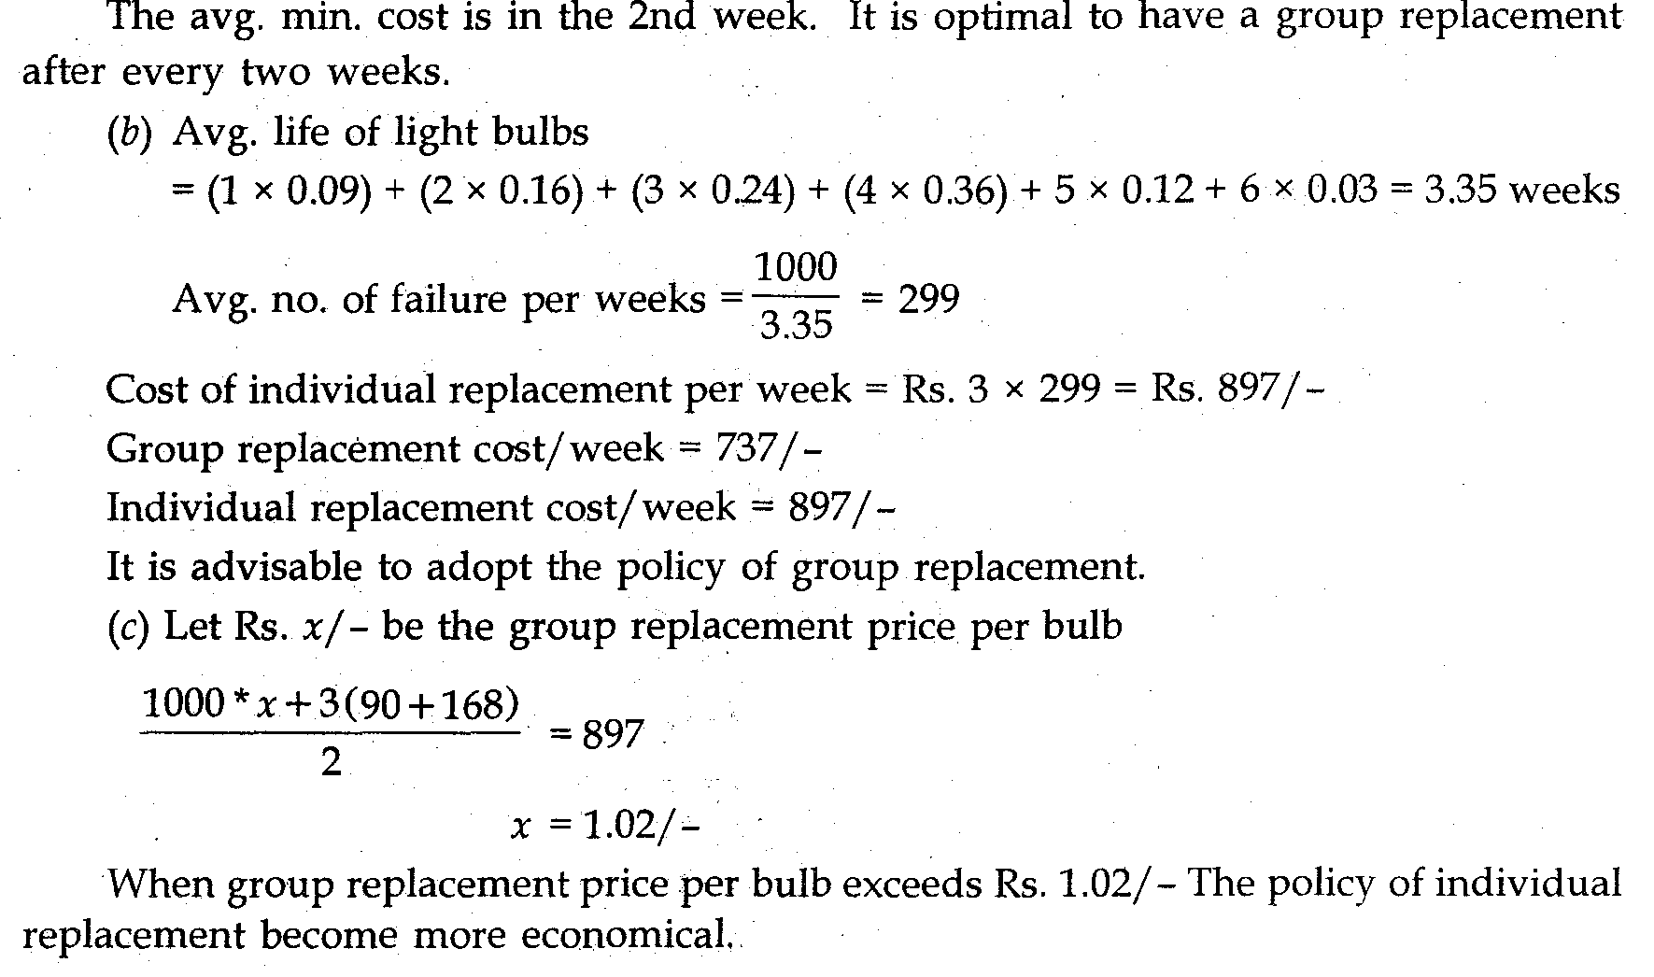

Slide 13
GAME THEORY
GAME THEORY
A competitive situation in business can be treated similar to a game. There are two or more players and each player uses a strategy to out play the opponent.
A strategy is an action plan adopted by a player in-order to counter the other player. In our of game theory we have two players namely Player A and Player B.
The basic objective would be that
Player A – plays to Maximize profit (offensive) - Maxi (min) criteria Player B – plays to Minimize losses (defensive) - Mini (max) criteria
The Maxi (Min) criteria is that – Maximum profit out of minimum possibilities The Mini (max) criteria is that – Minimze losses out of maximum possibilities.
Game theory helps in finding out the best course of action for a firm in view of the anticipated counter-moves from the competing organizations.
TERMINOLOGIES
Zero Sum game because the Gain of A – Loss of B = 0. In other words, the gain of Player A is the Loss of Player B.
Pure strategy If a player knows exactly what the other player is going to do, a deterministic situation is obtained and objective function is to minimize the gain Therefore the pure strategy is a decision rule always to select a particular course of action.
Mixed strategy If a player is guessing as to which activity is to be selected by the other on any particular occasion, a probabilistic situation is obtained and objective function is to maximize the expected gain. Thus, the mixed strategy is a selection among pure strategies with fixed probabilities.
Optimal strategy The strategy that puts the player in the most preferred position irrespective of the strategy of his opponents is called an optimal strategy Any deviation from this strategy would reduce his payoff.

Slide 14
Saddle Point : If the Maxi (min) of A = Mini (max) of B then it is known as the Saddle Point Saddle point is the number, which is lowest in its row and highest in its column. When minimax value is equal to maximin value , the game is said to have saddle point. It is the cell in the payoff matrix which satisfies minimax to maximin value
Value of the Game : It is the average wining per play over a long no. of plays. It is the expected pay off when all the players adopt their optimum strategies .If the value of game is zero it is said to be a fair game , If the value of game is not zero it is said to be a unfair game . In all problems relating to game theory, first look for saddle point, then check out for rule of dominance and see if you can reduce the matrix.
Rule of Dominance:
The dominance and modified dominance principles and their applications for reducing the size of a game with or without a saddle point. If every value of one strategy of A is lesser than that of the other strategy of A, Then A will play the strategy with greater values and remove the strategy with the lesser payoff values.
If every value of one strategy of B is greater than that of other strategy of B, B will play the lesser value strategy and remove the strategy with higher payoff values.
Dominance rule for the row
If all the elements in a particular row is lower than or equal to all the elements in another row, then the row with the lower items are said to be dominated by row with higher ones, Then the row with lower elements will be eliminated.
Dominance rule for the column
If all the elements in a particular column is higher than or equal to all the elements in another column, then the column with the higher items are said to be dominated by column with lower ones, Then the column with higher elements will be eliminated.
Graphical Method
If one of the players, play only two strategies or if the game can be reduced such that one of the players play only two strategies. Then the game can be solved by the graphical method.
In case the pay-off matrix is of higher order (say m x n ), then we try to reduce as much as possible using dominance and modified dominance ,f we get a pay-off matrix of order 2 x n or n x 2 we try to reduce the size of the pay-off matrix to that of order 2 x 2 with the graphical method so that the value of game could be obtained

Slide 15
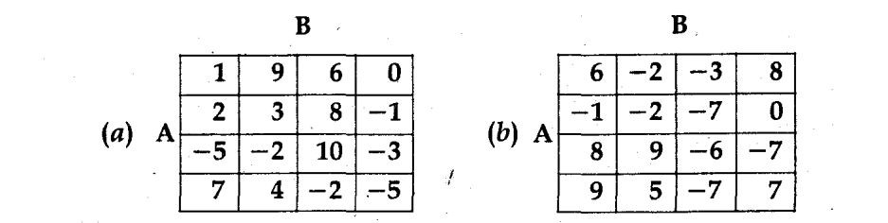
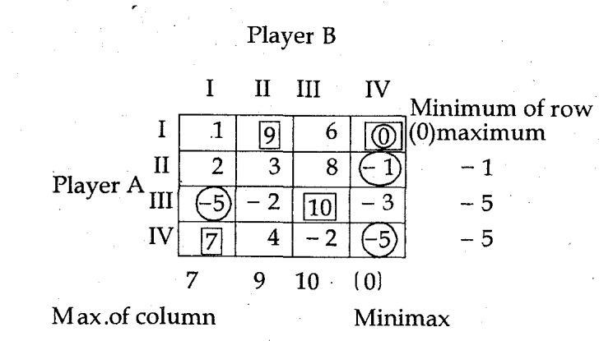
Problem 5. Find the value of games shown below also indicator whether they are fair or strictly determinable
Solution.
Solution.
(a)
Saddle point = (I, IV)
Game value 0 Strategy of A = Al Strategy of B = B IV
Since maximum = Minimax = 0 So game = Fair.

Slide 16
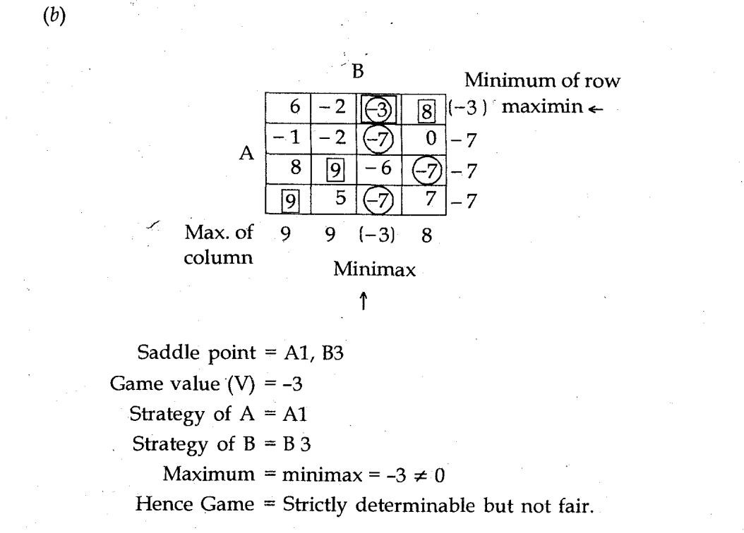

Slide 17
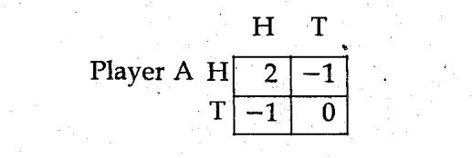
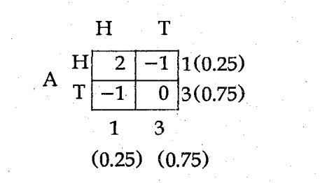

Problem 6. In a game of matching coins, player A wins Rs. 2. If there are two heads, win nothing if there are two tails and loses Rs. 1. When there are one head and one tail. Determine the pay off matrix, best strategies for each player and the value of game to A.
Solution. The payoff matrix for A will be
There is no saddle point By Arithmetic method
Player A best strategy (0.25, 0.75)
Player B best strategy (0.25, 0.75) Game value
Let B plays H; Value of the game

Slide 18
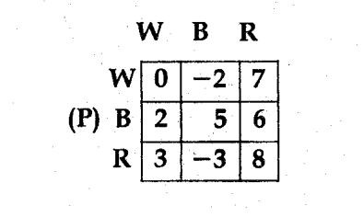
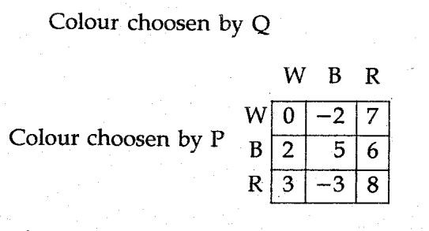
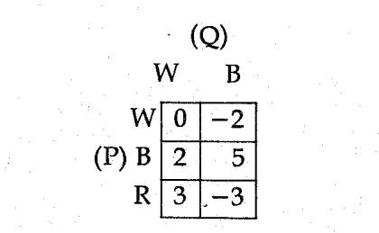
Problem 7. (By Dominance) Two players P and Q play a game. Each of them has to choose one of three colours, white (W) Black (B) and Red (R) independently of the other. There after the colours are compared. If both P and Q have choosen white (W,W) neither win anything. If player P selects white and player Q black (W, B), player P loses Rs. 2 or player Q wins the same amount and so on. The complete payoff table is shown. Find the optimum strategies for P and Q and the value of the game.
Solution.
There is no saddle point
By dominance rule for column, 3’ column may be removed. The resulting matrix is
By dominance rule for row, row may be removed The resultmg matrix (2 x 2) is

Slide 19
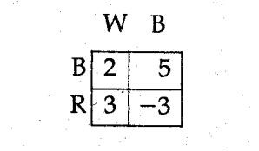
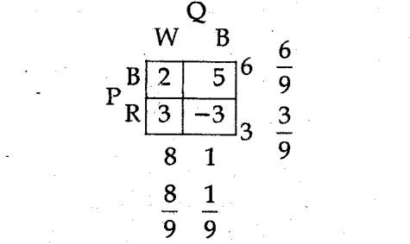

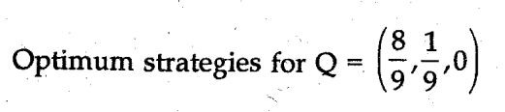
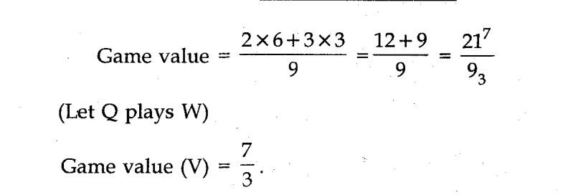
Applying Arithmatic method
Optimum strategies for P

Slide 20
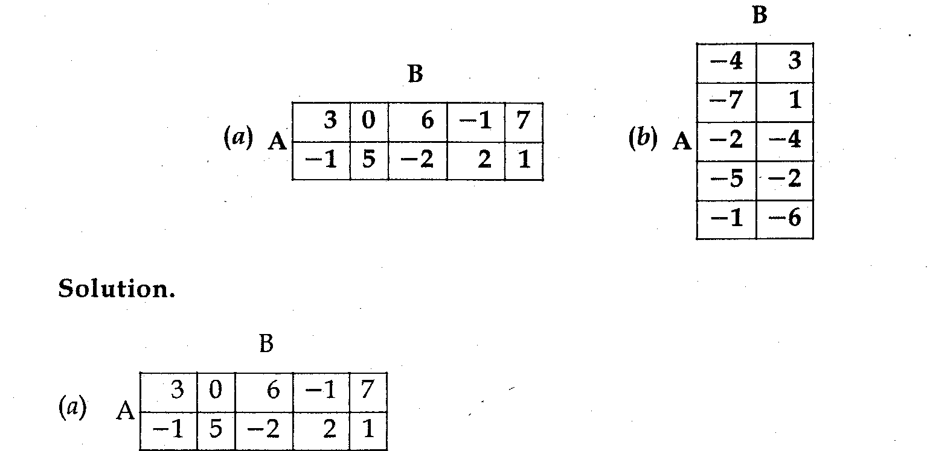
Problem 8. Solve the following games by reducing them to 2 x 2 games by graphical method.
reduce by dominance rule for column 2 and 5th column may be deleted as dominated by 4th and 3’ column.
The resulting matrix is
  No saddle point

Slide 21
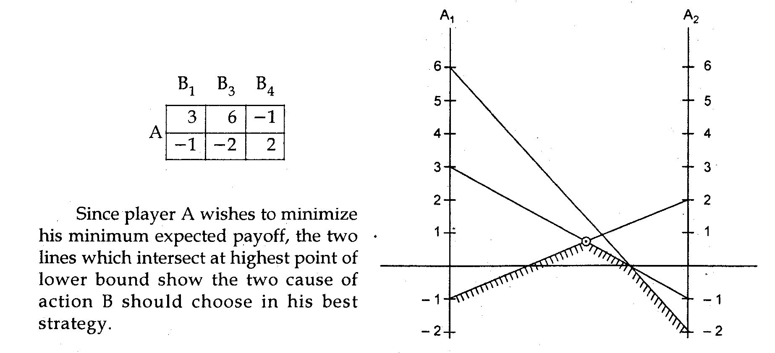
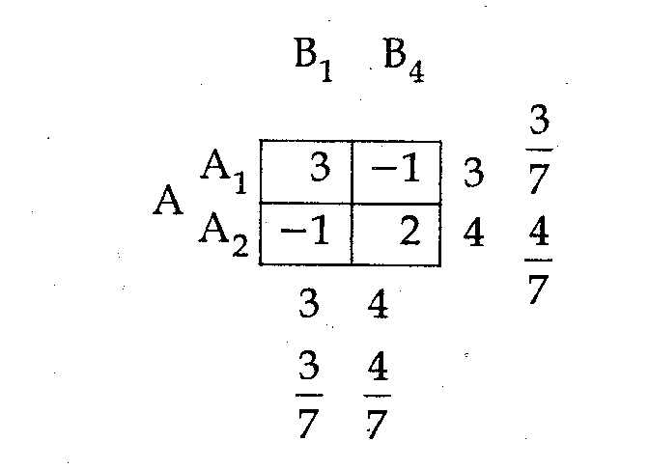
Resulting matrix

Slide 22
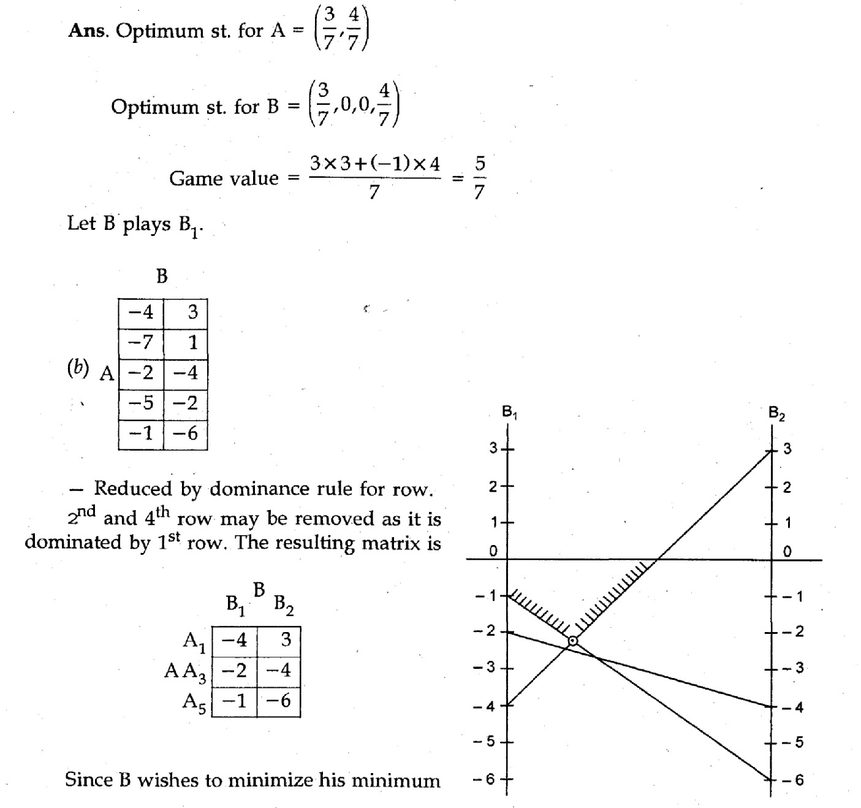

Slide 23
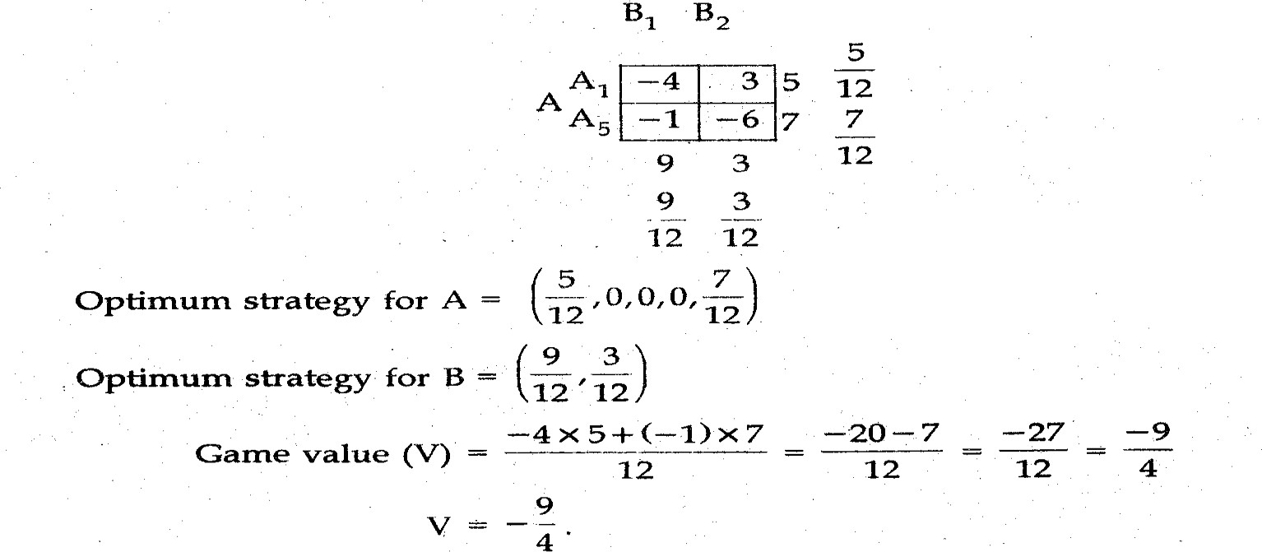
expected payoff the two lines which intersect at lowest pomt of upper bound show the two course of action A should choose in his best strategy.
The resulting matrix is

Slide 24
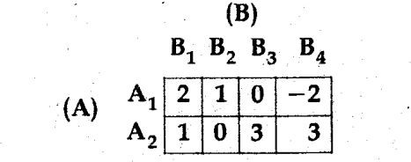
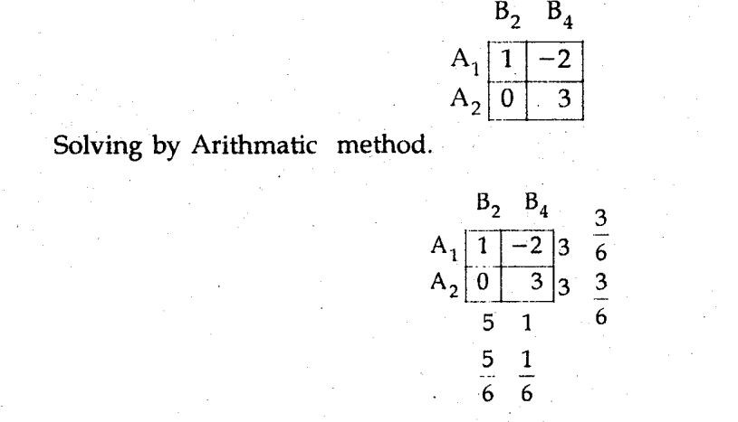
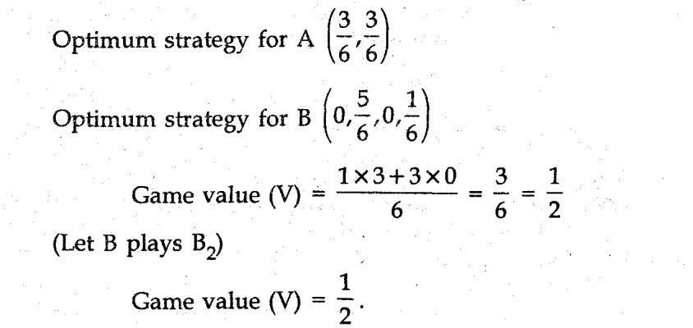
Problem 9. Solve the following game.
Solution There is no saddle point in the game By rule of dommance for column 1st and 3’ column may be deleted as dominated by 2nd and 4th column respectively. Thus the resulting matrix is

Slide 25
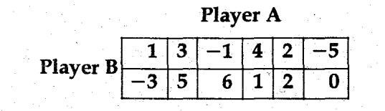
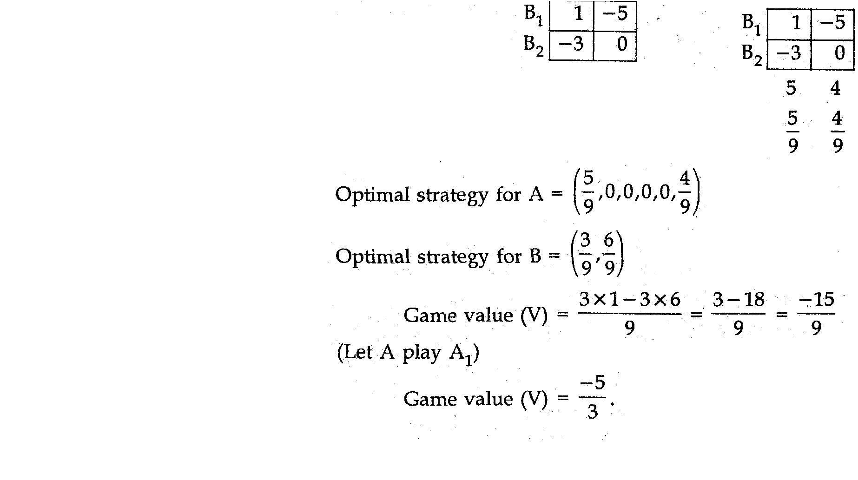
Problem 10. Obtain the optimal strategies for both persons and the value of the game for zero sum two person game whose payoff matrix is given as follows:
Solution. There is no saddle point m the game by rule of dominance for column 2nd,
4th and 5th column are dominated by 1st column and 3rd column dommated by 6th column hence 2nd, 4th, 5th and 3rd column may be removed. The resulting matrix is (2x2).

Slide 26
THANK YOU

