Slide 1

SONG RECOMMENDER USING FACIAL EXPRESSION

Slide 2

PROBLEM STATEMENT :
THE PROJECT IS TO DEVELOP AN EMOTION BASED MUSIC
PLAYER WHICH IS AN ANDROID APPLICATION MEANT
FOR USERS TO MINIMIZE HUMAN EFFORTS IN MANAGING
PLAYLISTS.

Slide 3


Slide 4
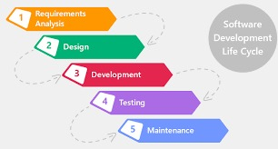
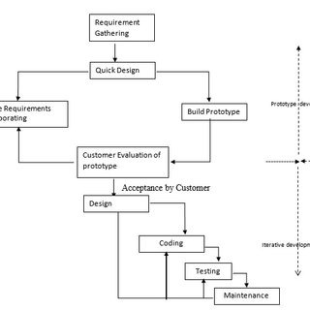

Slide 5

There are a lot of music/song recommender system but, none has the ability to give songs based on the present human emotion.
So, we came up with the idea to use these resources to develop a app which uses Deep Learning and song datasets to recommend songs to the user based on his current emotion.
Yes, there are apps which takes user’s manual input and recommends song but, this system reduces the user’s work and makes his search low.
So, it struck us that why shouldn’t we give it a go and make it a reality for the user’s as an instant song listening app.

Slide 6
ABSTRACT:
Music plays an important role in an individual’s life. It is an important source of entertainment and is often associated with a therapeutic role.
This is an android application where a user will be able to play songs according to their mood (emotion).
This application lets the user select the language and using facial expression recognition, it selects and plays a song according to their mood.

Slide 7

Scope:
We presented a model to recommend a music-based om the emotion based detected from the facial expression.
Designed & developed an emotion-based music recommendation system using face recognition System.
Thus, the proposed system presents Face based emotion recognition system to detect the emotions and play music from the emotion detected.

Slide 8


Slide 9
Requirements:
HARDWARE REQUIREMENTS:
1) ANDRIOD DEVICE/EMULATOR
2) Android 8 or more.
3) Min of 4GB RAM in device.
SOFTWARE REQUIREMENTS:
1) VSCode/Android Studio for making any development changes
2) Flutter SDK 2.5 or more.

Slide 10
Requirements:
Functional requirements include:
Acquiring face images,
Image pre-processing,
Face detection
Managing users face images.
Non-functional requirements include:
Usability,
Scalability,
Convenience to capture image,
Guidelines for acquiring face images.

Slide 11
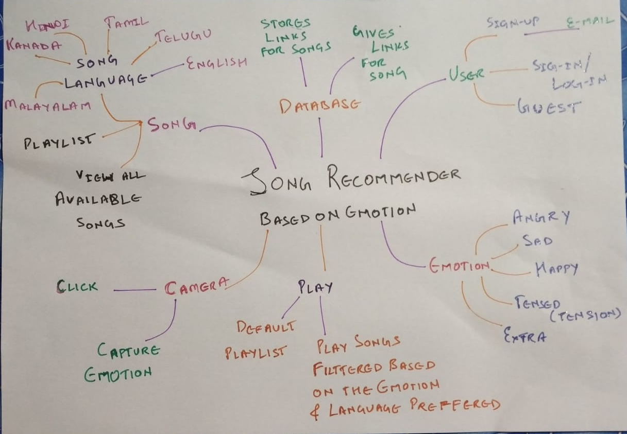
IDEATION MAP

Slide 12
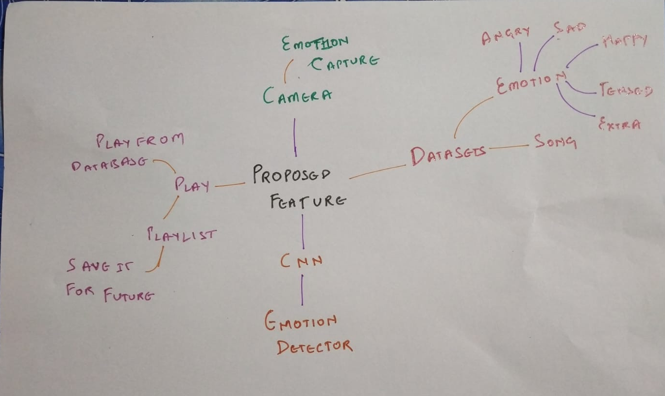
PROPOSED WORK:

Slide 13
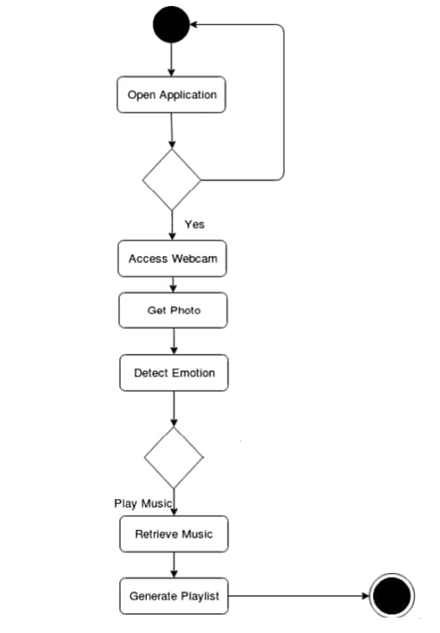
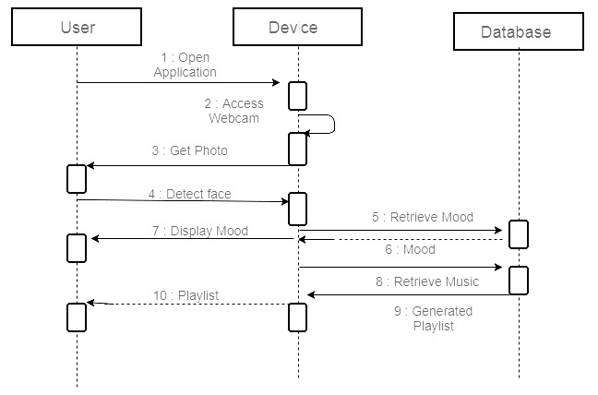
ACTIVITY DIAGRAM: SEQUENCE DIAGRAM:

Slide 14


Slide 15
Tools used:
MODULE DESCRIPTION
The proposed system majorly involves modules
A.Face extraction module.
B.Emotion recognition module
C. Audio extraction module
D. Emotion-audio recognition module
OpenCV
Flutter(front-end)
Kraggle
Postgres (database)
CNN for recognition
Tensorflow
Keras Module( Tensorflow Module)

Slide 16
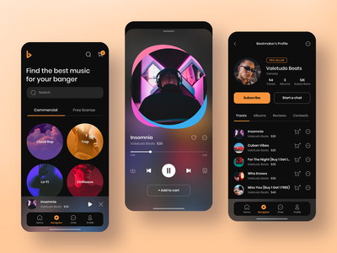
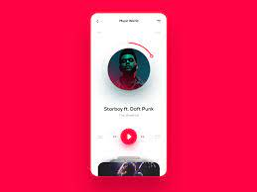
UI/UX

Slide 17

PROCESS:
FACE CAPTURING:
Capture images so here we are using the common device i.e., webcam or can use any other physical devices.
Computer Vision Library.
We authenticate and classify the images and we use positive images that actually contain images in order to train the classifier.

Slide 18
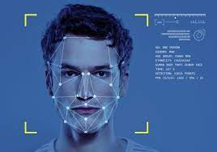
PROCESS:
FACE DETECTION:
This image processing system is used for reducing the face space dimensions.
To obtain the feature of the image characteristics.
We use this because it maximizes the training process in between classes.

Slide 19
EMOTION CLASSIFICATION
The images that are extracted previously will processed using the function.
The code will extract the facial spatial positions from the face image and it is based on the pixel’s intensity values that are indexed at each point.
MUSIC RECOMMENDATION:
The input images that is acquired is from the camera and is used to capture real-time images.
It compares the values that are present as a threshold in the code.
The values will be transferred to perform the service. The songs will be played from the detected emotion

Slide 20
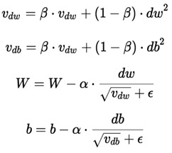



PROCESS:
We used algorithms like CNN (Convolution Neural Network), HaarCascade, MobileNet.
Optimization algorithms such as, RMS-Prop (Root Mean Square Propagation), Adam (Adaptive Moment Estimation).
Training error is the error that you get when you run the trained model back on the training data.
Test error is the error you get when you run the trained model on a set of data that it has previously never been exposed to.
In optimization we used Early Stopping and Loss Function.

Slide 21
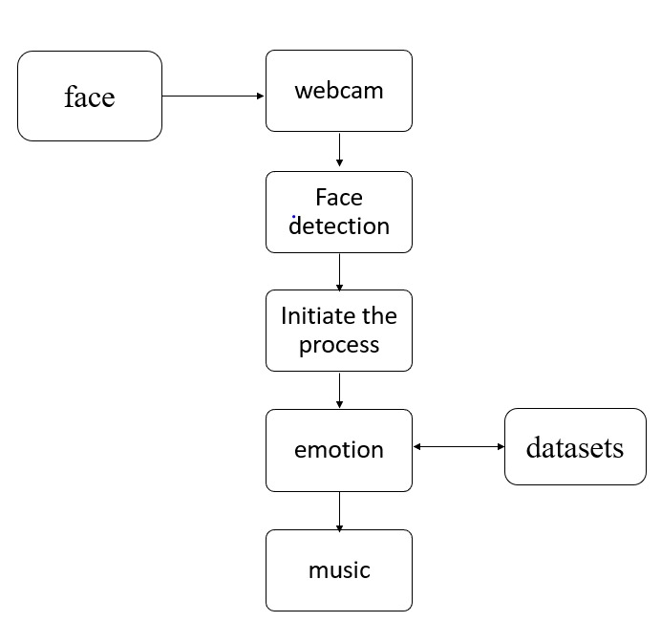
PROCESS:
Methods like TRANFER LEARNING, DATA AUGMENTATION, BATCH NORMALIZATION are also used.
We also used LOSS CATEGORICAL CROSS ENTROPY which means Cross-entropy builds upon the idea of entropy from information theory.

Slide 22
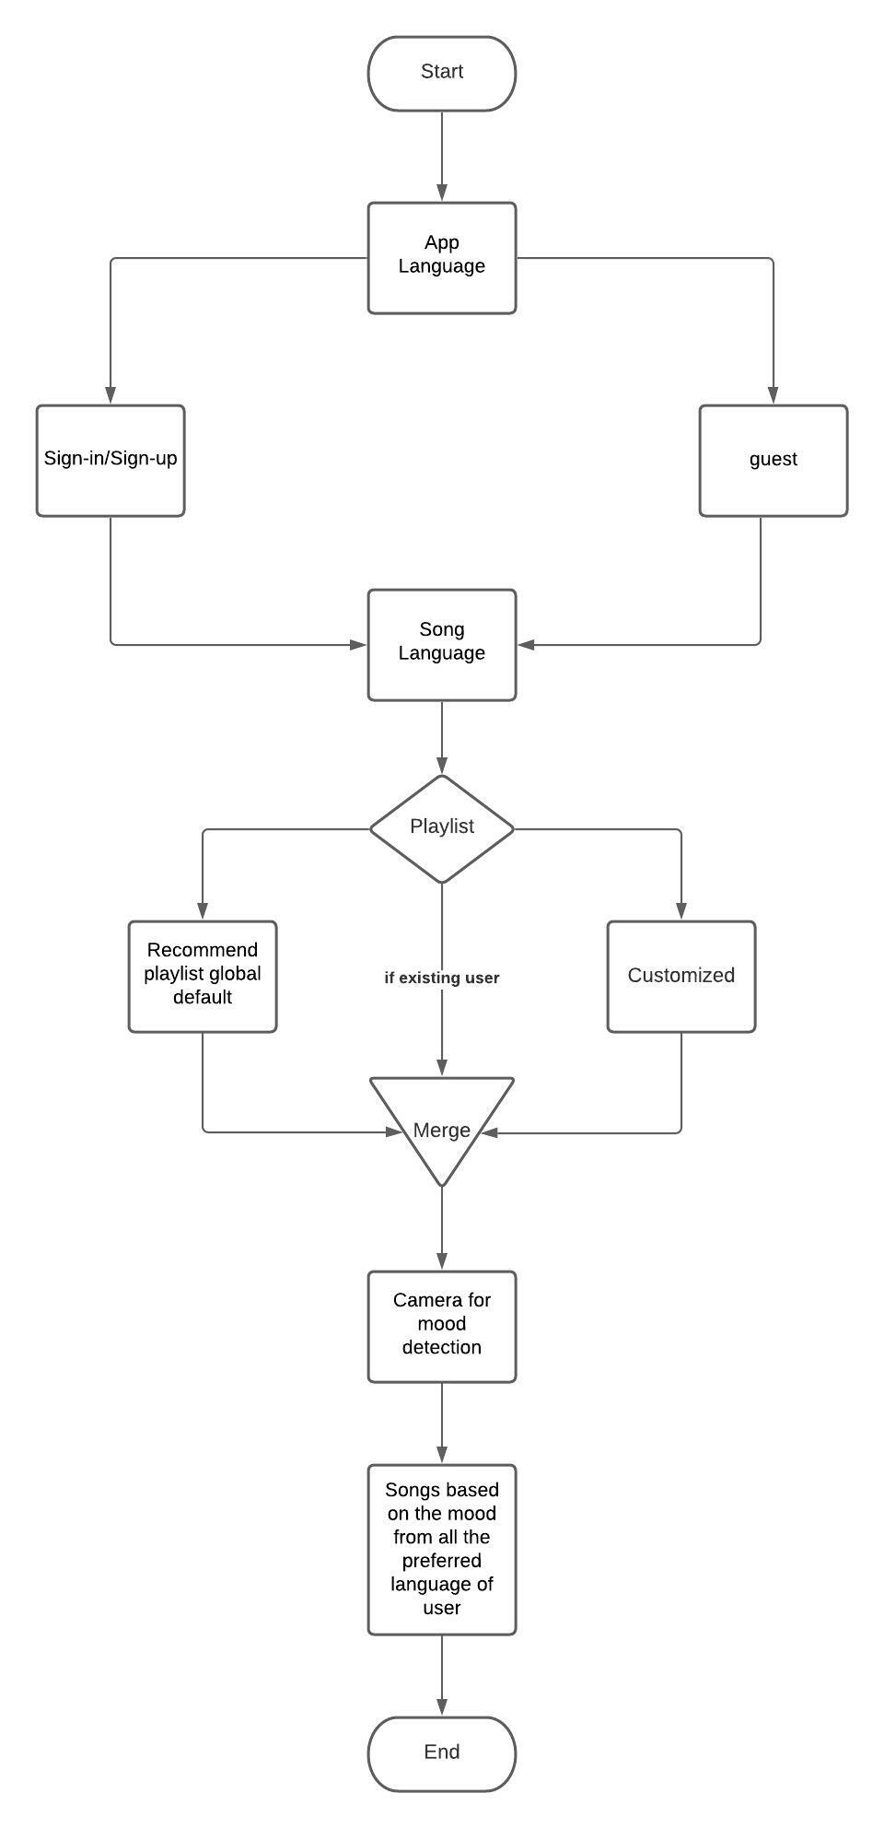
PROCESS:
Step 1: The user gives input, which is in the form of the image captured using the camera.
Step 2: The image gets analysed by our model and gets classified as a happy, sad, neutral or angry emotion.
Step 3: The data gets extracted and detected with the training datasets, which are fer-13 datasets.
Step 4: The playlist or songs are chosen according to the facial mood recognition of the user.
Step 5: The music gets played to boost the user’s mood after successful detection of the sentiments

Slide 23
Results and Discussion
This implementation by default detects emotions on all faces in the webcam feed. With a simple 4-layer CNN, the test accuracy reached 63.2% in 50 epochs.
The original FER2013 dataset in Kaggle is available as a single csv file. It has been converted into a dataset of images in the PNG format for training/testing and provided this as the dataset.
It is one of the more challenging datasets with human-level accuracy only at 65±5% and the highest performing published works achieving 75.2% test accuracy. Easily downloadable on Kaggle, the dataset’s 35,887 contained images are normalized to 224,224 pixels in grayscale. FER2013 is, however, not a balanced dataset.

Slide 24
Conclusion
This project has been developed to give us great advancement in the field of machine learning technology.
Emotion Based Music player fulfils to sort out the music based on the emotions of the user such as whether it is happy or sad.
So, totally our work aims to develop a player which is based on user need and it helps to revive in case of free time or leisure time if we want to hear music based on our current situation.
The front-end of the app is to be developed and will be submitted later.

Slide 25
REFERENCES: 1) Spotify — Song Prediction and Recommendation System by : Sunku Sowmya Sree Source: https://medium.com/swlh/spotify-song-prediction-and-recommendation-system-b3bbc71398ad 2) Create Music Recommendation System Using Python by : Ajinkya Khobragade Source: https://towardsdatascience.com/create-music-recommendation-system-using-python-ce5401317159 [3] A Complete Guide to Adam and RMSprop Optimizer By: Sanghvirajit Source: https://medium.com/analytics-vidhya/a-complete-guide-to-adam-and-rmsprop-optimizer-75f4502d83be [5] Dataset source By: Kaggle website Source: https://www.kaggle.com/c/challenges-in-representation-learning-facial-expression-recognition-challenge/data

Slide 26
ADVANTAGES
Users don’t want to select song manually.
No need of playlist.
Users don’t want to classify the songs based on the emotions.

Slide 27


