Slide 1


The Family History Guide
GETTING MORE PEOPLE CONNECTED WITH FAMILY HISTORY EACH WEEK

Slide 2

About the Family History Guide
* The Family History Guide is free.
* It’s for everyone.
* It’s produced by The Family History Guide L3C, an independent company.
* It has links to records but does not own them.
* The site grows and evolve with family history on the Web.

Slide 3
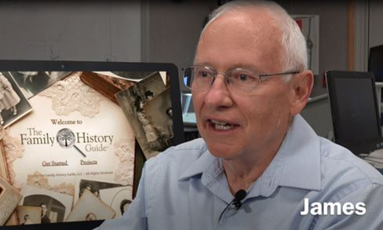
What They Are Saying …
* Worth the Wait
"I’ve been waiting for exactly this kind of site, and am amazed at how incredibly well- organized and inclusive it is. Thank you!" - Calif.
* A Significant Contribution
"Wow! This is a learning tool that will point you where you want to go when you want to go there." - Utah

Slide 4


The FHG has 2 Purposes:
1. Get people in the game.
2. Keep them in the game.
Mission Statement: A) Increase the number of people actively involved in family history worldwide, and B) Make everyone’s family history journey easier, more efficient, and more enjoyable.

Slide 5
1: Getting In
* Why aren’t more people doing family history?
A) “It’s too difficult”
B) “I don’t have enough time”
C) “It’s all been done” or “My aunt does it”
GET IN THE GAME … AND STAY IN THE GAME

Slide 6
A) Too difficult?
* Warm up to family history or tech basics.
* Choose tasks you can actually do.
* Find learning resources to help.
GET IN THE GAME … AND STAY IN THE GAME

Slide 7
B) Not enough time?
* Smaller tasks = shorter time segments needed
* More enjoyment = more time spent
* Leverage resources & people = more success
GET IN THE GAME … AND STAY IN THE GAME

Slide 8
C) Has it all been done?
* Missing branches and twigs
* Descendancy research
* Sources and cleanup
* Don’t miss your family history experience!
GET IN THE GAME … AND STAY IN THE GAME

Slide 9
What If More People Got In?
* Closer ties to living family and ancestors
* Greater connection to culture/history
* More collaboration, faster results
* More temple work done for LDS members
* Growth of the genealogy ecosystem
GET IN THE GAME … AND STAY IN THE GAME

Slide 10

Let’s Go for a Drive …
* www.thefhguide.com

