Slide 1

Novelty Search-based Bat Algorithm: Adjusting Distance among Solutions for Multimodal Optimization
The 22nd Asia Pacific Symposium on Intelligent and Evolutionary Systems
Takuya Iwase Ryo Takano Fumito Uwano Hiroyuki Sato Keiki Takadama
The University of Electro-Communications, Japan
Notes:
I am Takuya Iwase from the university of electro-communications. Today, I would like to talk about my research entitled by…

Slide 2
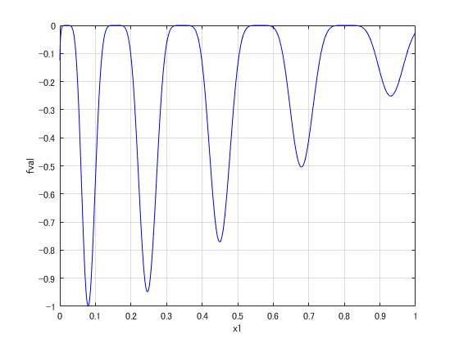
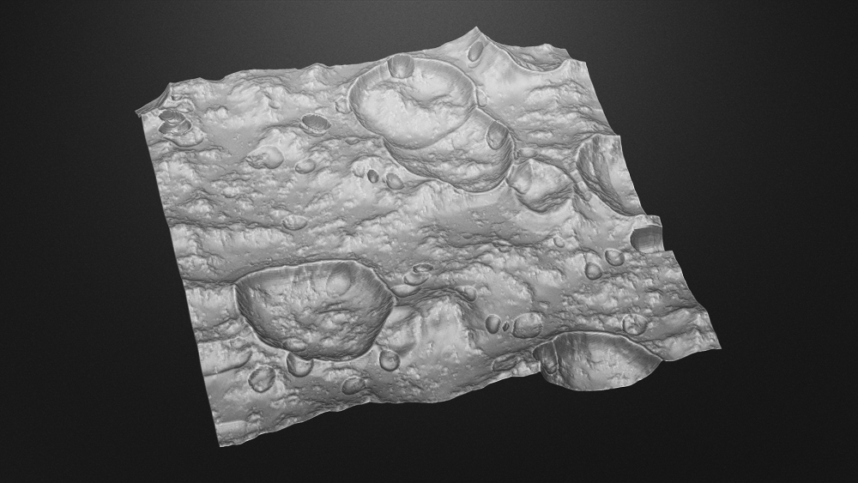
Introduction
(2 / 21)
Importance:
Searching multiple optima for multimodal optimization problems
e.g., Multimodal function for minimization
e.g., Interesting landing sites selection in lunar mission
important
local optima
Highlighted interesting sites
global optimum
: interesting sites (global & local optima)
Notes:
Real world problems are often represented as “multimodal” which have the multiple global & local optima.
For example, the left figure shows the multimodal function, which has several multiple optima. In detail, the deep red solution indicates the global optimum while the light red solutions indicate the local optima for the minimization problem. The right figure, on the other hand, shows the interesting landing site selection in lunar mission as one of real world problems. In this case, we have to find many interesting sites (represented by the red point). Like as the multimodal function, the deep red solution indicates the global optimum while the light red solutions indicate the local optima from interesting sites. For this issue, we want to know the location of interesting sites as much as possible.

Slide 3
Motivation
(3 / 21)
Finding multiple optima by Niching methods [X. Li, 2013]
Niching methods | Evolutionary Algorithms (EAs) | Niching scheme
CDE [R.Thomsen, 2004] | DE (mainly exploitation) [R. Storn, 1997] | crowding (replace solutions with nearest neighbor high-quality solution candidates)
SDE [X.Li, 2005] | DE (〃) | speciation (move solutions away from the nearest neighbor solutions)
Proposed (NSBA) | Bat Algorithm (exploitati-on + exploration) [Yang, 2010] | Novelty search (search never visited area) [J. Lehman et. al., 2008]
Notes:
To find multiple optima, the niching methods are proposed by X.Li. According to X.Li., the niching methods are designed by combining evolutionary algorithms with niching scheme. As major niching methods, the crowding DE is proposed by Thomsen to replace solutions with similar high-quality solution candidates, and DE with Speciation is proposed by Li to move solutions away from the nearest neighbor solutions.
What should be noted here is that these methods are not enough to find multiple local optima due to a weak of “exploration” search(anime). In detail, (1) DE updates the solutions from the current one, that is, the exploitation based search, which is hard to find the other solutions; and (2) the niching methods such as crowing and speciation mechanisms contributes to exploring solutions, but its search is not effective because they simply replace the solutions or move solutions from other solutions.
In these reasons, we proposed novelty search-based bat algorithm. The bat algorithm can adjust exploitation and exploration search. Besides, novelty search is to search new solutions where never visited area.

Slide 4


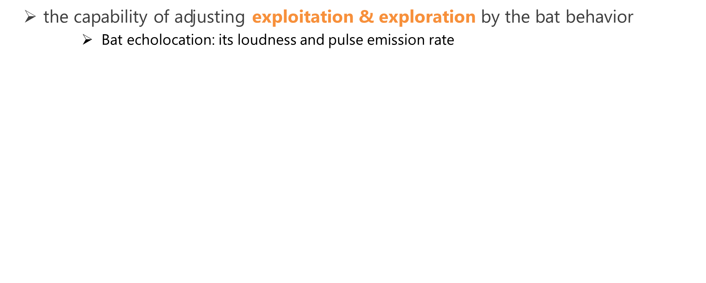
Bat Algorithm (BA)
(4 / 21)
the capability of adjusting exploitation & exploration by the bat behavior
Bat echolocation: its loudness and pulse emission rate
Exploitation
Exploration
Toward the global best solution
Near the global best solution
Loudness
Random search
Pulse emission rate
：Solution
：the global best solution
：solution candidate
Notes:
To tackle this problem, we employed Bat algorithm which is one of the evolutionary algorithms and inspired by the bat behavior. BA is superior for adjusting exploitation and exploration search.
As bats approach the global best solution, the loudness decreases while the pulse emission rate increases, to control the search area and the precision of distance to the global best solution.
As shown in this slide, BA consists of 3 search mechanisms, where the first two mechanisms are based on the exploitation search while the third mechanism is based on the exploration search.
In detail, BA updates the gray circle solutions to the orange circle solution candidates toward the star marked global best solution. And the other exploitation search, generate solution candidate around the global best solution represented by the orange dashed-line area as the exploitation search. BA also searches new areas by the random search as the exploration search.

Slide 5
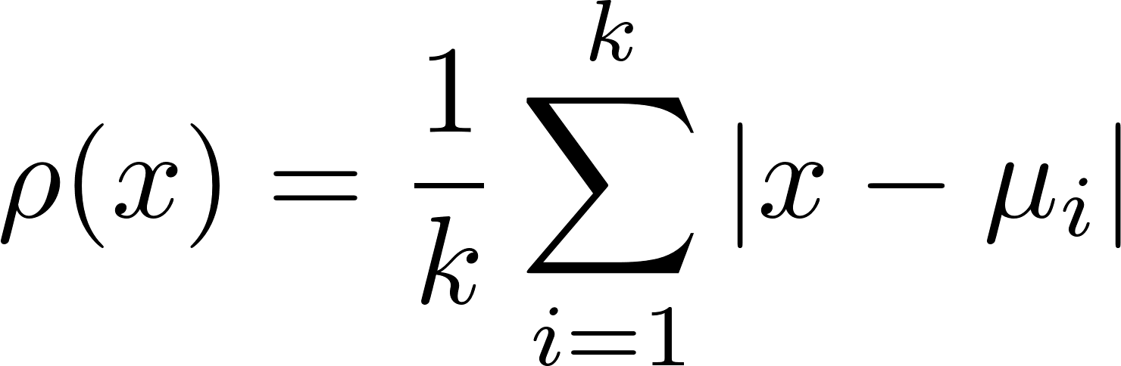














Novelty search (NS)
(5 / 21)
Search new solutions where never visited
The sparseness function:
${ μ}_{i}$: i-th nearest neighbor of $x$
$k$: the number of nearest neighbor
k=5
$$μ_{1}$$
$$μ_{1}$$
$$μ_{2}$$
$$μ_{2}$$
$$x$$
$$x$$
：target solution $x$
$$μ_{3}$$
$$μ_{3}$$
$$μ_{4}$$
$$μ_{4}$$
：solution $μ_{i}$
Notes:
Next, NS proposed by Lehman aims at searching never visited area, which has a potential of finding new solutions.
This figure shows how the new solution is searched in the case of the num of nearest neighbor k=5. Concretely, the new solution (corresponding to the orange target solution x) is searched by considering the distance to the other solutions (that is, four gray solutions u_1, u_2, u_3, and u_4).
To find the never visited area, NS calculates the sparseness of solutions by the following equation, meaning that the solutions are sparse when the ρ value is large. Note that we assume that never visited area can be searched when the solution becomes sparse.
In this example, the orange target solution x is promoted to be moved to the red solution because the ρ value becomes large by increasing the all of distance to the other four gray solutions.

Slide 6
Bat Algorithm (BA)
(6 / 21)
BA Flowchart
STEP1
Initialize population and parameters
STEP2
Generate solution candidates toward the global best solution
STEP3
Local search around the global best solution
STEP4
Random search in the search space
STEP5
Evaluate and update solutions
STEP6
Return to STEP2
Notes:
This is the BA flowchart which is divided in the following six steps.
In step 1, the population is initialized as well as the parameters.
(For each bat, the three solution candidates are generated)
In step 2, new solution candidates are generated toward the global best solution
In step 3, other new solution candidates are generated around a global best solution as the local search.
In step 4, in addition to them, other new solution candidates are explored as the random search in the search space.
In step 5, if one of three new solution candidates is better than the current solution, the current solution is replaced by better new solution candidate.
Finally, return to the step 2.

Slide 7






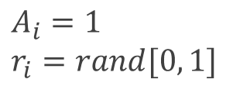


Bat Algorithm (BA)
(7 / 21)
BA description
STEP1: Initialize population and parameters
for i = 1 to N
$$x_{4}$$
$$\left(i=1,2,…, N\right)$$
$$x_{3}$$
rand $∈[0, 1]$
$x_{ub}:$ upper bound of the search space
$$x_{1}$$
$x_{lb}:$ lower bound of the search space
$$x_{2}=x_{∗}$$
$$A_{i}=1$$
$$r_{i}=rand[0, 1]$$
Endfor
: solution
Notes:
In step1, the population is randomly generated by the equation as shown in the right figure.
In detail, the i-th solution, x_i is generated within the upper bound of the search space (x_ub) and the lower bound of the search space (x_lb). Here, x2 = x* (anime)

Slide 8

Bat Algorithm (BA)
(7 / 21)
BA description
STEP1: Initialize population and parameters
for i = 1 to N
$$x_{4}$$
$$\left(i=1,2,…, N\right)$$
$$x_{3}$$
rand $∈[0, 1]$
$x_{ub}:$ upper bound of the search space
$$x_{1}$$
$x_{lb}:$ lower bound of the search space
$$x_{2}=x_{∗}$$
$$A_{i}=1$$
$$r_{i}=rand[0, 1]$$
Endfor
: solution

Slide 9
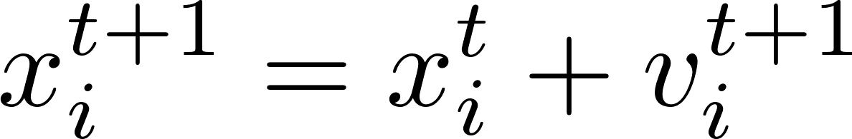



Bat Algorithm (BA)
(8 / 21)
BA description
STEP2: Generate solution candidates toward the global best solution
for i = 1 to N
$$x_{4}$$
$$x_{3}$$
$$x_{1}$$
Endfor
$$x_{i}^{t+1}$$
$$x_{2}=x_{∗}$$
$x_{∗} :$ global best solution
rand $∈[0, 1]$
: solution
: solution candidate
Notes:
After that, In step 2, new solution candidates are generated toward the global best solution.
For example, x_1 moves to right, x_3 moves down, and x_4 moves left to be close to the global best solution. Such moved solutions become new solution candidates. Note that x_2 does not move because the x_2 is the global best solution, (that is, the distance to the global best solution is 0.)

Slide 10
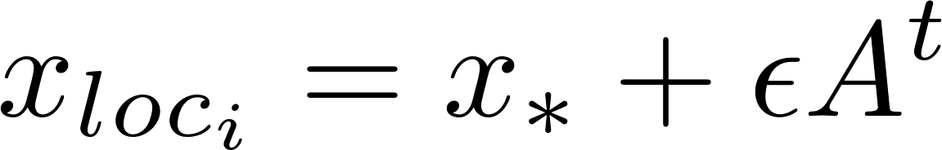




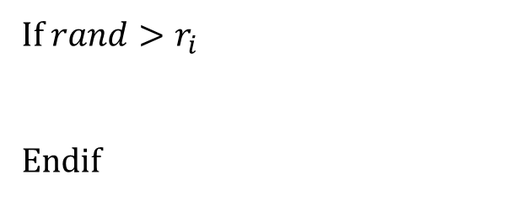


Bat Algorithm (BA)
(9 / 21)
BA description
STEP3: Local search around a global best solution
for i = 1 to N
$$x_{4}$$
If $rand>r_{i}$
Endif
$2εA$
$$x_{3}$$
$$x_{1}$$
$$x_{loc_{i}}$$
Endfor
$$x_{∗}$$
$ε$: parameter to control the search area in this step
: solution
: solution candidate
Notes:
In step 3, if the pulse emission rate r is less than random value, other new solution candidates are generated around the global best solution as the local search.
In detail, the solution of x_loc_i is generated around x_* by the equation as shown in this figure.
$2εA$ is the window of x_* which means that solution candidates x_loc_i are generated within this range limited by $ε$.

Slide 11

Bat Algorithm (BA)
(10 / 21)
BA description
STEP4: Random search in the search space
for i = 1 to N
$$x_{4}$$
$$x_{3}$$
$$x_{rnd_{i}}$$
Endfor
$$x_{1}$$
$$x_{∗}$$
: solution
: solution candidate
Notes:
other new solution candidate, x_rnd_i is randomly generated in the search space by the equation, which is the same one in step 1.

Slide 12
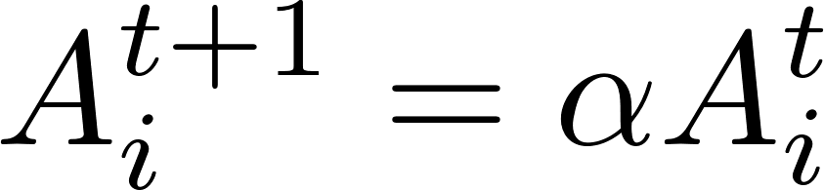
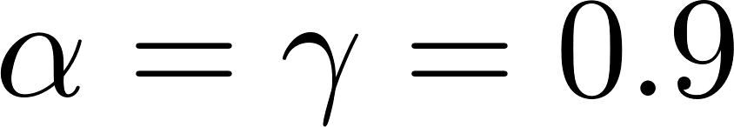
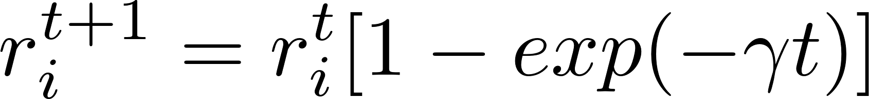
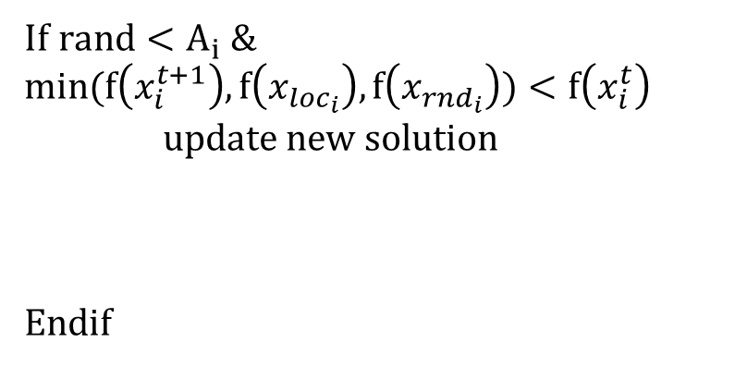

Bat Algorithm (BA)
(11 / 21)
BA description
STEP5: Evaluate and update
STEP6: Return to STEP2 (until final iteration)
for i = 1 to N
$$x_{4}$$
If $rand<A_{i} \&$ $$min(f\left(x_{i}^{t+1}\right), f\left(x_{loc_{i}}\right), f\left(x_{rnd_{i}}\right))<f\left(x_{i}^{t}\right)$$
update new solution
Endif
$$x_{3}$$
$$x_{1}$$
$$x_{i}^{t+1}$$
$$x_{∗}$$
Endfor
: solution
: new solution
Notes:
In step 5, if the loudness value is larger than random value and one of three new solution candidates is better than the current solution, the current solution is replaced by better new solution candidate.
After that the loudness value decreases, while the pulse emission rate increases in contrast.
In step 6, return to the step 2.

Slide 13




Bat Algorithm (BA)
(11 / 21)
BA description
STEP5: Evaluate and update
STEP6: Return to STEP2 (until final iteration)
for i = 1 to N
If $rand<A_{i} \&$ $$min(f\left(x_{i}^{t+1}\right), f\left(x_{loc_{i}}\right), f\left(x_{rnd_{i}}\right))<f\left(x_{i}^{t}\right)$$
update new solution
Endif
$$x_{2}$$
$$x_{4}$$
$$x_{3}$$
$$x_{∗}$$
Converge to the global best solution
Endfor
: solution
: new solution
Notes:
Through the cycle of these six steps, the solutions are closed to the global best solution, and finally converge to the global optima.

Slide 14
Novelty Search-based Bat Algorithm (NSBA)
(12 / 21)
BA and NSBA Flowchart
STEP1
Initialize population and parameters
STEP2
Generate solution candidates toward the global best solution
STEP3
Local search around the global best solution
STEP4
Random search in the search space
STEP5
Evaluate and update solutions
STEP6
Return to STEP2
STEP1
Initialize population and parameters
STEP2
Generate solution candidates toward sparse area
STEP3
Local search around the personal best solution
STEP4
Random search in the search space
STEP5
Evaluate and update solutions
STEP6
Return to STEP2
Notes:
This slide adds the NSBA flowchart in the BA flowchart
As you can see, we improve two parts for NSBA.
In detail, the step 2 is improved to introduce Novelty search into BA for finding many optima which has not yet found. The step 3 is also improved to generate new solution candidates around the personal best solution instead of the global best solution. This change aims for finding better solutions around the personal best solution.
I will explain these improvements from the next slide.

Slide 15
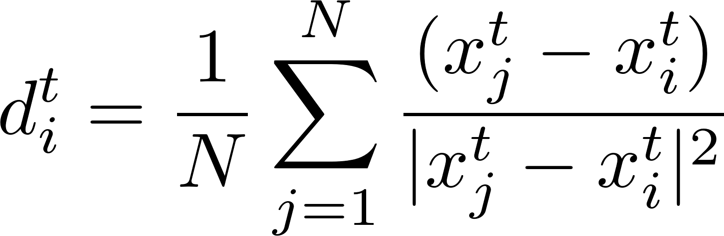
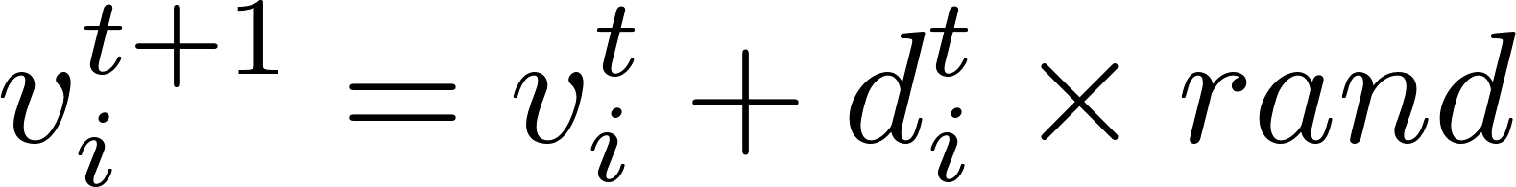





Novelty Search-based Bat Algorithm (NSBA)
(13 / 21)
NSBA description
STEP2: Generate new solution candidates toward sparse area
Novelty Search
$$x_{4}$$
$$x_{i}^{t+1}$$
The sparseness function:
Spread solutions to never visited area
$$x_{3}$$
${ μ}_{i}$: i-th nearest neighbor of $x$
$$x_{1}$$
$$x_{2}$$
$N:$ population size
rand $∈[0, 1]$
: solution
: solution candidate
Notes:
In order to find other solutions, the step 2 in NSBA move solutions from dense area to sparse area by NS. Concretely, NSBA calculates the distance vector of solution by this equation, where this part corresponds to the sparseness function. What should be noted hear (highlight) is that this equation is modified from the norm (the absolute value of x_j – u_i) to the vector (x_j – x_i) to determine the moving direction and is also modified to adjust the moving distance by dividing it with the square of the norm.
From this equation, for example, x_1 moves to left up, x_2 moves to left down, x_3 moves up left, and x_4 moves to right down in order to move from dense area to sparse area. Since square of distance between x_i and x_j becomes large when solutions already distributed, the moving distance is calculated almost 0.

Slide 16
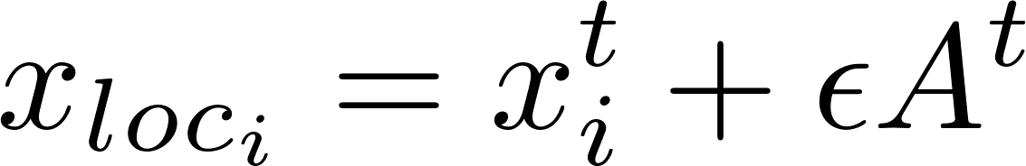




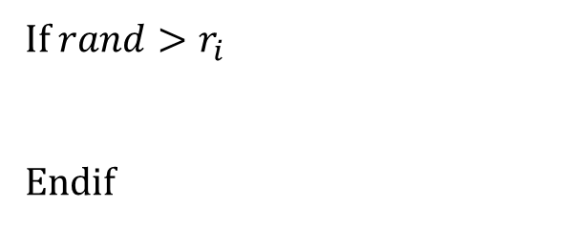



Novelty Search-based Bat Algorithm (NSBA)
(14 / 21)
NSBA description
STEP3: Local search around the personal best solution
If $rand>r_{i}$
Endif
$$x_{4}$$
$2εA$
$2εA$
$2εA$
$$x_{3}$$
$$x_{1}$$
$2εA$
$$x_{loc_{i}}$$
$$x_{2}$$
: solution
: solution candidate
Notes:
To keep and improve the multiple solutions, the step 3 in NSBA search the solution around the personal best solution instead of the global best solution.
From this modification, for example, the x_loc_1, the local solution of x_1 is generated around x_1 within the range of $2εA$. The local solution of x_2 is also generated around x_2 within the range of $2εA$, and so on.

Slide 17

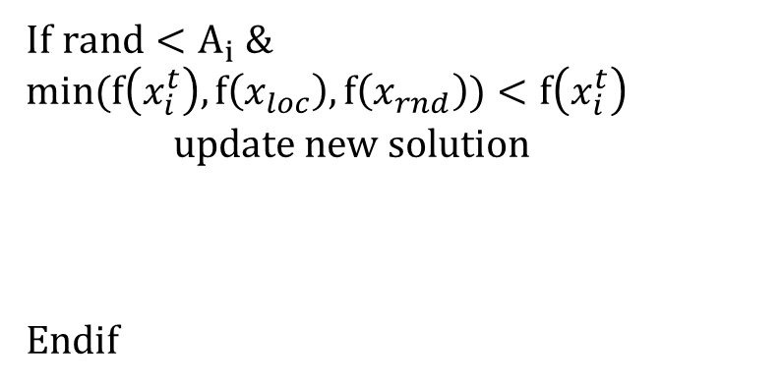
Novelty Search-based Bat Algorithm (NSBA)
(15 / 21)
NSBA description
STEP5: Evaluate and update
STEP6: Return to STEP2 (until final iteration)
If $rand<A_{i} \&$ $$min(f\left(x_{i}^{t}\right), f\left(x_{loc}\right), f\left(x_{rnd}\right))<f\left(x_{i}^{t}\right)$$
update new solution
Endif
$$x_{4}$$
$$x_{3}$$
$$x_{2}$$
$$x_{i}^{t+1}$$
: solution
: new solution
Notes:
This mechanism can locate solutions to multiple local optima.
The conventional BA tends to converge to the global best solution, in contrast, NSBA enables solutions to locate at never visited area as you can see the right figure.

Slide 18
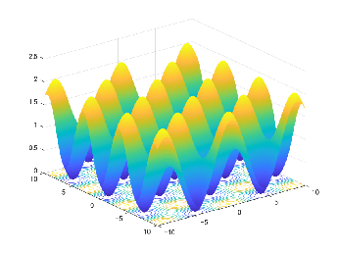
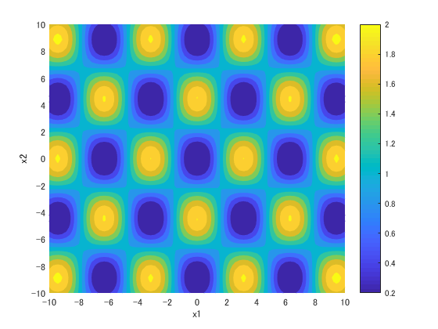
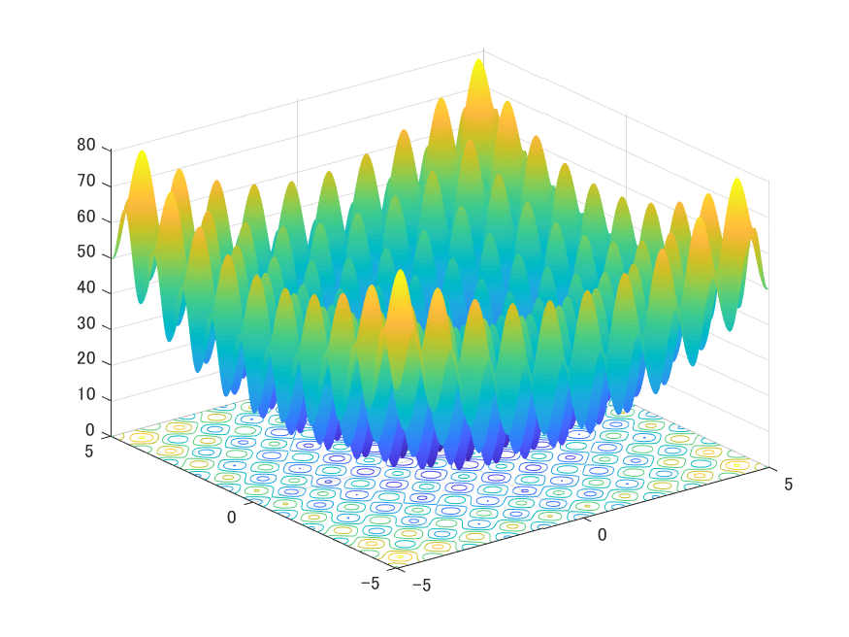
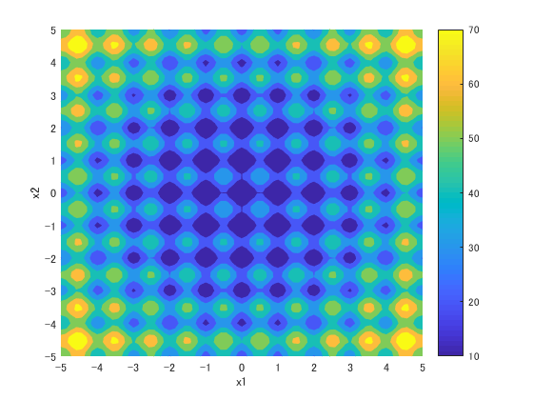
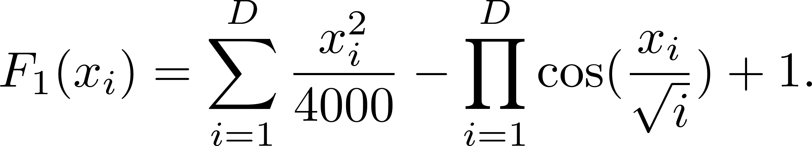
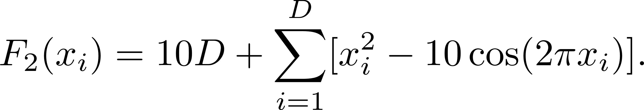
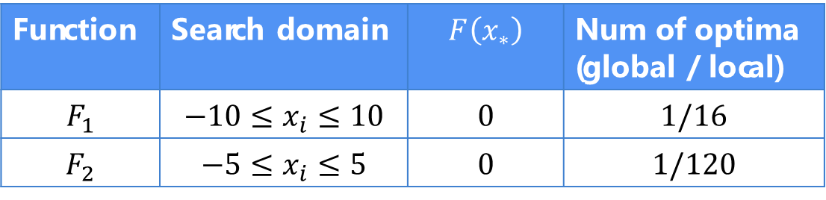


Test-bed problems
(16 / 21)
Benchmark test functions for minimization
$F_{1}$: Griewank Function
$F_{2}$: Rastrigin Function
: global optimum
Function | Search domain | $$F\left(x_{∗}\right)$$ | Num of optima (global / local)
$$F_{1}$$ | $$−10≤x_{i}≤10$$ | 0 | $1$/16
$$F_{2}$$ | $$−5≤x_{i}≤5$$ | 0 | 1/120
Notes:
To investigate the effectiveness of NSBA compared with BA, we employ 2 multimodal functions for minimization. These figures show the 2-dimensional fitness landscape and the contour plot. The left figure shows the Griewank Function represented by this equation, while the right figure shows the Rastrigin function represented by this equation. (As the characteristics of these functions, Griewank Function has …. while Rastrigin function has…)
In detail, the search space in F1 is the range from -10 to 10 in each dimension and the global best solution is 0, while the search space in F2 is the range from -5 to 51in each dimension and the global best solution is also 0.
Since the blue area indicates the good solution area while the yellow area indicates the bad solution area in this figure, the global and local optima are located in the blue area in both functions. The global optimum is located at [0, 0] in both functions (yellow star as shown in the contour plot).
In detail, F1 has 1/16, and F2 has 1/120. The global optimum of both function is located as the center of this function and the better local optima are located around the global optimum (as shown in this figure).

Slide 19
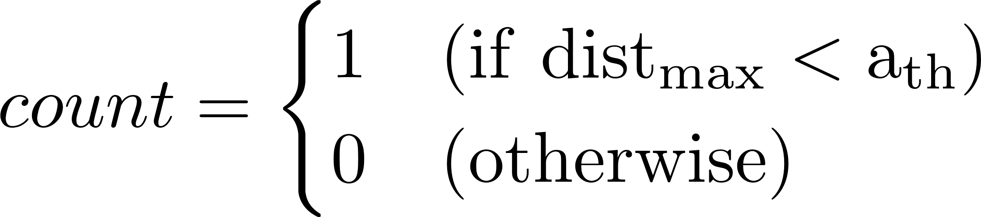

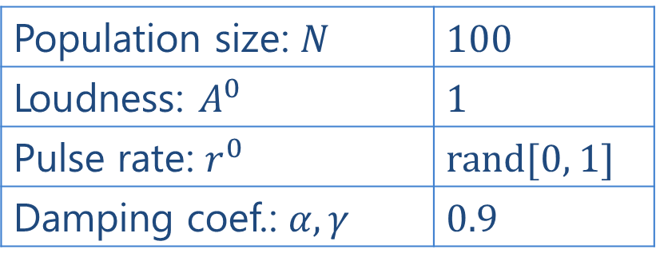
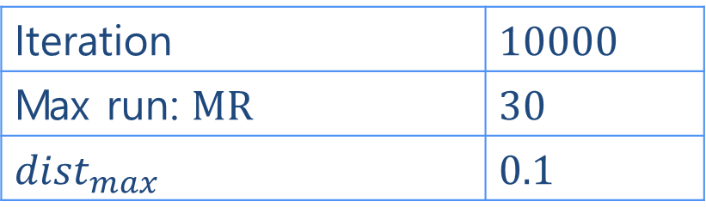

Experiment
(17 / 21)
Comparison to BA with NSBA
Parameters setting
BA and NSBA
Population size: $N$ | 100
Loudness: $A^{0}$ | 1
Pulse rate: $r^{0}$ | rand[0, 1]
Damping coef.: $α, γ$ | 0.9
Case 1: $F_{1} (D=2)$
Case 2: $F_{2} (D=2)$
the number of found peaks (global & local optima)
$FPs=\sum_{i=1}^{TP}{count_{i}}$
the ratio of FPs
$Peak Ratio \left(PR\right)=\frac{\sum_{run=1}^{MR}{FPs}}{TP∗MR}$
Evaluation measurement
Iteration | 10000
Max run: MR | 30
$${dist}_{max}$$ | 0.1
$TP:$ Total peaks
Notes:
To compare BA with NSBA, we employed Found Peaks (FPs) and Peak ratio (PR) as the evaluation criteria. FPs means how many peaks the algorithm found. In this experiment, we defined the peak is found, when Euclidean distance between the peak and the nearest neighbor solution less than threshold dist_{max}0.1.
And PR means the ratio of FPs.
Parameters are setting as right table.

Slide 20

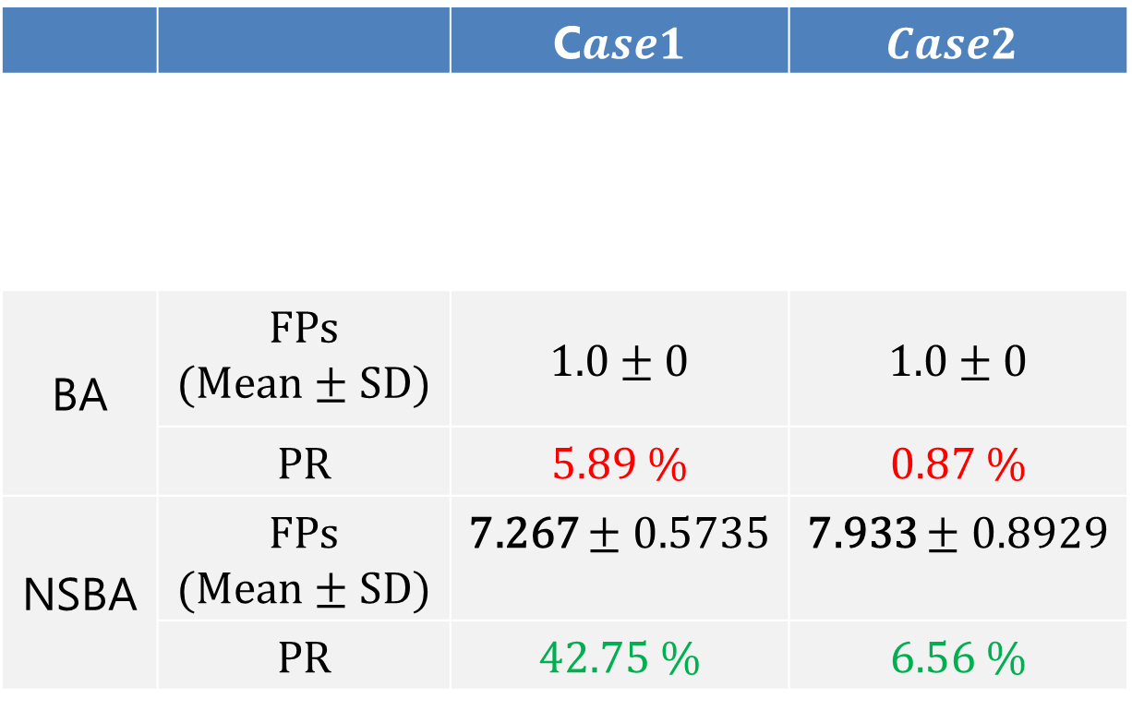
Results
(18 / 21)
Found Peaks(FPs) and Peak Ratio (PR) of BA and NSBA (averaged over 30 runs)
 |  | C$ase1$ | $$Case2$$
BA | FPs (Mean ± SD) | 1.0 ± 0 | 1.0 ± 0
 | PR | 5.89 % | 0.87 %
NSBA | FPs (Mean ± SD) | 7.267 ± 0.5735 | 7.933 ± 0.8929
 | PR | 42.75 % | 6.56 %
Notes:
From F1, BA found just 1 peak and the PR was 5.89%. NSBA found about 7 peaks and the PR was 42.75% (dramatically higher than BA).
From F2, BA also found just 1peak (and the PR was 0.87%), but NSBA found 7.9 peaks and the PR was 6.56%.
NSBA outperformed than BA from this table, but the PR of BA and NSBA were quite small value.

Slide 21
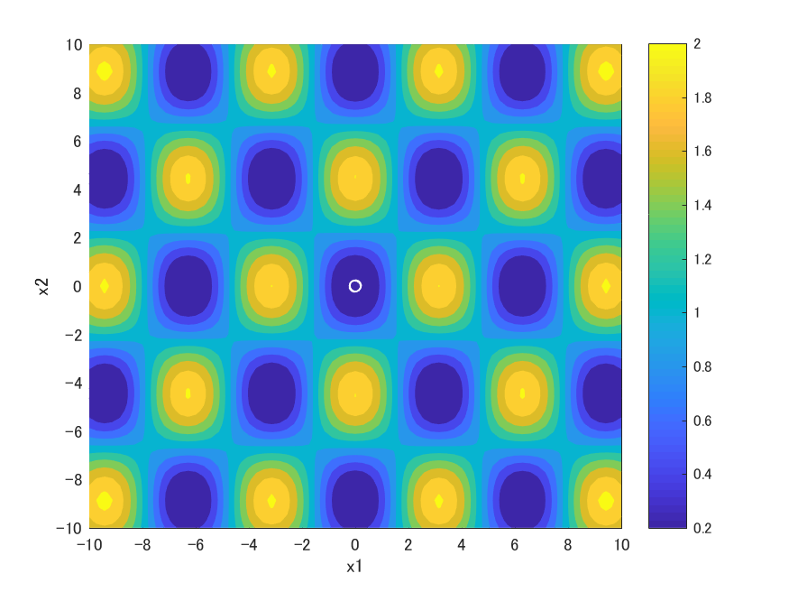
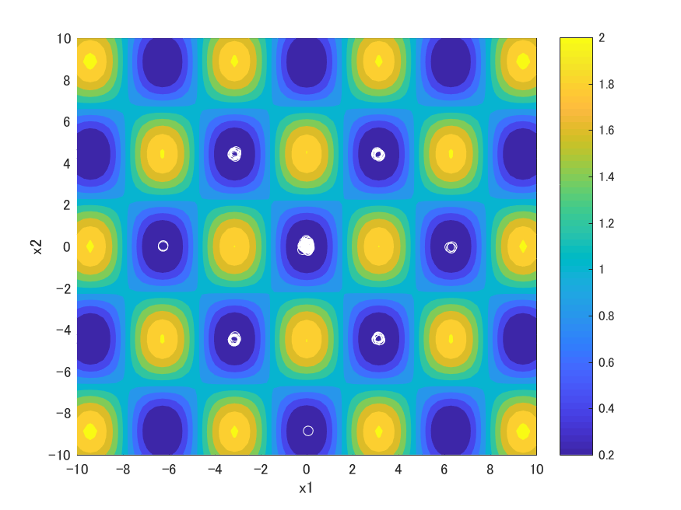
Result: Case1
(19 / 21)
Solution distribution at the final iteration
BA
NSBA
Advantage: NSBA found the global optima and some local optima
Notes:
These figures are the solution distribution of BA and NSBA.
The white circle shows solutions at the final iteration.
From case1, BA found only the global optimum, however, NSBA found the global optimum with some local optima around it.

Slide 22

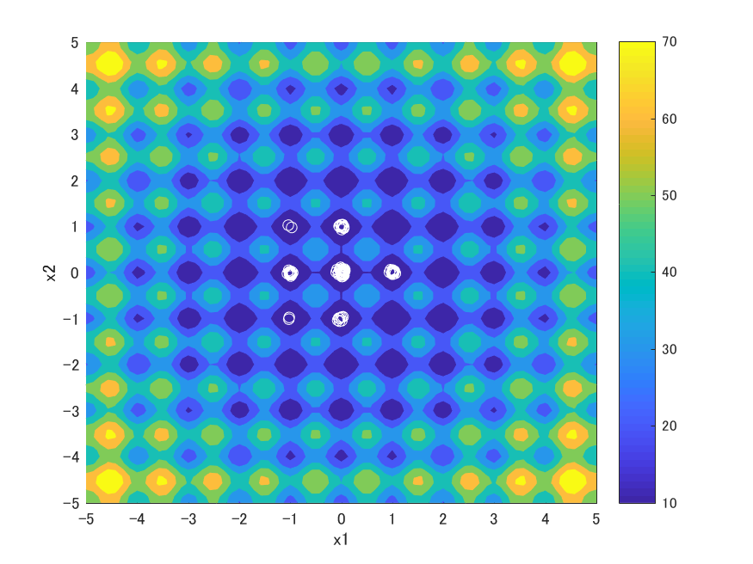

Result: Case2
(20 / 21)
Solution distribution at the final iteration
BA
NSBA
Advantage: NSBA found the global optima and some local optima
Notes:
In case2, BA also found only the global optimum. But NSBA found 7 optima including global and local optima.

Slide 23
Conclusion
(21 / 21)
Objective:
Searching multiple optima in multimodal optimization
Proposed method:
Novelty Search-based Bat Algorithm
Extends BA with searching new solutions where never visited
Changes exploitation around the personal best solution
Implications:
NSBA can search both a single global optimum and some local optima
NSBA > BA
Future work:
Find and keep all global and local optima
Notes:
In conclusion, for searching multiple optima in multimodal optimization, we proposed Novelty search-based Bat algorithm which extends BA with a mechanism (NS) to search new solutions where never visited.
We made 2 changes from conventional BA. The one is to extend with Novelty search, and the other is change exploitation around the personal best solution.
As a result of simulations of BA and NSBA, BA just searched a single global optimum, but NSBA could search both a single global optimum and some local optima.
In the future, we will find and keep all global and local optima.

Slide 24
appendix

Slide 25
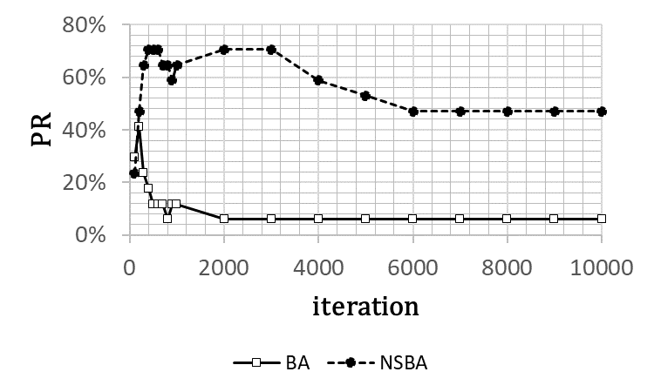
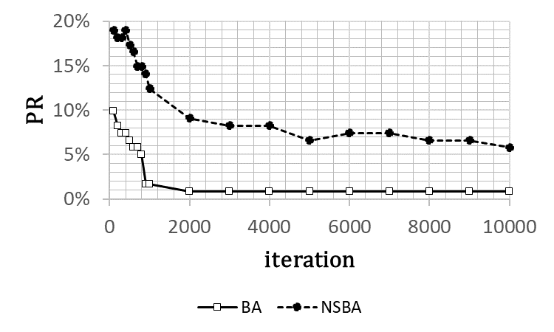


Results
(23 / 21)
Performance of BA and NSBA
$F_{1}$: Griewank
$F_{2}$: Rastrigin

Slide 26
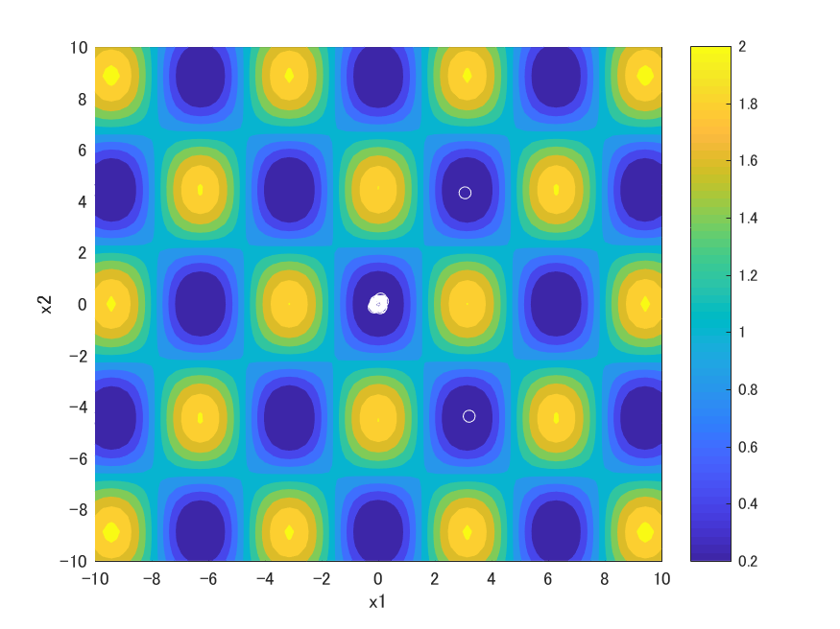
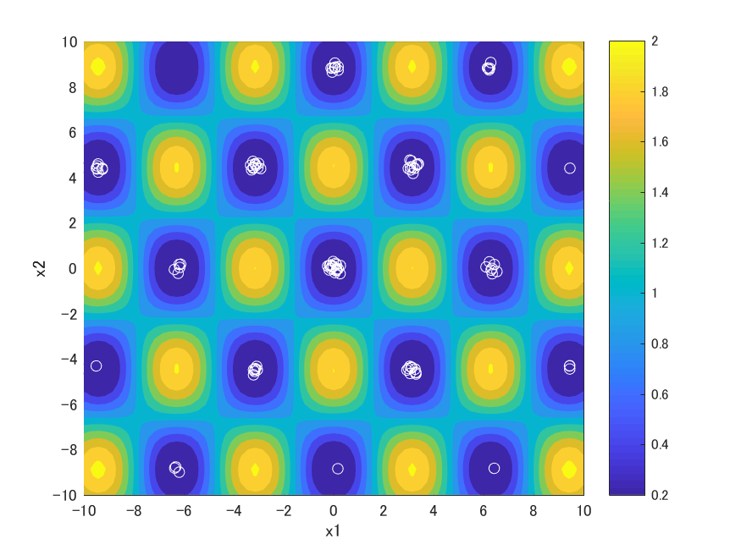
Results
(24 / 21)
Solution distribution at the 1000 iterations
BA
NSBA
Advantage: NSBA found more optima at the iteration 1000 than the final iteration

Slide 27

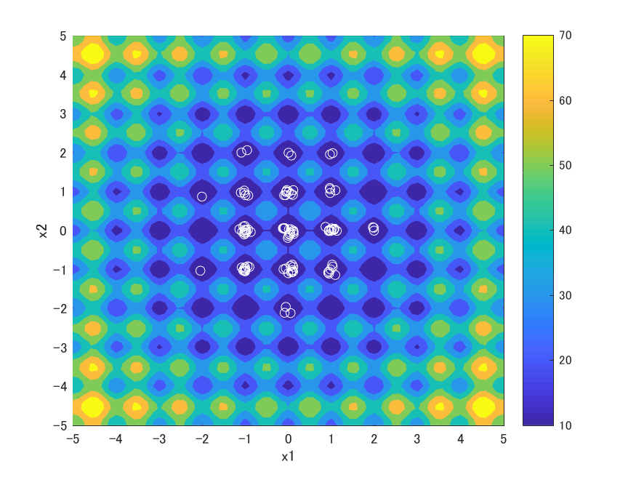
Results
(25 / 21)
Solution distribution at the 1000 iterations
BA
NSBA
Advantage: NSBA found more optima at the iteration 1000 than the final iteration

