Slide 1

Novelty Search-based Bat Algorithm: Adjusting Distance among Solutions for Multimodal Optimization
The 22nd Asia Pacific Symposium on Intelligent and Evolutionary Systems
〇Takuya Iwase† Ryo Takano† Fumito Uwano† Hiroyuki Sato† Keiki Takadama†
† The University of Electro-Communications
Notes:
My name is …. I am 2nd year student in master degree at the university of electro-communications. Today, I would like to tell you about my research. The title is….

Slide 2
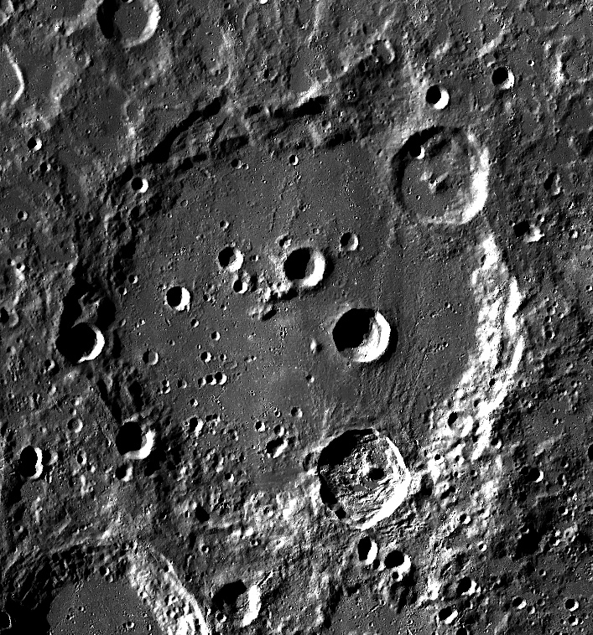
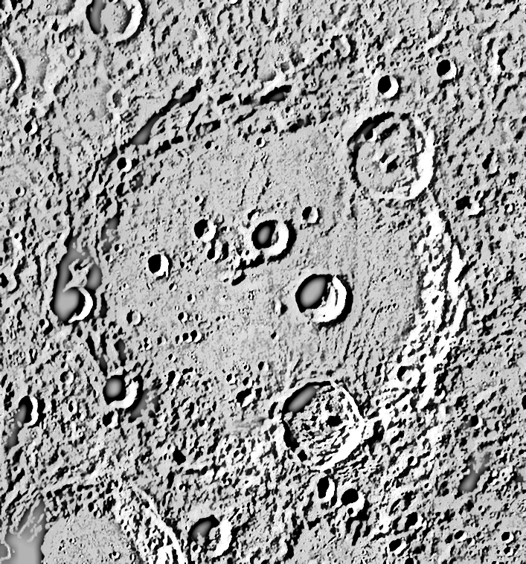
Introduction
(2 / 15)
Searching multiple optima for multimodal optimization problems
i.e., some landing sites selection in lunar mission by the orbiter spacecraft
Better communication time, and smaller inclination angle
: proposed landing sites (=optima)
Raw image of moon
Highlighted landing sites
Notes:
Evolutionary algorithms (EAs) gradually became used for real-world problems, (i.e., …).
In this case (from left figure), we have to find some landing sites which are located in flat area and here, we can easily communicate for sending moon data to the earth (shown in the right figure). Finding one best landing site is important, but the best landing site is not always the best because it might be changed.
So, we would like to know some landing sites as optima as possible as we can

Slide 3
Introduction
(3 / 15)
Evolutionary Algorithms (EAs) are designed for searching a single global optimum (i,e., PSO, FA, DE)
Bat Algorithm (BA): the capability of switching several search steps by the bat echolocation
Exploitation
Local search
Exploration
Toward a global best solution
Nearby a global best solution
Random search
：Solution (bat)
：a global best solution (a bat nearby food/prey)
：new candidate solution
Notes:
For searching multiple optima problems, EAs are used as measure methods. But, EAs are designed….
One of the algorithms, bat algorithm is superior for switching several search steps here. The BA mechanism consists of 3 search steps.

Slide 4

Motivation
(4 / 15)
To solve multimodal optimization problems
BA also tends to straightforward converge to a single global optima
Extends BA with a new mechanism: enabling solutions to spread away
Novelty search [J. Lehman et al., 2008]: spread solutions away from the dense area to sparse area
Bat Algorithm
$$+$$
Novelty Search
Novelty Search-based Bat Algorithm :
Notes:
However, BA also tends to straightforward converge to a single global optimum, so we focused on the BA extending with a mechanism which enables solutions to spread away toward sparse area.

Slide 5
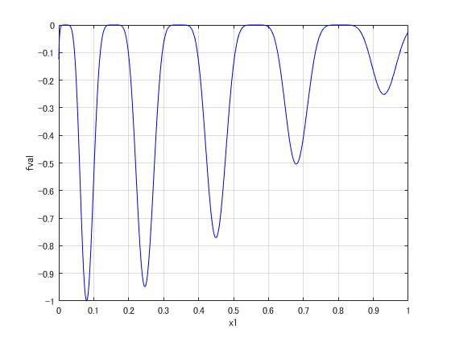




Proposed method
(5 / 15)
Novelty Search-based Bat Algorithm (NSBA)
STEP1: Initialize population and parameters
$$x_{4}$$
$$x_{3}$$
$$x_{1}$$
$$x_{2}$$
: solution

Slide 6
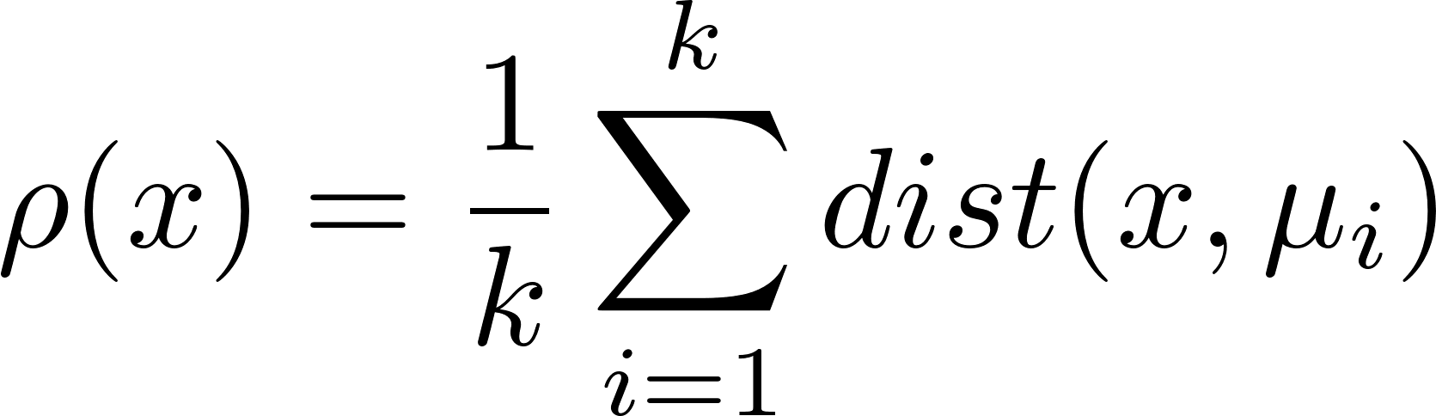
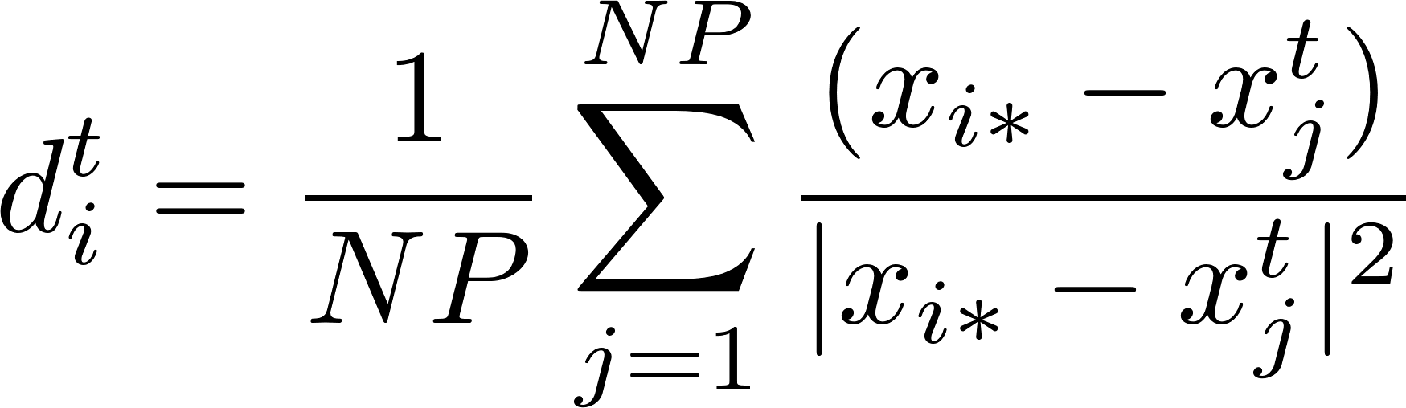
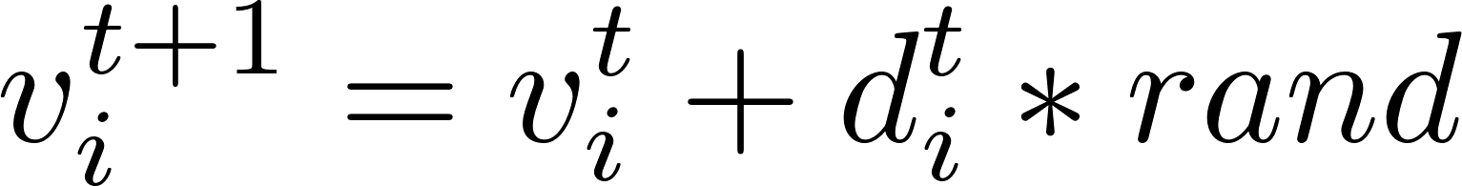
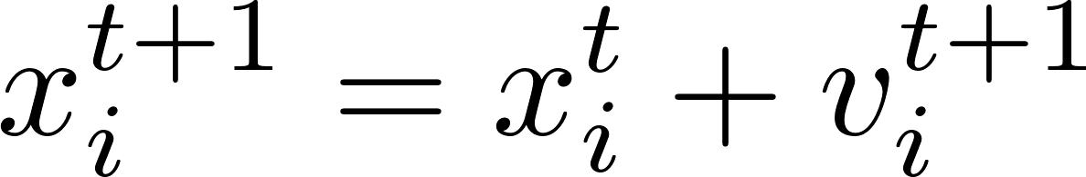



Proposed method
(6 / 15)
Novelty Search-based Bat Algorithm (NSBA)
STEP2: Generate a new solution candidate and velocity
Novelty Search
$$x_{4}$$
$$x_{1}^{t+1}$$
The sparseness function:
$$x_{3}$$
${ μ}_{i}$: i-th nearest neighbor of $x$
$$x_{1}$$
$$x_{2}$$
rand $∈[0, 1]$
: solution
: solution candidate
Notes:
This is the novelty search. When some solutions are crowded in the dense area, the sparseness function rho can keep solution x away from the nearest neighbor solutions mu. But this function calculates norm vector, so we represented it to vector equation as below.

Slide 7
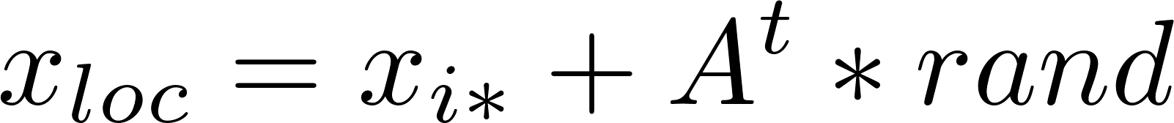


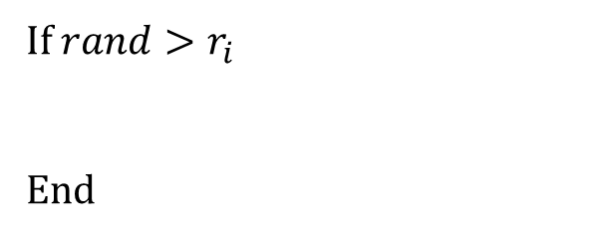
Proposed method
(7 / 15)
Novelty Search-based Bat Algorithm (NSBA)
STEP3: Local search around a personal best solution
If $rand>r_{i}$
End
$$x_{4}$$
rand $∈[0, 1]$
$$x_{3}$$
$$x_{1}$$
$$x_{loc}$$
$$x_{2}$$
: solution
: solution candidate

Slide 8

Proposed method
(8 / 15)
Novelty Search-based Bat Algorithm (NSBA)
STEP4: Random search in the search space
$$x_{4}$$
$$x_{3}$$
$$x_{rnd}$$
$$x_{1}$$
$$x_{2}$$
: solution
: solution candidate

Slide 9
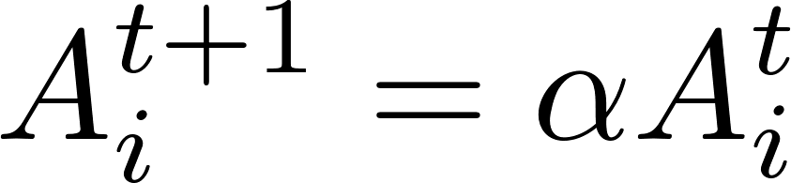
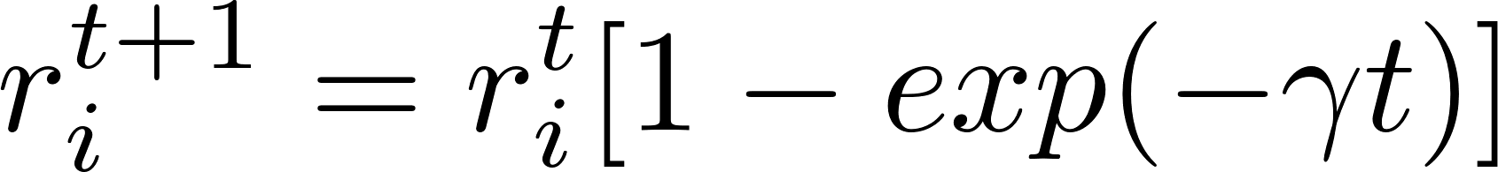

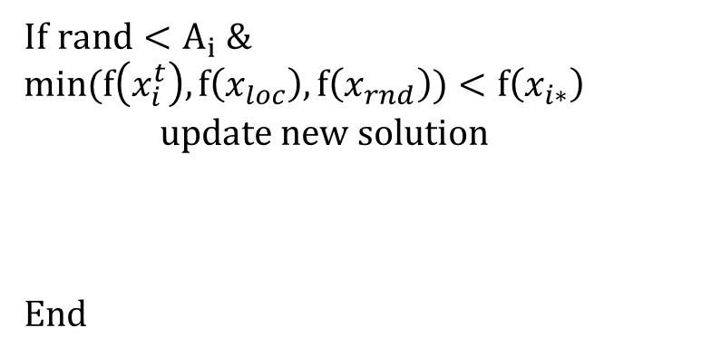
Proposed method
(9 / 15)
Novelty Search-based Bat Algorithm (NSBA)
STEP5: Evaluate and update
STEP6: Return to STEP2 (until final iteration)
If $rand<A_{i} \&$ $$min(f\left(x_{i}^{t}\right), f\left(x_{loc}\right), f\left(x_{rnd}\right))<f\left(x_{i∗}\right)$$
update new solution
End
$$x_{4}$$
$$x_{3}$$
$$x_{2}$$
$$x_{1}^{t+1}$$
: solution
: new solution

Slide 10
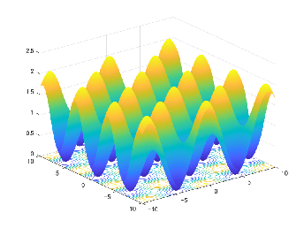
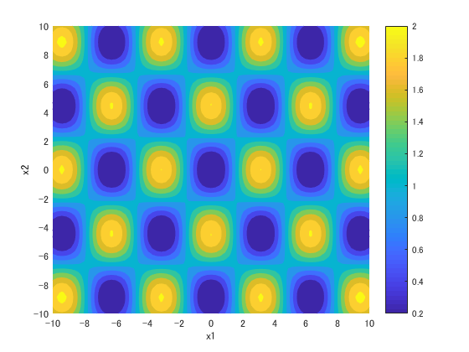
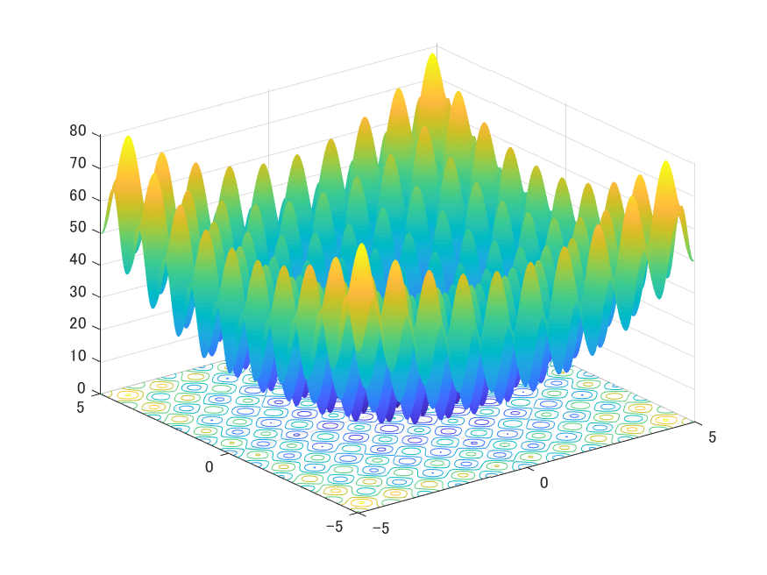
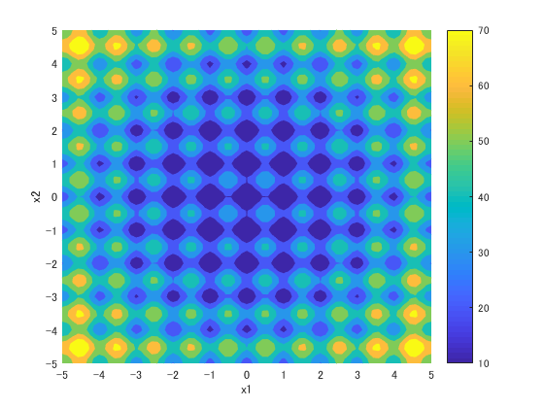
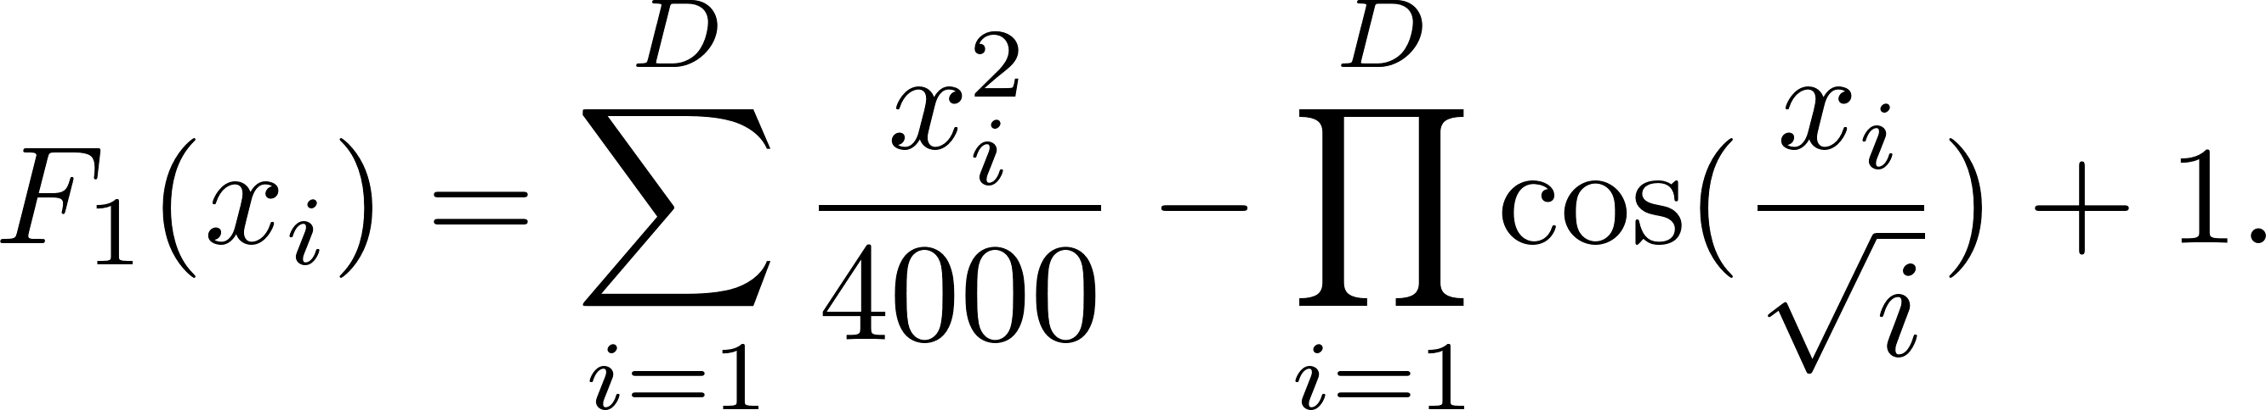
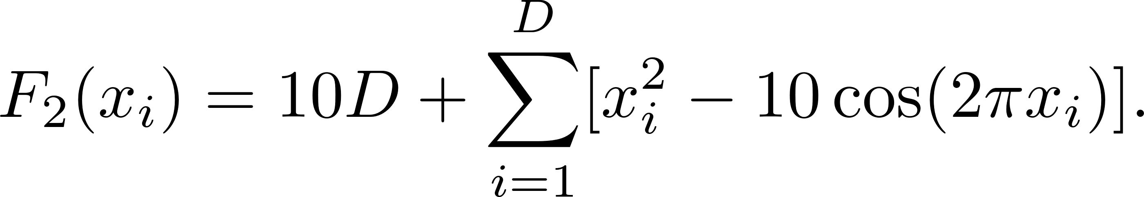
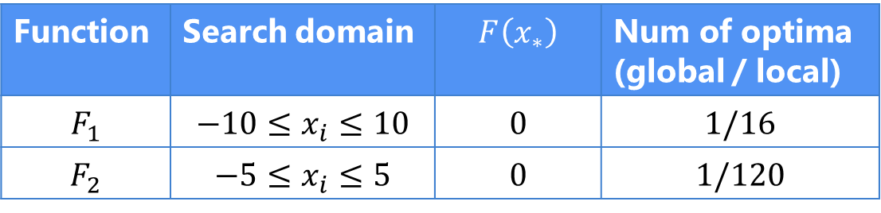


Experimental setup
(10 / 15)
Benchmark test functions
$F_{1}$: Griewank Function
$F_{2}$: Rastrigin Function
Function | Search domain | $$F\left(x_{∗}\right)$$ | Num of optima (global / local)
$$F_{1}$$ | $$−10≤x_{i}≤10$$ | 0 | $1$/16
$$F_{2}$$ | $$−5≤x_{i}≤5$$ | 0 | 1/120

Slide 11

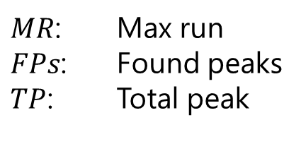
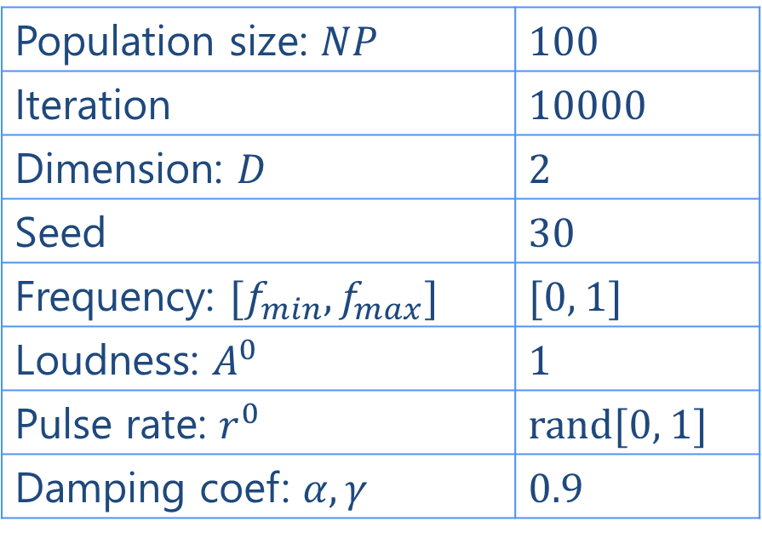
Experimental setup
(11 / 15)
Evaluation measurement
Parameters
$$Peak Ratio (PR)=\frac{\sum_{run=1}^{MR}{FPs}}{TP∗MR}$$
BA vs. NSBA
Population size: $NP$ | 100
Iteration | 10000
Dimension: $D$ | 2
Seed | 30
Frequency: $[f_{min}, f_{max}]$ | [0, 1]
Loudness: $A^{0}$ | 1
Pulse rate: $r^{0}$ | rand[0, 1]
Damping coef: $α, γ$ | 0.9
$MR$: Max run
$FPs$: Found peaks
$TP$: Total peak
Compared algorithm

Slide 12
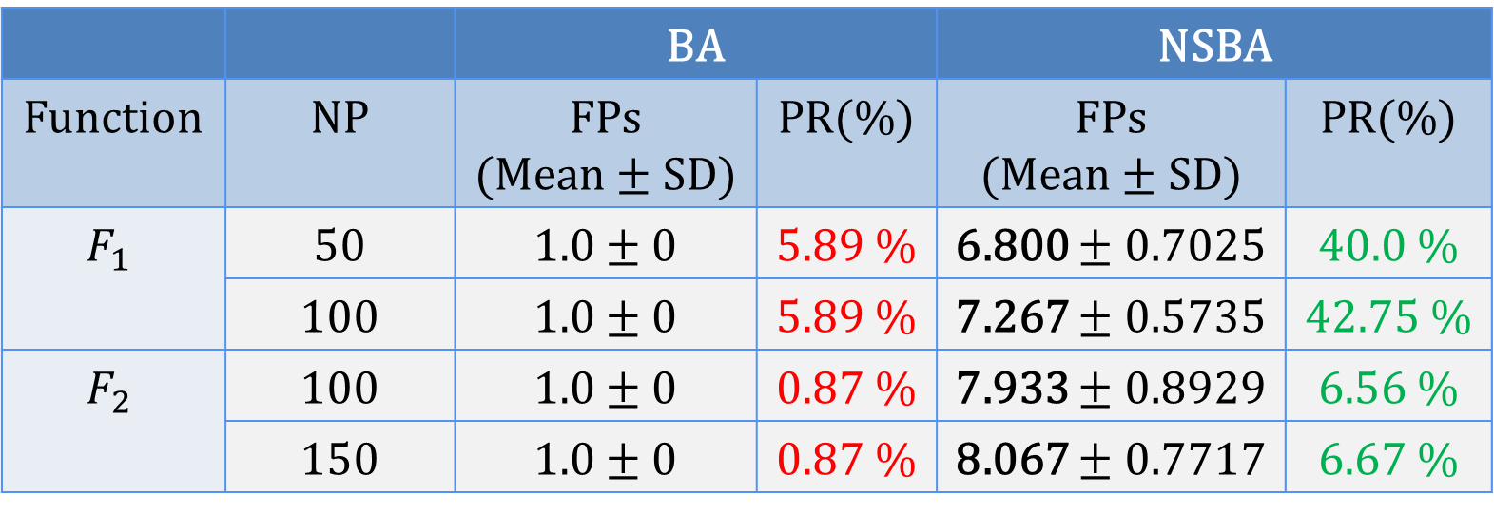
Experimental Results
(12 / 15)
Found Peaks(FPs) and Peak Ratio (PR) of BA and NSBA (averaged over 30 simulations)
 |  | BA |  | NSBA
Function | NP | FPs (Mean ± SD) | PR(%) | FPs (Mean ± SD) | PR(%)
$$F_{1}$$ | 50 | 1.0 ± 0 | 5.89 % | 6.800 ± 0.7025 | 40.0 %
 | 100 | 1.0 ± 0 | 5.89 % | 7.267 ± 0.5735 | 42.75 %
$$F_{2}$$ | 100 | 1.0 ± 0 | 0.87 % | 7.933 ± 0.8929 | 6.56 %
 | 150 | 1.0 ± 0 | 0.87 % | 8.067 ± 0.7717 | 6.67 %

Slide 13
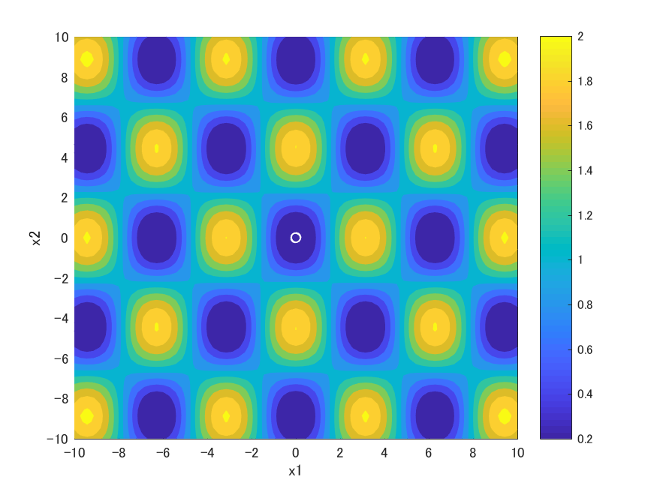
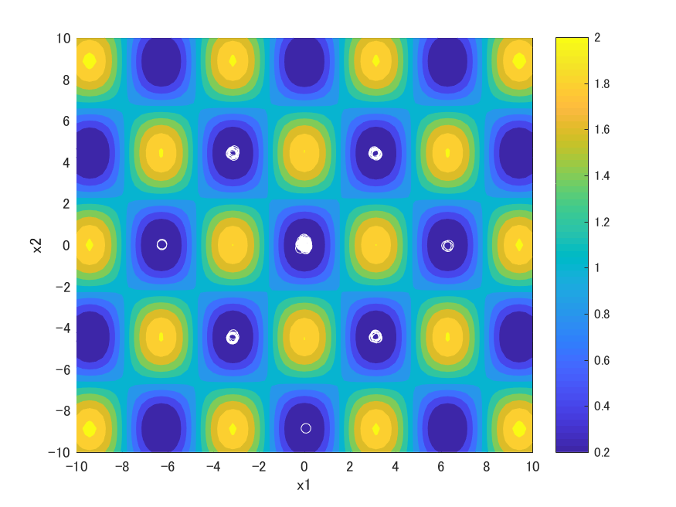


Experimental Results
(13 / 15)
Solution distribution at the final iteration
$F_{1}$: BA
$F_{1}$: NSBA
Advantage: NSBA found a global optima and some local optima

Slide 14

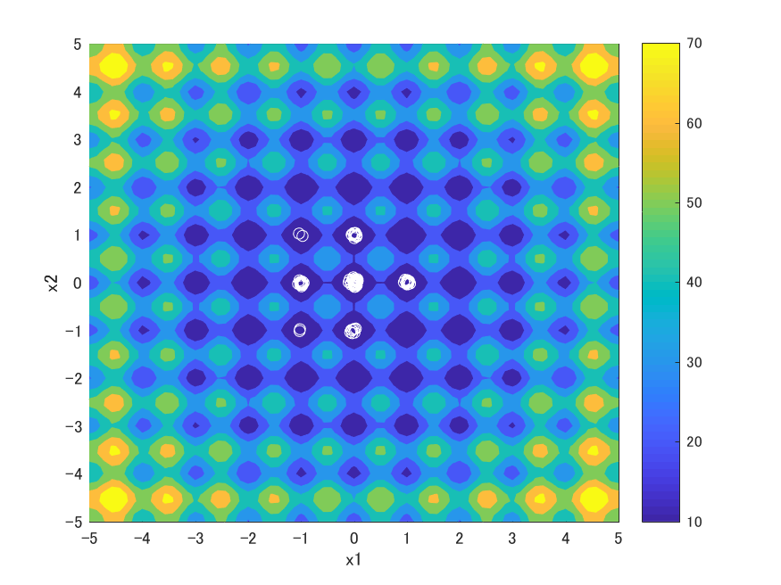


Experimental Results
(14 / 15)
Solution distribution at the final iteration
$F_{2}$: BA
$F_{2}$: NSBA
Advantage: NSBA found a global optima and some local optima

Slide 15
Conclusion
(15 / 15)
Searching multiple optima in multimodal optimization problems
Novelty Search-based Bat Algorithm
Extends BA with a new mechanism: enabling solutions to spread away
NSBA can search a single global optima and some local optima

Slide 16
appendix

Slide 17
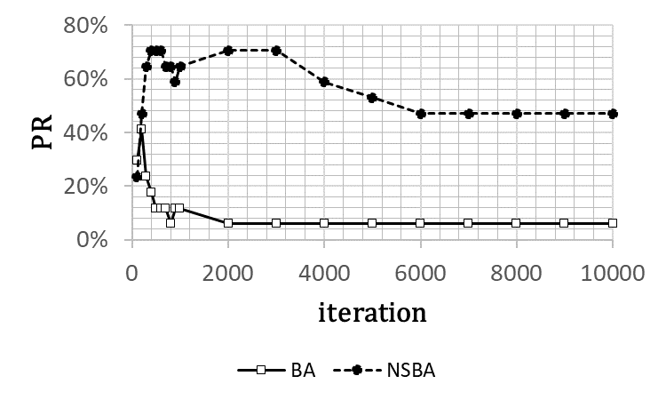
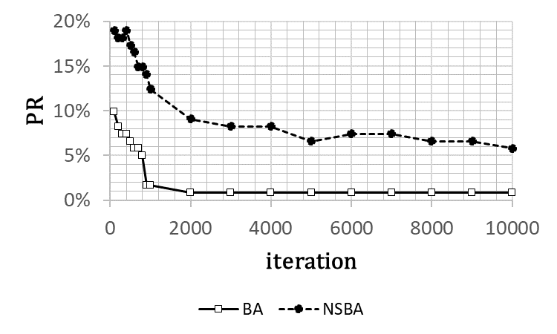


Experimental Results
(17 / 15)
Performance of BA and NSBA
$F_{1}$: Griewank
$F_{2}$: Rastrigin

Slide 18
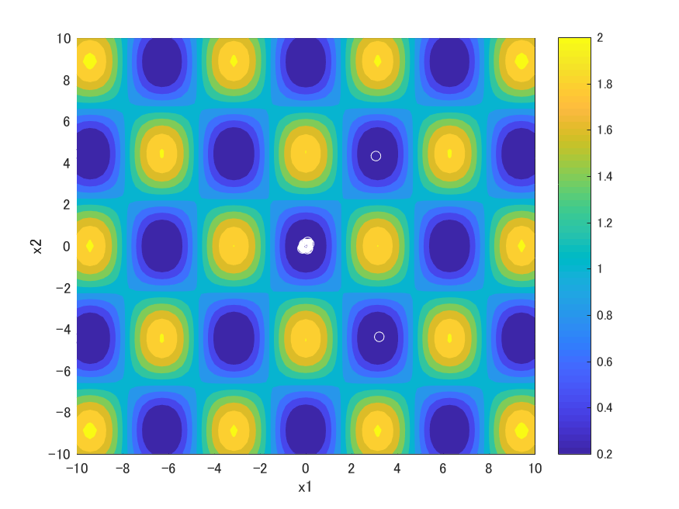
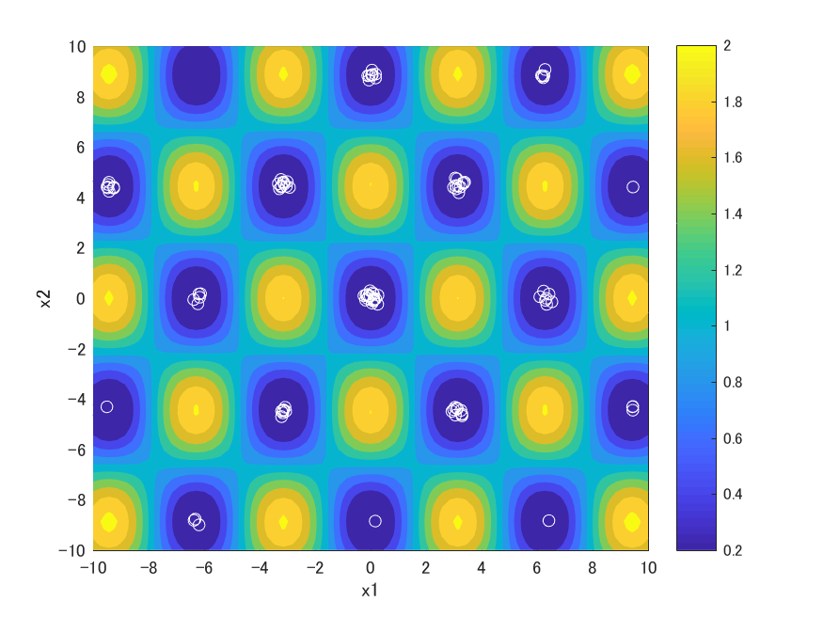
Experimental Results
(18 / 15)
Solution distribution at the 1000 iterations
$F_{2}$: BA
$F_{2}$: NSBA
Advantage: NSBA found more optima at the 1000 iteration than the final iteration

Slide 19

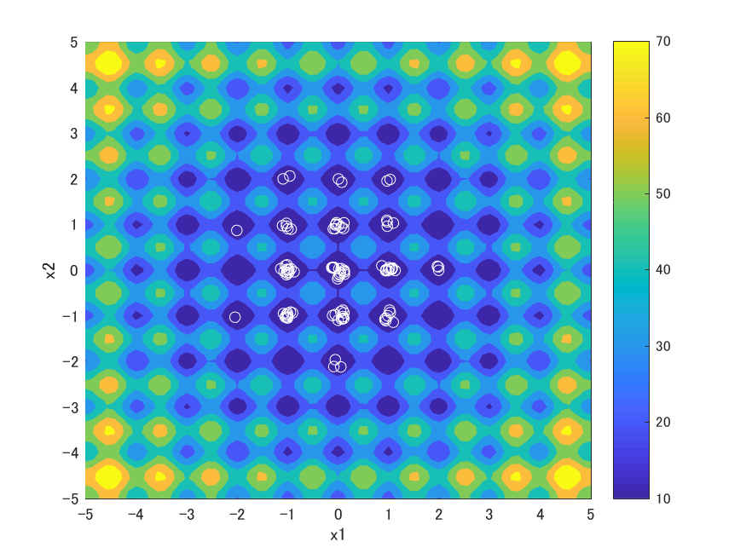
Experimental Results
(19 / 15)
Solution distribution at the 1000 iterations
$F_{2}$: BA
$F_{2}$: NSBA
Advantage: NSBA found more optima at the 1000 iteration than the final iteration

