Slide 1

Novelty Search-based Bat Algorithm: Adjusting Distance among Solutions for Multimodal Optimization
The 22nd Asia Pacific Symposium on Intelligent and Evolutionary Systems
〇Takuya Iwase† Ryo Takano† Fumito Uwano† Hiroyuki Sato† Keiki Takadama†
† The University of Electro-Communications
Notes:
My name is …. I am 2nd year student in master degree at the university of electro-communications. Today, I would like to tell you about my research. The title is….

Slide 2
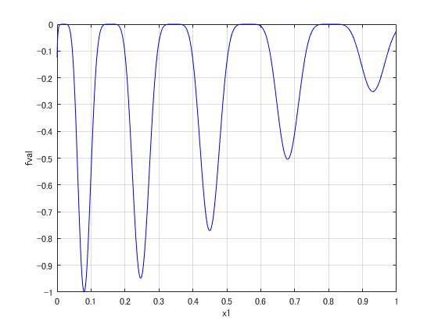
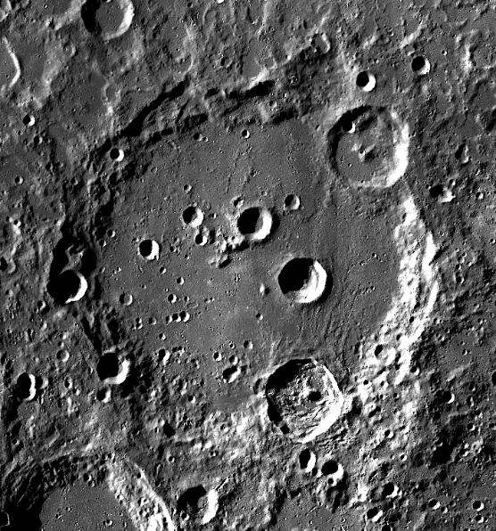
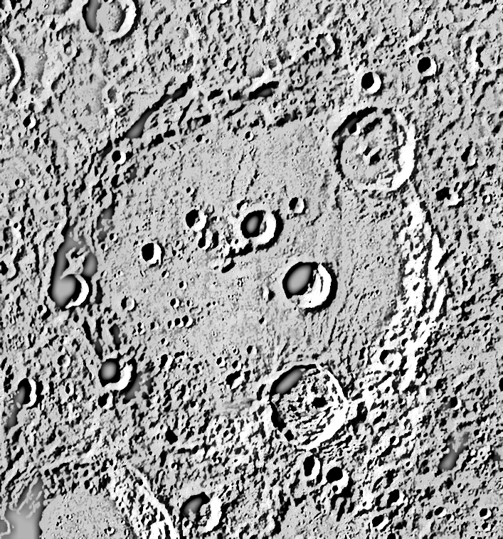
Introduction
(2 / 20)
Importance:
Searching multiple optima for multimodal optimization problems
e.g., Multimodal function for minimization
e.g., Safe landing sites selection in lunar mission
global and local optima
Raw image of moon
Highlighted landing sites
: safe landing sites (global & local optima)
Notes:
Real world problems are often represented as “multimodal” which means multiple local optima are exited, like this function.
An example of real world problems is safe landing sites selection in lunar mission. In this case, we have to find many landing sites (at the red point) which are located in flat area and here, we can easily communicate for sending moon data to the earth (shown in the right figure). Finding one best landing site is important, but the best landing site is not always the best because it might be changed.
So, we would like to know some landing sites as possible as we can.

Slide 3

Motivation
(3 / 20)
Finding multiple optima (global or local) = Niching methods
Evolutionary algorithms (EAs): PSO, DE, CMA-ES, etc.
$$+$$
Niching scheme: crowding, fitness sharing, clustering, etc.
Niching methods | EAs (multiple solution search) | Niching scheme
CDE [R.Thomsen, 2004] | DE (mainly exploitation) | crowding (replace high-quality solution with similar solution candidates)
SDE [X.Li, 2005] | DE (〃) | speciation (keep solutions away from the nearest neighbor solutions)
Proposed (NSBA) | Bat (exploitation + exploration) | Novelty search (search primitive area)
Notes:
For searching multiple optima is so-called Niching methods in the research field “evolutionary computation”.
In a couple of decades, many niching methods have been developed in the past.
Basically, niching methods are designed evolutionary algorithms combined with niching scheme. As major niching methods, crowding DE is proposed by Thomsen to replace high-quality solution with similar solution candidates, and DE with Speciation is proposed by Li to keep solutions away from the nearest neighbor solutions.
However, these methods are not enough to find multiple local optima solutions are fallen into global optima or high-fitness local optima. These mechanisms are just considered the solution movement between nearest neighbor solution. They need to consider the global search.

Slide 4
Motivation
(3 / 20)
Finding multiple optima (global or local) = Niching methods
Evolutionary algorithms (EAs): PSO, DE, CMA-ES, etc.
$$+$$
Niching scheme: crowding, fitness sharing, clustering, etc.
Niching methods | EAs (multiple solution search) | Niching scheme
CDE [R.Thomsen, 2004] | DE (mainly exploitation) | crowding (replace high-quality solution with similar solution candidates)
SDE [X.Li, 2005] | DE (〃) | speciation (keep solutions away from the nearest neighbor solutions)
Proposed (NSBA) | Bat (exploitation + exploration) | Novelty search (search primitive area)
Still fallen to global or high-fitness optima
Notes:
For searching multiple optima is so-called Niching methods in the research field “evolutionary computation”.
In a couple of decades, many niching methods have been developed in the past.
Basically, niching methods are designed evolutionary algorithms combined with niching scheme. As major niching methods, crowding DE is proposed by Thomsen to replace high-quality solution with similar solution candidates, and DE with Speciation is proposed by Li to keep solutions away from the nearest neighbor solutions.
However (anime), these methods are not enough to find multiple local optima solutions are fallen into global optima or high-fitness local optima. These mechanisms are just considered the solution movement between nearest neighbor solution. They need to consider the exploration search not only keep local optima.
Therefore, we proposed a hybrid algorithm novelty search-based Bat algorithm which can switch the exploitation and exploration for searching many optima which are never found.

Slide 5

Bat Algorithm (BA) [Yang, 2010]
(4 / 20)
the capability of switching exploitation & exploration by the bat behavior
Bat echolocation: its loudness $A$and pulse emission rate $r$
Exploitation
Exploration
Toward a global best solution
Nearby a global best solution
Random search
：Solution (bat)
：a global best solution (a bat near food/prey)
：new candidate solution
Notes:
We focused on Bat algorithm, this is one of the evolutionary algorithms. BA is superior for switching exploitation and exploration search here.
As bat approach a food/prey, the loudness decreases and the pulse emission rate increases, to control the search performance.
The BA mechanism consists of 3 search steps.

Slide 6







Bat Algorithm (BA) [Yang, 2010]
(5 / 20)
BA description
STEP1: Initialize population
$$x_{4}$$
rand $∈[0, 1]$
$$x_{3}$$
$$x_{1}$$
$x_{ub}:$ upper bound of the search space
$$x_{2}=x_{∗}$$
$x_{lb}:$ lower bound of the search space
: solution
Notes:
In this case, x2 = x* (anime)

Slide 7
Bat Algorithm (BA) [Yang, 2010]
(5 / 20)
BA description
STEP1: Initialize population
$$x_{4}$$
rand $∈[0, 1]$
$$x_{3}$$
$$x_{1}$$
$x_{ub}:$ upper bound of the search space
$$x_{2}=x_{∗}$$
$x_{lb}:$ lower bound of the search space
: solution

Slide 8
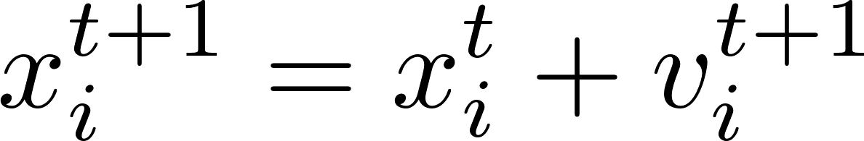



Bat Algorithm (BA) [Yang, 2010]
(6 / 20)
BA description
STEP2: Generate a new solution candidate toward the global best solution
$$x_{4}$$
$$x_{3}$$
$$x_{1}$$
$$x_{i}^{t+1}$$
$$x_{2}=x_{∗}$$
$x_{∗} :$ global best solution
rand $∈[0, 1]$
: solution
: solution candidate
Notes:
In step2 (local search),

Slide 9
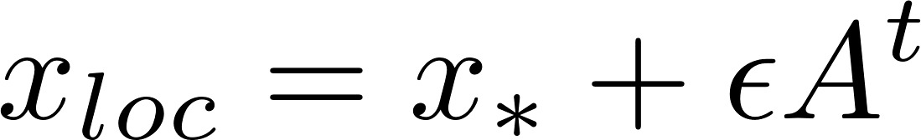




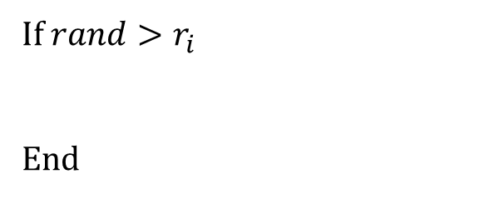


Bat Algorithm (BA) [Yang, 2010]
(7 / 20)
BA description
STEP3: Local search around a global best solution
If $rand>r_{i}$
End
$$x_{4}$$
$$x_{3}$$
$$x_{1}$$
$$x_{loc}$$
$$x_{∗}$$
$ε$: parameter to control the search area in this step
$2ε$
: solution
: solution candidate
Notes:
Another local search in step3, if pulse rate r is less than random value, solution candidates are generated as this equation.

Slide 10

Bat Algorithm (BA) [Yang, 2010]
(8 / 20)
BA description
STEP4: Random search in the search space
$$x_{4}$$
$$x_{3}$$
$$x_{rnd}$$
$$x_{1}$$
$$x_{∗}$$
: solution
: solution candidate
Notes:
In step4, solution candidates are randomly generated in the search space.

Slide 11
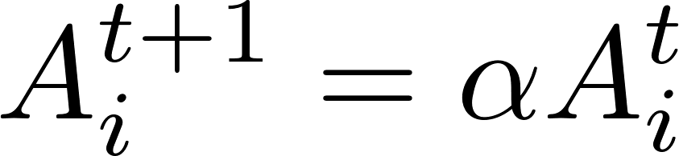
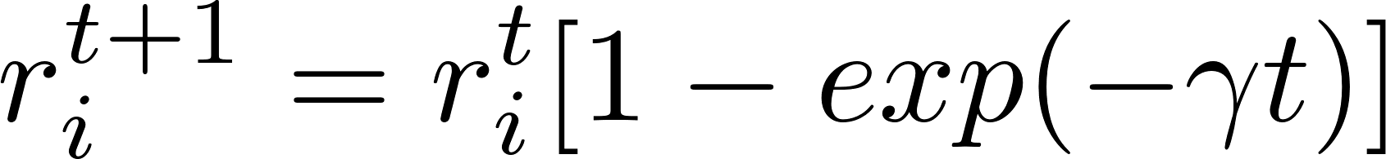
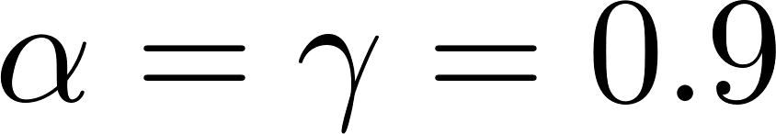
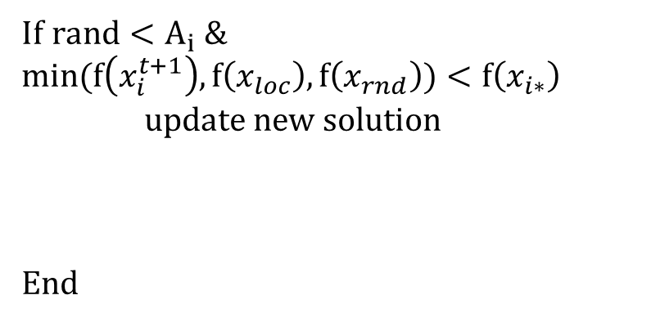

Bat Algorithm (BA) [Yang, 2010]
(9 / 20)
BA description
STEP5: Evaluate and update
STEP6: Return to STEP2 (until final iteration)
If $rand<A_{i} \&$ $$min(f\left(x_{i}^{t+1}\right), f\left(x_{loc}\right), f\left(x_{rnd}\right))<f\left(x_{i∗}\right)$$
update new solution
End
$$x_{4}$$
$$x_{3}$$
$$x_{1}$$
$$x_{i}^{t+1}$$
$$x_{∗}$$
Converge to the global optima
: solution
: new solution
Notes:
Then here, if the loudness value is larger than random value and the fitness value of candidates are better than the current solution, the new one is overwritten as the current solution. Moreover, the loudness value goes down and the pulse emission rate rises up in contrast.

Slide 12

Novelty Search-based Bat Algorithm (NSBA)
(10 / 20)
NSBA description
STEP1: Initialize population
$$x_{4}$$
same as BA
$$x_{3}$$
$$x_{1}$$
$$x_{2}$$
: solution

Slide 13
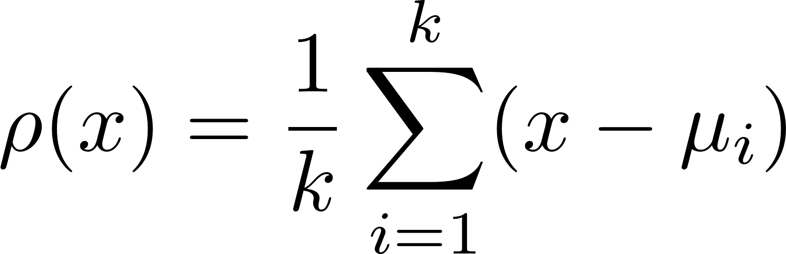
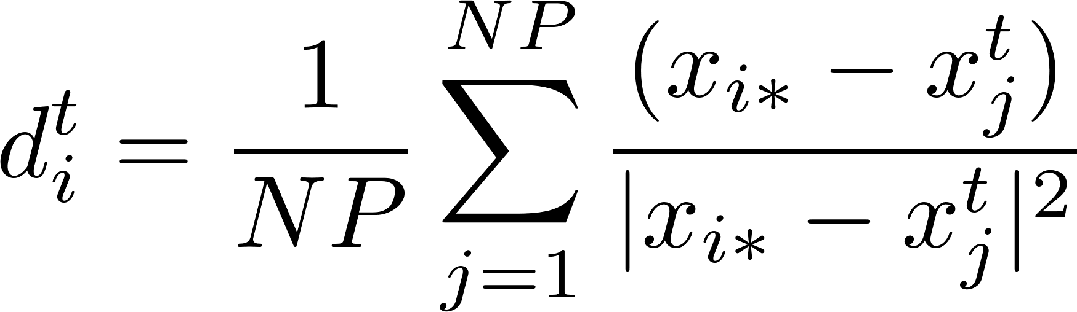
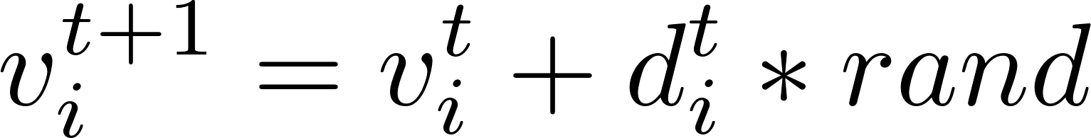




Novelty Search-based Bat Algorithm (NSBA)
(11 / 20)
NSBA description
STEP2: Generate a new solution candidate
Novelty Search
$$x_{4}$$
$$x_{i}^{t+1}$$
The sparseness function:
Spread solutions to primitive area
$$x_{3}$$
${ μ}_{i}$: i-th nearest neighbor of $x$
$$x_{1}$$
$$x_{2}$$
$NP:$ num of population
rand $∈[0, 1]$
: solution
: solution candidate
Notes:
This is the novelty search. When some solutions are crowded in the dense area, the sparseness function rho can keep solution x away from the nearest neighbor solutions mu i. But this function calculates norm vector, so we represented it to vector equation as below. Moreover, we changed this equation independent of parameter k. when solutions already distributed, the vector is calculated almost 0.

Slide 14
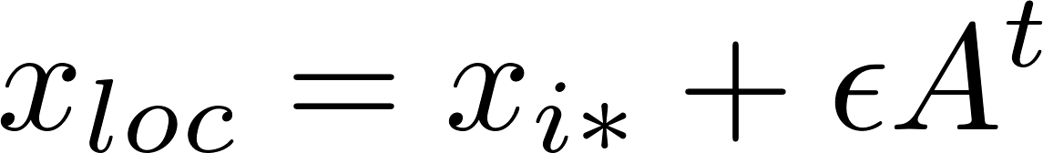






Novelty Search-based Bat Algorithm (NSBA)
(12 / 20)
NSBA description
STEP3: Local search around a personal best solution
If $rand>r_{i}$
End
$$x_{4}$$
$$x_{3}$$
$$x_{1}$$
$$x_{loc}$$
$$x_{2}$$
$2ε$
$2ε$
$2ε$
$2ε$
: solution
: solution candidate
Notes:
In this step from conventional BA to NSBA, we changed global best solution to local best solution.

Slide 15
Novelty Search-based Bat Algorithm (NSBA)
(13 / 20)
NSBA description
STEP4: Random search in the search space
$$x_{4}$$
same as BA
$$x_{3}$$
$$x_{rnd}$$
$$x_{1}$$
$$x_{2}$$
: solution
: solution candidate

Slide 16

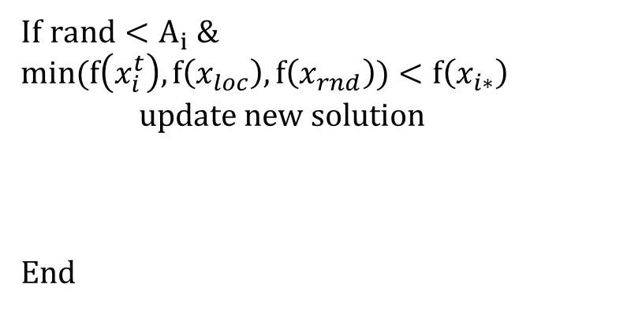
Novelty Search-based Bat Algorithm (NSBA)
(14 / 20)
NSBA description
STEP5: Evaluate and update
STEP6: Return to STEP2 (until final iteration)
If $rand<A_{i} \&$ $$min(f\left(x_{i}^{t}\right), f\left(x_{loc}\right), f\left(x_{rnd}\right))<f\left(x_{i∗}\right)$$
update new solution
End
$$x_{4}$$
$$x_{3}$$
$$x_{2}$$
$$x_{i}^{t+1}$$
: solution
: new solution
Notes:
This mechanism can locate solutions to multiple local optima.

Slide 17
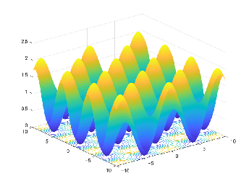
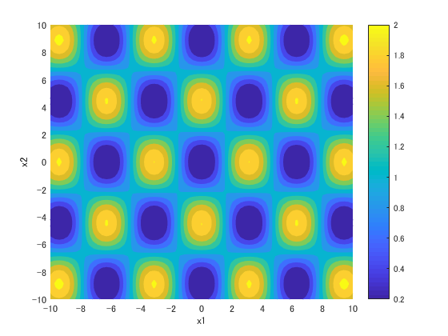
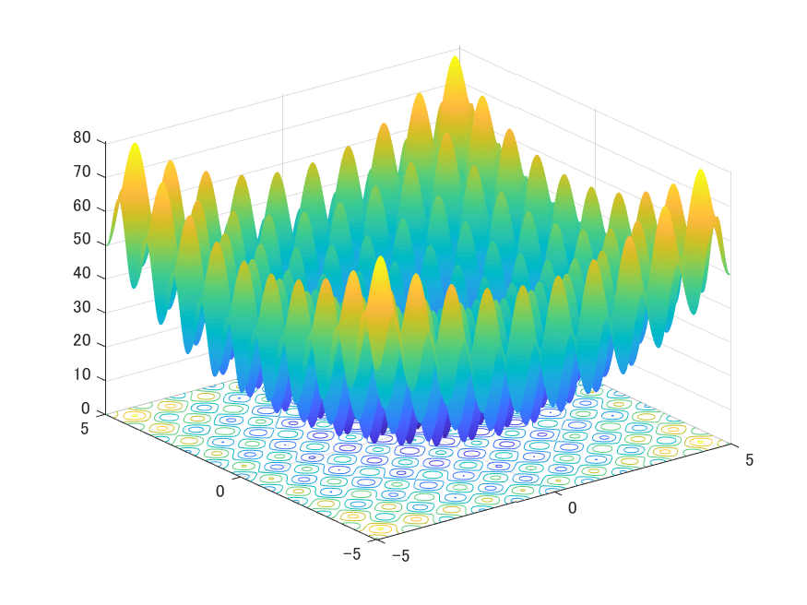
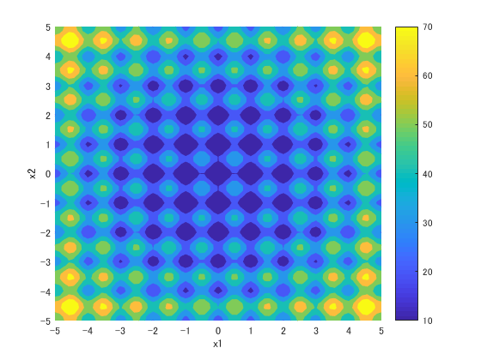
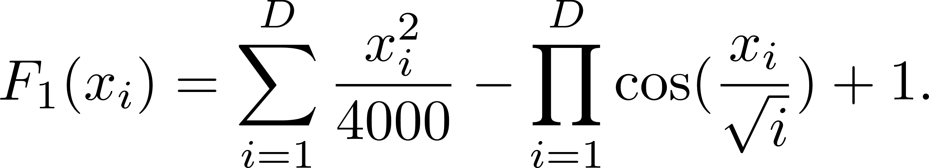
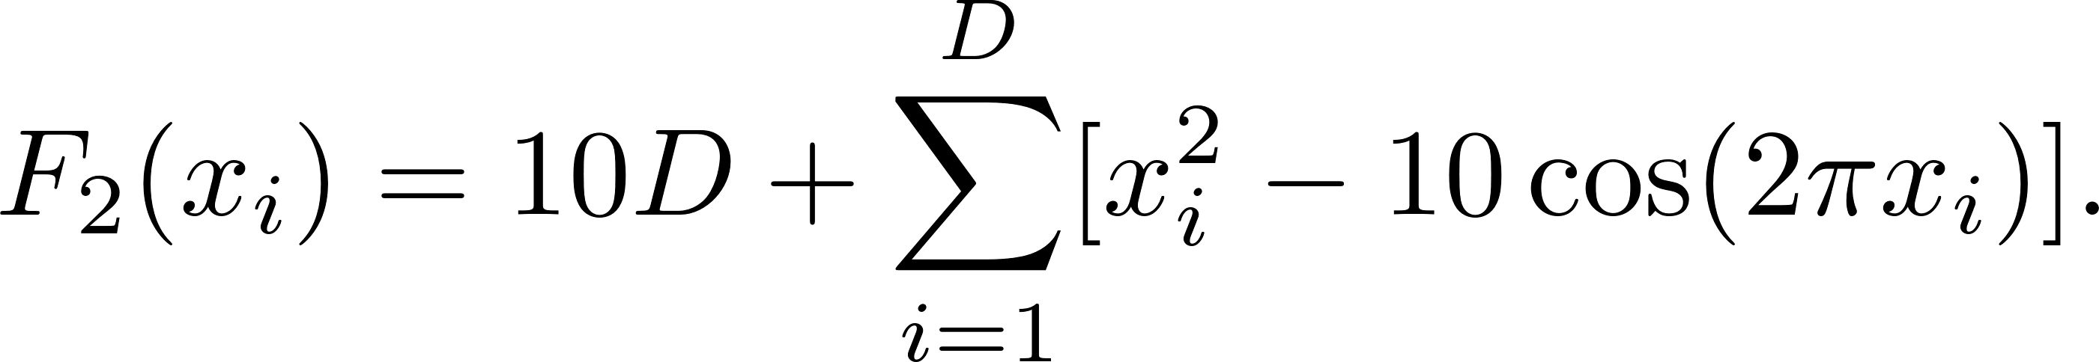
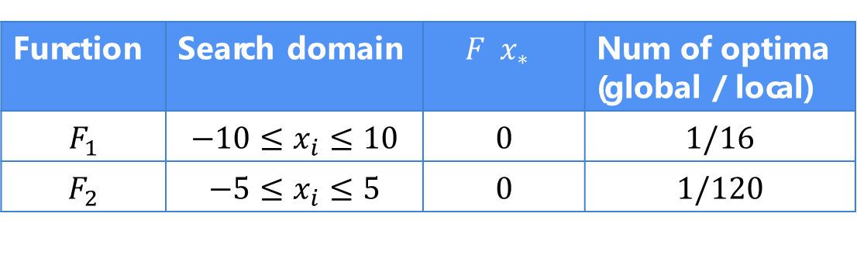


Test-bed problems
(15 / 20)
Benchmark test functions for minimization
$F_{1}$: Griewank Function
$F_{2}$: Rastrigin Function
Function | Search domain | $$F\left(x_{∗}\right)$$ | Num of optima (global / local)
$$F_{1}$$ | $$−10≤x_{i}≤10$$ | 0 | $1$/16
$$F_{2}$$ | $$−5≤x_{i}≤5$$ | 0 | 1/120
Notes:
To measure the number of global and local optima by NSBA compared with BA, we employed 2 multimodal functions for minimization. These figures show the 2-dimensional fitness landscape and the contour plot. The global and local optima located in the blue area in both functions. F1 has 1/16, and F2 has 1/120.

Slide 18
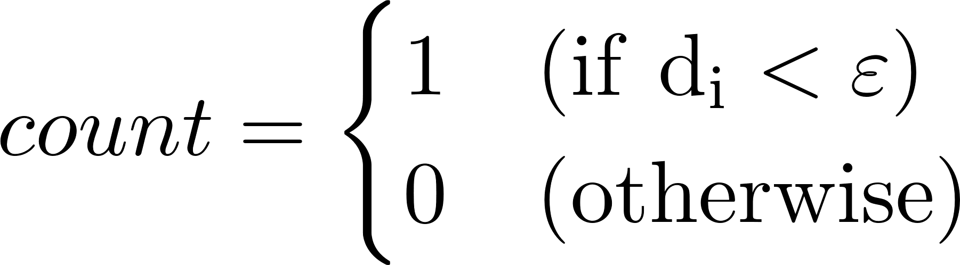
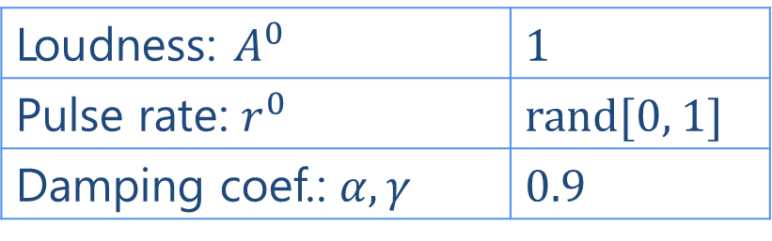
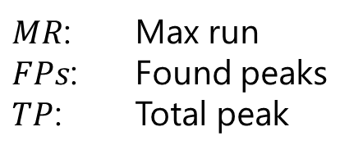
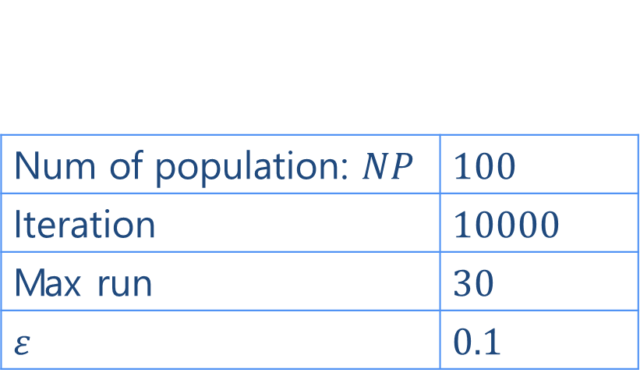

Experiment
(16 / 20)
Compared BA vs. NSBA
Parameters setting
Case 1: $F_{1}(D=2)$
Case 2: $F_{2}(D=2)$
$FPs=\sum_{i=1}^{TP}{count_{i}}$
$Peak Ratio (PR)=\frac{\sum_{run=1}^{MR}{FPs}}{TP∗MR}$
BA and NSBA
Loudness: $A^{0}$ | 1
Pulse rate: $r^{0}$ | rand[0, 1]
Damping coef.: $α, γ$ | 0.9
Evaluation measurement
Num of population: $NP$ | 100
Iteration | 10000
Max run | 30
$$ε$$ | 0.1
$MR$: Max run
$FPs$: Found peaks
$TP$: Total peak

Slide 19

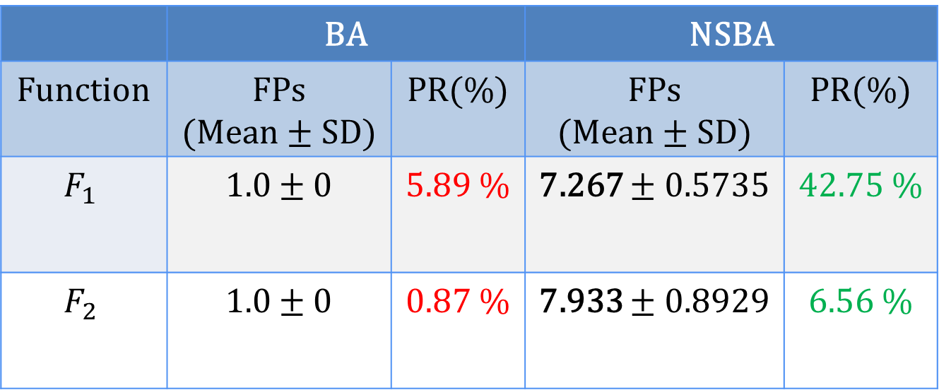
Results
(17 / 20)
Found Peaks(FPs) and Peak Ratio (PR) of BA and NSBA (averaged over 30 runs)
 | BA |  | NSBA
Function | FPs (Mean ± SD) | PR(%) | FPs (Mean ± SD) | PR(%)
$$F_{1}$$ | 1.0 ± 0 | 5.89 % | 7.267 ± 0.5735 | 42.75 %
$$F_{2}$$ | 1.0 ± 0 | 0.87 % | 7.933 ± 0.8929 | 6.56 %

Slide 20
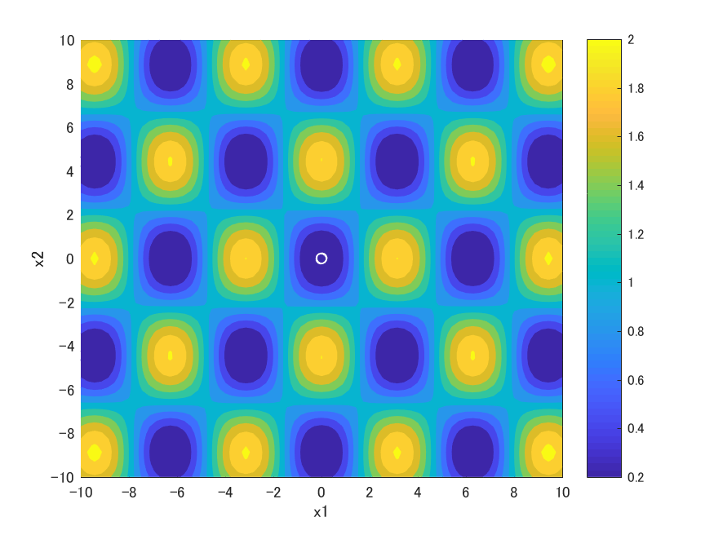
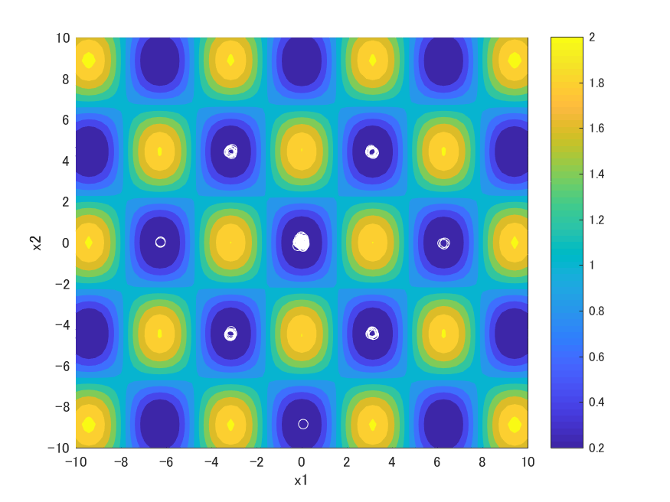


Results
(18 / 20)
Solution distribution at the final iteration
$F_{1}$: BA
$F_{1}$: NSBA
Advantage: NSBA found a global optima and some local optima

Slide 21

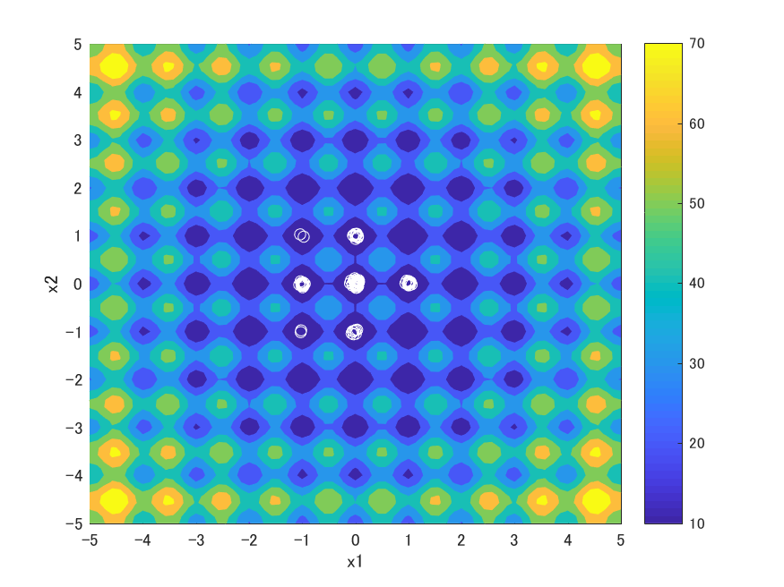



Results
(19 / 20)
Solution distribution at the final iteration
$F_{2}$: BA
$F_{2}$: NSBA
Advantage: NSBA found a global optima and some local optima

Slide 22
Conclusion
(20 / 20)
Searching multiple optima in multimodal optimization problems
Implications:
Novelty Search-based Bat Algorithm
Extends BA with searching primitive area
Changes exploitation around the personal best solution
NSBA can search a single global optima and some local optima
NSBA > BA
Future work:
we aim to find all optima (global and local) and brush up the performance of NSBA

Slide 23
appendix

Slide 24
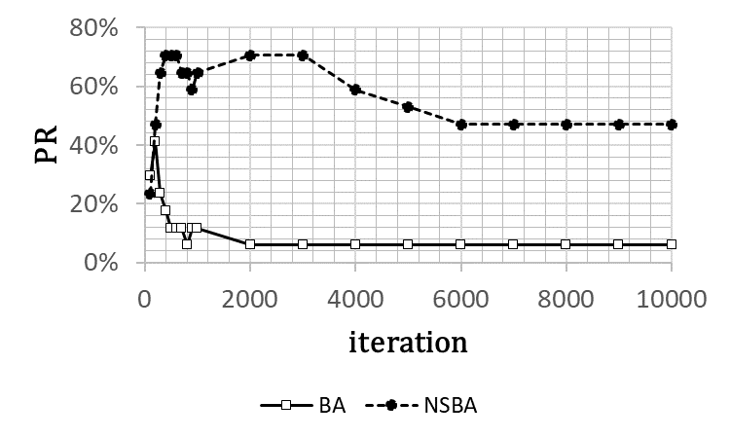
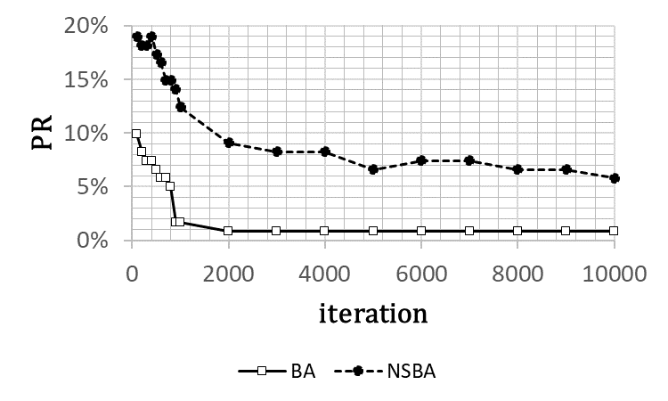


Results
(22 / 21)
Performance of BA and NSBA
$F_{1}$: Griewank
$F_{2}$: Rastrigin

Slide 25
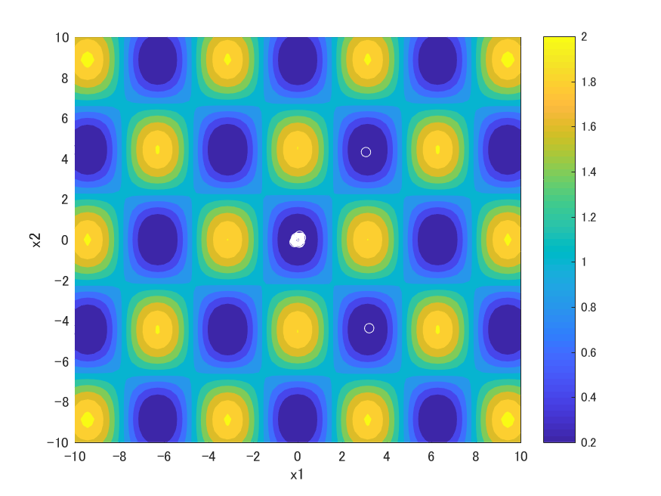
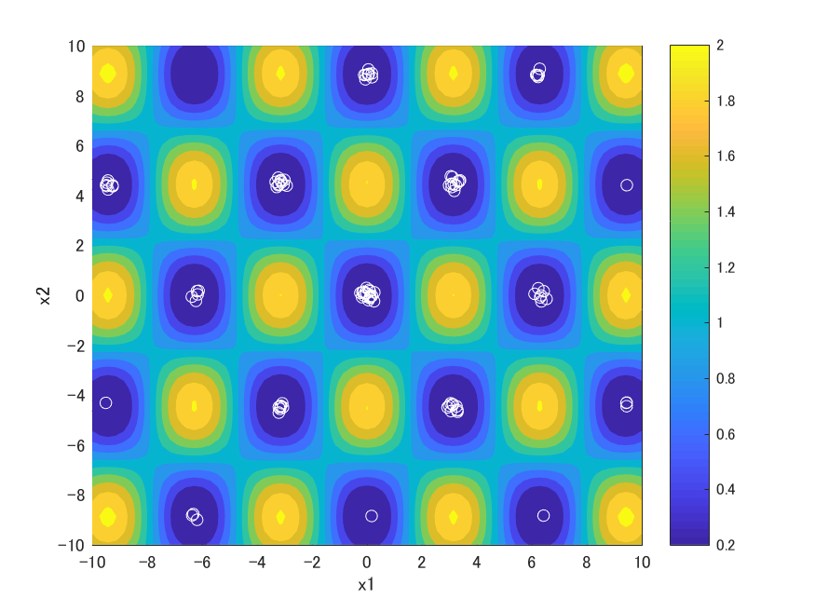


Results
(23 / 21)
Solution distribution at the 1000 iterations
$F_{2}$: BA
$F_{2}$: NSBA
Advantage: NSBA found more optima at the 1000 iteration than the final iteration

Slide 26

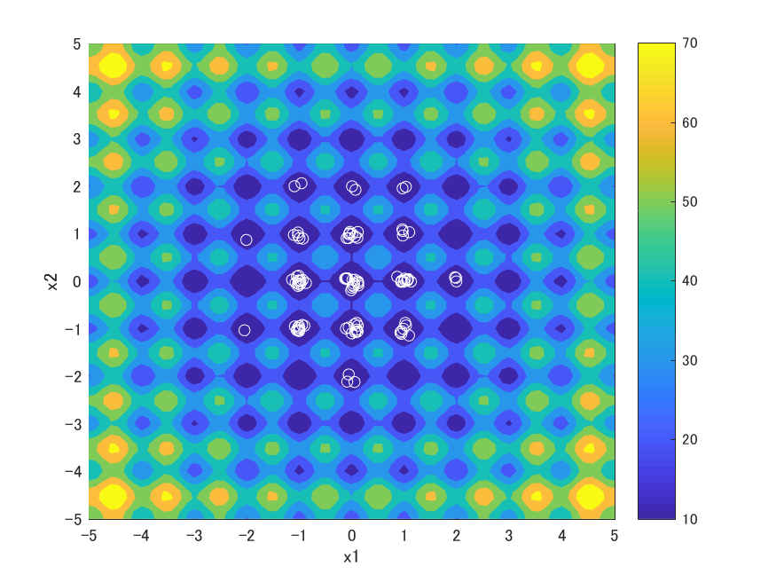
Results
(24 / 21)
Solution distribution at the 1000 iterations
$F_{2}$: BA
$F_{2}$: NSBA
Advantage: NSBA found more optima at the 1000 iteration than the final iteration

