Slide 1

Novelty Search-based Bat Algorithm: Adjusting Distance among Solutions for Multimodal Optimization
The 22nd Asia Pacific Symposium on Intelligent and Evolutionary Systems
Takuya Iwase Ryo Takano Fumito Uwano Hiroyuki Sato Keiki Takadama
The University of Electro-Communications, Japan
Notes:
My name is …. I am 2nd year master degree student at the university of electro-communications. Today, I would like to tell you about my research. The title is….

Slide 2
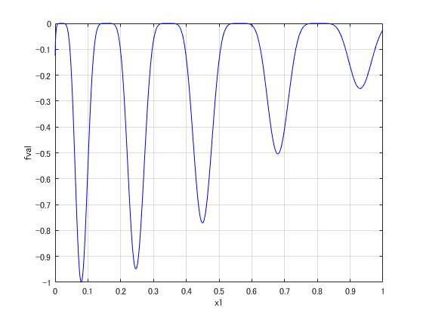
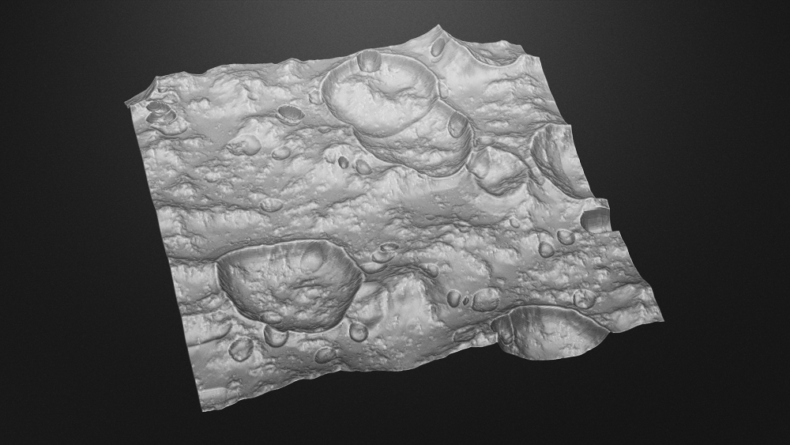
Introduction
(2 / 21)
Importance:
Searching multiple optima for multimodal optimization problems
e.g., Multimodal function for minimization
e.g., Safe landing sites selection in lunar mission
important
local optima
Highlighted danger spots
global optimum
: danger spots (global & local optima)
Notes:
Real world problems are often represented as “multimodal” which means multiple global & local optima exist.
For example, the left figure shows the multimodal function, which have several multiple solutions. In detail, the deep red solution indicates the global optimum while the light red solutions indicate the local optima for the minimization problem. The right figure, on the other hand, shows the safe landing site selection in lunar mission as one of real world problems. In this case, we have to find many danger spots (at the red point) where are located on bumpy surface. Like as the multimodal function, the red solution indicates the global best optima and light red solution indicates the local optima from danger spots. For avoiding these danger spots, we would like to know where some danger spots are located as possible as we can.

Slide 3
Motivation
(3 / 21)
Finding multiple optima by Niching methods [X. Li, 2013]
Niching methods | Evolutionary Algorithms (EAs) | Niching scheme
CDE [R.Thomsen, 2004] | DE (mainly exploitation) [R. Storn, 1997] | crowding (replace solutions with similar high-quality solution candidates)
SDE [X.Li, 2005] | DE (〃) | speciation (keep solutions away from the nearest neighbor solutions)
Proposed (NSBA) | Bat Algorithm (exploitati-on + exploration) [Yang, 2010] | Novelty search (search never found area) [J. Lehman et. al., 2008]
Notes:
To find multiple optima which is so-called Niching methods, are proposed by X.Li. Concretely, niching methods are designed by combining evolutionary algorithms with niching scheme. As major niching methods, crowding DE is proposed by Thomsen to replace solutions with similar high-quality solution candidates, and DE with Speciation is proposed by Li to keep solutions away from the nearest neighbor solutions.
However, these methods are not enough to find multiple local optima solutions due to a weak of exploration search. These mechanisms are just considered the keep solutions and the solution movement between nearest neighbor solution. They need to consider the global search.

Slide 4


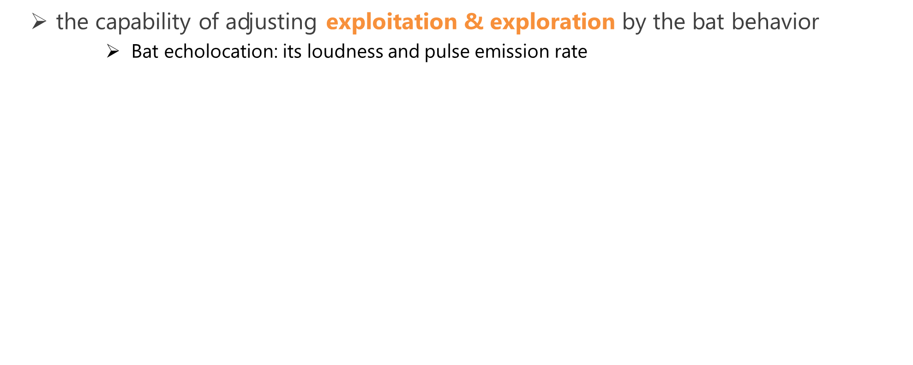
Bat Algorithm (BA)
(4 / 21)
the capability of adjusting exploitation & exploration by the bat behavior
Bat echolocation: its loudness and pulse emission rate
Exploitation
Exploration
Toward the global best solution
Nearby a global best solution
Loudness
Random search
Pulse emission rate
：Solution
：a global best solution
：solution candidate
Notes:
To tackle this problem, we employed Bat algorithm, this is one of the evolutionary algorithms. BA is superior for adjusting exploitation and exploration search here.
As bat approach toward the global best solution, the loudness decreases and the pulse emission rate increases, to control the search performance.
The BA mechanism consists of 3 search steps.

Slide 5
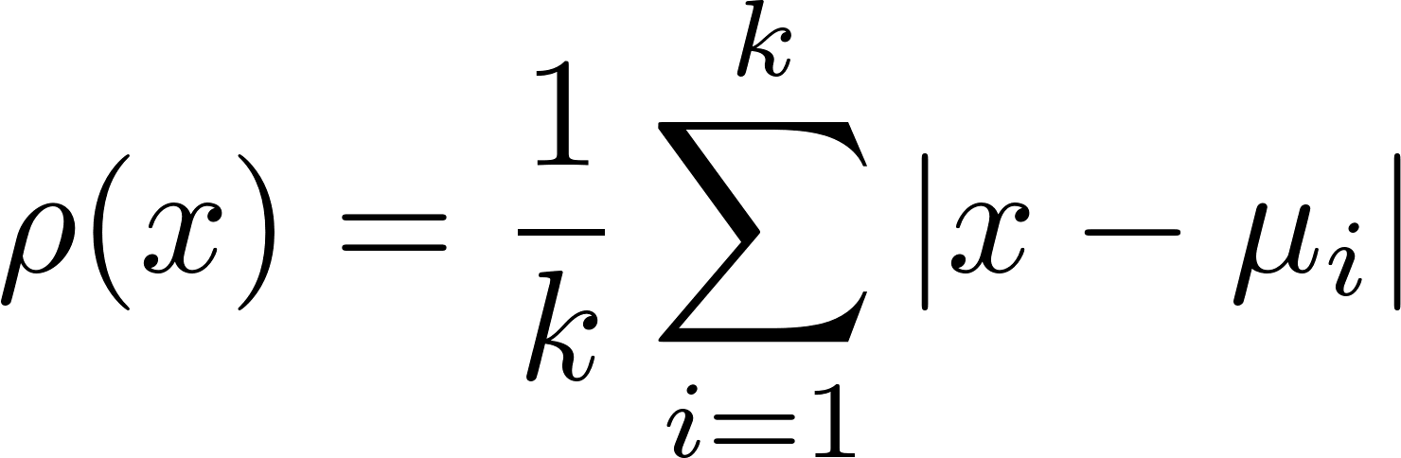














Novelty search (NS)
(5 / 21)
Search new solutions where never reached
The sparseness function:
${ μ}_{i}$: i-th nearest neighbor of $x$
$k$: the number of nearest neighbor
k=5
$$μ_{1}$$
$$μ_{1}$$
$$μ_{2}$$
$$μ_{2}$$
$$x$$
$$x$$
：target solution $x$
$$μ_{3}$$
$$μ_{3}$$
$$μ_{4}$$
$$μ_{4}$$
：solution $μ_{i}$
Notes:
while NS is also employed because it searches unvisited area, which has a potential of finding new solutions.
An example of the num of nearest neighbor k=5, the sparseness function is calculated by this equation for the target solution. In this case, the target solution get the red norm vector as shown in right figure.

Slide 6
Bat Algorithm (BA)
(6 / 21)
BA Flowchart
STEP1
Initialize population and parameters
STEP2
Generate solution candidates toward the global best solution
STEP3
Local search around the global best solution
STEP4
Random search in the search space
STEP5
Evaluate and update solutions
STEP6
Return to STEP2
Notes:
This is the BA flowchart.

Slide 7






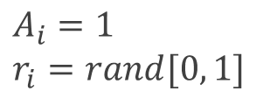


Bat Algorithm (BA)
(7 / 21)
BA description
STEP1: Initialize population and parameters
for i = 1 to N
$$x_{4}$$
$$\left(i=1,2,…, N\right)$$
$$x_{3}$$
rand $∈[0, 1]$
$x_{ub}:$ upper bound of the search space
$$x_{1}$$
$x_{lb}:$ lower bound of the search space
$$x_{2}=x_{∗}$$
$$A_{i}=1$$
$$r_{i}=rand[0, 1]$$
Endfor
: solution
Notes:
First, initialize population and parameters.
In this right figure for minimization, x2 = x* (anime)

Slide 8

Bat Algorithm (BA)
(7 / 21)
BA description
STEP1: Initialize population and parameters
for i = 1 to N
$$x_{4}$$
$$\left(i=1,2,…, N\right)$$
$$x_{3}$$
rand $∈[0, 1]$
$x_{ub}:$ upper bound of the search space
$$x_{1}$$
$x_{lb}:$ lower bound of the search space
$$x_{2}=x_{∗}$$
$$A_{i}=1$$
$$r_{i}=rand[0, 1]$$
Endfor
: solution

Slide 9
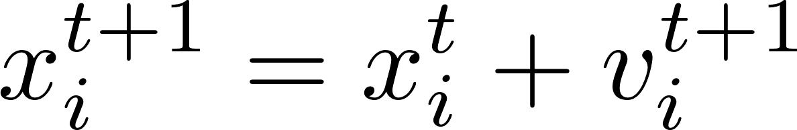



Bat Algorithm (BA)
(8 / 21)
BA description
STEP2: Generate solution candidates toward the global best solution
for i = 1 to N
$$x_{4}$$
$$x_{3}$$
$$x_{1}$$
Endfor
$$x_{i}^{t+1}$$
$$x_{2}=x_{∗}$$
$x_{∗} :$ global best solution
rand $∈[0, 1]$
: solution
: solution candidate
Notes:
After that, in step2 (local search), generate solution candidates toward the global best solution

Slide 10
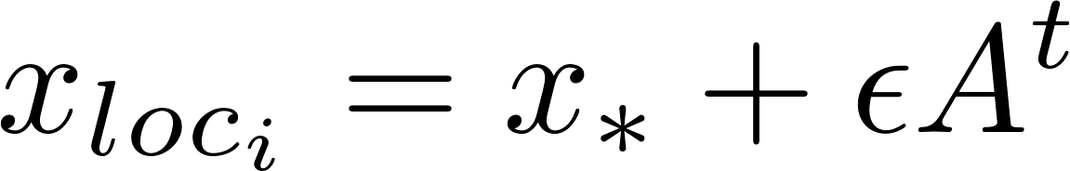




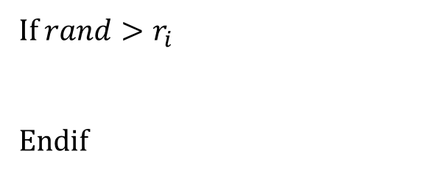


Bat Algorithm (BA)
(9 / 21)
BA description
STEP3: Local search around a global best solution
for i = 1 to N
$$x_{4}$$
If $rand>r_{i}$
Endif
$2εA$
$$x_{3}$$
$$x_{1}$$
$$x_{loc_{i}}$$
Endfor
$$x_{∗}$$
$ε$: parameter to control the search area in this step
: solution
: solution candidate
Notes:
Another local search in step3, if pulse rate r is less than random value, solution candidates are generated as this equation.

Slide 11

Bat Algorithm (BA)
(10 / 21)
BA description
STEP4: Random search in the search space
for i = 1 to N
$$x_{4}$$
$$x_{3}$$
$$x_{rnd_{i}}$$
Endfor
$$x_{1}$$
$$x_{∗}$$
: solution
: solution candidate
Notes:
In step4, solution candidates are randomly generated in the search space.

Slide 12
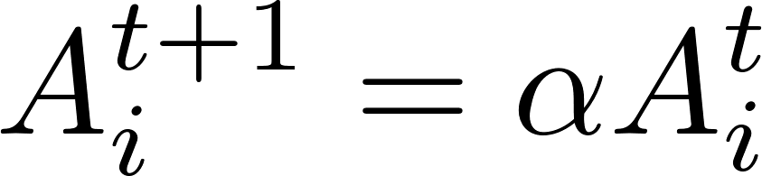
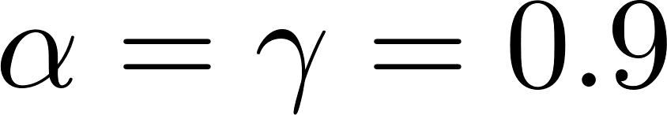
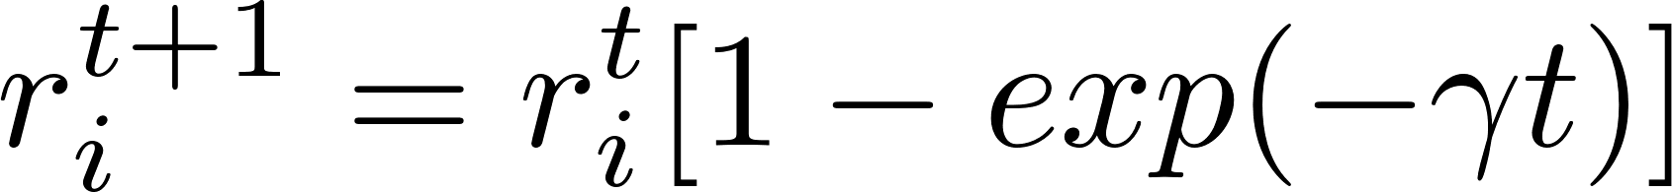
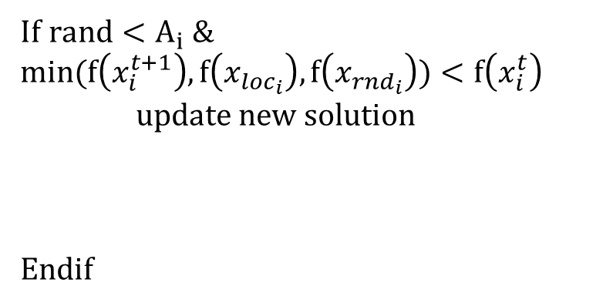

Bat Algorithm (BA)
(11 / 21)
BA description
STEP5: Evaluate and update
STEP6: Return to STEP2 (until final iteration)
for i = 1 to N
$$x_{4}$$
If $rand<A_{i} \&$ $$min(f\left(x_{i}^{t+1}\right), f\left(x_{loc_{i}}\right), f\left(x_{rnd_{i}}\right))<f\left(x_{i}^{t}\right)$$
update new solution
Endif
$$x_{3}$$
$$x_{1}$$
$$x_{i}^{t+1}$$
$$x_{∗}$$
Endfor
: solution
: new solution
Notes:
Then here, if the loudness value is larger than random value and the fitness value of candidates are better than the current solution, the new one is overwritten as the current solution. Moreover, the loudness value goes down and the pulse emission rate rises up in contrast.

Slide 13




Bat Algorithm (BA)
(11 / 21)
BA description
STEP5: Evaluate and update
STEP6: Return to STEP2 (until final iteration)
for i = 1 to N
If $rand<A_{i} \&$ $$min(f\left(x_{i}^{t+1}\right), f\left(x_{loc_{i}}\right), f\left(x_{rnd_{i}}\right))<f\left(x_{i}^{t}\right)$$
update new solution
Endif
$$x_{2}$$
$$x_{4}$$
$$x_{3}$$
$$x_{∗}$$
Converge to the global best solution
Endfor
: solution
: new solution
Notes:
After this first iteration, these solutions come to approach the global best solution again and again. Then, converge to the global optima.

Slide 14
Novelty Search-based Bat Algorithm (NSBA)
(12 / 21)
BA and NSBA Flowchart
STEP1
Initialize population and parameters
STEP2
Generate solution candidates toward the global best solution
STEP3
Local search around the global best solution
STEP4
Random search in the search space
STEP5
Evaluate and update solutions
STEP6
Return to STEP2
STEP1
Initialize population and parameters
STEP2
Generate solution candidates toward sparse area
STEP3
Local search around the personal best solution
STEP4
Random search in the search space
STEP5
Evaluate and update solutions
STEP6
Return to STEP2
Notes:
This is the BA and NSBA flowchart.
In our proposed method, we made 2 changes. The one change is to extend BA with Novelty search for finding many optima which never found. The other one is to generate new solution candidates around the personal best solution in the exploitation.

Slide 15
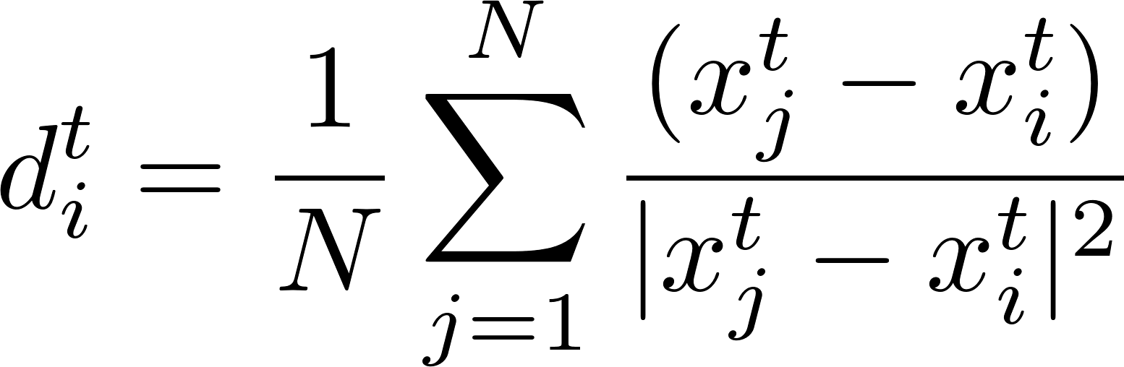
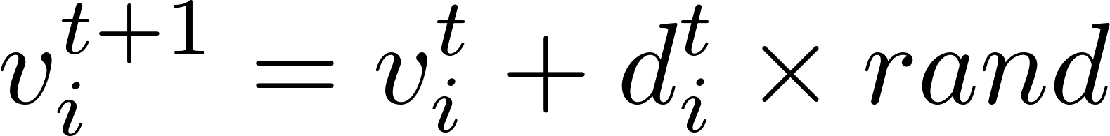





Novelty Search-based Bat Algorithm (NSBA)
(13 / 21)
NSBA description
STEP2: Generate new solution candidates toward sparse area
Novelty Search
$$x_{4}$$
$$x_{i}^{t+1}$$
The sparseness function:
Spread solutions to primitive area
$$x_{3}$$
${ μ}_{i}$: i-th nearest neighbor of $x$
$$x_{1}$$
$$x_{2}$$
$N:$ population size
rand $∈[0, 1]$
: solution
: solution candidate
Notes:
This is the novelty search. When some solutions are crowded in the dense area, the sparseness function rho can keep solution x away from the nearest neighbor solutions mu i. But this function calculates norm vector, so we represented it to vector equation as below. Moreover, we changed this equation independent of parameter k. when solutions already distributed, the vector is calculated almost 0.

Slide 16
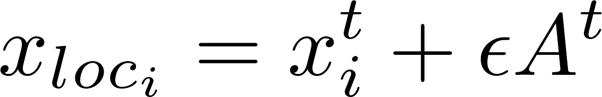




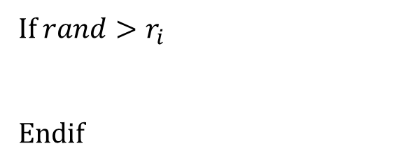



Novelty Search-based Bat Algorithm (NSBA)
(14 / 21)
NSBA description
STEP3: Local search around the personal best solution
If $rand>r_{i}$
Endif
$$x_{4}$$
$2εA$
$2εA$
$2εA$
$$x_{3}$$
$$x_{1}$$
$2εA$
$$x_{loc_{i}}$$
$$x_{2}$$
: solution
: solution candidate
Notes:
In this step from conventional BA to NSBA, we changed global best solution to local best solution.

Slide 17

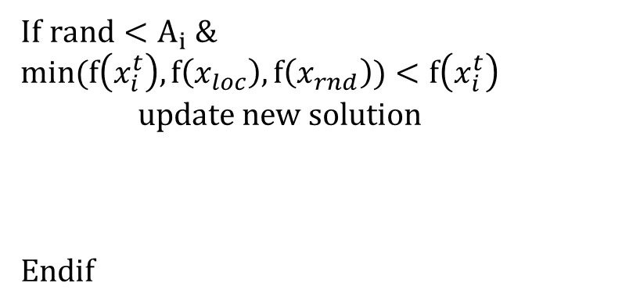
Novelty Search-based Bat Algorithm (NSBA)
(15 / 21)
NSBA description
STEP5: Evaluate and update
STEP6: Return to STEP2 (until final iteration)
If $rand<A_{i} \&$ $$min(f\left(x_{i}^{t}\right), f\left(x_{loc}\right), f\left(x_{rnd}\right))<f\left(x_{i}^{t}\right)$$
update new solution
Endif
$$x_{4}$$
$$x_{3}$$
$$x_{2}$$
$$x_{i}^{t+1}$$
: solution
: new solution
Notes:
This mechanism can locate solutions to multiple local optima.

Slide 18
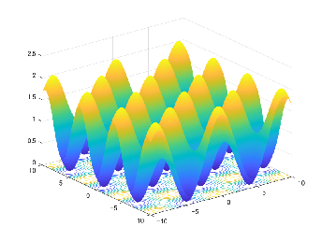
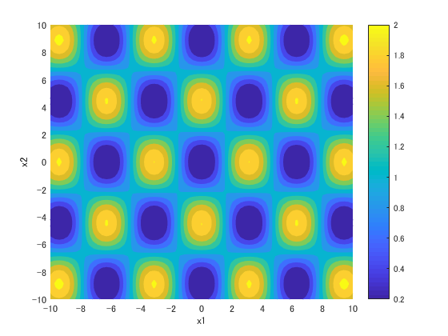
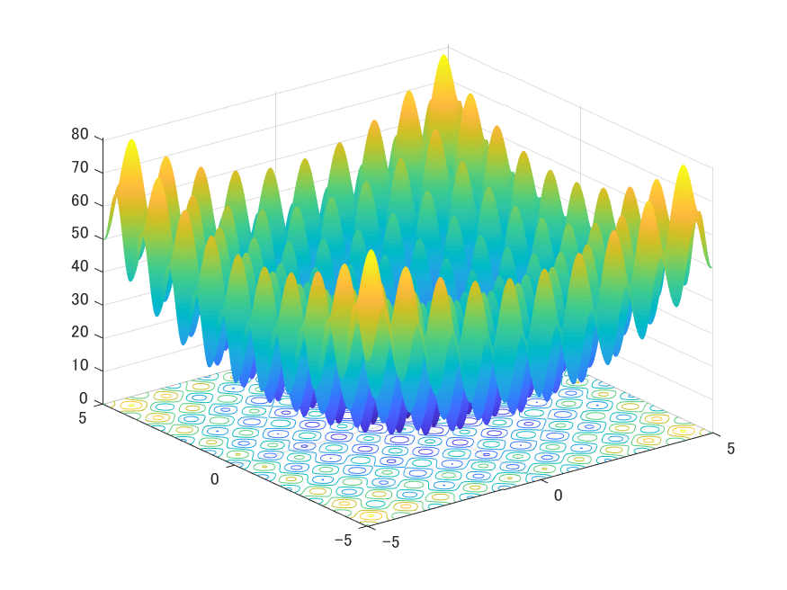
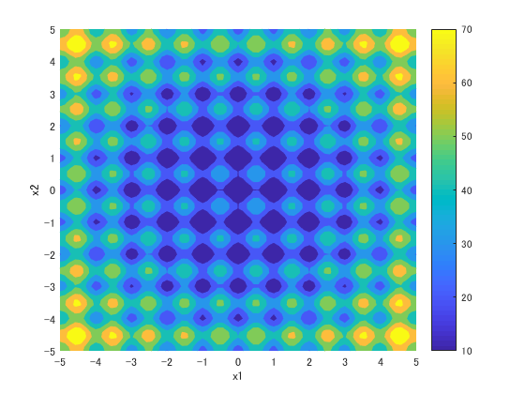
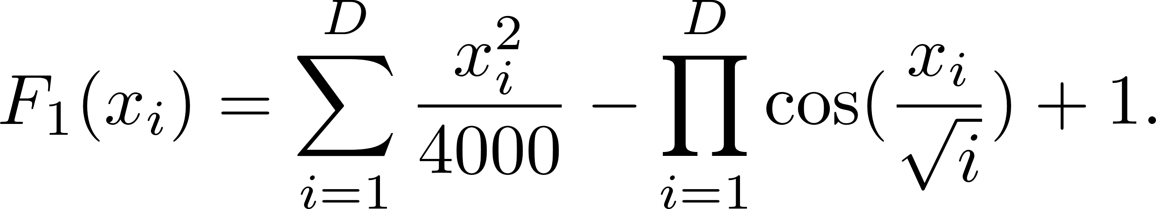
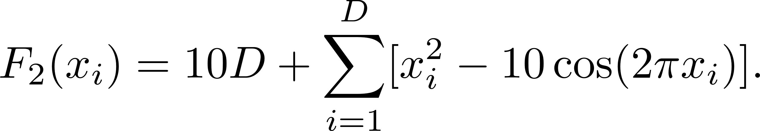
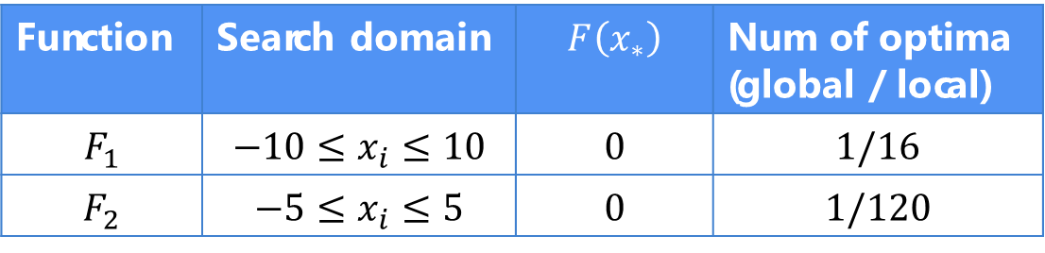


Test-bed problems
(16 / 21)
Benchmark test functions for minimization
$F_{1}$: Griewank Function
$F_{2}$: Rastrigin Function
Function | Search domain | $$F\left(x_{∗}\right)$$ | Num of optima (global / local)
$$F_{1}$$ | $$−10≤x_{i}≤10$$ | 0 | $1$/16
$$F_{2}$$ | $$−5≤x_{i}≤5$$ | 0 | 1/120
Notes:
To measure the number of global and local optima by NSBA compared with BA, we employed 2 multimodal functions for minimization. These figures show the 2-dimensional fitness landscape and the contour plot. The global and local optima located in the blue area in both functions. F1 has 1/16, and F2 has 1/120.

Slide 19
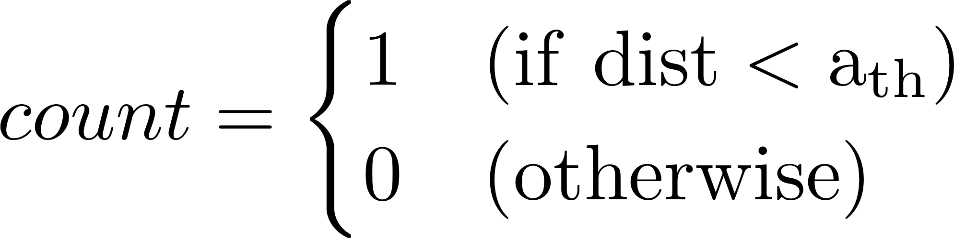

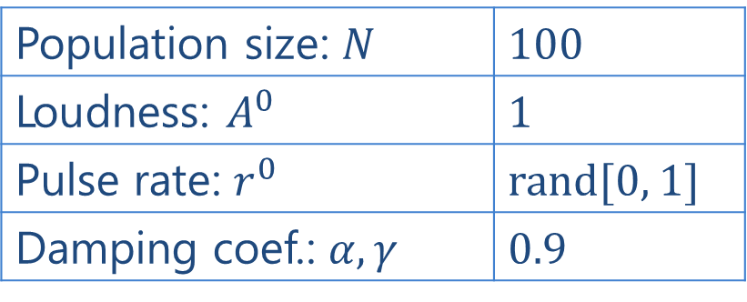
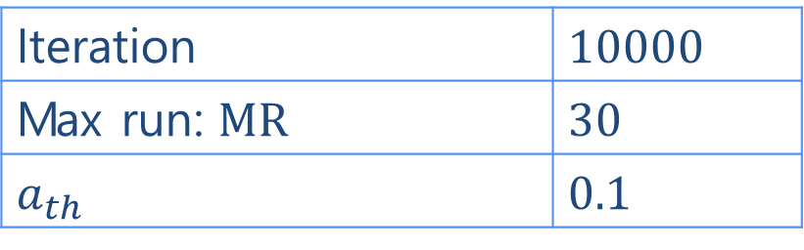

Experiment
(17 / 21)
Comparison to BA with NSBA
Parameters setting
Case 1: $F_{1} (D=2)$
Case 2: $F_{2} (D=2)$
$FPs=\sum_{i=1}^{TP}{count_{i}}$ the number of found peaks (global & local optima)
$Peak Ratio \left(PR\right)=\frac{\sum_{run=1}^{MR}{FPs}}{TP∗MR}$ the ratio of FPs
BA and NSBA
Population size: $N$ | 100
Loudness: $A^{0}$ | 1
Pulse rate: $r^{0}$ | rand[0, 1]
Damping coef.: $α, γ$ | 0.9
Evaluation measurement
Iteration | 10000
Max run: MR | 30
$$a_{th}$$ | 0.1
$TP:$ Total peaks
Notes:
To compare BA with NSBA, we employed Found Peaks (FPs) and Peak ratio (PR) as the evaluation criteria. FPs means how many peaks the algorithm found. In this experiment, we defined the peak is found, when Euclidean distance between the peak and the nearest neighbor solution less than threshold 0.1.
And PR means the ratio of FPs.
Parameters are setting as right table.

Slide 20

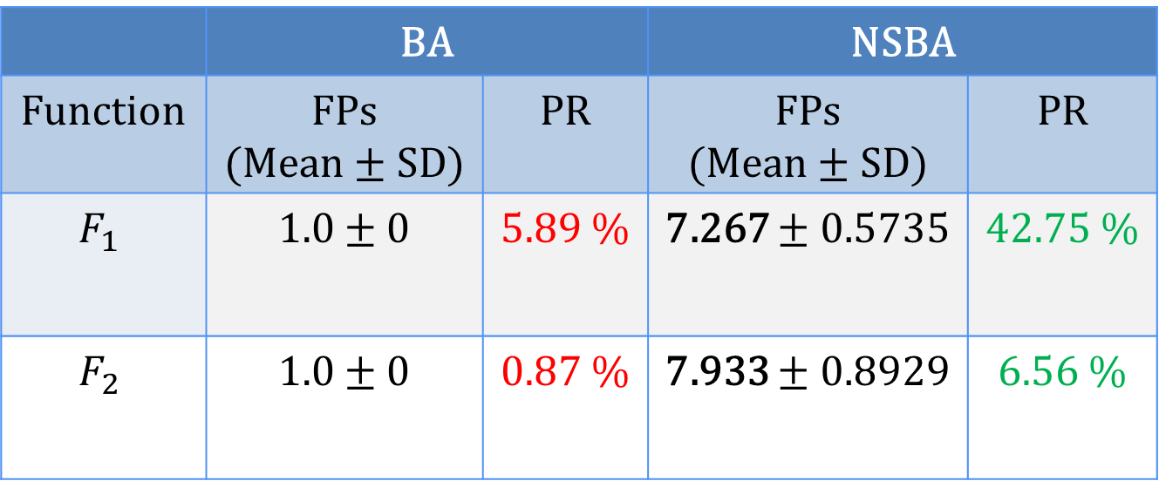
Results
(20 / 20)
Found Peaks(FPs) and Peak Ratio (PR) of BA and NSBA (averaged over 30 runs)
 | BA |  | NSBA
Function | FPs (Mean ± SD) | PR | FPs (Mean ± SD) | PR
$$F_{1}$$ | 1.0 ± 0 | 5.89 % | 7.267 ± 0.5735 | 42.75 %
$$F_{2}$$ | 1.0 ± 0 | 0.87 % | 7.933 ± 0.8929 | 6.56 %

Slide 21
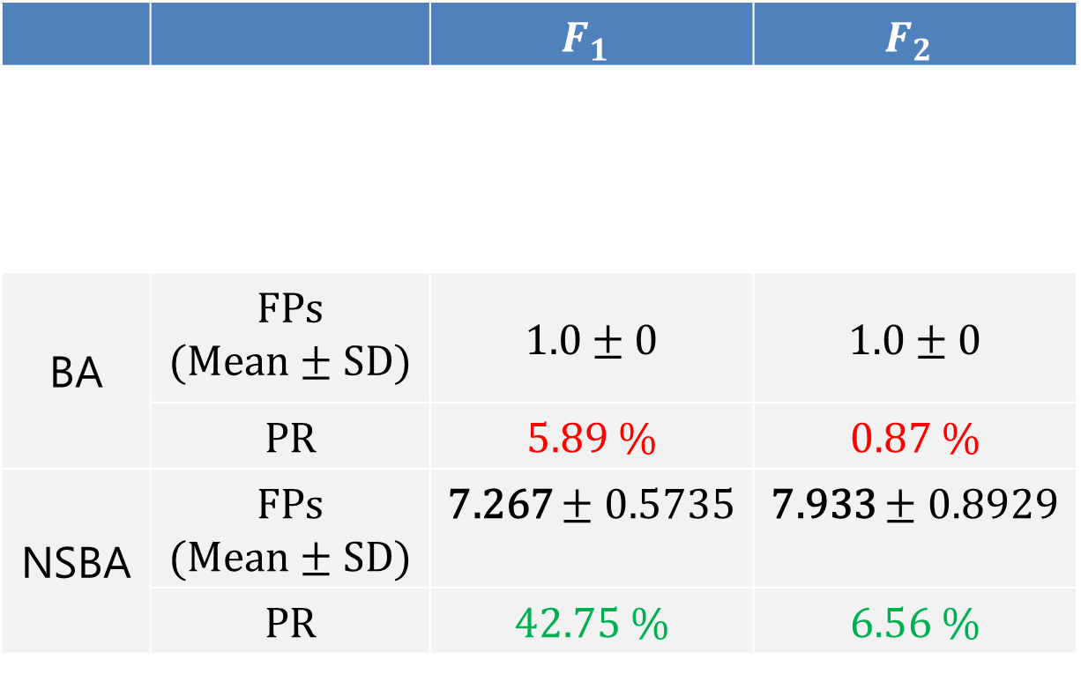
Results
(18 / 21)
Found Peaks(FPs) and Peak Ratio (PR) of BA and NSBA (averaged over 30 runs)
 |  | $$F_{1}$$ | $$F_{2}$$
BA | FPs (Mean ± SD) | 1.0 ± 0 | 1.0 ± 0
 | PR | 5.89 % | 0.87 %
NSBA | FPs (Mean ± SD) | 7.267 ± 0.5735 | 7.933 ± 0.8929
 | PR | 42.75 % | 6.56 %

Slide 22
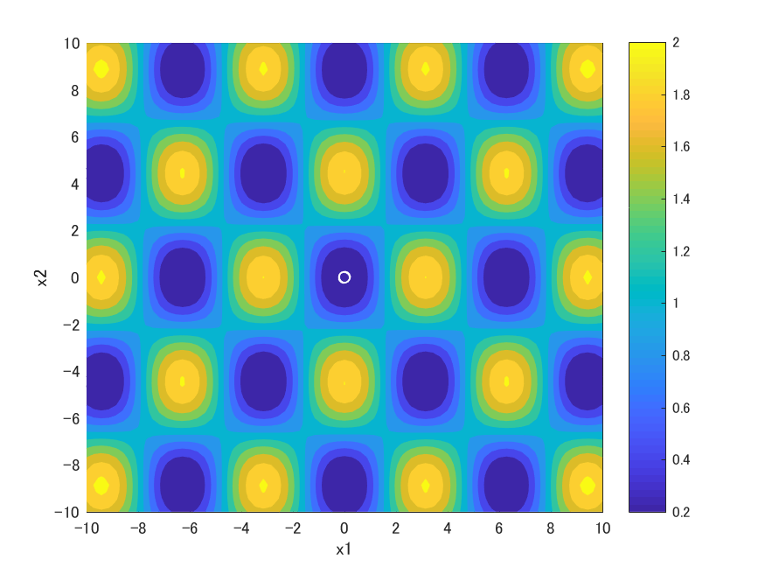
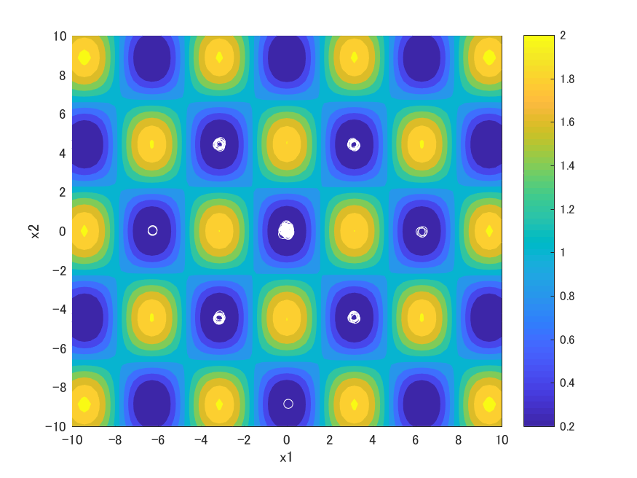
Result: Case1
(19 / 21)
Solution distribution at the final iteration
BA
NSBA
Advantage: NSBA found the global optima and some local optima
Notes:
The white circle shows solutions.

Slide 23

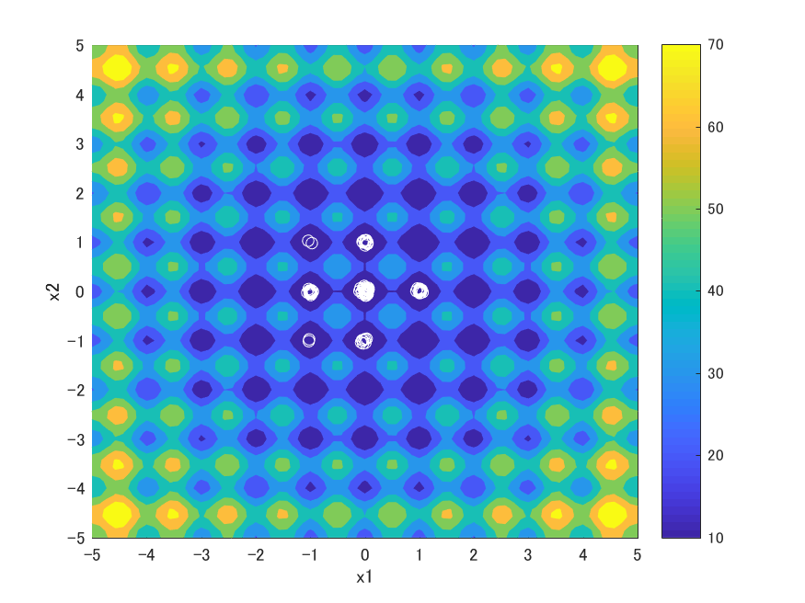

Result: Case2
(20 / 21)
Solution distribution at the final iteration
BA
NSBA
Advantage: NSBA found the global optima and some local optima

Slide 24
Conclusion
(21 / 21)
Objective:
Searching multiple optima in multimodal optimization
Proposed method:
Novelty Search-based Bat Algorithm
Extends BA with searching new solutions where never found
Changes exploitation around the personal best solution
Implications:
NSBA can search both a single global optimum and some local optima
NSBA > BA
Future work:
Find and keep all global and local optima

Slide 25
appendix

Slide 26
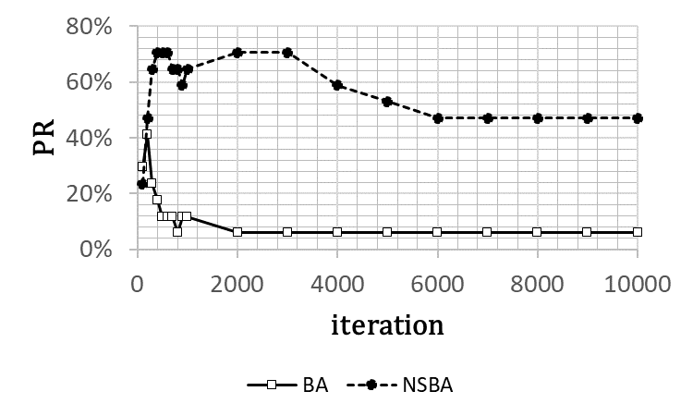
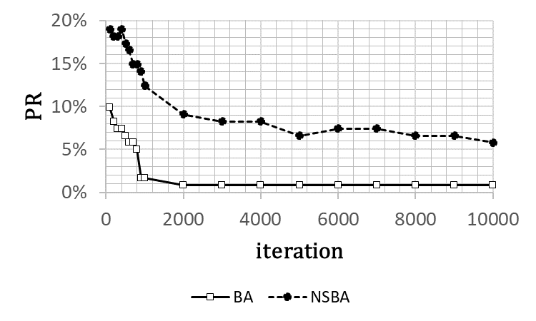


Results
(23 / 21)
Performance of BA and NSBA
$F_{1}$: Griewank
$F_{2}$: Rastrigin

Slide 27
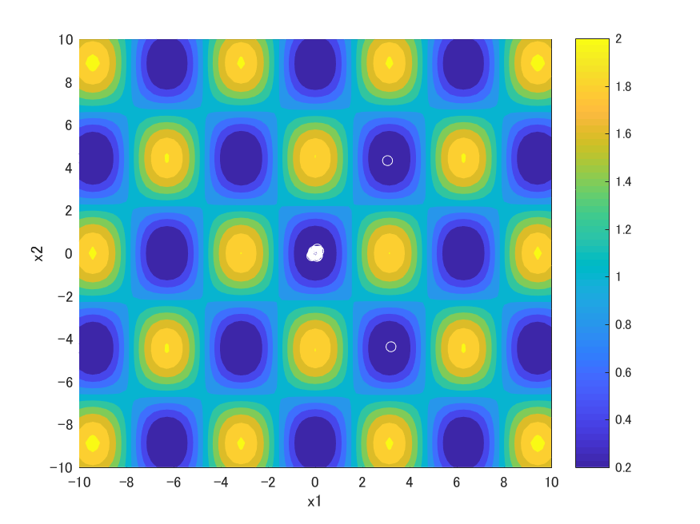
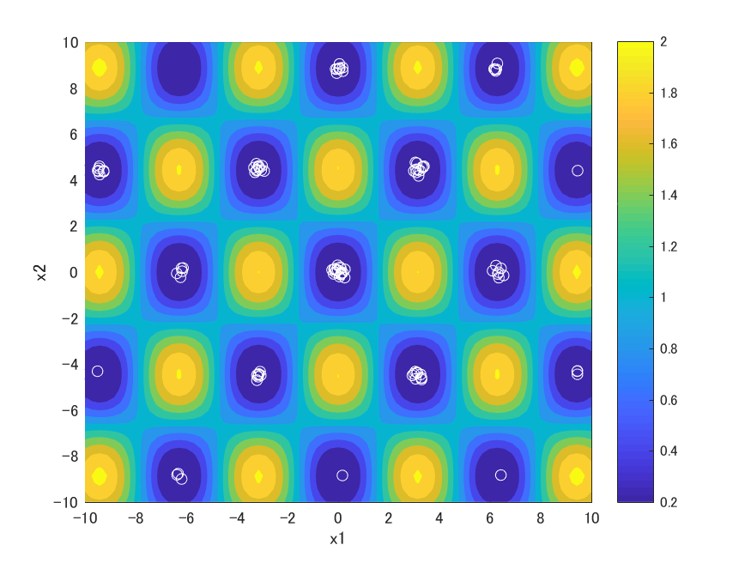
Results
(24 / 21)
Solution distribution at the 1000 iterations
BA
NSBA
Advantage: NSBA found more optima at the iteration 1000 than the final iteration

Slide 28

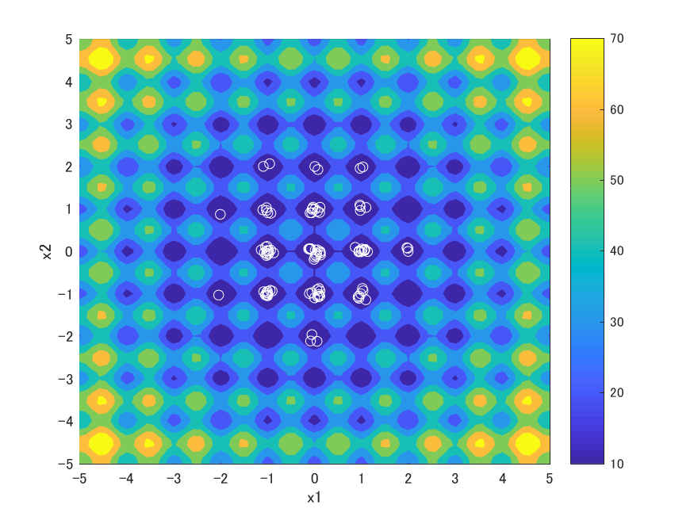
Results
(25 / 21)
Solution distribution at the 1000 iterations
BA
NSBA
Advantage: NSBA found more optima at the iteration 1000 than the final iteration

