Slide 1

The Bat Algorithm with Dynamic Niche Radius for Multimodal Optimization
The 3rd International Conference on Intelligent Systems, Metaheuristics & Swarm Intelligence
Takuya Iwase Ryo Takano Fumito Uwano Hiroyuki Sato Keiki Takadama
The University of Electro-Communications, Japan
March 23-24th 2019 @Male, Maldives
Notes:
I am Takuya Iwase from the university of electro-communications. Today, I would like to talk about my research entitled by…

Slide 2
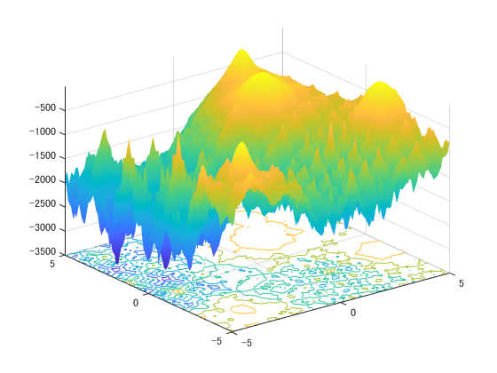
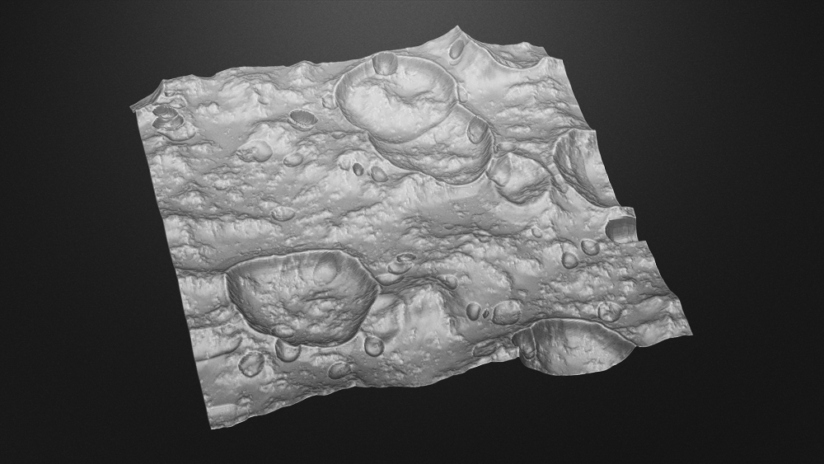
Introduction
2
Selecting landing sites in lunar mission
An example of Multimodal Function
better
INPUT: coordinate
OUTPUT: communication time
fitness
Landing site candidates global local optimum
worse
: global and local optima
Important to keep local optima not only global optimum
Notes:
In real-world optimization problems, finding multiple optima not only a single global optimum is important because of enabling to provide local optimum as one choice instead of global optimum. Real-world problems for example, there is selecting landing sites in lunar mission. are often represented as “multimodal” which have the multiple global & local optima.
The left figure shows the fitness landscape of an example of multimodal function for the maximization problem, and red marker indicates the place of global & local optima. for example, right figure shows the real-world problem which is. the landing site candidates which mean the global & local optima, in the lunar interface. In this case, we have to find
Real world problems are often represented as “multimodal” which have the multiple global & local optima.

Slide 3
Motivation
3
Niching methods [X. Li, 2013]: finding multiple optima on multimodal optimization
Evolutionary Algorithm
find a single global optimum
e.g. Clustering GA
e.g. GA, NSGA-II
Niching scheme
Enable solutions to avoid overlapping
Swarm Intelligence
find a single global optimum
(by multiple solutions)
e.g. Clustering, Crowding, fitness sharing
e.g. Crowding DE, Speciation DE, CPSO
e.g. PSO, FA
Notes:
To tackle this problem, numerous studies which are called ‘Niching methods’ have proposed. In resent years (anime), evolutionary algorithms extending niching scheme which enables solutions to avoid overlapping at the same place, are focused on solving multimodal optimization problems. And also swarm intelligence which is inspired from natural or biological evolution is often used for this problems (anime). However, these niching methods are not enough to find

Slide 4
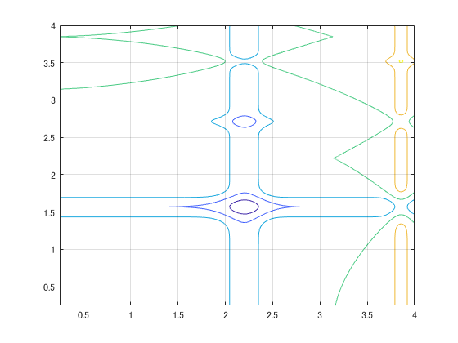














Bat Algorithm (BA) [X. S. Yang, 2010]
4
the capability of adjusting exploitation & exploration by the bat behavior
STEP1
Exploitation toward the global best solution
STEP2
Local search around the global best solution
STEP3
Random search in the search space
STEP4
Evaluate and update solutions
STEP5
Return to STEP1
$$x_{2}$$
$$v_{2}$$
$$x_{1}$$
$$v_{1}$$
$$x_{3}$$
$$x_{∗}$$
$$x_{i}^{t+1}$$
$$v_{3}$$
$$v_{4}$$
$$v_{5}$$
$$x_{4}$$
$$x_{5}$$
：solution $x_{i}$
: solution candidate
: the current best solution $x_{∗}$
Notes:
right figure shows an example of initializing 5 individuals. New solution candidates are generated toward the global best solution by velocity v (anime).

Slide 5
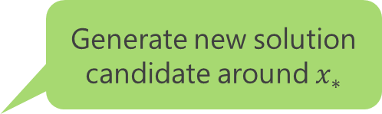


Bat Algorithm (BA) [X. S. Yang, 2010]
4
the capability of adjusting exploitation & exploration by the bat behavior
STEP1
Exploitation toward the global best solution
STEP2
Local search around the global best solution
STEP3
Random search in the search space
STEP4
Evaluate and update solutions
STEP5
Return to STEP1
Generate new solution candidate around $x_{∗}$
$$x_{2}$$
$$x_{1}$$
$$x_{loc_{i}}$$
$$x_{3}$$
$$x_{∗}$$
$$x_{4}$$
$$x_{5}$$
：solution $x_{i}$
: solution candidate
: the current best solution $x_{∗}$
Notes:
In STEP2 local search, generate new solution candidates around global best solution.

Slide 6


Bat Algorithm (BA) [X. S. Yang, 2010]
4
the capability of adjusting exploitation & exploration by the bat behavior
STEP1
Exploitation toward the global best solution
STEP2
Local search around the global best solution
STEP3
Random search in the search space
STEP4
Evaluate and update solutions
STEP5
Return to STEP1
$$x_{2}$$
$$x_{1}$$
$$x_{3}$$
$$x_{∗}$$
$$x_{rnd_{i}}$$
$$x_{4}$$
$$x_{5}$$
：solution $x_{i}$
: solution candidate
: the current best solution $x_{∗}$
Notes:
In STEP3 random search, new solution candidates are randomly generated in the search space.

Slide 7


Bat Algorithm (BA) [X. S. Yang, 2010]
4
the capability of adjusting exploitation & exploration by the bat behavior
STEP1
Exploitation toward the global best solution
STEP2
Local search around the global best solution
STEP3
Random search in the search space
STEP4
Evaluate and update solutions
STEP5
Return to STEP1
$$x_{2}$$
$$x_{1}$$
$$x_{i}^{t+1}$$
$$x_{3}$$
$$x_{∗}$$
$$x_{loc_{i}}$$
$$x_{rnd_{i}}$$
$$x_{4}$$
$$x_{5}$$
Notes:
In STEP4, one of three new solution candidates is better than the current solution (anime*4), the current solution is replaced by better new solution candidate.

Slide 8






Bat Algorithm (BA) [X. S. Yang, 2010]
4
the capability of adjusting exploitation & exploration by the bat behavior
STEP1
Exploitation toward the global best solution
STEP2
Local search around the global best solution
STEP3
Random search in the search space
STEP4
Evaluate and update solutions
STEP5
Return to STEP1
$$x_{1}$$
$$x_{3}$$
$$x_{2}$$
$$x_{4}$$
$$x_{∗}$$
$$x_{5}$$
Notes:
In STEP5, loop to the STEP1 unless termination is not satisfied.

Slide 9















Dynamic Niche Radius-based Bat Algorithm (DNRBA)
6
adaptable to change Niche radius according to the dense of individuals distribution
Dynamic Niche Radius [B. Miller, 1996]: calculated by the search space and the num of solutions
 | BA | DNRBA
Exploitation ↓ Exploration | Toward the global best solution | Keep away from the personal best solution in the Niche radius
Local search | Around the global best solution | In Niche radius of the personal best solution
Random search | In the search space | In Niche radius of the solution
$$x_{1}$$
$$x_{1}$$
$$x_{3}$$
$$x_{3}$$
$$x_{2}$$
$$x_{NR∗}$$
$$x_{NR∗}$$
$$x_{4}$$
$$x_{2}$$
$$x_{4}$$
$$σ$$
$$σ$$
Niche radius : $σ$
: individual $x_{i}$
: the best solution $x_{NR∗}$

Slide 10





Description of DNRBA
7
STEP0
Calculate the dense of individual and Niche radius
STEP1
Exploration: keep away from the personal best solution in the Niche radius
STEP2
Local search in Niche radius of the personal best solution
STEP3
Random search in Niche radius of the solution
STEP4
Evaluate and update solutions
STEP5
Return to STEP1
$$x_{2}$$
$$x_{1}$$
$$x_{3}$$
$$σ$$
$$x_{NR∗}$$
$$x_{4}$$
$$x_{5}$$
：individual $x_{i}$
Niche radius : $σ$
: the best solution $x_{NR∗}$
Notes:
For locating multiple optima, our improvements are the following highlighted sentences.
The 1st change in STEP0 is introducing Dynamic Niche Radius to locate global or local optima depending on the dense of individual.
The 2nd change in Exploitation is keep solutions away from the personal best solution in the Niche Radius, instead of approaching the global best solution.
The 3rd change in local search is generating new solution candidates nearby the personal best solution in Niche radius.
The 4th change in random search is generating new solution candidates in the Niche radius of the solution.
From the next slide, we explain the proposed mechanism in detail.

Slide 11
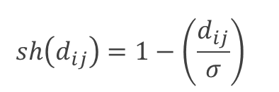



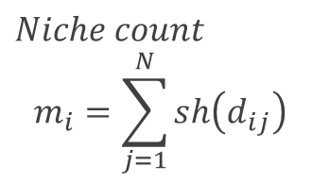
Description of DNRBA
7
STEP0
Calculate the dense of individual and Niche radius
STEP1
Exploration: keep away from the personal best solution in the Niche radius
STEP2
Local search in Niche radius of the personal best solution
STEP3
Random search in Niche radius of the solution
STEP4
Evaluate and update solutions
STEP5
Return to STEP1
$$x_{1}$$
$$sh\left(d_{ij}\right)=1−{\left(\frac{d_{ij}}{σ}\right)}^{}$$
$$x_{2}$$
$$d_{23}$$
$$x_{3}$$
$$σ$$
$$x_{NR∗}$$
$Niche count$
$$m_{i}=\sum_{j=1}^{N}{sh\left(d_{ij}\right)}$$
$$x_{4}$$
$$x_{5}$$
[B. Miler, 1996]
：individual $x_{i}$
Niche radius : $σ$
: the best solution $x_{NR∗}$

Slide 12


Description of DNRBA
7
STEP0
Calculate the dense of individual and Niche radius
STEP1
Exploration: keep away from the personal best solution in the Niche radius
STEP2
Local search in Niche radius of the personal best solution
STEP3
Random search in Niche radius of the solution
STEP4
Evaluate and update solutions
STEP5
Return to STEP1
$$x_{2}$$
$$x_{1}$$
$$v_{3}$$
$$x_{3}$$
$$x_{NR∗}$$
$$x_{3}^{t+1}$$
$$x_{4}$$
$$x_{5}$$
：individual $x_{i}$
: the best solution $x_{NR∗}$
: solution candidate
Notes:
個体候補を生成(アニメ)

Slide 13

Description of DNRBA
7
STEP0
Calculate the dense of individual and Niche radius
STEP1
Exploration: keep away from the personal best solution in the Niche radius
STEP2
Local search in Niche radius of the personal best solution
STEP3
Random search in Niche radius of the solution
STEP4
Evaluate and update solutions
STEP5
Return to STEP1
Generate new solution candidate within yellow domain
$$x_{2}$$
$$x_{1}$$
$${x_{loc}}_{3}$$
$$x_{3}$$
$$x_{NR∗}$$
$$x_{4}$$
$$x_{5}$$
：individual $x_{i}$
: the best solution $x_{NR∗}$
: solution candidate
Notes:
個体候補を生成(アニメ)

Slide 14

Description of DNRBA
7
STEP0
Calculate the dense of individual and Niche radius
STEP1
Exploration: keep away from the personal best solution in the Niche radius
STEP2
Local search in Niche radius of the personal best solution
STEP3
Random search in Niche radius of the solution
STEP4
Evaluate and update solutions
STEP5
Return to STEP1
Generate new solution candidate within the blue domain
$${x_{rnd}}_{3}$$
$$x_{2}$$
$$x_{1}$$
$$x_{3}$$
$$x_{NR∗}$$
$$x_{4}$$
$$x_{5}$$
：individual $x_{i}$
: the best solution $x_{NR∗}$
: solution candidate
Notes:
個体候補を生成(アニメ)

Slide 15

Description of DNRBA
7
STEP0
Calculate the dense of individual and Niche radius
STEP1
Exploration: keep away from the personal best solution in the Niche radius
STEP2
Local search in Niche radius of the personal best solution
STEP3
Random search in Niche radius of the solution
STEP4
Evaluate and update solutions
STEP5
Return to STEP1
$${x_{rnd}}_{3}$$
$$x_{2}$$
$$x_{1}$$
$${x_{loc}}_{3}$$
$$x_{3}$$
$$x_{NR∗}$$
$$x_{3}^{t+1}$$
$$x_{4}$$
$$x_{5}$$
：individual $x_{i}$
: the best solution $x_{NR∗}$
Notes:
他の個体についても同様に評価を行っていく

Slide 16

Description of DNRBA
7
STEP0
Calculate the dense of individual and Niche radius
STEP1
Exploration: keep away from the personal best solution in the Niche radius
STEP2
Local search in Niche radius of the personal best solution
STEP3
Random search in Niche radius of the solution
STEP4
Evaluate and update solutions
STEP5
Return to STEP1
$$x_{2}$$
$$x_{1}$$
$$x_{3}^{t+1}$$
$$x_{NR∗}$$
$$x_{4}$$
$$x_{5}$$
：individual $x_{i}$
: the best solution $x_{NR∗}$

Slide 17
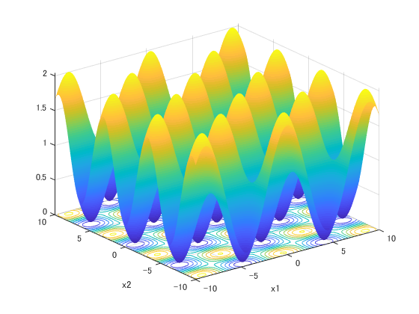
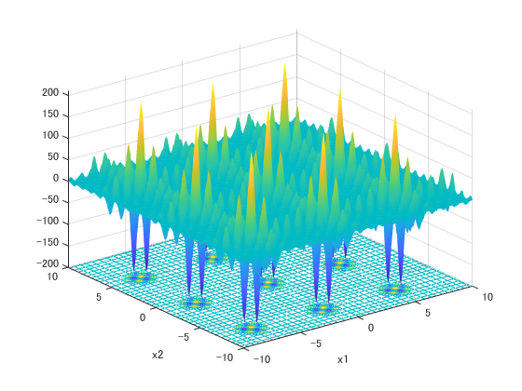

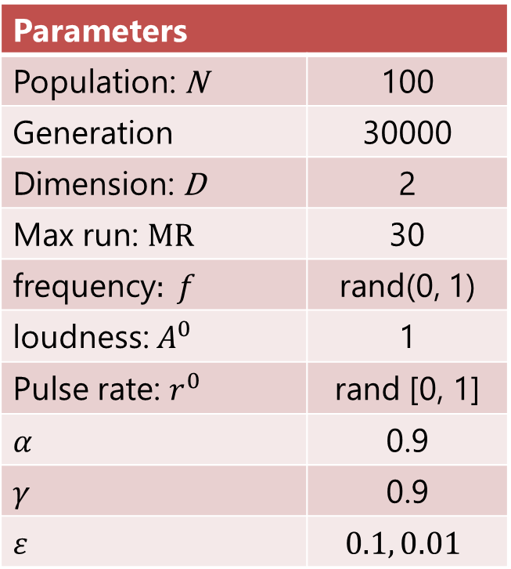
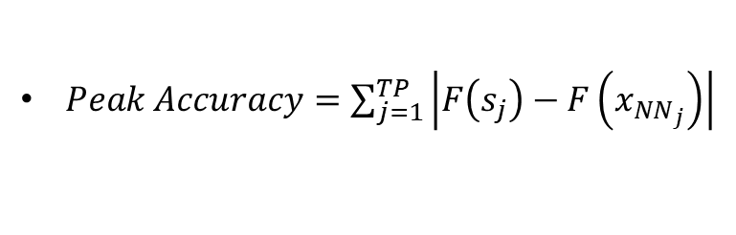


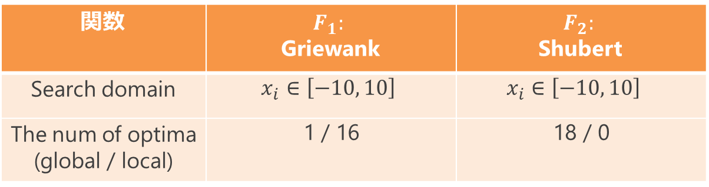

Experiment
8
Parameters
Population: N | 100
Generation | 30000
Dimension: D | 2
Max run: MR | 30
frequency$: f_{}$ | rand(0, 1)
loudness: $A^{0}$ | 1
Pulse rate: $r^{0}$ | rand [0, 1]
$$α$$ | 0.9
$$γ$$ | 0.9
$$ε$$ | $$0.1, 0.01$$
関数 | $$F_{1}:$$ Griewank | $$F_{2}:$$ Shubert
Search domain | $$x_{i}∈\left[−10, 10\right]$$ | $$x_{i}∈\left[−10, 10\right]$$
The num of optima (global / local) | 1 / 16 | 18 / 0
Evaluation measurement
$Peak Ratio= \frac{\sum_{run=1}^{MR}{FPs}}{TP∗MR}$
$FPs$: found peaks (optima)
[X.Li, et. al,2013]
$MR$: Max run
$TP$: total peak
$Peak Accuracy=\sum_{j=1}^{TP}{\left|F\left(s_{j}\right)−F\left(x_{NN_{j}}\right)\right|}$
[R. Thomsen,2004]
Notes:
To measure the number of optima found, and the convergence speed of BA vs. DNRBA, we employ 2 evaluation measurements. Peak Ratio means how many optima the algorithm found averaged over max run. The PR value indicates between 0 and 1. Peak Accuracy means how far how close solutions to the nearest neighbor optima

Slide 18
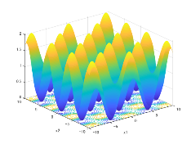

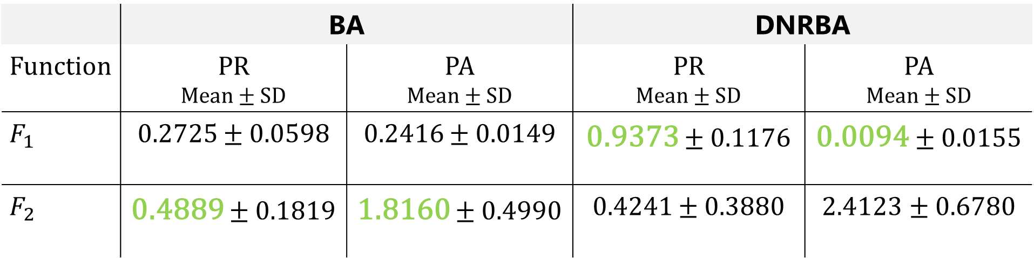
Results
9
Peak Ratio and Peak Accuracy of BA vs. DNRBA (averaged over 30 runs)
$$ε=1.0E−1$$
 | BA |  | DNRBA
Function | PR Mean $±$ SD | PA Mean $±$ SD | PR Mean $±$ SD | PA Mean $±$ SD
$$F_{1}$$ | 0.2725 $±$ 0.0598 | 0.2416 $±$ 0.0149 | 0.9373 $±$ 0.1176 | 0.0094 $±$ 0.0155
$$F_{2}$$ | 0.4889 $±$ 0.1819 | 1.8160 $±$ 0.4990 | 0.4241 $±$ 0.3880 | 2.4123 $±$ 0.6780
$F_{1}$から$F_{3}$関数までDNRBAの探索性能が最も高い
Notes:
From this table, the PR value of DNRBA is higher than BA in Function1.

Slide 19
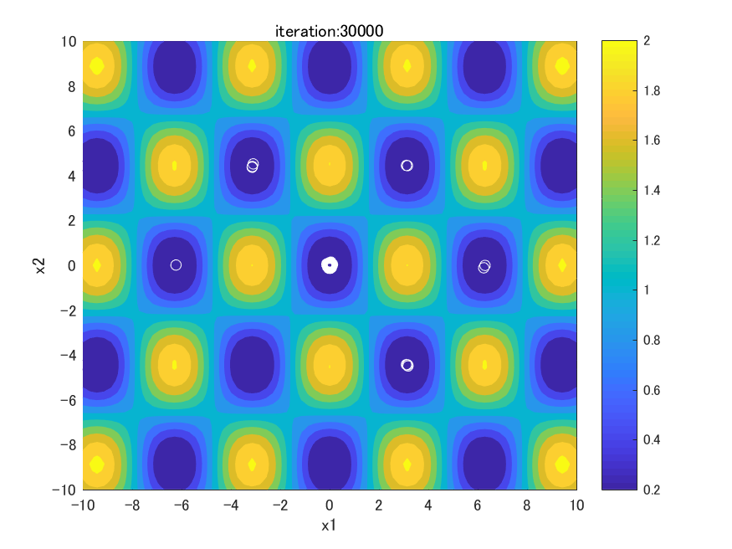
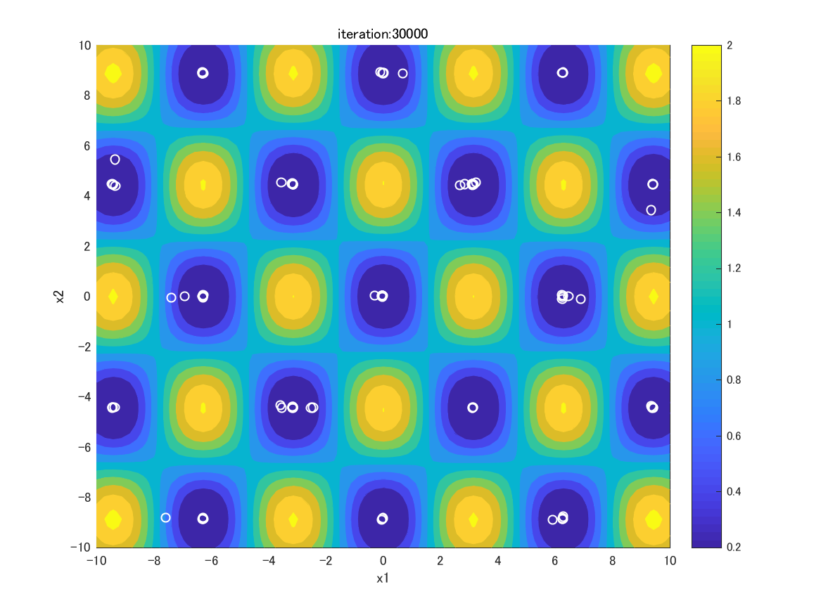

Results – Individual distribution
10
fitness
1 global optimum
16 local optima
：individual
BA
DNRBA
$F_{1}:$Griewank
1 global optimum
5 local optima
Notes:
青いエリアが最適解及び局所解を示す

Slide 20
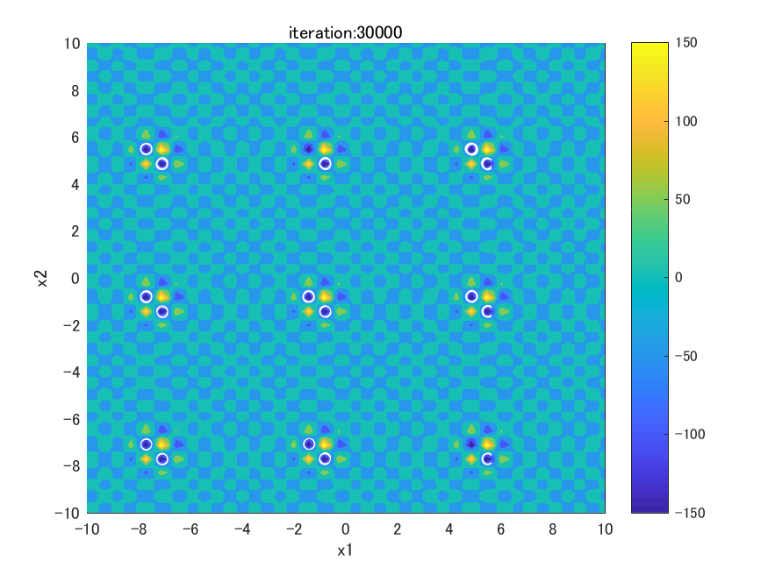
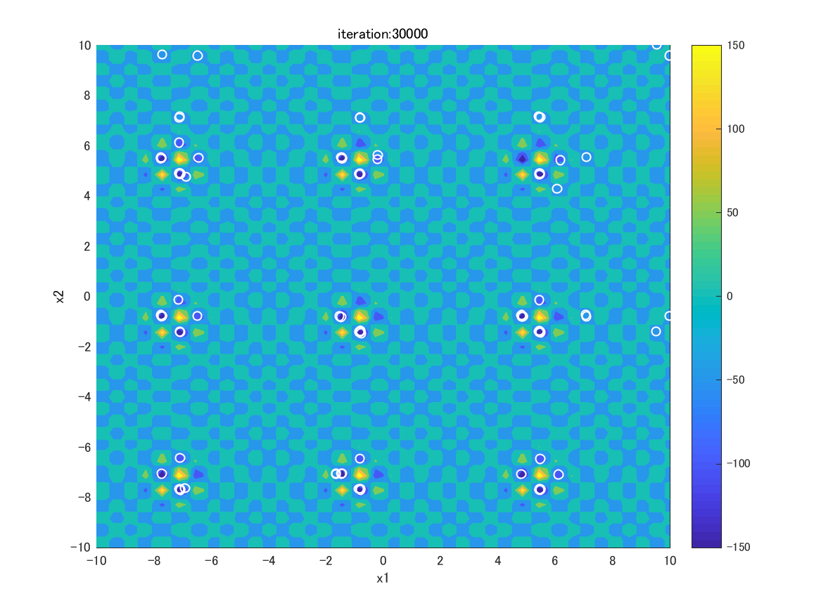

Results – Individual distribution
10
fitness
6 global optima
：individual
BA
DNRBA
$F_{1}:$Shubert
6 global optima
Notes:
青いエリアが最適解及び局所解を示す

Slide 21
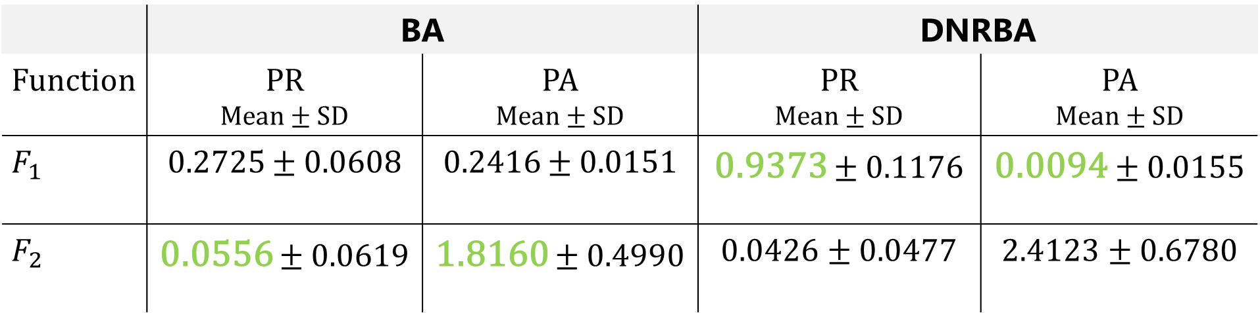
Results
9
Peak Ratio and Peak Accuracy of BA vs. DNRBA (averaged over 30 runs)
$$ε=1.0E−2$$
 | BA |  | DNRBA
Function | PR Mean $±$ SD | PA Mean $±$ SD | PR Mean $±$ SD | PA Mean $±$ SD
$$F_{1}$$ | 0.2725 $±$ 0.0608 | 0.2416 $±$ 0.0151 | 0.9373 $±$ 0.1176 | 0.0094 $±$ 0.0155
$$F_{2}$$ | 0.0556 $±$ 0.0619 | 1.8160 $±$ 0.4990 | 0.0426 $±$ 0.0477 | 2.4123 $±$ 0.6780
$F_{1}$から$F_{3}$関数までDNRBAの探索性能が最も高い

Slide 22
Results – Individual distribution
10
fitness
1 global optimum
16 local optima
：individual
BA
DNRBA
$F_{1}:$Griewank
6 global optima
Notes:
青いエリアが最適解及び局所解を示す

Slide 23
Results – Individual distribution
10
fitness
1 global optimum
：individual
BA
DNRBA
$F_{1}:$Shubert
0 global optimum
Notes:
青いエリアが最適解及び局所解を示す

Slide 24
Conclusion
14
Objective
BA with Dynamic Niche Radius for locating global & local optima on Multimodal optimization
Implications
Keeping solutions away from the personal best solution in Niche radius
Generate solution candidates in Niche radius of the personal best solution
Generate solution candidates in Niche radius of the solution
Results
DNRBA is more effective in the function which has global & local optima than BA
DNRBA is nearly the same performance in the function which has only global optima as BA
Future works
Compare with state-of-the-art Niching methods

Slide 25
Appendix

Slide 27













従来の問題に対するアプローチ
6
多点探索アルゴリズム + 複数解探索する機構
Novelty Search-based Bat Algorithm (NSBA)
未探索空間に新しく個体候補を生成する
$$x_{1}$$
 | BA | NSBA
収束方向へ探索 | 最良個体 方向へ移動 | 最良個体から 離れる方向へ移動
局所探索 | 最良個体付近 | 各個体付近
ランダム探索 | 解探索空間 | BAと同じ
$$x_{2}$$
$$x_{2}$$
$$x_{1}$$
$$x_{3}$$
$$x_{3}$$
$$x_{∗}$$
$$x_{∗}$$
$$x_{4}$$
$$x_{4}$$
: 個体 $x_{i} \left(i=1,2,…,N\right)$
: 最$良個体 x_{∗}$
問題点
ランダム探索により保持していた局所解から より良い評価値を持つ解へ移動する
$$dist\left(x_{∗}, x_{i}\right)$$

Slide 28















従来の問題に対するアプローチ
7
多点探索アルゴリズム + 複数解探索する機構
Niche Radius-based Bat Algorithm (NRBA)
探索範囲を分割し，同じ局所解に個体を収束させない機構
 | BA | NRBA
収束方向への探索 | 最良個体 方向へ移動 | Niche radius(分割した探索範囲)内の最良個体から 離れる方向へ移動
局所探索 | 最良個体 付近 | Niche radius内の最良個体
ランダム探索 | 解探索空間 | Niche radius内
アルゴリズムの特徴 | 全個体が 最適解へ 収束 | 探索空間内の局所解 も捕捉可能
$$x_{1}$$
$$x_{1}$$
$$x_{3}$$
$$x_{3}$$
$$x_{2}$$
$$x_{NR∗}$$
$$x_{NR∗}$$
$$x_{4}$$
$$x_{2}$$
$$x_{4}$$
$$σ$$
$$σ$$
Niche radius: $σ$
: 個体 $x_{i}$
: 最良個体 $x_{NR∗}$
問題点
評価値の低い局所解で留まる

