Slide 1

The Bat Algorithm with Dynamic Niche Radius for Multimodal Optimization
The 3rd International Conference on Intelligent Systems, Metaheuristics & Swarm Intelligence
Takuya Iwase Ryo Takano Fumito Uwano Hiroyuki Sato Keiki Takadama
The University of Electro-Communications, Japan
March 23-24th 2019 @Male, Maldives
Notes:
I am Takuya Iwase from the university of electro-communications. Today, I would like to talk about my research entitled by…

Slide 2
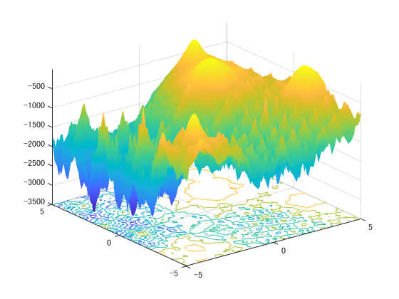
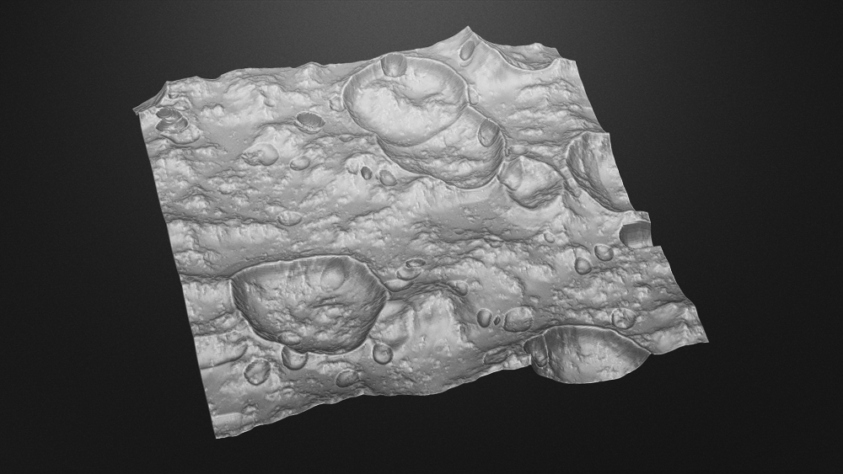
Introduction
2
Ex. Selecting landing sites in lunar mission
Multimodal Function
better
INPUT: coordinate
OUTPUT: communication time
fitness
Landing site candidates global local optimum
worse
: global and local optima
Important: to find local optima in addition to a global optimum
Notes:
In real-world optimization problems, finding multiple optima not only a single global optimum is important because of enabling to provide local optimum as one choice instead of global optimum. Real-world problems for example, left figure shows selecting landing sites in lunar mission. In this case, the hyper parameter is the coordinate at the landing site candidate and the fitness is communication time, these are described as shown in right figure.
The right figure shows the fitness landscape of multimodal function for the maximization problem, and red marker indicates the place of global & local optima. We want to know several optimal landing site candidates which have longer communication time than the other place.

Slide 3
Approach to the problem
3
Niching methods [X. Li, 2013]: finding multiple optima on multimodal optimization
Evolutionary Algorithm
Local search
(Easy to converge local optima)
e.g. Clustering GA
e.g. GA, Simulated Annealing
Niching scheme
Enable solutions to avoid overlapping
Population-based
Global search
(Depending on the probability of Initializing)
e.g. Clustering, Crowding, fitness sharing
e.g. Crowding DE, Speciation DE, CPSO
e.g. PSO, DE
Need to exploitation & exploration simultaneously
Notes:
To tackle this problem, numerous studies which are called ‘Niching methods’ have proposed. In resent years (anime), evolutionary algorithms extending niching scheme which enables solutions to avoid overlapping at the same place, are focused on solving multimodal optimization problems. And also population-based algorithms which use multiple solutions to find a single global optimum globally is often used for this problems (anime). However, these niching methods are not enough to find multiple optima because they do not consider the solution movement globally although they just consider the movement according to the Euclidean distance between the nearest solutions (anime).
In this paper, we focus on the algorithm which can search multiple optima globally and locally extending with niching scheme which can keep local optima.

Slide 4
Bat Algorithm (BA) [X. S. Yang, 2010]
4
Capability of adjusting exploitation & exploration by the bat behavior
STEP1
Move toward the global best solution
STEP2
Local search around the global best solution
STEP3
Random search in the search space
STEP4
Evaluate and update solutions
STEP5
Return to STEP1
exploitation
exploration
Notes:
Bat algorithm which is one of the population-based algorithms, is superior for adjusting exploitation and exploration search.
The algorithm consists of three search steps which enable exploitation and exploration.
STEP1 and 2 for exploitation and STEP3 for exploration. From the next slide, I will explain the algorithm flowchart in detail by the following steps.

Slide 5
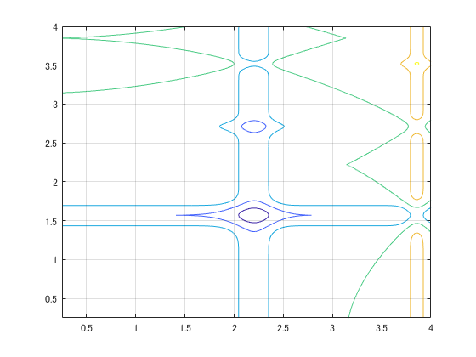














Bat Algorithm (BA) [X. S. Yang, 2010]
4
Capability of adjusting exploitation & exploration by the bat behavior
STEP1
Move toward the global best solution
STEP2
Local search around the global best solution
STEP3
Random search in the search space
STEP4
Evaluate and update solutions
STEP5
Return to STEP1
$$x_{2}$$
$$v_{2}$$
$$x_{1}$$
$$v_{1}$$
$$x_{3}$$
$$x_{∗}$$
$$x_{i}^{t+1}$$
$$v_{3}$$
$$v_{4}$$
$$v_{5}$$
$$x_{4}$$
$$x_{5}$$
：solution $x_{i}$
: solution candidate
: the current best solution $x_{∗}$
Notes:
right figure shows an example of initializing 5 individuals. In STEP1, New solution candidates are generated toward the global best solution by velocity v (anime).

Slide 6
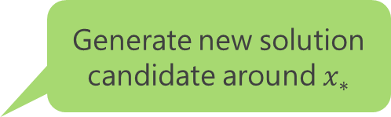


Bat Algorithm (BA) [X. S. Yang, 2010]
4
Capability of adjusting exploitation & exploration by the bat behavior
STEP1
Move toward the global best solution
STEP2
Local search around the global best solution
STEP3
Random search in the search space
STEP4
Evaluate and update solutions
STEP5
Return to STEP1
Generate new solution candidate around $x_{∗}$
$$x_{2}$$
$$x_{1}$$
$$x_{loc_{i}}$$
$$x_{3}$$
$$x_{∗}$$
$$x_{4}$$
$$x_{5}$$
：solution $x_{i}$
: solution candidate
: the current best solution $x_{∗}$
Notes:
In STEP2 local search, generate new solution candidates around global best solution (anime).

Slide 7


Bat Algorithm (BA) [X. S. Yang, 2010]
4
Capability of adjusting exploitation & exploration by the bat behavior
STEP1
Move toward the global best solution
STEP2
Local search around the global best solution
STEP3
Random search in the search space
STEP4
Evaluate and update solutions
STEP5
Return to STEP1
$$x_{2}$$
$$x_{1}$$
$$x_{3}$$
$$x_{∗}$$
$$x_{rnd_{i}}$$
$$x_{4}$$
$$x_{5}$$
：solution $x_{i}$
: solution candidate
: the current best solution $x_{∗}$
Notes:
In STEP3 random search, new solution candidates are randomly generated in the search space (anime).

Slide 8


Bat Algorithm (BA) [X. S. Yang, 2010]
4
Capability of adjusting exploitation & exploration by the bat behavior
STEP1
Move toward the global best solution
STEP2
Local search around the global best solution
STEP3
Random search in the search space
STEP4
Evaluate and update solutions
STEP5
Return to STEP1
$$x_{2}$$
$$x_{1}$$
$$x_{i}^{t+1}$$
$$x_{3}$$
$$x_{∗}$$
$$x_{loc_{i}}$$
$$x_{rnd_{i}}$$
$$x_{4}$$
$$x_{5}$$
Notes:
In STEP4, one of three new solution candidates is better than the current solution (anime*4), the current solution is replaced by better new solution candidate.

Slide 9






Bat Algorithm (BA) [X. S. Yang, 2010]
4
Capability of adjusting exploitation & exploration by the bat behavior
STEP1
Move toward the global best solution
STEP2
Local search around the global best solution
STEP3
Random search in the search space
STEP4
Evaluate and update solutions
STEP5
Return to STEP1
$$x_{1}$$
$$x_{3}$$
$$x_{2}$$
$$x_{4}$$
$$x_{∗}$$
$$x_{5}$$
Notes:
In STEP5, loop to the STEP1 unless termination is not satisfied.

Slide 10


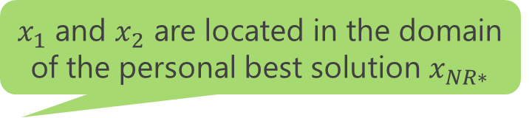














Dynamic Niche Radius [B. Miller, 1996]
5
Calculated by the search space and the number of solutions
$x_{1}$ and $x_{2}$ are located in the domain of the personal best solution $x_{NR∗}$
$$x_{1}$$
The radius of $x_{1}$ and $x_{2}$ become larger as shown in blue domain
$$x_{1}$$
$$x_{3}$$
$$x_{3}$$
$$x_{2}$$
$$x_{NR∗}$$
$$x_{NR∗}$$
$$x_{4}$$
$$x_{2}$$
$$x_{4}$$
$$σ$$
$$σ$$
Niche radius : $σ$
: individual $x_{i}$
: the personal best solution $x_{NR∗}$
Advantage: to enable to keep local optima and prompt search globally
Notes:
This is a kind of niching scheme Dynamic Niche Radius which is based on the search space and the number of solutions. The figure shows x1, x2, and x3 are located within the radius of the personal best solution. In this case, the dense of individual x1 and x2 are high, so these radius become larger described the blue area. Using this niching scheme, we aim to keep local optima and find the other optima efficiently.

Slide 11
Proposal for Multimodal Optimization
6
Dynamic Niche Radius-based Bat Algorithm (DNRBA)
Three improvements from conventional BA to DNRBA
BA
exploitation | Move toward the global best solution
exploitation | Around the global best solution
exploration | In the search space
DNRBA
exploration | Keep away from the personal best solution in the Niche radius
exploitation | In Niche radius of the personal best solution
exploration | In Niche radius of the current solution
Notes:
For finding multiple optima, we proposed the new Bat Algorithm extending with Dynamic Niche Radius. We improved these search steps of BA to DNRBA on the table.

Slide 12





Description of DNRBA
7
STEP0
Calculate the dense of individual and Niche radius
STEP1
Keep away from the personal best solution in the Niche radius
STEP2
Local search in Niche radius of the personal best solution
STEP3
Random search in Niche radius of the current solution
STEP4
Evaluate and update solutions
STEP5
Return to STEP1
$$x_{2}$$
$$x_{1}$$
$$x_{3}$$
$$σ$$
$$x_{NR∗}$$
$$x_{4}$$
$$x_{5}$$
：individual $x_{i}$
Niche radius : $σ$
: the best solution $x_{NR∗}$
Notes:
This is the flowchart of DNRBA. Our improvements are the following highlighted sentences.
The 1st improvement in STEP0 is introducing Dynamic Niche Radius to locate global or local optima depending on the dense of individual.
The 2nd improvement in is keep solutions away from the personal best solution in the Niche Radius, instead of approaching the global best solution.
The 3rd improvement in local search is generating new solution candidates nearby the personal best solution in Niche radius.
The 4th improvement in random search is generating new solution candidates in the Niche radius of the solution.
From the next slide, we explain the proposed mechanism in detail.

Slide 13



Description of DNRBA
7
STEP0
Calculate the dense of individual and Niche radius
STEP1
Keep away from the personal best solution in the Niche radius
STEP2
Local search in Niche radius of the personal best solution
STEP3
Random search in Niche radius of the current solution
STEP4
Evaluate and update solutions
STEP5
Return to STEP1
$$x_{1}$$
$$x_{2}$$
$$d_{23}$$
$$x_{3}$$
$$σ$$
$$x_{NR∗}$$
$$x_{4}$$
$$x_{5}$$
：individual $x_{i}$
Niche radius : $σ$
: the best solution $x_{NR∗}$
Notes:
In STEP0, from right figure, all individuals have same length of radius. The distance d23 between x2 and x3 is less than Niche radius, so the Niche radius of x3 becomes larger (anime)

Slide 14


Description of DNRBA
7
STEP0
Calculate the dense of individual and Niche radius
STEP1
Keep away from the personal best solution in the Niche radius
STEP2
Local search in Niche radius of the personal best solution
STEP3
Random search in Niche radius of the current solution
STEP4
Evaluate and update solutions
STEP5
Return to STEP1
$$x_{2}$$
$$x_{1}$$
$$v_{3}$$
$$x_{3}$$
$$x_{NR∗}$$
$$x_{3}^{t+1}$$
$$x_{4}$$
$$x_{5}$$
：individual $x_{i}$
: the best solution $x_{NR∗}$
: solution candidate
Notes:
Now, the search domain of x3 includes the personal best solution x_NR*, so the new solution candidate are generated apart from the solution (anime).

Slide 15

Description of DNRBA
7
STEP0
Calculate the dense of individual and Niche radius
STEP1
Keep away from the personal best solution in the Niche radius
STEP2
Local search in Niche radius of the personal best solution
STEP3
Random search in Niche radius of the current solution
STEP4
Evaluate and update solutions
STEP5
Return to STEP1
Generate new solution candidate within yellow domain
$$x_{2}$$
$$x_{1}$$
$${x_{loc}}_{3}$$
$$x_{3}$$
$$x_{NR∗}$$
$$x_{4}$$
$$x_{5}$$
：individual $x_{i}$
: the best solution $x_{NR∗}$
: solution candidate
Notes:
In STEP2 local search, new solution candidate is generated within the Niche radius of the personal best solution x_NR* (anime)

Slide 16

Description of DNRBA
7
STEP0
Calculate the dense of individual and Niche radius
STEP1
Keep away from the personal best solution in the Niche radius
STEP2
Local search in Niche radius of the personal best solution
STEP3
Random search in Niche radius of the current solution
STEP4
Evaluate and update solutions
STEP5
Return to STEP1
Generate new solution candidate within the blue domain
$${x_{rnd}}_{3}$$
$$x_{2}$$
$$x_{1}$$
$$x_{3}$$
$$x_{NR∗}$$
$$x_{4}$$
$$x_{5}$$
：individual $x_{i}$
: the best solution $x_{NR∗}$
: solution candidate
Notes:
Then in STEP3 random search, new solution candidate is generated in the Niche radius of the solution x3.

Slide 17

Description of DNRBA
7
STEP0
Calculate the dense of individual and Niche radius
STEP1
Keep away from the personal best solution in the Niche radius
STEP2
Local search in Niche radius of the personal best solution
STEP3
Random search in Niche radius of the current solution
STEP4
Evaluate and update solutions
STEP5
Return to STEP1
$${x_{rnd}}_{3}$$
$$x_{2}$$
$$x_{1}$$
$${x_{loc}}_{3}$$
$$x_{3}$$
$$x_{NR∗}$$
$$x_{3}^{t+1}$$
$$x_{4}$$
$$x_{5}$$
：individual $x_{i}$
: the best solution $x_{NR∗}$
Notes:
In this STEP is same as conventional BA. The one of three new solution candidates is better than the current solution (anime*4), the current solution is replaced by better new solution candidate.

Slide 18

Description of DNRBA
7
STEP0
Calculate the dense of individual and Niche radius
STEP1
Keep away from the personal best solution in the Niche radius
STEP2
Local search in Niche radius of the personal best solution
STEP3
Random search in Niche radius of the current solution
STEP4
Evaluate and update solutions
STEP5
Return to STEP1
$$x_{2}$$
$$x_{1}$$
$$x_{3}^{t+1}$$
$$x_{NR∗}$$
$$x_{4}$$
$$x_{5}$$
：individual $x_{i}$
: the best solution $x_{NR∗}$
Notes:
Then, loop to the STEP1 unless termination is not satisfied.

Slide 19
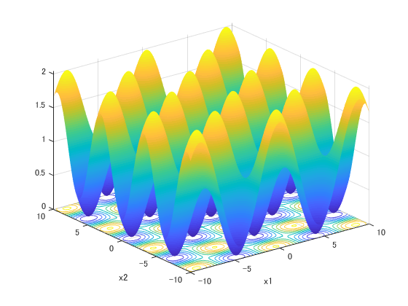
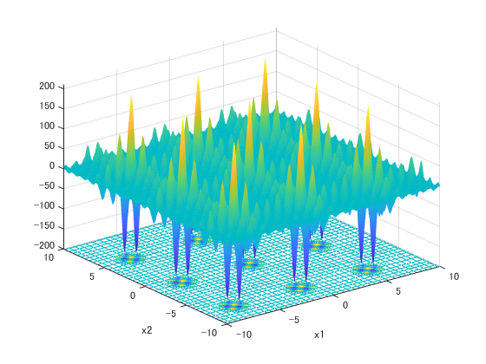



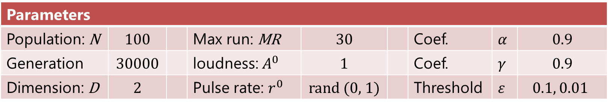
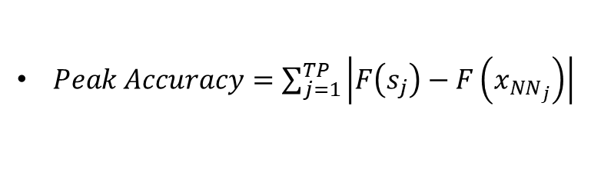


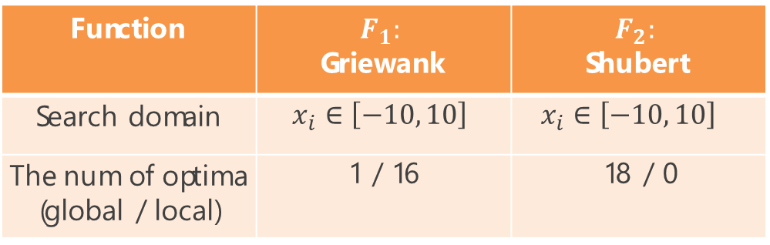

Experiment BA vs. DNRBA
8
Evaluation measurement
$Peak Ratio= \frac{\sum_{run=1}^{MR}{FPs}}{TP∗MR}$
[X.Li, et. al, 2013]
Function | $$F_{1}:$$ Griewank | $$F_{2}:$$ Shubert
Search domain | $$x_{i}∈\left[−10, 10\right]$$ | $$x_{i}∈\left[−10, 10\right]$$
The num of optima (global / local) | 1 / 16 | 18 / 0
$FPs$: found peaks (optima)
$MR$: Max run
$TP$: total peak
$Peak Accuracy=\sum_{j=1}^{TP}{\left|F\left(s_{j}\right)−F\left(x_{NN_{j}}\right)\right|}$
[R. Thomsen, 2004]
$S_{j}$: peak (optima)
$x_{NN_{j}}$: nearest neighbor solution
Parameters
Population: N | 100 |  | Max run: MR | 30 |  | Coef. | $$α$$ | 0.9
Generation | 30000 |  | loudness: $A^{0}$ | 1 |  | Coef. | $$γ$$ | 0.9
Dimension: D | 2 |  | Pulse rate: $r^{0}$ | rand (0, 1) |  | Threshold | $$ε$$ | $$0.1, 0.01$$
Notes:
To measure the number of optima found, and the convergence speed of BA vs. DNRBA, we employ 2 evaluation measurements. Peak Ratio means how many optima the algorithm found averaged over max run. The PR value indicates between 0 and 1. Peak Accuracy means how close solutions to the nearest neighbor optima. As the distance between optima and the nearest neighbor solution is close, the PA value also close to 0. finding optima is defined by threshold value sigma. the parameter setting is on the below table.

Slide 20
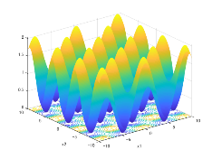

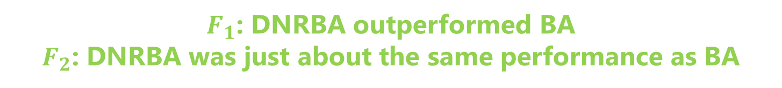
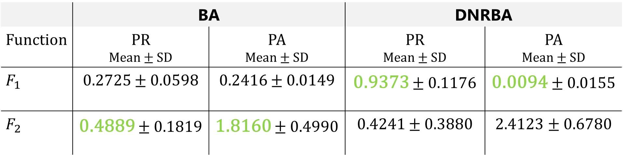
Results
9
Peak Ratio and Peak Accuracy of BA vs. DNRBA (averaged over 30 runs)
$$ε=1.0E−1$$
 | BA |  | DNRBA
Function | PR Mean $±$ SD | PA Mean $±$ SD | PR Mean $±$ SD | PA Mean $±$ SD
$$F_{1}$$ | 0.2725 $±$ 0.0598 | 0.2416 $±$ 0.0149 | 0.9373 $±$ 0.1176 | 0.0094 $±$ 0.0155
$$F_{2}$$ | 0.4889 $±$ 0.1819 | 1.8160 $±$ 0.4990 | 0.4241 $±$ 0.3880 | 2.4123 $±$ 0.6780
$F_{1}$: DNRBA outperformed BA
$F_{2}$: DNRBA was just about the same performance as BA
Notes:
From this table, the PR value of DNRBA is higher than BA in Function1.

Slide 21
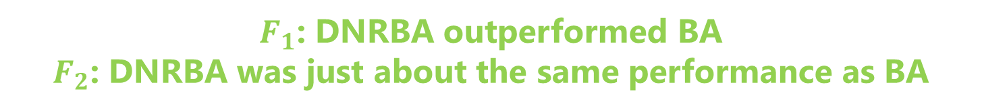
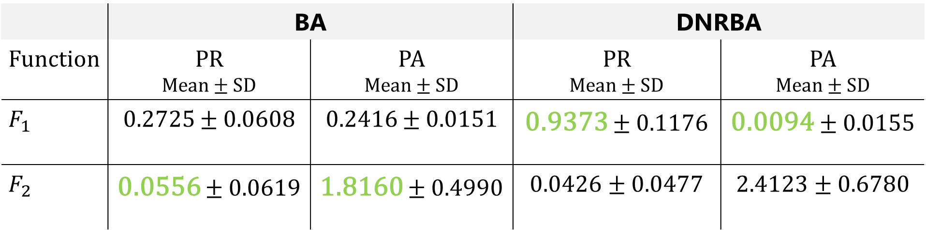
Results
10
Peak Ratio and Peak Accuracy of BA vs. DNRBA (averaged over 30 runs)
$$ε=1.0E−2$$
 | BA |  | DNRBA
Function | PR Mean $±$ SD | PA Mean $±$ SD | PR Mean $±$ SD | PA Mean $±$ SD
$$F_{1}$$ | 0.2725 $±$ 0.0608 | 0.2416 $±$ 0.0151 | 0.9373 $±$ 0.1176 | 0.0094 $±$ 0.0155
$$F_{2}$$ | 0.0556 $±$ 0.0619 | 1.8160 $±$ 0.4990 | 0.0426 $±$ 0.0477 | 2.4123 $±$ 0.6780
$F_{1}$: DNRBA outperformed BA
$F_{2}$: DNRBA was just about the same performance as BA

Slide 22
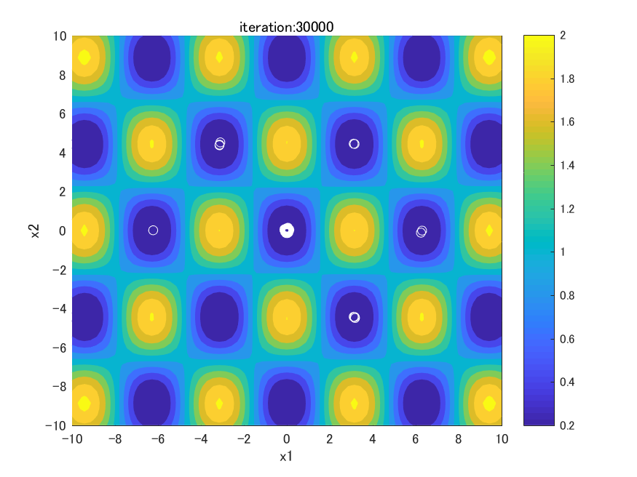
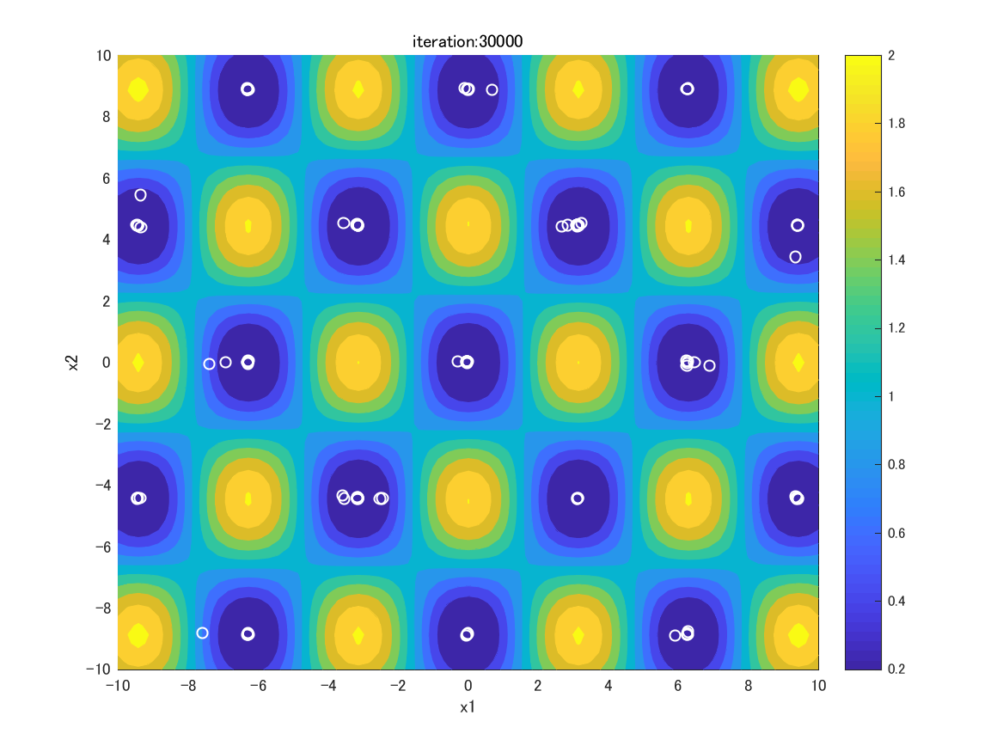

Results – Individual distribution
11
fitness
1 global optimum
16 local optima
：individual
BA
DNRBA
$F_{1}:$Griewank
1 global optimum
5 local optima
Notes:
These figures show the individual distribution of BA and DNRBA.
The blue area indicates the place of global & local optima. White circle indicates the individual.

Slide 23
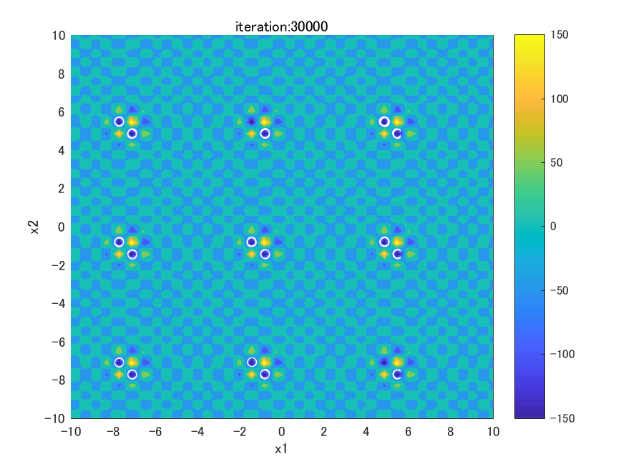
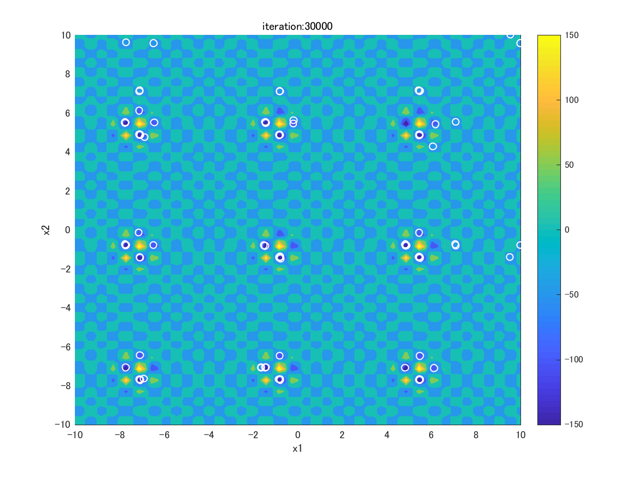

Results – Individual distribution
12
fitness
6 global optima
：individual
1 global optimum
BA
DNRBA
$F_{2}:$Shubert
6 global optima
Not found
Notes:
青いエリアが最適解及び局所解を示す

Slide 24
Conclusion
13
Objective
BA with Dynamic Niche Radius for finding global & local optima on Multimodal optimization
Implications
Keep solutions away from the personal best solution in Niche radius
Generate solution candidates in Niche radius of the personal best solution
Generate solution candidates in Niche radius of the current solution
Results
DNRBA is more effective in the function which has global & local optima than BA
DNRBA is just about the same performance in the function which has only global optima as BA
Future works
Compare with state-of-the-art Niching methods
Notes:
In conclusion,

Slide 25
Appendix

Slide 26
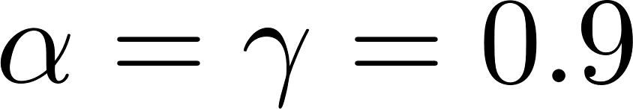
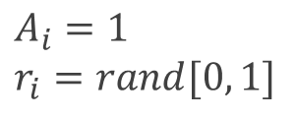




BA flowchart
STEP0: Initialize Population
for i = 1 to N
$$\left(i=1,2,…, N\right)$$
$$x_{2}$$
$$x_{1}$$
rand $∈[0, 1]$
$$x_{3}$$
$$x_{∗}$$
$x_{ub}:$ upper bound of the search space
$x_{lb}:$ lower bound of the search space
$$A_{i}=1$$
$$r_{i}=rand[0, 1]$$
$$x_{4}$$
$$x_{5}$$
Endfor
：solution $x_{i}$
: solution candidate
: the current best solution $x_{∗}$

Slide 27
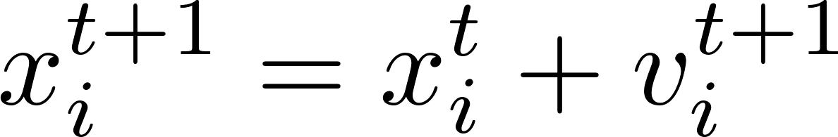


BA flowchart
STEP1: Move toward the global best solution
for i = 1 to N
$$x_{2}$$
$$v_{2}$$
$$x_{1}$$
$$v_{1}$$
$$x_{3}$$
$$x_{∗}$$
$$x_{i}^{t+1}$$
$$v_{3}$$
Endfor
$$v_{4}$$
$$v_{5}$$
$$x_{4}$$
$$x_{5}$$
$x_{∗} :$ global best solution
rand $∈[0, 1]$
：solution $x_{i}$
: solution candidate
: the current best solution $x_{∗}$

Slide 28
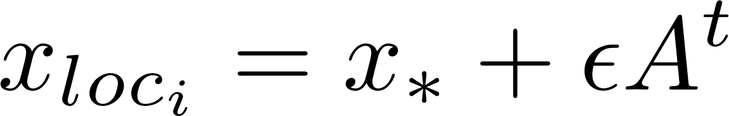
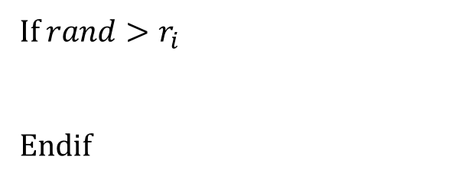
BA flowchart
STEP2: Local search around the global best solution
Generate new solution candidate around $x_{∗}$
for i = 1 to N
If $rand>r_{i}$
Endif
$$x_{2}$$
$$x_{1}$$
$$x_{loc_{i}}$$
$$x_{3}$$
$$x_{∗}$$
Endfor
$$x_{4}$$
$$x_{5}$$
：solution $x_{i}$
: solution candidate
$ε$: parameter to control the search area in this step
: the current best solution $x_{∗}$

Slide 29
BA flowchart
STEP3: Random search in the search space
for i = 1 to N
$$x_{2}$$
$$x_{1}$$
Endfor
$$x_{3}$$
$$x_{∗}$$
$$x_{rnd_{i}}$$
$$x_{4}$$
$$x_{5}$$
：solution $x_{i}$
: solution candidate
: the current best solution $x_{∗}$

Slide 30
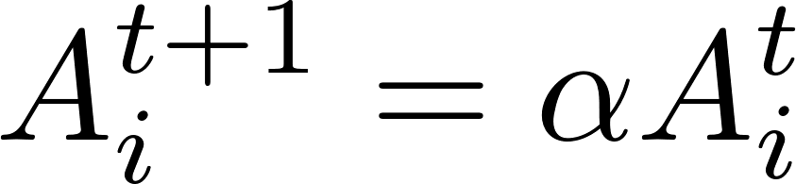
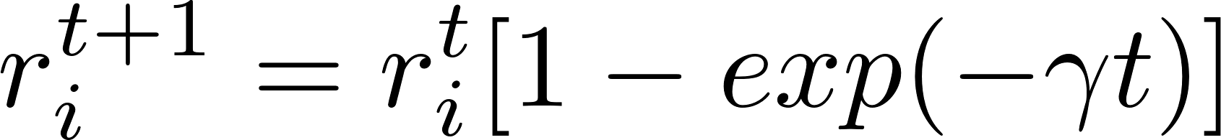
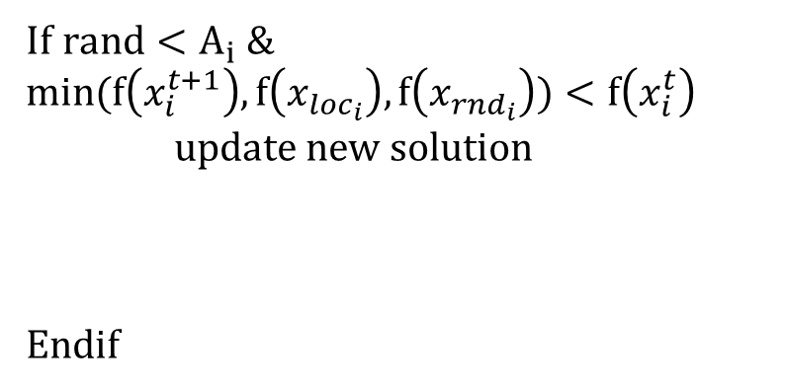
BA flowchart
STEP4: Evaluate and update solutions
for i = 1 to N
If $rand<A_{i} \&$ $$min(f\left(x_{i}^{t+1}\right), f\left(x_{loc_{i}}\right), f\left(x_{rnd_{i}}\right))<f\left(x_{i}^{t}\right)$$
update new solution
Endif
$$x_{2}$$
$$x_{1}$$
$$x_{i}^{t+1}$$
$$x_{3}$$
$$x_{∗}$$
$$x_{loc_{i}}$$
$$x_{rnd_{i}}$$
$$x_{4}$$
$$x_{5}$$
Endfor

Slide 31
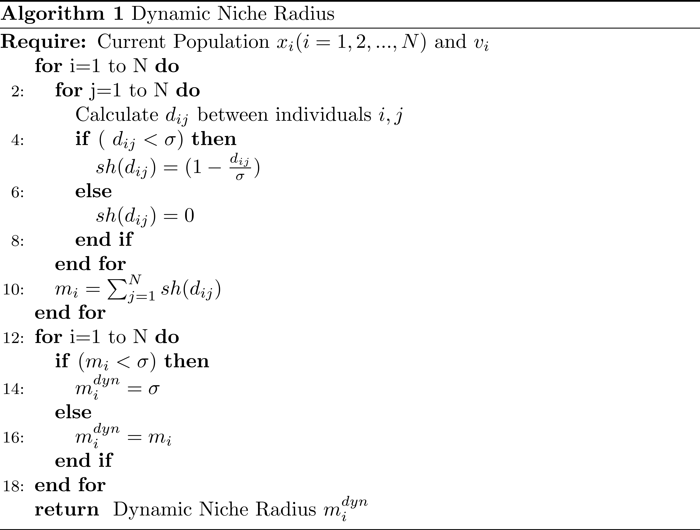
Pseudo code of DNRBA

Slide 32
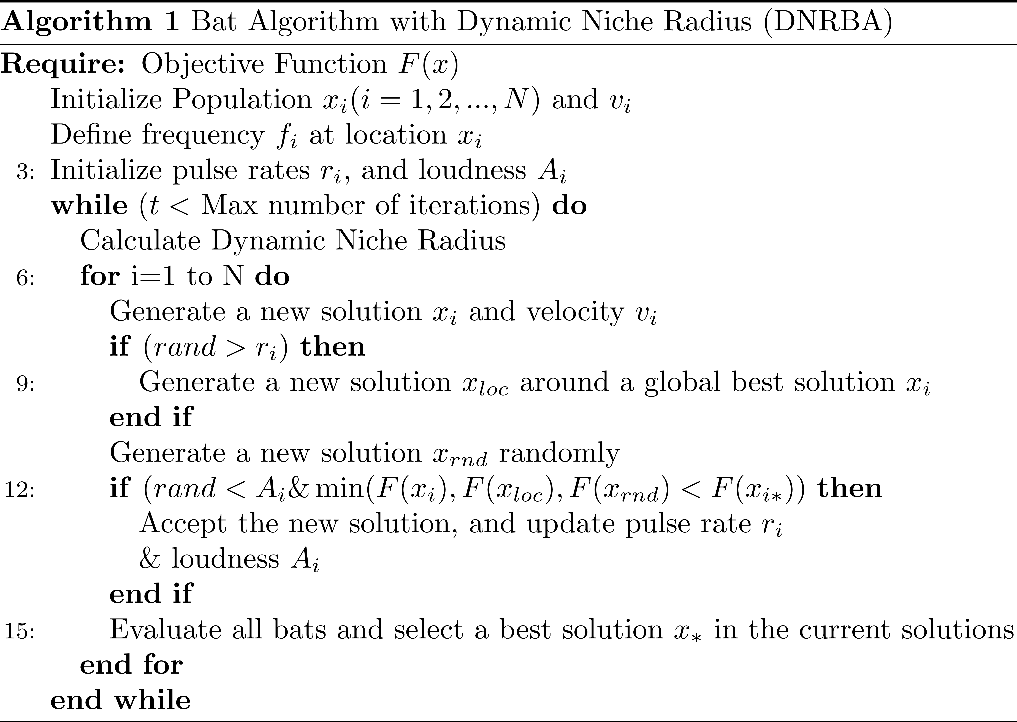
Pseudo code of DNRBA

