Slide 1

Novelty Search-based Bat Algorithm for Multimodal Optimization
Takuya Iwase
The University of Electro-Communications
2nd Aug, 2018

Slide 2
Outline
Introduction
- About Evolutionary Algorithms
Why multimodal optimization ?
Motivation
The algorithm
- Bat algorithm
Novelty search
Novelty search-based bat algorithm
Experiment
Conclusion

Slide 3
Introduction
About Evolutionary Algorithms (EAs)
EAs were designed to find the single best solution in optimization problems
ex.) genetic algorithm(GA), evolution strategies(ES), swarm intelligence, etc.
Why multimodal optimization ?
- Most of the real world problems is “multimodal” and complicated
- Multimodal optimization has multiple optimal solutions (global and local)
It is desirable to find local optima if they become proper solutions alternative global optima
Notes:
Because of global selection scheme used.
If changed search domain.

Slide 4
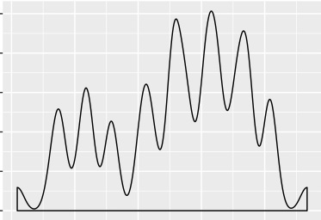
Motivation
- For adapting real world problems
- Proposed the algorithm using nearly the same number of individuals or more as global and local solutions
: Individuals
Notes:
It is quite hard to prepare many individuals like 100 or more. This is not practical.

Slide 5
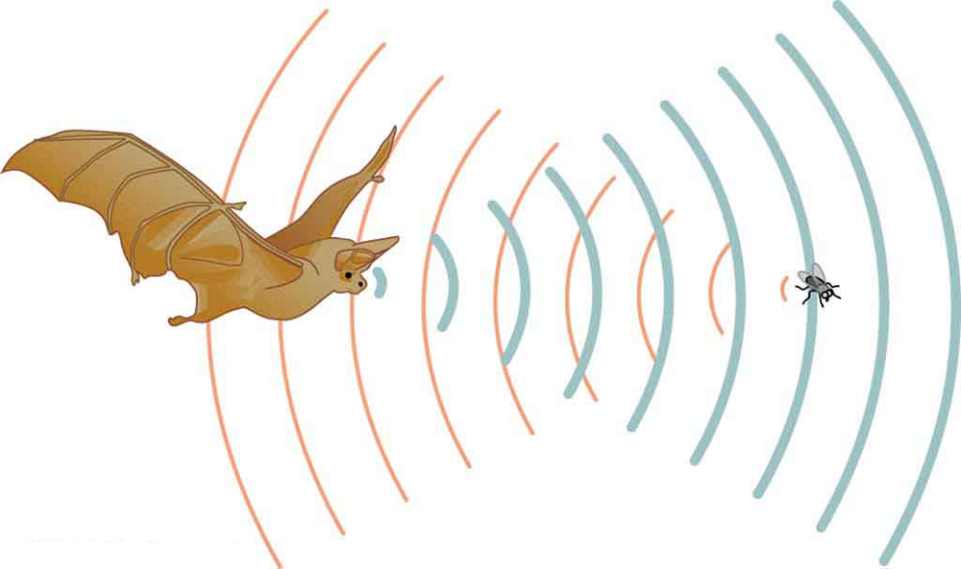
The algorithm
Bat algorithm [Xin. S., 2010]
Echolocation
Loudness: the sound waves bats emitted to prey/ food
Pulse rate: the reflected waves of loudness
Parse rate
Loudness
Notes:
They are able to see the distance between their own position and the target by reflected large or small emission

Slide 6
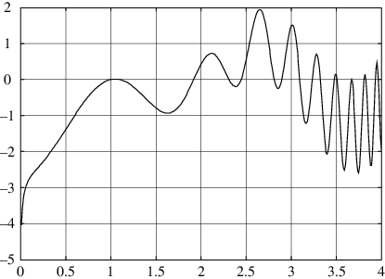
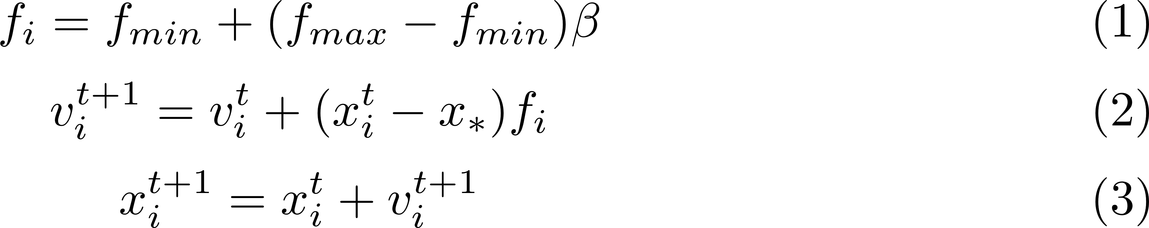
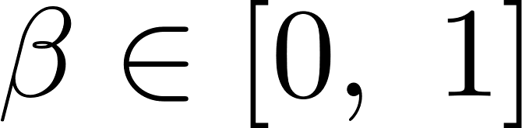
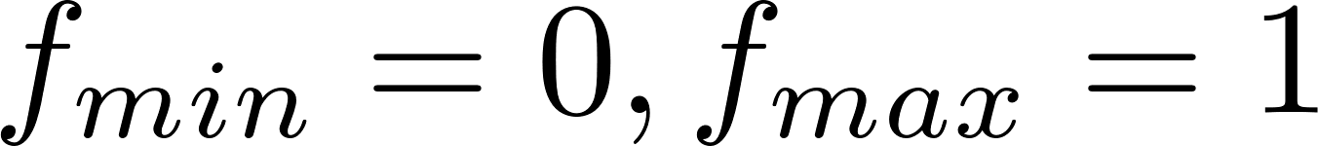












The algorithm
$$f\left(x\right)$$
Bat algorithm
Bat behavior
All bats fly randomly with
frequency $f_{i}$ to adjust bats velocity $v_{i}$
velocity $v_{i}$
at position $x_{i}$
loudness $A^{0}$ to approach prey
$$x_{1}^{t−1}$$
$$x_{4}^{t−1}$$
$$v_{i}^{t}$$
$$x_{∗}^{}$$
$$x_{1}^{t}$$
$$x_{3}^{t−1}$$
$$x$$
$x_{∗}$: the current best solution (global best)
$t$: the number of iteration
$i$: id number of individual
Notes:
Beta is parameter of uniform random distribution.

Slide 7
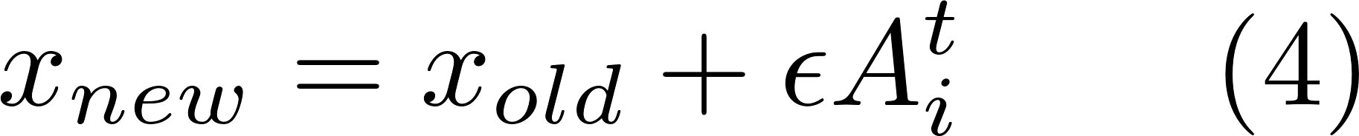
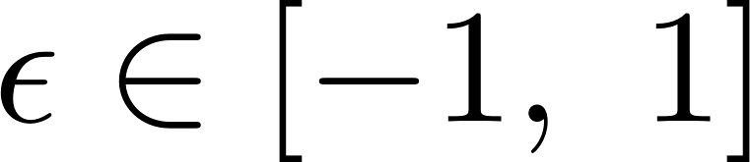
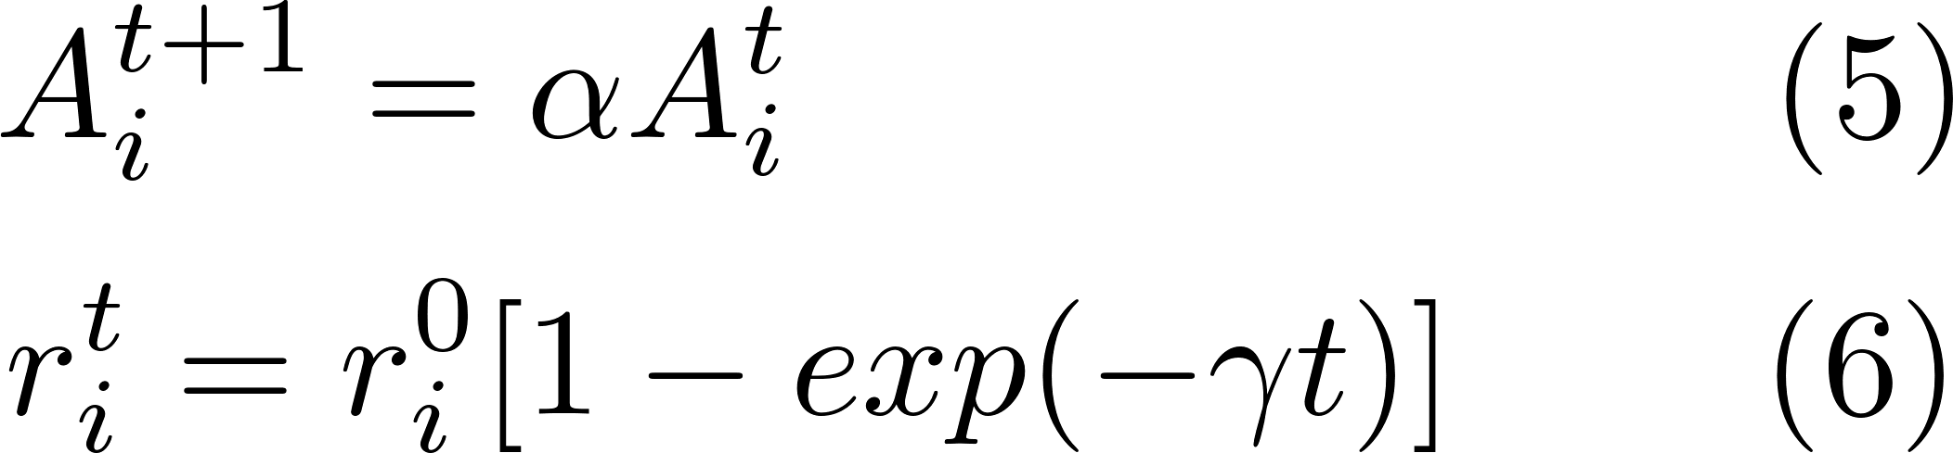





The algorithm
$$f\left(x\right)$$
Bat algorithm
Random walk
Evaluate loudness and pulse emission where $α, γ$ are constants parameter ($α=γ=0.9$ as default )
$$x_{new}^{}$$
$$x_{1}^{t}$$
$$x$$

Slide 8
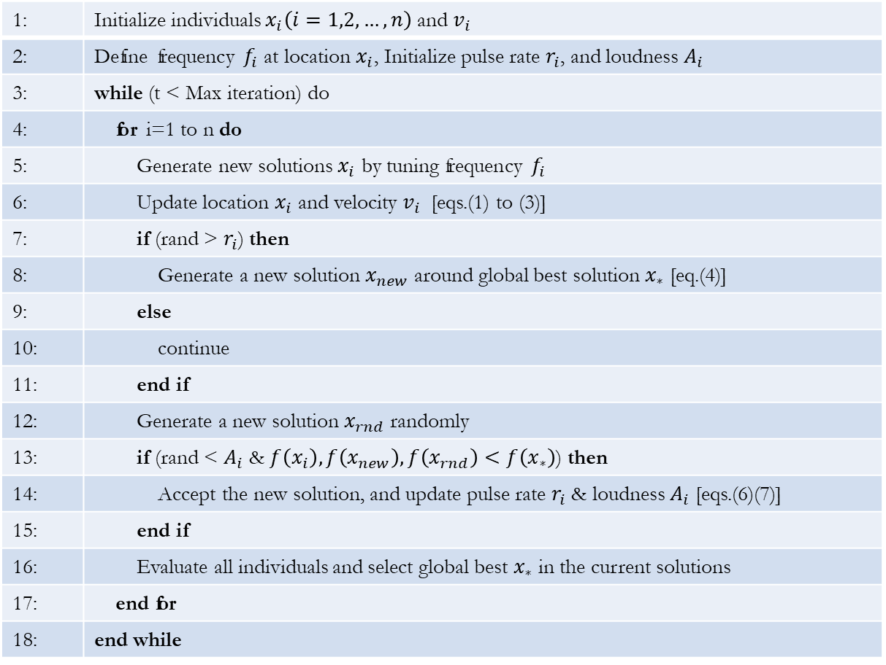
The algorithm
1: | Initialize individuals $x_{i}\left(i=1,2,…,n\right)$ and $v_{i}$
2: | Define frequency $f_{i}$ at location $x_{i}$, Initialize pulse rate $r_{i}$, and loudness $A_{i}$
3: | while (t < Max iteration) do
4: | for i=1 to n do
5: | Generate new solutions $x_{i}$ by tuning frequency $f_{i}$
6: | Update location $x_{i}$ and velocity $v_{i}$ [eqs.(1) to (3)]
7: | if (rand > $r_{i}$) then
8: | Generate a new solution $x_{new}$ around global best solution $x_{∗}$ [eq.(4)]
9: | else
10: | continue
11: | end if
12: | Generate a new solution $x_{rnd}$ randomly
13: | if (rand < $A_{i}$ & $f\left(x_{i}\right), f\left(x_{new}\right), f\left(x_{rnd}\right)<f\left(x_{∗}\right)$) then
14: | Accept the new solution, and update pulse rate $r_{i}$ & loudness $A_{i}$ [eqs.(6)(7)]
15: | end if
16: | Evaluate all individuals and select global best $x_{∗}$ in the current solutions
17: | end for
18: | end while
Bat algorithm
Pseudo code

Slide 9



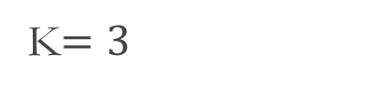







The algorithm
Novelty Search [Joel L, et al, 2008]
$$ρ\left(x\right)=\frac{1}{K}\sum_{i=1}^{K}{distance\left(x, μ_{i}\right)}$$
K: the number of nearest individual
K$=3$
$$x$$
$$x$$
$$dist\left(x,μ_{i}\right)$$
$$μ_{1}$$
$$μ_{3}$$
$$μ_{3}$$
$$μ_{1}$$
$$μ_{2}$$
$$μ_{2}$$

Slide 10
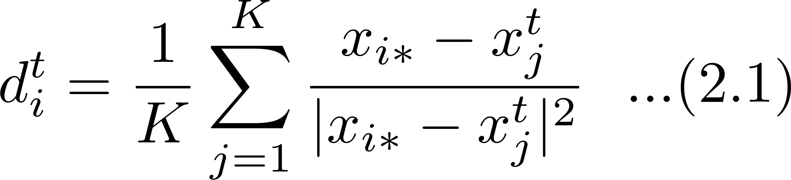





The algorithm
Novelty search-based bat algorithm(NSBA)
$${x_{3}}^{t−1}$$
$${x_{2}}^{t−1}$$
$${x_{i∗}}^{}$$
$${v_{i}}^{t}$$
$${x_{1}}^{t−1}$$

Slide 11
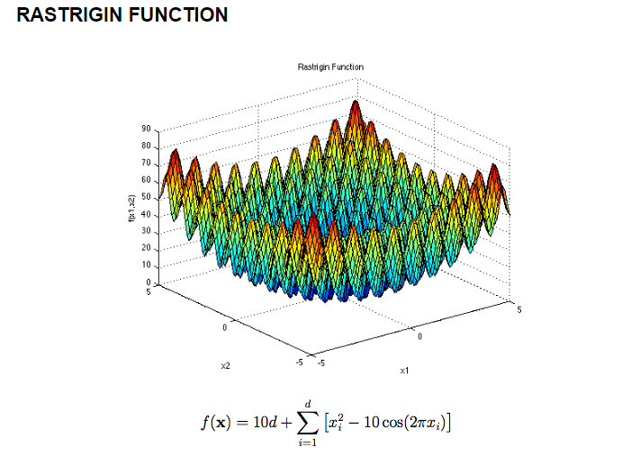
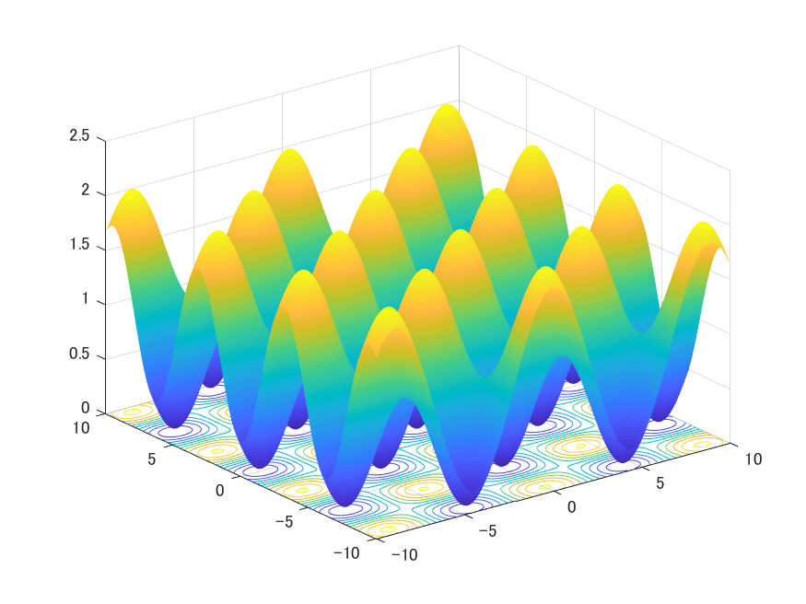
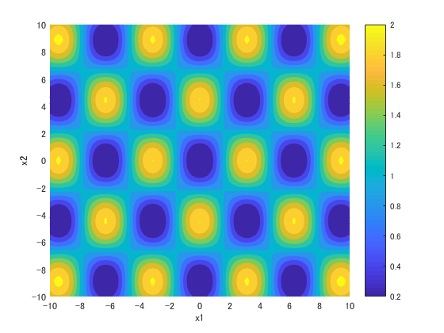
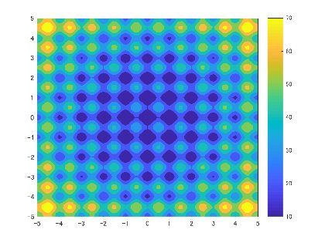
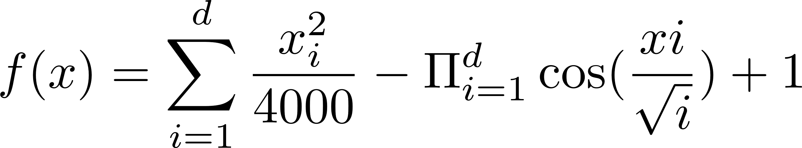
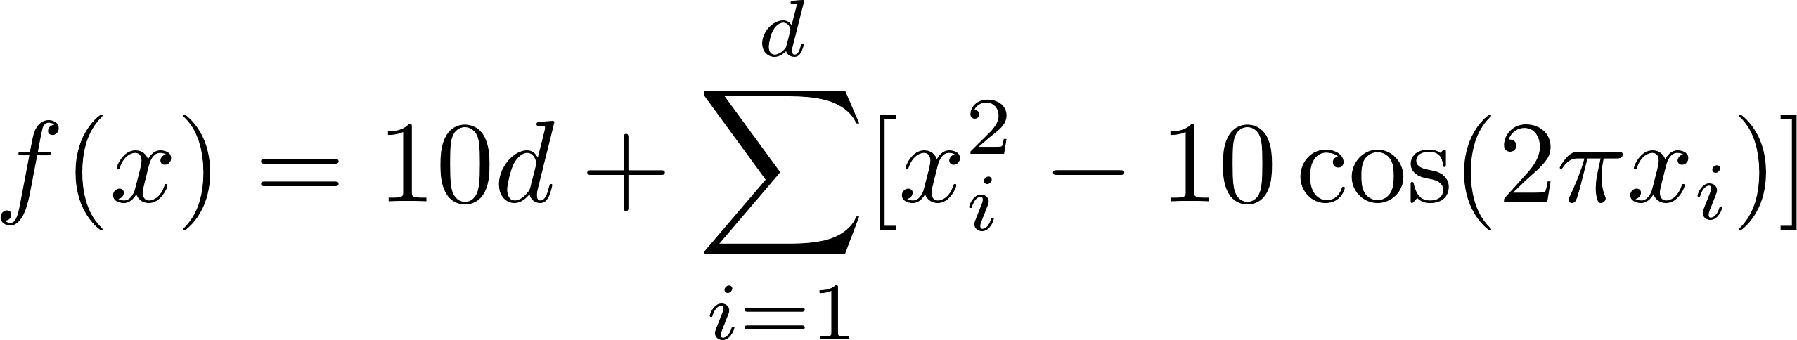
Experiment
Benchmark test functions
Function | Range of search domain | Peak fitness | Peak location | No. of global optimum | No. of local optimum
Griewank | [-10 10] | 0 | [0 0] | 1 | 16
Rastrigin | [-5 5] | 0 | [0 0] | 1 | 120

Slide 12
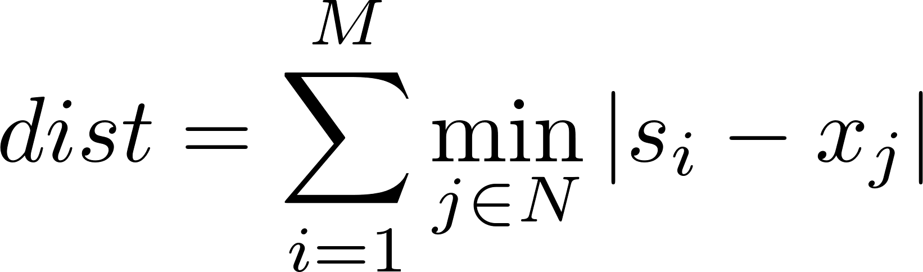
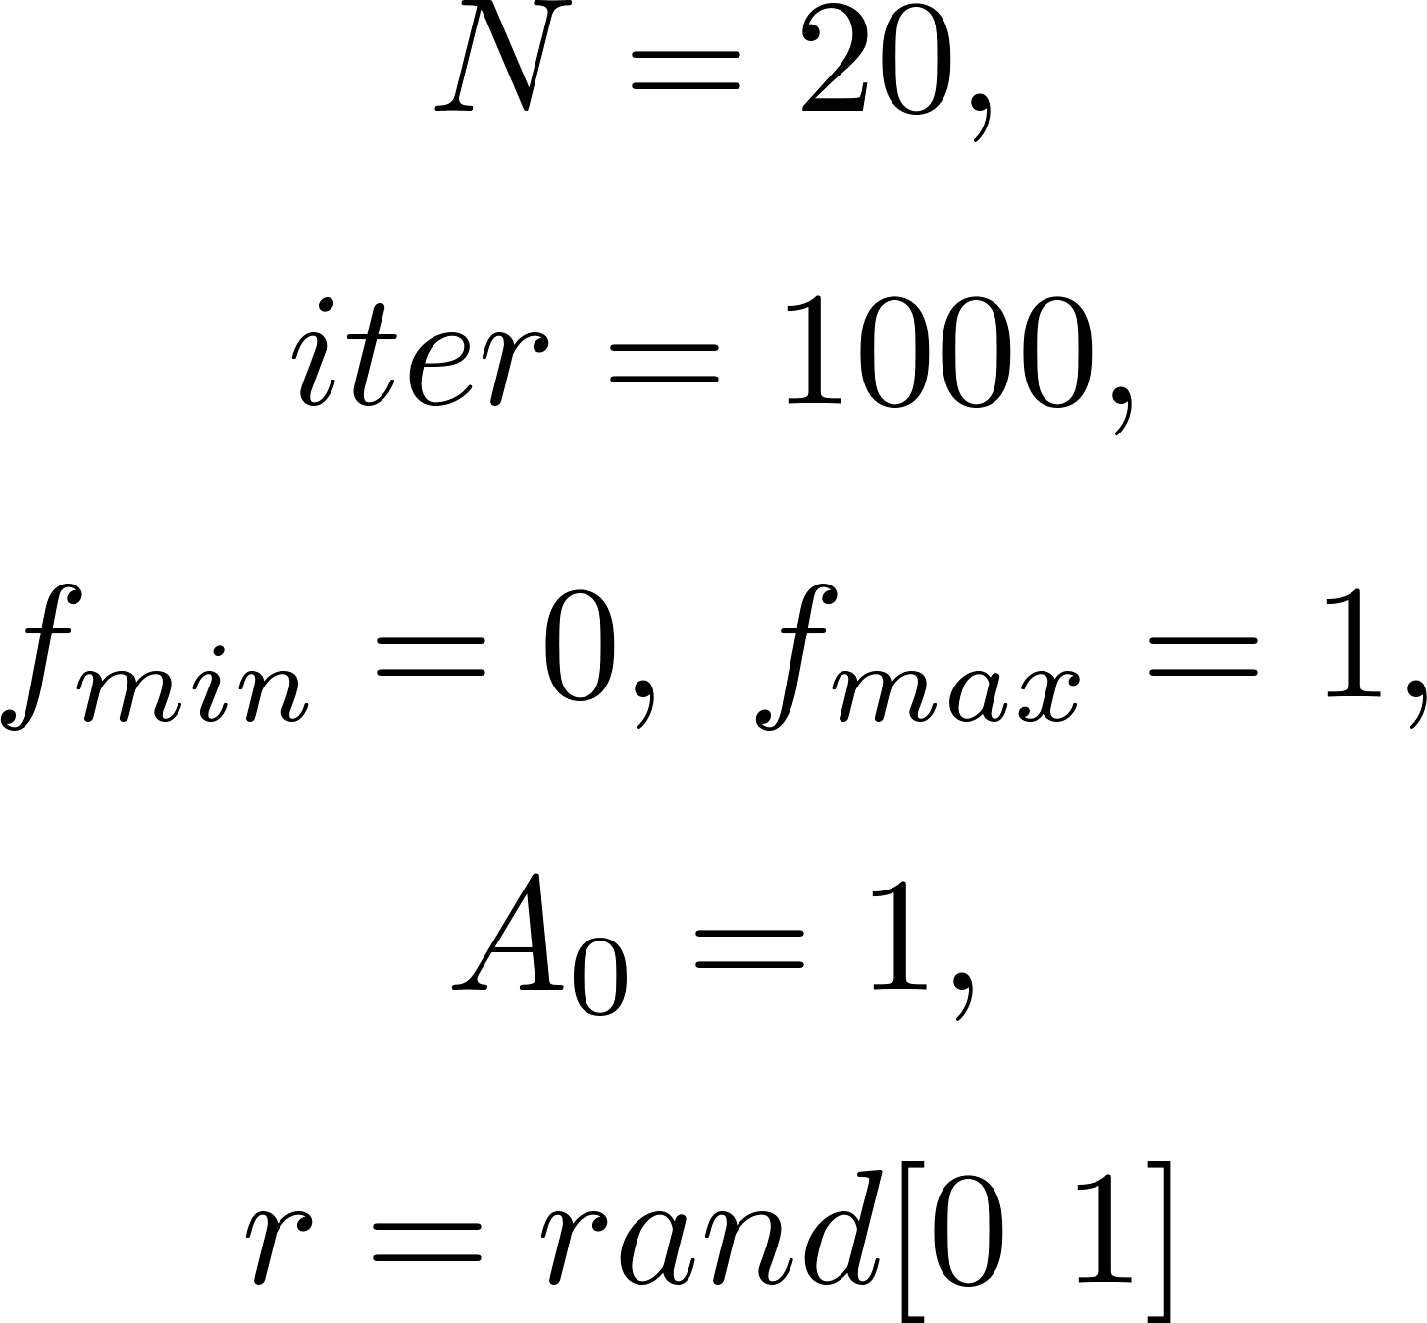




Experiment
Evaluation criteria
Parameters
$M$: No. of peak
$s$: location of peak
$N$: maximum number of individual
$x$: location of individuals

Slide 13
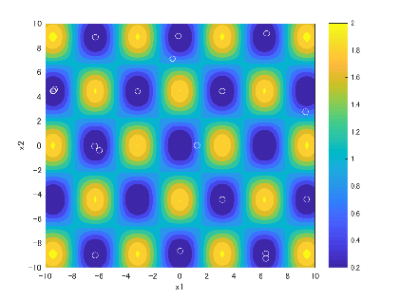
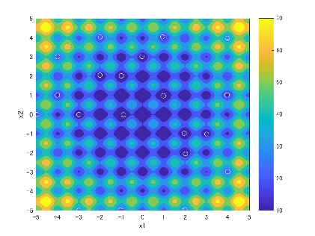
Experiment
Griewank
K=4
Rastrigin
K=4

Slide 14
Conclusion
Problems
- This algorithm definitely evaluates better solution than current one even if found local optima
- Depending on parameter k-nearest individual

