Slide 1

Niche Radius Adaptation in Bat Algorithm for Locating Multiple Optima in Multimodal Optimization
2019 IEEE Congress on Evolutionary Computation (CEC)
Takuya Iwase Ryo Takano Fumito Uwano Hiroyuki Sato Keiki Takadama
The University of Electro-Communications, Japan
June 11th 2019 @Wellington, New Zealand
Notes:
I am Takuya Iwase from the university of electro-communications. Today, I would like to talk about my research entitled by…

Slide 2
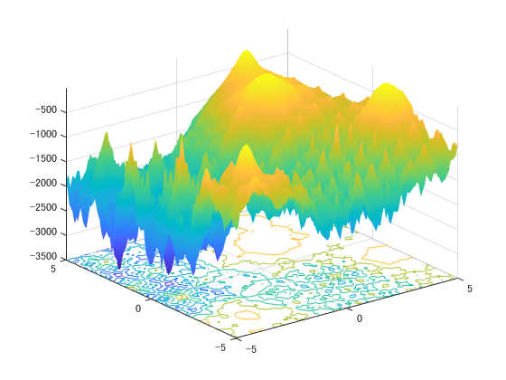
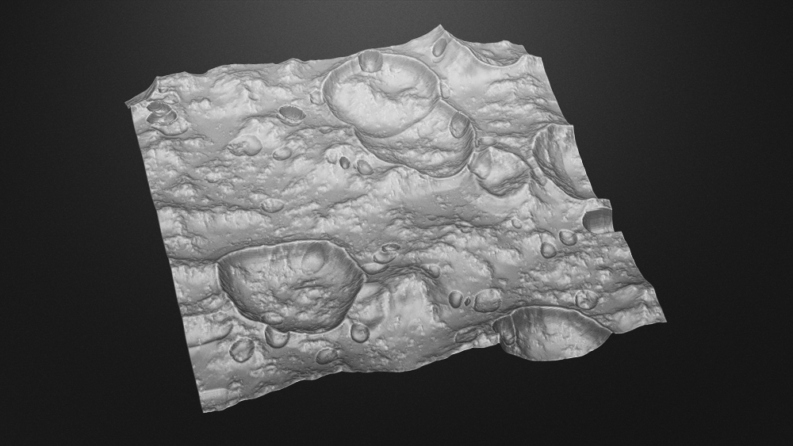
Introduction
2
Ex. Selecting landing sites in lunar mission
Multimodal Function
better
INPUT: coordinate
OUTPUT: communication time
fitness
Landing site candidates global local optimum
worse
: global and local optima
Important: to find local optima in addition to a global optimum
Notes:
In real-world optimization problems, finding multiple optima not only a single global optimum is important because of enabling to provide local optimum as one choice instead of global optimum. Real-world problems for example, left figure shows selecting landing sites in lunar mission. In this case, the hyper parameter is the coordinate at the landing site candidate and the fitness is communication time, these are described as shown in right figure.
The right figure shows the fitness landscape of multimodal function for the maximization problem, and red marker indicates the place of global & local optima. We want to know several optimal landing site candidates which have longer communication time than the other place.

Slide 3
Approach to the problem
3
Niching methods [X. Li, 2013]: finding multiple optima on multimodal optimization
Evolutionary Algorithm
Local search
(Easy to converge local optima)
e.g. Clustering GA
e.g. GA, Simulated Annealing
Niching scheme
Enable solutions to avoid overlapping
Population-based
Global search
(Depending on the probability of Initializing)
e.g. Clustering, Crowding, fitness sharing
e.g. Crowding DE, Speciation DE, CPSO
e.g. PSO, DE
Need to exploitation & exploration simultaneously
Notes:
To tackle this problem, numerous studies which are called ‘Niching methods’ have proposed. In resent years (anime), evolutionary algorithms extending niching scheme which enables solutions to avoid overlapping at the same place, are focused on solving multimodal optimization problems. And also population-based algorithms which use multiple solutions to find a single global optimum globally is often used for this problems (anime). However, these niching methods are not enough to find multiple optima because they do not consider the solution movement globally although they just consider the movement according to the Euclidean distance between the nearest solutions (anime).
In this paper, we focus on the algorithm which can search multiple optima globally and locally extending with niching scheme which can keep local optima.

Slide 4
Bat Algorithm (BA) [X. S. Yang, 2010]
4
Capability of adjusting exploitation & exploration by the bat behavior
STEP1
Move toward the global best solution
STEP2
Local search around the global best solution
STEP3
Random search in the search space
STEP4
Evaluate and update solutions
STEP5
Return to STEP1
exploitation
exploration
Notes:
Bat algorithm which is one of the population-based algorithms, is superior for adjusting exploitation and exploration search.
The algorithm consists of three search steps which enable exploitation and exploration.
STEP1 and 2 for exploitation and STEP3 for exploration. From the next slide, I will explain the algorithm flowchart in detail by the following steps.

Slide 5
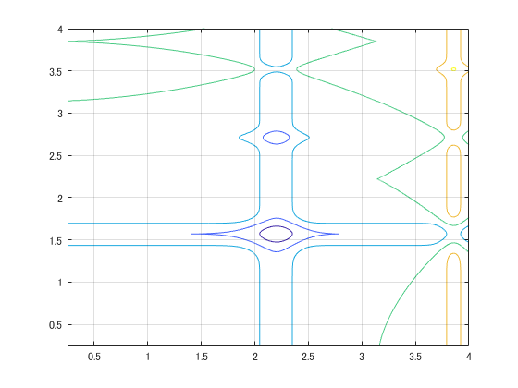














Bat Algorithm (BA) [X. S. Yang, 2010]
4
Capability of adjusting exploitation & exploration by the bat behavior
STEP1
Move toward the global best solution
STEP2
Local search around the global best solution
STEP3
Random search in the search space
STEP4
Evaluate and update solutions
STEP5
Return to STEP1
$$x_{2}$$
$$v_{2}$$
$$x_{1}$$
$$v_{1}$$
$$x_{3}$$
$$x_{∗}$$
$$x_{i}^{t+1}$$
$$v_{3}$$
$$v_{4}$$
$$v_{5}$$
$$x_{4}$$
$$x_{5}$$
：solution $x_{i}$
: solution candidate
: the current best solution $x_{∗}$
Notes:
right figure shows an example of initializing 5 individuals. In STEP1, New solution candidates are generated toward the global best solution by velocity v (anime).

Slide 6
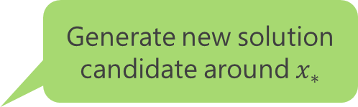


Bat Algorithm (BA) [X. S. Yang, 2010]
4
Capability of adjusting exploitation & exploration by the bat behavior
STEP1
Move toward the global best solution
STEP2
Local search around the global best solution
STEP3
Random search in the search space
STEP4
Evaluate and update solutions
STEP5
Return to STEP1
Generate new solution candidate around $x_{∗}$
$$x_{2}$$
$$x_{1}$$
$$x_{loc_{i}}$$
$$x_{3}$$
$$x_{∗}$$
$$x_{4}$$
$$x_{5}$$
：solution $x_{i}$
: solution candidate
: the current best solution $x_{∗}$
Notes:
In STEP2 local search, generate new solution candidates around global best solution (anime).

Slide 7


Bat Algorithm (BA) [X. S. Yang, 2010]
4
Capability of adjusting exploitation & exploration by the bat behavior
STEP1
Move toward the global best solution
STEP2
Local search around the global best solution
STEP3
Random search in the search space
STEP4
Evaluate and update solutions
STEP5
Return to STEP1
$$x_{2}$$
$$x_{1}$$
$$x_{3}$$
$$x_{∗}$$
$$x_{rnd_{i}}$$
$$x_{4}$$
$$x_{5}$$
：solution $x_{i}$
: solution candidate
: the current best solution $x_{∗}$
Notes:
In STEP3 random search, new solution candidates are randomly generated in the search space (anime).

Slide 8


Bat Algorithm (BA) [X. S. Yang, 2010]
4
Capability of adjusting exploitation & exploration by the bat behavior
STEP1
Move toward the global best solution
STEP2
Local search around the global best solution
STEP3
Random search in the search space
STEP4
Evaluate and update solutions
STEP5
Return to STEP1
$$x_{2}$$
$$x_{1}$$
$$x_{i}^{t+1}$$
$$x_{3}$$
$$x_{∗}$$
$$x_{loc_{i}}$$
$$x_{rnd_{i}}$$
$$x_{4}$$
$$x_{5}$$
Notes:
In STEP4, one of three new solution candidates is better than the current solution (anime*4), the current solution is replaced by better new solution candidate.

Slide 9






Bat Algorithm (BA) [X. S. Yang, 2010]
4
Capability of adjusting exploitation & exploration by the bat behavior
STEP1
Move toward the global best solution
STEP2
Local search around the global best solution
STEP3
Random search in the search space
STEP4
Evaluate and update solutions
STEP5
Return to STEP1
$$x_{1}$$
$$x_{3}$$
$$x_{2}$$
$$x_{4}$$
$$x_{∗}$$
$$x_{5}$$
Notes:
In STEP5, loop to the STEP1 unless termination is not satisfied.

Slide 10


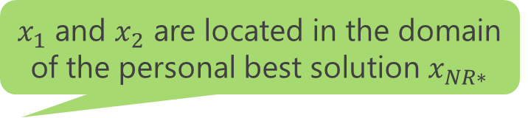













Niche Radius [D. Beasley et.al, 1993]
5
Calculated by the size of search space and the number of solutions
$x_{1}$ and $x_{2}$ are located in the domain of the personal best solution $x_{NR∗}$
$$x_{1}$$
$$x_{1}$$
$$x_{3}$$
$$x_{3}$$
$$x_{2}$$
$$x_{NR∗}$$
$$x_{NR∗}$$
$$x_{4}$$
$$x_{2}$$
$$x_{4}$$
$$σ$$
$$σ$$
Niche radius : $σ$
: individual $x_{i}$
: the personal best solution $x_{NR∗}$
Advantage: to enable solutions to avoid overlapping the same domain
Notes:
This is a kind of niching scheme Niche Radius which is based on the search space and the number of solutions. The figure shows x1, x2, and x3 are located within the radius of the personal best solution. In this case, the dense of individual x1 and x2 are high, so these radius become larger described the blue area. Using this niching scheme, we aim to keep local optima and find the other optima efficiently.

Slide 11
Proposal for Multimodal Optimization
6
Niche Radius-based Bat Algorithm (NRBA)
Three improvements from conventional BA to NRBA
BA
exploitation | Move toward the global best solution
exploitation | Around the global best solution
exploration | In the search space
NRBA
exploration | Keep away from the personal best solution in the Niche radius
exploitation | In Niche radius of the personal best solution
exploration | In Niche radius of the current solution
Notes:
For finding multiple optima, we proposed the new Bat Algorithm extending with Niche Radius. We improved these search steps of BA to NRBA on the table.

Slide 12







Description of NRBA
7
STEP0
Calculate Niche radius
STEP1
Keep away from the personal best solution in the Niche radius
STEP2
Local search in Niche radius of the personal best solution
STEP3
Random search in Niche radius of the current solution
STEP4
Evaluate and update solutions
STEP5
Return to STEP1
$$x_{2}$$
$$x_{1}$$
$$σ$$
$$x_{3}$$
$$x_{NR∗}$$
$$x_{4}$$
$$x_{5}$$
：individual $x_{i}$
Niche radius : $σ$
: the best solution $x_{NR∗}$
Notes:
This is the flowchart of NRBA. Our improvements are the following highlighted sentences.
The 1st improvement in STEP0 is introducing Niche Radius to locate global or local optima depending on the dense of individual.
The 2nd improvement in is keep solutions away from the personal best solution in the Niche Radius, instead of approaching the global best solution.
The 3rd improvement in local search is generating new solution candidates nearby the personal best solution in Niche radius.
The 4th improvement in random search is generating new solution candidates in the Niche radius of the solution.
From the next slide, we explain the proposed mechanism in detail.

Slide 13
Description of NRBA
7
STEP0
Calculate Niche radius
STEP1
Keep away from the personal best solution in the Niche radius
STEP2
Local search in Niche radius of the personal best solution
STEP3
Random search in Niche radius of the current solution
STEP4
Evaluate and update solutions
STEP5
Return to STEP1
$$x_{2}$$
$$x_{1}$$
$$σ$$
$$x_{3}$$
$$x_{NR∗}$$
$$x_{4}$$
$$x_{5}$$
：individual $x_{i}$
Niche radius : $σ$
: the best solution $x_{NR∗}$
Notes:
In STEP0, from right figure, all individuals have same length of radius. The distance d23 between x2 and x3 is less than Niche radius, so the Niche radius of x3 becomes larger (anime)

Slide 14


Description of NRBA
7
STEP0
Calculate Niche radius
STEP1
Keep away from the personal best solution in the Niche radius
STEP2
Local search in Niche radius of the personal best solution
STEP3
Random search in Niche radius of the current solution
STEP4
Evaluate and update solutions
STEP5
Return to STEP1
$$x_{2}^{t+1}$$
$$x_{2}$$
$$x_{1}$$
$$x_{3}^{t+1}$$
$$σ$$
$$x_{3}$$
$$x_{NR∗}$$
$$x_{4}$$
$$x_{5}$$
：individual $x_{i}$
Niche radius : $σ$
: the best solution $x_{NR∗}$
: solution candidate
Notes:
Now, the search domain of x3 includes the personal best solution x_NR*, so the new solution candidate are generated apart from the solution (anime).

Slide 15


Description of NRBA
7
STEP0
Calculate Niche radius
STEP1
Keep away from the personal best solution in the Niche radius
STEP2
Local search in Niche radius of the personal best solution
STEP3
Random search in Niche radius of the current solution
STEP4
Evaluate and update solutions
STEP5
Return to STEP1
$$x_{loc2}^{}$$
$$x_{2}$$
$$x_{1}$$
$$σ$$
$$x_{3}$$
$$x_{NR∗}$$
$$x_{loc3}^{}$$
$$x_{4}$$
$$x_{5}$$
：individual $x_{i}$
Niche radius : $σ$
: the best solution $x_{NR∗}$
: solution candidate
Notes:
In STEP2 local search, new solution candidate is generated within the Niche radius of the personal best solution x_NR* (anime)

Slide 16


Description of NRBA
7
STEP0
Calculate Niche radius
STEP1
Keep away from the personal best solution in the Niche radius
STEP2
Local search in Niche radius of the personal best solution
STEP3
Random search in Niche radius of the current solution
STEP4
Evaluate and update solutions
STEP5
Return to STEP1
$${x_{rnd}}_{2}$$
$$x_{2}$$
$$x_{1}$$
$$σ$$
$$x_{3}$$
$${x_{rnd}}_{3}$$
$$x_{NR∗}$$
$$x_{4}$$
$$x_{5}$$
：individual $x_{i}$
Niche radius : $σ$
: the best solution $x_{NR∗}$
: solution candidate
Notes:
Then in STEP3 random search, new solution candidate is generated in the Niche radius of the solution x3.

Slide 17

Description of NRBA
7
STEP0
Calculate Niche radius
STEP1
Keep away from the personal best solution in the Niche radius
STEP2
Local search in Niche radius of the personal best solution
STEP3
Random search in Niche radius of the current solution
STEP4
Evaluate and update solutions
STEP5
Return to STEP1
$$x_{2}^{t+1}$$
$${x_{rnd}}_{2}$$
$$x_{loc2}^{}$$
$$x_{2}$$
$$x_{1}$$
$$x_{3}^{t+1}$$
$$σ$$
$$x_{3}$$
$${x_{rnd}}_{3}$$
$$x_{NR∗}$$
$$x_{loc3}^{}$$
$$x_{4}$$
$$x_{5}$$
：individual $x_{i}$
Niche radius : $σ$
: the best solution $x_{NR∗}$
Notes:
In this STEP is same as conventional BA. The one of three new solution candidates is better than the current solution (anime*4), the current solution is replaced by better new solution candidate.

Slide 18
Description of NRBA
7
STEP0
Calculate Niche radius
STEP1
Keep away from the personal best solution in the Niche radius
STEP2
Local search in Niche radius of the personal best solution
STEP3
Random search in Niche radius of the current solution
STEP4
Evaluate and update solutions
STEP5
Return to STEP1
$$x_{2}$$
$$x_{1}$$
$$x_{3}$$
$$x_{NR∗}$$
$$x_{4}$$
$$x_{5}$$
：individual $x_{i}$
Niche radius : $σ$
: the best solution $x_{NR∗}$
Notes:
Then, loop to the STEP1 unless termination is not satisfied.

Slide 19
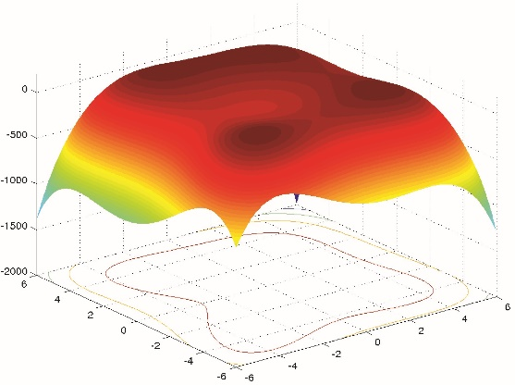
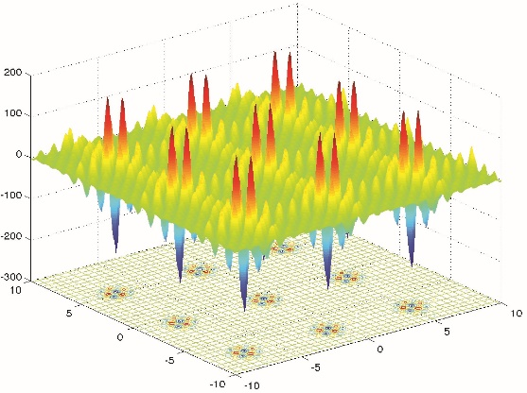
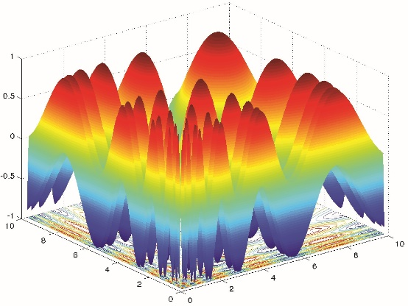
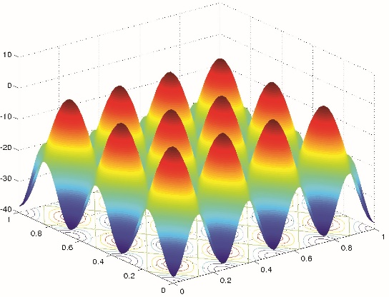
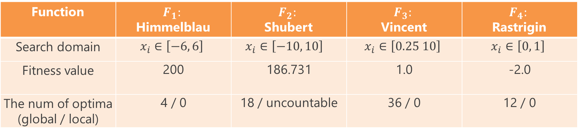
Experiment BA vs. NSBA vs. NRBA
8
Function | $$F_{1}:$$ Himmelblau | $$F_{2}:$$ Shubert | $$F_{3}:$$ Vincent | $$F_{4}:$$ Rastrigin
Search domain | $$x_{i}∈\left[−6, 6\right]$$ | $$x_{i}∈\left[−10, 10\right]$$ | $$x_{i}∈\left[0.25 10\right]$$ | $$x_{i}∈\left[0, 1\right]$$
Fitness value | 200 | 186.731 | 1.0 | -2.0
The num of optima (global / local) | 4 / 0 | 18 / uncountable | 36 / 0 | 12 / 0
Notes:
To measure the number of optima found, and the convergence speed of BA vs. NRBA, we employ 2 evaluation measurements. Peak Ratio means how many optima the algorithm found averaged over max run. The PR value indicates between 0 and 1. Peak Accuracy means how close solutions to the nearest neighbor optima. As the distance between optima and the nearest neighbor solution is close, the PA value also close to 0. finding optima is defined by threshold value sigma. the parameter setting is on the below table.

Slide 20

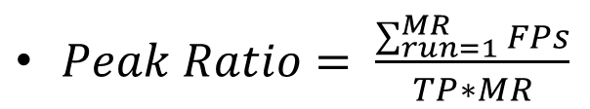
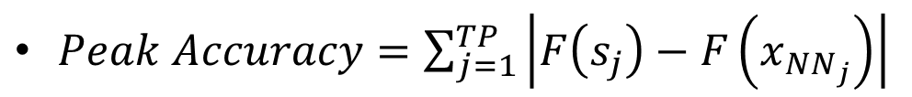
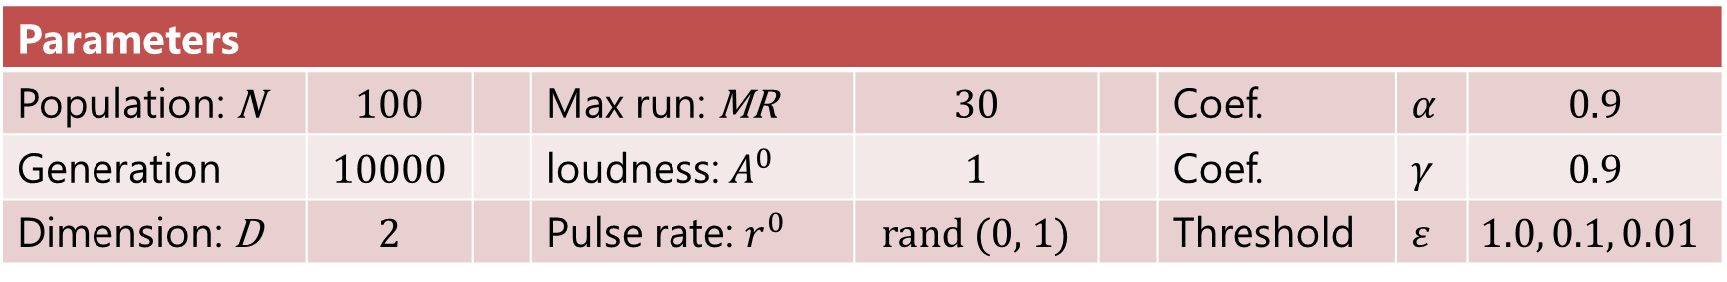




Experiment BA vs. NSBA vs. NRBA
9
Evaluation measurement
$Peak Ratio= \frac{\sum_{run=1}^{MR}{FPs}}{TP∗MR}$
$FPs$: found peaks (optima)
[X.Li, et. al, 2013]
$TP$: total peak
$MR$: Max run
$Peak Accuracy=\sum_{j=1}^{TP}{\left|F\left(s_{j}\right)−F\left(x_{NN_{j}}\right)\right|}$
[R. Thomsen, 2004]
$S_{j}$ : peak (optima)
$x_{NN_{j}}$: nearest neighbor solution
Parameters
Population: N | 100 |  | Max run: MR | 30 |  | Coef. | $$α$$ | 0.9
Generation | 10000 |  | loudness: $A^{0}$ | 1 |  | Coef. | $$γ$$ | 0.9
Dimension: D | 2 |  | Pulse rate: $r^{0}$ | rand (0, 1) |  | Threshold | $$ε$$ | $$1.0, 0.1, 0.01$$

Slide 21
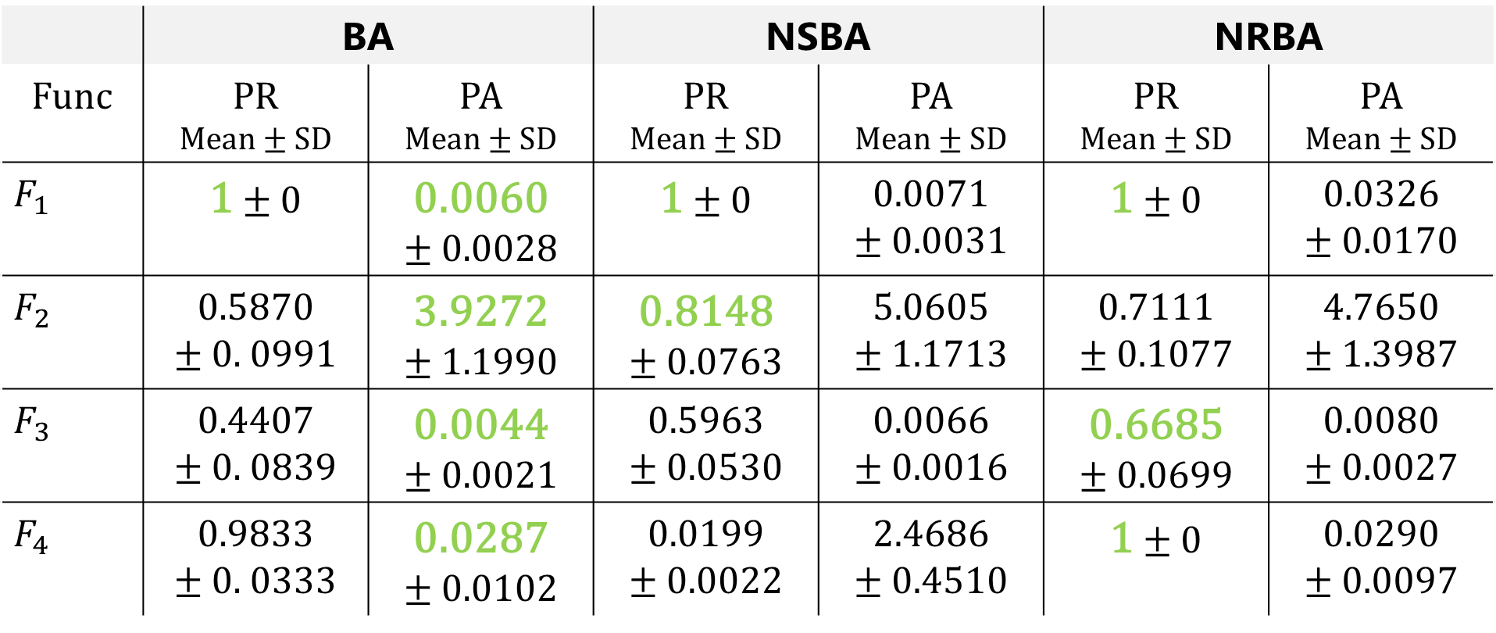
Results
10
PR and PA of BA vs. NSBA vs. NRBA (averaged over 30 runs)
$$ε=1.0E$$
 | BA |  | NSBA |  | NRBA
Func | PR Mean $±$ SD | PA Mean $±$ SD | PR Mean $±$ SD | PA Mean $±$ SD | PR Mean $±$ SD | PA Mean $±$ SD
$$F_{1}$$ | 1 $±$ 0 | 0.0060 $±$ 0.0028 | 1 $±$ 0 | 0.0071 $±$ 0.0031 | 1 $±$ 0 | 0.0326 $±$ 0.0170
$$F_{2}$$ | 0.5870 $±$ 0. 0991 | 3.9272 $±$ 1.1990 | 0.8148 $±$ 0.0763 | 5.0605 $±$ 1.1713 | 0.7111 $±$ 0.1077 | 4.7650 $±$ 1.3987
$$F_{3}$$ | 0.4407 $±$ 0. 0839 | 0.0044 $±$ 0.0021 | 0.5963 $±$ 0.0530 | 0.0066 $±$ 0.0016 | 0.6685 $±$ 0.0699 | 0.0080 $±$ 0.0027
$$F_{4}$$ | 0.9833 $±$ 0. 0333 | 0.0287 $±$ 0.0102 | 0.0199 $±$ 0.0022 | 2.4686 $±$ 0.4510 | 1 $±$ 0 | 0.0290 $±$ 0.0097

Slide 22
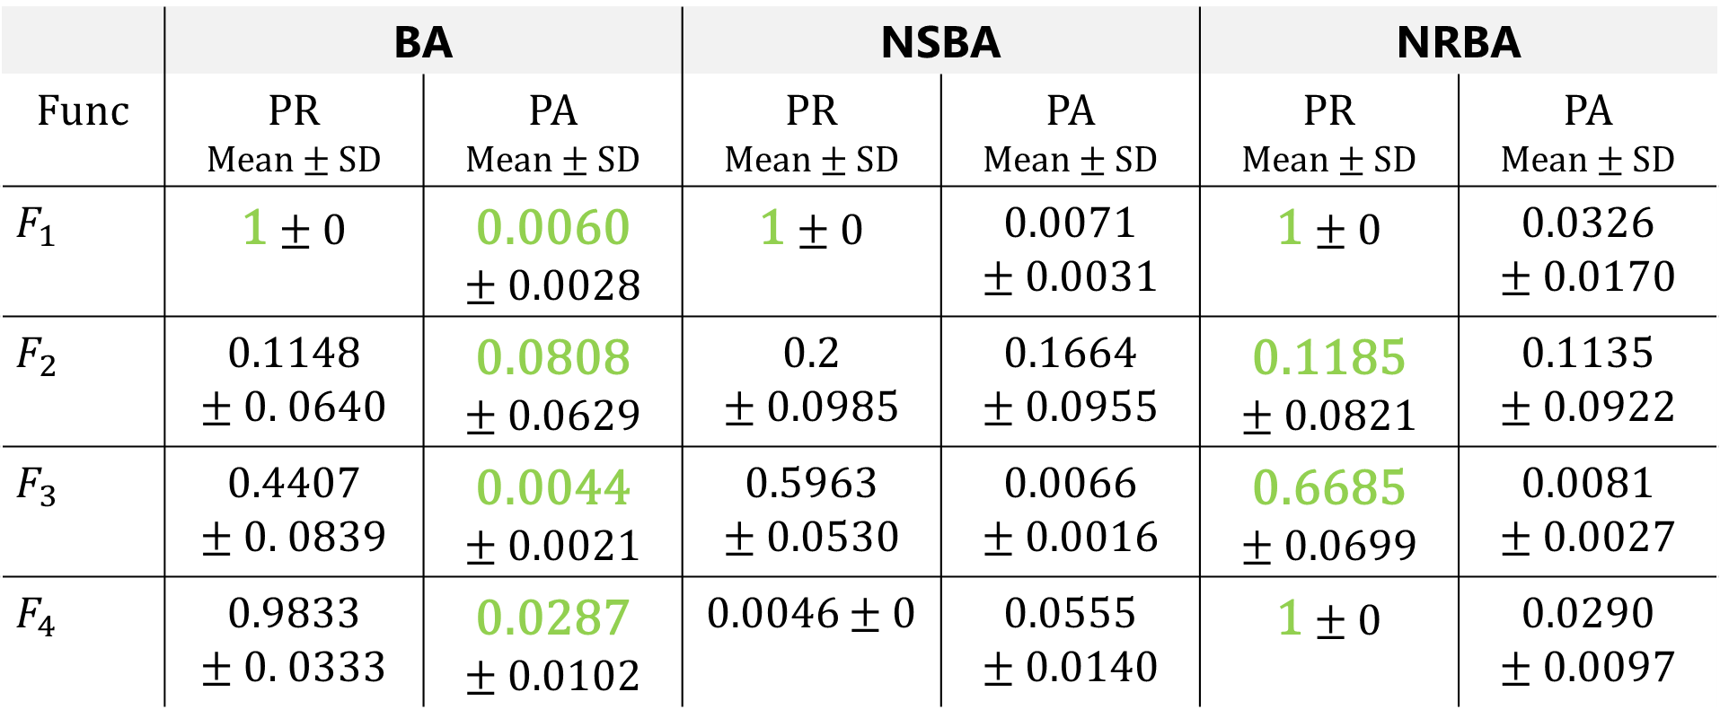
Results
11
PR and PA of BA vs. NSBA vs. NRBA (averaged over 30 runs)
$$ε=1.0E−1$$
 | BA |  | NSBA |  | NRBA
Func | PR Mean $±$ SD | PA Mean $±$ SD | PR Mean $±$ SD | PA Mean $±$ SD | PR Mean $±$ SD | PA Mean $±$ SD
$$F_{1}$$ | 1 $±$ 0 | 0.0060 $±$ 0.0028 | 1 $±$ 0 | 0.0071 $±$ 0.0031 | 1 $±$ 0 | 0.0326 $±$ 0.0170
$$F_{2}$$ | 0.1148 $±$ 0. 0640 | 0.0808 $±$ 0.0629 | 0.2 $±$ 0.0985 | 0.1664 $±$ 0.0955 | 0.1185 $±$ 0.0821 | 0.1135 $±$ 0.0922
$$F_{3}$$ | 0.4407 $±$ 0. 0839 | 0.0044 $±$ 0.0021 | 0.5963 $±$ 0.0530 | 0.0066 $±$ 0.0016 | 0.6685 $±$ 0.0699 | 0.0081 $±$ 0.0027
$$F_{4}$$ | 0.9833 $±$ 0. 0333 | 0.0287 $±$ 0.0102 | 0.0046 $±$ 0 | 0.0555 $±$ 0.0140 | 1 $±$ 0 | 0.0290 $±$ 0.0097

Slide 23
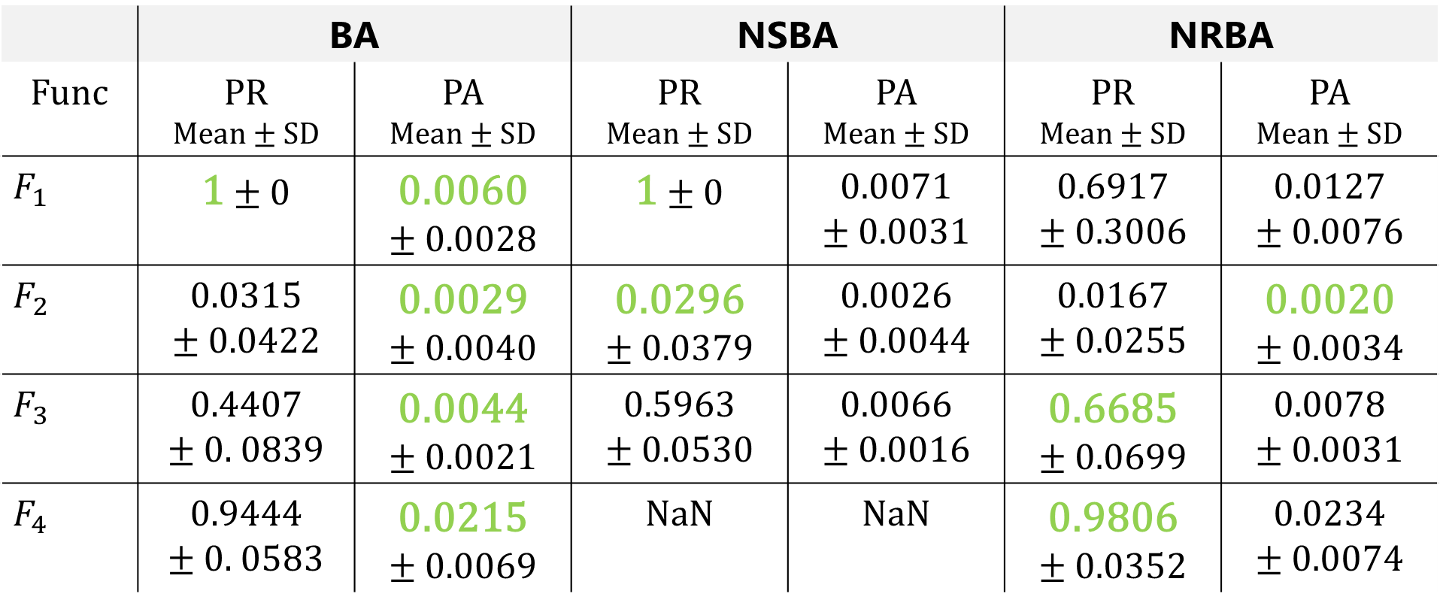
Results
12
PR and PA of BA vs. NSBA vs. NRBA (averaged over 30 runs)
$$ε=1.0E−2$$
 | BA |  | NSBA |  | NRBA
Func | PR Mean $±$ SD | PA Mean $±$ SD | PR Mean $±$ SD | PA Mean $±$ SD | PR Mean $±$ SD | PA Mean $±$ SD
$$F_{1}$$ | 1 $±$ 0 | 0.0060 $±$ 0.0028 | 1 $±$ 0 | 0.0071 $±$ 0.0031 | 0.6917 $±$ 0.3006 | 0.0127 $±$ 0.0076
$$F_{2}$$ | 0.0315 $±$ 0.0422 | 0.0029 $±$ 0.0040 | 0.0296 $±$ 0.0379 | 0.0026 $±$ 0.0044 | 0.0167 $±$ 0.0255 | 0.0020 $±$ 0.0034
$$F_{3}$$ | 0.4407 $±$ 0. 0839 | 0.0044 $±$ 0.0021 | 0.5963 $±$ 0.0530 | 0.0066 $±$ 0.0016 | 0.6685 $±$ 0.0699 | 0.0078 $±$ 0.0031
$$F_{4}$$ | 0.9444 $±$ 0. 0583 | 0.0215 $±$ 0.0069 | NaN | NaN | 0.9806 $±$ 0.0352 | 0.0234 $±$ 0.0074

Slide 24
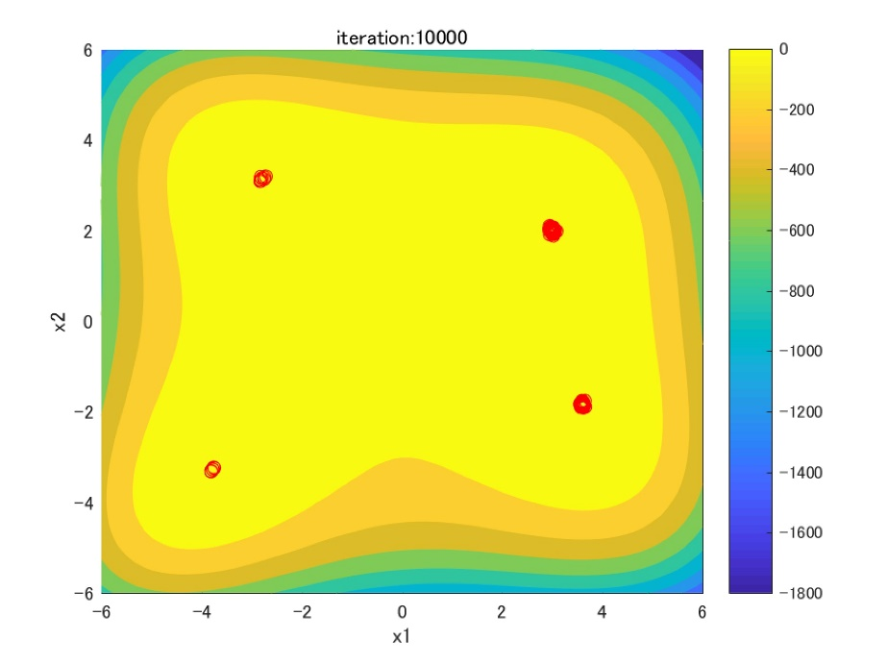
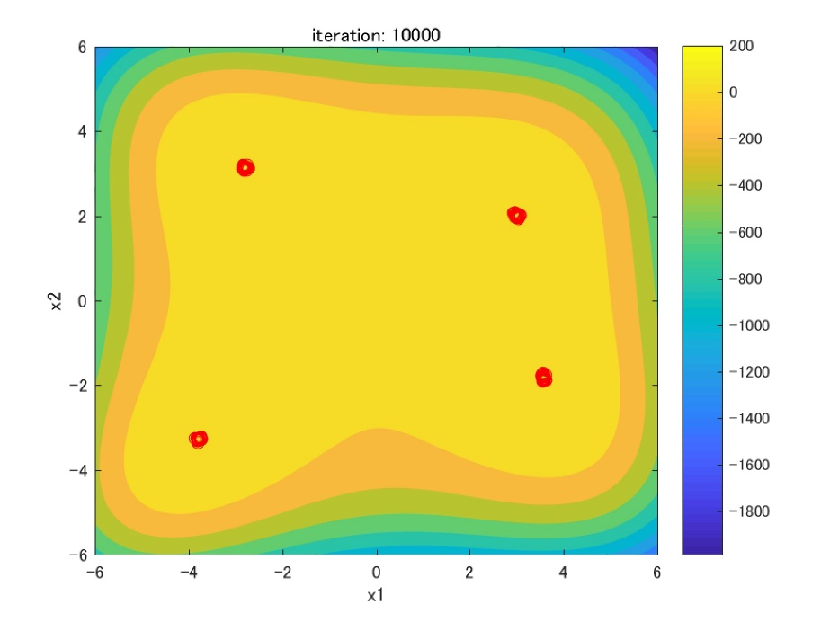
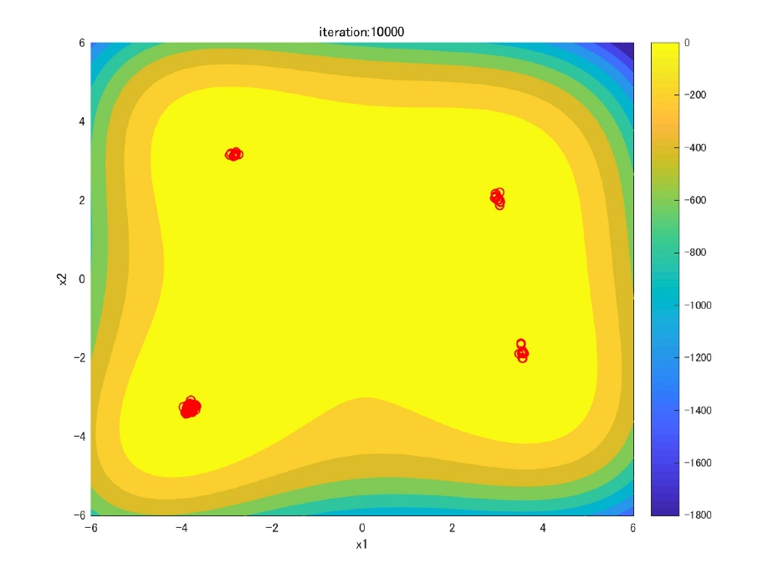
Results – Individual distribution
13
fitness
：individual
BA
NSBA
NRBA
Notes:
These figures show the individual distribution of BA and NRBA.
The blue area indicates the place of global & local optima. White circle indicates the individual.

Slide 25
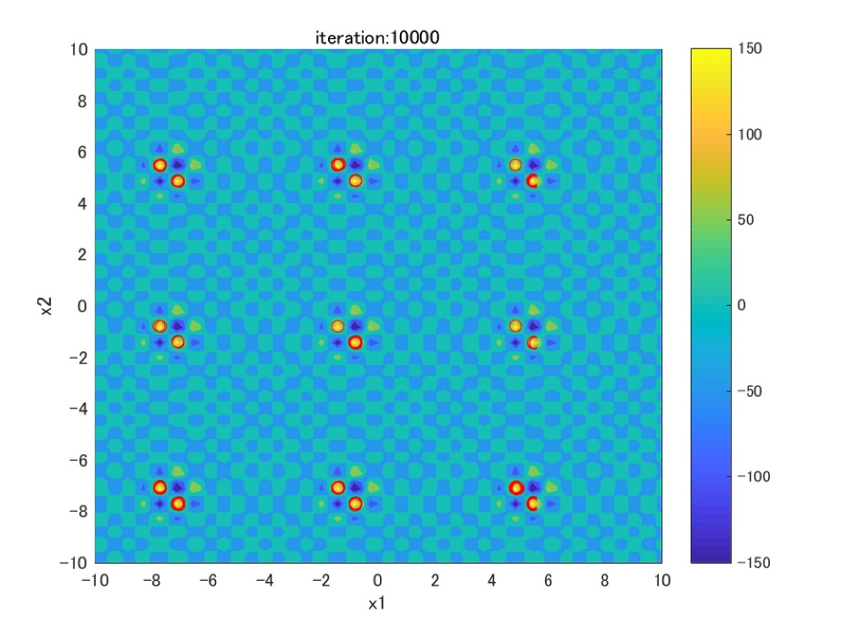
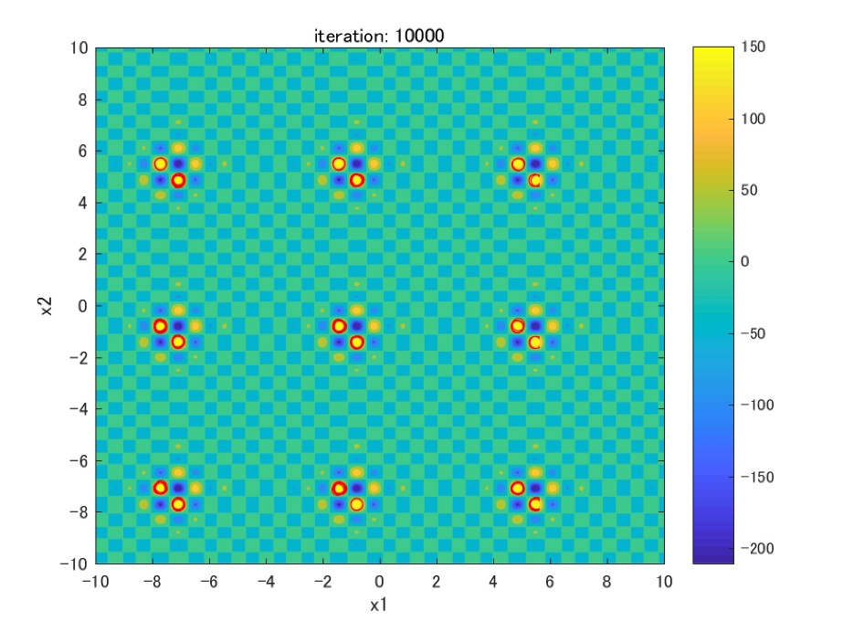
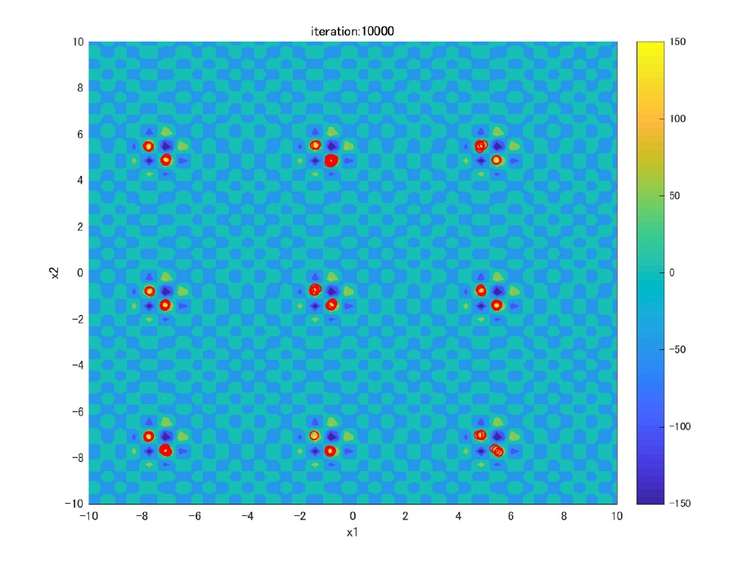
Results – Individual distribution
14
fitness
：individual
BA
NSBA
NRBA
Notes:
青いエリアが最適解及び局所解を示す

Slide 26
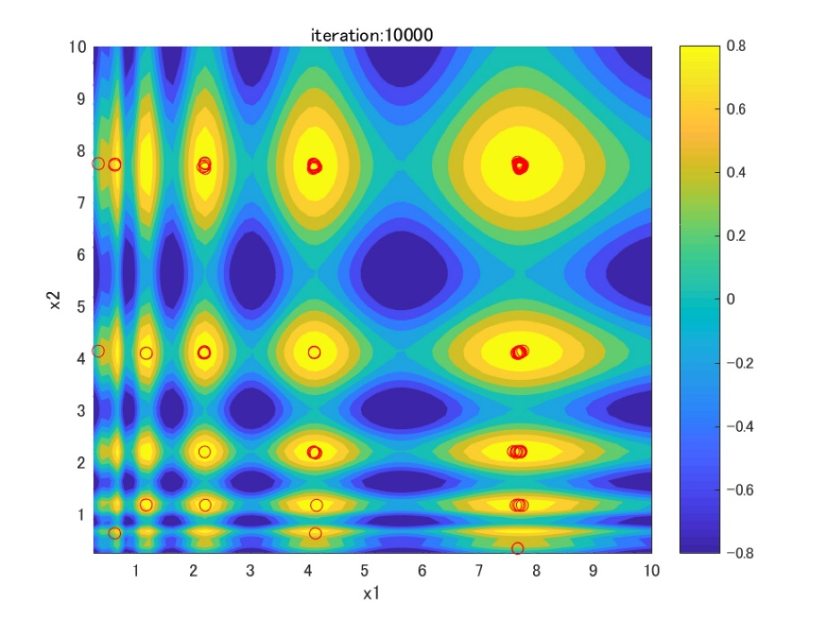
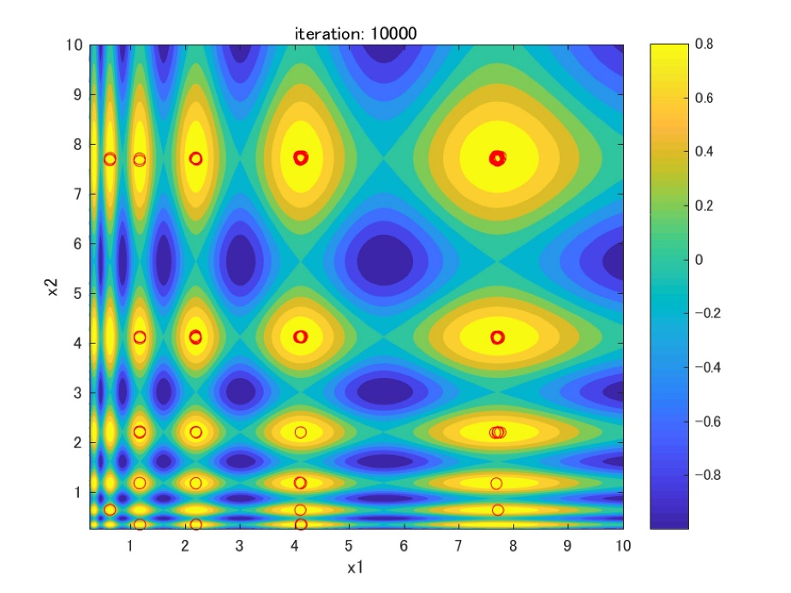
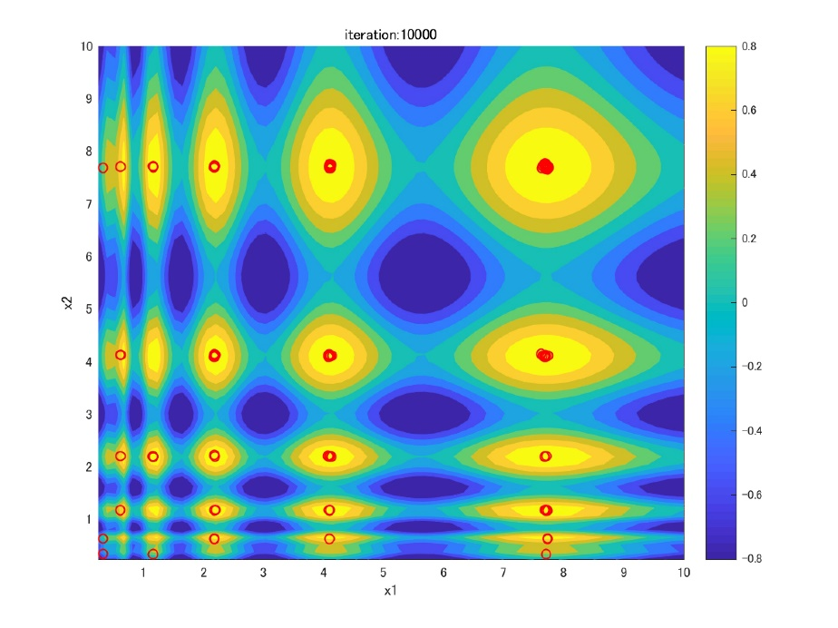
Results – Individual distribution
15
fitness
：individual
BA
NSBA
NRBA
Notes:
青いエリアが最適解及び局所解を示す

Slide 27
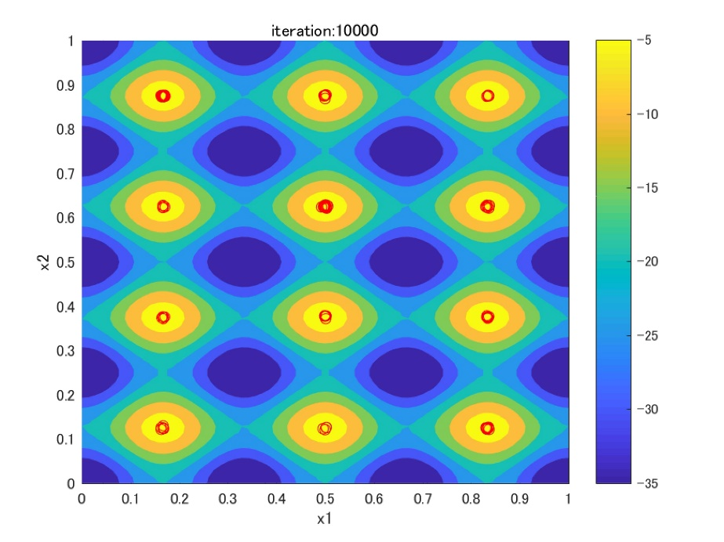
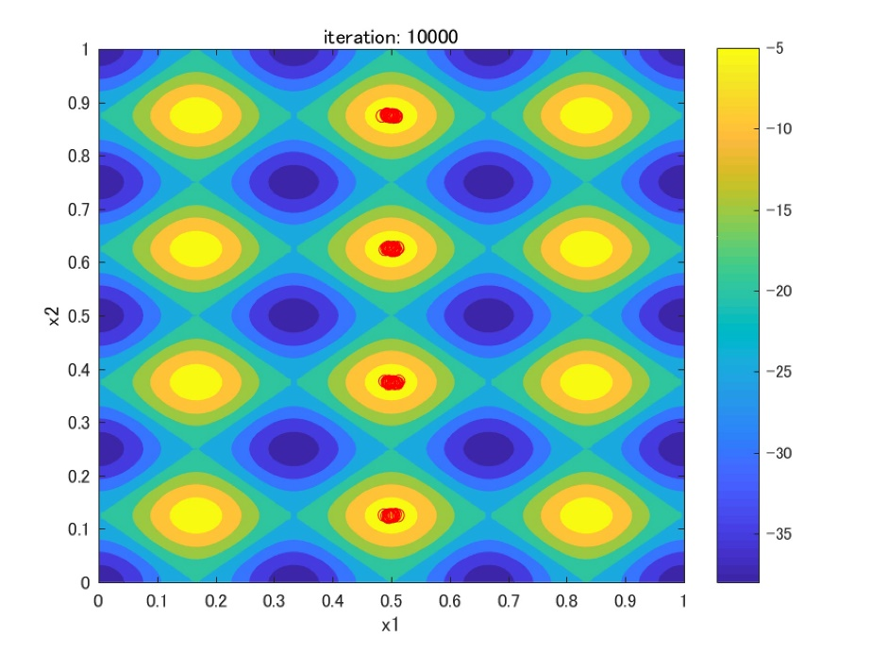
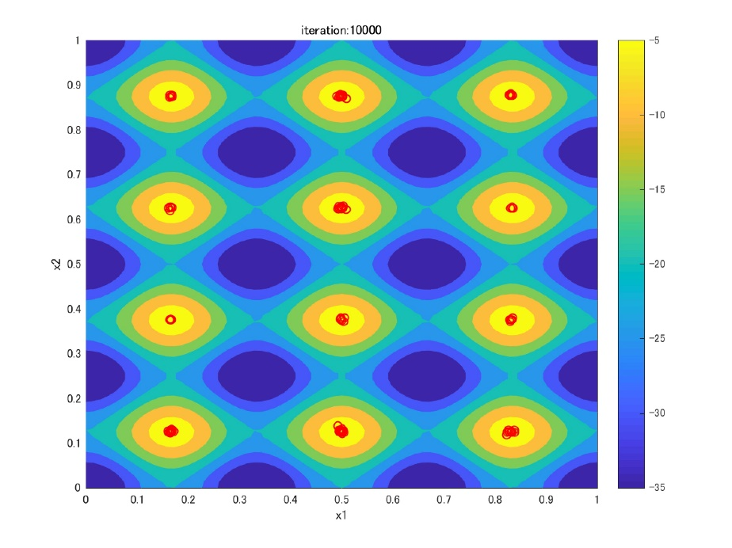
Results – Individual distribution
16
fitness
：individual
BA
NSBA
NRBA
Notes:
青いエリアが最適解及び局所解を示す

Slide 28
Conclusion
17
Objective
BA with Niche Radius for finding global & local optima on Multimodal optimization
Implications
Keep solutions away from the personal best solution in Niche radius
Generate solution candidates in Niche radius of the personal best solution
Generate solution candidates in Niche radius of the current solution
Results
NRBA is more effective in the function which has global & local optima than BA
NRBA is just about the same performance in the function which has only global optima as BA
Future works
Compare with state-of-the-art Niching methods
Notes:
In conclusion,

Slide 29
Appendix

Slide 30
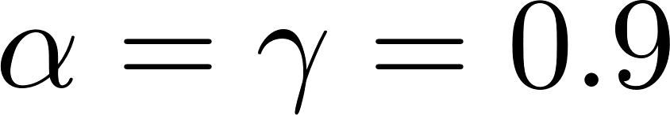
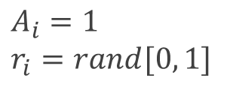




BA flowchart
STEP0: Initialize Population
for i = 1 to N
$$\left(i=1,2,…, N\right)$$
$$x_{2}$$
$$x_{1}$$
rand $∈[0, 1]$
$$x_{3}$$
$$x_{∗}$$
$x_{ub}:$ upper bound of the search space
$x_{lb}:$ lower bound of the search space
$$A_{i}=1$$
$$r_{i}=rand[0, 1]$$
$$x_{4}$$
$$x_{5}$$
Endfor
：solution $x_{i}$
: solution candidate
: the current best solution $x_{∗}$

Slide 31
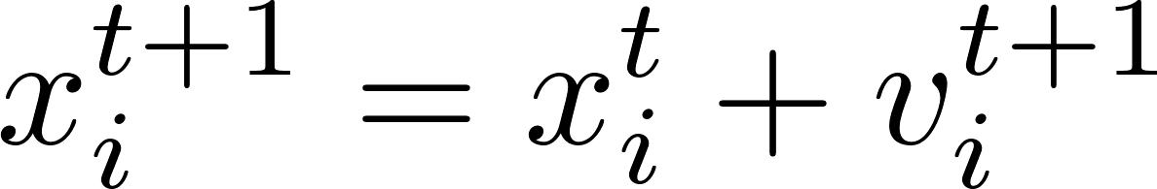


BA flowchart
STEP1: Move toward the global best solution
for i = 1 to N
$$x_{2}$$
$$v_{2}$$
$$x_{1}$$
$$v_{1}$$
$$x_{3}$$
$$x_{∗}$$
$$x_{i}^{t+1}$$
$$v_{3}$$
Endfor
$$v_{4}$$
$$v_{5}$$
$$x_{4}$$
$$x_{5}$$
$x_{∗} :$ global best solution
rand $∈[0, 1]$
：solution $x_{i}$
: solution candidate
: the current best solution $x_{∗}$

Slide 32
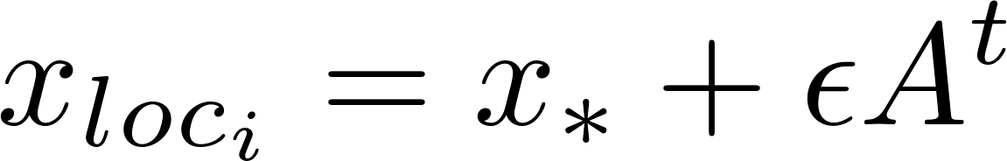
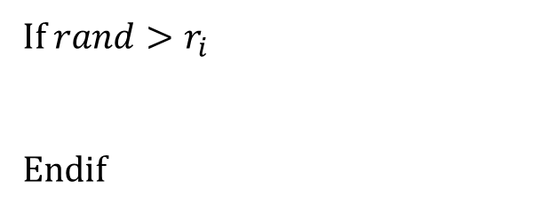
BA flowchart
STEP2: Local search around the global best solution
Generate new solution candidate around $x_{∗}$
for i = 1 to N
If $rand>r_{i}$
Endif
$$x_{2}$$
$$x_{1}$$
$$x_{loc_{i}}$$
$$x_{3}$$
$$x_{∗}$$
Endfor
$$x_{4}$$
$$x_{5}$$
：solution $x_{i}$
: solution candidate
$ε$: parameter to control the search area in this step
: the current best solution $x_{∗}$

Slide 33
BA flowchart
STEP3: Random search in the search space
for i = 1 to N
$$x_{2}$$
$$x_{1}$$
Endfor
$$x_{3}$$
$$x_{∗}$$
$$x_{rnd_{i}}$$
$$x_{4}$$
$$x_{5}$$
：solution $x_{i}$
: solution candidate
: the current best solution $x_{∗}$

Slide 34
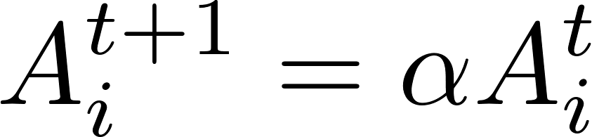
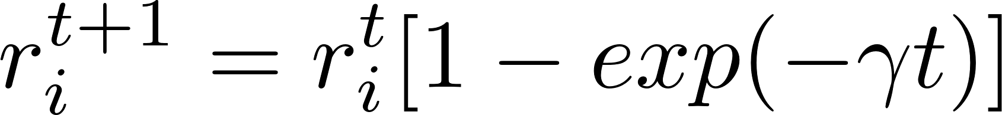
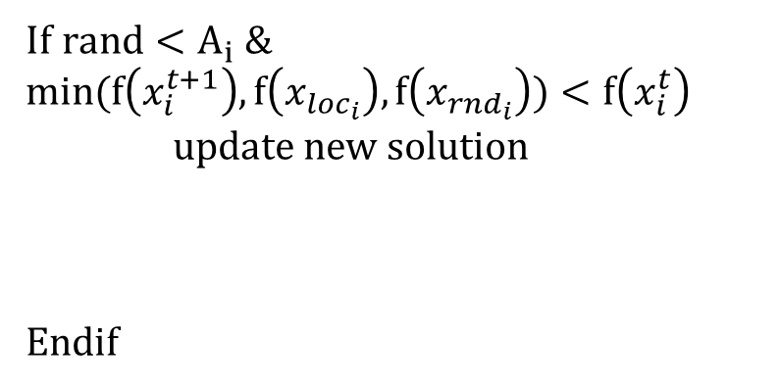
BA flowchart
STEP4: Evaluate and update solutions
for i = 1 to N
If $rand<A_{i} \&$ $$min(f\left(x_{i}^{t+1}\right), f\left(x_{loc_{i}}\right), f\left(x_{rnd_{i}}\right))<f\left(x_{i}^{t}\right)$$
update new solution
Endif
$$x_{2}$$
$$x_{1}$$
$$x_{i}^{t+1}$$
$$x_{3}$$
$$x_{∗}$$
$$x_{loc_{i}}$$
$$x_{rnd_{i}}$$
$$x_{4}$$
$$x_{5}$$
Endfor

Slide 35
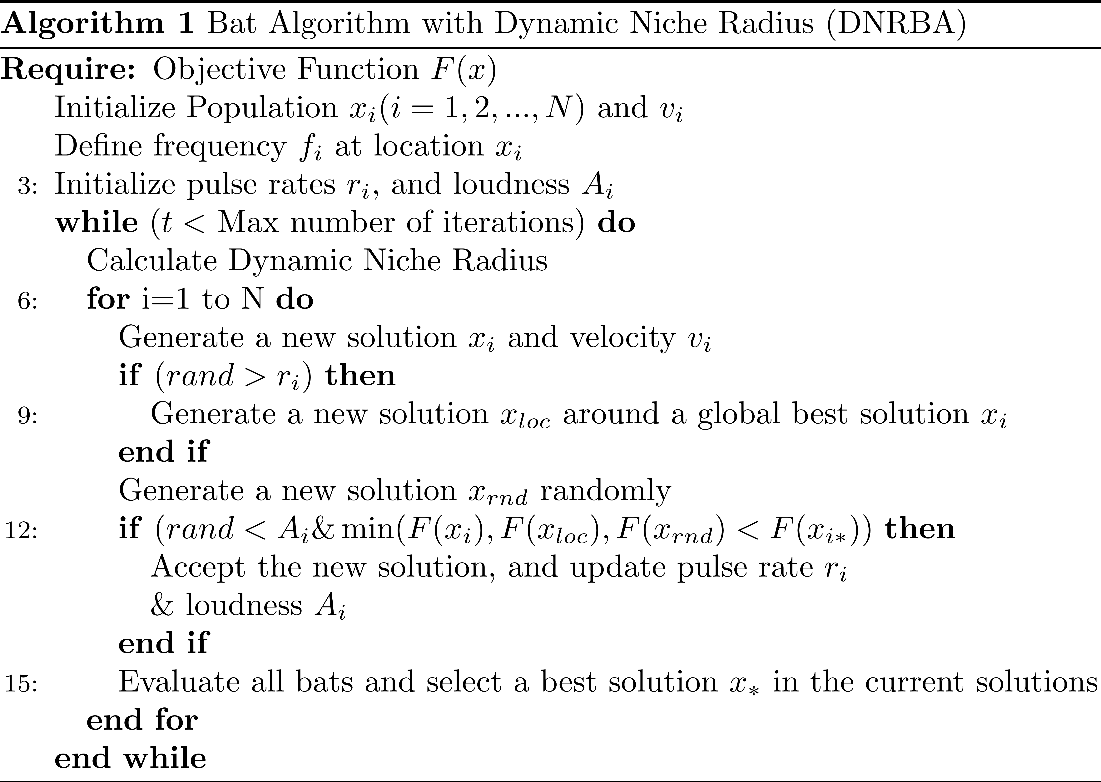
Pseudo code of NRBA

