Slide 1
CSE 544
Advanced Systems Security
Trent Jaeger
Systems and Internet Infrastructure Security (SIIS) Lab
Computer Science and Engineering Department
Pennsylvania State University
January 11, 2011

Slide 2
About Me
Trent Jaeger (PhD, University of Michigan)
Associate Professor, CSE -- after 9 years at IBM Research
Research: Operating System Security
Example Projects
  L4 Microkernel -- minimal, high performance OS
  Linux -- Open source, UNIX variant
  Xen hypervisor -- Open source, virtual machine platform
Office Hours: by appointment
Office: 346A IST Bldg
Email: tjaeger@cse.psu.edu
Notes:
What about everyone else in the class?

Slide 3
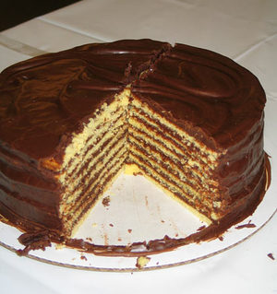
Motivation
Security mechanisms and policies have been
implemented at several system layers (app, OS, VM,
network)
Are we now secure?
Notes:
Why are we insecure?

Slide 4
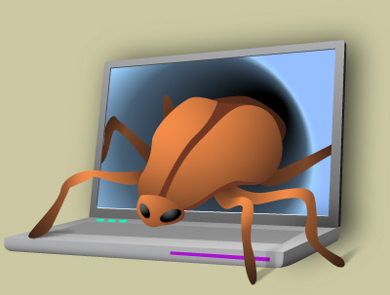
Current Security Problems
Most current security problems are based on the failure of people to deploy hosts securely
Botnets
Rootkits
Web attacks: XSS, SQL Inject, …
Worms (Conficker, Stuxnet)
Password Guessing
Buffer Overflows
Arbitrary App Flaws

Slide 5
Security State
SANS Top Security Risks
http://www.sans.org/top-cyber-security-risks/
Client-side software is unpatched (apps patched slower)
Web servers are vulnerable (XSS are 80%)
Application vulnerabilities exceed OS vulnerabilities
Attacks on Mac systems (QuickTime)
US is the major attack target (30:1)
Still buffer (and heap) overflows
We will study the structure of attacks on hosts and a general procedure for their prevention

Slide 6
Cross-site Scripting (XSS)
Aim: Get a client to run an attackers’ code at higher privilege (Privilege Escalation)
Attack:
  Attacker places content on trusted site
  Client downloads content and that content attacks an unpatched client program (e.g., media player)
  Attacker can run as client user
  Install reverse shell backdoor (outbound HTTPS)
  Download local privilege escalation program (again unpatched client code)
  Attack other machines – Windows domain controller
Notes:
We know that we can translate program and system policies to information flow policy graphs.
Each node has an associated label. That label indicates security requirements for that node.
An information flow policy is a directed graph that shows the flows allowed by the policy. The nodes represent the subjects and objects that the policy rules and the edges represent the flows that are allowed between them

Slide 7
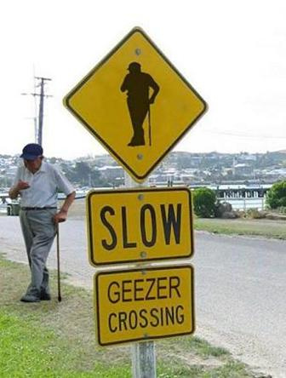
Security Mythology
Claim: All these problems were solved in Multics
Is this claim true?
Why not just use it?
What is necessary?
By whom?
Can we make it happen?
Claim: We are still trying to solve the same security problems since Multics
Notes:
We know that we can translate program and system policies to information flow policy graphs.
Each node has an associated label. That label indicates security requirements for that node.
An information flow policy is a directed graph that shows the flows allowed by the policy. The nodes represent the subjects and objects that the policy rules and the edges represent the flows that are allowed between them

Slide 8
Who Has a Role?
We want to examine what all the interested parties do/do not want for security/function and what they can/cannot know to resolve conflicts
Programmers (may be multiple groups)
OS Distributors
Administrators
Users
Service Providers
Content Providers
Notes:
We know that we can translate program and system policies to information flow policy graphs.
Each node has an associated label. That label indicates security requirements for that node.
An information flow policy is a directed graph that shows the flows allowed by the policy. The nodes represent the subjects and objects that the policy rules and the edges represent the flows that are allowed between them

Slide 9
This course….
Is a systems course that teaches principles for building a secure system and techniques for implementing those principles
  Caveat: We are still trying to figure out the latter
  Topics: What makes a system secure (mechanisms and policies); Example implementations of such principles (at OS, VMM, and application); Tools to assist in such implementations; How do we put it together; Recent research in secure systems design
Notes:
We know that we can translate program and system policies to information flow policy graphs.
Each node has an associated label. That label indicates security requirements for that node.
An information flow policy is a directed graph that shows the flows allowed by the policy. The nodes represent the subjects and objects that the policy rules and the edges represent the flows that are allowed between them

Slide 10
Background
Required:
  CSE 543
Expected:
  Solid OS and PL background
Additional:
  Willingness to read
    We are going to read a lot of systems security papers
  Willingness to program
    We are going to have some OS programming assignments (Linux)

Slide 11
Course Materials
Website
  http://www.cse.psu.edu/~tjaeger/cse544-s11/
  Course assignments, slides, etc. will be placed here
    Check back often -- I may change some of the papers/assignments
Course Textbook
  My book: Operating Systems Security
  Augmented with research papers
Notes:
We have an additional requirement. For a program policy and a system policy to be compliant the system policy must protect application components.

Slide 12
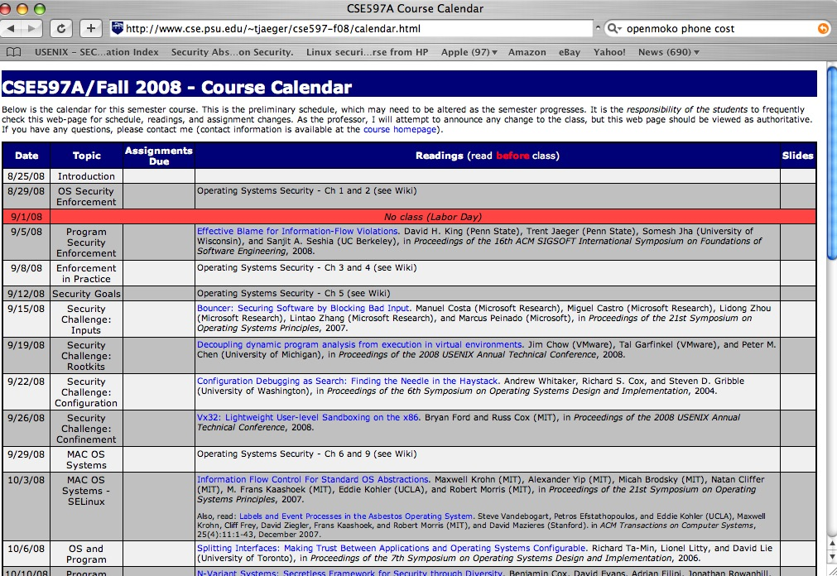
Course Calendar
The course calendar has all the details
Links to online papers for readings
Links to projects
Please check the calendar frequently
  it’s the real-time state of the course
Notes:
We realized that the requirements we defined for our system are also the requirements of a Reference Monitor

Slide 13
Course Mailing List
Via ANGEL
  Use with care
I will send a test email
  Please reply if you do not receive by Fr
  May need to forward to your CSE account
Can use to email me
  Please use “544” in the subject

Slide 14

Grading
Exams (55%)
  Midterm (25%)
    Take home – do the readings
  Final (30%)
    In class
Projects (35%)
  3 programming projects
  OS and Source code analysis
Participation (10%)

Slide 15
Projects
We are going to have three project deliverables
  Per person
Topics
  Type Safety
  Linux Security Module
  Security Policy
  Source Code Analysis for Security
C programming required
  Kernel debugging also

Slide 16
Lateness Policy
Assignments and project milestones are assessed a 20% per-day late penalty, up to a maximum of 4 days. Unless the problem is apocalyptic, don’t give me excuses. Students with legitimate reasons who contact the professor before the deadline may apply for an extension.
You decide what you turn in
Notes:
Problem to test compliance.

Slide 17
Ethics Statement
This course considers topics involving personal and public privacy and security. As part of this investigation we will cover technologies whose abuse may infringe on the rights of others. As an instructor, I rely on the ethical use of these technologies. Unethical use may include circumvention of existing security or privacy measurements for any purpose, or the dissemination, promotion, or exploitation of vulnerabilities of these services. Exceptions to these guidelines may occur in the process of reporting vulnerabilities through public and authoritative channels. Any activity outside the letter or spirit of these guidelines will be reported to the proper authorities and may result in dismissal from the class.
When in doubt, please contact the instructor for advice. Do not undertake any action which could be perceived as technology misuse anywhere and/or under any circumstances unless you have received explicit permission from Professor Jaeger.

Slide 18
Road Map
Introduction
  1. What is security? 2. What are the fundamental principles if secure execution?
Designing for Security and Protection
  1. Experiences with Multics and UNIX/Windows
Mandatory Access Control
  1. Policy Models 2. Lattice Models in Depth
Systems Security Architectures
  1. Security Kernels 2. Secure UNIX Variants 3. Capability Systems 4. VM Systems
Assurance
  1. Common Criteria 2. Program Analysis
Practical System Integrity
  1. System Integrity Models 2. Decentralized Label Model 3. Data/Control Flow Integrity
Special Topics
  1. Trustworthy Computing 2. Device Security 3. Storage Security 4. Web Security
Notes:
We propose an approach to solve the problem of relating two policies.
This approach is based on some simple observations.

Slide 19

Review
Are we speaking the same language?
General Terms
  Principals/Subjects and Adversaries/Attackers
  Trust Model
  Threat Model
  Security Model
We will develop (semi-)formal models for each
Notes:
This slide illustrates the way our approach works.

