Slide 1
Advanced Systems Security:
Linux Security Modules
Trent Jaeger
Systems and Internet Infrastructure Security (SIIS) Lab
Computer Science and Engineering Department
Pennsylvania State University
February 25, 2010

Slide 2
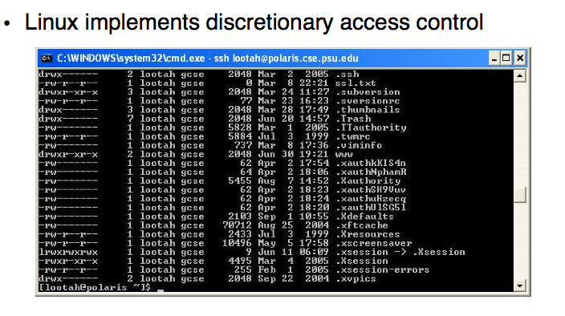
Linux Authorization circa 2000

Slide 3
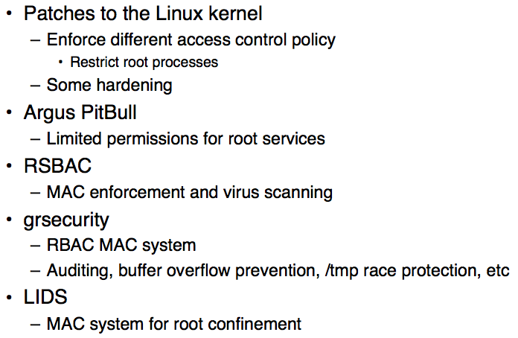
Linux Security circa 2000

Slide 4
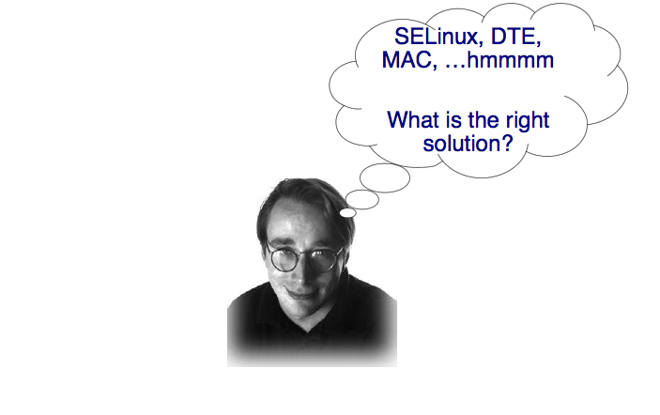
Linus’ Dilemna

Slide 5
The Answer
The solution to all computer science problems
Add another layer of indirection

Slide 6
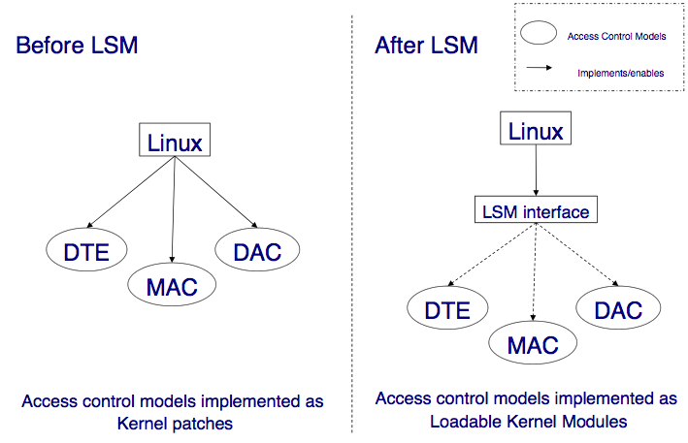
Linux Before and After

Slide 7
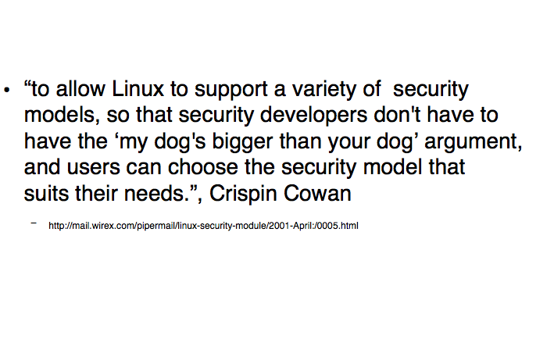
Linux Security Modules Was Born

Slide 8
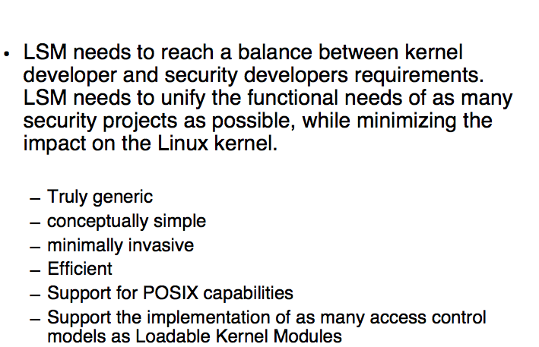
LSM Requirements

Slide 9
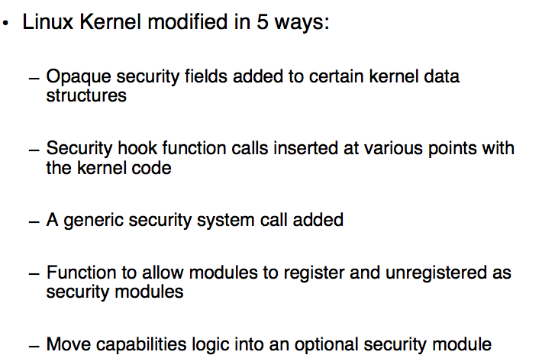
LSM Tasks

Slide 10
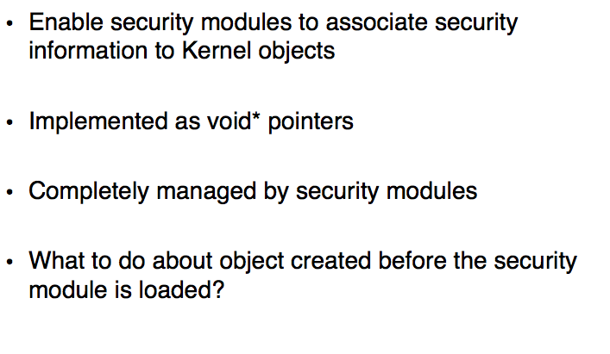
LSM Security Fields

Slide 11
LSM Security Fields

Slide 12
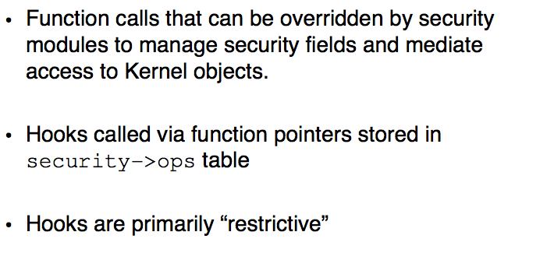
LSM Hooks

Slide 13
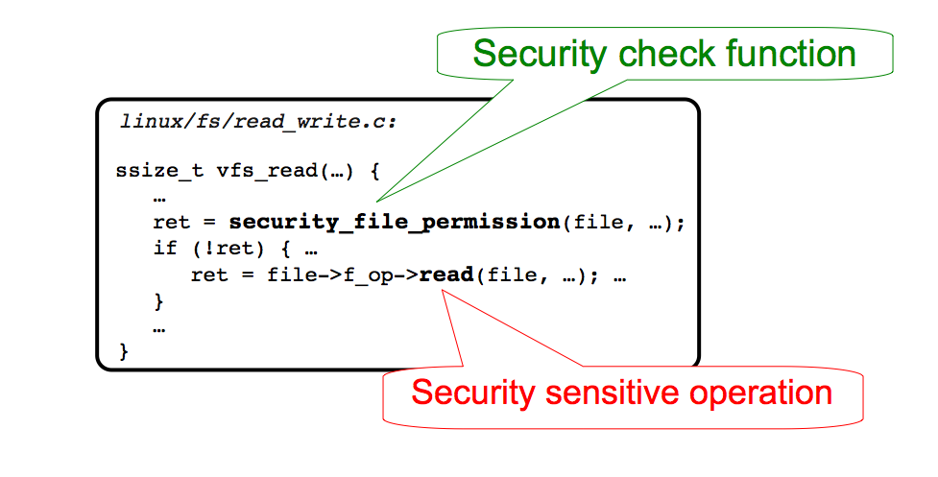
LSM Hooks

Slide 14
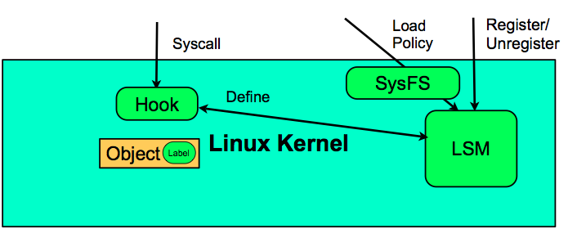
LSM API

Slide 15
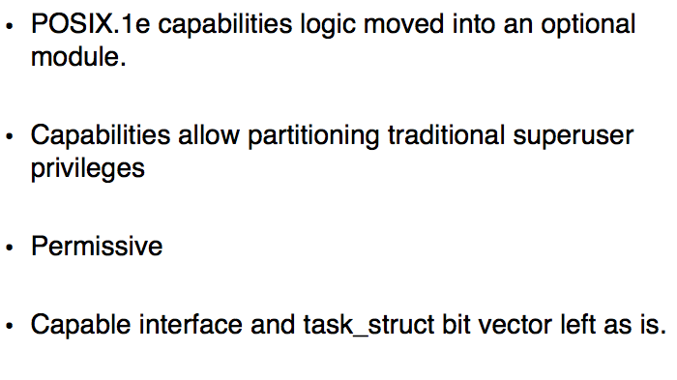
POSIX Capabilities

Slide 16
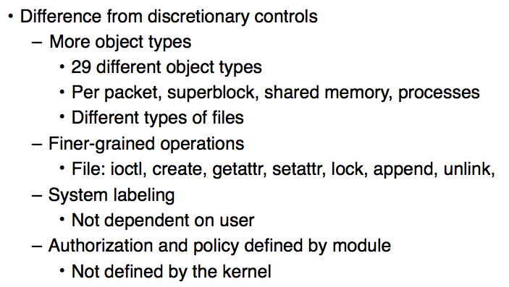
Hook Details

Slide 17
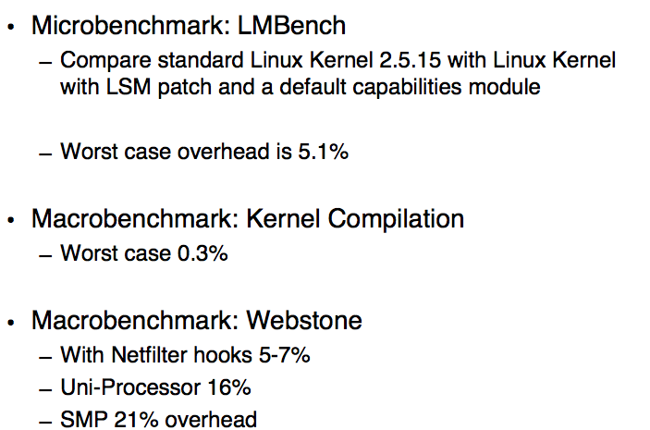
LSM Performance

Slide 18
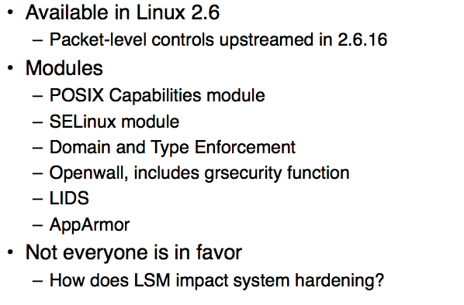
LSM Use

Slide 19
LSM and Complete Mediation
LSM is mainly responsible for complete mediation
  What was the basis for choosing security-sensitive operations?
  Pretty ad hoc…
How did that work out?

Slide 20
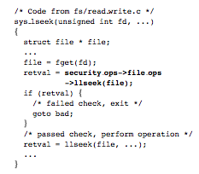
LSM Analysis
Static analysis of Zhang, Edwards, and Jaeger [USENIX Security 2002]
  Based on a tool called CQUAL
Approach
  Objects of particular types can be in two states
    Checked, Unchecked
  All objects in a “controlled operation” must be checked
    Structure member access on objects

Slide 21
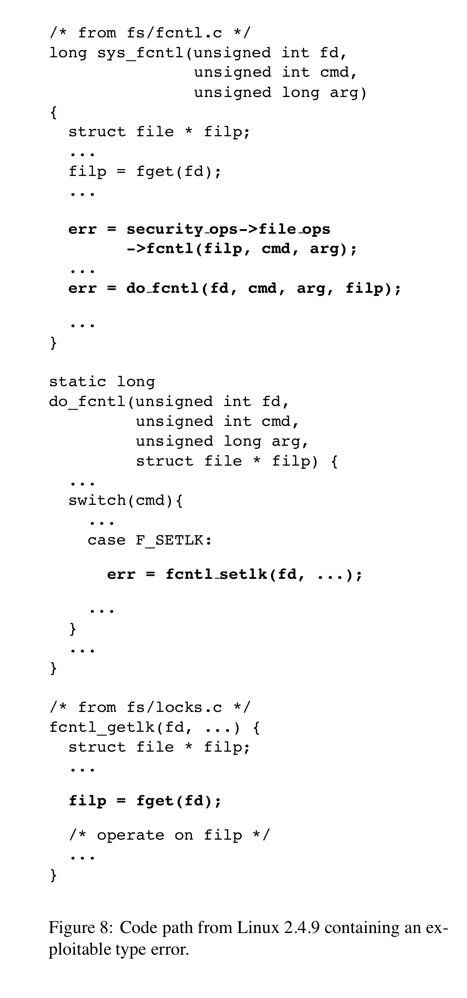
LSM Analysis
Static analysis of Zhang, Edwards, and Jaeger [USENIX Security 2002]
  Based on a tool called CQUAL
Found a TOCTTOU bug
  Authorize filp in sys_fcntl
  But pass fd again to fcntl_getlk
  Many supplementary analyses were necessary to support CQUAL

Slide 22
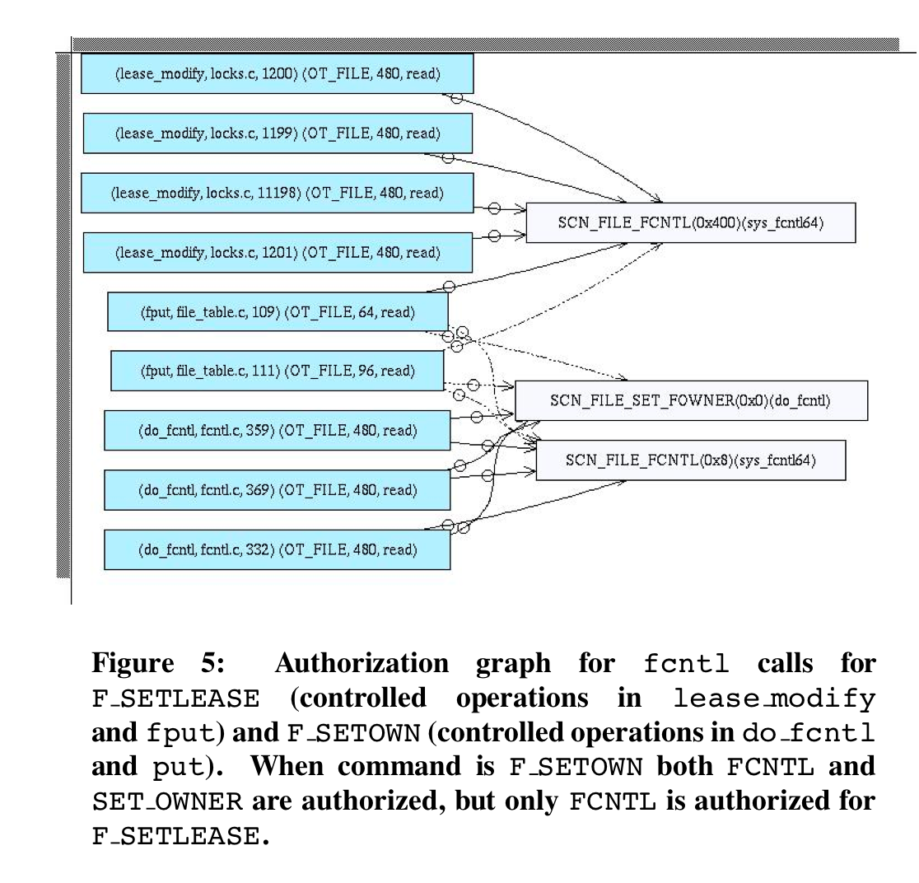
LSM Analysis
Runtime analysis of Edwards, Zhang, and Jaeger [ACM CCS 2002]
  Built a runtime kernel monitor
  Logs structure member accesses
  Rules describe expected consistency
Good for finding missing hooks where one is specified
  Six cases were found

Slide 23
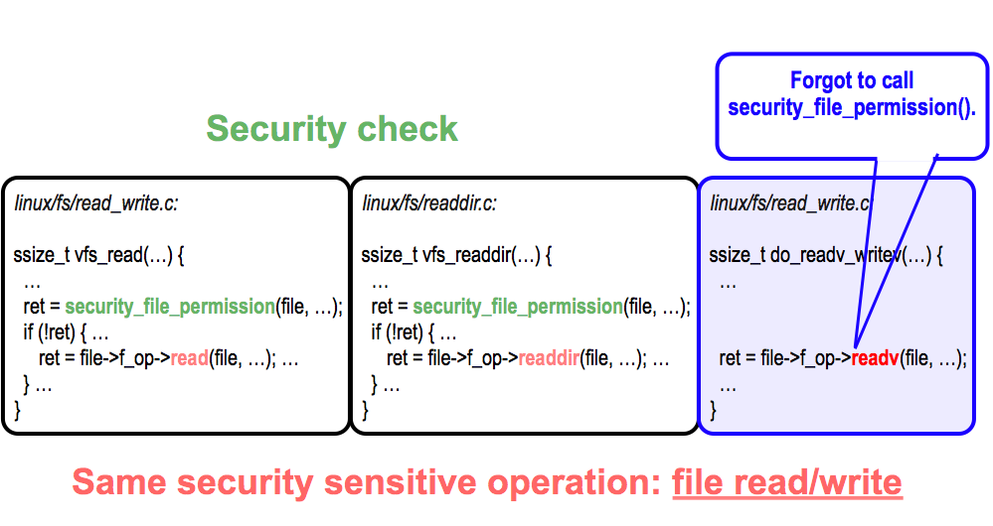
LSM Analysis
Automatically inferring security specifications from code – Tan, Zhang, Ma, Xiong, Zhou [USENIX Security 2008]
  Automate look at which fns are behind pointers

Slide 24
Take Away
Aiming for mandatory controls in Linux
  But everyone had their own approach
Linux Security Modules is a general interface for any* authorization module
  Much finer controls – interface is union of what everyone can do
What does this effort say about
    Achieving complete mediation?
    Whether complete mediation should be policy-dependent?

