Slide 1
Advanced Systems Security:
Security-Enhanced Linux
Trent Jaeger
Systems and Internet Infrastructure Security (SIIS) Lab
Computer Science and Engineering Department
Pennsylvania State University
March 3, 2011

Slide 2
SELinux Deployment
You’ve configured your SELinux policy
  Now what is left?
Surprisingly, a lot
  Many services must be aware of SELinux
  Got to get the policy installed in the kernel
  Got to manage all this policy
And then there is the question of getting the policy to do what you want

Slide 3

User-space Services
What kind of security decisions are made by user-space services?

Slide 4
User-space Services
What kind of security decisions are made by user-space services?
  Authentication (e.g., sshd)
  Access control (e.g., X windows, DBs, etc)
  Configuration (e.g., policy build and installation)
Also, many services need to be aware of SELinux to enable usability
  E.g., Listing files/processes with SELinux contexts (ls/ps)

Slide 5
User-space Services
Authentication
  Various authentication services need to create a subject context on a user login
  Like login in general, except we set an SELinux context and a UID for the generated shell
How do you get all these ad hoc authentication services to interact with SELinux?

Slide 6
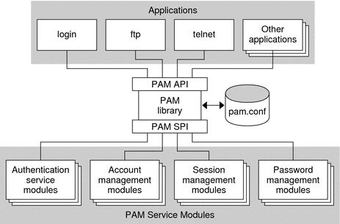
Authentication for SELinux
Pluggable Authentication Modules
  There is a module for SELinux that various authentication services use to create a subject context

Slide 7
User-space Services
Access Control
  Many user-space services are shared among clients of different security
    Problem: service may leak one client’s secret to another
If your SELinux policy allows multiple clients with different security requirements to talk to the same service, what can you do?

Slide 8
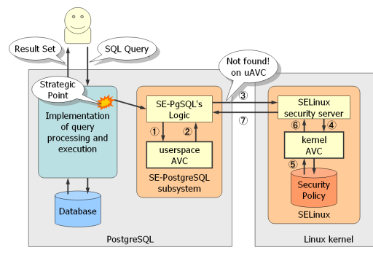
User-space Services
Add SELinux support to the service
  X Windows, postgres, dbus, gconf, telephony server
E.g., Postgres with the SELinux user-space library

Slide 9
User-space Services
Configuration
  You need to get the SELinux policy constructed and loaded into the kernel
    Without allowing attacker to control the system policy
    And policy can change dynamically
How to compose policies?
How to install policies?

Slide 10
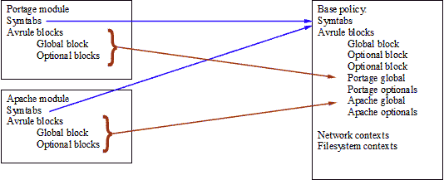
Compose Policies
The SELinux policy is modular
  Although not in a pure, object-oriented sense
    Too much had been done
Policy management system composes the policy from modules, linking a module to previous definitions and loads them

Slide 11
Installing Policies
sys_security system call rejected
  Linux maintainers do not want to add system calls
  The use of a void* input to the kernel will not be allowed
How would you enable many different parties to push data into the kernel?
  Only one is active at a time_x0018_

Slide 12
sysfs Background
During the 2.5 development cycle, the Linux driver model was introduced to fix several shortcomings of the 2.4 kernel:
  No unified method of representing driver-device relationships existed.
  There was no generic hotplug mechanism.
  procfs was cluttered with lots of non-process information.
Main uses
  Configure drivers
  Export driver information

Slide 13
sysfs Example: load_policy
From kernel: security/selinux/selinuxfs.c
enum sel_inos {
SEL_ROOT_INO = 2,
SEL_LOAD, /* load policy */
SEL_ENFORCE, /* get or set enforcing status */
static struct tree_descr selinux_files[] = {
[SEL_LOAD] = {"load", &sel_load_ops, S_IRUSR|S_IWUSR},
[SEL_ENFORCE] = {"enforce", &sel_enforce_ops,
S_IRUGO|S_IWUSR},
static struct file_operations sel_load_ops = {
.write = sel_write_load,
};

Slide 14
sysfs Example: load_policy
From userspace: libselinux/src/load_policy.c
int security_load_policy(void *data, size_t len)
{
char path[PATH_MAX];
int fd, ret;
snprintf(path, sizeof path, "%s/load", selinux_mnt);
fd = open(path, O_RDWR);
if (fd < 0)
return -1;
ret = write(fd, data, len);
close(fd);

Slide 15
sysfs Example: load_policy
From kernel: security/selinux/selinuxfs.c
static ssize_t sel_write_load(struct file * file, const char __user * buf,
size_t count, loff_t *ppos)
{
…
length = task_has_security(current, SECURITY__LOAD_POLICY);
if (length)
goto out;
…
if (copy_from_user(data, buf, count) != 0)
goto out;
length = security_load_policy(data, count); --- ss/services.c
if (length)
goto out;

Slide 16
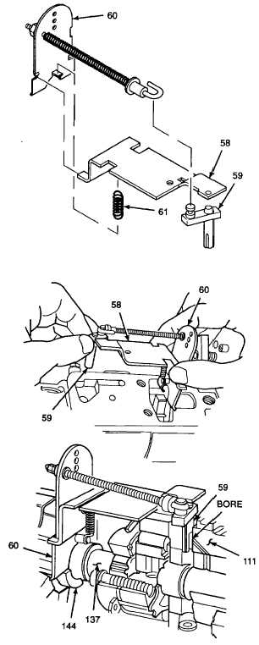
When Are We Done?
There is a significant configuration effort to get the SELinux system deployed
  Who does this?
  What happens if I want to change something?
  Does it prevent the major threats?

Slide 17
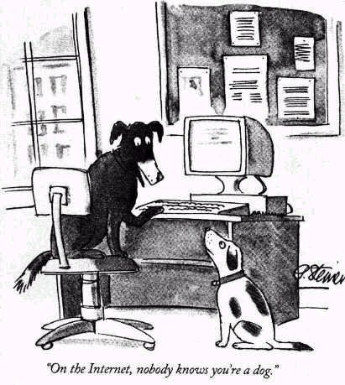
Threat: Remote Attackers
How do we design policies if our threat is remote attackers?

Slide 18
Goal: Confine Network Daemons
Motivation for AppArmor the other major LSM (supported by SuSE and other Linux versions)
  SELinux targeted policy has same aim
Goal: keep a compromised daemon from compromising the system
Challenge: some daemons must be trusted (e.g., SSH, DNS, DHCP)
Result: Chen, Li, and Mao (NDSS 2009) found that AppArmor and SELinux (targeted) have attack paths from network daemons (SELinux has more)

Slide 19

Threat: Protect System Integrity
How do we design policies to protect the system’s trusted computing base?

Slide 20
Goal: Methodology to Find TCB
Take the SELinux Example Policy and customize for the particular site (a security target)
Goal: Find a trusted computing base from those processes in the trust model
Challenge: Many policy rules allow interaction of trusted and untrusted processes
Result: Develop a methodology for customizing a policy, but some leaps of faith result

Slide 21
SELinux Example Policy
Policy is designed for each Target Application
  Definer has a threat model in mind
  Definer specifies policy against that model
  Definer and others test that the application runs given that policy
For System
  Aggregate of application policies
  No coherent threat model
  Application interactions not examined in detail

Slide 22
Experiment: Find SELinux TCB
Can we identify a TCB in SELinux Example Policy whose integrity protection can be managed?
  (1) Propose a TCB
  (2) Identify Biba integrity violations
  (3) “Handle” integrity violations
    Classify integrity violations
    Remove violations that can be managed (TP)
    Revise TCB proposal
    Revise SELinux policy

Slide 23
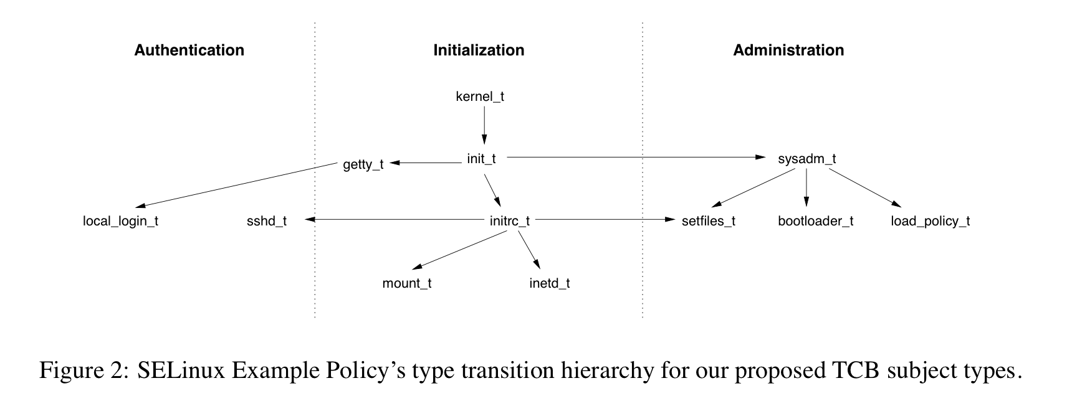
Propose a TCB
Can use transition state graph (exec) to server programs (httpd_t) to identify base subject types
Ones that provide TCB services (e.g., authentication)
Others that have many transitions (hard to contain)

Slide 24
Biba Integrity Analysis
High Subject
Object Read
Subject
Perm
Low Subject
Can Modify
Input To High
Perm
Subject
Object Write
Low Subject

Slide 25
Expressing Conflicts
setfiles
S-P Assign
Conflict
S-P Assign
file_type
read
user_ssh
rw
user_ssh
rw
user
sysadm
sshd_tmp
read
sshd_tmp
rw
httpd
admin
sshd
logfile
read
logrotate
lastlog
read
lastlog
write
xdm
High
Subject
Type
Attr
Perm
Low
Subject
Type
Perm
Perm
The subject-permission assignments that lead to
a conflict result in a minimal cover of all conflicts

Slide 26
Are There Integrity Violations?
Permissions
  129 perms used to “read down”
    57 socket perms, 25 fifo perms
  1583 perms used to “write up”
Subjects
  28 high integrity subjects “read down”
    35 perms for sysadm_t, 4 perms for load_policy_t
  150 low integrity subjects “write up”

Slide 27
Example Conflicts
Generic conflicts
  Processes read from sockets
  Processes read fifos
  Trusted subjects are given broad access
Specific issues
  Files: /tmp, /etc, /etc/resolv.conf, /var
  Logs: logfiles, backups
  Others: ttys, devices

Slide 28
Classify Integrity Violations
Classify Based on Possible Resolutions
  Type classifications:
    Upgrade low subject type to trusted – “should be trusted”
    Exclude low subject type – “troublemaker”
    Downgrade trusted subject type – “not possible to trust”
    Exclude conflicting object type – “troublemaker objects”
  Permission classifications:
    Sanitize perm use (allow) – “filtering permissions”
    Deny access to conflicting perms (deny) – “troublemaker perms”
    Modify policy – “major surgery”

Slide 29
Classification Approach
Should trust or troublemaker?
  Exclude/trust writeup subjects that conflict with many readdown perms (sendmail)
  Downgrade readdown subjects that conflict with many writeup perms
“Filter” Readdown Perms
  Read-write integrity vs read-only integrity
  Small number of readdown subjects (fifos)
  Assess permission type/use (sockets)

Slide 30
Classification Approach (con’t)
Exclude Conflicting Writeup Objects
  Writeup perm that impacts several readdown perms
  Remove excluded subject type perms (*)
Deny Conflicting Writeup Perms
  Find conflicting perm between readdown and writeup
    Broad readdowns (user files, all files, …)
  Test if can be denied
Change The Policy
  When all else fails…

Slide 31
Example Classifications
Generic conflicts
  Sanitize: Processes read from sockets
  Sanitize: Processes read fifos
  Deny: Broad access that conflicts
Specific issues
  Sanitize: /var, logfiles, backups
  Exclude subjects: /etc, /etc/resolv.conf
  Deny/change: sysadm_t, httpd_t
  False: /tmp directory

Slide 32
Results
30 Trusted Subject Types (more since then)
  Obvious: kernel_t, init_t, getty_t, …
  Admin: sysadm_t, load_policy_t, setfiles_t,
  Auth: sshd_t, sshd_login_t, …
  Less obvious: apt_t, hwclock_t, ipsec, cardmgr, …
SELinux Core Subject Types (policy)
25 Excluded Subject Types (more since then)
4 Excluded Object Types (removable_dev)

Slide 33
Take Away
Problem: Turn the SELinux policy into a working, usable reference monitor
  Work with user-space services
  Design the policy that you want
There are many requirements for user-space services to provide authentication, access control, and policy configuration itself
  PAM, Policy Mgmt, User-space access, Network support
Turn a set of app policies into a coherent system
  Prevent network threats and design for app integrity

Slide 34

Threat: Input Low Integrity Data
Why don’t we just deal with all places where low integrity data enters the system?

Slide 35
Goal: Confine Network Daemons
Motivation for Usable Mandatory Integrity Protection and CW-Lite
Goal: keep a low integrity input from compromising or poisoning the system
Challenge: Some services receive low integrity inputs but they may be able to handle them
Result: UMIP defines programs that may access low integrity inputs without lowering system integrity; CW-Lite defines that low

Slide 36
User-space Services
Networking
  SELinux has a variety of support for labeled networking
  CIPSO (netlabel), IPsec (Labeled IPsec), firewalls (Secmark)
How does inetd know what permissions to assign a process handling a network request?

Slide 37
Networking
Applications can query the kernel to identify the label of the network communication
  System call: getsockopt
  Returns the label of the connection
    Implications?
Can then create processes with that label
  Next child process
  Or just change your label (setcon)
    Implications?

