Slide 1
Advanced Systems Security:
Capability Systems
Trent Jaeger
Systems and Internet Infrastructure Security (SIIS) Lab
Computer Science and Engineering Department
Pennsylvania State University
March 17, 2011

Slide 2
A Problem
A UNIX-like system has a compiler (SYSX)
Normal users can run the compiler on their code
SYSX writes two files: the compiler output and billing information
Users can also provide the name of a file to receive debugging information
The compiler runs with RW access to these files
What happens when a user specifies the billing information file as the file to receive debugging info?

Slide 3
The Confused Deputy Problem
A server process runs with the rights of its clients
  All its clients
And a client can trick the server into using another client’s permission for it
  Or the server’s permissions, as in the billing info
How can we prevent this problem?

Slide 4
The Confused Deputy Solutions
Intersect the client’s and server’s permissions
  Are those enough?
Run with client’s permissions
  Are those enough?
Switch between the client’s permissions and the server’s permissions
  When? Can that be attacked?
Define conditions when a server may have all its permissions
  What might these be?

Slide 5
Capability Solution (Conceptual)
Server has some base permissions
Client provides additional permissions with its request
Server uses the combination of its base permissions and client permissions to handle the request
  Is that good enough for the billing info example?

Slide 6
Capability Solution (Conceptual)
I don’t think so.
The compiler should make sure that it uses its own permissions for writing billing info and the client’s for writing debugging
  Identity and access are both important
Thus, permissions must be managed per function
  Like Hydra (later)

Slide 7
Capability Systems
Goes back to the mid-1960s (Dennis and van Horn, Plessey system, CTSS)
Idea: include accessibility with reference
What is a normal reference?
What defines accessibility?

Slide 8
Capabilities
Analogy
Like a house key
  Possession grants access
  Need to use the right key for the right job
  Can make copies and give those to others
  Changing the lock invalidates all keys
  Losing the key loses access
  Can’t easily keep track of where the copied keys go

Slide 9
What’s a Capability?
Consists of a reference
  Object ID, memory value, segment number, label, …
And rights
  Operations specific to that object type (class in SELinux)
And an integrity value (optional)
  Needed if a capability may be handled by an untrusted party (like communicating a message securely)
Present this to an object server to obtain access to the reference to use the rights

Slide 10
Capability Requirement
Capabilities must be unforgeable
In what ways can a user forge a capability?
Representations of Capabilities
  Hardware capabilities
    Hardware associates permissions with reference
  System-controlled capabilities
    System stores mapping of permissions to reference
  Cryptographic capabilities
    User processes hold and distribute capability objects

Slide 11
Hydra System
“Everything is an object” capability system
  Name, data type, “representation”
Representation: current state of object
  C-List: capabilities to access other objects
Processes are objects, as are procedures
  Protection at procedure granularity
Your rights are based on the procedure you are currently executing

Slide 12
Hydra System
Local Name Space
Caps
Caps
Call
Local Name Space
Procedure
Caps
Caps
Caps
Delegate
All authorized operations of a procedure
are defined by its (inherited) capabilities
and those passed by the caller

Slide 13
Capability System Problem
Boebert: “the right to exercise access includes the right to grant access”
  Why is that a problem?

Slide 14
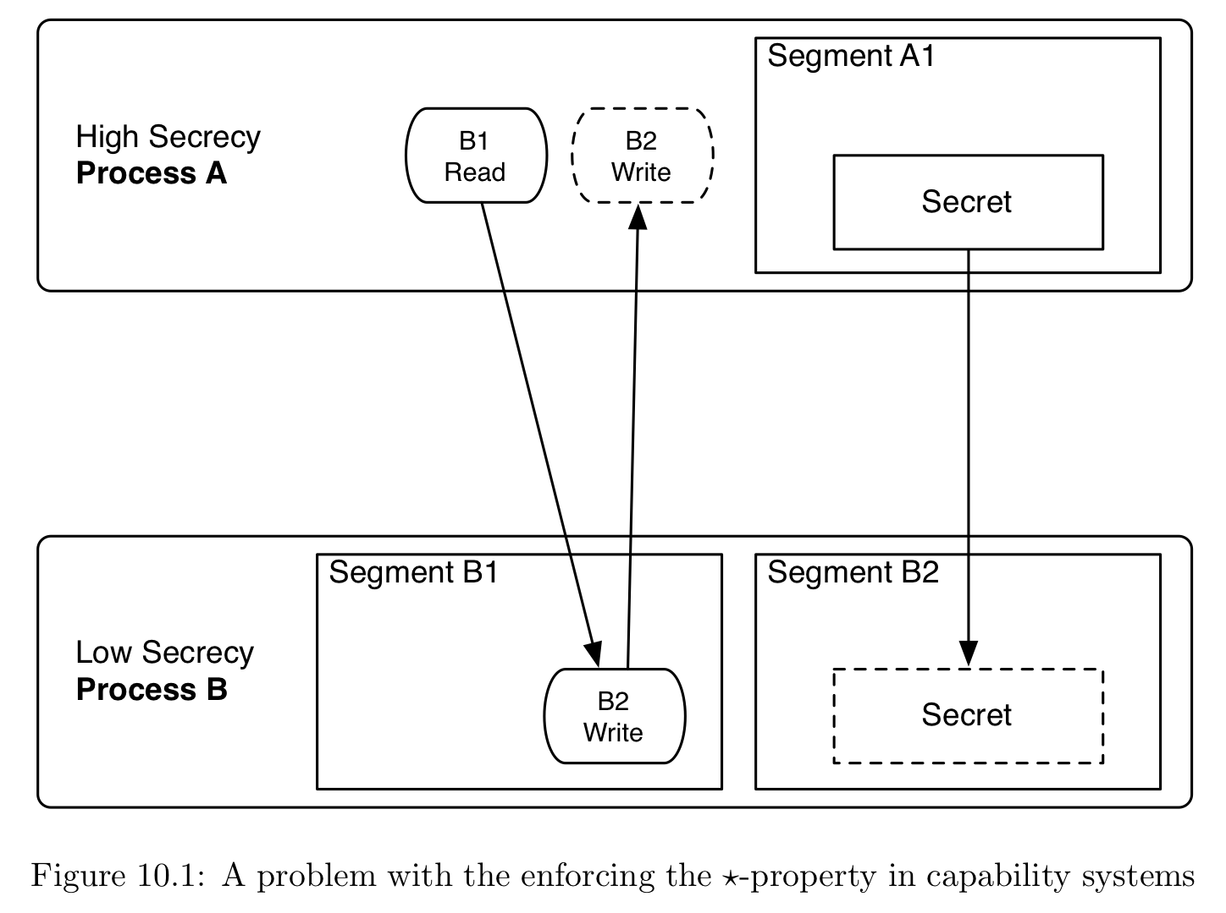
Capability and *-Property

Slide 15
Capability System Problem
Boebert: “the right to exercise access includes the right to grant access”
If I can talk to you, I can give you permissions
Capabilities can also be leaked via covert channels
  It is just a bit string
Make covert channels harder to control

Slide 16
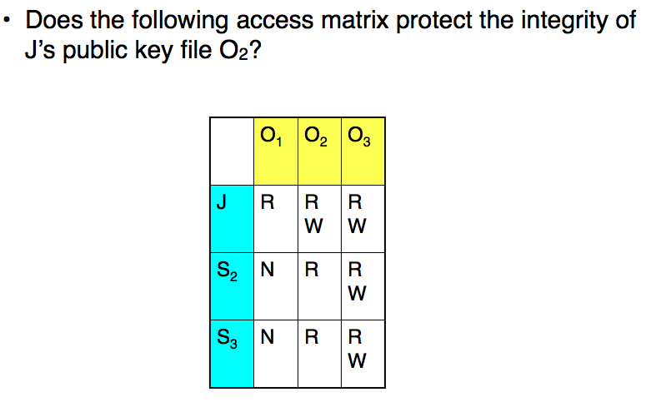
Access Matrix
Back to the access matrix

Slide 17
Access Matrix
Access Control Lists: Ordinary systems use those – what about secure OS’s?

Slide 18
Access Matrix
Capability Lists: An alternative representation of the same thing, but…

Slide 19
Access Matrix
Capability Lists: Does not include identity for authorization system to check
Anyone can use –
regardless of the
access matrix

Slide 20
Protection vs. Security
Consider a benign process
  If it has a fault, will it leak a capability?
  Will it receive another’s capability to leak information?
  Will it forge a capability?
Consider a malicious process
  It will try to leak a capability
  It will try to leak information
  It will try to forge a capability
Capability systems aim for protection, not security

Slide 21
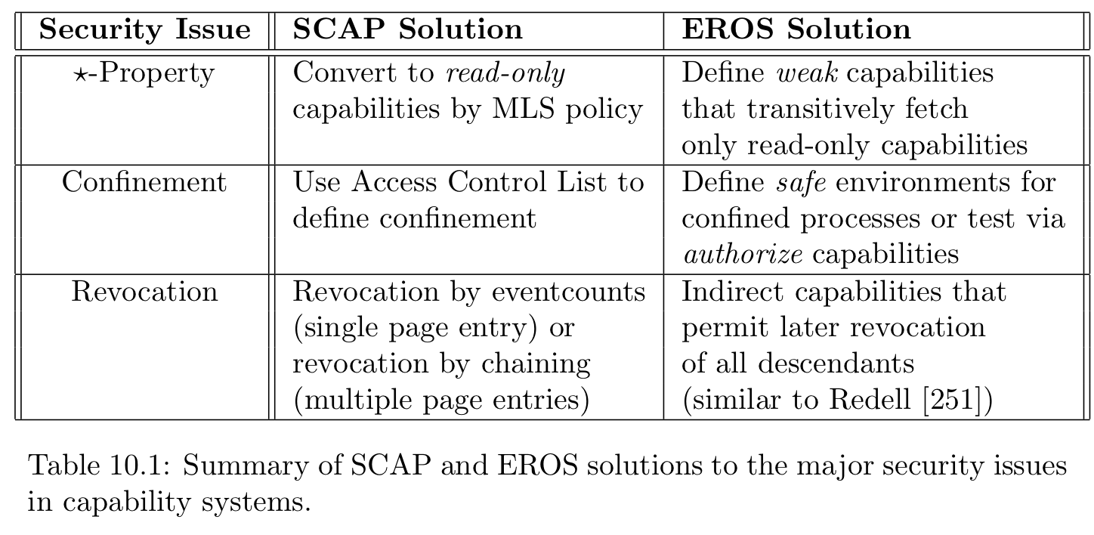
What to do?

Slide 22
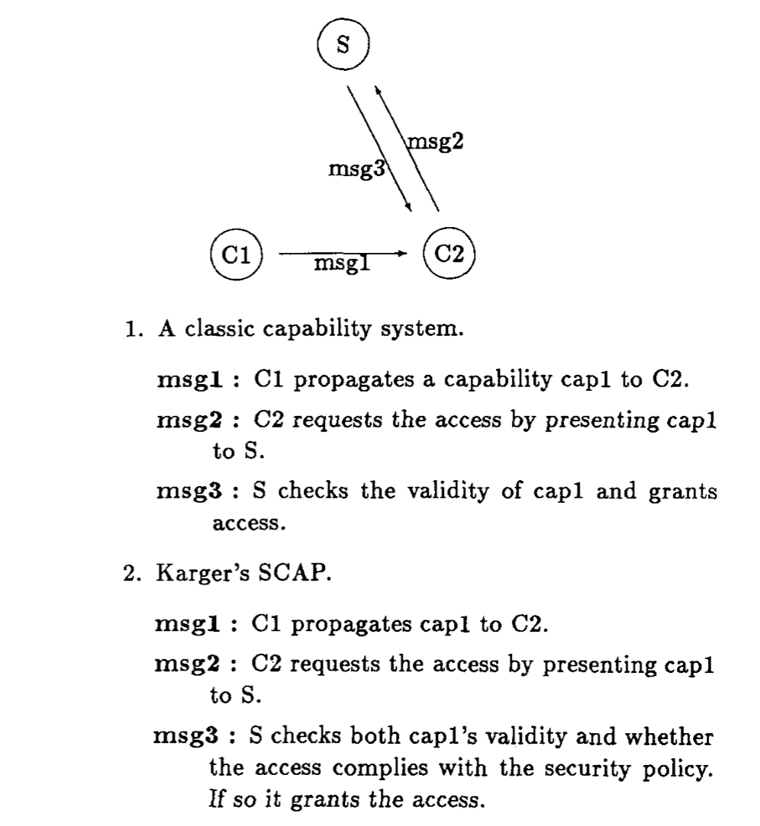
Confinement
Restrict permissions to satisfy a policy for the presenting subject
  Rather than simply permitting access via possession
SCAP
  Need cap and policy to authorize
EROS
  Test capability set in advance
  Or authorize via policy

Slide 23
ICAP
Add the identity of the holder into the capability
  (client ID, obj ID, rights, integrity)
Authorize transfer of capabilities
  C1 constructs a signed message to grant a capability to C2 – C1 must be the identity in the capability
  C2 presents capability and signed grant on first use
  Server authorizes based on security policy and creates a capability for C2 to use

Slide 24
*-Property
Confinement limits access, so that a high secrecy subject cannot use a write-capability to a low secrecy object
  Validate for yourself
EROS – use a weak capability
  Give a high secrecy process a weak capability to read from a low secrecy object
  Any capabilities obtained via this capability are made read-only and weak
  Couldn’t a Trojan horse still read memory and then provide that as a capability later?

Slide 25
Revocation Problem
How do I get the house key I copied for you?
  Without changing my locks…
It is not practical to scan through memory to find capabilities

Slide 26
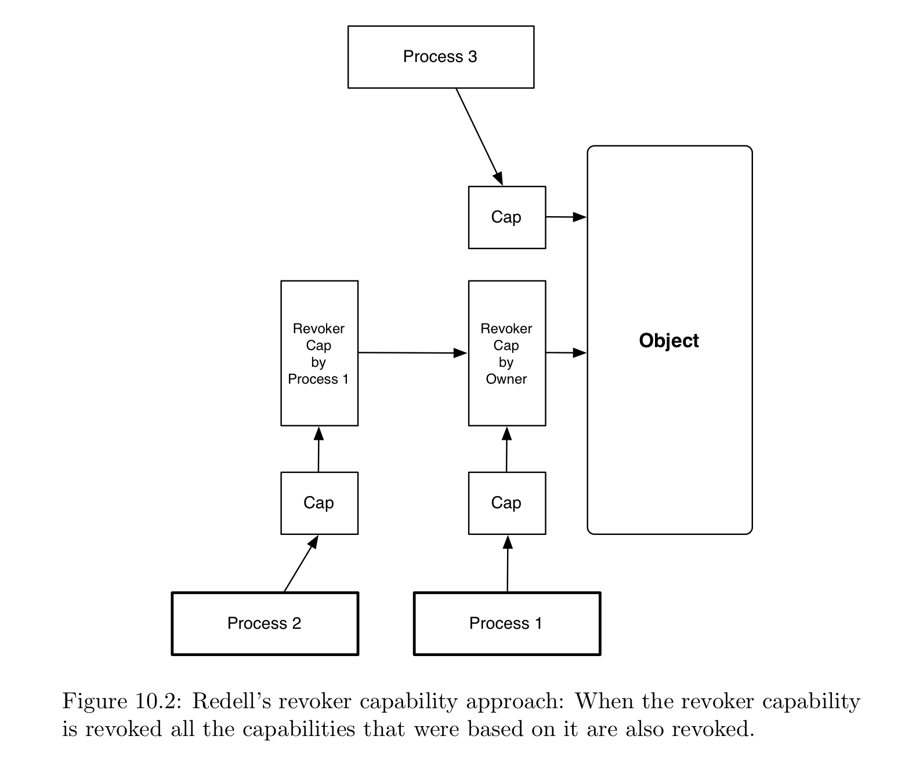
Revocation – Redell’s Solution

Slide 27
Revocation – Others
Other solutions are a bit convoluted
SCAP
  Event counts: compare page table entry count to capability
    Revalidate if different
ICAP
  Revocation list with Redell’s propagation tree

Slide 28
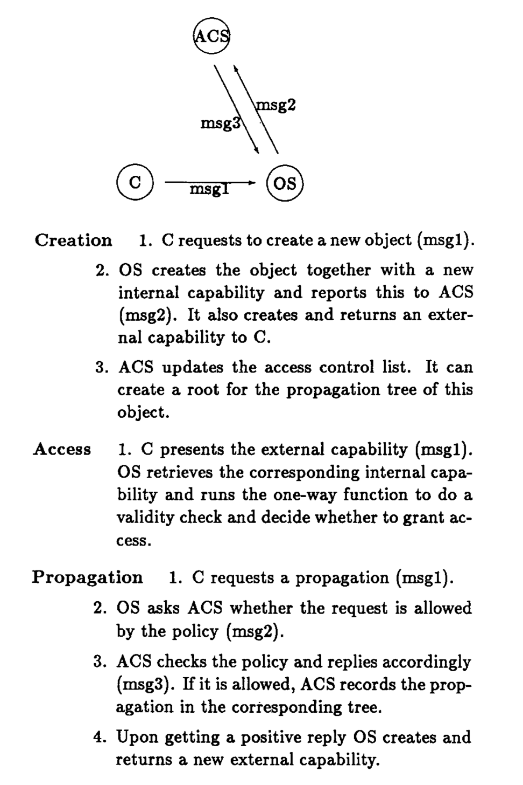
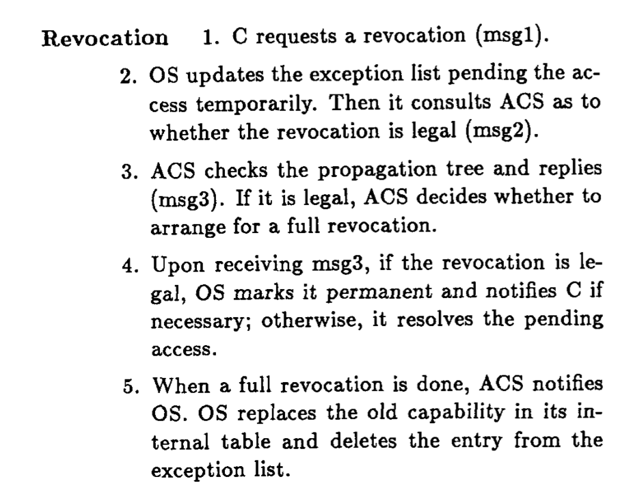
Overall: ICAP

Slide 29
Take Away
Problem: Control Access and Confused Deputy
  Using a “key” is a natural way to control access
    No centralized service required
  Prevent need for a server to manage all its clients permissions
Unfortunately, neither of these problems can be completely solved by capabilities
  Confinement: Need identity to control access – end up with a centralized access server (holds or verifies perms)
  Revocation: Need to track delegation somewhat

