Slide 1
Advanced Systems Security:
Virtual Machine Systems
Trent Jaeger
Systems and Internet Infrastructure Security (SIIS) Lab
Computer Science and Engineering Department
Pennsylvania State University
March 24, 2011

Slide 2

Where are we?
OS Security from Reference Monitor perspective
  Mediation
    LSM
  Tamperproof
    Linux and TCB
  Simple enough to verify
    Correct code
    Correct policy
Notes:
This slide illustrates the way our approach works.

Slide 3

Basis for OS Security
Isolation
  A protection domain defines a boundary of isolation
Based on
  Rings
  Address spaces
  Access control policy
Do these work in modern OSes?

Slide 4
Virtual Machine Systems
Protection domain is extended to operating systems on one physical platform
  Invented for resource utilization
But, also provide a potential security benefit due to default
  ISOLATION
How does VM isolation differ from OS isolation?

Slide 5
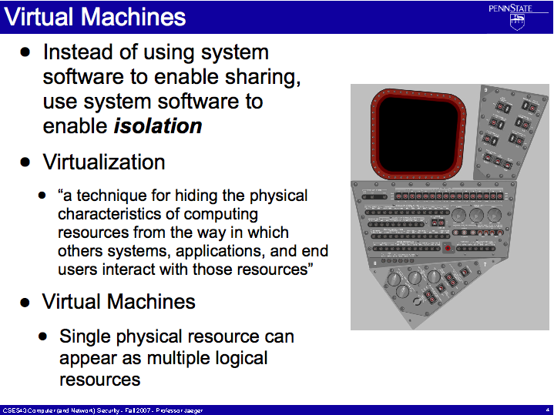


Slide 6
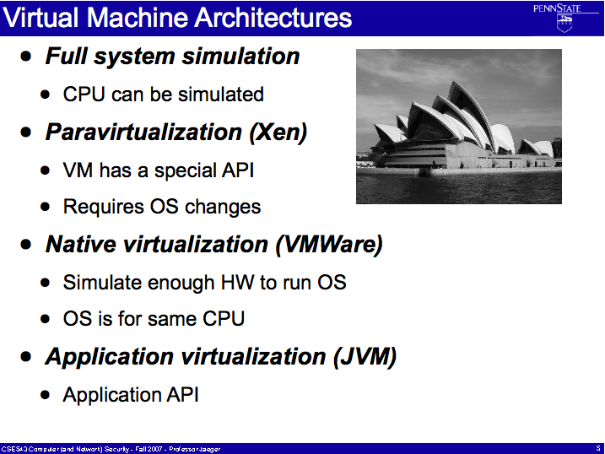

Slide 7
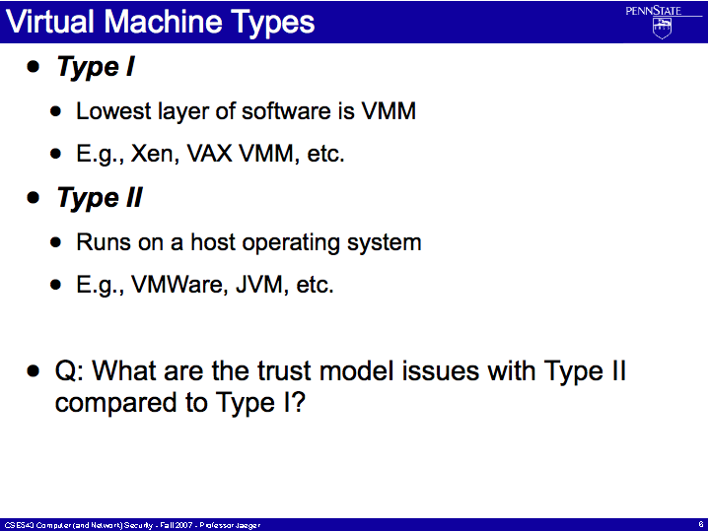

Slide 8
VM Systems and Ref Monitor
How does a VM System improve ability to achieve reference monitor guarantees?

Slide 9
VM Systems and Ref Monitor
How does a VM System improve ability to achieve reference monitor guarantees?
Mediation
  Mediation between VM interactions
Tamperproof
  Protection boundaries between OS
Simple Enough to Verify
  Code that needs to be correct?
  Policy

Slide 10
VAX VMM
A1-assured VMM system
Carefully crafted VMM
Mediation
  VM interaction
Tamperproof
  Minimal TCB
Simple enough to verify
  Code assurance
  Policy assurance: MLS policy, Biba policy, privileges

Slide 11
VAX VMM Reference Monitor
Key design tasks
  Virtualize processor
    Make all sensitive instructions privileged
  More rings
    Need a new ring for the VMM
  I/O emulation
  Self-virtualizable
What components constitute the VAX VMM reference monitor?

Slide 12
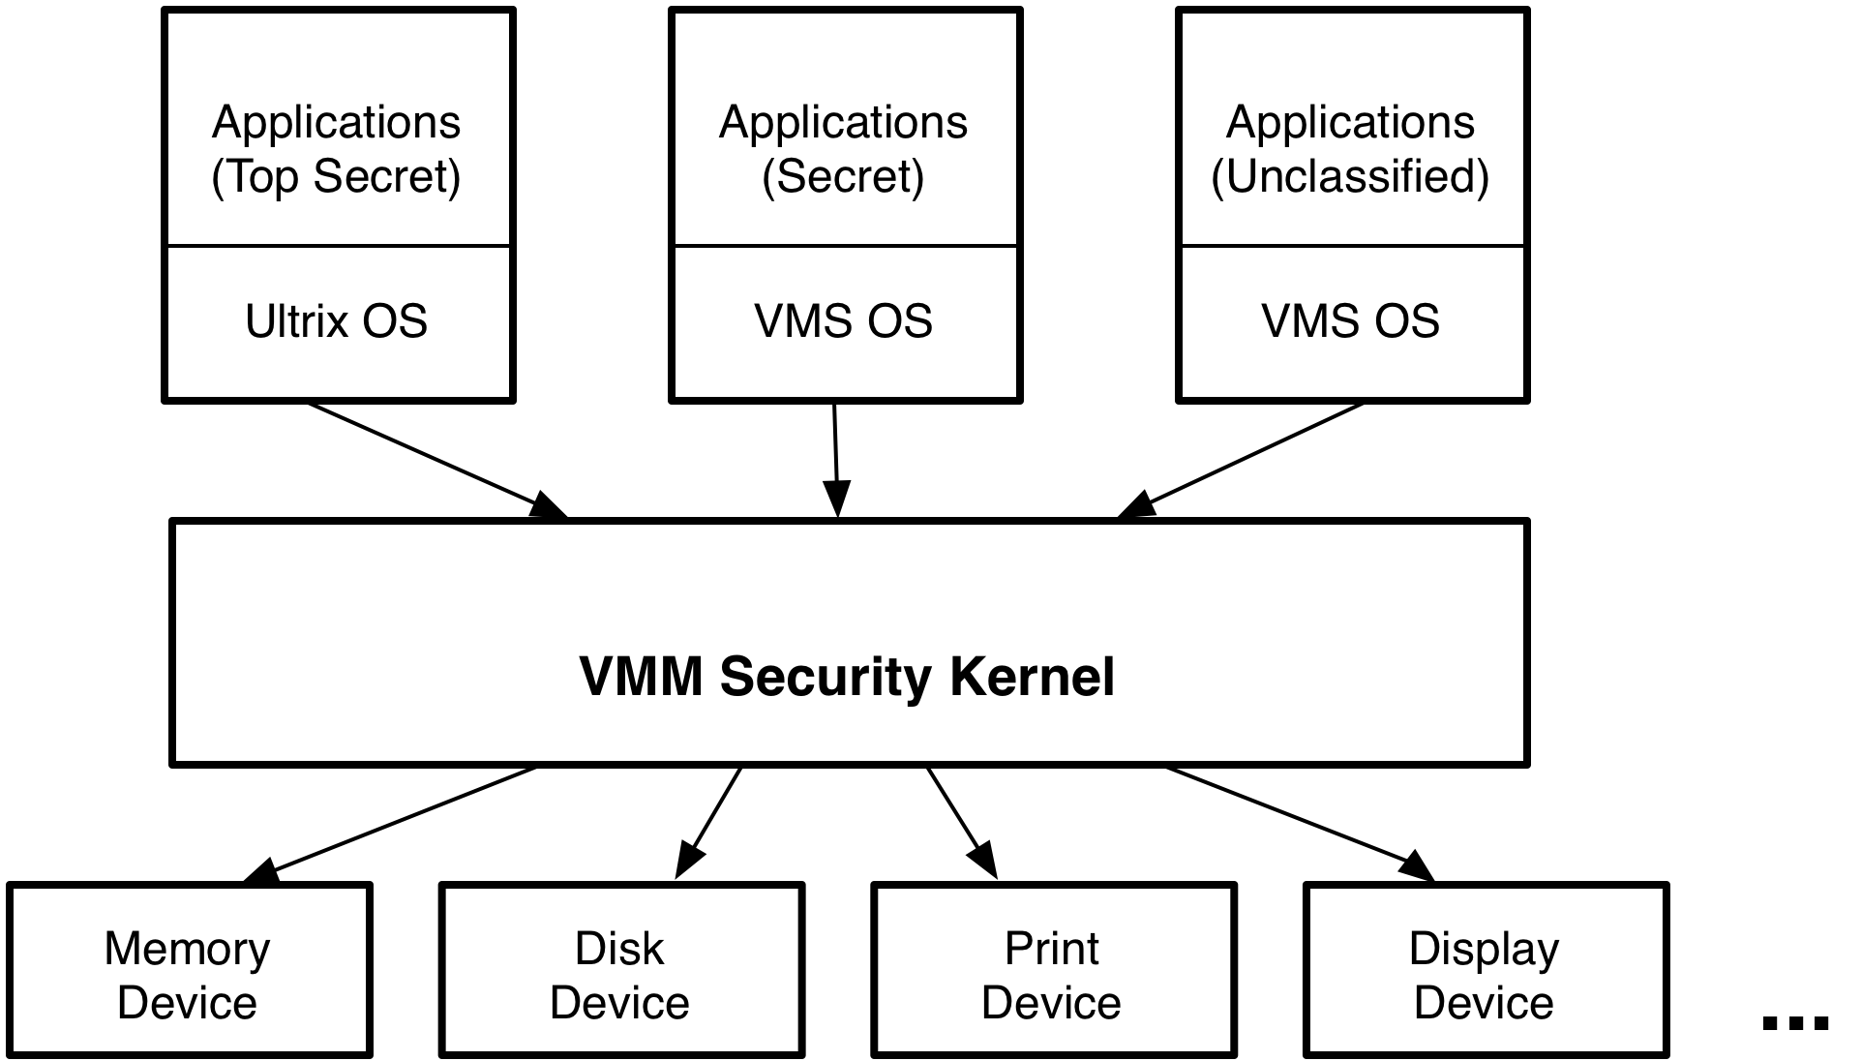
VAX VMM Design

Slide 13
VAX VMM Policy
MLS
  Control secrecy
Biba
  Control integrity
Privileges
  Exceptional accesses
  Audited
  There are more of these than meets the eye!
How is the protection state modified?

Slide 14
VAX VMM Evaluation
Mediation: ensure all security-sensitive operations are mediated?
  Virtualizing instructions, I/O emulation
  VM-level operations? Privileges
Mediation: mediate all resources?
  VMM level
Mediation: verify complete mediation?
  A1-assured at VMM level

Slide 15
VAX VMM Evaluation
Tamperproof: protect VMM?
  Similar to Multics (no gatekeepers, but some kind of filters); authentication in VMM; protection system ops in VMM; fixed system?
Tamperproof: protect TCB?
  All trusted code at ring 0; trusted path from VMs for admin;
Verification: verify code?
  A1-assured at VMM level
Verification: verify policy?
  MLS and Biba express goals and policy; Privileges are ad hoc

Slide 16
VAX VMM Challenges
Despite A1 assurance still several challenges in VAX VMM system
  Device driver management; no network
  Amount of assembler code
  Covert channel countermeasures
  Implications of ‘privileges’
Nonetheless, interesting mechanisms
  Trusted path administration
  Architecture of VMM
  Virtualization for security

Slide 17
Modern VM Systems
The development of a virtual machine monitor for x86 systems unleashed VMs on the masses
  Why did this take so long?
VMware, Xen, KVM, NetTop, …
  Everyone is a virtual machine monitor now
How do we implement a reference validation mechanism for these systems?
  What granularity of control?

Slide 18
Isolation and Network
VMware and NetTop assume that the VMM (and privileged VM) will isolate guest VMs
Then, the problem is to control inter-VM communication
  Only other communication is via the network
VMware uses network layer
  Also supports VMCI for direct communication between VMs
NetTop is built on VMware where only VMs of the same label may communicate

Slide 19
VMs as Processes
Type II VM systems can treat VMs as processes
KVM uses SELinux to control access of VMs as if they are a process
  VMs are processes to the host OS
  VMs can access host OS resources (files)
Uses SELinux to control VM access

Slide 20
Control of VMM Resources
There are many virtual machine monitor resources that may be used to communicate
  Memory, devices, IPC, VMs themselves, …
sHype adds reference monitor for some objects (IPC) and the privileged VM uses for networking
Xen Security Modules (XSM) adds reference validation on the Xen hypervisor’s distribution of these resources
  Less trust in privileged VMs, so finer-grained policy results
Minimizing TCB versus simplicity

Slide 21
Xen as a Reference Monitor?
Reference Monitor
  XSM in Xen
  Scope includes dom0 Linux and user-level
Mediation
  XSM to control VMM operations
  SELinux in dom0; use network to communicate
Tamperproof
  Xen has a much larger TCB, and more flexible
Verification
  Code – lots
  Policy – SELinux style

Slide 22
AMD SVM / Intel VT-x In A Nutshell
Virtualization based on VMRUN/VMRESUME instruction
VMRUN/VMRESUME executed by host causes the guest to run
Guest runs until it exits back to the host
Host resumes at the instruction following VMRUN/VMRESUME
World-switch: host → guest → host
World switches are not cheap
VMRUN
Guest executes
VMCB
Notes:
Remove vmresume references and remove intel vt-x from title (just keep it about AMD)
VMRUN executes guest until it makes a call back (scheduling?) VMMCALL, then like a big context switch
VMCB is VM control block, which stores VM state while not running like a TCB

Slide 23
CPU Virtualization Trends
The key trend is to eliminate the overhead of virtualization
  Reduce overall world-switch times
  Reduce world-switch frequencies
  Reduce resources needed by the VMM
Reduce world-switch times
  Tag TLB by ASID
  Better caching of VMCB state
Reduce world-switch frequencies
  Nested paging
  Direct device assignment
  Implement more functions in the guest OS through paravirtualization
App
App
Guest OS 1
Guest OS 2
VMM
Hardware
Notes:
Future is the cost of an exception – ideally what you would like to get to
ASID: address space IDs – guest and host TLB entries can co-exist – TLB entries can persist beyond a context switch

Slide 24
Nested Page Tables
GUEST
Hardware
1GB
4GB
1GB
4GB
4GB
0
0
0
0
0
Guest Virtual
Address space
Guest Physical
Address space
Guest Virtual
Address space
Guest Physical
Address space
System Physical
Address space
VMM
1GB
4GB
Traditionally the hypervisor maintains shadow page tables:
  Expensive to emulate correct behavior (accessed/modified bits)
Nested paging eliminates this by performing a recursive walk
  Available in Barcelona …
  Reduces number of #VMEXITs by 40-70%
cr3
0
0
Guest Virtual
Address space
System Physical
Address space
Notes:
Left is shadow page table, right is double walker
When HW modifies bits they must be reflected in guest physical, guest uses modified bits to make paging decisions
One NPT for all guests (rather than one shadow pt for each gpt)

Slide 25
Take Away
VM Systems provide isolation
  Between OSes/apps that may be untrusted
VM Systems enable a small TCB
  Type 1 VMMs
  A1-Assured, like VAX VMM
VM Systems can mediate inter-VM actions
  Virtualized operations
  Inter-VM operations

Slide 26
Trusted VMs
VMware and NetTop assume that the privileged VM (there is only one in these systems) prevents information flow (like a kernel)
Thus, the only information flows between VMs are via networking
  Privileged VM controls inter-VM communication via networking
sHype controls IPC and networking at hypervisor level
  Privileged VM uses hypervisor as policy store

